Slide 1
Agentic Health Interoperability Framework
An AI-native framework for building healthcare integration copilots on IRIS for Health
InterSystems AI Hub | May 2026

Slide 2
The Opportunity
The Problem
Integration engineers spend 70% of their time on repetitive tasks: wiring productions, writing DTLs, debugging HL7 segment mappings
Deep IRIS expertise is scarce -- new engineers face a steep learning curve on ObjectScript, Productions, DTL, and the HS.* class library
Every customer builds the same plumbing from scratch: ADT routing, HL7-to-FHIR pipelines, error triage dashboards
No AI assistance exists today for IRIS-specific interoperability tasks -- general-purpose LLMs don't know Productions, SDA3, or the Ens.* class catalog
The Solution
An AI framework built into IRIS for Health that understands Productions, DTL, HL7, FHIR, and the complete class library
Natural-language interface: engineers describe what they want, the agent builds it -- searching catalogs, proposing configurations, asking for approval, and validating results
Out-of-the-box agents, tools, and skills that cover the most common integration patterns -- ready to use on day one
Extensible framework: customers, SEs, and the dev community can add their own agents, MCPs, tools, and skills without modifying the core

Slide 3
Vision: An AI-Native Interoperability Platform
The %AI Framework provides the primitives. We build the healthcare layer on top.
Integration Engineer (natural language)
Chat UI (streaming)
Admin UI (configuration)
Health Interop Agent + 12 Domain Skills + Policies
MCP: Production
MCP: Transform
MCP: Testing
MCP: Catalog
42 Tools (ObjectScript + SQL + Embedded Python)
IRIS for Health | Vector Search | Secured Wallet | Productions | %Dictionary

Slide 4
Three Core Use Cases
BUILD
OPERATE
TRANSFORM
Build Productions
Review & Improve
Create Transformations
Describe what you need in plain English
Agent searches class catalog for right Business Hosts
Proposes production layout for approval
Creates production, adds hosts, configures settings
Sends test messages and validates end-to-end
Triage errors across all productions
Identify bottlenecks and recommend settings
Review DTLs for hardcoded values and missing checks
Suggest modernization using newer IRIS features
Verify fixes with automated validation
Trace data flow: HL7 v2 -> SDA3 -> FHIR R4
Introspect HL7 schemas at sub-field level
Create DTLs with correct source/target classes
Dry-run transformations against sample data
Field-level gap analysis via the Transformation and Mapping Catalog

Slide 5
Capabilities: Framework + Content
The framework ships with production-ready content. Customers and the community extend it without modifying the core.
Out of the Box (shipped by InterSystems)
Community & Customer Content
1 Agent: Health Interop (router with orchestration policies)
4 MCP Servers: Production, Transform, Testing, Catalog
5 ToolSets with 42 Tools covering the full integration lifecycle
12 Skills: Productions, DTL, BPL, HL7 v2, FHIR R4, SDA, CDA, X12, Routing Rules, ESB Patterns, Adapters, REST
2 Vector Catalogs: Ens.* (164 classes) + HS.* (58 classes)
Transformation and Mapping Catalog: 1,538 field-level mappings across HL7/SDA3/FHIR
Admin UI + Chat UI, audit trail, connection manager
Custom Agents: specialty copilots (Lab, Pharmacy, Claims, Imaging)
Custom MCP Servers: wrap customer-specific APIs, EHR integrations, payer endpoints
Custom Tools: call internal REST services, query custom tables, invoke Python ML models
Custom Skills: organization-specific knowledge (local HL7 profiles, DTL conventions, naming standards)
SE-built accelerators: pre-built productions for common patterns (ADT routing, HL7-to-FHIR, claims processing)
ISV extensions: third-party tool packs distributed via IPM / Open Exchange

Slide 6
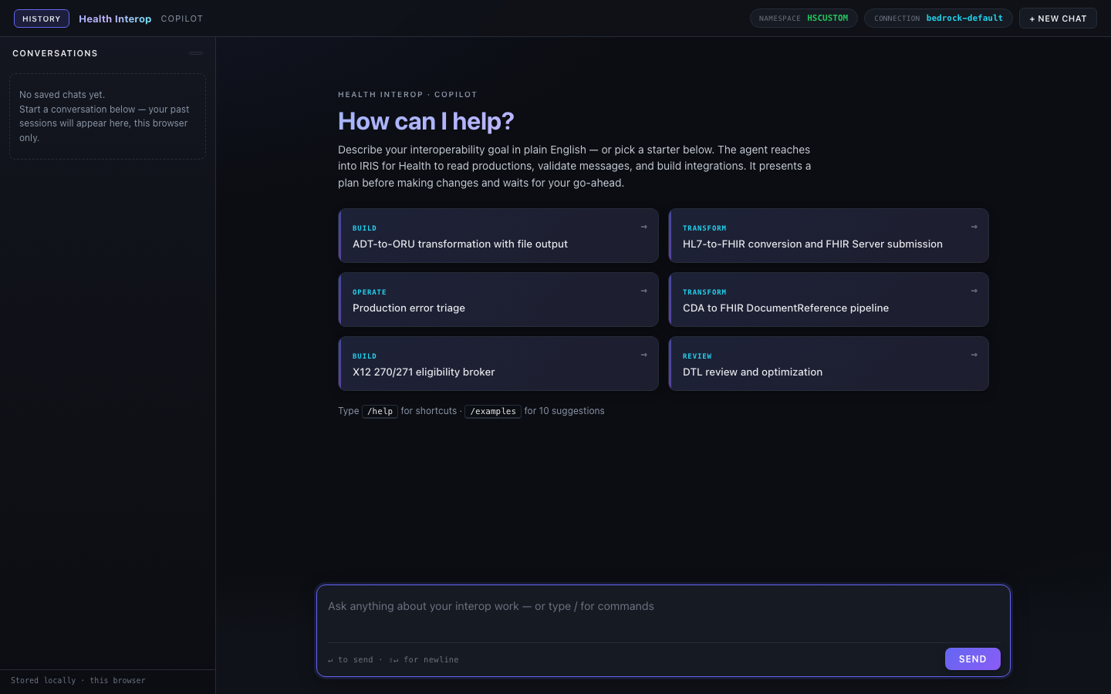
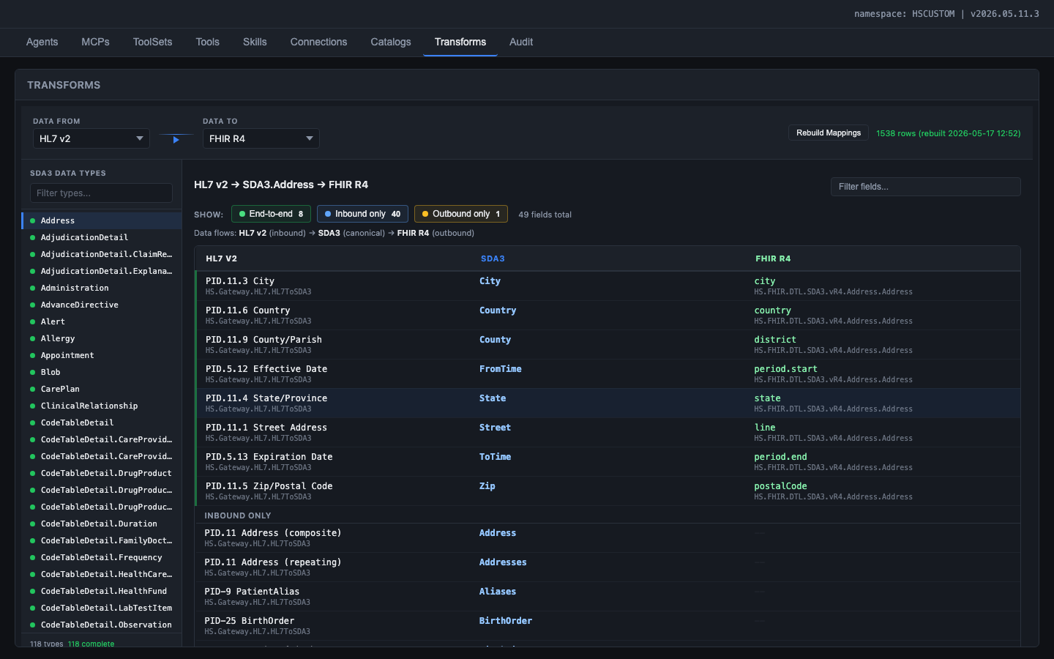
Use Case: Healthcare Agent Interop
What we built to prove the framework -- a working Copilot on IRIS for Health 2026.2
Chat: natural-language production builder with streaming + tool cards
Transformation and Mapping Catalog: field-level HL7 v2 -> SDA3 -> FHIR R4 mapping explorer
61
42
12
4
1,538
222
ObjectScript Classes
AI Tools
Domain Skills
MCP Servers
Field Mappings
Indexed Classes

Slide 7
Why This Matters
Faster Time-to-Value
DAYS MIN
Lower Barrier to Entry
DAY 1
Higher Quality
0 ERRORS
Engineers describe what they need in plain English. The agent builds, configures, and validates -- reducing production setup from days to minutes.
New engineers are productive immediately. Natural-language guidance replaces the steep learning curve of ObjectScript, DTL, and the Ens.* class library.
Automated PostBuildValidation catches misconfigurations, missing settings, and broken routing before they ever reach a live production environment.
Measured: 25s planning, 2-5 min full build
Zero ramp-up
Built-in validation
Platform Stickiness
IRIS
Community Flywheel
1+1=3
Market Differentiator
ONLY ONE
AI assistance embedded in the integration engine is a compelling reason to choose and stay on IRIS for Health. No competitor offers this today.
Every custom tool, skill, and agent built by customers, SEs, and ISVs benefits the entire ecosystem. Content compounds; the platform gets smarter over time.
No other integration platform ships an AI framework with domain-specific healthcare tools. This is a first-mover advantage in the agentic AI era.
Unique to IRIS
Network effects
First in market

Slide 8
Next Steps
1
Immediate
2
Q3-Q4 2026
3
2027
Fix & Ship
Field Trial
Ecosystem
Fix 2 blocker bugs (Skill $ZF, Bedrock hang)
Ship ToolFilter as framework default
Document %AI.ToolMgr.ExecuteTool path
Package as IPM for 3 customer pilots
Build 2-3 specialty agents (Lab, Pharmacy, Claims)
Open tool/skill authoring to SE community
Publish to Open Exchange
SE accelerator library (20+ patterns)
Community marketplace for tools and skills
Built on IRIS for Health 2026.2 | %AI Framework build 162.0 | 61 classes, 42 tools, 12 skills | Ready for field trial

