Slide 1
Agentic Health Interoperability
From conversation to production in minutes.
Built 100% on the InterSystems %AI Framework.

Slide 2
Why this matters now
The cost is not the tooling. The cost is engineer time and time-to-revenue on every implementation.
Integration is our most expensive customer surface. — A complex HL7-to-FHIR interface takes a senior engineer two to three days. Most of that time is spent searching documentation, browsing the class dictionary, and iterating on DTLs.
The skills gap keeps widening. — Healthcare data expertise (HL7, FHIR, SDA) is one labor market. InterSystems platform fluency (Productions, DTL, BPL, Adapters) is another. New engineers need months to bridge them.
Competitors are productizing AI for integration. — Rhapsody, Smile CDR, and cloud HDS players are all moving here. The window to lead with a native, framework-grounded approach is now.

Slide 3
What we built
Ships as one IPM package. Installs into any IRIS for Health 2026.2+ namespace with a single command.
A copilot, native to IRIS for Health. — Engineers describe goals in plain English. The agent searches, plans, builds, and tests inside an IRIS namespace. 64 classes, one IPM package.
100% on the %AI Framework. — %AI.Agent orchestrates the conversation. %AI.Tool exposes 42 callable methods. %AI.Agent.Skill delivers domain knowledge on demand. %AI.RAG.KnowledgeBase powers semantic search. Zero external orchestration.
Safe by design. — Every mutation requires explicit engineer approval. Seven approval gates in a typical production build. Full audit trail. 60-second deadline and 50,000-token budget per turn.

Slide 4
Foundation: the %AI Framework
Everything runs where the data already lives. No external orchestration layer, no sidecar, no cloud dependency.
%AI.Agent — Orchestrates the full conversation loop. Receives the user prompt, decides which tools to call, manages context across turns, enforces iteration limits. One agent class, configured through the admin UI.
%AI.Tool — 42 public ClassMethods across 5 tool classes (Production, Transform, Testing, Catalog, Monitoring). Each method has a typed schema and a description the LLM reads as its API contract. The agent never calls raw IRIS APIs directly.
%AI.Agent.Skill — 12 specialist skills distilled from InterSystems documentation. Invoked as sub-agent tools so the LLM loads domain knowledge on demand instead of carrying it all in the system prompt. Saves thousands of tokens per request.
%AI.RAG.KnowledgeBase — Two vector catalogs index 222 classes with FastEmbed 384-dimensional embeddings and HNSW search. The agent finds classes by meaning, not by memorized names.

Slide 5
Data Catalogs: how the agent knows
The agent does not guess which classes to use. It searches catalogs grounded in the actual class dictionary of the target namespace.
search_ens (164 classes) — Every Business Host, Service, Process, Operation, and Adapter in the Ens.* hierarchy. Curated prose descriptions extracted from %Dictionary, not raw class dumps. The agent searches "HL7 TCP inbound service" and finds EnsLib.HL7.Service.TCPService.
search_hs (58 classes) — HealthShare transformation classes, FHIR mappers, SDA helpers, HL7 gateways. The agent searches "HL7 to SDA to FHIR" and finds the exact DTL chain: HL7ToSDA3 + SDA3.vR4.Patient.
Transformation and Mapping Catalog (1,538 mappings) — Pre-computed field-level mappings across HL7 v2, SDA3, FHIR R4, CDA, and X12. The agent traces PID.11 sub-fields through SDA3 Address to FHIR Patient.address and identifies coverage gaps before writing a single line of DTL.

Slide 6
Skills: domain knowledge on demand
Skills close the knowledge gap. The agent has the equivalent of a senior InterSystems engineer available for every domain, every time.
Distilled from InterSystems documentation. — Each skill is a markdown INSTRUCTIONS document covering one domain: DTL syntax, BPL activities, routing rule patterns, HL7 segment anatomy, FHIR resource structures, SDA3 as a transformation hub. Written by developers who know the platform.
Invoked on demand, not loaded upfront. — The LLM calls a skill as a sub-agent tool only when it needs that knowledge. A production build invokes Productions, HL7v2, DTL, and RoutingRules skills. A FHIR pipeline invokes FHIR R4 and SDA. Token cost stays low because only relevant knowledge is loaded.
12 skills ship today. — Productions, DTL, BPL, Routing Rules, HL7 v2, FHIR R4, SDA, REST in Productions, ESB Pattern, X12/HIPAA, CDA/C-CDA, and Adapters. Each one teaches the agent platform concepts a new engineer would need months to learn.

Slide 7
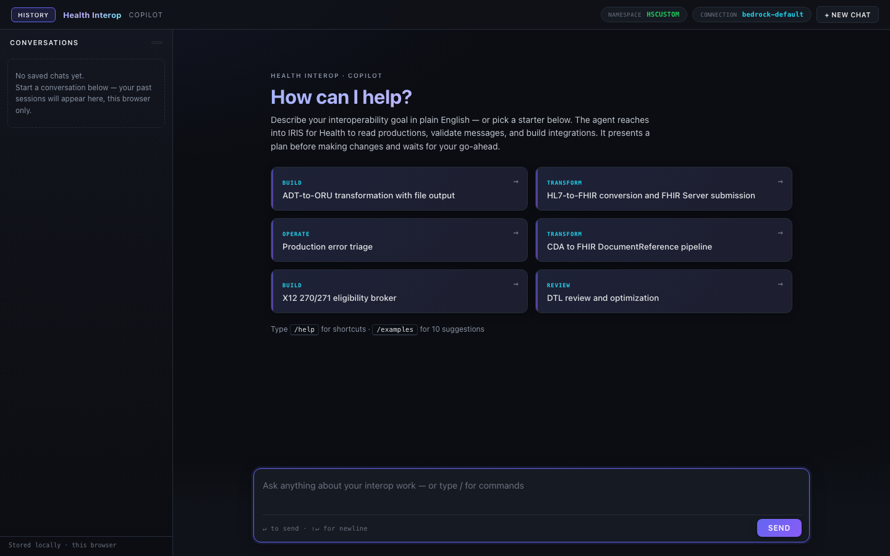
Use case: build an HL7 production
An interface engineer asks the copilot to build a complete ADT inbound production.

Slide 8
The agent works in four phases
The engineer made seven decisions. The agent did everything else. 25 tool calls, 4 MCP servers, 3 skills consulted, 4 RAG searches.
RESEARCH. — 4 RAG searches across search_ens and search_hs to find the right Service, Router, Operation, and DTL classes. DescribeClass inspects adapter settings on each candidate. Skills for Productions and HL7v2 provide pattern guidance.
PLAN. — GetHL7SchemaMap introspects the HL7 v2.5 message structure at sub-field level. DescribeTransformationPipeline traces the HL7-to-SDA-to-FHIR class chain. DTL and RoutingRules skills teach syntax and semantics. The agent presents a complete plan and waits for approval.
BUILD. — CreateProduction, AddBusinessHost (x4), BuildDTLXml with schema-resolved paths, CreateDTL, CreateRoutingRule with auto-corrected constraints, UpdateBusinessHostSettings, StartProduction. Seven approval gates. Every mutation is explicit.
TEST. — BuildAndSendHL7TestMessage sends a sample ADT A01. ValidateHL7Structure checks the ACK. PostBuildValidation runs a 7-point checklist: production running, hosts enabled, no errors, messages routed, pipeline coverage, settings configured.

Slide 9
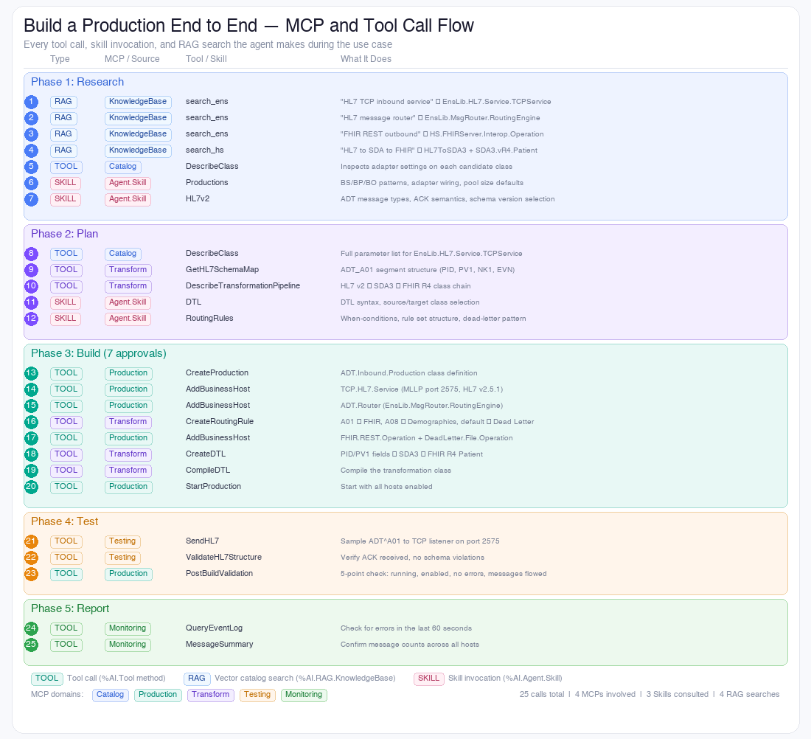
Under the hood: 25 tool calls across 4 MCP servers

Slide 10
What it takes to get there
The LLM provides language understanding. Everything else comes from the layers above.
Each layer enables the one above it. Remove any layer and the use case breaks.
IRIS for Health — The runtime. Productions, DTL engine, HL7/FHIR schemas, %Dictionary, event log, message trace. Everything the tools operate on.
%AI Framework — %AI.Agent, %AI.Tool, %AI.Agent.Skill, %AI.RAG.KnowledgeBase. The orchestration layer that connects the LLM to IRIS internals without external middleware.
Data Catalogs — 222 classes indexed with semantic embeddings. 1,538 field-level mappings. The agent searches by intent ("HL7 TCP inbound") and gets the exact class name, adapter settings, and parameter list.
Skills — 12 domain experts distilled from documentation. The agent loads RoutingRules skill and learns that constraints must match the INCOMING message type, not the transformed output. Without this, the routing rule would be wrong.
Tools — 42 methods that execute real IRIS APIs. BuildDTLXml resolves virtual document paths from the schema. CreateRoutingRule auto-corrects constraint mismatches. PostBuildValidation runs 7 checks. The tools enforce correctness the LLM cannot.

Slide 11
Intelligence lives in the tools, not the prompt
The system prompt tells the LLM what to do. The tools ensure it does it correctly.
Schema-resolved paths. — BuildDTLXml reads the HL7 v2.5 schema from ^EnsHL7.Schema to resolve virtual document paths. It knows PID lives at PIDgrpgrp(1).PIDgrp.PID in an ORU_R01. The LLM never writes raw VDoc paths.
Auto-correction over rejection. — CreateRoutingRule detects when the LLM sets docName to the DTL output type instead of the incoming type. Instead of rejecting (which triggers an expensive error-fix loop), it silently corrects the constraint and reports what it changed.
Structured validation. — PostBuildValidation runs 7 automated checks after every build: production exists, running, hosts healthy, no errors in event log, messages routed through all pipeline stages, settings configured. Pass/fail with specific detail on every check.
Token budget enforcement. — 60-second deadline and 50,000-token ceiling per chat turn. The monitor kills runaway conversations before they cost real money. The agent breaks complex work into multiple short turns with visible progress.

Slide 12
Business impact
Measured against the manual ADT-to-FHIR baseline. Generalizes to most production-class interfaces.
Minutes, not days. — A complete HL7 inbound production with DTL, routing rules, and end-to-end validation built in a single conversation. The manual baseline is two to three days for a senior engineer.
Day-one productivity for new hires. — No ObjectScript required. No Management Portal navigation. The engineer describes the goal, reviews the plan, approves each step. The copilot handles class selection, adapter configuration, schema introspection, and DTL authoring.
Zero lines of code written by the engineer. — Every artifact is generated by tools that use real IRIS APIs (not templates). The engineer reviews code in approval cards, not in an IDE. Source control hooks capture everything for CI/CD.
Under $1 per production build. — A complete ADT production build consumes roughly 80-150K tokens across 3-5 approval turns, costing $0.30-$0.75 at current Bedrock Sonnet pricing. Compare that to two to three days of senior engineer labor. Skills load on demand to keep each turn under 35K tokens.

Slide 13
Thank you

