Slide 1
Agentic Health Interoperability
From Conversation to Production in Minutes

Slide 2
The Challenge
Manual Production Building — Integration engineers navigate dozens of Management Portal screens, write ObjectScript by hand, and cross-reference documentation to find the right Business Hosts and adapters
Knowledge Bottleneck — IRIS for Health ships hundreds of classes across Ens.* and HS.* hierarchies. Finding the right one for a requirement means searching docs, browsing %Dictionary, or asking a colleague
Slow Iteration Cycle — Build a production, test it, find an issue, fix the DTL, recompile, test again. Each cycle takes minutes. A complex interface can take days to get right
Onboarding Gap — New integration engineers need months to learn the platform. The gap between healthcare data expertise and InterSystems platform knowledge slows every project

Slide 3
The Solution: AI Copilot for IRIS for Health
Natural Language Interface — Engineers describe what they need in plain English. The copilot translates intent into real IRIS API calls
42 Tools Across 5 Domains — Production management, DTL/BPL transformations, HL7/FHIR testing, class catalog search, and production monitoring
Semantic Search Over the Class Library — Vector catalogs index 164 Business Hosts and 58 transformation classes. The agent finds the right class by meaning, not by memorized name
Confirmation Gate on Every Mutation — Nothing changes in IRIS until the engineer clicks Approve. Create, delete, compile, start, stop all require explicit consent
Built on the %AI Framework — 100% native IRIS primitives: %AI.Agent, %AI.Tool, %AI.Agent.Skill, %AI.RAG.KnowledgeBase. No external orchestration layer

Slide 4
Use Case: Build an HL7 ADT Inbound Production

Slide 5
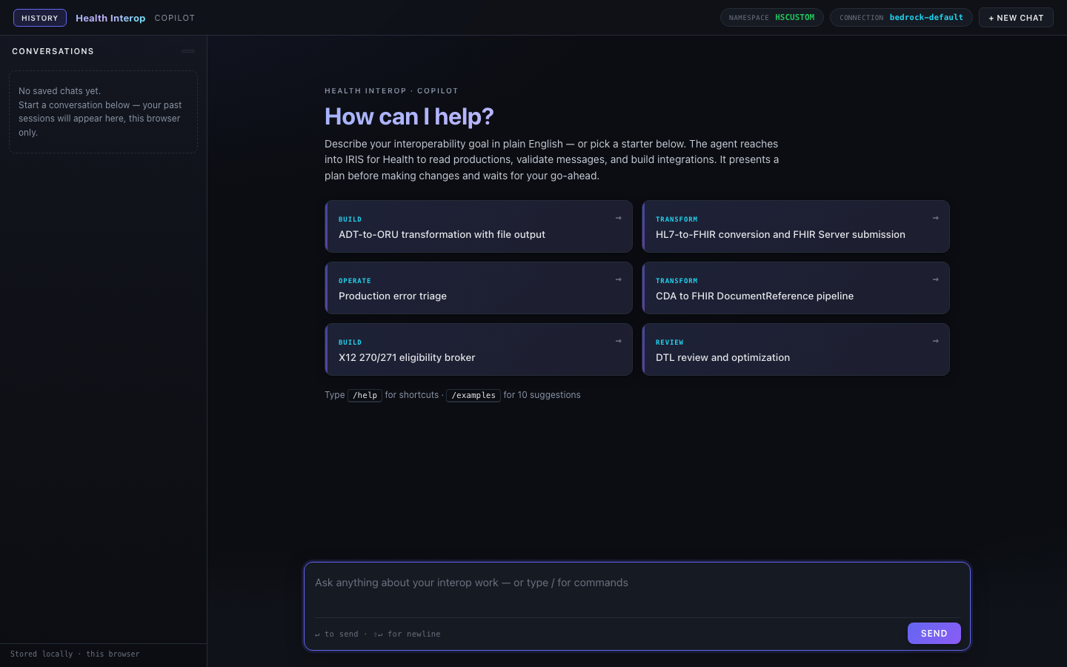
Step 1: The Interface Engineer Describes the Goal
The chatbot interface — streaming responses, tool-call cards, and guided starter prompts

Slide 6
Step 2: The Agent Researches, Plans, and Builds
Research — Searches the Ens.* vector catalog for 'HL7 TCP inbound service' → finds EnsLib.HL7.Service.TCPService. Searches for 'FHIR REST operation' → finds HS.FHIRServer.Interop.Operation
Plan — Proposes the production layout: TCP Business Service (port 2575, HL7 v2.5.1), Router Business Process (ADT message routing), FHIR REST Business Operation. Asks the engineer to approve
Build — Creates the production class, adds each Business Host with correct adapter settings, compiles. Each step shows a tool-call card with Approve/Reject
Test — Sends a sample ADT^A01 message through the production. Validates: production running, all hosts enabled, no errors in the Event Log, message flowed end-to-end
Report — Summarizes what was built, what was tested, and any issues found. The full trace is in the Audit tab

Slide 7
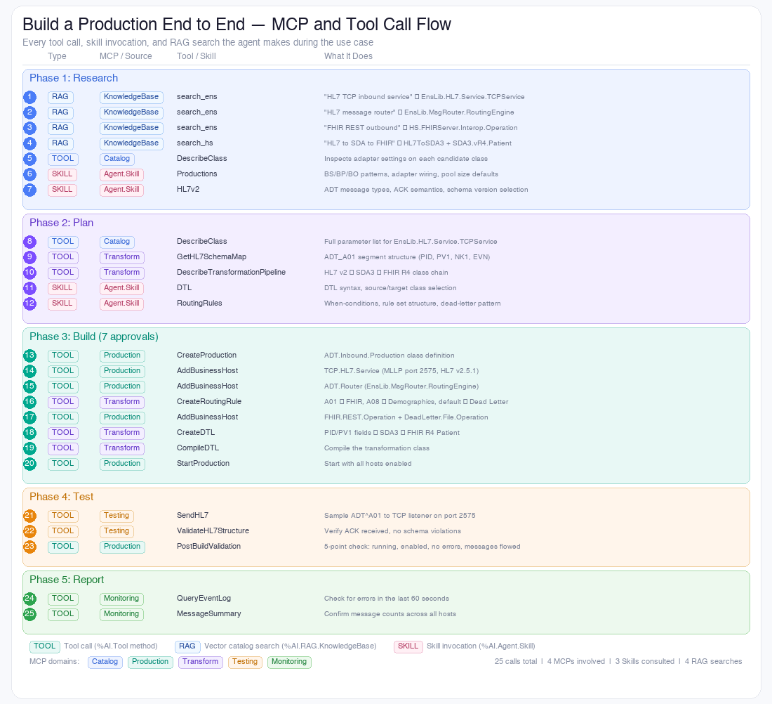
Under the Hood: 25 Calls Across 4 MCPs
Every tool call, skill invocation, and RAG search the agent makes during the production build

Slide 8
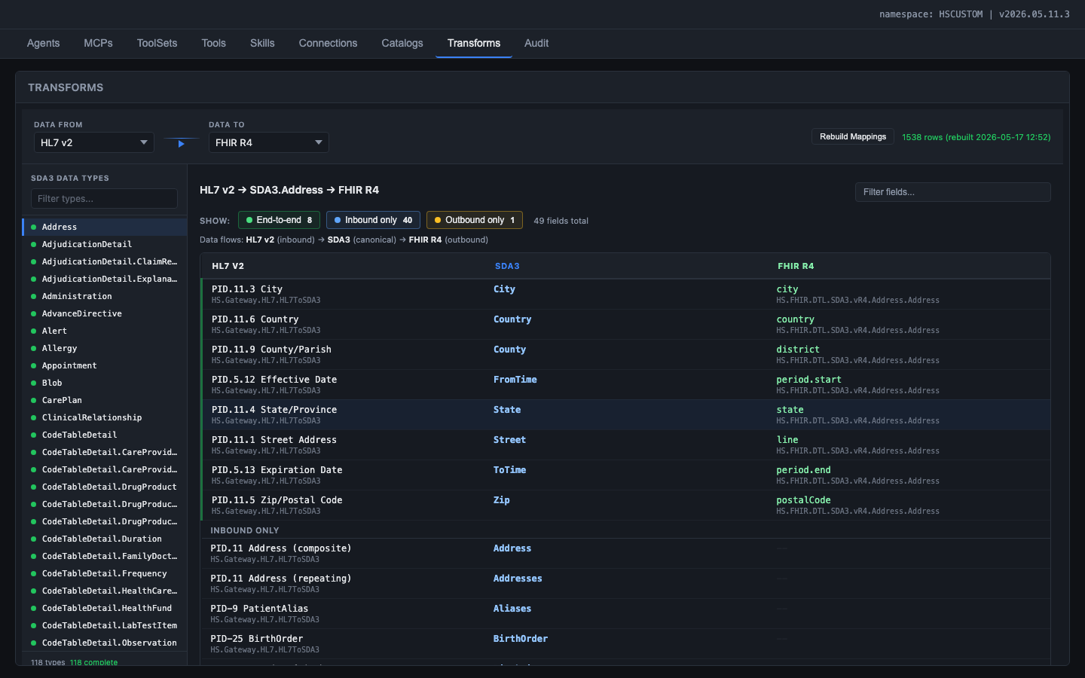
Step 3: Field-Level Mapping Intelligence
Transformation and Mapping Catalog — 1,538 pre-computed field-level mappings across HL7 v2, SDA3, FHIR R4, CDA, X12

Slide 9
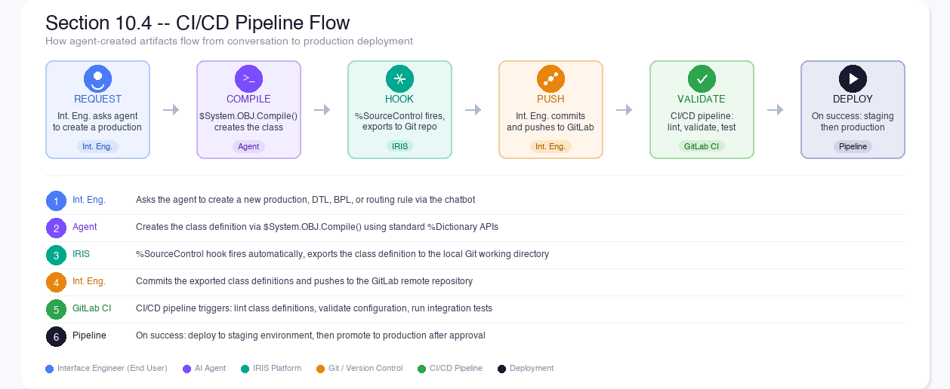
From Conversation to Deployment
Agent-created artifacts flow through source control hooks into the Git/CI/CD pipeline automatically

Slide 10
Business Impact
Days → Minutes
Production building time reduced from 2-3 days to a single conversation
Under $1 Per Build
A full production build costs ~$0.50 in LLM tokens vs. 2-3 days of engineer time
Zero Manual Coding
Interface Engineers build productions without writing ObjectScript
Instant Onboarding
New team members are productive on day one with guided prompts
What Ships Today
64 ObjectScript classes in one IPM package
42 LLM-callable tools across 5 domains
12 Domain skills distilled from IS documentation
1,538 Pre-computed field-level mappings
2 Vector catalogs (164 + 58 indexed classes)

Slide 11
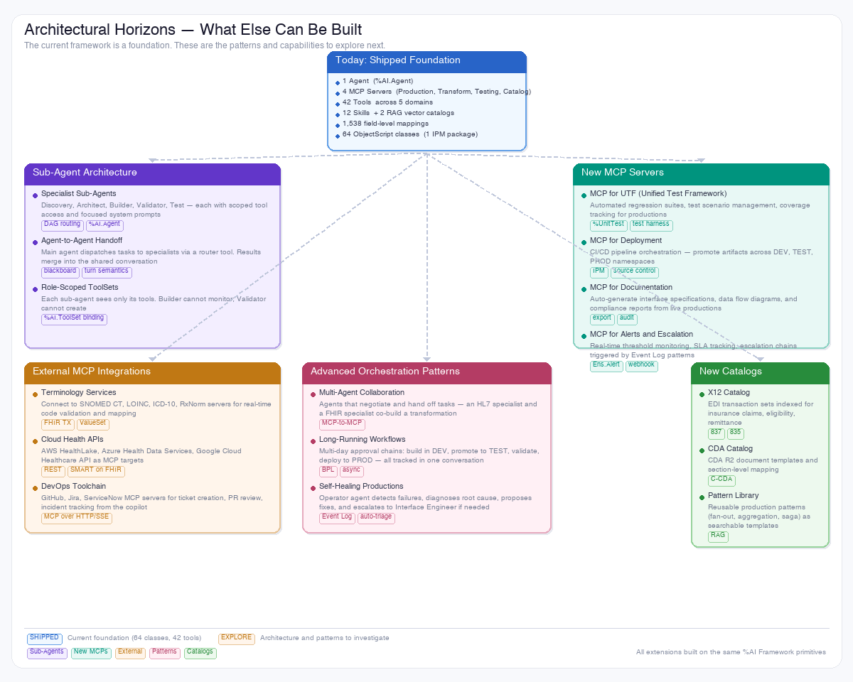
Architectural Horizons — What Else Can Be Built
The %AI Framework supports sub-agents, new MCP servers, external integrations, and advanced orchestration patterns

Slide 12
Four Personas, One Platform
Developer — Writes Tool classes, authors Skills, builds vector catalogs. Ships compiled classes via IPM. Defines what the copilot can do
AI Hub Admin — Configures agents, connections, catalogs, and role-based access through the admin UI. Decides how the copilot behaves
Interface Engineer — Creates new productions, DTLs, BPLs, and routing rules through conversation. Dev-time role with full mutating tool access
Operator — Monitors, triages, and reviews existing integrations at run-time. Read-only access. Structural changes escalate to the Interface Engineer

Slide 13
Thank You

