Slide 1
HUMANITY + AI, INC. · 501(c)(3) NONPROFIT
AI Builders
Academy
After-school artificial intelligence program for grades 3–12
Students learn to build with AI — not just use it.
School partnership overview
Launching Fall 2026 · Pinellas County, Florida
Notes:
Opening. AI Builders Academy is the after-school AI program of Humanity + AI, Inc., a 501(c)(3) nonprofit. This deck is the school-partner overview: what the program is, what students do, what we provide, and what a partnership looks like.

Slide 2



THE CASE FOR AI LITERACY
Why this program, why now
Every career
Very few schools
Use vs. build
The students in your building will enter a workforce where AI is a default tool, not a specialty.
Structured, age-appropriate AI instruction is still rare — especially outside of magnet and private programs.
Most kids already use AI. Almost none understand how it works, where it fails, or how to build with it.
Our mission is to make artificial intelligence accessible to everyone — starting with the students who will inherit it.
Notes:
Frame the gap: exposure is universal, understanding is not. We are a nonprofit — access is the point, not the upsell.

Slide 3
PROGRAM STRUCTURE
The program at a glance
6
1
20
3–12
Weeks per
cohort
Class per week
90 minutes
Students maximum
per class
Grades served, in
three separate bands
How a session runs
1
Warm-up concept
2
Guided build
3
Team challenge
4
Share & reflect
15 min
40 min
25 min
10 min
Notes:
Six weeks, ninety minutes, capped at twenty. The cap is deliberate — every student needs hands on a keyboard and an instructor within reach.

Slide 4
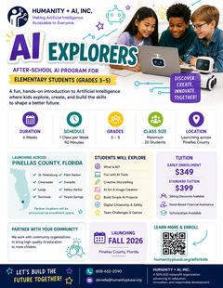
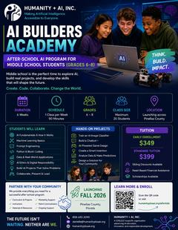
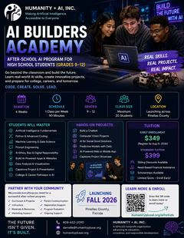
ONE PROGRAM, THREE CURRICULA
Built for the age in the room
ELEMENTARY · GRADES 3–5
MIDDLE SCHOOL · GRADES 6–8
HIGH SCHOOL · GRADES 9–12
AI Explorers
AI Builders
AI Builders
Discover. Create.
Innovate. Together!
Think. Build. Impact.
Real skills. Real projects.
Real impact.
Playful, screen-light introduction. Kids meet AI through storytelling, art, games and team challenges — and learn what it means to be safe and kind online.
Concepts get real. Students train models, write prompts with intent, touch Python and block code, and ship projects that solve a problem they picked.
Portfolio work. Python, machine learning, data science and ethics culminate in a capstone the student can show a college or an employer.
Printed flyer
available for
family takeaway
Printed flyer
available for
family takeaway
Printed flyer
available for
family takeaway
Notes:
Same program identity, three genuinely different curricula. A fifth grader and a junior are not doing scaled versions of the same worksheet.

Slide 5

GRADES 3–5
AI Explorers — elementary
Students will explore
What is AI? — how machines "learn"
Fun with everyday AI tools
Creative storytelling with AI
AI art and image creation
Building simple AI projects
Digital citizenship and safety
Team challenges and games
What it feels like in the room
Low-pressure and hands-on. Kids name what AI is good at and where it gets things wrong, make something they are proud to show a parent, and leave with language for talking about technology safely. No prior computer experience is assumed or required.
Notes:
Elementary is the on-ramp. Confidence and vocabulary matter more than technical depth at this age.

Slide 6

GRADES 6–8
AI Builders — middle school
Students will learn
AI fundamentals and how it works
Machine learning basics
Prompt engineering
Python and block-based coding
Data and real-world applications
AI ethics and digital responsibility
Building AI projects that solve problems
Collaborating, presenting and leading
Hands-on projects
Train an AI image classifier
Build a working chatbot
AI-powered game design
Create a smart invention
Analyze data and make predictions
Design a solution for your community
Notes:
Middle school is where the program shifts from using AI to building with it. Every unit ends in something the student made.

Slide 7
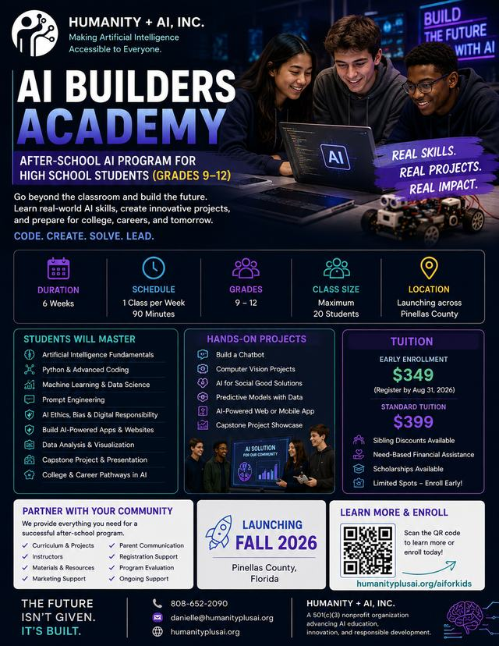
GRADES 9–12
AI Builders — high school
Students will master
AI fundamentals
Python and advanced coding
Machine learning and data science
Prompt engineering
AI ethics, bias and responsibility
Building AI-powered apps and websites
Data analysis and visualization
Capstone project and presentation
College and career pathways in AI
The capstone
Each student ships one real project — a chatbot, a computer-vision tool, a predictive model, an AI-powered app, or an AI-for-social-good solution — and presents it at a public showcase for families and community partners.
Notes:
High school is portfolio work. The capstone showcase is also the strongest recruiting event for the next cohort.

Slide 8








PARTNERSHIP
What we provide your school
Curriculum & projects
Instructors
Insurance
Registration support
Complete six-week scope and sequence, lesson plans, and all project materials.
Trained, vetted instructors who run the sessions. Your staff do not teach the content.
We carry our own coverage for the program. Certificates provided on request.
Enrollment, rosters, payment processing and waitlists are handled by us.
Marketing materials
Parent communication
Materials & resources
Ongoing support
Grade-specific flyers, digital assets and family-facing copy, co-branded with your school.
Welcome letters, weekly updates, and a direct line for family questions.
Devices and software guidance, printed workbooks, and take-home extensions.
A named program contact, mid-cohort check-ins, and end-of-program evaluation.
Flexible partnership options available — host site, co-hosted, or full-service delivery.
Notes:
This is the slide administrators care about most. The short version: we bring the program, the people and the paperwork. The school brings the room and the students.

Slide 9

WHO RUNS IT
Leadership and credentials
Instructor standards
Background-checked before any student contact
Trained on our curriculum and classroom protocols
Experience teaching or mentoring school-age students
A second adult present for every session
Danielle A. Franklin
Founder & CEO, Humanity + AI, Inc.
Former NVIDIA
20 years supporting the U.S. Department of Defense
Founder, Doolittle Corporation
Developer of ROSIE, an applied AI research platform
About Humanity + AI
A 501(c)(3) nonprofit advancing AI education, innovation and responsible development. Our programs span AI literacy, ethics and governance, accessibility, and applied research — the academy is how that work reaches the next generation.
Notes:
Credibility slide. Nonprofit status, real technical background, and clear child-safety standards.

Slide 10

COST AND ACCESS
Tuition families actually pay
TUITION
COHORT DATES
$399
Fall 2026
No family turned
away for cost
Full six-week program.
All materials included.
Exact start dates are confirmed
with each partner school.
Sibling discounts
Need-based financial assistance
Scholarships available
For your families
Tuition is paid directly to Humanity + AI — your school never handles money for this program. Scholarship requests are reviewed by us, confidentially, and families apply through the same enrollment form. Schools may also sponsor seats for students they identify.
Notes:
Important for administrators: no money changes hands at the school. Scholarship handling is confidential and on our side. Tuition is a flat $399 for the full six-week program; cohort start dates are set with each school once a partnership is agreed.

Slide 11
WHERE AND WHEN
Launching Fall 2026 across Pinellas County
Launch communities
Getting started
St. Petersburg
Palm Harbor
1
Intro meeting
30 minutes — fit, grade bands, room and schedule
Clearwater
Dunedin
2
Partnership agreement
Largo
Safety Harbor
Scope, dates, insurance certificates, logistics
3
Family launch
Seminole
Tarpon Springs
Co-branded flyers go home; enrollment opens online
4
Cohort begins
Partner locations announced as enrollment opens.
Six weeks later: showcase night for families
Lead time we need
Roughly eight weeks between a signed agreement and the first class — enough to staff instructors, print co-branded materials, run family enrollment, and reach a workable class size. Earlier conversations mean better placement in the fall schedule.
Notes:
Set expectations on lead time. Eight weeks is the realistic floor.

Slide 12


LET’S BUILD THE FUTURE TOGETHER
Bring AI Builders
Academy to your school
The next step is a thirty-minute conversation. We will walk your team through the curriculum, answer questions about insurance and staffing, and see whether a fall cohort fits your calendar.
808-652-2090
danielle@humanityplusai.org
humanityplusai.org/aiforkids/schools
Humanity + AI, Inc. — a 501(c)(3) nonprofit organization advancing AI education,
innovation, and responsible development.
Notes:
Close with the ask: a thirty-minute meeting. Schedule directly at humanityplusai.org/aiforkids/schools.

