Slide 1
The Problem:
Breast Cancer Diagnosis

Slide 2
The Problem:
Breast Cancer Diagnosis:
False Negatives
(minimize)

Slide 3
The Data:
31 Variable: Diagnosis (“M” of “B”) and 30 Data Points
a) radius (mean of distances from center to points on the perimeter)
b) texture (standard deviation of gray-scale values)
c) perimeter
d) area
e) smoothness (local variation in radius lengths)
f) compactness (perimeter^2 / area - 1.0)
g) concavity (severity of concave portions of the contour)
h) concave points (number of concave portions of the contour)
i) symmetry
j) fractal dimension ("coastline approximation" - 1)

Slide 4
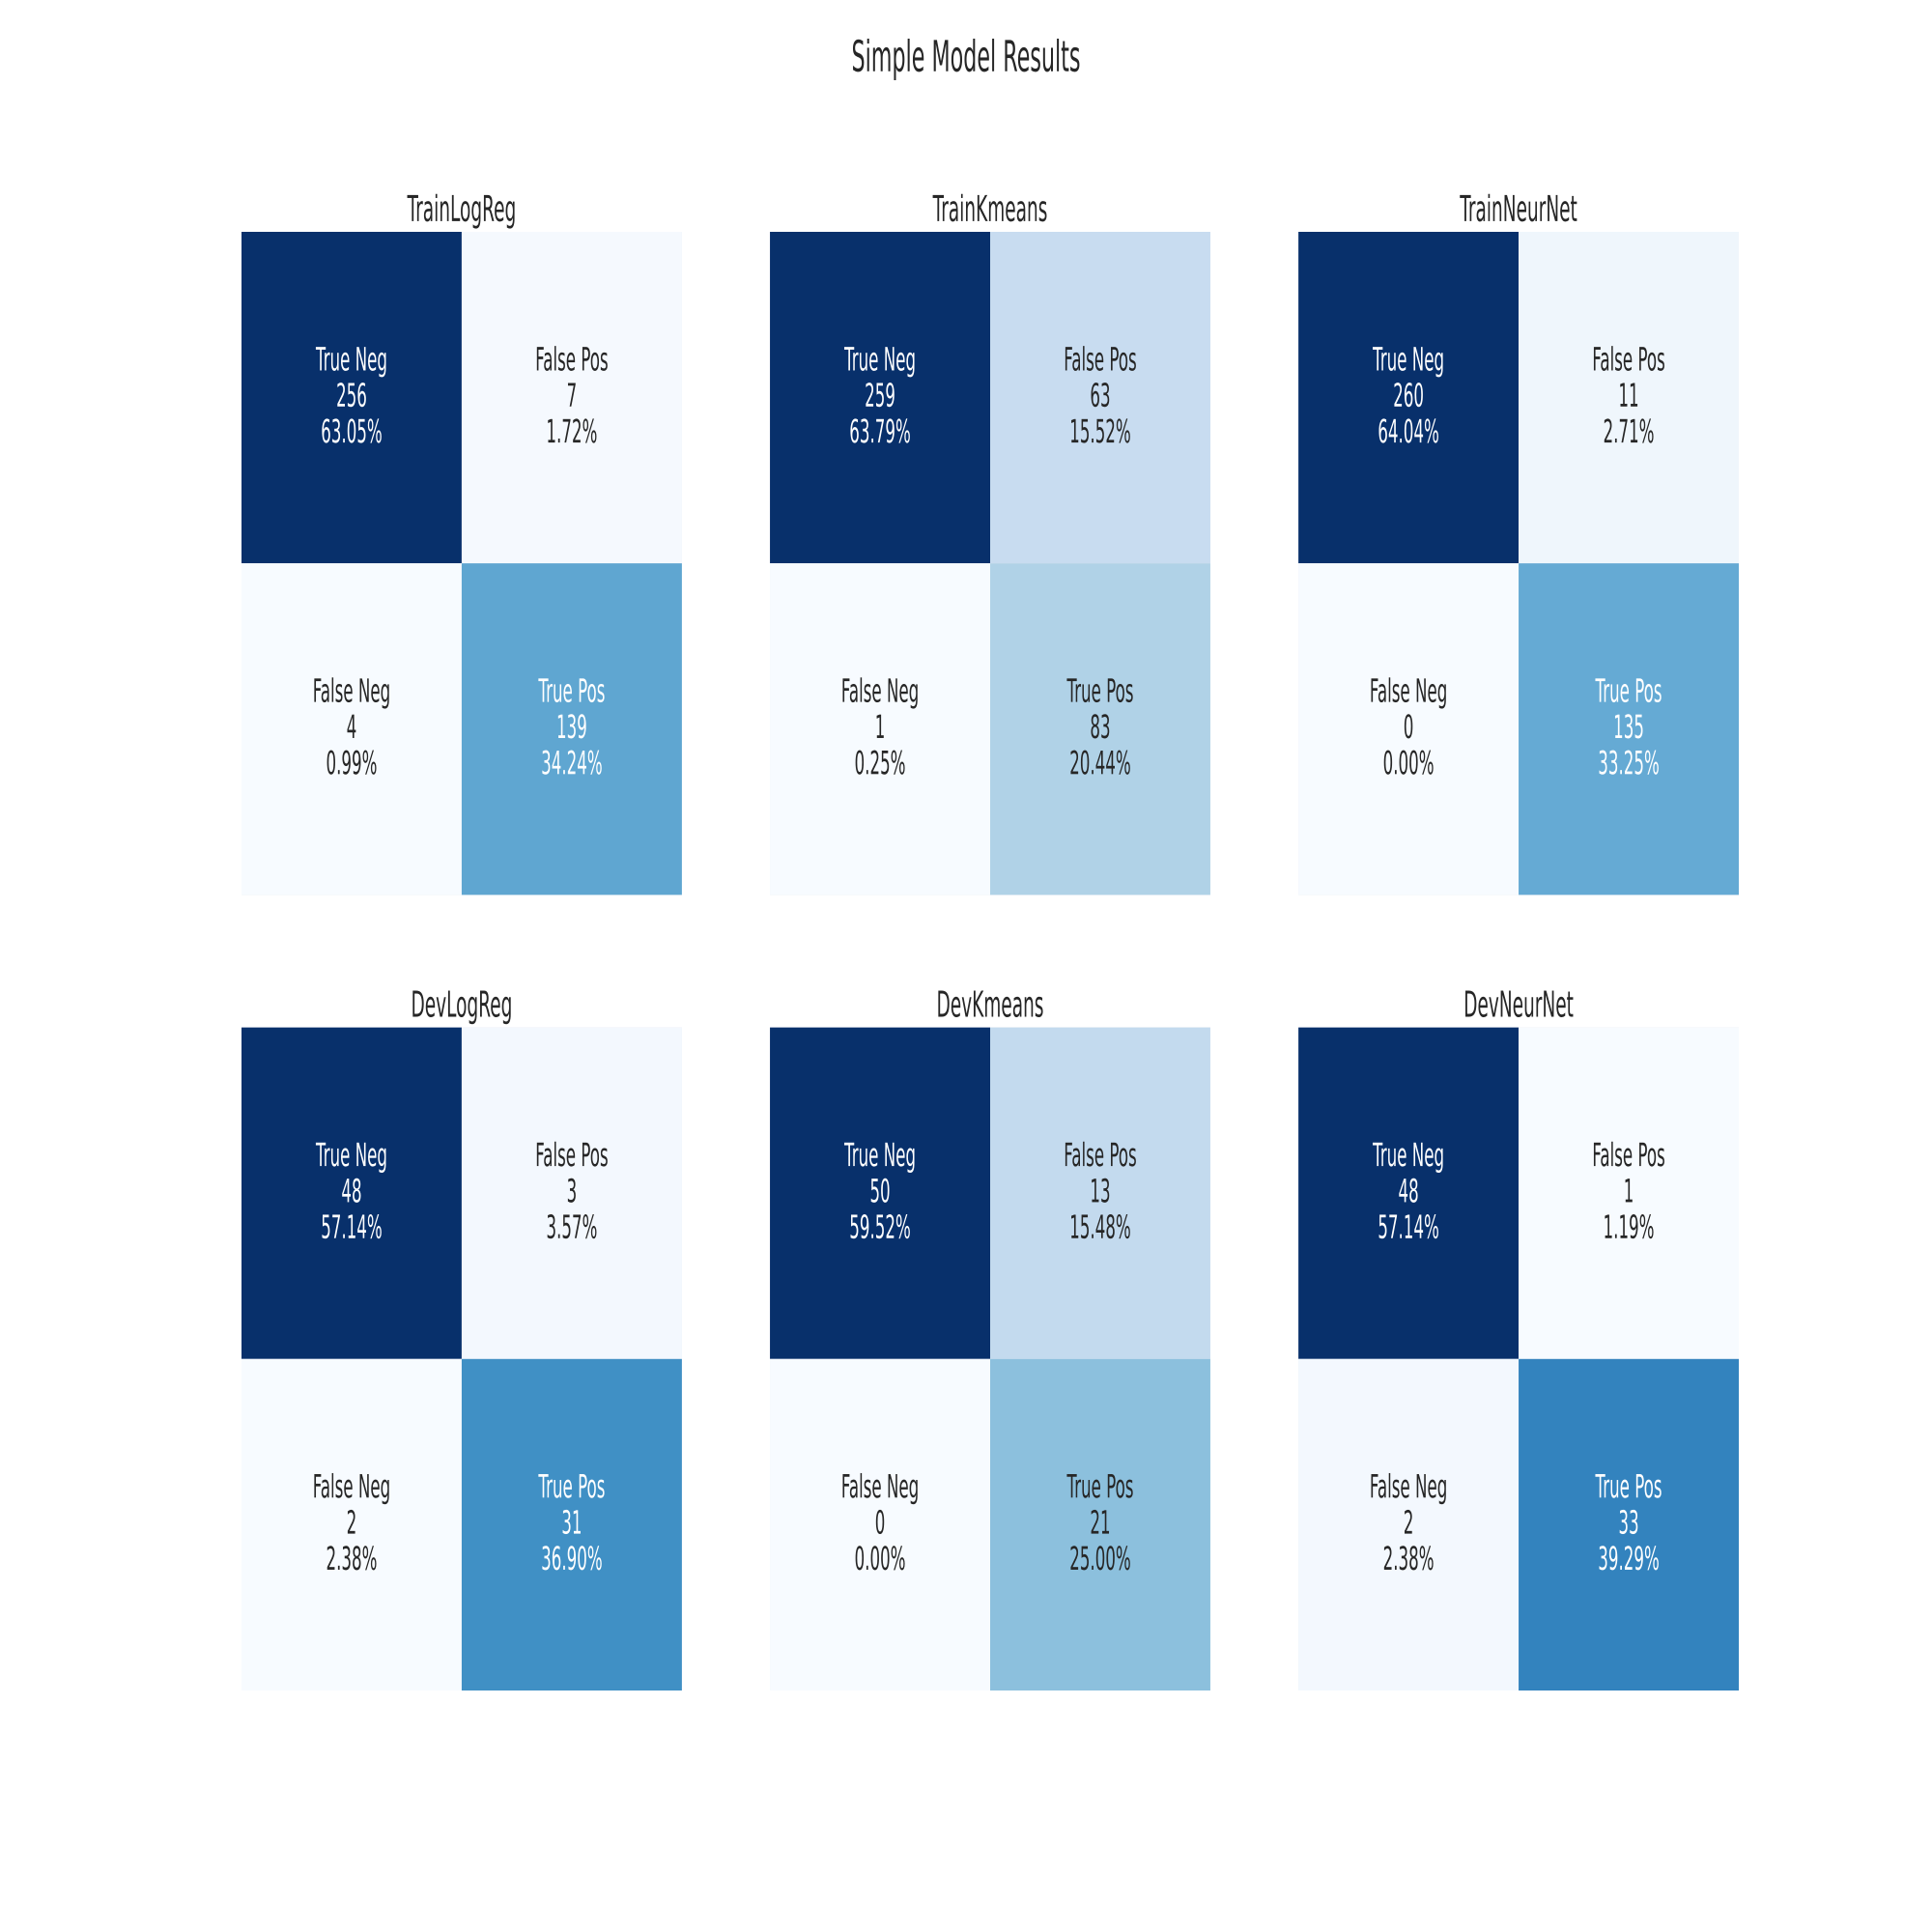
Simple Models

Slide 5
Ideal Case
(Whiteboard)

Slide 6
The Ensemble
(Whiteboard)

Slide 7
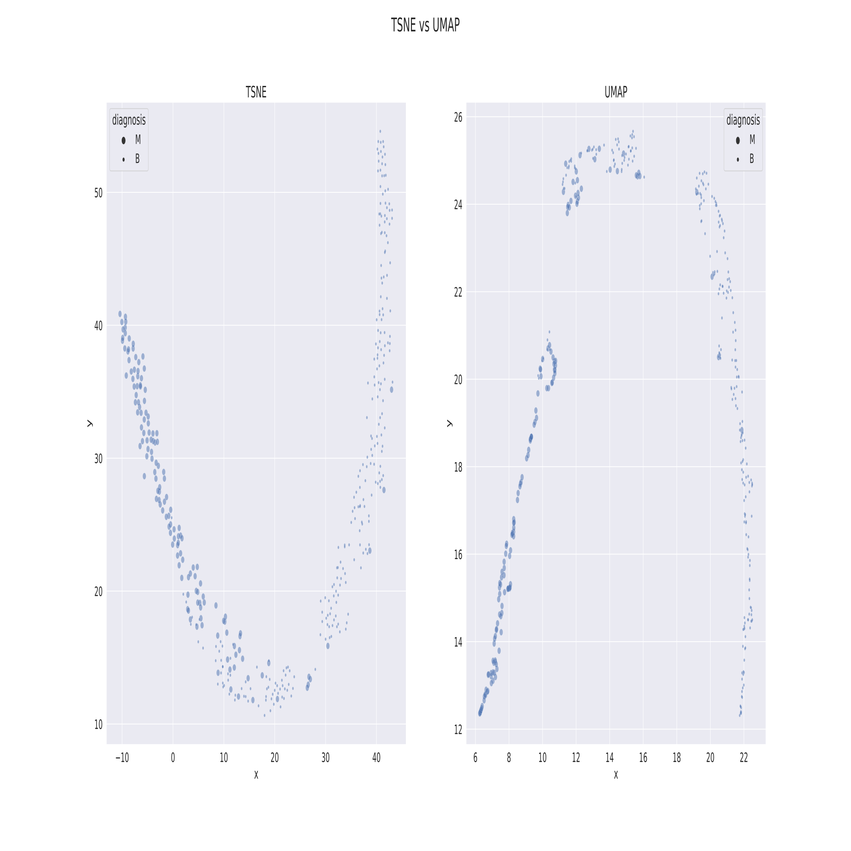
TSNE vs UMAP

Slide 8
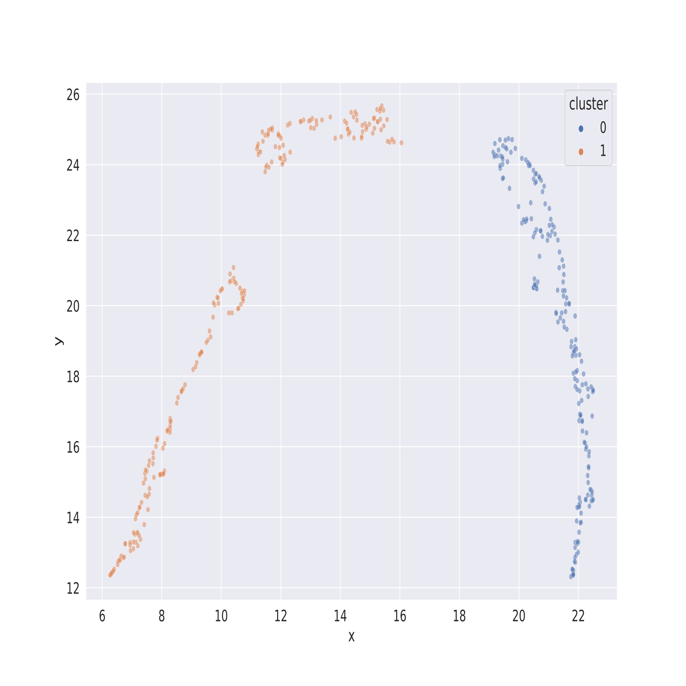
Train Kmeans

Slide 9
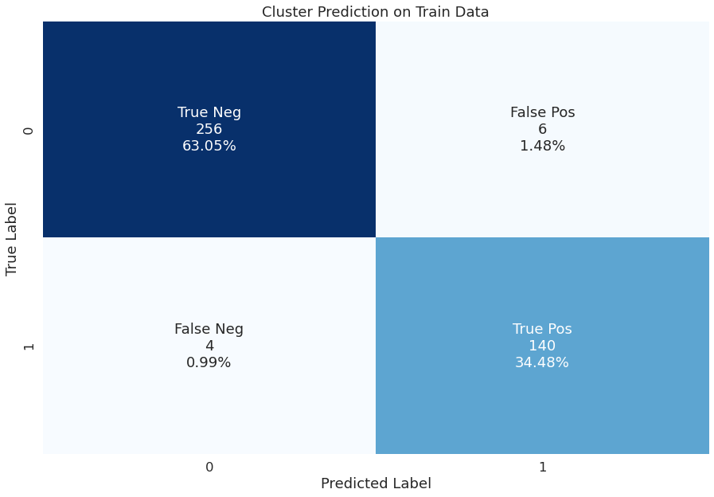
Train NN on each Cluster
To predict classification

Slide 10
Problems with UMAP
(Streamlit)

Slide 11
UMAP Predict Model
(Whiteboard)
Test Loss Functions:
MSLE
MAPE
Huber

Slide 12
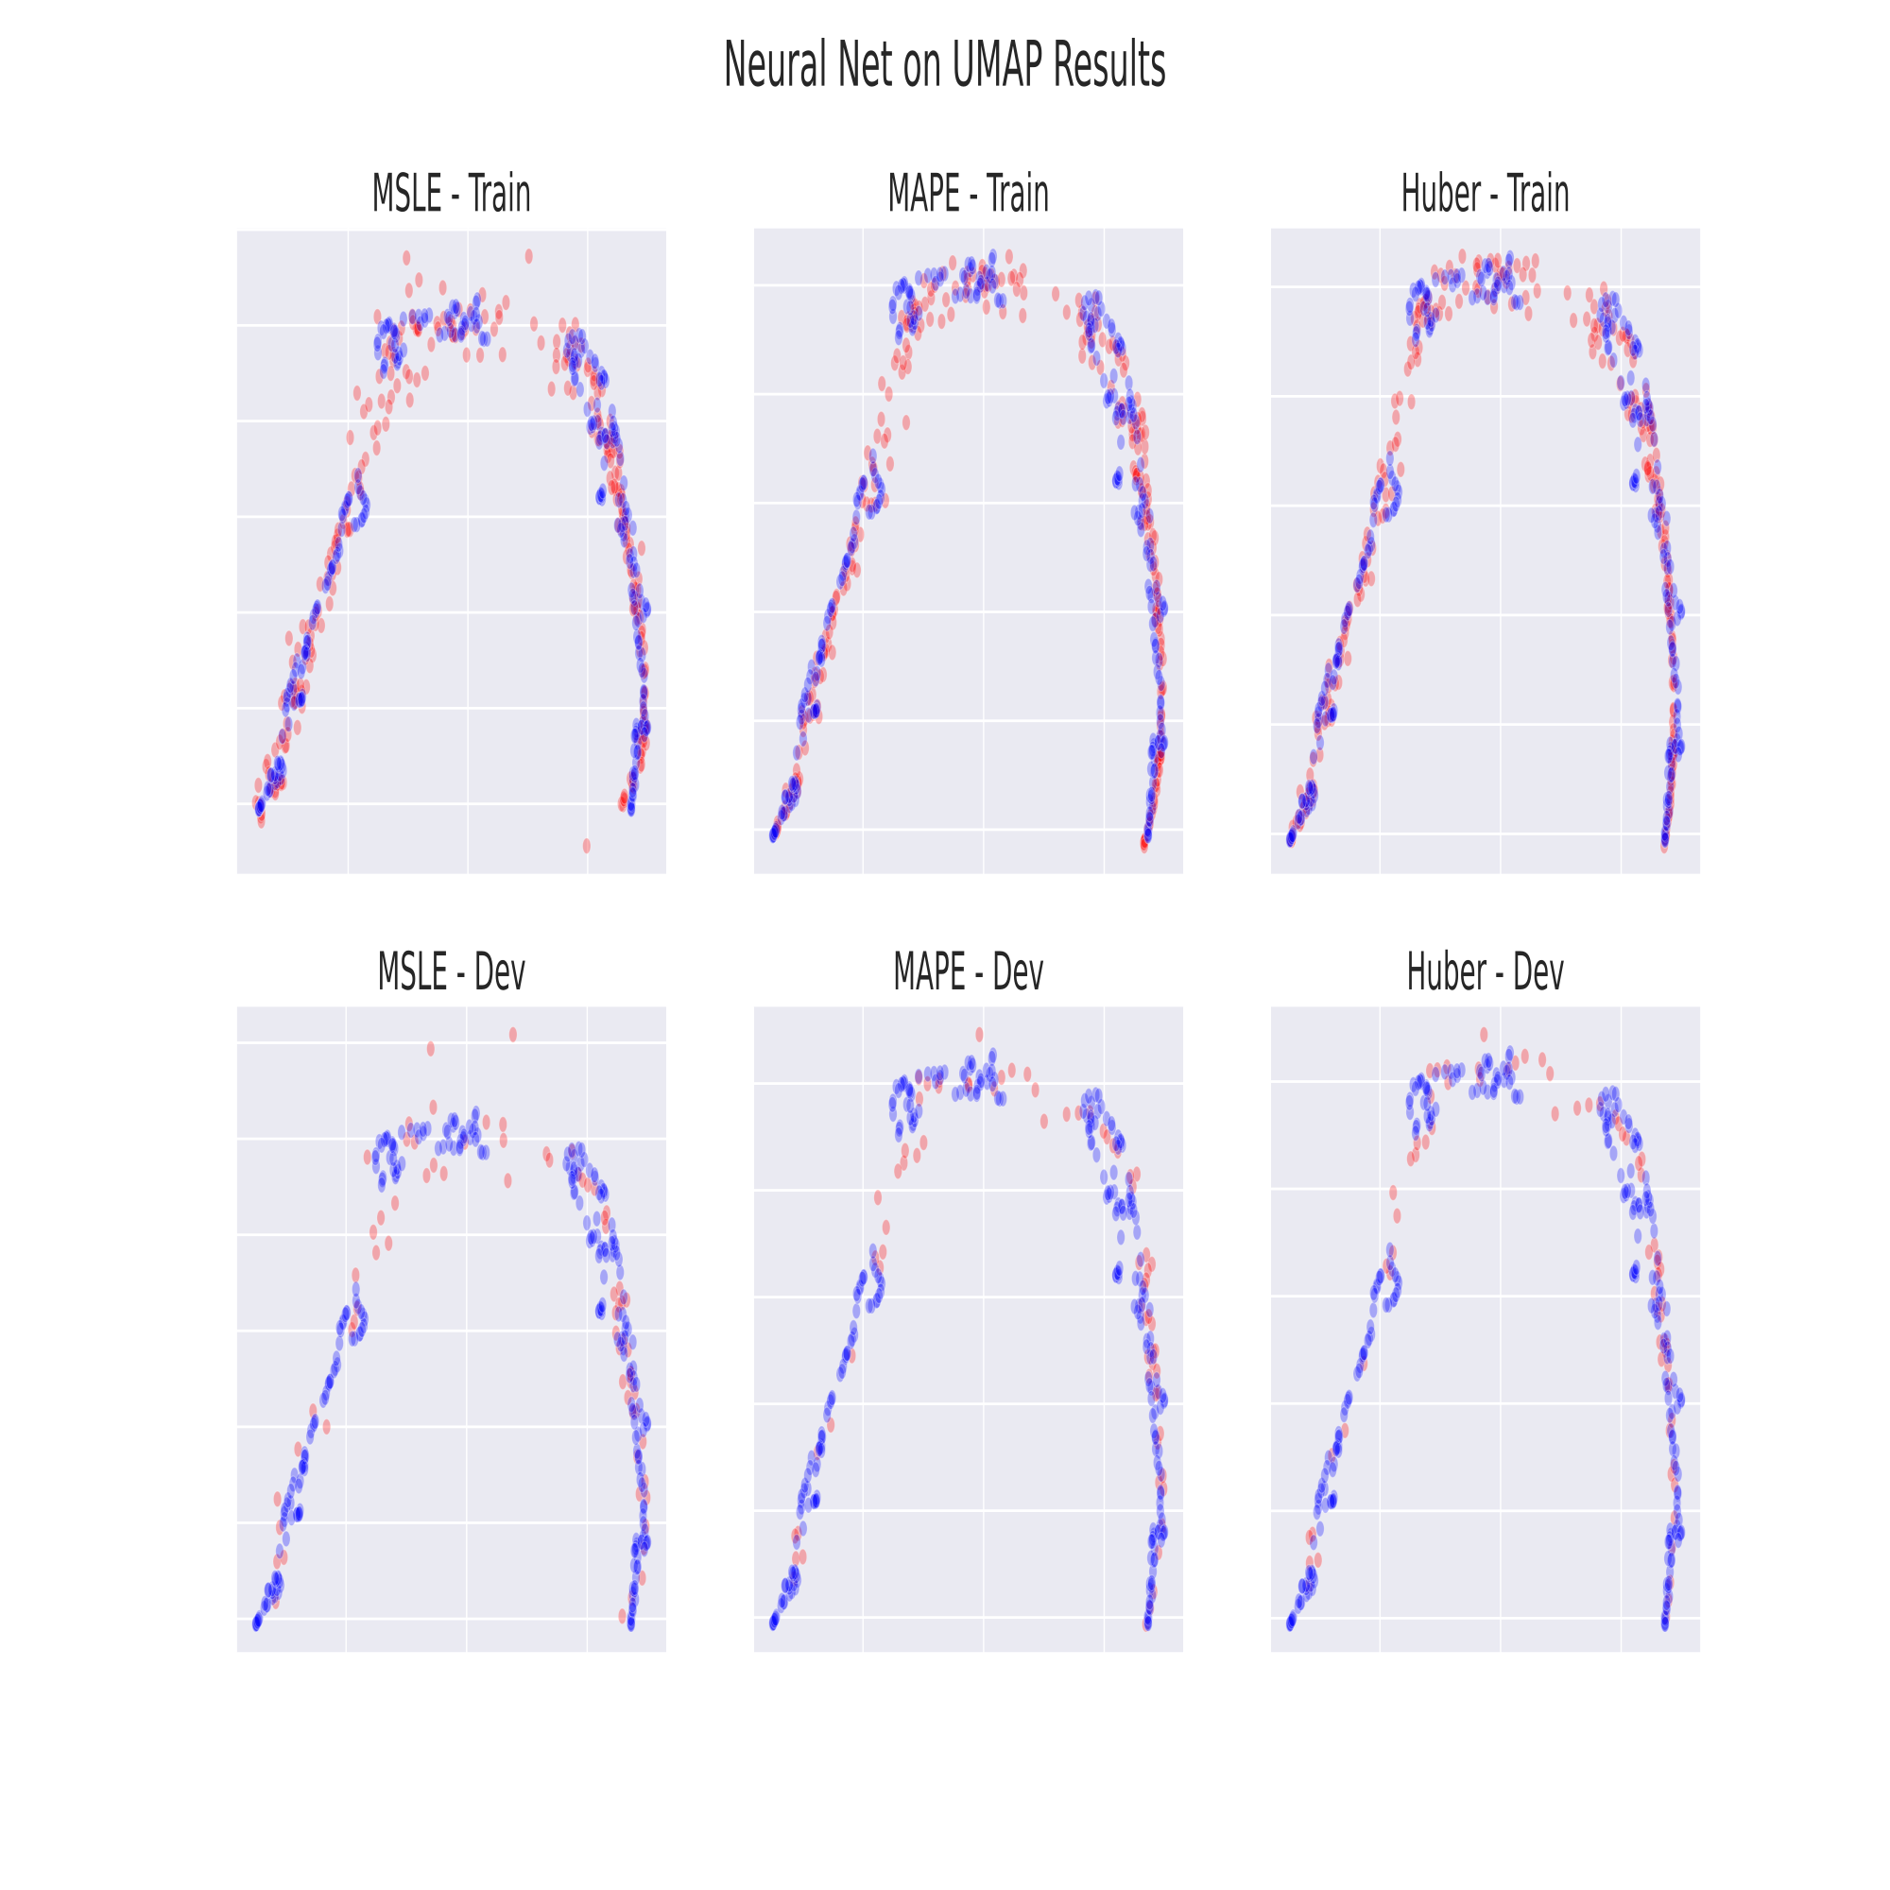
UMAP Parmeters

Slide 13
UMAP Parameters
the KMeans model was able to predict 66 correct memberships with the MSLE loss function the Dev set
the KMeans model was able to predict 67 correct memberships with the MAPE loss function the Dev set
the KMeans model was able to predict 67 correct memberships with the Huber loss function the Dev set
Total observations in Dev set is: 70
the KMeans model was able to predict 54 correct memberships with the MSLE loss function the Test set
the KMeans model was able to predict 55 correct memberships with the MAPE loss function the Test set
the KMeans model was able to predict 56 correct memberships with the Huber loss function the Test set
Total observations in Test set is: 56

Slide 14
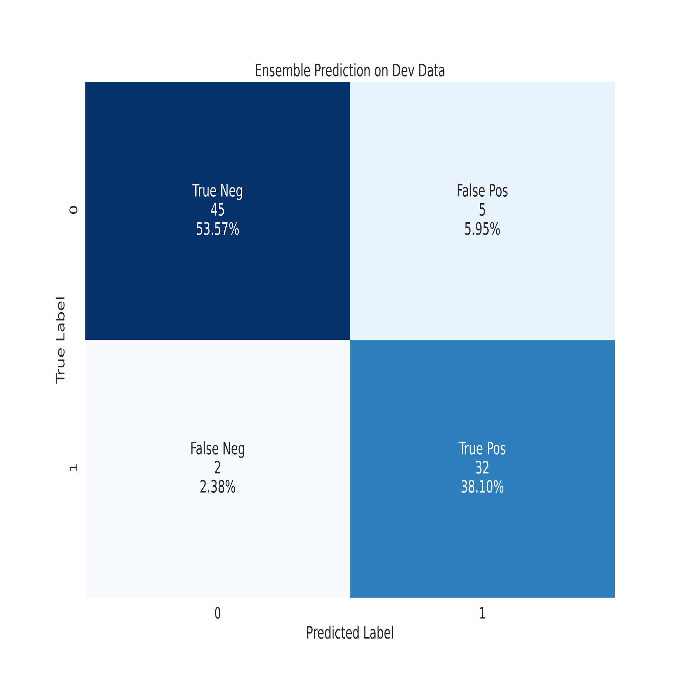
Ensemble Model Results

Slide 15
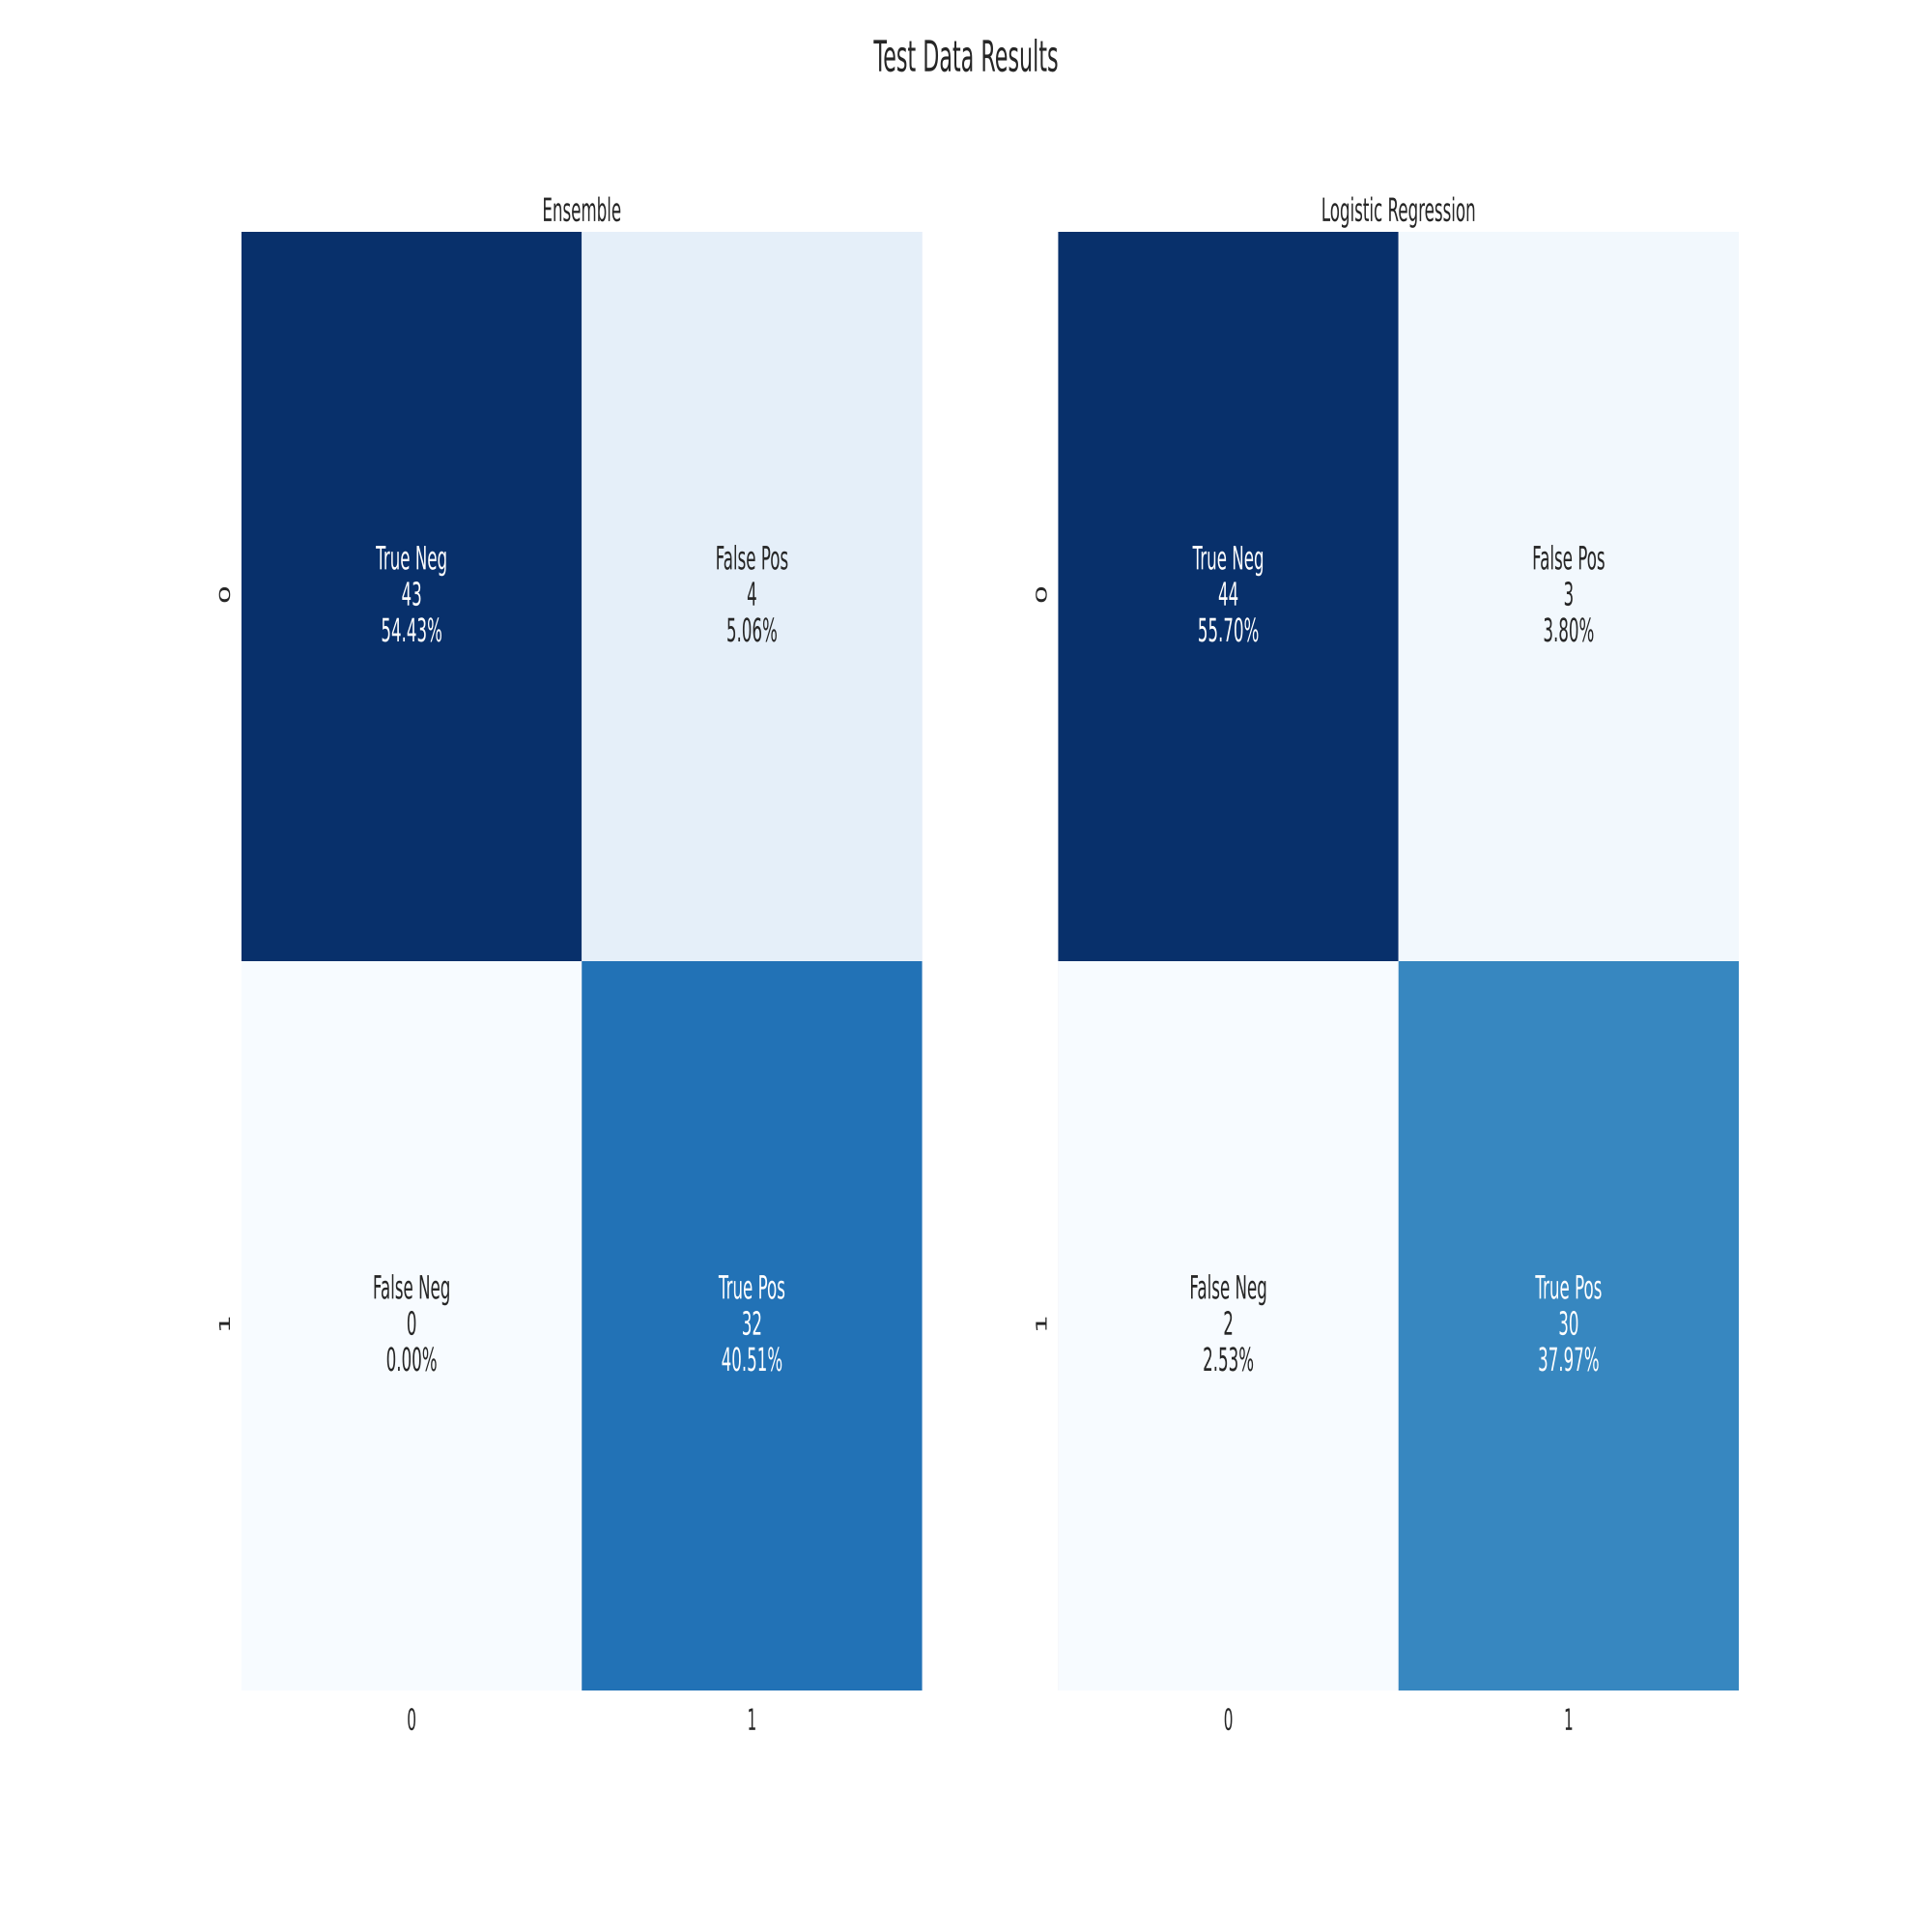
Ensemble Model Results

Slide 16
Conclusion
I would not rely on this model.
Does not give consistent results; any good results could be because of data split
Does not significantly outperform a simple Logistic Regression Model.
UMAP uses a stochastic method of reducing dimensionality. Because our data was normalized, we assumed data was homogeneous. If data is not homogeneous, any stochastic method would be inappropriate.
Have less than 600 data points; need more data.

