Slide 1
Project Luther
Jonathan Cosme

Slide 2
Contents
Background
1
Models
2
Conclusion
3
Purpose, brief time series background
Data overview, and model walk-through
Model evaluation, and further consideration

Slide 3
Background
Purpose of project
Time series background

Slide 4
Purpose
A: Compare Simple & Complex
B: Compare NN to rest
We will build two models:
“Simple” model: 1 variable.
“Complex” model: 13 variables.
and compare the results.
We will build a Neural Network model, and compare it’s performance to the “Simple” and “Complex” models.
Notes:
notice “build an ACCURATE model” is not one of the purposes

Slide 5
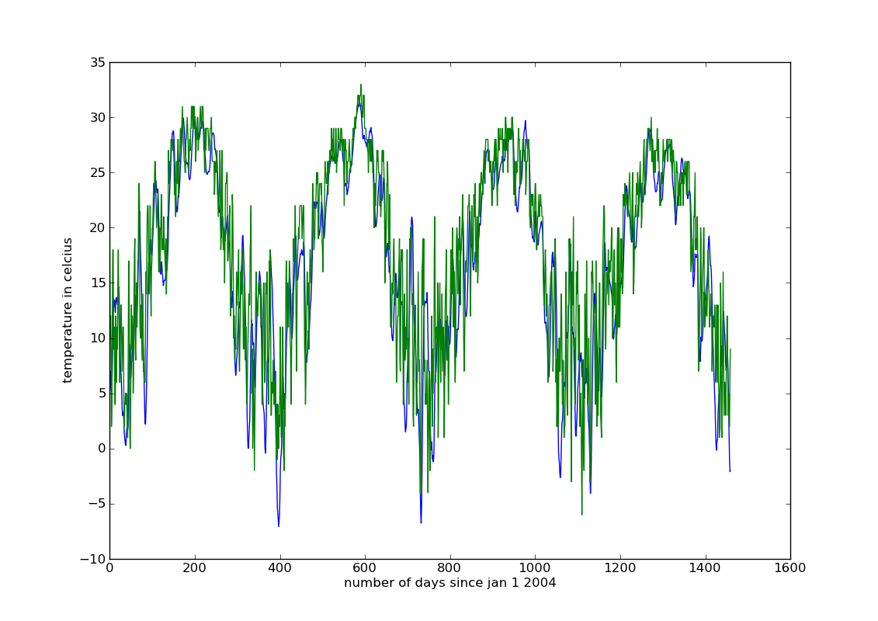
Auto-Regression
Need Stationarity
E.g. can build an AR model on temperature data.

Slide 6
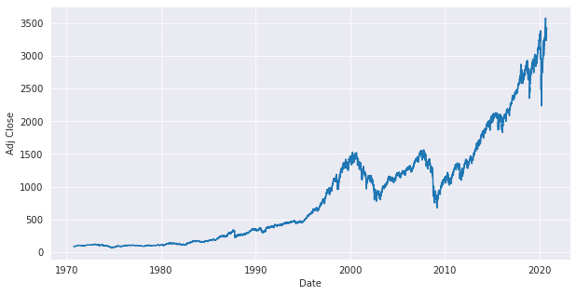
Auto-Regression
Need Stationarity
E.g. cannot build an AR model on stock prices!

Slide 7
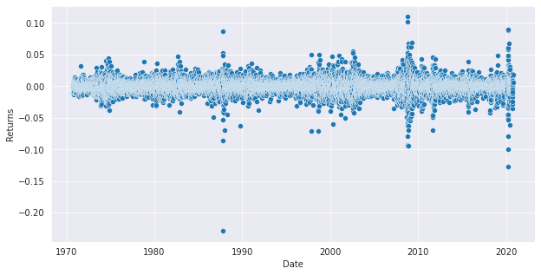
Auto-Regression
Need Stationarity
We use the return (continous % change) of stock prices.
Notes:
VERY important to use CONTINUOUS returns and NOT discrete (simple) returns

Slide 8
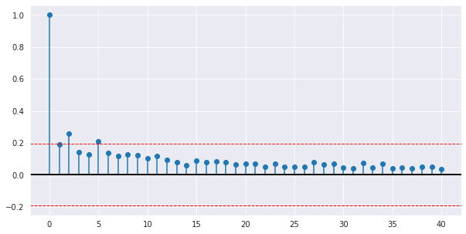
Auto-Regression
Step 1: Plot the ACF
Notes:
This

Slide 9
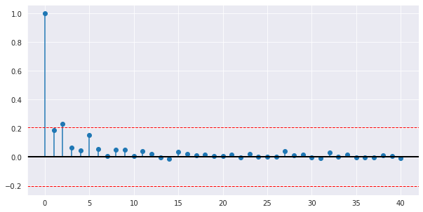
Auto-Regression
Step 1: Plot the ACF
Step 2: Plot the PACF

Slide 10
Models
Data used in models
Simple Model
Complex Model
Neural Network Model

Slide 11
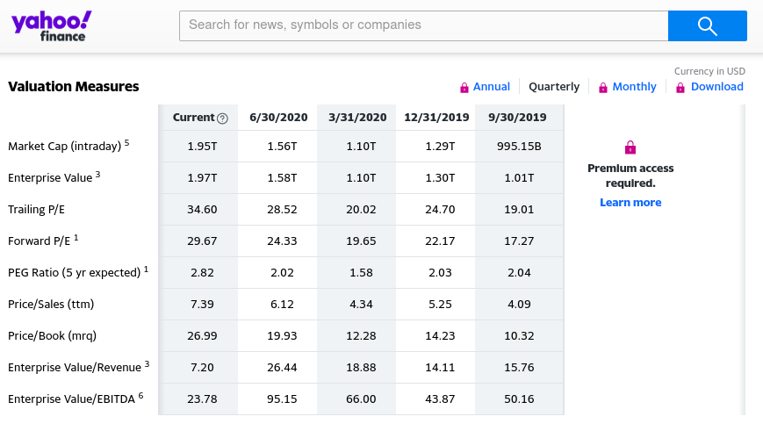
The Data
Scrape S&P 500 components from Wikipedia
Used Yahoo Finance API to obtain price information from Oct 1, 2019 to Sep 29, 2020
Scraped components stats from Yahoo Finance Page

Slide 12
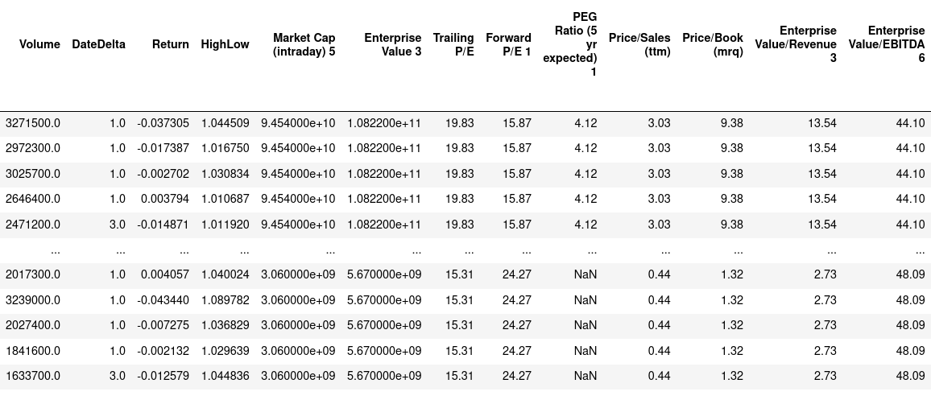
The Data

Slide 13
The Data
We will have multi-colinearity

Slide 14
Simple Model

Slide 15
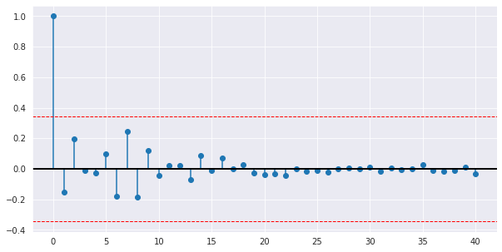
Simple Model
Step 1: Plot the ACF
Note: No significant auto-correlation in series. Thus, an AR model is not appropriate for this data.

Slide 16
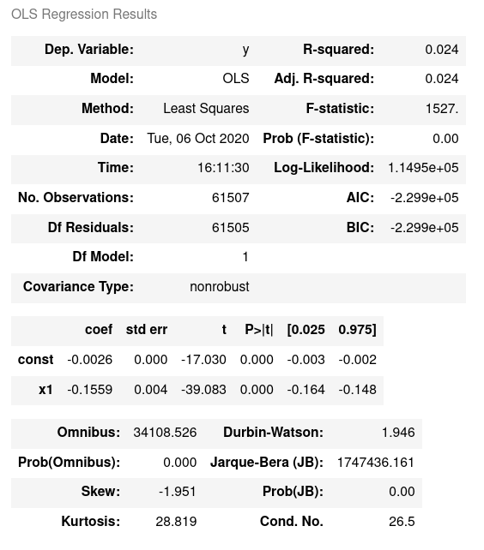
Simple AR(1) Model

Slide 17
Complex Model

Slide 18
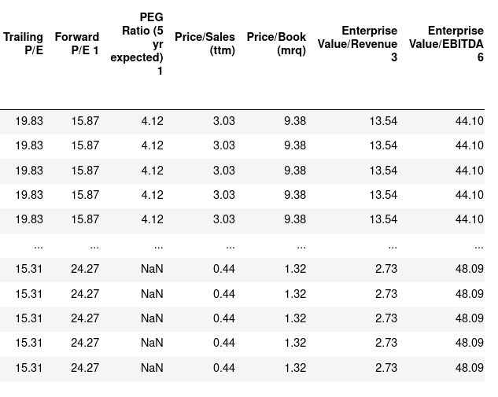
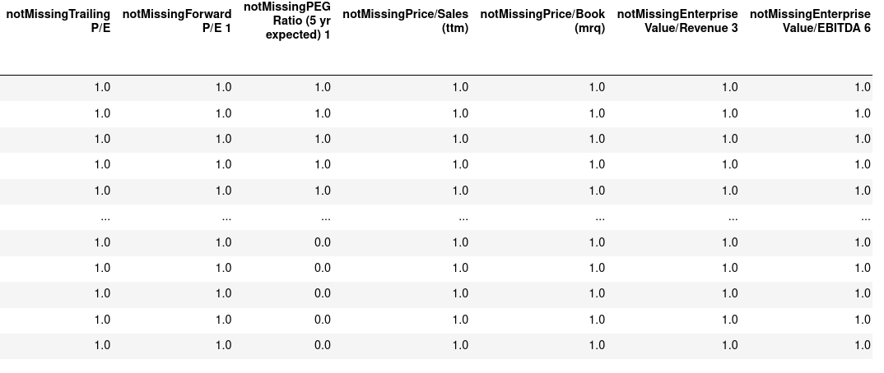
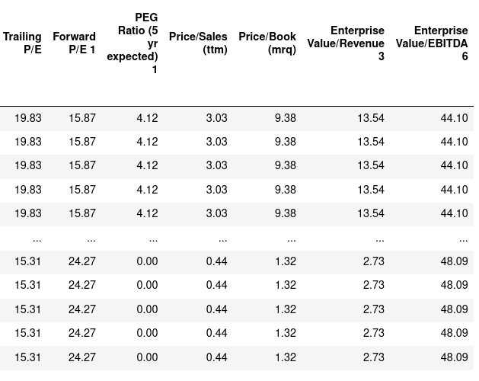
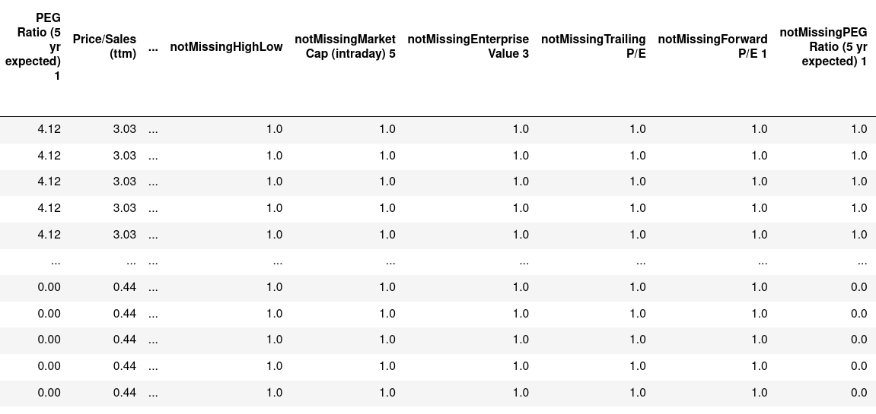
Complex Model
1
2
We regress all 13 variables, (plus the 13 “notMissing” encodings), on T+1 returns.
3
4

Slide 19
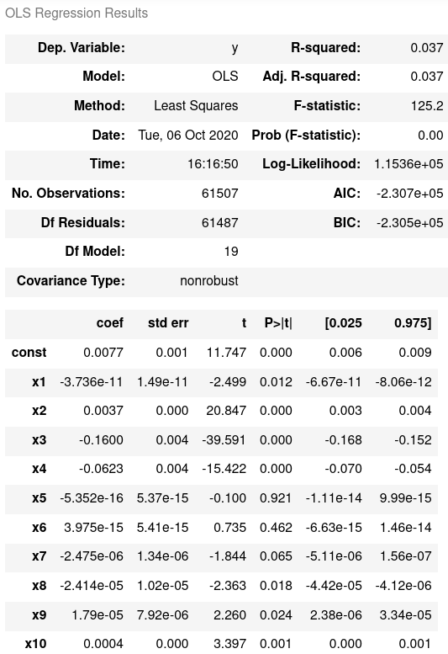
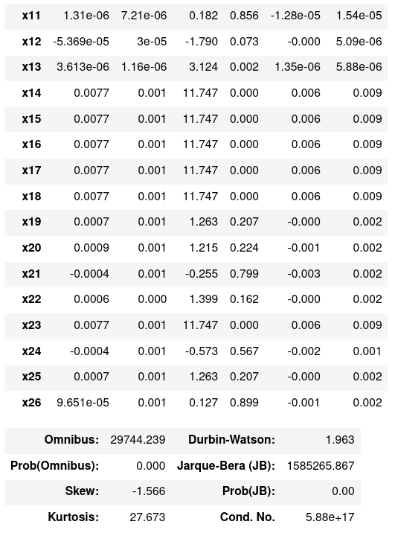
Complex Model

Slide 20
Neural Network Model

Slide 21
Neural Network Model
We use 2 layers.
L1: 26 nodes; leaky relu activation
L2: 1 node; relu activation
F1
Leaky ReLu
F2
Leaky ReLu
F3
Leaky ReLu
ReLu
y-hat
.
.
.
.
.
.
F26
Leaky ReLu

Slide 22
Conclusion
Model Performance
Further consideration

Slide 23
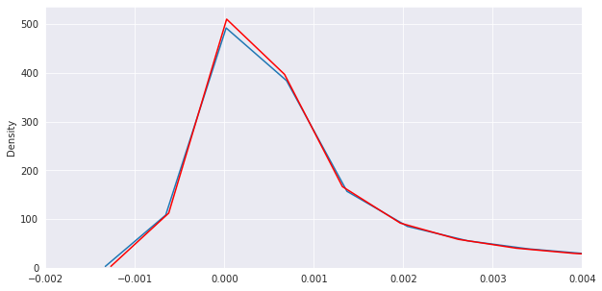
Simple vs Complex
Dev set MSE for Simple model: 0.0014718622471362882
Dev set MSE for Complex model: 0.0015187861917754437
One-way ANOVA results: F-Stat = 2.8797 (pval = 0.0897)

Slide 24
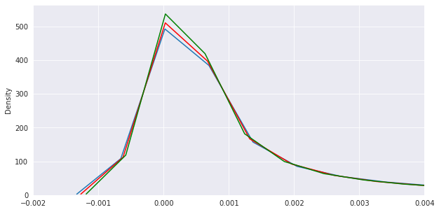
NN vs Rest
Dev set MSE for Neural Net model: 0.001402712182856231
One-way ANOVA results: F-Stat = 7.003 (pval = 0.0081)
Dev set MSE for Simple model: 0.0014718622471362882
Dev set MSE for Complex model: 0.0015187861917754437

Slide 25
Further Consideration
Using levels rather than returns makes performance worse, in addition to violating the stationarity condition of AR models.
Using more than 1 year of data would also help build a better model.
Note S&P 500 components change over time; it’s important to make sure one gets correct components for the time period.
Building a categorical predictive model, rather than a coninuous model (predict if returns will be positive or negative, rather than the value of the return) might be more appropriate for this data.
Building a continuous model for predicting the squared returns (volatility) would also be more appropriate for this data. Serial correlation of volatility is a well known phenomenon.
Combining the above two: build a categorical predictive model, then a model for predicting squared returns for each, would be an interesting thing to explore.

Slide 26
Thanks!
Does anyone have any questions?

