Slide 1
Basketball Shot Selection
Data Scraping
K-means Clustering

Slide 2
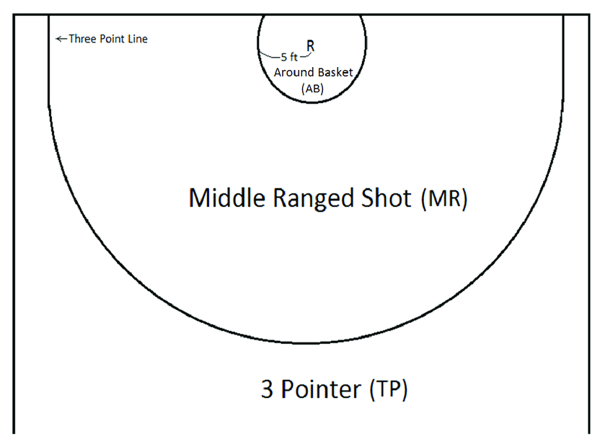
Different types of shots a basketball player can make:
Around the basket, or paint, worth 2 points
Farther from the basket, but still worth 2 points, known as midrange
Outside the perimeter line, worth 3 points

Slide 3
Data Scraping
Data scraping consists of automatically creating datasets, by extracting data from websites using scripts.
Allows to make custom datasets with specific data, which may not have been originally arranged together in the website.
Script coded using the language python
Retrieved wanted data from basketball-reference.com
In total 4920 games were analysed, throughout 4 seasons, giving 120 data points related to the annual stats of each team
Stored the data into a dataset as an excel file

Slide 4
Clustering
Used the Sklearn Python library to apply the k-means clustering algorithm to the dataset
Goal:
Find a correlation between a team’s average shot distance and win rate
Find clusters of teams based on their percentage of attempts in the paint and behind the three point line. Find correlation between each cluster and win rate.

Slide 5
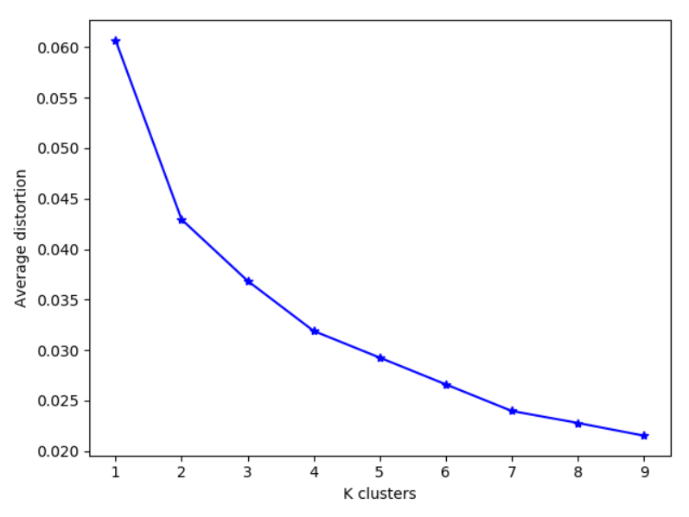
Elbow Method
Allows to find the optimum number of clusters for a certain dataset
Calculates the average distance for each point inside a cluster in relation to its centroid
The optimum number of clusters is found where the average distortion stops decreasing at an increased rate

Slide 6
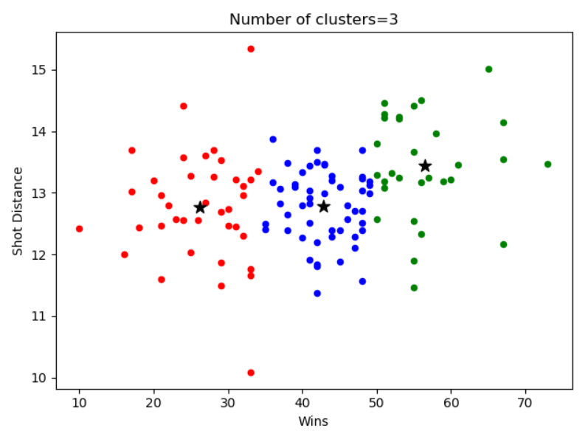
Clustering
Find a correlation between a team’s average shot distance and win rate:
using k = 3 clusters
inconclusive results, due mostly to the nature of averages

Slide 7
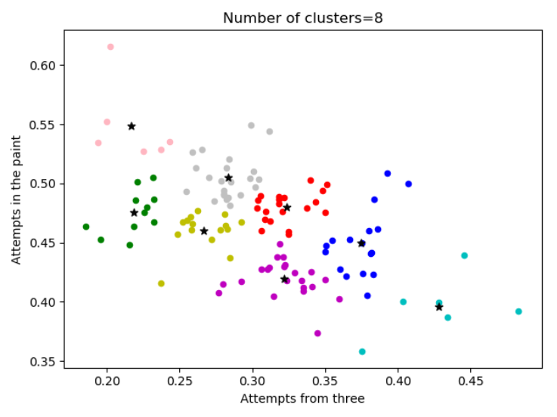
Clustering
Clustering around paint and three-point attempts:
Showed that the two edge clusters pink and cyan, which specialise in paint attempts and three-point attempts respectively, average 50 wins every season
Every other cluster’s teams average around 40

Slide 8
Clustering
Clustering around paint and three-point attempts:
Using percentage of teams per cluster who record over 50 wins
Cyan has 66% of teams over50, while Pink only has 50%
Blue, the team with second highest 3p attempts, has 40%
Grey, with second highest paint attempts, only has 30%

Slide 9
Clustering
Clustering around paint and three-point attempts:
The remainder of teams, which focus more on midrange shots, have all only around 10% of their teams over 50 wins

Slide 10
Conclusion
Using clustering algorithms, we were able to prove that, over the last 4 years, teams that avoided the midrange attempts were massively more successful than those who gave it more importance
Additionally, teams that focused on three-point attempts were more successful than those that focused on paint attempts

