Slide 1
Alphas, all Neurons

Slide 2
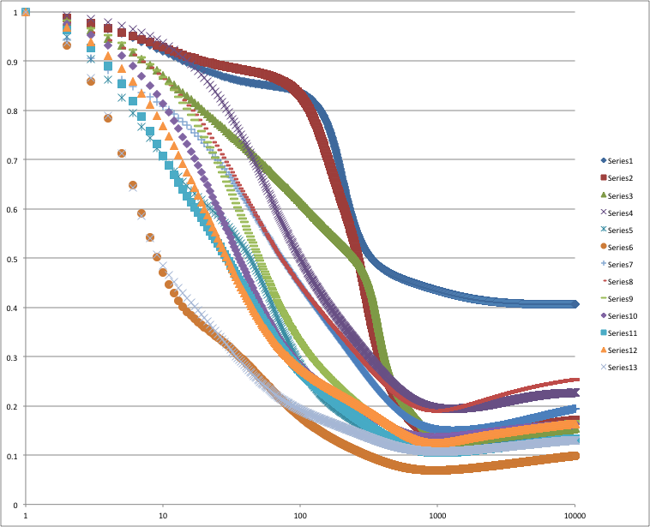
alpha0.005Neurons1..13

Slide 3
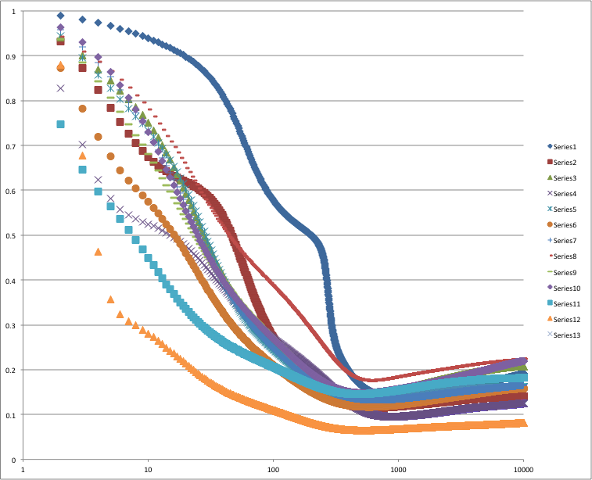
alpha0.01Neurons1..13

Slide 4
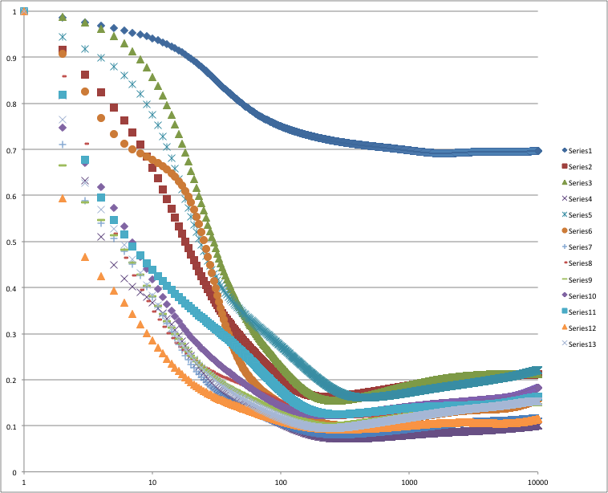
alpha 0.02, Neurons 1-12

Slide 5
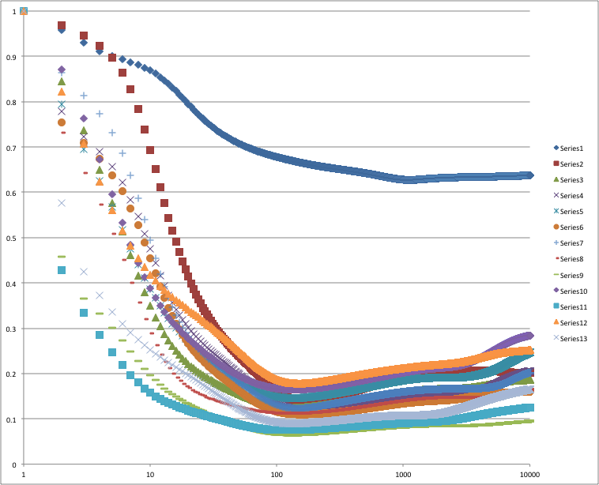
alpha 0.04, Neurons 1-12

Slide 6
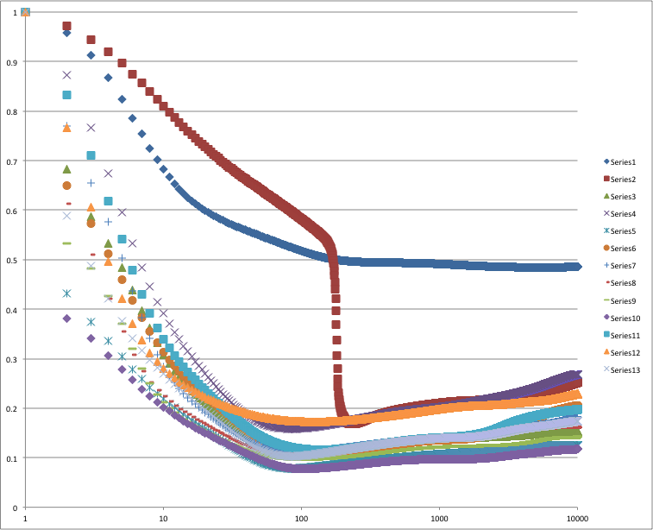
alpha 0.06, Neurons 1-13

Slide 7
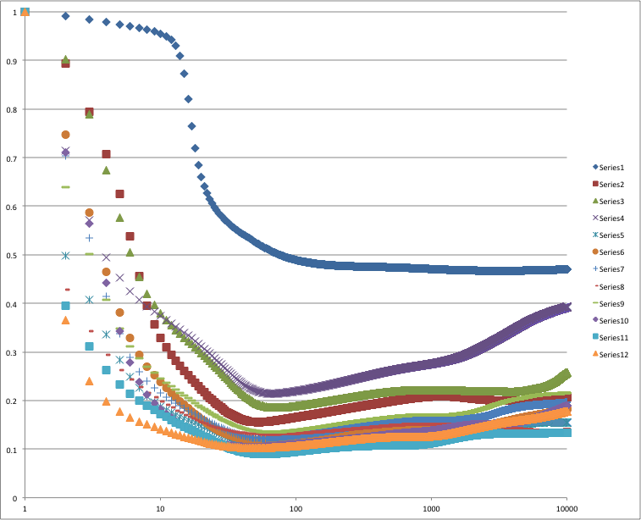
alpha 0.1, Neurons 1-12

Slide 8
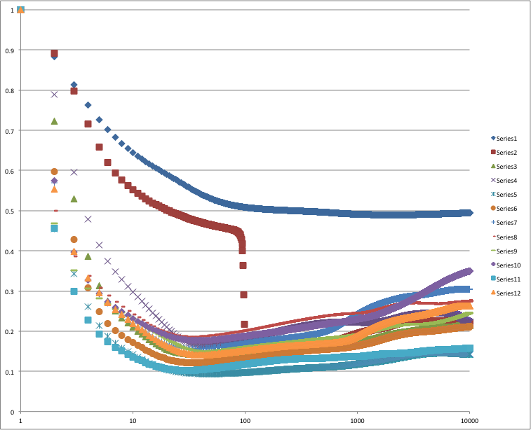
alpha 0.15, Neurons 1-12

Slide 9
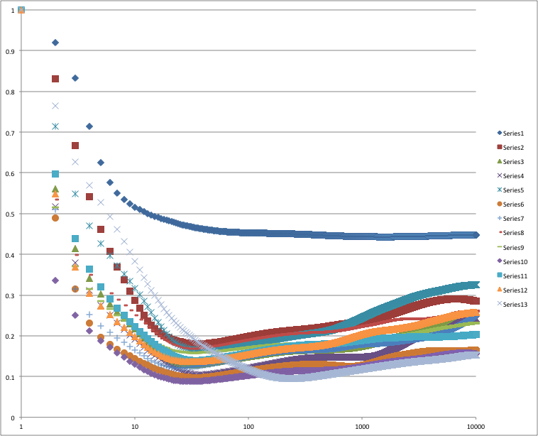
alpha 0.2, Neurons 1-13

Slide 10
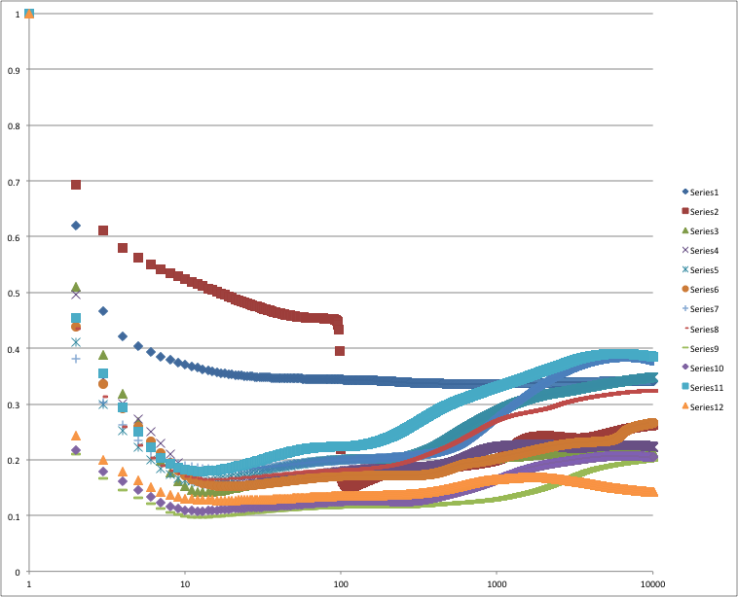
alpha0.5, Neurons1-12

