Slide 1
# Neurons, all alphas

Slide 2
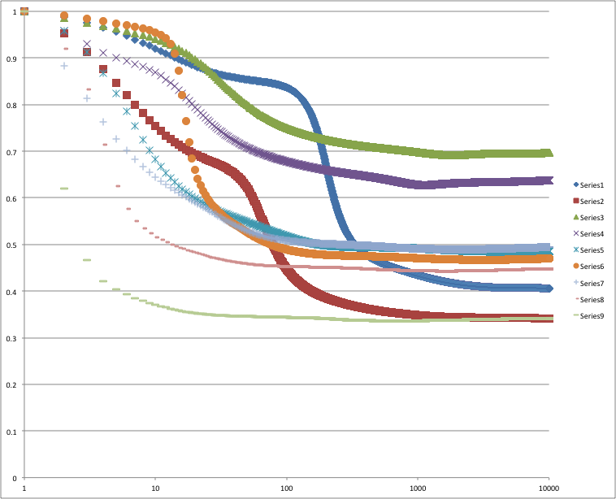
# Neurons = 1, All alphas

Slide 3
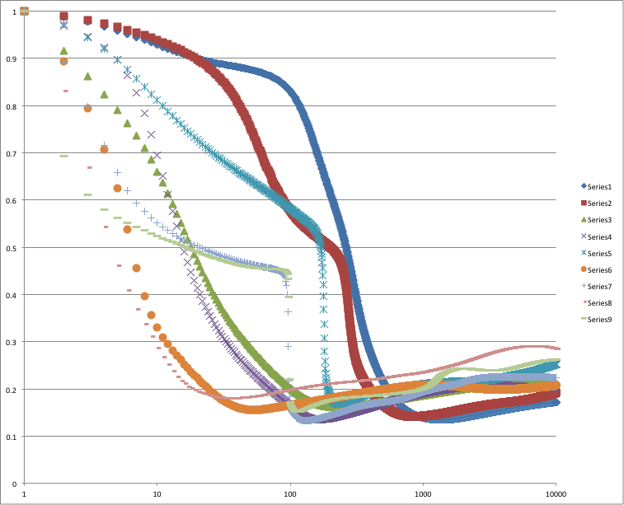
# Neurons = 2, All alphas

Slide 4
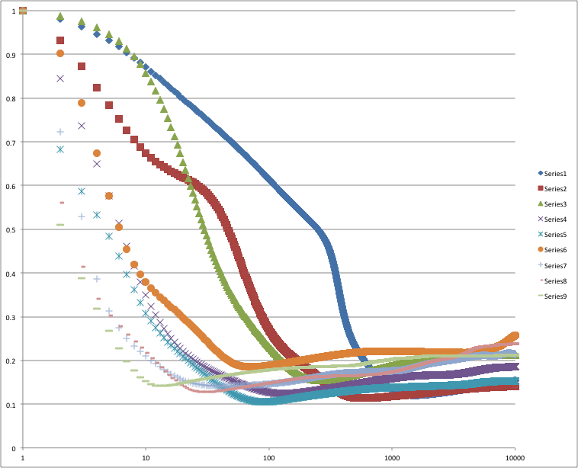
# Neurons = 3, All alphas

Slide 5
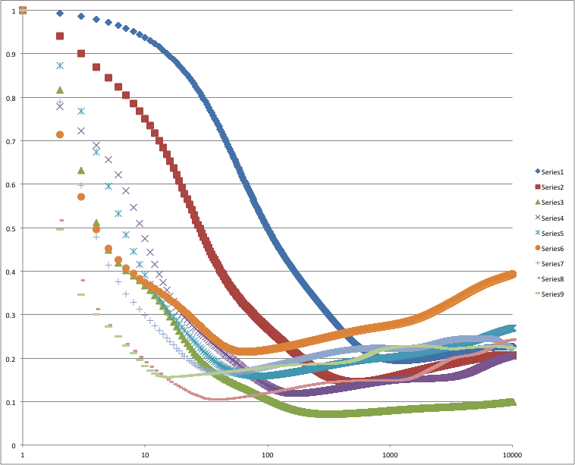
# Neurons = 4, All alphas

Slide 6
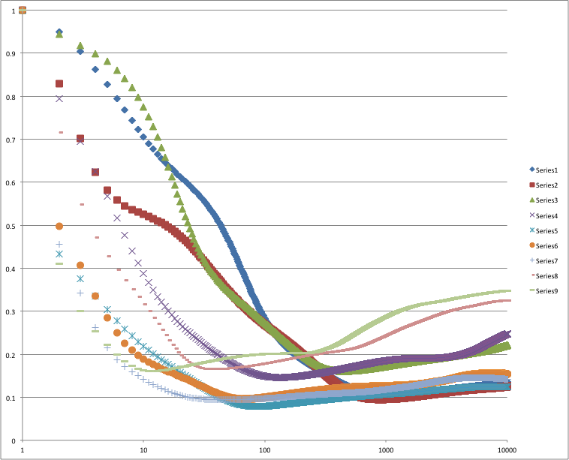
# Neurons = 5, All alphas

Slide 7
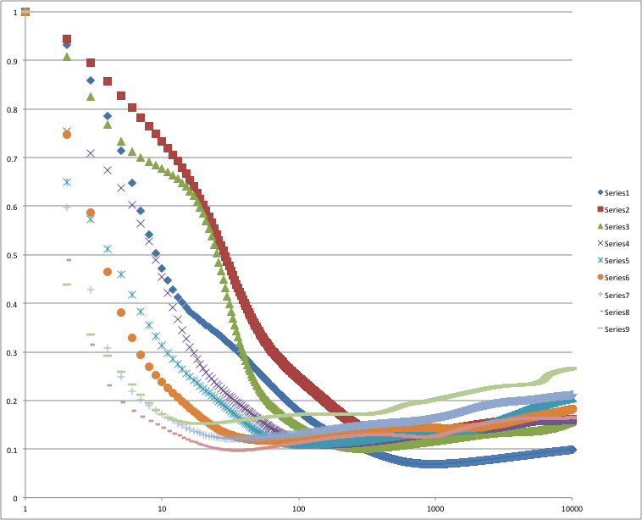
# Neurons = 6, All alphas

Slide 8
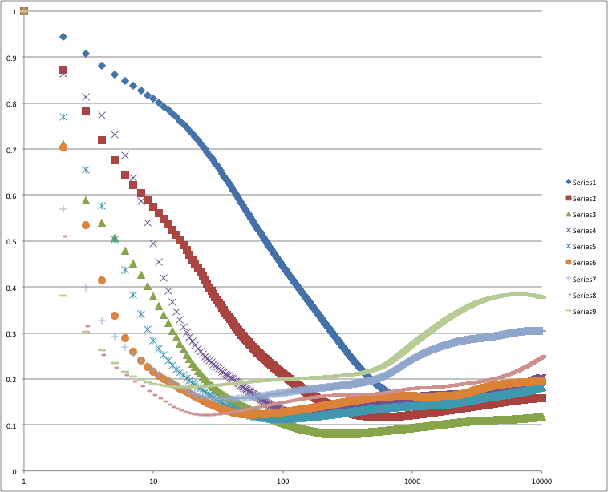
# Neurons = 7, All alphas

Slide 9
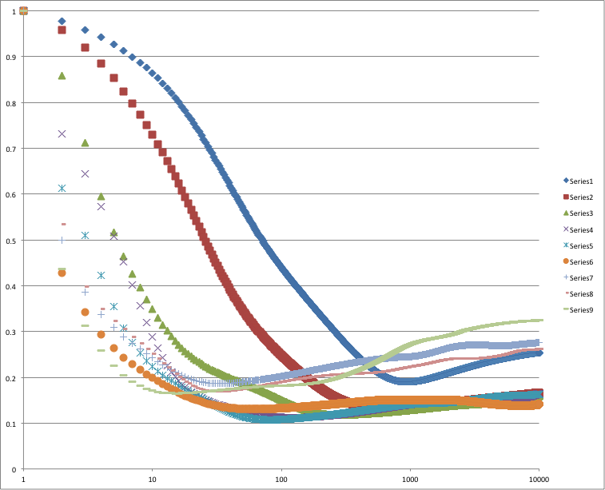
# Neurons = 8, All alphas

Slide 10
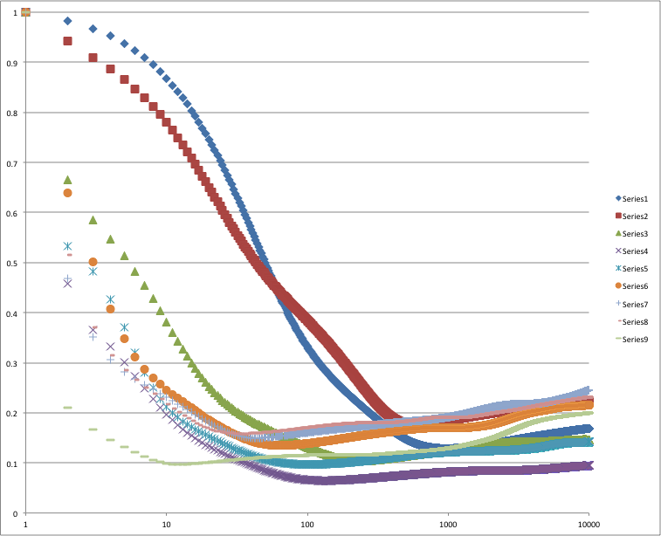
# Neurons = 9, All alphas

Slide 11
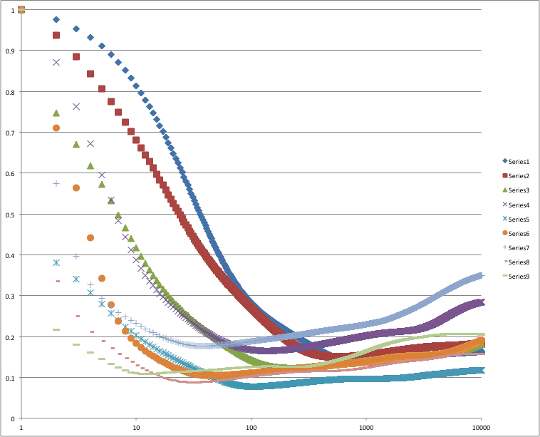
# Neurons = 10, All alphas

Slide 12
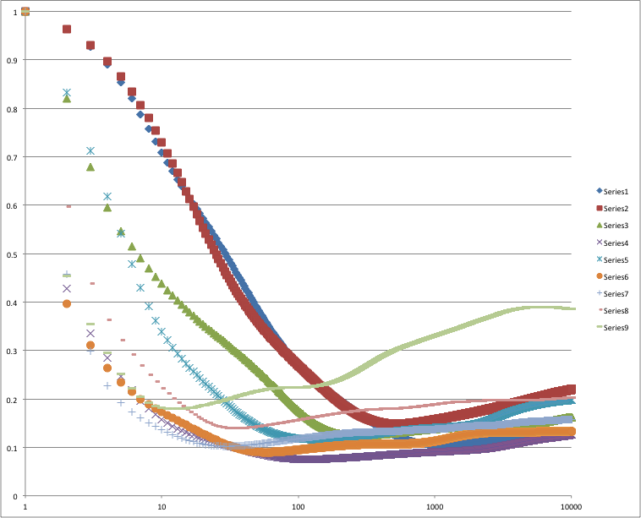
# Neurons = 11, All alphas

Slide 13
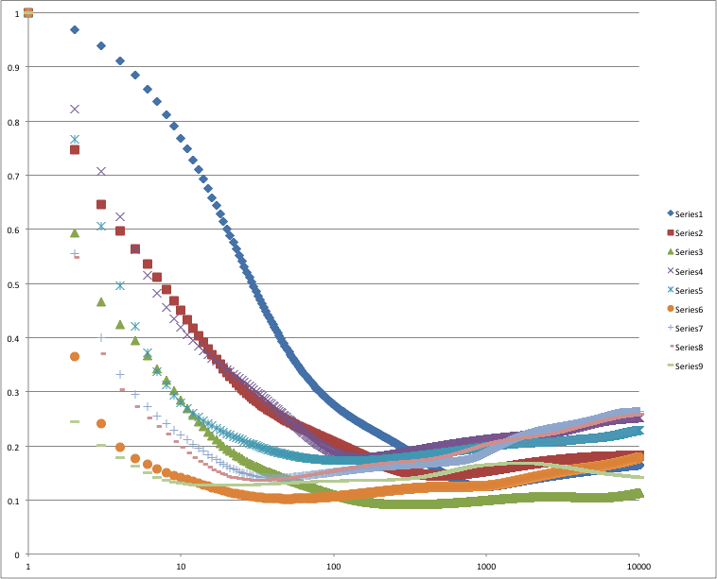
# Neurons = 12, All alphas

Slide 14
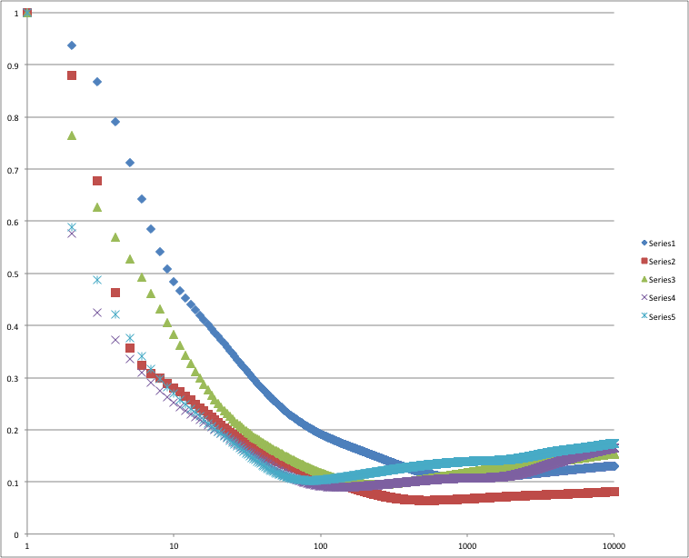
13 Neurons

