Slide 1
Graphs

Slide 2
Graphs
A graph G= (V,E) is a set of vertices V and a set of edges E, such that there are 2 vertices associated with each edge.
Edges are denoted in this text by the pair (i,j) which means the edge connects vertex i with vertex j.
Sometimes the edges have a direction (called directed graphs or digraphs)

Slide 3
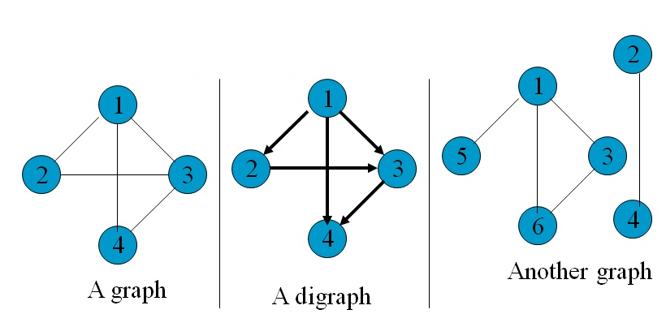
Graphs

Slide 4
Definitions
Vertices are called adjacent if there is a edge connecting them.
If an edge touches a vertex they are called incident.
For the graph
V = {1,2,3,4}
E = {(1,2),(1,3),(1,4),(2,3),(3,4)}
Vertices 1 and 4 are adjacent
Vertices 2 and 4 are NOT adjacent
the edge (1,4) is incident to both
vertex 1 and vertex 4.
1
2
3
4

Slide 5
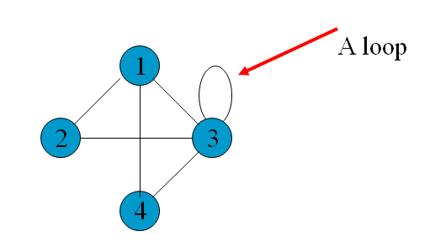
Definitions
A weighted graph is a G = (V,E, W) where W is a set of weights, each weight is associated with an edge.
A weighted digraph is called a network.
A loop or self-edge is a edge which is only incident to 1 vertex.

Slide 6
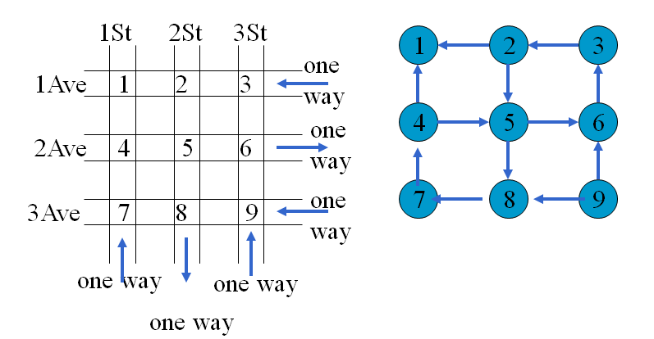
Applications
Path problems
In a city with many streets, we can say each intersection is a vertex and each the streets are edges.
A sequence of adjacent vertices is called a path. A simple path is a path in which all vertices, except possibly the first and the last are different.

Slide 7
Spanning Trees
A graph G is called connected if there is a path between every pair of vertices in G.
If the vertices represent computers and the edges communication links, connectedness means can every computer talk to every other computer.
If it is connected can some edges be eliminated (redundant). Can more edges be added and where to make it more robust.
A graph H = (V’, E’) is a subgraph of G= (V,E) if and only if its V’ ⊆ V and E’ ⊆ E .
A cycle is a simple path with the same start and end point.
A graph with no cycles is called a tree.
A subgraph with no cycles that contains all the vertices of a graph is called a Spanning Tree.

Slide 8
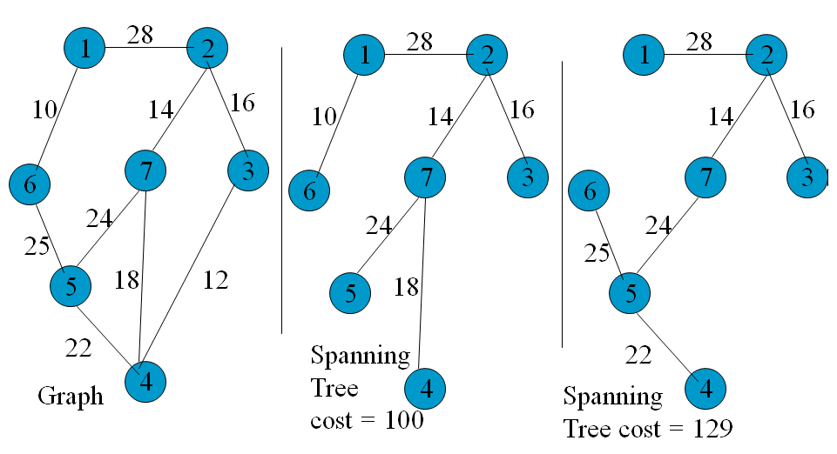
Spanning Trees
If the graph is weighted with weights representing costs for that link, it is often desirable to find the minimum weight spanning tree.

Slide 9
Minimum Weight Spanning Tree
Since every spanning tree of an n-vertex undirected network G has exactly n-1 edges, the problem is to select the n-1 edges in such a way that the sum of the edge weights is minimized.
There are 3 methods to do this. Kruskal’s, Prim’s and Sollen’s.
All use the greedy strategy. (do what looks best right now and the end will turn out the best)

Slide 10
Kruskal’s Algorithm
From the remaining edges select the minimum cost edge which does not result in a cycle when added to the already selected edges.

Slide 11
Kruskal’s Algorithm
Analysis
It will have to go through the select edge cycle at most e times.
The process of selecting the minimum weight edge and checking for a cycle will dependent on the implementation. For example, if the edges are put in a heap, it will only require Θ(lg(e)) time to find a minimum edge. To check if the edge (u,v) forms a cycle need only check if both u and v are already in the set of vertices. If use an array of bits to store the vertices (set the bit to 1 if the vertex is present and 0 otherwise), Θ(1)

Slide 12
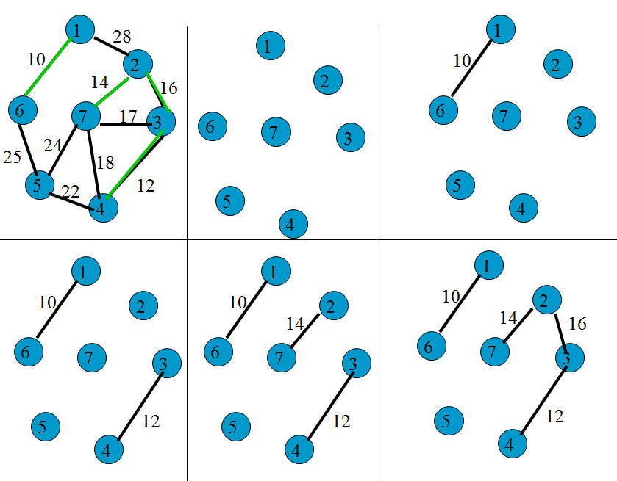
MinWeight Spanning Tree Example

Slide 13
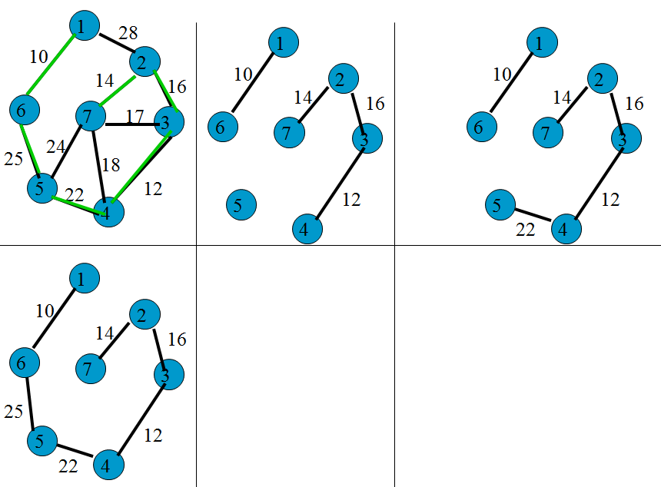
MinWeight Spanning Tree Example

Slide 14
Kruskal PseudoCode
//Find a minimum-cost spanning tree in an n-vertex network
Let T be the set of selected edges. Initialize T = ∅
Let E be the set of network edges.
while (E ≠ ∅) && (|T| ≠ n-1) {
Let (u,v) be the least cost edge in E.
E = E-{(u,v)}, //delete edge from E
if ((u,v) does not create a cycle in T) Add edge (u,v) to T
}
if (|T| == n-1) T is a minimum-cost spanning tree
else The network is not connected and has no spanning tree.

Slide 15
Kruskal Complexity
If we use a heap we Θ(e) to initialize the heap and O(lg(e)) to extract.
Using a simple array finds and union can be done in Θ(1) time.
There are at most n number of these.
Hence the total time is
Θ(e + n+ elg(e)) = Θ(e+ elg(e))

Slide 16
Prim’s Algorithm
From the remaining edges select the minimum cost edge which added to the already selected edges forms a tree.

Slide 17
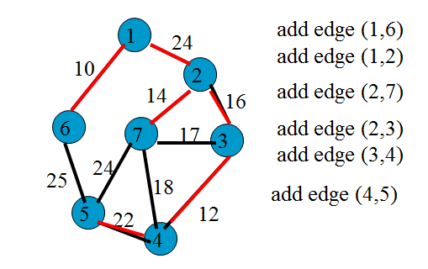
MinWeight Spanning Tree Example
Start at vertex 1

Slide 18
Prim’s Algorithm/Complexity
//Find a minimum-cost spanning tree in an n-vertex network
Let TV be the set of selected edges in the tree. Initialize T = ∅
Let E be the set of network edges.
while (E ≠ ∅) && (|T| ≠ n-1) {
Let (u,v) be the least cost edge in E such that u∈TV and v∉TV.
E = E-{(u,v)}, //delete edge from E
Add edge (u,v) to TV
}
if (|T| == n-1) T is a minimum-cost spanning tree
else The network is not connected and has no spanning tree.
This can be implemented to have a time complexity of O(n²)

Slide 19
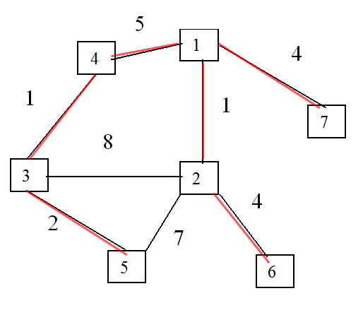
MinWeight Spanning Tree Example

Slide 20
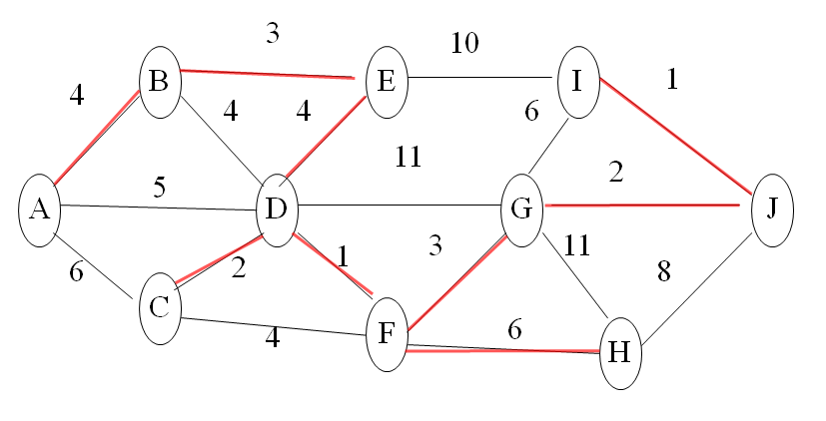
MinWeight Spanning Tree Example

Slide 21
Bipartite Graph
The vertices can be divided into 2 sets such that vertices in each set are not adjacent to other vertices in the same set. Such a graph is called bipartite.

Slide 22
Bipartite Example
Consider a party where many of the people speak only foreign languages {L₁, L₂, …, L_{n}}. The rest speak only English. You have available a set of interpreters who can translate between English and some other languages.
Task is to select the fewest number of interpreters needed to translate between English and the remaining languages.
Can formulate this as a graph problem. Let the vertices be the n languages and the pool of interpreters.
Draw an edge between a language and an interpreter if the interpreter speaks that language. Want the smallest interpreters set that covers the language set.

Slide 23
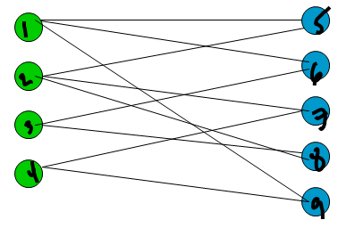
Bipartite Example
Interpreters Languages

Slide 24
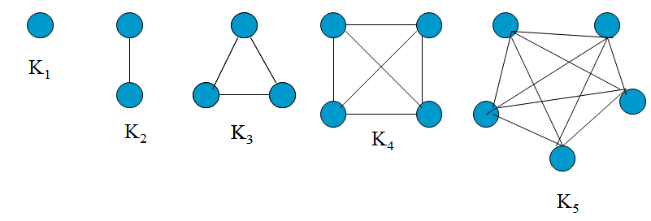
Properties
Let G be a undirected graph. The degree d_{i} of vertex i is the number of edges incident on vertex i.
Let G = (V,E) be an undirected graph. Let |V| = n; |E| = e; and d_{i} = degree of vertex i.
Σ _{i= 1}^{n} d_{i} = 2e 0 < e < n(n-1)/2
An n-vertex simple graph with n(n-1)/2 edges is called a complete graph and denoted K_{n}.
All the vertices in K_{i} have degree i-1.

Slide 25
Properties
Let G be a digraph. The in-degree d_{i}^{in} of vertex i is the number of edges incident to vertex i. (coming into vertex i)
The out-degree d_{i}^{out} of vertex i is the number of edges incident from vertex i. (coming out of vertex i)
Let G=(V,E) be a simple digraph. Let |V| = n, |E| = e
0< e< n(n-1) Σ _{i= 1}^{n} d_{i}^{in} = Σ _{i= 1}^{n} d_{i}^{out} = e

Slide 26
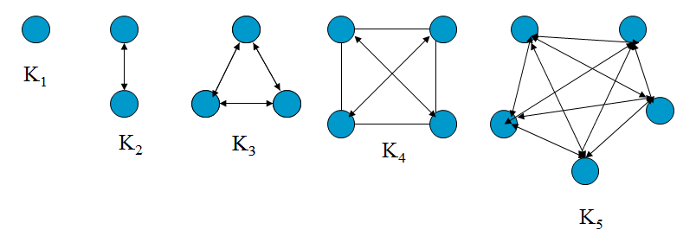
Properties

Slide 27
ADT Graph
AbstractDataType Graph
{
instances
a set V of vertices and a set of E of edges
operations
Create(n) create an undirected graph with n vertices and no edges
Exist(i,j) returns true if edge (i,j) exists and false otherwise
Edges(), return the number of edges in the graph
Verticies(); return the number of vertices in the graph
Add(i,j); add the edge (i,j) to the graph
Delete(i,j); delete the edge (i,j)
Degree(i); return the degree of vertex i
InDegree(i); synonym for degree
OutDegree(i); synonym for degree
}

Slide 28
ADT Digraph
AbstractDataType Graph
{
instances
a set V of vertices and a set of E of edges
operations
Create(n) create an undirected graph with n vertices and no edges
Exist(i,j) returns true if edge (i,j) exists and false otherwise
Edges(), return the number of vertices in the graph
Verticies(); return the number of vertices in the graph
Add(i,j); add the edge (i,j) to the graph
Delete(i,j); delete the edge (i,j)
InDegree(i); return the in-degree of vertex i
OutDegree(i); return the out-degree of vertex i
}

Slide 29
Adjacency Matrix
The Adjacency matrix of an n-vertex graph
G= (V,E) is an n x n matrix A. Each element of A is either zero or one. We shall assume that
V = {1,2,…,n}. If G is an undirected graph, then the elements of A are defined as follows:
If G is a digraph, then the elements of A are defined as follows:

Slide 30
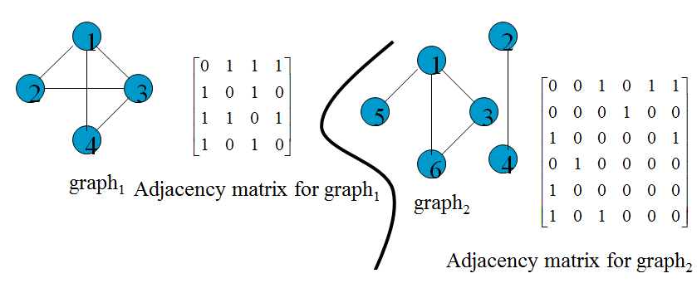
Adjacency Matrix Examples

Slide 31
Properties of the Adjacency Matrix
A(i,j) = 0 if graph has no edges.
The adjacency matrix of an undirected graph is symmetric. That is , A(i,j) = A(j,i), 1 < i < n, 1 < j < n.
For an n-vertex undirected graph, recall (d_{i} is the degree of vertex i.)
For an n vertex digraph

Slide 32
Mapping the Adjacency Matrix into an Array
The n x n adjacency can be mapped into an (n+1) x (n+1) matrix (if start counting at 1) The array can be mapped into an n x n if map the i^{th} element into the index i –1. For undirected graphs, ½ the information is redundant since A(i,j) = A(j,i) hence only the top half of the matrix is needed. If there are no loops then the main diagonal is always 0 so that is also redundant. A further reduction can be made by using only 1 bit for storage so each entry contains 16 entries.

Slide 33
Adjacency Matrix Time Analysis
To determine if there is an edge from i to j or add or delete an edge takes Θ(1). To determine the degree of a vertex is Θ(n)

Slide 34
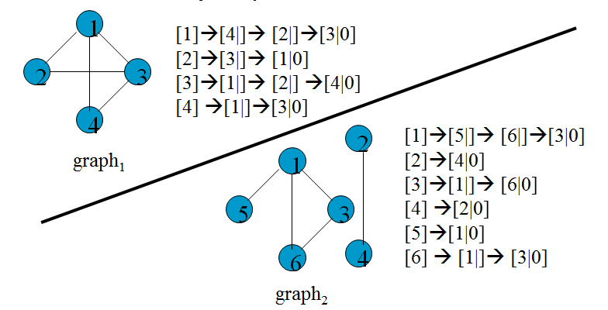
Linked Adjacency Lists
In this case each adjacency list is maintained as chain.
If each pointer is 2 bytes, the space is 2(n+m+1) m = 2e, for undirected graph and e for a directed graph

Slide 35
Linked Adjacency Lists Time Analysis
This provides easy addition and deletion of edges.
The time is related to the length of the list for each vertex.

Slide 36
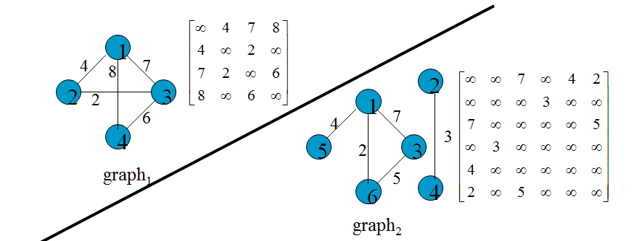
Representation of Networks (matrix)
Instead of an Adjacency List we can put the add an extra field for each node in the list to hold the weight
The ∞ indicates no edge.

Slide 37
Networks Time Analysis
Again time for insert or delete is O(1) but finding the degree takes longer.

Slide 38
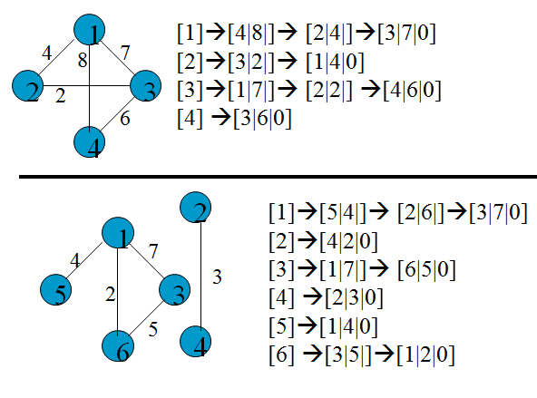
Representation of Networks (list)
Networks (weighted graphs) are represented using extensions of the previous schemes . 1st is the edge, 2nd is the weight.

Slide 39
Topological Sorting
Often a complex project may be decomposed into a collection of simpler tasks with the property that the completion of all theses implies that the project has been completed.
For example, to assembly a car, the tasks might be
put chassis on the line
mount axles
mount the wheels on the axles
fit the seats onto chassis
paint
install brakes
etc
The task might have to follow a precedence chart
Some tasks must be done before others.

Slide 40
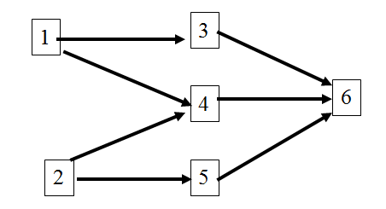
Topological Sorting Example
This might be represented as a digraph
Task 1 must be done before 3 and 4
Task 3 and 5 must be done before 6
We want to find the correct order in which to do the tasks
A greedy algorithm for this might be
choose the vertex whose in-degree is 0
Eliminate that vertex and then continue

Slide 41
Topological Sorting Example
Choose task 1
Choose task 2
Choose 3, 4, 5
Choose 6

Slide 42
Topological Sorting Code
Let n be the number of vertices in the digraph.
Let V be an empty sequence.
while (true)
{
Let w be an vertex whose indegree is 0 not in V
If no such w end
else add w to the end of V
}

Slide 43
Topological Sorting Analysis
Analysis
Use a stack to hold V
Can use a 1 dim array to hold indegrees of the vertices
Takes n time to choose each vertex. update the indegrees will take n time if we use an adjacency matrix
Total using Adjacency Matrix is Θ(n²)
Total using a Adjacency List is Θ(n + e)

Slide 44
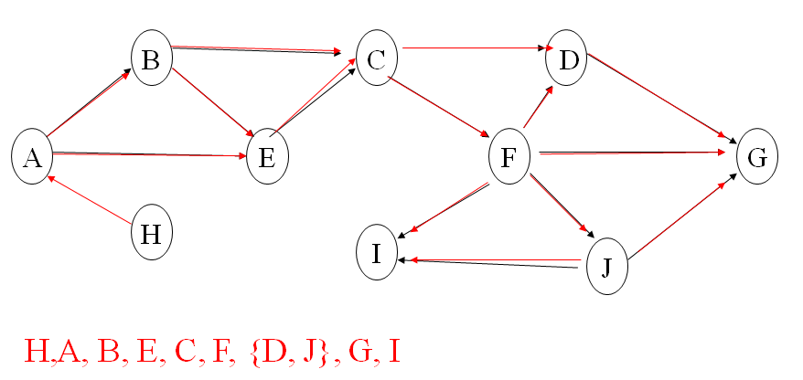
Find a Topological Sort

Slide 45
Shortest Path Algorithms
In this problem we are given a digraph G with the property that each edge (i, j) has a nonnegative edge weight or cost (a[i][j]). The length of a path is the sum of the edge weights along the path.
Given a single source vertex s, find the shortest path to all other vertices
We can solve the problem with negative edge weights as long as there are no cycles where the total edge weight of the cycle is negative.

Slide 46
Unweighted Shortest Path
First find all vertices 1 edge away
Then use this to find all vertices 2 edges away

Slide 47
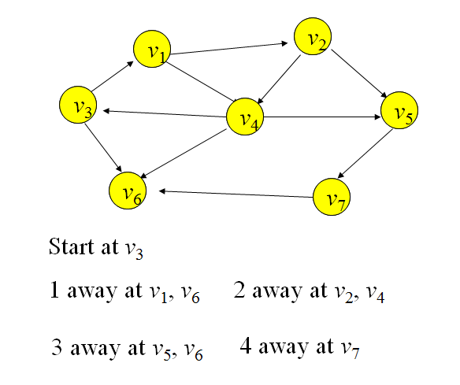
Unweighted Shortest Path Example

Slide 48
Single Source Shortest Paths Weighted
In this problem we are give a digraph G with the property that each edge (i, j) has a nonnegative edge weight or cost (a[i][j]). The length of a path is the sum of the edge weights along the path.
Given a single source vertex s, find the shortest path to all other vertices
We will use a greedy algorithm developed by Dijkstra.
From all vertices that have not been visited, select the one that results in the least additional total path length. This strategy does not always work. An alternative is to look at all of the shortest paths so far generated and for each of these paths determine a shortest one-edge extension. Then pick the shortest.

Slide 49
Single Source Shortest Paths Weighted
1
0
8
1
2
1
3
2
Shortest
Paths
4
5
2
5
4
1
3
4
3
3
3
4
1
1
2
4
Graph
1
3
4
5
6

Slide 50
Single Source Shortest Algorithm
Step 1 Initialize d[i] = a[s][i], 1< i < n.
Set p[i] = s for all i adjacent from s.
Set p[i] = 0 for all other vertices
Create a list L of all vertices for which p[i] ≠ 0
Step 2 If L is empty terminate, otherwise go to 3.
Step 3 Delete from L the vertex i with least value of d (ties are broken arbitrarily)
Step 4 Update d[j] to min (d[j], d[i] + a[i][j]) for all unreached vertices j adjacent from i.
If d[j] changes, set p[j] = i and add j to L in case it is not already there.
Goto Step 2.

Slide 51
Single Source Shortest Example
Step 1 Initialize d[i] = a[s][i], 1< i < n.
Set p[i] = s for all i adjacent from s.
Set p[i] = 0 for all other vertices
Create a list L of all vertices for which p[i] ≠ 0
Step 2 If L is empty terminate, otherwise go to 3.
Step 3 Delete from L the vertex i with least value of d (ties are broken arbitrarily)
Step 4 Update d[j] to min (d[j], d[i] + a[i][j]) for all unreached vertices j adjacent from i.
If d[j] changes, set p[j] = i and add j to L in case it is not already there.
Goto Step 2.
2
3
b
c
3
d
5
8
2
6
a
5
7
e
4
4
f
g
4
7
3
4
4
4
h
i
j
2
6

Slide 52
Shortest-Path Algorithms
Input → A weighted graph with edge (v_{i},v_{j}) having cost c_{i,j}.
Output→the weighted path length Σ_{k=1}^{N-1} c_{i,j+1} of the path v₁v₂…,v_{n}.
The number of edges on the path is the unweighted path length

Slide 53
Single Source Shortest Path
Given as input a weighted graph, G= (V,E) and a start vertex, s, find the shortest weighted path from s to every other vertex in G.
This graph has no edges of negative edge cost.
Negative edge costs can be problematic since if the graph has a negative weight cycle, no shortest path exists
1
2
2
4
1
10
3
3
2
4
2
5
5
8
4
6
7
6
10

Slide 54
Single Source Shortest Path
The cycle (2,5,4) can be gone over and over always decreasing the path weight.
1
2
2
4
1
-10
3
3
2
4
2
5
5
8
4
6
7
6
1

Slide 55
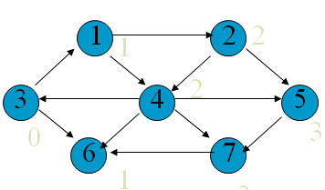
Unweighted Shortest Paths
In this problem, just count the edges.
Special case of the weighted graph
Know that distance from 3 to 3 is 0
Next find the vertices a distance 1 from the start
Next find all vertices a distance 2 away.
By tracing back the p_{v} variable the actual path
can be determined

Slide 56
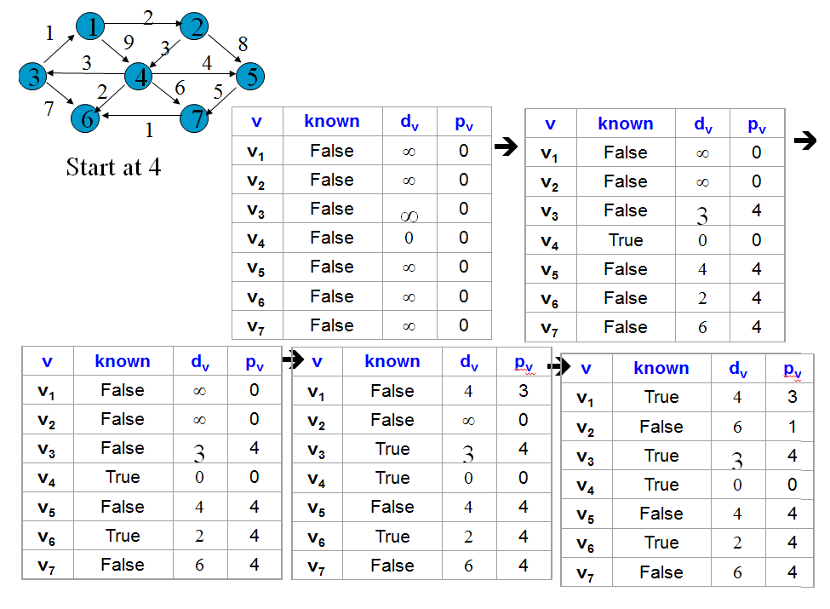
Example Continued

Slide 57
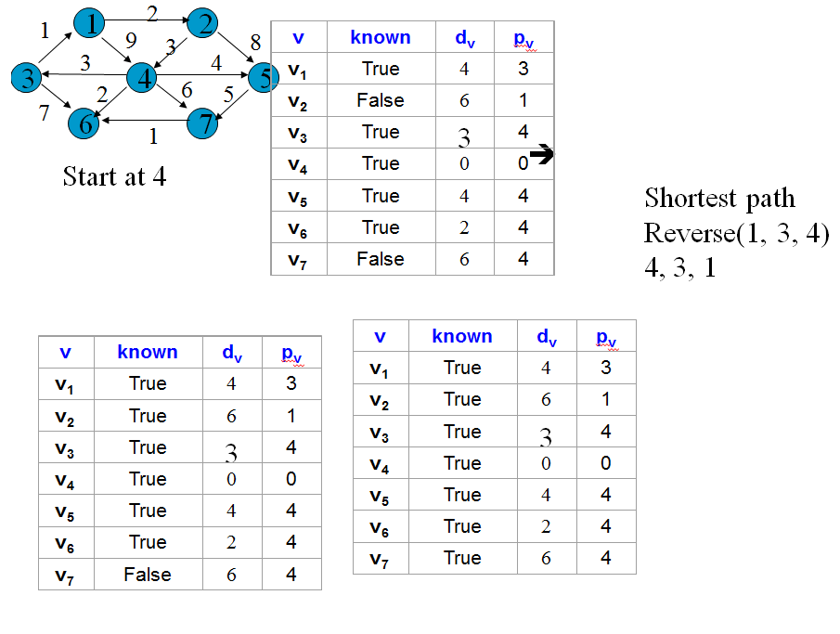
Example Continued

Slide 58
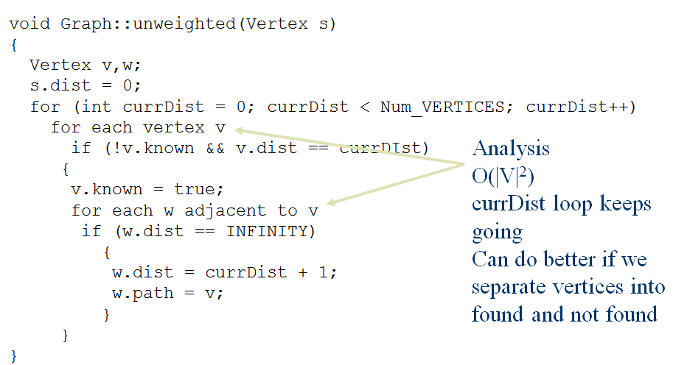
Unweighted Shortest Paths Code

Slide 59
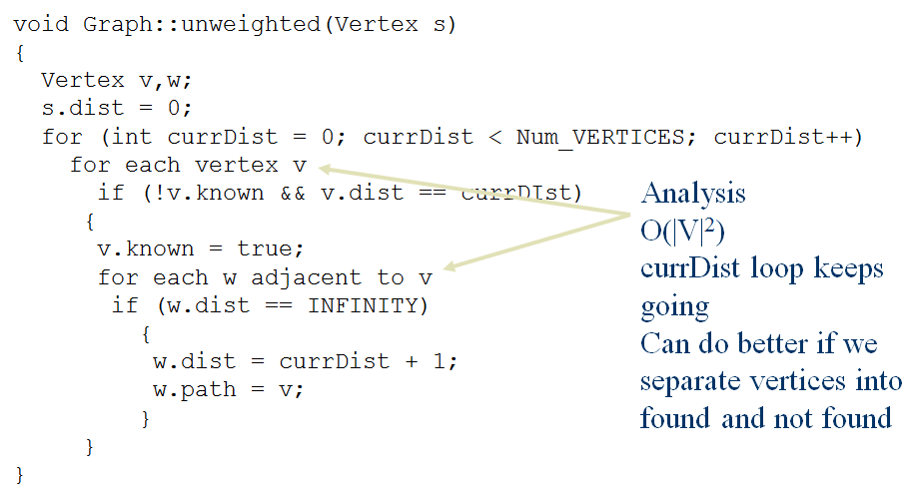
Unweighted Shortest Paths Code

Slide 60
Weighted Shortest Paths (Dijkstra’s)
Can’t use a “greedy” algorithm. A path that starts short might turn out to be long.
In this case, expand from closest vertex so far.

Slide 61
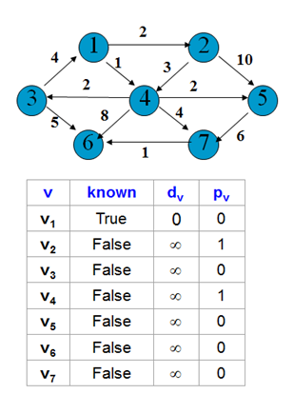
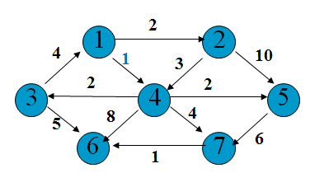
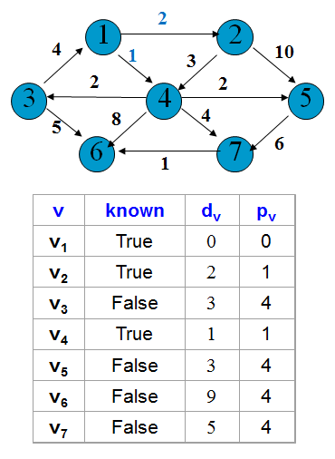
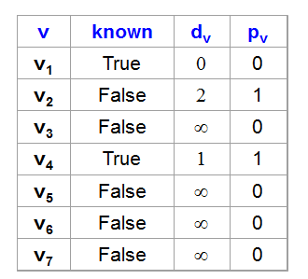
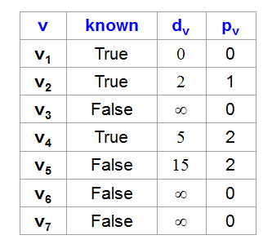
Weighted Shortest Paths (Dijkstra’s)
For this example, start at vertex 1
➔
➔

Slide 62
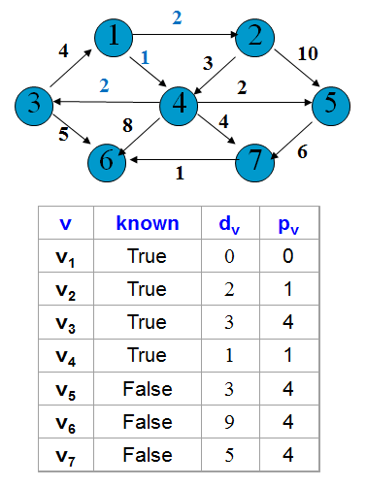
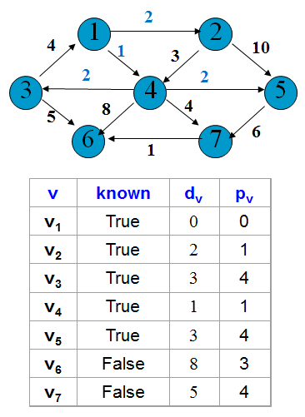
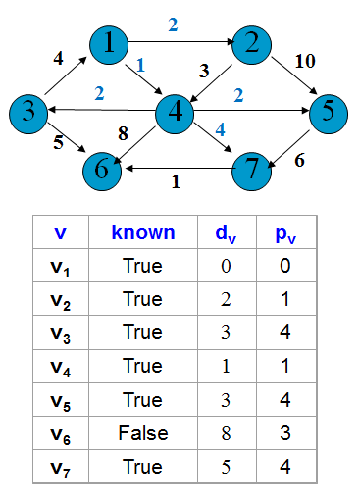
Weighted Shortest Paths (Dijkstra’s)
➔
➔

Slide 63
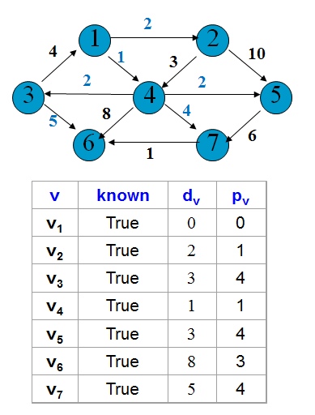
Weighted Shortest Paths (Dijkstra’s)
Done since all nodes accounted for

Slide 64
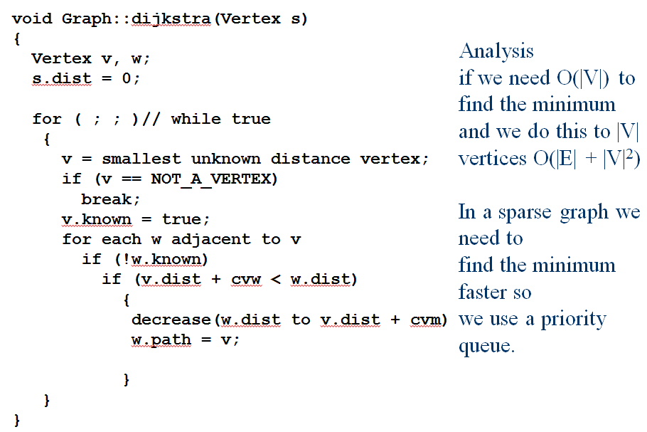
Dijkstra’s Code

Slide 65
Data Structure for Dijkstra
vertex
{
int name;
bool known;
int pv ;
double dv;
vector<vertex *> adj;
}

