Slide 1
Super Wack Bros.
Or, what I did over Christmas vacation.
Keypad Competition Entry
Nathan Oelger
15 January 2013

Slide 2
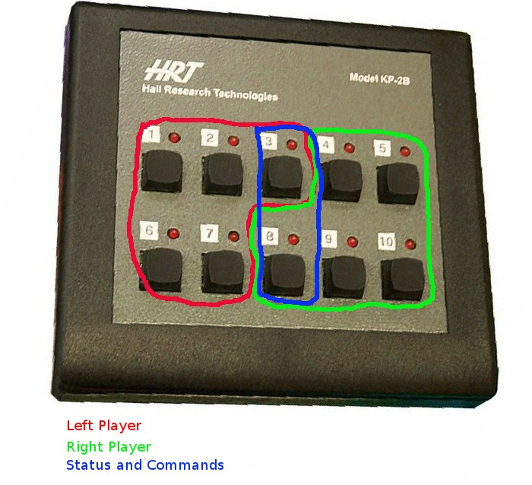
Overview
Super Wack Bros. is a super wack whack-a-mole game that pits two human players against each other. It's features include variable-speed game play, auto reset at end of game, player status feedback, music, sound, and an attract mode.

Slide 3

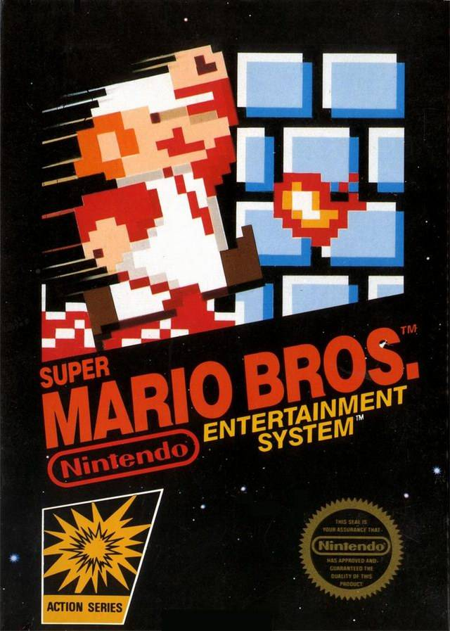
Old School Box Art
If you really want to know what an old-school game is about, you check out the box art, right?
Original?
Inspiration

Slide 4
Cooperative Multitasking Framework
Microcontrollers can generally only do one thing at a time.
Multitasking schemes can make it appear they're doing multiple things simultaneously.
Cooperative multitasking works by each task cooperating and relinquishing resources voluntarily.
Probably overkill for this game, but a learning experience for me.

Slide 5
Super Wack Bros. Tasks
Read raw keypad input and debounce.
Main game logic: From button, timing, and internally calculates states command lights and sound outputs.
Music output routine
Lights output routine

Slide 6
Task Dispatching
// A task gets dispatched on every millisecond based on examining a flag set by a timer interupt routine.
void task_dispatch(void)
{
/* Scan the task bits for an active task and execute it */
uint8_t task;
// Take care of the task timers. if the value is 0 skip it else decrement it.
// If it decrements to zero, activate the task associated with it.
task=0;
while (task < NUM_TASKS )
{
// If the timer for this task is not zero.
if (taskTimers[task])
{
// Decrement the timer.
taskTimers[task]--;
// If the timer for this task is now zero
if (taskTimers[task] == 0 )
{
// Activate the task bit.
taskBits |= 1<<task;
}
}
// Examine the next task.
task++;
}
// Below each task routine is called if its corresponding bit is set.
...
}

Slide 7
Optimizations
Final version binaries:
  2042 of 2048 bytes program space (99.7%)
  102 of 128 bytes EEPROM (81%)
8-bit variables/constants when possible
  Reorganization of low-level lights command/switch read which allowed for per player assignment/reading.
Music and tones stored in EEPROM
Local variables vs global variables
Dynamically allocated variables vs automatic local variables

Slide 8
Optimizations (continued)
Understanding of volatile registers
  Group references together
  Most are 0 at reset
Compiler optimizer is magic
  Tried many different things; very surprised at times.
  Commenting out LFSR routine added ~50 bytes to program space.
  Moving a line of code a few lines saved dozens of bytes of program space.

Slide 9
Miscellaneous Hacks
Watchdog timer was used to reset game.
User input used to provide initial seed to psuedo-random generator.
Music and sound played through RS-232 level converter
Music and multiple sound effects multiplexed on same lines using exclusive OR.

Slide 10

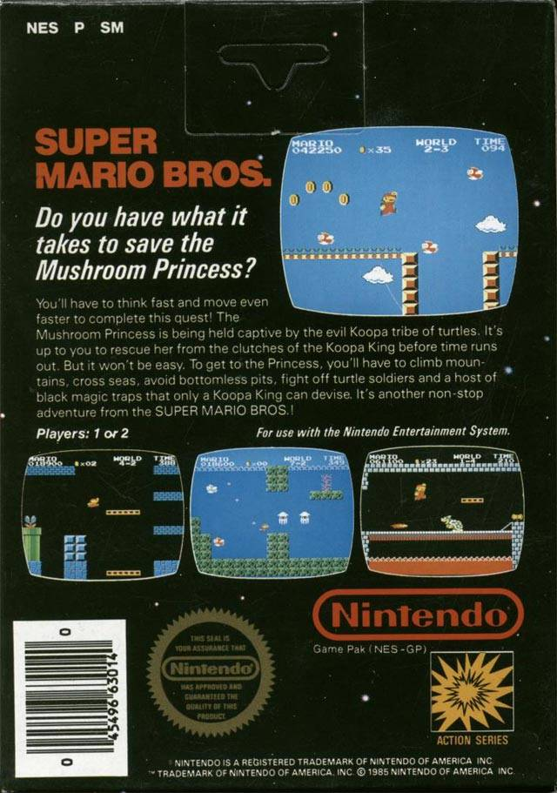
Questions?
Questions?
Super Wack Bros. is open source and can be found at: https://github.com/oelgern/keypadContest

