Slide 1
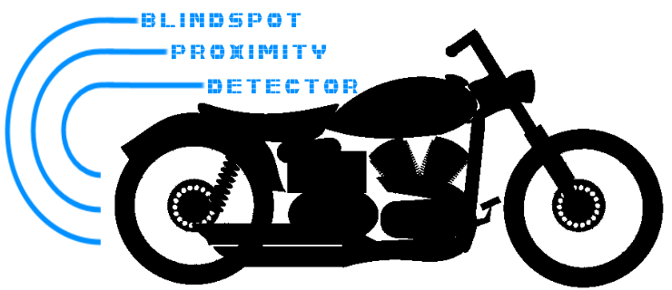
Branden Driver
Rusty Wiseman
Daniel Frister
Noah Erickson

Slide 2

Problem
Limited rear and blind spot visibility for motorcycle riders wearing full-faced helmets.
Turning head takes attention off the road in front
Rearview mirrors are not always reliable or easy to see
Bar end mirrors
Vibration
Safety and riding awareness
Lane positioning
Traffic density

Slide 3
Objective
A working prototype that will give visual indication of position of close proximity traffic to the rear and sides of the motorcycle behind the rider’s field of view. A simple non-video display will lend an old-school vibe to appeal to vintage enthusiasts.
Alternatives
Reevu MSX-1 Rear-View Helmet - $399.99
Internal rear-view mirror, works off rear-reflection
Skully AR-1 Helmet - $1499
Rear-view camera, internal HUD
Lucky Bike Motorcyle Rear-View Camera System - $89
4.3” Video display with night vision

Slide 4
Requirements
Easy to use
Real-time visual indication of distance to rear and sides
Three zones
0-5 ft, 5-10 ft, 10-15 ft
Weather resistant
Battery powered
Bright enough for sunlit conditions.
Low profile and easily mounted

Slide 5
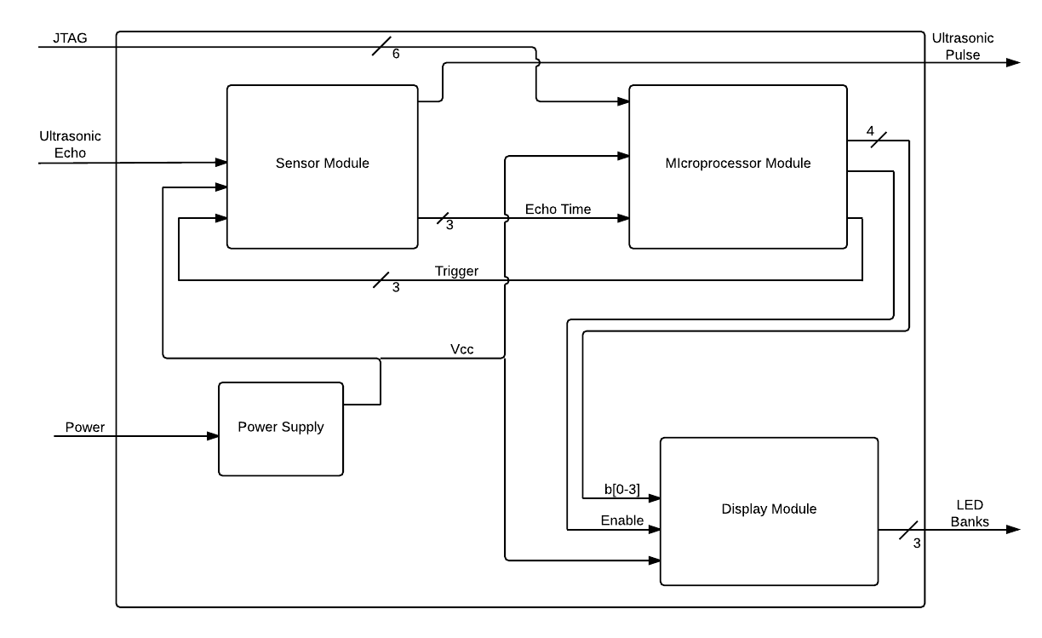
System Operation

Slide 6
Design Considerations
Sensor Module
Sensor range ~15ft.
Type of sensor (ultrasonic, IR, etc)
Integration with microprocessor
Power
Regulation
Sources
Microprocessor
Number/type of I/O ports
IDE/support
Power Consumption
Simplicity
Display
Visibility
Size
Intuitive

Slide 7
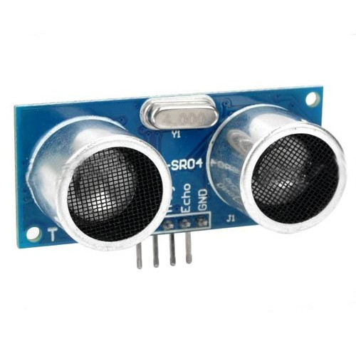
Implementation
Ultrasonic sensors
HC-SR04
Send and receive series of pulses when triggered
Time between tx and rx passed as logic high
Length of logic high tells timing to microprocessor
Compatible with Arduino IDE

Slide 8
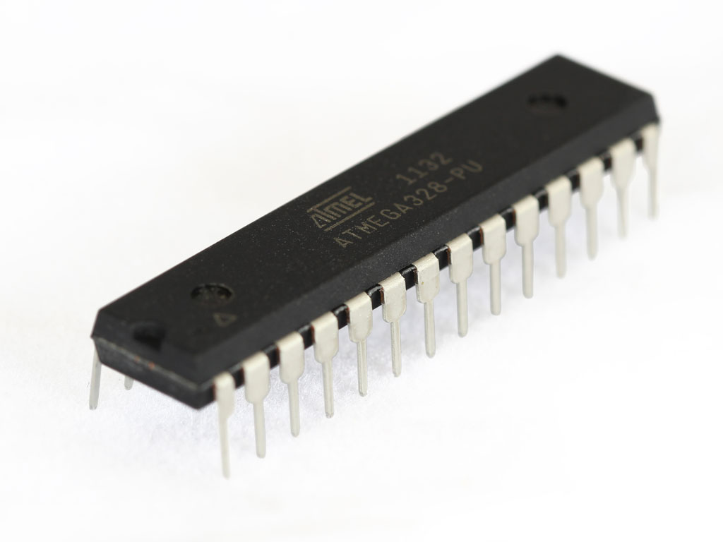
Microprocessor
ATMega328-PU
8-bit microcontroller
RISC Architecture
Programmed with Arduino IDE
Functionality
Trigger sensors
Receive sensor data
Output binary code for LED identification

Slide 10
PCB Module Testing:
System consists of three separate boards, each with its own testing plan.
Display Board
Voltage and current checks on full power.
Pin by pin check of latches with Mux disabled.
Processor Board
Voltage check for power supply.
Simple “Blink” output using serial pin loader.
Sensor Breakout
Tested each sensor using Arduino Uno.
Verified pin continuity once assembled.

Slide 11
Integration Testing:
Two integration tests for the devices were completed before uploading the final code.
Integration Test One: Step through all possible input codes from processor board to Display.
Integration Test Two: Connect sensor boards to processor and run the short distance detection code.

