Slide 1
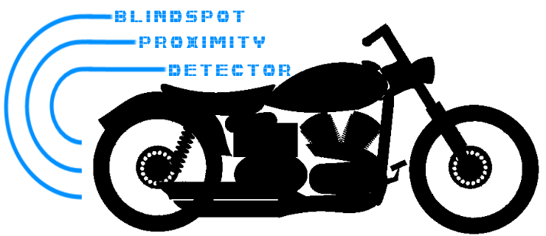
Branden Driver
Rusty Wiseman
Daniel Frister
Noah Erickson

Slide 2

Problem
Limited rear and blind spot visibility for motorcycle riders wearing full-faced helmets.
Turning head takes attention off the road in front
Rearview mirrors are not always reliable or easy to see
Bar end mirrors
Vibration
Safety and riding awareness
Lane positioning
Traffic density

Slide 3
Objective
A working prototype that will give visual indication of position of close proximity traffic to the rear and sides of the motorcycle behind the rider’s field of view. A simple non-video display will lend an old-school vibe to appeal to vintage enthusiasts.
Alternatives
Reevu MSX-1 Rear-View Helmet - $399.99
Internal rear-view mirror, works off rear-reflection
Skully AR-1 Helmet - $1499
Rear-view camera, internal HUD
Lucky Bike Motorcyle Rear-View Camera System - $89
4.3” Video display with night vision

Slide 4
Requirements
Easy to use
Real-time visual indication of distance to rear and sides
Three zones
0-5 ft, 5-10 ft, 10-15 ft
Weather resistant
Battery powered
Bright enough for sunlit conditions.
Low profile and easily mounted

Slide 5
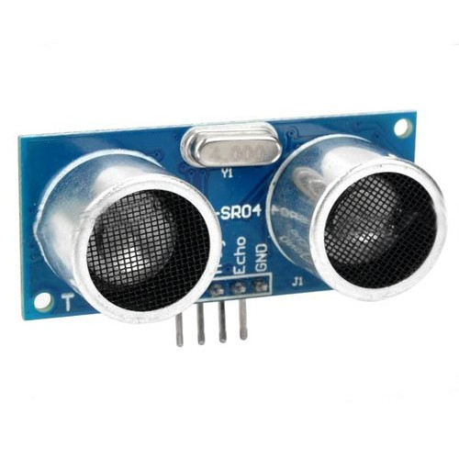
Operation
Ultrasonic sensors
HC-SR04
Send and receive series of pulses when triggered
Time between tx and rx passed as logic high
Length of logic high tells timing to microprocessor
Compatible with Arduino IDE

Slide 6
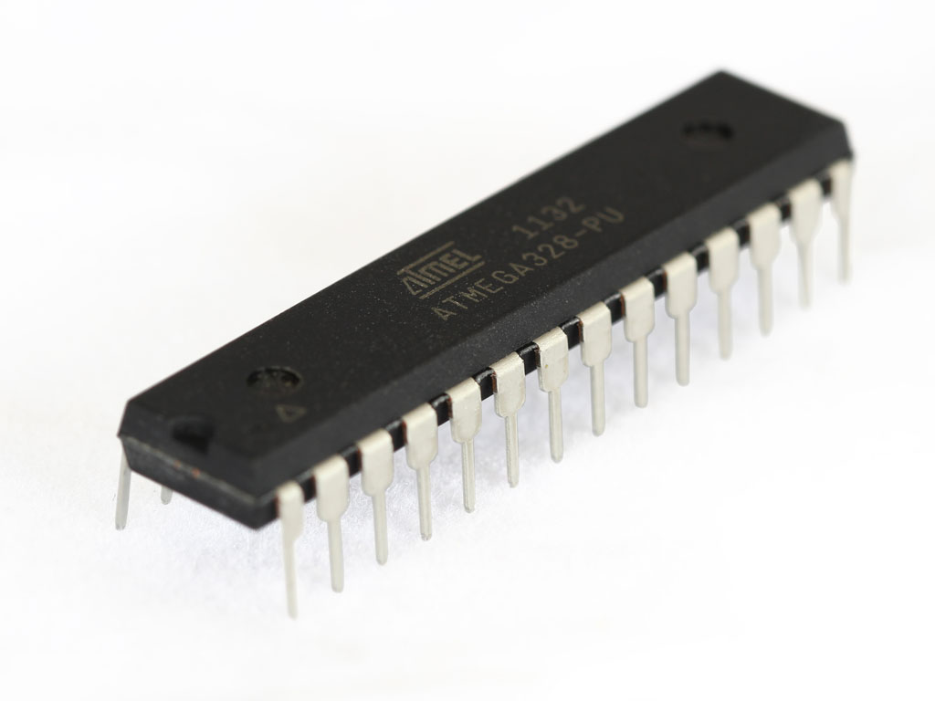
Microprocessor
ATMega328-PU
8-bit microcontroller
RISC Architecture
Programmed with Arduino IDE
Use
Trigger sensors
Receive sensor data
Output binary

