Slide 1

Branden Driver
Rusty Wiseman
Daniel Frister
Noah Erickson
Team T04

Slide 2

PROBLEM
Limited rear and blind spot visibility for motorcycle riders wearing full-faced helmets.
Turning head takes attention off the road in front
Rearview mirrors are not always reliable or easy to see
Bar end mirrors
Vibration
Safety and riding awareness
Lane positioning
Traffic density
Notes:
Rusty 1 min

Slide 3
Objective
A working prototype that will give visual indication of position of close proximity traffic to the rear and sides of the motorcycle behind the rider’s field of view. A simple non-video display will lend an old-school vibe to appeal to vintage enthusiasts.
Alternatives
Reevu MSX-1 Rear-View Helmet - $399.99
Internal rear-view mirror, works off rear-reflection
Skully AR-1 Helmet - $1499
Rear-view camera, internal HUD
Lucky Bike Motorcyle Rear-View Camera System - $89
4.3” Video display with night vision
Notes:
Rusty 1 min

Slide 4
Requirements
Requirements
Easy to use
Real-time visual indication of distance to rear and sides
Three zones
0-5 ft, 5-10 ft, 10-15 ft
Weather resistant
Battery powered
Bright enough for sunlit conditions.
Low profile and easily mounted
Notes:
Rusty 1 min

Slide 5
Design considerations
Sensor Module
Sensor range ~15ft.
Type of sensor (ultrasonic, IR, etc)
Integration with microprocessor
Power
Regulation
Sources
Microprocessor
Number/type of I/O ports
IDE/support
Power Consumption
Simplicity
Display
Visibility
Size
Intuitive
Notes:
Branden 1 min

Slide 6
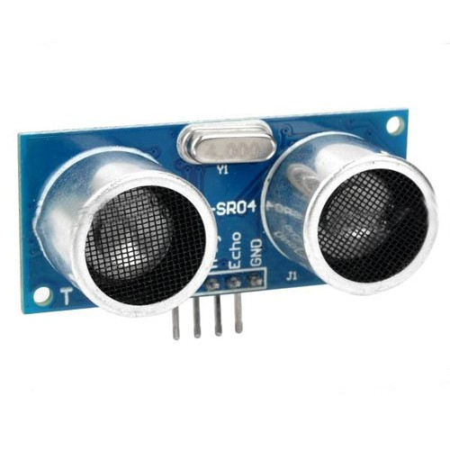
Implementation
Ultrasonic sensors
HC-SR04
Send and receive series of pulses when triggered
Time between tx and rx passed as logic high
Length of logic high tells timing to microprocessor
Compatible with Arduino IDE
Notes:
Branden 1 min

Slide 7
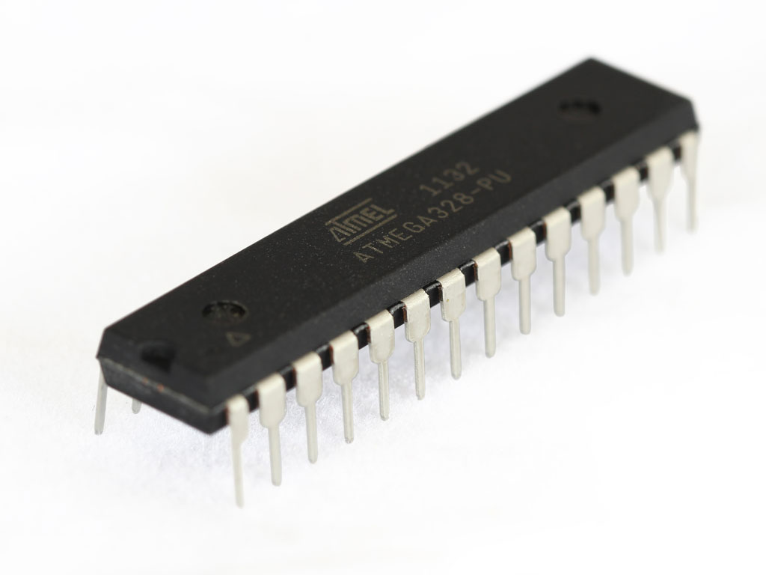
Implementation
Microprocessor
ATMega328-PU
8-bit microcontroller
RISC Architecture
Programmed with Arduino IDE
Functionality
Trigger sensors
Receive sensor data
Output binary code for LED identification
Notes:
Branden 1 min

Slide 8
Implementation
Display
Receive binary code from microprocessor
4-16 Demux for LED selection
Quad SR latch for each LED array
One LED array per sensor
Short range < 5ft. (Red)
Med range 5-10ft. (Yellow)
Long range 10-15ft. (Green)
FET switch for each LED
Power
Up to 15V DC supply
LM7805 linear regulator
5V rail for operation
Notes:
Branden 1 min

Slide 9
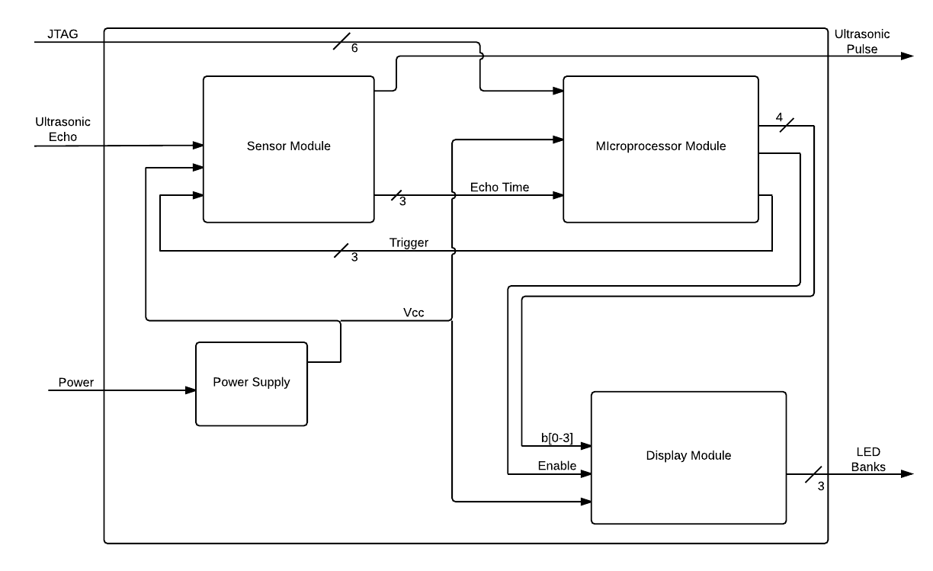
System operation
Notes:
Noah 3 min

Slide 10
Code algorithm
While device is powered:
Trigger Left Sensor, wait for echo signal
Calculate left distance with echo signal
Trigger Right Sensor, wait for echo signal
Calculate right distance with echo signal
Trigger rear Sensor, wait for echo signal
Calculate rear distance with echo signal
Send all reset codes to MUX
Send left LED array codes by distance calculated
Send right LED array codes by distance calculated
Send rear LED array codes by distance calculated
Notes:
Noah 1 min

Slide 11
Pcb module testing
Display Board
Voltage and current checks on full power
Pin by pin check of latches with Mux disabled
Processor Board
Voltage check for power supply
Simple “Blink” output using serial pin loader
Sensor Breakout
Tested each sensor using an Arduino Uno
Verified pin continuity once assembled
Notes:
Dan 1 min

Slide 12
Integration testing
Two integration tests for the devices were completed before uploading the final code.
Integration Test One: Step through all possible input codes from processor board to Display.
Integration Test Two: Connect sensor boards to processor and run the short distance detection code.
Notes:
Dan 1 min

Slide 13
results
NO MOD WIRES ON OUR LAYOUTS!
Some minor code modifications were made to iron timing when polling sensors.
Thorough testing procedures on the breadboard prototype helped us avoid any major failures with the final build.
Rusty did manage to put 1 amp through a latch (installed backwards) but it survived.
Notes:
Dan 1 min

Slide 14
Lessons learned
Mark pin 1 on all ICs and connector headers on board layout
Write project schedule before beginning project
Breadboard prototyping is extremely valuable
Component package selection earlier in project
Design boards for easy reflow
Minimize number of boards
Method on display board of disabling components
Keep up weekly meetings
Testing and debugging earlier is better
Notes:
Dan 1 min

Slide 15
contributions
Circuit design
Dan
Noah
Branden
Board layout
Branden
Dan
Enclosure design
Rusty
Branden
Code
Noah
Dan
Parts requisition
Rusty
Dan
Presentation preparation
All
Testing and debug
Dan
Noah
Rusty
Scheduling and management
Rusty
Dan
Notes:
Dan 1 min

Slide 16
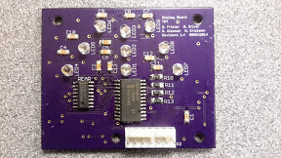
Questions?
133 Lines of code
$48.45 per system
70% surface mount components for system
NO MOD WIRES!
stats

Slide 17
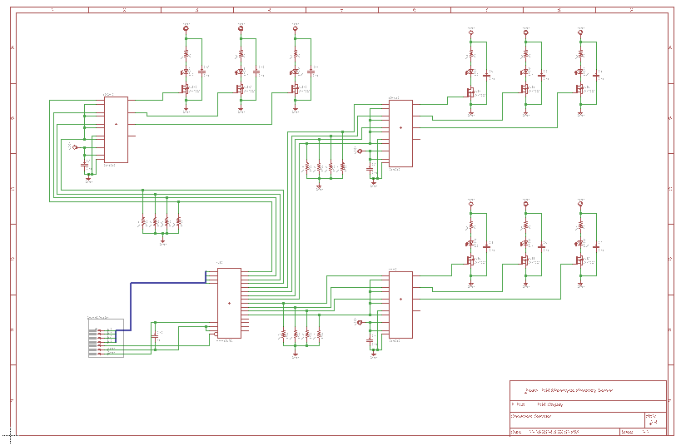
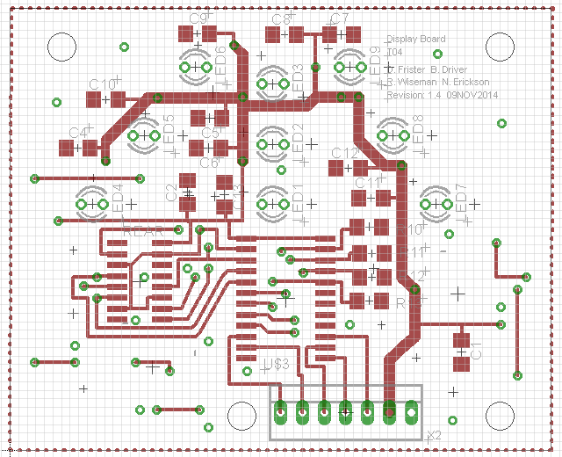
Schematics
Notes:
Dan 1 min

Slide 18
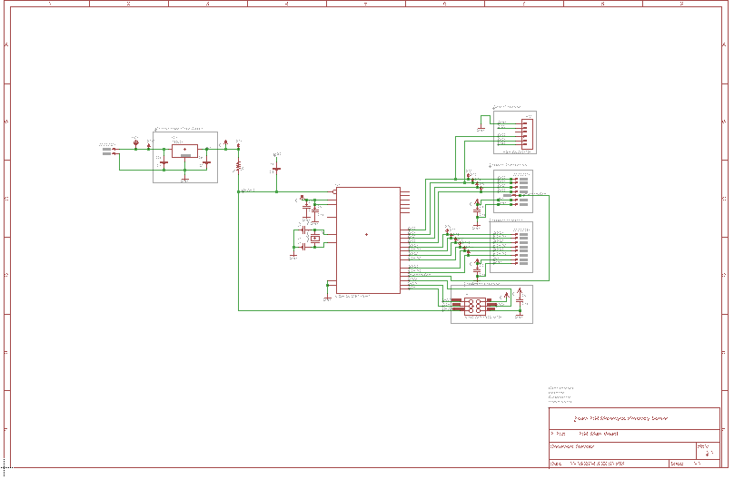
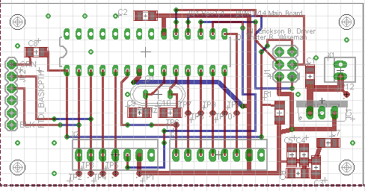
Schematics
Notes:
Dan 1 min

