Slide 1
The Rabbit Hunt
An example Java program

Slide 2
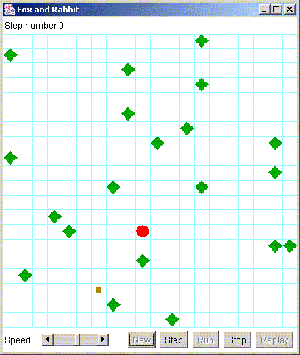
The user interface

Slide 3
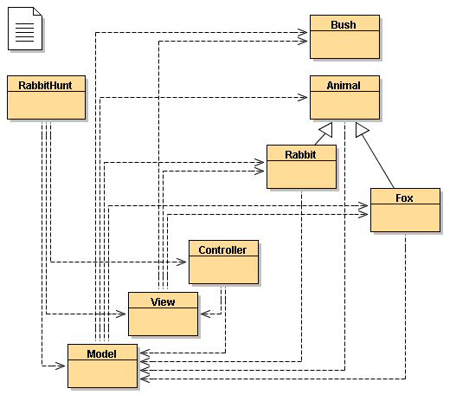
The program design

Slide 4
The eight classes
RabbitHunt -- just gets things started
Controller -- accepts GUI commands from user
View -- creates the animated display
Model -- coordinates all the actual work
  Bush -- just sits there
  Animal -- handles basic sight and movement
  Fox -- an Animal that tries to catch the rabbit
  Rabbit -- an Animal that tries to escape the fox

Slide 5
RabbitHunt I
public class RabbitHunt {
// class variables
private static Object[ ][ ] field;
private static Model model;
private static View view;
private static Controller controller;
static int numberOfRows;
static int numberOfColumns;

Slide 6
RabbitHunt II
public static void main(String args[]) {
numberOfRows = numberOfColumns = 20;
field = new
Object[numberOfRows][numberOfColumns];
model = new Model(field);
view = new View(field);
controller = new Controller(model, view);
}

Slide 7
Controller
Creates the GUI (buttons, scrollbar, “field”
Handles user actions (button presses, moving the scrollbar, resizing the window)
Enables and disables buttons as needed
Alternately--
  tells the model to “make a move”
  tells the view to display the results
Displays a final message when the hunt ends

Slide 8
View
Displays the current state of the hunt, that is, the “field” and the things on it
(That’s all it does)

Slide 9
Model
Places the fox, rabbit, and bushes in the field
Alternately gives the rabbit and the fox a chance to move
Decides when the hunt is over (and who won)
Provides several constants and a method for use by the animals

Slide 10
A note about names
I have named the central classes Model, View, and Controller to make the connection with the MVC model obvious
I could have named them anything I wanted
In this program, the Model actually comprises five classes: Model (the “boss” class), Animal and its subclasses Fox and Rabbit, and Bush

Slide 11
Why MVC is good
The Controller class sets up lots of GUI stuff and handles it
  You haven’t studied GUIs yet
The View class does a lot of work
  you can probably figure out how View works
None of this matters to your assignment!
  Because the model is independent of the view and the controller, you can totally ignore them
  Still, you might learn something from them...

Slide 12
Directions
Because Java does not define a “direction” type, Model provides several constants:
  N, S, E, W -- the four main compass directions
  NE, NW, SE, SW -- the four secondary directions
  MIN_DIRECTION, MAX_DIRECTION -- in case you want a for loop that goes through all eight directions (you probably will)
  STAY -- a direction meaning “don’t move”

Slide 13
The turn method
The Model class provides one direction method that you might find useful:
static int turn(int direction, int amount)
Given a direction and an amount to turn clockwise, turn returns the resultant direction
Examples:
  turn(Model.N, 1) returns Model.NE
  turn(Model.N, -2) returns Model.W

Slide 14
Other objects
Model also provides constants for “things you can see”:
  BUSH, RABBIT, FOX -- the obvious things
  EDGE -- the edge of the “playing field”
In other classes (such as Rabbit), you can refer to these constants as Model.BUSH, Model.FOX, Model.NW, Model.STAY, etc.

Slide 15
The Bush class
We’ll start with the simplest class: Bush
What does a bush have to know?
What must a bush be able to do?
Here’s the complete definition of this class:
  public class Bush {
  }
Believe it or not, this is still a useful class!

Slide 16
Isn’t Bush totally useless?
(Please note: this is not a reference to the current U.S. president)
With another program design, a Bush might be expected to draw itself
  In MVC, it doesn’t even do that--View does
The program can (and does) create bushes
The program can (and does) detect whether a square in the field contains a bush

Slide 17
Creating and detecting Bushes
To create a bush:
  Bush bush = new Bush();
  Works because Bush has a default constructor
To test if an object obj is a bush:
  if (obj instanceof Bush) ...
  instanceof is a keyword, used mainly like this
This is all we do with the Bush class

Slide 18
The Animal class
Animal is the superclass of Fox and Rabbit
  Hence, Fox and Rabbit have a lot in common
  You can get ideas about how to program a Rabbit by studying the Fox class
Animal provides several important methods that can be used directly by any subclass

Slide 19
Animal instance variables
public class Animal {
private Model model;
int row;
int column;
The model gives access to several constants
The row and column tell you where you are
  You may look at these variables, but you are not allowed to change them
  I tried to make it impossible for you to change these variables, but I didn’t succeed

Slide 20
Animal methods I
int look(int direction)
  look in the given direction (one of the constants Model.N, Model.NE, etc.) and return what you see (one of Model.BUSH, Model.EDGE, etc.)
  Example: if (look(Model.N) == Model.FOX)
int distance(int direction)
  returns how many steps it is to the nearest object you see in that direction (if 1, you’re right next to it)
  diagonal steps are no longer than other steps

Slide 21
Animal methods II
boolean canMove(int direction)
  tells whether it is possible for you to move in the given direction
  false if that move would put you in a bush or off the edge of the board
  true if that move would be to an empty space
  true if that move would be onto another animal Good for the fox, bad for the rabbit

Slide 22
int decideMove( )
The fox and the rabbit each have only one responsibility: to decide where to move next
The decideMove( ) method does this
decideMove( ) returns an integer
  It can return one of the eight direction constants
  It can also return the constant Model.STAY
  If decideMove( ) returns an illegal move, it is treated as Model.STAY
This doesn’t seem like much, but “deciding a move” is what you do in many games

Slide 23
How the rabbit moves
The rabbit is stupid
int decideMove( ) {
return random(Model.MIN_DIRECTION,
Model.MAX_DIRECTION);
}
No wonder he gets eaten so often!
Wouldn’t you like to help this poor, stupid rabbit?
By the way, random is a utility routine in Animal

Slide 24
How the fox moves
Each turn, the fox starts by looking in every direction for the rabbit
If the fox has not seen the rabbit, it continues on in whatever direction it was last going
If the fox sees the rabbit, it remembers both the direction and the distance
  it moves directly to the spot where it last saw the rabbit
  if it gets there without seeing the rabbit again, it just continues in the same direction
The fox tries to dodge obstacles, but if it can’t, it chooses a new direction randomly

Slide 25
Looking around...
// look all around for rabbit
canSeeRabbitNow = false;
for (int i = Model.MIN_DIRECTION;
i <= Model.MAX_DIRECTION; i++) {
if (look(i) == Model.RABBIT) {
canSeeRabbitNow = haveSeenRabbit = true;
directionToRabbit = i;
distanceToRabbit = distance(i);
}
}

Slide 26
Heading toward the rabbit
// if rabbit has been seen recently (not necessarily
// this time), move toward its last known position
if (haveSeenRabbit) {
if (distanceToRabbit > 0) {
distanceToRabbit--;
return directionToRabbit;
}
else { // rabbit was here--where did it go?
haveSeenRabbit = false;
currentDirection =
Model.random(Model.MIN_DIRECTION,
Model.MAX_DIRECTION);
}
}

Slide 27
Haven’t seen a rabbit
// either haven't seen rabbit, or lost track of rabbit
// continue with current direction, maybe dodging bushes
if (canMove(currentDirection))
return currentDirection;
else if (canMove(Model.turn(currentDirection, 1)))
return Model.turn(currentDirection, 1);
else if (canMove(Model.turn(currentDirection, -1)))
return Model.turn(currentDirection, -1);
else { . . .

Slide 28
Can’t move ahead, can’t dodge bush
else {
currentDirection = Model.random(Model.MIN_DIRECTION,
Model.MAX_DIRECTION);
for (int i = 0; i < 8; i++) {
if (canMove(currentDirection))
return currentDirection;
else
currentDirection = Model.turn(currentDirection, 1);
}
}
// stuck! cannot move
return Model.STAY;

Slide 29
The assignment
Your assignment is to write a new decideMove( ) method for Rabbit
Your grade will be the percentage of times the rabbit escapes (almost certainly less than 100!), plus some bonus for style and documentation

Slide 30
The End

