Slide 1
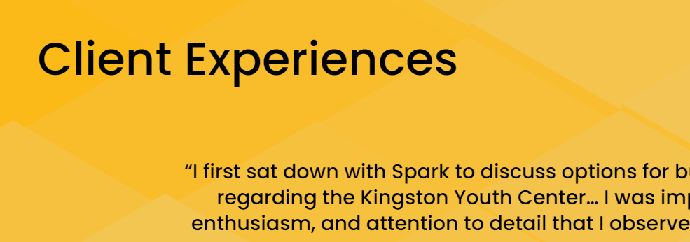
Project brief. Kingston Utilities Proposal Pump monitoring
By: Diego Rueda
04/23/2024
Email: diego.ruedaplazas@student.sl.on.ca
Phone: 416 458 1248

Slide 2
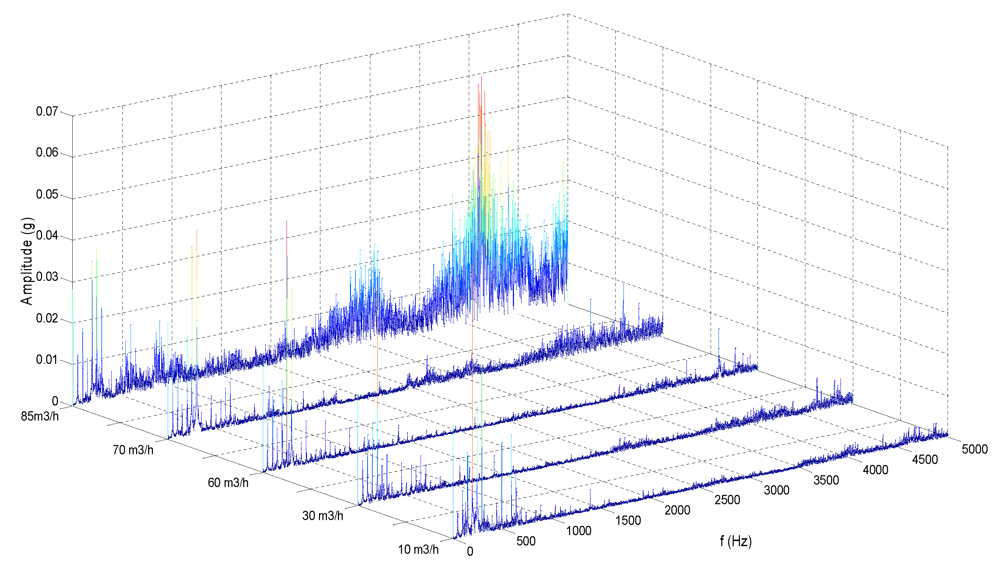
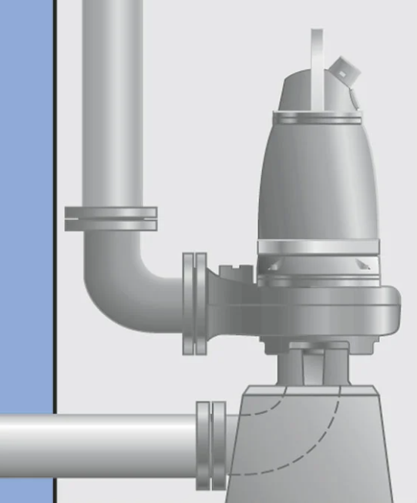

Project Brief
Project Overview
Project Objective
Create a model for condition monitoring for pumps used in the sewage system at Kingston Utilities. Enabling remote monitoring and analysis of assets health and performance while reducing maintenance and depreciation cost.
Cultivate knowledge around condition monitoring using vibration sensor technologies. Developing valuable detection and prevention mechanisms against failures while improving efficiency.
Plan
In Scope
Timeline: 22 weeks
Install one vibration sensor over one of the Sewage pumps located at Kingston City and extract data from its operation. The team will try various models and share the findings and all knowledge acquire.
The installed sensor will collect data from a selected pump in the city. With the data the team will work ways to understand the health of the pump and attempt to predict its probability of happening.
4 weeks definition, setting up and installation.
3 waves: six month each:
Install software, collect data, analyze, review results, and generate improvements with a new software version.
Vibration Analysis
Too much vibration can point to misalignment issues, imbalanced impellers, or other mechanical problems. These vibrations can fast-track wear and tear, forcing you to replace the pump sooner than expected.

Slide 3


Stakeholders.
The participation in the project will be limited to 3 different parties. The value of the project can be share between the 3 and this slide will explain how each one will benefit for transparency.
Diego Rueda.
St Lawrences Student, Business Analytics
Project Value.
Project Value.
Project Value.
Direct beneficiary of the monitoring and knowledge generated during the data collection. All strategies, results and approaches will be delivered so it remains as know-how for the organization for future larger scale monitoring projects.
Indirect beneficiary of the sensor development and research applications of their sensors. As part of their business in mining, the new development of the vibration sensor requires an intensive R&D, this project opens the door for new applications in their industry.
Diego Rueda as student of Business analytics at St Lawrence college represents the interests of the organization and its image. The benefits come in form of know-how around predictive maintenance and condition monitoring.
Participation.
Participation.
Participation.
Grant access to install one sensor on a sewage pump located in the city of Kingston.
Provide one vibration sensor and availability in their platform for monitoring.
Create the multiple versions and updates of the vibration sensor software, collect results, analysis and sharing of the findings.

Slide 4
Thank you

