Slide 1
DFRWS Forensic Challenges

Slide 2
Agenda
2013 Challenge results and winner
  Wietse Venema on behalf of Vassil Roussev
2014 Challenge announcement
  Eoghan Casey

Slide 3
2013 Challenge overview
We challenge the competitors to develop the fastest and most accurate data block classifier.
Tool must be open source, and must support at least one of MS Windows, Mac OS, or Linux.
First prize: up to 2 free registrations for the DFRWS 2013 conference, for members of the winning team.

Slide 4
Technical requirements
Command line invocation:
  $ <tool_name> <target> <block_size(bytes)> [<concurrency_factor>]
Tools must work right out of the box, and will be tested both on actual drive images, as well as sequences of block samples glued together for convenience.

Slide 5
Example output
$ data_sniffer target 1024
0 jpg JPEG data
1024 jpg xml XML inside a JPEG
2048 jpg jpg JPEG inside another JPEG (thumbnail)
3072 pdf jpg zlib JPEG & deflate-compressed data in PDF document
4096 html js JavaScript inside html
5120 zlib-xml Zlib-compressed xml
6144 pdf base85-jpg PDF document with base85-encoded JPEG
7168 null Unknown/unable to classify
Other content types of interest:
  Office documents, audio/video, file-system metadata.

Slide 6
Presentation by the teams
Naval Postgraduate School: Simson Garfinkel, Bruce Allen, Mike Shick, Joel Young.
Digital Forensic Research Center, Korea University: Jungheum Park, Jewan Bang, Yunho Lee, Jonghyun Choi.
Indicated in the scores (next slides) as S1, S2, but I won’t disclose yet which team is S1 or S2.

Slide 7
Judging the submissions, part 1: Known data sets
Controlled tests: targets with well-known ground truth.
  2012 Challenge test data (published).
  Manual review of results.

Slide 8
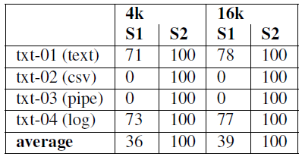
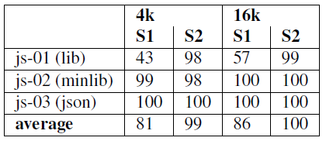
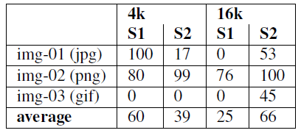
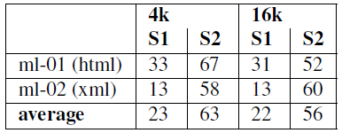
2012 Challenge test data true positive rates, part 1/3
Text
JavaScript, JSON
Images
Markup

Slide 9
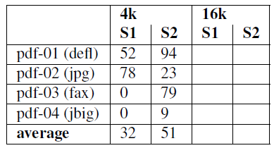
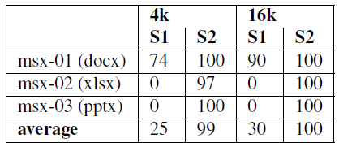
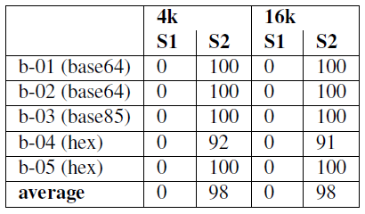
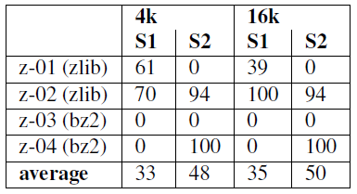
2012 Challenge test data true positive rates, part 2/3

Slide 10
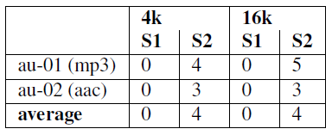
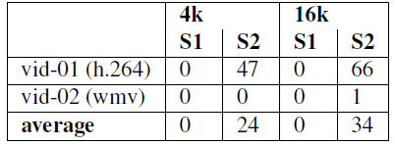
2012 Challenge test data true positive rates, part 3/3
Single-core run time: S1 42s; S2 188s.
Audio
Video

Slide 11
Judging the submissions, part 2: Unknown data sets
Large targets with a variety of real-world files.
  2013 Challenge test data (not yet published).
    “Most test data will be obtained from public Internet sources. We expect that text content will be English.”
  Limited manual review.

Slide 12
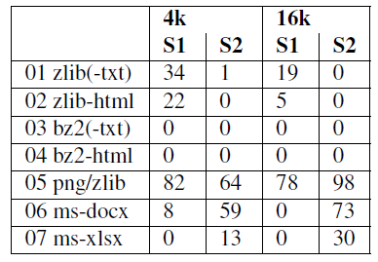
2013 Challenge test data true positive rates
Only categories that at least 1 tool handles well.
1 MiB files: interleaved blocks (4 or 16 kiB) from each category, using round-robin selection.

Slide 13
Observations
Overall, the submitted tools show a higher level of maturity than last year’s submissions and are approaching a point where they could be fruitfully deployed in the field.
Some of the high results we observed on the 2012 test for S2 (e.g. bzip2) were not confirmed in more rigorous tests, but it appears that real progress is being made with respect to deflate/zlib-coded data.

Slide 14
The winner

Slide 15
The winner
The first prize in the 2013 DFRWS Forensic Challenge is awarded to the team from DFRC, Korea University. Congratulations.

Slide 16
Thanks
Thanks to the submitting teams for their effort.
Thanks to Vassil Roussev who did all the work.

Slide 17
DFRWS 2014 Challenge Announcement
Eoghan Casey

