Slide 1
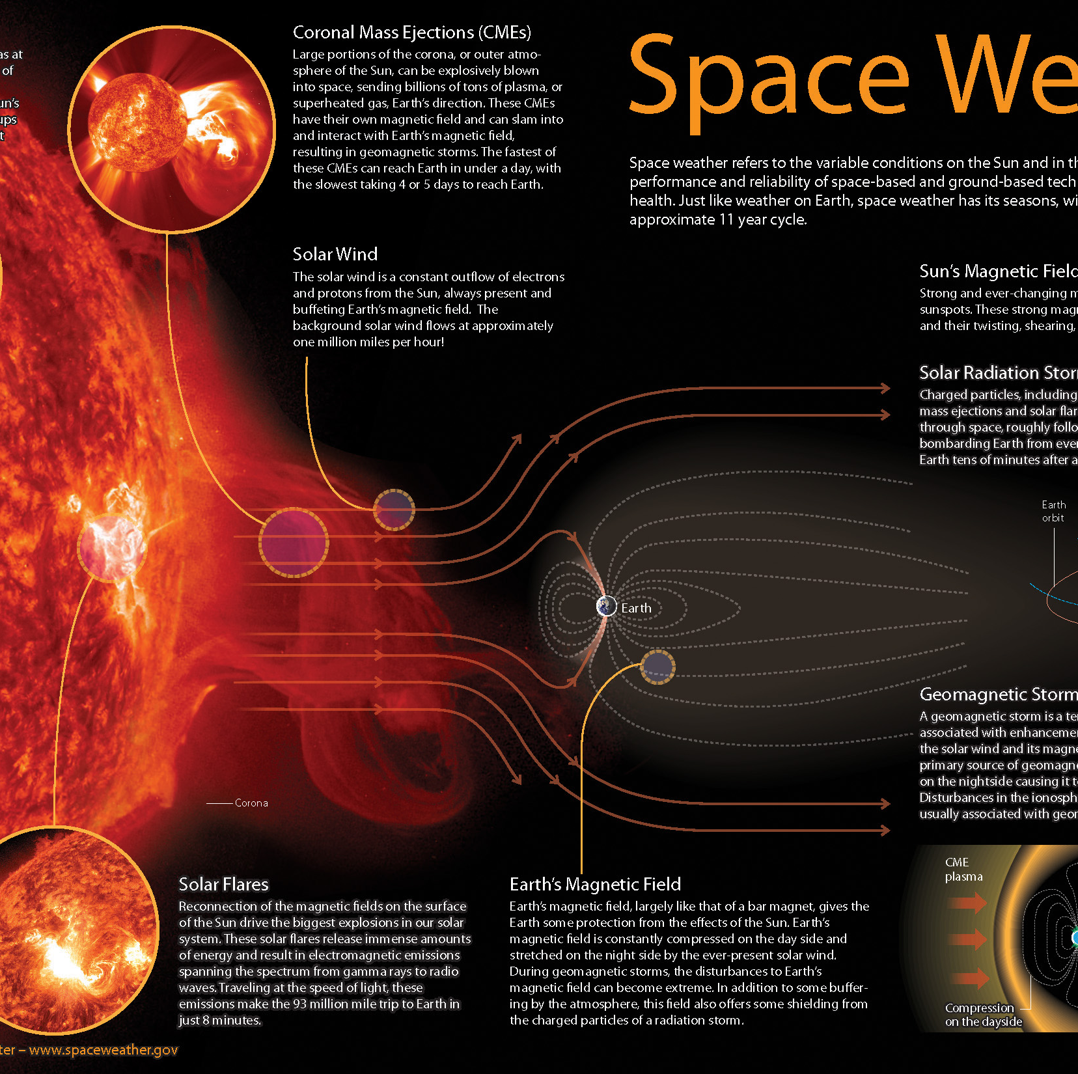
Technical challenges
Space weather is affected by a lot of different factors.
Instant data is hard to gather.
Periodic factors as well as unexpected factors.
Satellite communication and space exploration becoming more popular.

Slide 2
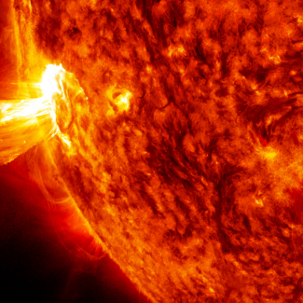
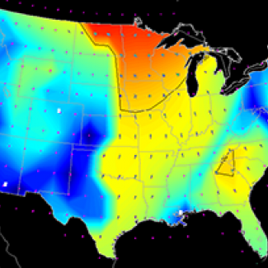
Related Works:
Researchers plans to obtain 'in-situ' measurements from space (but inside Earth’s magnetosphere) by using hosted payload instruments which is a smart way to boost economic efficiency.
The primary objective of the in-situ is the observations of the interplanetary medium, including solar wind speed, density, temperature and dynamic pressure, as well as characteristics of the charged particle environment and the direction.
This gives visibility of the multiplication of plasma clouds emitted by the Sun toward Earth, as well as views of the solar disk before it rotates into view from Earth.

Slide 3
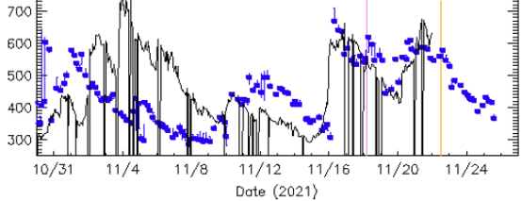
Your Approach and result
Gather data from Space Weather Prediction Center
Converted raw data into usable data
Used the data to produce a linear progression.
Made a predictive model

Slide 4
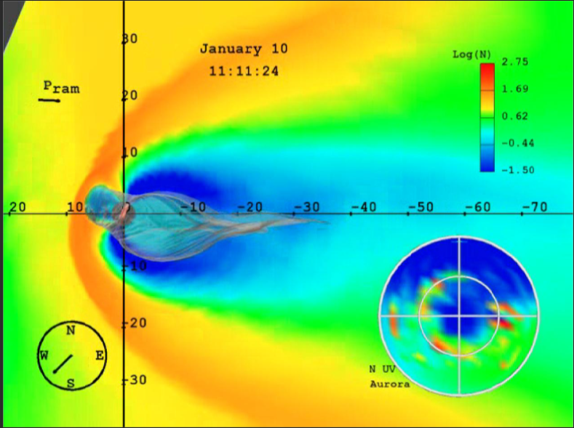
Problem Statement
Problem/Motivation:
-With satellite communication becoming popular and people trying to commercialize space/earth's orbit expeditions, space weather has become a key focus.
-This leads to the importance of space weather studies, which collects data on all the Sun and its events.
-With the exponentially expanding technological focus towards global communications, there has been an increasing focus to study and understand the environment in which these communications propagate.
-These communications can be adversely affected by a multitude of phenomena like solar flares and electromagnetic storms, which we are currently unable to predict accurately!
Input/Output of Problem:
-We used the raw data for our input! We created a graphical representation of the solar radiations level by using the data which we acquired from the Space Weather Prediction Centre!
-For output we predicted the changes in solar radiation as we made an effective model for our specific period of time and we compared that model with our specific use of time!

Slide 5
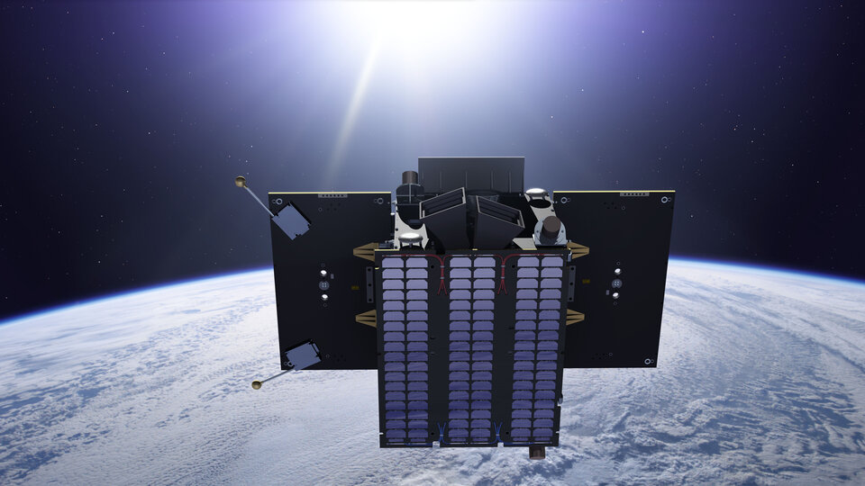
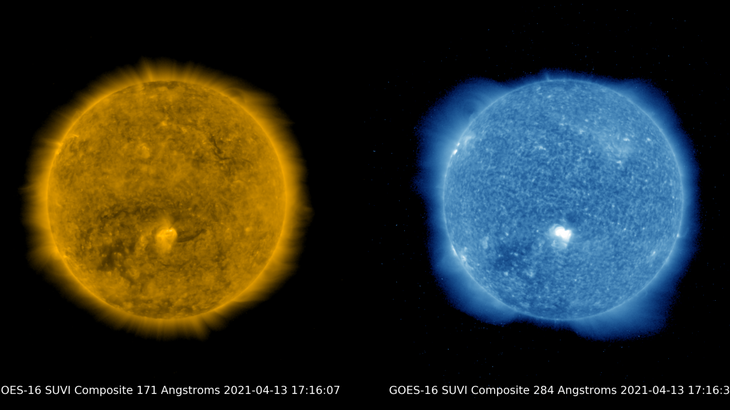
What are the limitations of your work?
What are areas for future improvements?
The limitations of our work was that we didn’t have that much information. By that I mean is that instead of finding the solar wind speed on Earth’s orbit and Radical polarity at earth’s orbit for this month. We could've found out the data for the whole year so we could’ve had a better understanding.
In the future, the area we would improve on is the data we gather. Also we can improve on better representing the data.

Slide 6
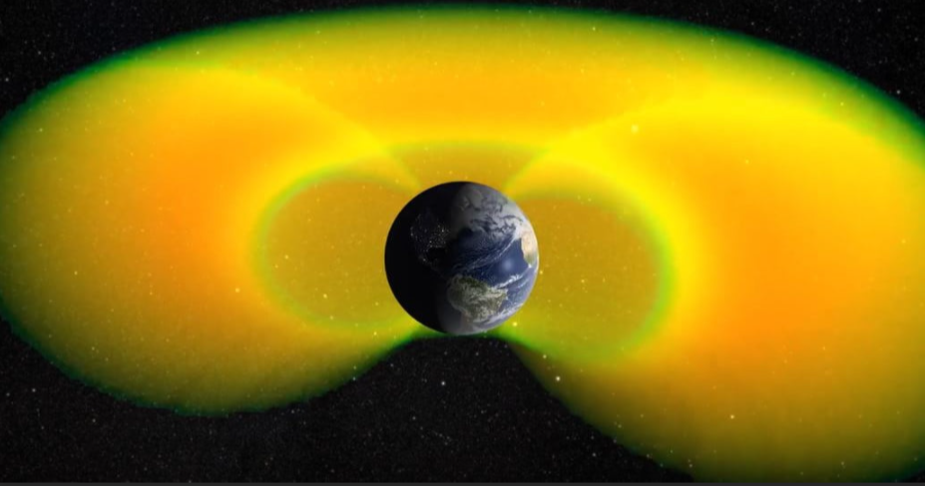
Broader Impact
-How do you expect the impact of your work to be?
---Impact: Huge!
---We used the data we acquired in the past to make a predictive model which will predict the solar radiation levels on earth and how accurate this model is in comparison with the real data!
-The impact of our work will allow for a more accurate data to be attained to measure signal accuracy in the affect of space weather on global tech devices!
-What can others learn from our work and apply it to their own problems?
-Space weather, as it’s known, refers to the way that solar winds and variations in the Earth’s magnetosphere and atmosphere can affect conditions in our Solar System.
-This includes “space storms” in which high-energy particles can bombard satellites or spacecraft, causing serious damage. These particles are even referred to as “killer electrons” because they can hamper navigation, communications, and weather monitoring satellites.
-Picture above displays predicting space weather to protect spacecraft from killer electrons! People can learn the effect of space weather by using data weather conditions to predict future conditions, to predict future space weather occurrences before it even happens so that equipments can be adjusted according to space weather!

