Slide 1

Improving ECN Marking Scheme with Micro-burst Traffic in Data Center Networks
Danfeng Shan, Fengyuan Ren
IEEE INFOCOM 2017
Notes:
Hi, all. I’m Danfeng Shan, from Tsinghua University.
Today, I’m going to share our recent work, ….., This is a joint work with my advisor Fengyuan Ren.
轮廓

Slide 2
Outline
Background & Motivation
Analysis
Solution
Evaluation
Conclusion
Notes:
First, let’s talk about the background of our work.

Slide 3

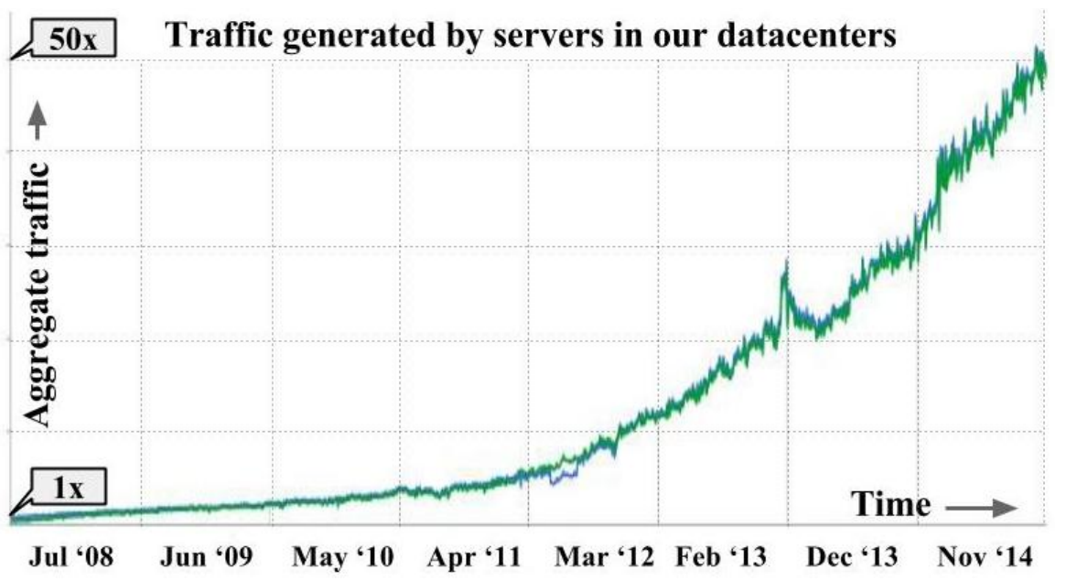



Data Center Networks
Intra DC
Distributed applications
High throughput & Low latency
Growing traffic
Google, SIGCOMM15
Notes:
Data center is not a new topic.
There are many distributed applications deployed in it. Some applications require high throughput, and some requires low latency.
Because of these distributed applications, the traffic inside the data centers is growing. As is shown in this figure, the traffic has increased by 50 times in 6 years

Slide 4
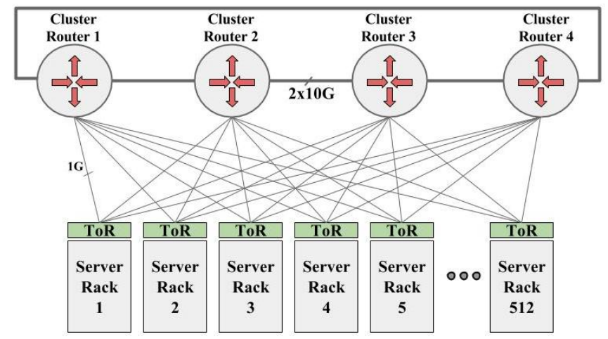
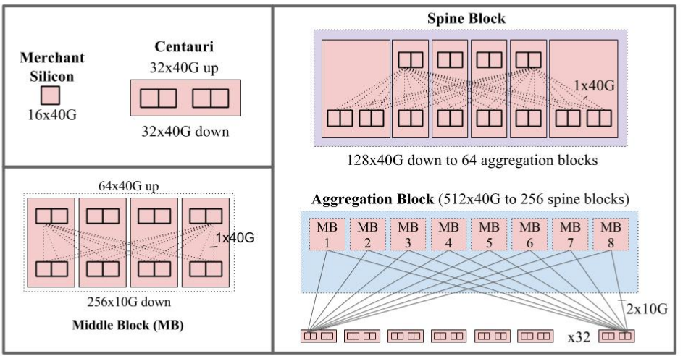
Data Center Networks
DCN architecture
Google, SIGCOMM15
1/10Gbps Network (2004)
10/40Gbps Network
(2015)
Notes:
To support the diverse applications and growing traffic, the data center architecture has increased from 1/10Gbps to 10/40Gbps. And 100Gbps nework is ongoing.

Slide 5
Data Center Networks
Reducing CPU overhead: batching
Large Segment Offload: TSO, GSO
Receive Side Offload: RSC, LRO, GRO
Interrupt Coalescing (IC)
Jumbo Frame
…
Notes:
With such a high link rate, the CPU in a host will spend much more time in packet processing.
Therefore, lots of batching schemes are introduced, like large segment offload, receive side offload, interrupt coalescing, jumbo frame and so on

Slide 6
ECN Marking in DCN
ECN marking
DCTCP, ECN*, DCQCN, ……
Single ECN threshold, Instant queue length
If Qlen > K, mark packets with ECN
Senders slow down according to ECN feedbacks
cwnd
ECN Mark
qlen
K
rtt
Time
Time
Sender 1
Switch
Sender 2
Receiver
Notes:
On the other hand, inside the network, to achieve low latency and high throughput at the same time,
ECN is used by many data center transports, like
ECN works as follows, at sender, the cwnd will increase for 1 packet for each RTT
When qlen is larger than a CEN threshold

Slide 7
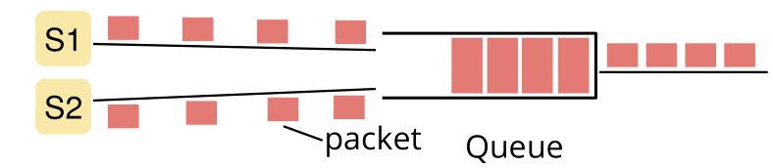
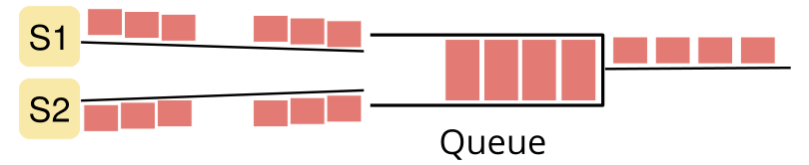
Buffer Underflow Problem
w/o burst
Batching
Micro-burst:
traffic burst in sub-RTT level
Notes:
Previously, we assume that there is without traffic burst in the network.
Recall that a host in high-speed data centers has many batching schemes to support high sending rate.
These batching schemes will introduce bursty traffic into network. (We call these bursts micro-burst, because these traffic burst is in sub-RTT leve.)
So what will happens if the traffic is bursty.

Slide 8
Buffer Underflow Problem
Queue Length
K (ECN Threshold)
0
Time
w/ micro-burst
Queue length oscillations
Queue Length
K
0
Buffer underflow
Time
Notes:
With traffic bursts in the network, the queue length evolution is not smooth.
The queue length will fluctuate, and the queue length will oscillates severely.
What’s more, ECN threshold is usually very low to decrease low queueing latency.
As a result, if we set ECN threshold so low that the minimum queue length is near 0, then there will be buffer underflow.

Slide 9
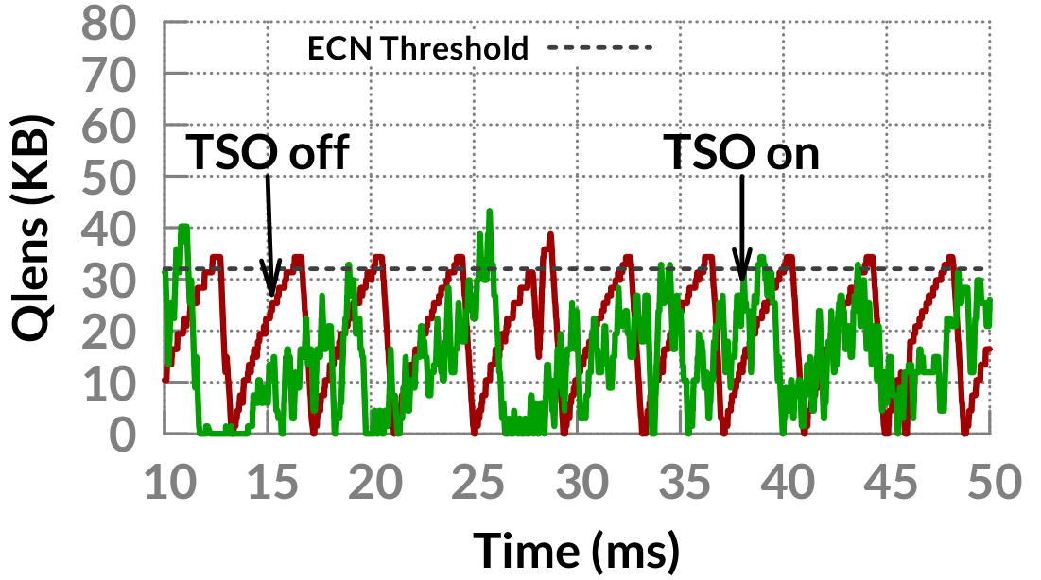
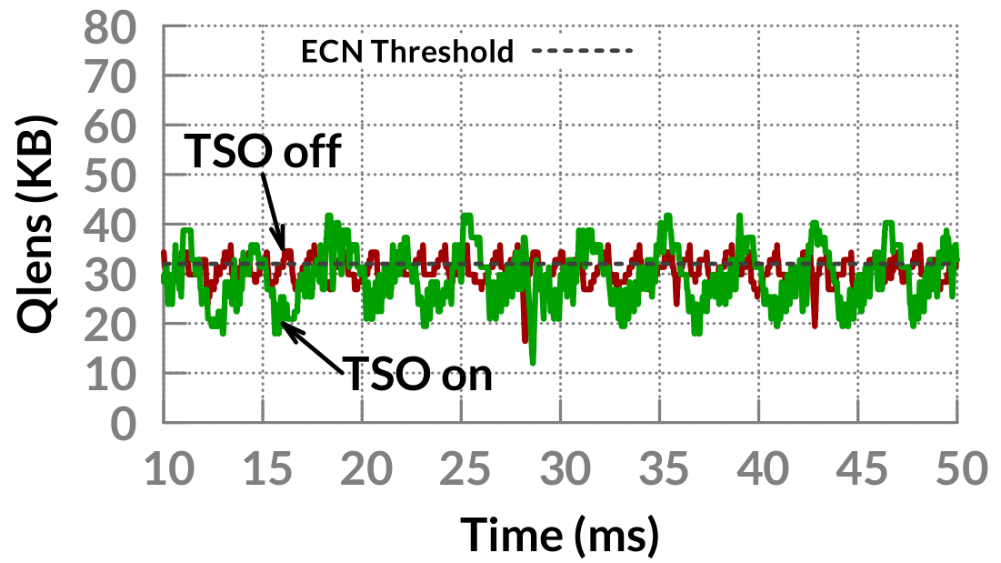
Buffer Underflow Problem
1Gbps
Sender 1
Switch
(NetFPGA)
Receiver
Sender 2
3x
Buffer underflow
ECN*
DCTCP
Notes:
We conduct experiments and simulations to show this problem.
In the experiment, two senders and one receiver is connected to a NetFPGA-based switch.
Two long-lived flows are from two senders, respectively, and to the same receiver.
The bottom two figures show the bottleneck queue length evolution in the switch.
The left figure shows the queue length evolution with ECN* protocol.
the red line denotes the queue length evolution when TSO is turned off, and the green line denotes the queue length evolution when TSO is turned on.
As is shown in this figure, the queue length is severely oscillating. And buffer can underflow.
The right figure shows queue length evolution with DCTCP protocol.
As is shown in the figure, with TSO, the amplitude of queue length is three times larger than the amplitude of queue length oscillations without TSO.

Slide 10
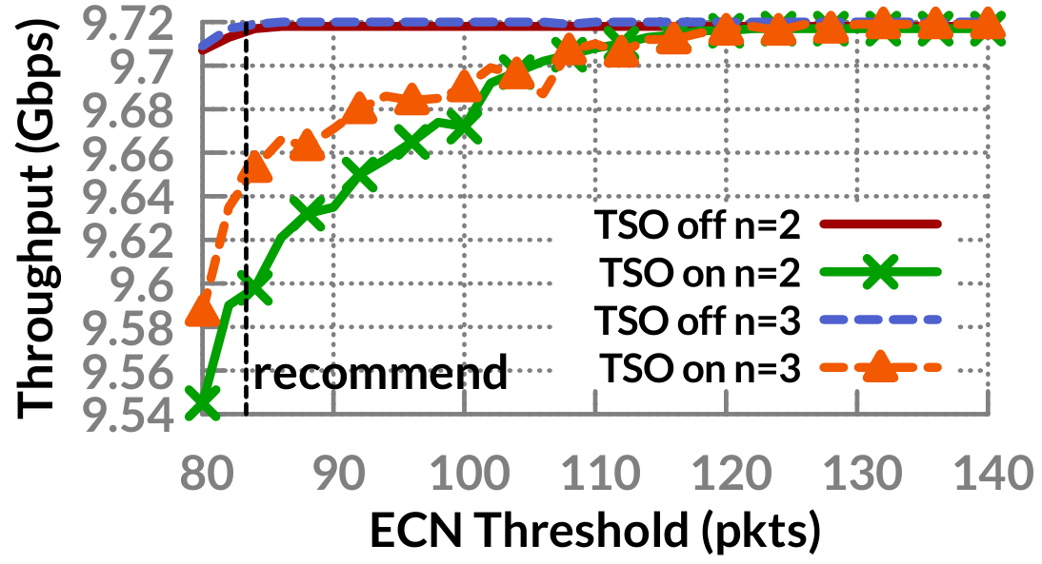
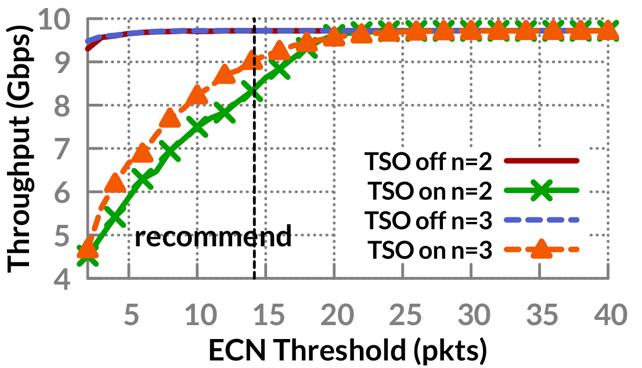
Buffer Underflow Problem
10Gbps
Sender 1
Switch
Receiver
Sender 2
ECN*
127Mbps throughput loss
DCTCP
1.391Gbps throughput loss
Notes:
We also conduct simulations in 10Gbps networks.
The topology is the same as that in experiments except that link rates is 10Gbps.
The figures shows the total throughput under different ECN threshold settings.
When we use the recommended ECN threshold settings, there are 127 megabit per second throughput loss with ECN*,
And 1.391 gigabit per second throughput loss with DCTCP

Slide 11

Brief Summary
Batching
Micro-burst
Severe queue length oscillations
Buffer underflow
Throughput loss
The amplitude of queue length oscillations?
How to set ECN threshold with micro-burst traffic?
Notes:
Now, here is a brief summary of the problem.
Batching schemes at host introduce micro-burst traffic into network.
These micro-burst traffic will result in severe queue length oscillations, which will lead to buffer underflow, and throughput loss.
So one might ask, can we quantify the amplitude of queue length oscillations.
And with micro-burst traffic, how to set the ECN threshold?

Slide 12
Outline
Background & Motivation
Analysis
Solution
Evaluation
Conclusion
Notes:
To answer the questions, we give a theoretical analysis about the queue length evolutions with micro-burst traffic.

Slide 13
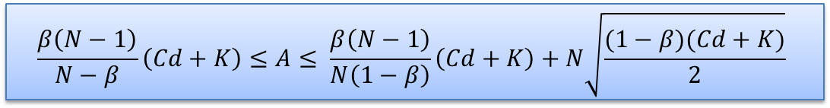
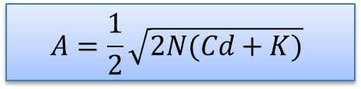
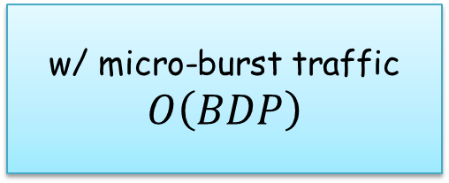

Analysis
Amplitude of queue length oscillations (DCTCP)
N: # of flows
C: link capacity
d: Base RTT
K: ECN threshold
A: Amplitude of oscillation
w/o micro-burst
$$A=\frac{1}{2}\sqrt{2N(Cd+K)}$$
BDP: Bandwidth Delay Product
w/ TSO-induced micro-burst
$$\frac{β\left(N−1\right)}{N−β}\left(Cd+K\right)≤A≤ \frac{β\left(N−1\right)}{N\left(1−β\right)}\left(Cd+K\right)+N\sqrt{\frac{(1−β)(Cd+K)}{2}}$$
w/o micro-burst traffic
$$O\left(\sqrt{BDP}\right)$$
w/ micro-burst traffic
$$O\left(BDP\right)$$
Notes:
The analysis is lengthy and we do not present the details of analysis.
Instead, we present some major results.
First, we show the amplitude of queue length oscillations of DCTCP w/ TSO and w/o batching scheme.
The range of the amplitude w/ TSO-induced micro-burst can be given by this inequality.
In comparison, the amplitude of queue length w/o micro-burst can be given by this expression.
In the experssion, Cd+K means the bandwidth delay product.
From these expressions, we find that, with micro-burst traffic, the queue length amplitude can be increased from order (square root of BDP) to order (BDP)

Slide 14
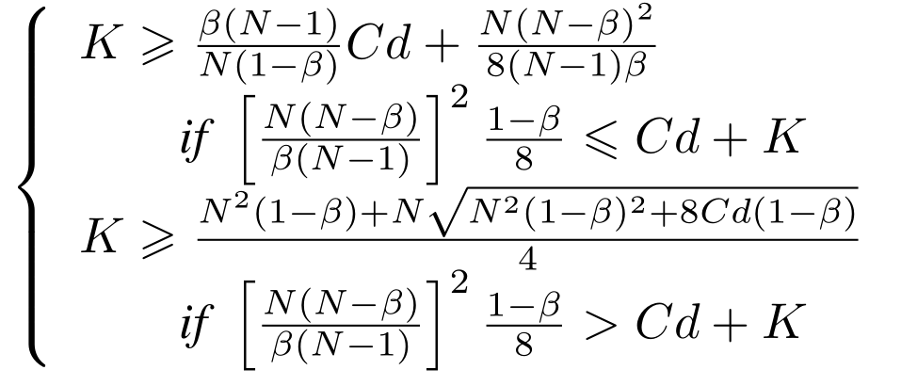

Analysis
N: # of flows
C: link capacity
d: Base RTT
K: ECN threshold
ECN threshold settings to achieve 100% throughput (DCTCP)
w/o micro-burst
$$K≥0.17Cd$$
w/ TSO-induced micro-burst
Notes:
Besides, to achieve 100% throughput, the ECN threshold should meet the following inqualities.
These expressions might be hard to understand. Therefore, we use an example to explain it.
uld meet the following requirements.

Slide 15
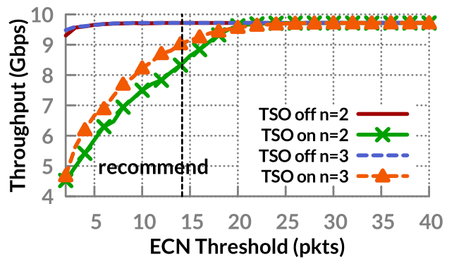



Analysis
An example
$N=2, β=\frac{1}{3}$
$BDP=83.3$ packets
RTT=100us, C=10Gbps
w/o micro-burst
$K≥16.7$ packets
w/ TSO-induced micro-burst
$K≥22.9$ packets
With TSO, the ECN threshold
should be 61.6% larger than that without batching.
Notes:
We consider the case in our previous simulations.
That is N is 2 and beta is one-third., BDP is larger than 83.3 packets, which is always the case, to achieve 100% throughput, Then the ECN threshold should set to be larger than 22.9packets w/ TSO.
In comparison, w/o micro-burst traffic, the ECN threshold only need to be larger than 16.7 packets.
We have two observations, first, the analysis result fits quite well as our simulation result.
Second, with TSO, the ECN threshold should be …
If we do not properly set the ECN threshold, the result is buffer underflow and throughput loss.

Slide 16
Outline
Background & Motivation
Analysis
Solution
Evaluation
Conclusion

Slide 17


What Can We Do?
Why the problem occurs?
Bursty traffic
ECN mis-marking
Eliminate bursty traffic
Improve ECN marking scheme
TCP pacing
Pacing at NIC
Increasing ECN threshold
Average queue length
Not enough:
TSO
Hard
Increase queueing latency
Hard to determine ECN threshold
Reduce responsiveness
Notes:
So what can we do to deal with this problem.
Rethinking the problem, is occurs for two reasons,
One is that there is bursty traffic in the network.
Therefore, the fundamental solution is to eliminate bursty traffic at sender.
The most simple way should be TCP pacing. However, this is not enough because some kinds of bursty traffic is created by the hadward NIC.
Therefore, we should pacing packets at NIC. However, implement a hardware pacer is hard because different flows should be separately paced and pacing rate should be dynamically determined
Therefore, eliminating bursty traffic at sender seems to be infeasible.
We resort to another direction， that is improving ECN marking scheme.
Increasing ECN threshold Leave enough room for queue length fluctuation
average queue length to accommodate bursty traffic, because senders may not be able to quickly react to congestion caused by fan-in traffic
So what else can we do?
用简单的句子把意思讲清楚 讲太多

Slide 18
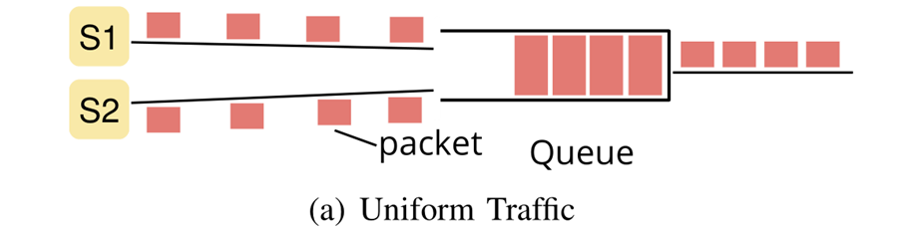
Queue Composition
Queue length
Backlog
Time
Uniform traffic
Notes:
Before introduce our solution, let us look at the queue length composition.
When there is without micro-burst traffic, the queue is composed of backlog queue representing the mismatching between congestion window size and pipeline capacity.

Slide 19
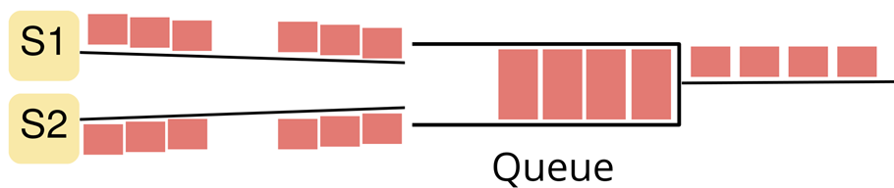
Queue Composition
Can we exclude it?
When making ECN mark decision
ECN Threshold
Multiplex
Should NOT be considered
Queue length
Backlog
Should be considered
Time
Bursty traffic
Notes:
However, when there is bursty traffic, the queue length has another component: queue length caused by multiplex of micro-burst traffic.

Slide 20
Basic Idea
ECN Threshold
Queue length
Multiplex
Backlog
Time
Queue length increasing is transient
ECN Threshold (K)
Enqueue
Bottleneck queue
Qlen > K: Mark the packet
Qlen < K: Unmark the packet
Dequeue
Notes:
The basic idea of our solution is based on the observation that the queue length increasing is transient
Therefore, the queue length might be larger than ECN threshold for only a short period of time.
Thus, we can make ECN marking decision according to the queue length at two time points: packet enqueuer and packet dequeuer.
Here is our solution.
When packet enqueuer and …
If qlen <Ｋ, then it is possible that the queue length increasing is caused by multiplex of micro-burst traffic,
And the packet is mis-marked with ECN. Therefore, we unmark the packet.

Slide 21

Basic Idea
Enqueue
Dequeue
ECN Threshold
Queue length
Multiplex
Backlog
Time
The queue length is decreasing: slope < 0
Notes:
However, if the time inverval between packet enqueuer and packet dequeue might be very small.
Then when packet is dequeued, the queue length might be larger than ECN threshold.
In this case, we observe that the queue length is decrease when packet is dequeued.
Therefore, we can use another information about queue length to help us make ECN marking decision: slope.
If the slope is lower than 0, then the queue length is decreasing, we also unmark the packet.

Slide 22
Our Solution: CEDM
Should be marked with ECN
K₂
Queue length
K₁
If qlen > K₂, Mark packets anyway
Notes:
With slope, there is side-effect.
That is, some packets are should be marked with ECN, while they are not marked.
When the queue length is too large, this will result in buffer overflow.
To prevent buffer overflow in this scenario, we use an additional threshold K_2, when qlen > K2,

Slide 23
Our Solution: CEDM
Combined Enqueue and Dequeue ECN Marking
Mark packet if
qlen > K₂
Or else:
Mark packet if
qlen >= K₁ and
slope >= 0
Unmark packet if
qlen < K₁ or
qlen > K₂ and slope < 0
Packet enqueue
Packet dequeue
qlen: queue length
slope: derivative of queue length
K: ECN threshold
Notes:
Finally, this is our solution: Combined Enqueue and Dequeue ECN marking.
When packet enqueue, the packet will be marked only if ….
When packet is dequeued

Slide 24
Outline
Background & Motivation
Analysis
Solution
Evaluation
Conclusion

Slide 25
Evaluation
Throughput
Sender 1
10Gbps
Switch
10Gbps
Receiver
Sender 2
Notes:
In the last, we present some evaluation results about CEDM.
All evaluations are performed on ns-2 platform.
First, we evaluate the throughput.

Slide 26
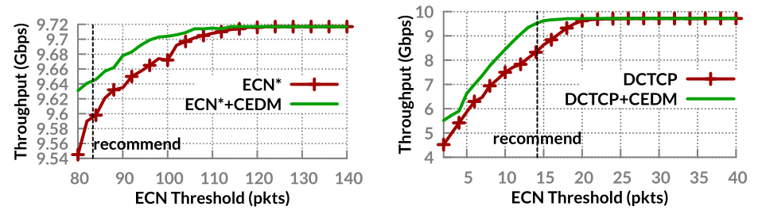
Evaluation
Throughput
Throughput loss is reduced by 1.6X
Throughput loss is reduced by 6X
Notes:
The figures show the throughput with difference ECN threshold settings.
The red line, green line
In the left figure
In the right figure

Slide 27
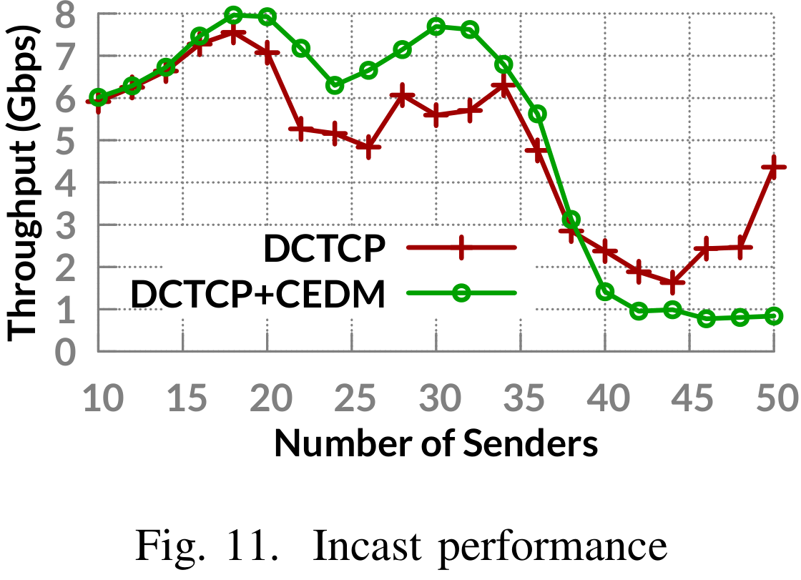
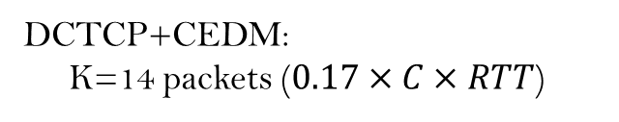
Evaluation
DCTCP: K=19 packets
Incast performance
DCTCP+CEDM:
K=14 packets ($0.17×C×RTT$)
Buffer size: 150KB
Link rate: 10Gbps
Notes:
CEDM cancels ECN marking of some packets, therefore one might wonder that CEDM is easier to cause buffer overflow.
Therefore, we show the performance of CEDM in incast scenario.
The figure shows the incast performance of CEDM.
The ECN threshold of DCTCP is set to the lowest value that there is no throughput loss.
Although CEDM unmark some packets, the incast performance is similar to that with normal ECN.

Slide 28
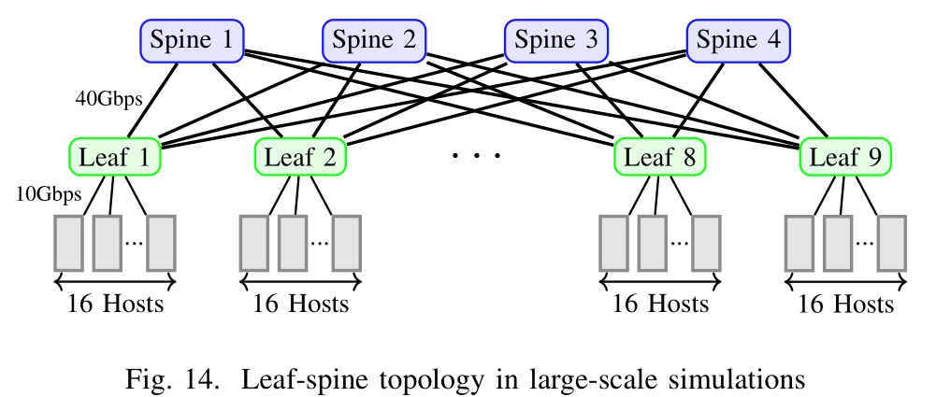
Evaluation
Large-scale simulations
Leaf-spine topology with 144 servers
10/40Gbps network
Notes:
We also perform large-scale simulations.
We use the leaf spine topologies with 144 servers.
These servers are connected to left switches swith 10Gps link, and the leaf switches are connected to spine swithes with 40Gbps links

Slide 29
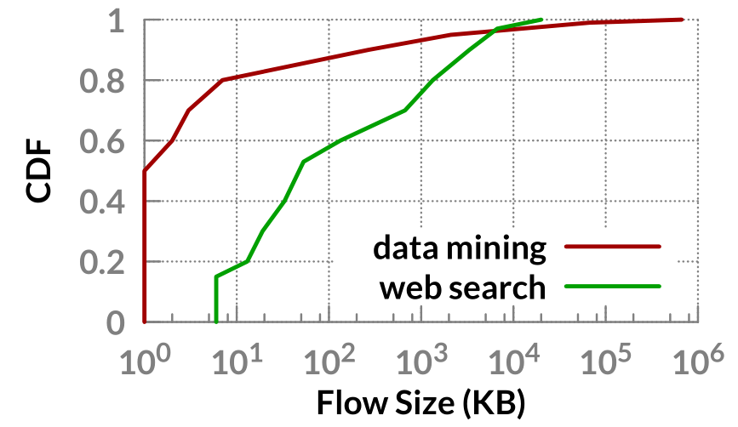
Evaluation
Large-scale simulations
Two widely used flow size distributions
Data mining workload
Web search workload
Notes:
We also use two widely used flow size distributions to generate traffic.

Slide 30
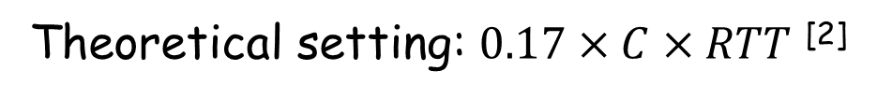
Evaluation
Large-scale simulations
Recommended settings in 10Gbps network ^{[1]}
Protocols | ECN threshold (packet)
DCTCP | K=65
DCTCP+CEDM | K=12
DCTCP | K=12
Theoretical setting: $0.17×C×RTT$ ^{[2]}
[1] M. Alizadeh, A. Greenberg, D. A. Maltz, J. Padhye, P. Patel, B. Prabhakar, S. Sengupta, and M. Sridharan, “Data Center TCP (DCTCP),” in SIGCOMM, 2010.
[2] M. Alizadeh, A. Javanmard, and B. Prabhakar, “Analysis of DCTCP: Stability, Convergence, and Fairness,” in SIGMETRICS, 2011.
Notes:
We compare DCTCP+CEDM to other two protocols.
With ECN threshold set to 65 packets.

Slide 31

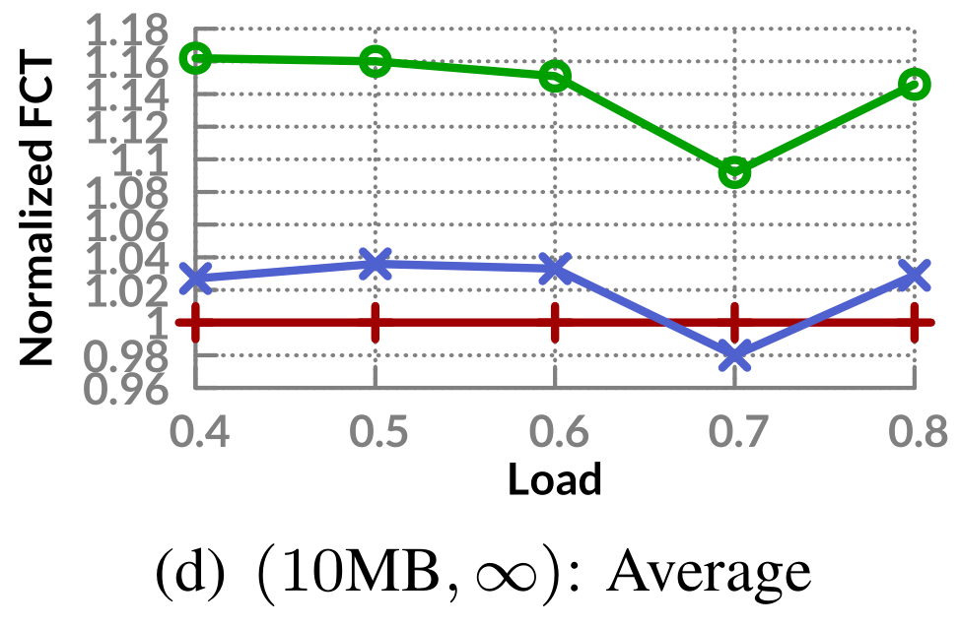
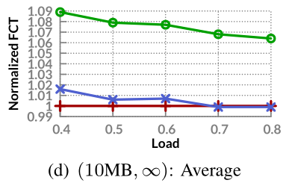
Evaluation
Large-scale simulations
Large flows
Data mining workload
Web search workload
Notes:
. FCT is normalized to the value achieved by DCTCP protocol whose ECN threshold is 65 packets for clear comparison.
Data mining: FCT extended by 9.2-16.2%
Web search: FCT exended by 7%-9%

Slide 32
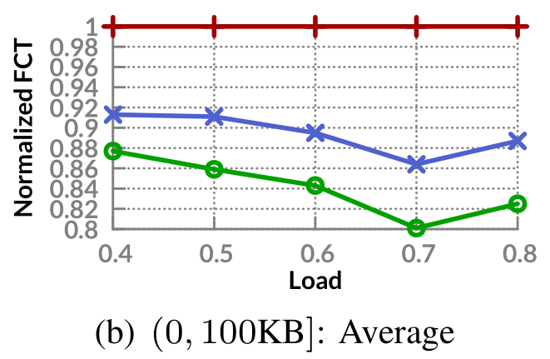
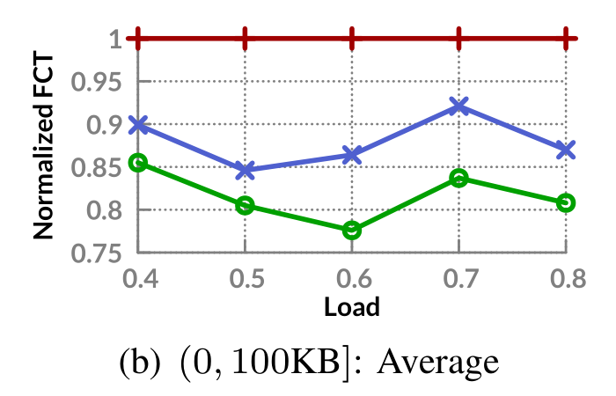
Evaluation
Large-scale simulations
Small flows
Data mining workload
Web search workload
Notes:
Data mining: FCT reduced by 9.7-13.6%
Web search: FCT reduced by 7.1-15.4%

Slide 33
Conclusion
Reveal the buffer underflow problem caused by
Instantaneous-queue-length-based ECN marking scheme
Batching-scheme-induced micro-burst traffic
Theoretically deduce the amplitude of queue length oscillations
CEDM: a simple ECN marking scheme
Exclude transient queue occupancy caused by multiplexing of micro-burst traffic
High throughput under low ECN threshold

Slide 34


Slide 35
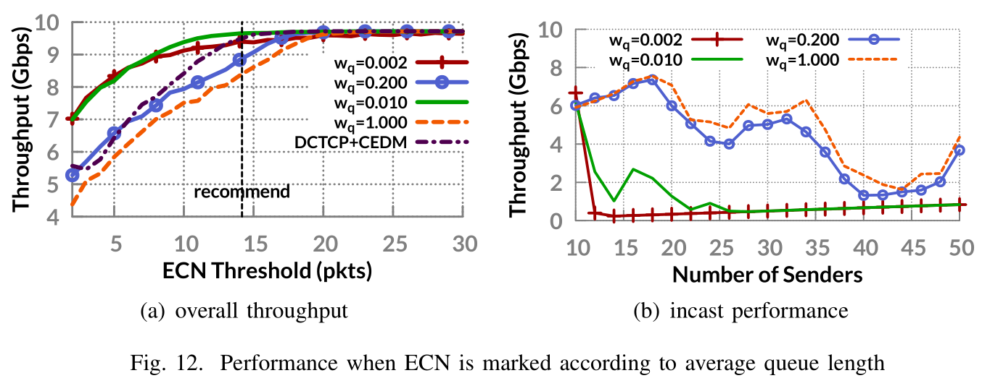
Backup Slide
Average queue length

Slide 36
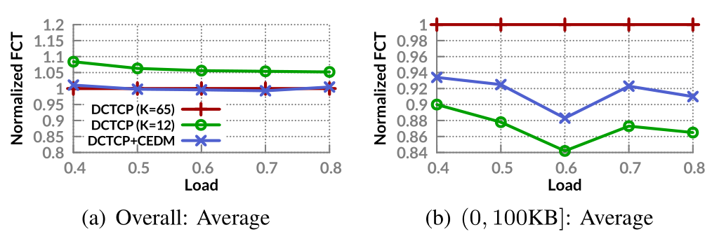
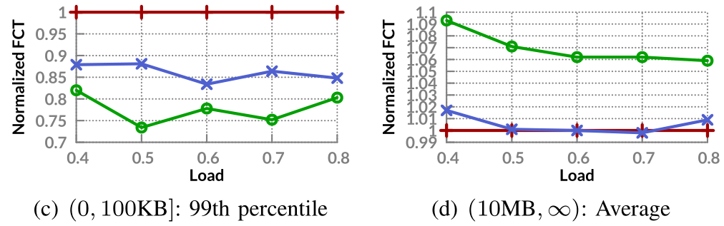
Backup Slide
2:1 oversubscribed network

Slide 37
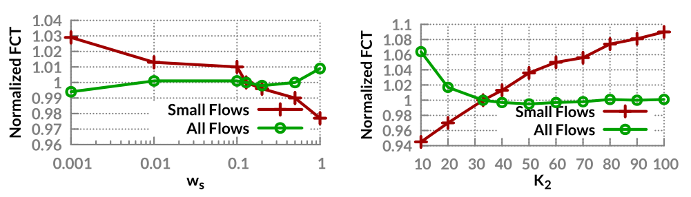
Backup Slide
Parameter sensitivity

Slide 38
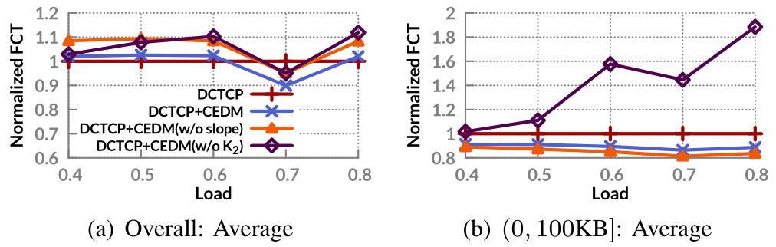
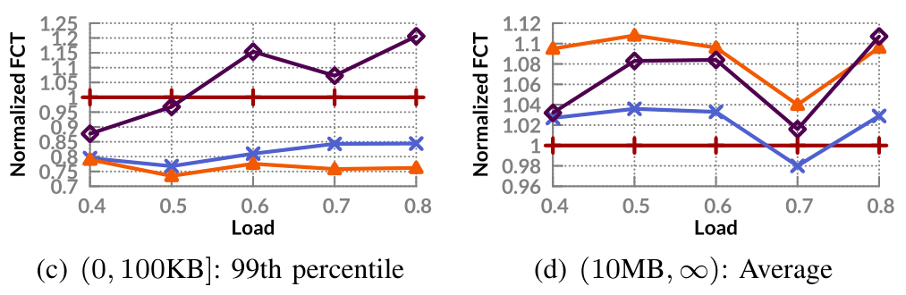
Backup Slide
Effective of slope and double threshold

