Slide 1
An Introduction to
Git for Scientists
Dr. Tim Schäfer
ESI for Neuroscience
Fries Lab Academy
March 06, 2023

Slide 2
About this Presentation
The title is Git for Scientists: the first part explains how Git can help scientists, but the rest is not specific to science.
Keep in mind that git is a very complex tool for distributed software development, and you do not need all of its features.
The recommendations given come from me (Tim) and are my personal opinion. As coding platform, I primarily use and thus focus on GitHub. Feel free to use another one, they all work.
This is a presentation, not a hands-on git workshop. The focus is on concepts, not git commands.
The git CLI can do everything and is shown here, use a GUI or the git integration of your favourite IDE later if you prefer.

Slide 3
Overview
Part 1: What version control can do for science
Versioning, Collaboration, Reproducibility
Part 2: Git basics: Local git
Repositories, commits, diffs, conflicts
Part 3: Distributed git
Platforms, Distributed Git Workflow, Branches, Conflicts
Part 4: Suggestions for getting started with git
Git, GitHub, IDE integration

Slide 4
1.
Science and version control
A step towards reproducibility

Slide 5
Version Control
Version control is a system that records changes to a set of files over time so that you can recall specific versions later.

Slide 6
Version Control was developed to:
Manage and access different versions of files
Typically source code, but it can be anything.
Work on a complex project with several people
… and solve the resulting versioning conflicts that will occur.
Previous solutions:
Manually create many copies of your project directory:
Copy or send files back and forth, e.g., via email,
and compare them manually or via diff/patch tools.
my_projects/
projectA_2023_02_02/
projectA_2023_02_05/
projectB_2023_02_12/
projectA_2023_03_11/

Slide 7
Version Control can solve the following problems for you
You messed up your Matlab script today, and you want to recover yesterday’s version.
You need to know the settings you used to compute the data for paper XY, but you changed the script in the meantime.
You received a new version of a script that circulates in the lab from a colleague, and you want to see the changes compared to your older version.
You are improving a script over time in an iterative fashion, and you want colleagues to be able to always access the latest version, without sending around emails after every change.
Both you and a colleague made changes to different parts of a script, and you want to merge your changes into a new version.
You want to collaborate with colleagues when writing a script or software, and allow them to see your code, and directly make or suggest changes.

Slide 8
What Version Control can do for you
Restore last/earlier version
Find changes compared to other version
Find version used for paper XY
Always make latest stable version available to colleagues
Collaborate on a project

Slide 9
Version Control to improve Reproducibility in Science
Replication Crisis
Open Science: first step to improve replicability is to improve reproducibility
Reproducibility requires access to:
Dataset
Data analysis pipeline
Software Environment to run the Pipeline
Versioning and Version Control are part of this
Public data repositories, Free Software, Docker / Singularity

Slide 10
Social Coding Platform (SCP)* benefits for Scientists
*GitHub, Sourceforge, Gitlab, BitBucket, …
Note: SCPs are build around VC, they act as a VC server.
They are social
Scientific collaboration
Networking, visibility for your projects, jobsearch
Easy integration with other services
E.g., publish a Python package from your Git repository, host project website, CI, get a DOI for a software version, build and publish documentation, …
Side effect: Synchronize work across devices
What about backup?
Note: SCPs often offer free professional accounts for scientists.

Slide 11
2.
VCS and Git basics
Git concepts and vocabulary

Slide 12

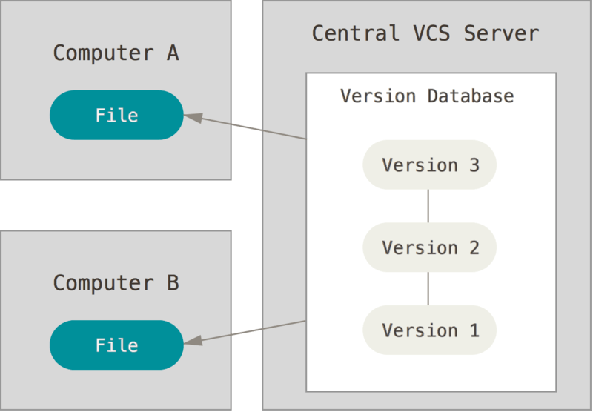
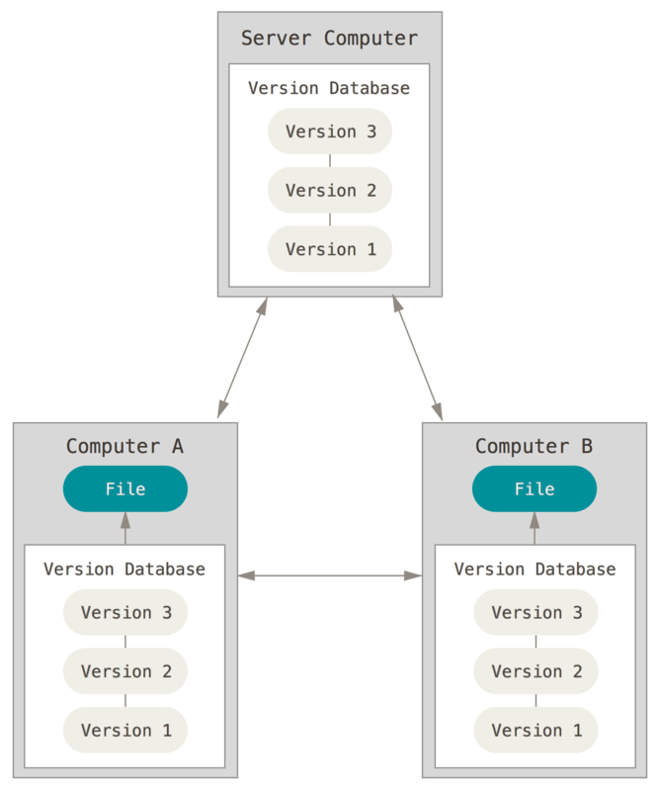
Version Control System (VCS)
Local
E.g., Revision Control System (RCS)
Centralized
Subversion, Concurrent Versions System (CVS)
Distributed
Mercurial, Bazaar, Darcs, Git
Image Credit: Scott Chacon and Ben Straub, Pro Git, https://git-scm.com/book, License: CC BY-NC-SA 3.0

Slide 13
Distributed VCS and Servers
Servers are optional for distributed VCS systems, but almost always used in practice
Team work, Access management, Backup, Integration with other services, …
Technically all repos are equal and the ‘authoritative’ server/repo is just a convention.
If a Server exists:
Stand-alone (on-premises, private SaaS / cloud instance)
Social Coding Platform (GitHub, GitLab, BitBucket, Sourceforge, …)

Slide 14
Git
widely used
speed, distributed workflows
Linus Torvalds, 2005, Linux
Open Source (GPL)
Data integrity
Secure against data loss
Powerful & complex
See, e.g.: De Rosso, S.P., and Jackson, D. “Purposes, Concepts, Misfits, and a Redesign of Git.” ACM Press, 2016. 292–310.
Image Credit: XKCD, https://xkcd.com/1597/, License: CC BY-NC 2.5

Slide 15
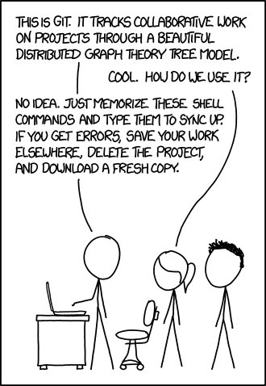
Git
widely used
speed, distributed workflows
Linus Torvalds, 2005, Linux
Open Source (GPL)
Data integrity
Secure against data loss
Powerful & complex
See, e.g.: De Rosso, S.P., and Jackson, D. “Purposes, Concepts, Misfits, and a Redesign of Git.” ACM Press, 2016. 292–310.
Image Credit: XKCD, https://xkcd.com/1597/, License: CC BY-NC 2.5

Slide 16
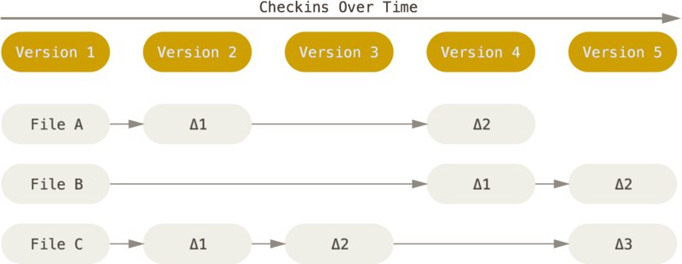
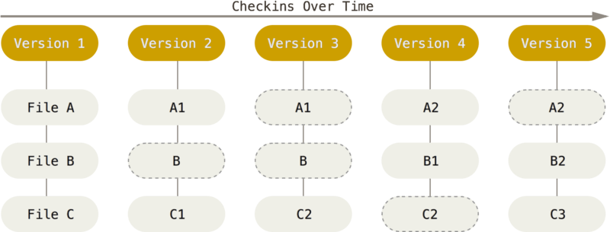
What is special about Git?
Each copy is the full repo
Most actions are local and thus fast
It works offline
Safe
Data integrity via checksums
Designed to add data, not delete it (but it's possible if absolutely needed)
Filesystem-like approach: Snapshots instead of Deltas
Delta approach Snapshot approach
Image Credit: Scott Chacon and Ben Straub, Pro Git, https://git-scm.com/book, License: CC BY-NC-SA 3.0

Slide 17
Git first time setup
Notes:
Command line interface (CLI) versus IDE / graphical UI
Concepts, not commands
git CLI follows convention: git <git_command> <cmd_options>
git help <git_command>

Slide 18
Git first time setup
Git Installation: pre-installed on many systems, otherwise download from https://git-scm.com
Commits have an author
git config user.name # Show it.
git config --global user.name "Jane Doe" # Set it.
git config --global user.email "me+code@institute.org"
Many more git config options are available, e.g., Credentials storage. Check the documentation: git help config

Slide 19
Getting a git repository - Two Options
Turn your existing project folder into a Git repository
cd myproject/
git init
Clone a remote repository (e.g., after creating an empty one on the Github website)
git clone https://github.com/myuser/myproject
cd myproject/
Creates subdirectory .git and other special files, e.g., .gitignore

Slide 20
Saving files to version control: commit
And working alone on a project on a single computer
cd myproject
git add *.py subdir1 subdir2
git commit -m "add my project"
# Now change some files
git status
git add changed_file1.py file2.m
git add file3 dir2/
git commit -m "add feature XY"
# Repeat.
Important: With git, users decide which files and changes are added to the database, and under which label (commit message). It does not happen automatically.
Saving files to the database is known as committing.
A commit should be made whenever something is done.

Slide 21
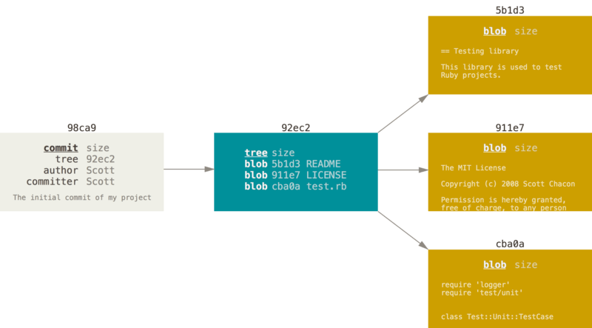
What is a commit?
snapshot
What the user sees: Git internals, in DB
commit identified by hash: 98ca9…
commit metadata (author, …)
A commit refers to a tree: a set of files (file paths) in a certain state. The contents of each file is represented internally as one blob (in the git database).
Image Credit: Scott Chacon and Ben Straub, Pro Git, https://git-scm.com/book, License: CC BY-NC-SA 3.0

Slide 22
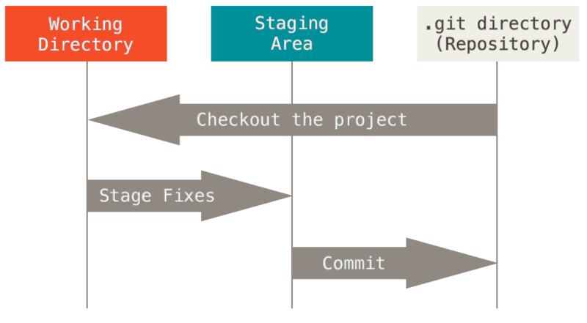
The three areas of a git repo: working dir, staging area, repo (database)
git clone https://gh…
# Now change some files
git add changed_file1 file2
git add file3 dir2/
git commit -m "add feature XY"
Saving has two parts:
stage
commit
step 1: stage step 2: commit
Image Credit: Scott Chacon and Ben Straub, Pro Git, https://git-scm.com/book, License: CC BY-NC-SA 3.0

Slide 23
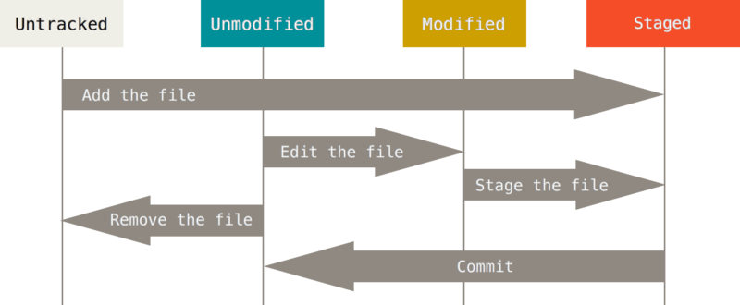
Adding changes to a repository: file states
The possible states of files
Image Credit: Scott Chacon and Ben Straub, Pro Git, https://git-scm.com/book, License: CC BY-NC-SA 3.0

Slide 24
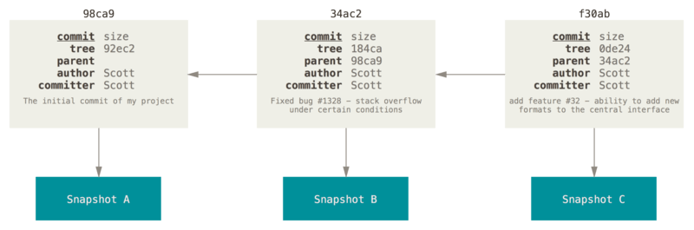
Note: Visualization of Commit History
Initial commit in a repo: root commit, no parent.
All other commits have a parent commit (one or more).
time
Image Credit: Scott Chacon and Ben Straub, Pro Git, https://git-scm.com/book, License: CC BY-NC-SA 3.0

Slide 25
Note: Visualization of Commit History
Initial commit in a repo: root commit, no parent.
All other commits have a parent commit (one or more).
time
Simplified representation:
0
1
2
Image Credit: Scott Chacon and Ben Straub, Pro Git, https://git-scm.com/book, License: CC BY-NC-SA 3.0

Slide 26
Histories of commits: Commit trees and Branches
time
Simplified representation:
0
1
2
3
root trunk leaf / tip

Slide 27
Histories of commits: Trees and Branches
time
4
Simplified representation:
0
1
2
3
root trunk branches leafs
5

Slide 28
Checking the status and history
Show the diff (difference) for a changed file (compared to last commit)
git diff path_to/file.py
Show repo status (changed files, staged files, …)
git status
Show history (previous commits and commit messages)
git log
Browse using web interface (e.g., gitweb) or other GUI
Remember: git help diff
git help status
git help log

Slide 29
Recap: Basic Git Concepts
Repository
A git project folder, including a database storing the snapshots of your files and metadata. Turn a folder into a repo with git init.
Staging, to stage
Mark changes (changed files) to be written to the repository on the next commit. Stage a file with git add <file>.
To commit, a commit
Add a set of changed to the versioning database. Commit with git commit -m <msg>.
Checkout / Snapshot
All project files from a repository at a certain point in time.

Slide 30
3.
Distributed Git
Remotes, Servers and Collaboration

Slide 31
Very simple workflow: 1 person, 2 PCs
We now have a server, e.g., a repo on Github.com or a local git server.
Laptop
0
clone
Server
0
Desktop
Image credit: https://www.atlassian.com/git/tutorials/syncing/git-pull

Slide 32
Very simple workflow: 1 person, 2 PCs
We now have a server, e.g., a repo on Github.com or a local git server.
commit commit commit
Laptop
0
1
2
3
clone
Server
0
Desktop
Image credit: https://www.atlassian.com/git/tutorials/syncing/git-pull

Slide 33
Very simple workflow: 1 person, 2 PCs
Sync changes to server: git push
Laptop
0
1
2
3
git push
Server
0
1
2
3
Desktop
Image credit: https://www.atlassian.com/git/tutorials/syncing/git-pull

Slide 34
Very simple workflow: 1 person, 2 PCs
commit commit commit
Laptop
0
1
2
3
4
5
6
Server
0
1
2
3
Desktop
Image credit: https://www.atlassian.com/git/tutorials/syncing/git-pull

Slide 35
Very simple workflow: 1 person, 2 PCs
commit commit commit
Laptop
0
1
2
3
4
5
6
git push
Server
0
1
2
3
4
5
6
Desktop
Image credit: https://www.atlassian.com/git/tutorials/syncing/git-pull

Slide 36
Very simple workflow: 1 person, 2 PCs
commit commit commit
Laptop
0
1
2
3
4
5
6
Server
0
1
2
3
4
5
6
git clone
Desktop
0
1
2
3
4
5
6
Image credit: https://www.atlassian.com/git/tutorials/syncing/git-pull

Slide 37
Very simple workflow: The git commands
Your Desktop PC at work Your Laptop at Home
create repo at https://github.com/me/pr1
server
git clone https://github.com/me/pr1
git clone https://github.com/me/pr1
cd pr1/
git add file2 file5
git commit -m "Work at ESI done."
git push
Time
cd pr1/
git pull
git add file2 file5 file7
git commit -m "Work pkg1 at laptop done."
git add file3 file7
git commit -m "Work pkg2 at laptop done."
git push
git pull
# Start working, then commit & push.

Slide 38
The Git Cycle
git pull
repeat:
1. change stuff
2. git add
3. git commit
git push

Slide 39
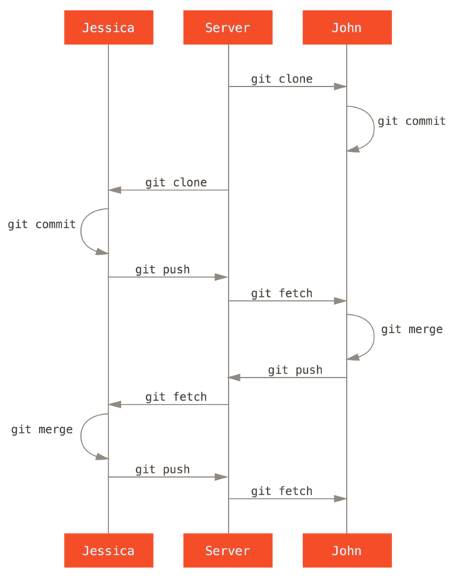
New Workflow: 2 Developers, central server
Everyone on the team has direct write access
Almost identical to the Desktop PC + Laptop scenario
But: people work in parallel, so there can be conflicts!
Image Credit: Scott Chacon and Ben Straub, Pro Git, https://git-scm.com/book, License: CC BY-NC-SA 3.0

Slide 40
Auto-merging and Conflicts
Jessica
0
1
2
3
Server
0
1
2
3
John
0
1
2
3

Slide 41
Auto-merging and Conflicts
Two developers working in parallel
Jessica
0
1
2
3
4a
5a
6a
Server
0
1
2
3
John
0
1
2
3
4b
5b
6b

Slide 42
Auto-merging and Conflicts
Two developers working in parallel
Jessica
0
1
2
3
4a
5a
6a
git push
Server
0
1
2
3
4a
5a
6a
John
0
1
2
3
4b
5b
6b

Slide 43
Auto-merging and Conflicts
Two developers working in parallel
Jessica
0
1
2
3
4a
5a
6a
Server
0
1
2
3
4a
5a
6a
?!
John
0
1
2
3
4b
5b
6b

Slide 44
Auto-merging and Conflicts
3-way merge: this creates a merge commit from 3 older commits.
Jessica
0
1
2
3
4a
5a
6a
merge commit
Server
0
1
2
3
4a
5a
6a
7ab
John
4b
5b
6b
Jessica's changes: 6a - 3
John's changes: 6b - 3

Slide 45
Merging scenario 1: auto merge possible
a text file
blahgjkagjskgjksakmvlksanvlsaknvlkasnlkfjlksagjlksgjksajglksfor ksajgksajgkajsglkjsagkjsaglkjsgjksajgksajg
Original Jessica John Okay: auto merge
added
deleted

Slide 46
Merging, scenario 2: merge conflict
a text file
?
Original Jessica John Merge conflict!

Slide 47
Merging and merge Conflicts
For non-conflicting changes, merges happen automatically: git does it for you!
If we changed the same line in the same file in different ways on the two branches, a conflict occurs.

Slide 48
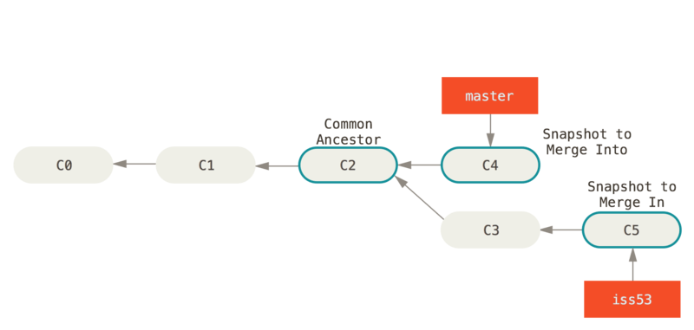
Merge Conflicts (1/2)
$ git merge iss53
Auto-merging index.html
CONFLICT (content): Merge conflict in index.html
Automatic merge failed; fix conflicts and then commit the result.
We find somewhere in the index.html file:
<<<<<<< HEAD:index.html
<div id="footer">contact : email.support@github.com</div>
=======
<div id="footer">
please contact us at support@github.com
</div>
>>>>>>> iss53:index.html
$ git status
On branch master
You have unmerged paths.
(fix conflicts and run "git commit")
Unmerged paths:
(use "git add <file>..." to mark resolution)
both modified: index.html
no changes added to commit (use "git add" and/or "git commit -a")
Image Credit: Scott Chacon and Ben Straub, Pro Git, https://git-scm.com/book, License: CC BY-NC-SA 3.0

Slide 49
Merge Conflicts (2/2)
Talk to your collaborator who introduced the changeset that is conflicting with yours.
Your options are: accept yours, accept theirs, or merge manually. Also remove the <<<<<<<, =======, >>>>>>> lines.
Once done, use git add on the file to mark the conflict as resolved, then commit.
We find somewhere in the index.html file:
<<<<<<< HEAD:index.html
<div id="footer">contact : email.support@github.com</div>
=======
<div id="footer">
please contact us at support@github.com
</div>
>>>>>>> iss53:index.html
Image Credit: Scott Chacon and Ben Straub, Pro Git, https://git-scm.com/book, License: CC BY-NC-SA 3.0

Slide 50
Recommendations for Merge Conflicts
Don't panic.
Merge early.
Test afterwards.

Slide 51
Undoing uncommitted changes (1/2)
Change a local commit (msg, files) with amend
$ git commit -m 'Initial commit'
$ git add forgotten_file
$ git commit --amend
Overwrites the old commit with the new one. Does not make sense if the commit has already been pushed to a remote.
Unstage a staged file with git reset
$ git add * # Stage CONTRIBUTING.md by accident.
$ git status # Notice it.
$ git reset HEAD CONTRIBUTING.md # Unstage.
Unstages the changes, so the file CONTRIBUTING.md is in state modified afterwards.
Alternative with git restore:
git restore --staged CONTRIBUTING.md

Slide 52
Undoing uncommitted changes (2/2)
Discarding your changes to a locally modified file
$ git status
$ git diff CONTRIBUTING.md
$ git checkout -- CONTRIBUTING.md
Dangerous: discards your changes, without ever committing them. The file CONTRIBUTING.md is in state unmodified afterwards.
Alternative:
git restore CONTRIBUTING.md
Alternative: Discard all local changes securely
$ git stash
Will be discussed in more detail later.

Slide 53
Undoing committed changes
This is dangerous territory if you have pushed already!
commits you want to undo
You
0
1
2
3
4
5
6
?
Colleague
7
8
Others may have continued based on the state you are about to undo!

Slide 54
Undoing committed changes: The save version
Recommended solution:
Add one undo commit per commit with git reset:
git revert <commit_hash>
git revert <oldest_commit_hash>..<latest_commit_hash>
state
identical
to (3)
commits you want to undo
reverse commits
new work
You
0
1
2
3
4
5
6
A
B
C
E
okay
Colleague
7
8

Slide 55
Undoing committed changes: The dangerous version
You are working alone, do not want the undo commits in the history, and are prepared for more trouble that may happen in the future?
Read up on git reset --hard and git push --force. You have been warned.
Note: This may actually be needed in some situation, e.g., if stuff got into the repo that really must not be there (e.g., from a legal or security point of view). Just talk to colleagues first!
commits you undid
You
0
1
2
3
4
5
6
4
5
Colleague
7
8

Slide 56
Branches
4
0
1
2
3
root branches leafs
5

Slide 57
Simple Workflow: Does it scale?
Dev3
Dev4
Dev5
Everyone on the team has direct write access
People work on the same code
Not feasible for complex software or more than 2 developers
broken state from another person
many conflicts
? ? ?
Image Credit: Scott Chacon and Ben Straub, Pro Git, https://git-scm.com/book, License: CC BY-NC-SA 3.0

Slide 58
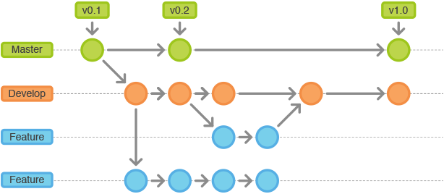
Solution for larger projects: Branching and Branches
Purpose
Diverge from main line of development, continue working in a separate copy without affecting the main branch. (Maybe unite later?)
Usage Examples
Start working on a Linux Version of a Windows software, or a new major version: new features in 1 branch, but same security fixes.
Note: The default branch is often called main or master.
Image Credit: Lutece CMS, https://lutece.paris.fr/support/wiki/git.html, License: BSD-3-Clause

Slide 59
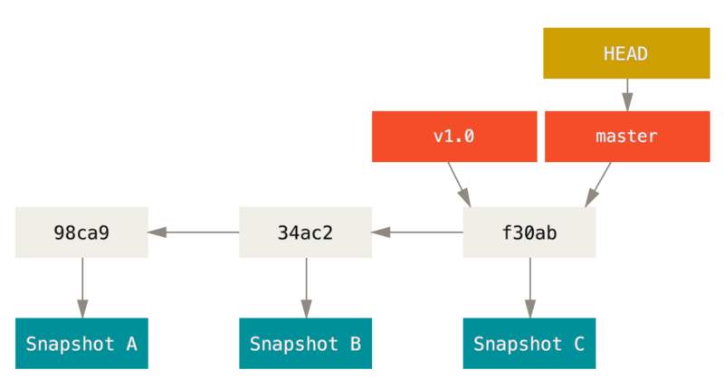
Branches, tags and HEAD
Branches are lightweight
A branch in Git is simply a lightweight movable pointer to a commit.
The pointer is moved automatically when you commit.
Head: the snapshot of your last commit on that branch.
Image Credit: Scott Chacon and Ben Straub, Pro Git, https://git-scm.com/book, License: CC BY-NC-SA 3.0

Slide 60
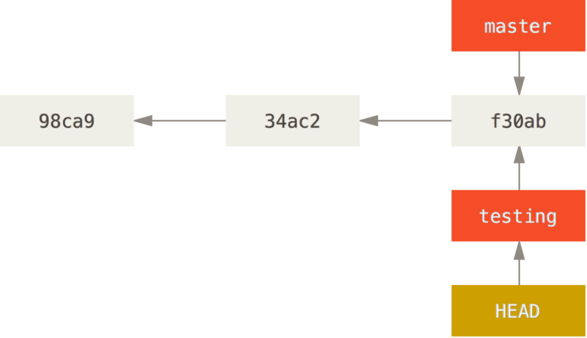
Changing the active branch
Branches are lightweight
Changing the branch just moves the pointer named HEAD to a new commit.
Example:
git checkout testing
Image Credit: Scott Chacon and Ben Straub, Pro Git, https://git-scm.com/book, License: CC BY-NC-SA 3.0

Slide 61
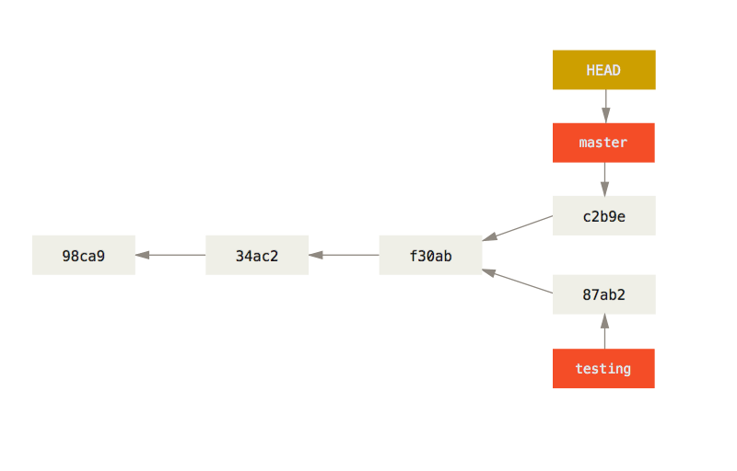
Diverging Branches
After committing to a new branch, the branches have diverged.
Image Credit: Scott Chacon and Ben Straub, Pro Git, https://git-scm.com/book, License: CC BY-NC-SA 3.0

Slide 62
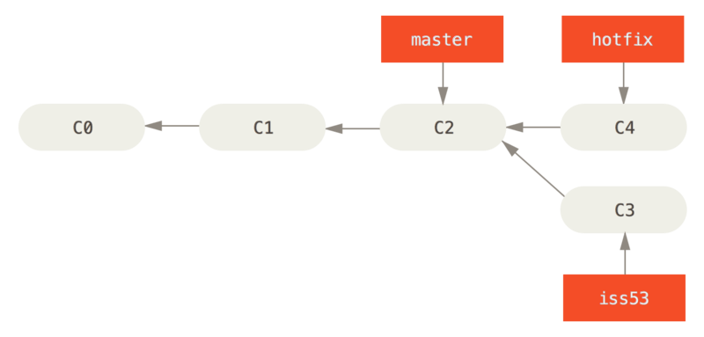
Branching: A practical example (1 / 3)
You have created a new branch iss53 off master.
Then, you applied a change (named hotfix) to the master branch. The hotfix is not yet on the iss53 branch.
Image Credit: Scott Chacon and Ben Straub, Pro Git, https://git-scm.com/book, License: CC BY-NC-SA 3.0

Slide 63
Branching: A practical example (2 / 3)
The branch iss53 is done and you want to merge it into master. This involves a three-way merge, based on commits C2, C4 and C5.
Git cannot simply move the pointer, it has to create a new snapshot (from a merge of C2, C4 and C5), and thus a new commit. This commit is a merge commit, it is special because it has several parents.
Image Credit: Scott Chacon and Ben Straub, Pro Git, https://git-scm.com/book, License: CC BY-NC-SA 3.0

Slide 64
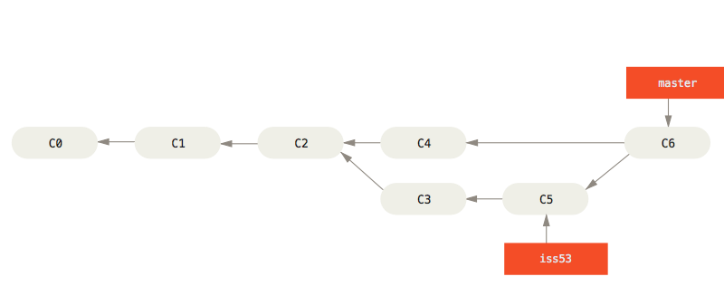
Branching: A practical example (3 / 3)
Situation before merge (from last slide).
git checkout master
git merge iss53
The result after the merge: C6 is the merge commit, on the master branch.
Image Credit: Scott Chacon and Ben Straub, Pro Git, https://git-scm.com/book, License: CC BY-NC-SA 3.0

Slide 65
Remote Branches
Tracking of remote branches
git checkout -b iss53
git push
git push origin iss53
Get info on new remote branches
git fetch
git fetch --all
git checkout iss76
git checkout remote2/iss76

Slide 66
Rebasing
Alternative to merging.
Only usable for series of commits (in different branches) that have not been pushed.
Allows for "cleaner" history (i.e., not the true history, but one that is easier to read/understand).
Works by making parallel changes on different branches appear to have happened sequentially on a single branch.
It is a matter of taste whether you want to use it.
See git rebase.

Slide 67
More info on
Remotes
Remote: another repository representing the same project
Can be on same computer or on remote server
May lack some of your commits, and/or may contain commits (or branches) you do not have locally.
The default remote is known as the origin.
You can add remotes, change the origin to another remote, or remove the origin.

Slide 68
Remotes
$ git clone https://github.com/esi-neuroscience/syncopy
$ cd syncopy
$ git remote -v
origin https://github.com/esi-neuroscience/syncopy (fetch)
origin https://github.com/esi-neuroscience/syncopy (push)
# Add another remote and fetch from it.
git remote add mycol https://github.com/my_colleague/syncopy
get fetch mycol
# Show origin, including tracked and new/stale branches.
git remote show origin

Slide 69
Tags
A name for a commit/state
E.g., "v1.0" or "biolpsych_paper"
Very useful to quickly find a specific version later
Should use this for every release
On GitHub, releases are created from tags.
See also: software versioning.
$ git log --pretty=oneline
$ git tag -a v1.2 9fceb02
$ git show v1.2
$ git push --tags

Slide 70
The git stash
Take from the top (pop).
Add on top (push).
stack
Scenario: You need to switch branch but have work in progress in an ugly state that you do not want to commit.
Add to stash to have it secured.
Can be (ab)used to clean your working directory in a safe way.
$ git status # Will show modified files, maybe some of them stashed.
$ git checkout dev # Does not work!
$ git stash # Store the changes on the stash
$ git checkout dev # Works. Now do some stuff.
$ git stash list
stash@{0}: WIP on master: 049d078 Create index file
stash@{1}: WIP on master: c264051 Revert "Add file_size"
$ git checkout main
$ git stash apply # Apply the latest one. Or: git stash apply stash@{1}

Slide 71
Git Concepts
- Remote
Clone (and origin)
A copy of a source repository, with all history. (The repo from which you copied is the origin.)
Pull
To retrieve changes (zero or more commits) from a remote repository (typically the origin).
Push
To send local changes (commits) to a remote repository (typically the origin).
git push <remote> <branch>
git push origin master
Fetch
Download data from a remote into your local repo under the remotes namespace (without merging anything or changing your files in any way).

Slide 72
Undoing things remotely
Change a local commit (msg, files) with amend
$ git commit -m 'Initial commit'
$ git add forgotten_file
$ git commit --amend
Overwrites the old commit with the new one. Does not make sense if the commit has already been pushed to a remote.
Discarding your changes to a locally modified file
$ git status
$ git diff CONTRIBUTING.md
$ git checkout -- CONTRIBUTING.md
Dangerous: discards your changes, without ever committing them. The file CONTRIBUTING.md is in state unmodified afterwards.
Alternative:
git restore CONTRIBUTING.md

Slide 73
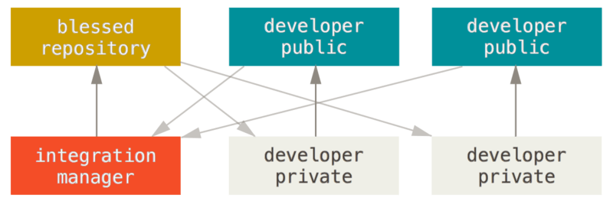
Workflow: Contributing a change to a public project on GitHub
Most projects used the Integration Manager workflow, where devs create PRs against the blessed repo and an integration manager decides on them (with help of test suite):
See https://martinfowler.com/articles/branching-patterns.html for more workflows.
Image Credit: Scott Chacon and Ben Straub, Pro Git, https://git-scm.com/book, License: CC BY-NC-SA 3.0

Slide 74
Workflow: Contributing a change to a public project on GitHub in 3 steps
1) Talk + Fork
Create an issue and talk to people to see whether they agree to have this changed.
Fork the project to your GitHub account, and clone your fork to your local computer.
2) Make changes
Checkout the proper branch (typically master or develop, but check the project) you want to branch off from.
Create a new branch and commit your changes into it.
3) Create Pull Request
Find your branch on your fork at the GitHub website, and click the Create Pull Request button.
Adapt your changes until they pass the review process. The project maintainers will then merge.

Slide 75
4.
Some tips on getting started with Git
IDEs, servers, workflow reminder

Slide 76
What to do next
Get a GitHub account
Create a private test repo
Setup git for your IDE & clone the repo
Hint: Maybe ignore branches for now.

Slide 77
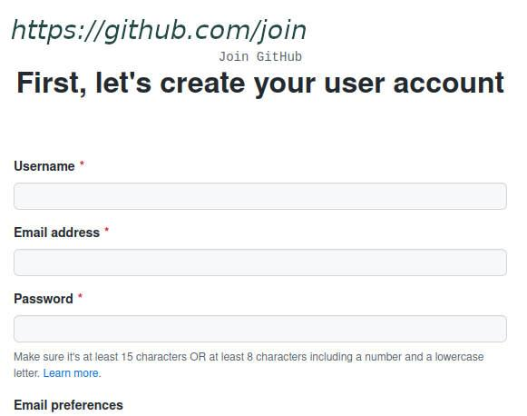
Get an account at a coding platform
like GitHub, SourceForge, GitLab, BitBucket, …
Free accounts typically have limits on team size for private repos or other restrictions
Note: You can often get a professional account for free as a researcher at a non-profit institution or OSS dev
Requires verification of status.
Not needed to get started.

Slide 78
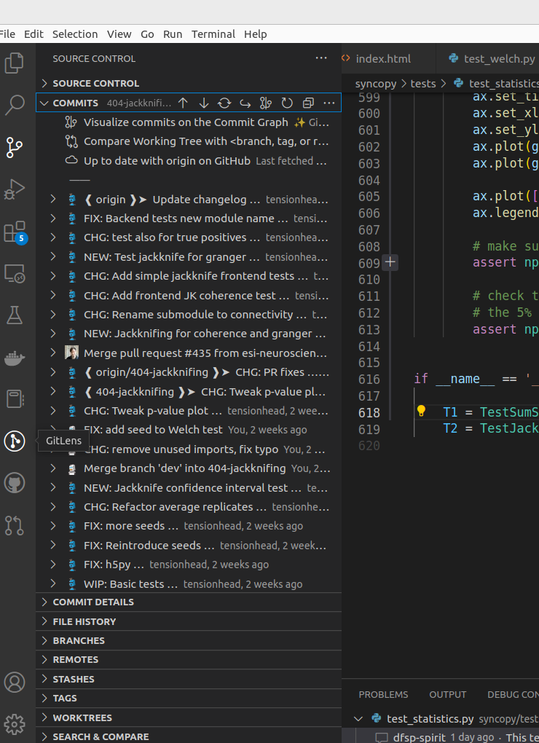
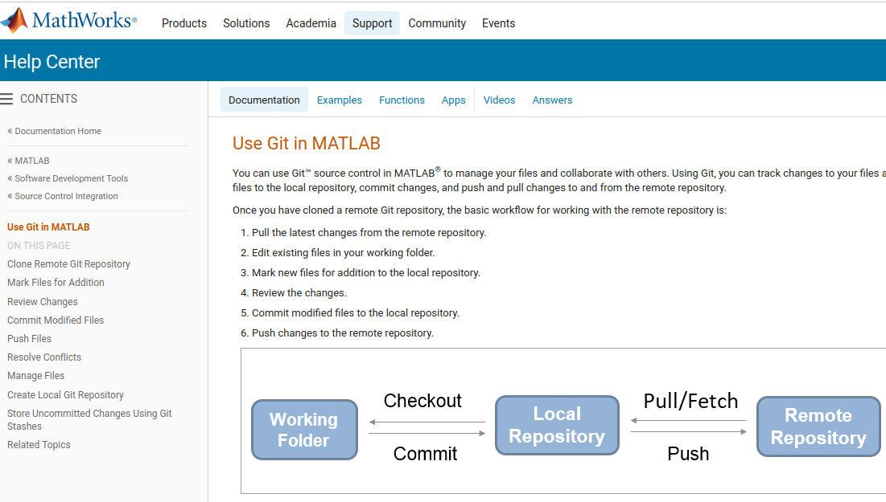
IDE Integration
Source control
Git is supported in all major IDEs
Matlab, PyCharm, VSCode (Source Control, Gitlens, GitHub, GitHub Copilot), …
Check the Documentation and PLugins for your IDE
Git Lens
GitHub
Image Credit: My own work (Tim Schäfer)

Slide 79
Outlook: Git Features and Topics Not Discussed Yet
Hooks
Automate things, e.g., run custom code after each commit
Submodules
Linking to another repo within yours
Git Servers
How to run your own, on-premises or in the cloud
Interaction with other VCSs and Services
E.g., synchronization to SVN, Jenkins, …
Large file support (LFS)
Store large files in git without slowing down your workflow
…

Slide 80
THANKS!
Any questions?

Slide 81
CREDITS
Examples and many figures from the Git Pro Book, License: Creative Commons CC BY-NC-SA 3.0
Presentation made with Google Slides
Presentation template "Technology Pixels" by SlidesCarnival, License: Creative Commons CC BY 4.0
https://www.slidescarnival.com/mowbray-free-presentation-template/1932

Slide 82
License
The content on these slides (my work, mostly a remix of the Git Pro book) is licensed under the following license:
Creative Commons CC BY-NC-SA 3.0
https://creativecommons.org/licenses/by-nc-sa/3.0/
Note that some figures are other people's work, and are under different (open!) licenses. See each slide / figure for the respective author and license. You can assume that figures without attribution were created by me, and are covered by the CC BY-NC-SA 3.0 license mentioned above.

