Slide 1

You Mad Bro?
A Twitter sentiment analysis
By: Darius Fuller

Slide 2



The Task & Goal
Create a model that can ‘read’ tweets
Detect sentiment:
Positive
Negative
Neutral
Gain insight on how public views your ‘product’
Can help understand behavior online

Slide 3
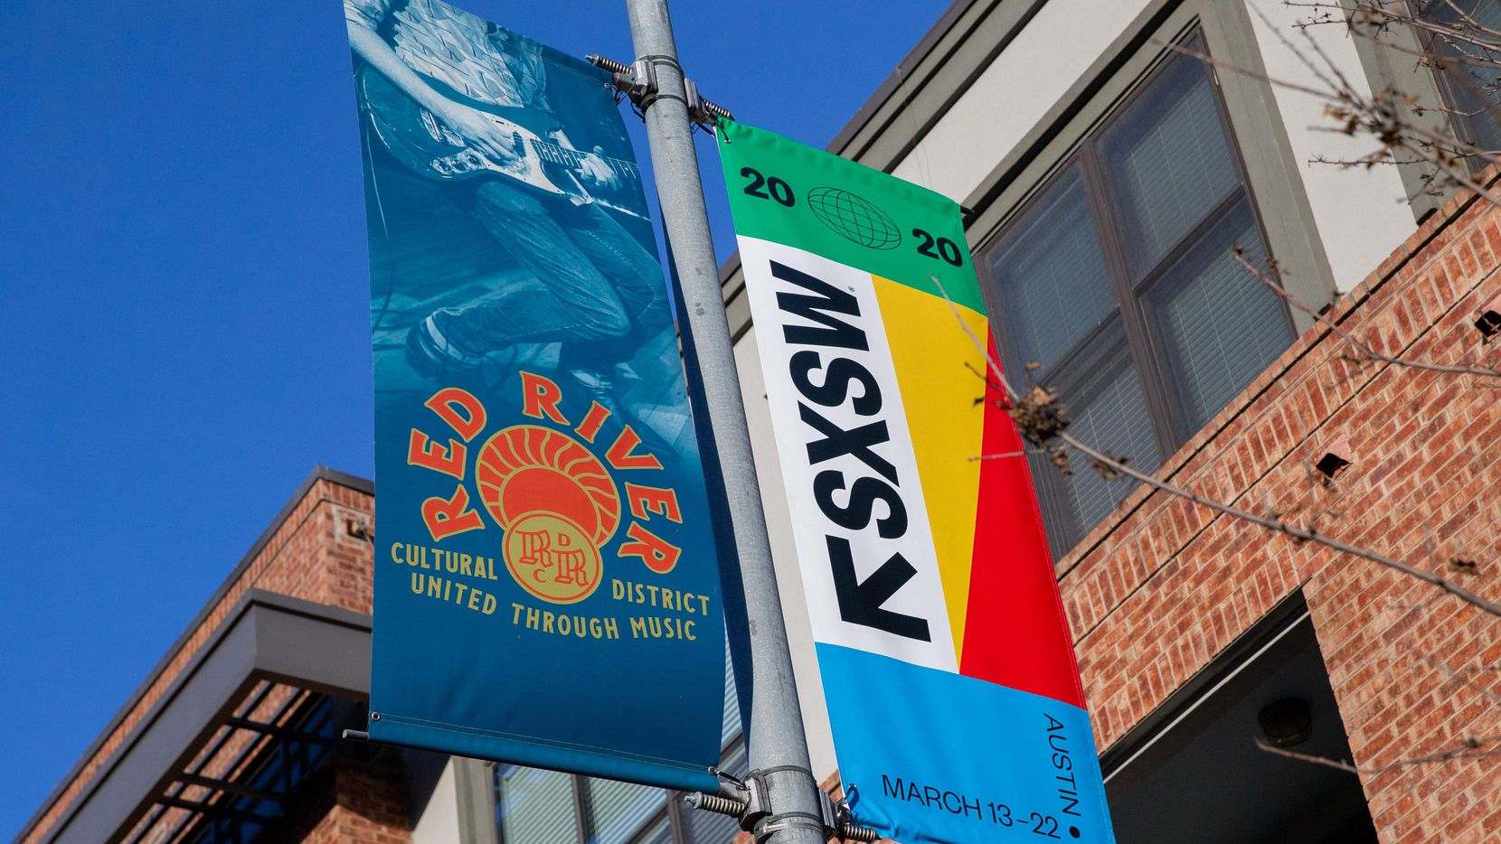
The Dataset
‘Brands and Product Emotions’
Data.world via Crowdflower
Asked if the tweet expressed emotion:
Towards a brand and/or product
What kind of emotion?
Over 9,000 tweets
~60% were neutral

Slide 4

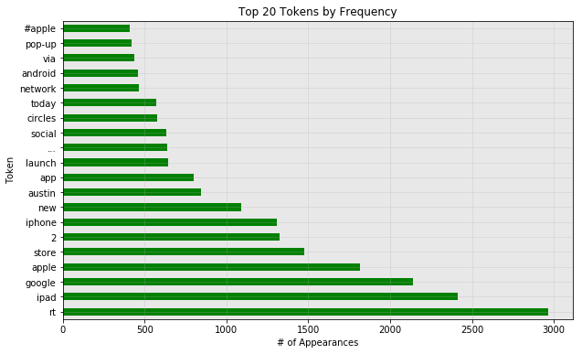
The Dataset - Explored
Entire Dataset:

Slide 5
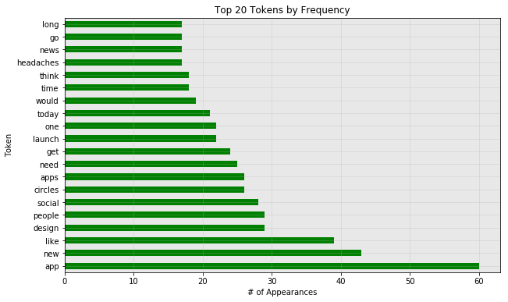
The Dataset - Explored
Negative Tweets:

Slide 6
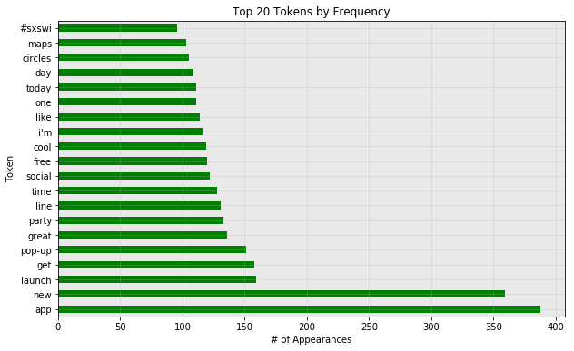
The Dataset - Explored
Positive Tweets:

Slide 7
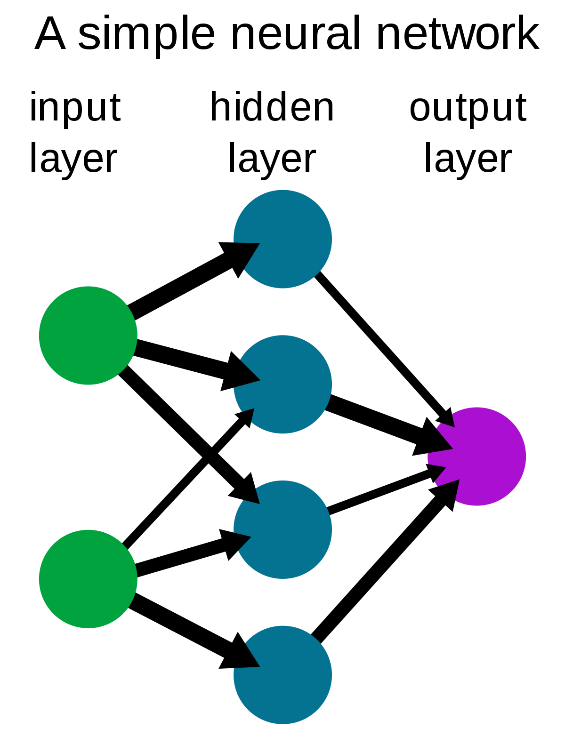
The Tools
Deep Learning with Natural Language Processing
Model ‘learns’ from ‘reading’ inputs
Make predictions
Keras/Tensorflow from Google
Cutting-edge modeling
More common for these tasks

Slide 8

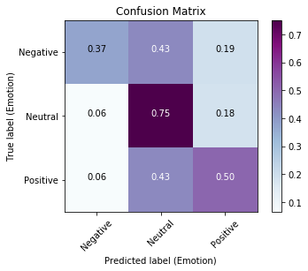
Results pt. 1
Final model achieved 65% overall accuracy
Any predictions likelihood of being correct
Considerably better than random chance (33%)
Intra-class accuracy (recall):
Negative = 37%
Neutral = 75%
Positive = 50%

Slide 9
Results pt. 2
Each cell:
The corresponding % of possible predictions made for this label
Each row totals to 100%
Ex:
75% of the available ‘Neutral’ tweets were correctly predicted to be so

Slide 10

Recommendations
This model is best used in a binary sense
It can be used to help filter ‘Neutral’ tweets
At the cost of 43% loss of non-neutral tweets (per class)
The rest is likely non-neutral
Can help sift through large amounts of tweets before humans
With 75% intra-class accuracy, can have humans look over rest
People care about time and money
Free is better!
Time is money

Slide 11
Future Works
More Data!
More to train with, more learning (generally)
More time with different Neural Network architectures
Unlimited amount of combinations available
Standard Machine Learning methods
Classifier such as RandomForest or Logistic Regression

Slide 12

Thank You!
Notes:
https://images.app.goo.gl/8iXCxbdMQcAsC1Wy9

