Slide 1

Module 3 Project Executive Summary
By Darius Fuller
Part-time cohort 100719
Notes:
Change the title! Have fun with it.

Slide 2
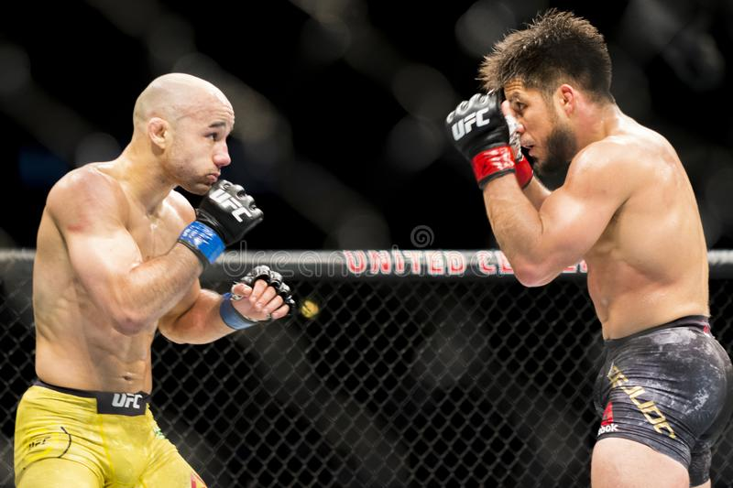
Target & Goal
Investigating whether I can create a machine learning model to predict the outcome of a UFC fight.
The ideal output will be a value representing the likelihood that either fighter will win.
The goal is that the model achieve the correct winner with 80% accuracy
Notes:
Take out the 80%.

Slide 3

The dataset
The dataset I used in this project is found at: https://www.kaggle.com/rajeevw/ufcdata
There are:
145 features and over 5000 rows
Details from every UFC fight up until June of 2019
There is information about:
Fighter's Win/Loss/Draw record prior to fight
Fighter's method of winning fights
Fighting stance and physical attributes
Pre-calculated averages covering:
Significant strikes
Submissions
'Passing' on the ground
etc.

Slide 4
The process - preprocessing
Filling missing values
Replacement
Removal
Creating the target
Draw, Win (Blue corner), Win (Red corner)
Notes:
Filling values isn’t completely necessary

Slide 5
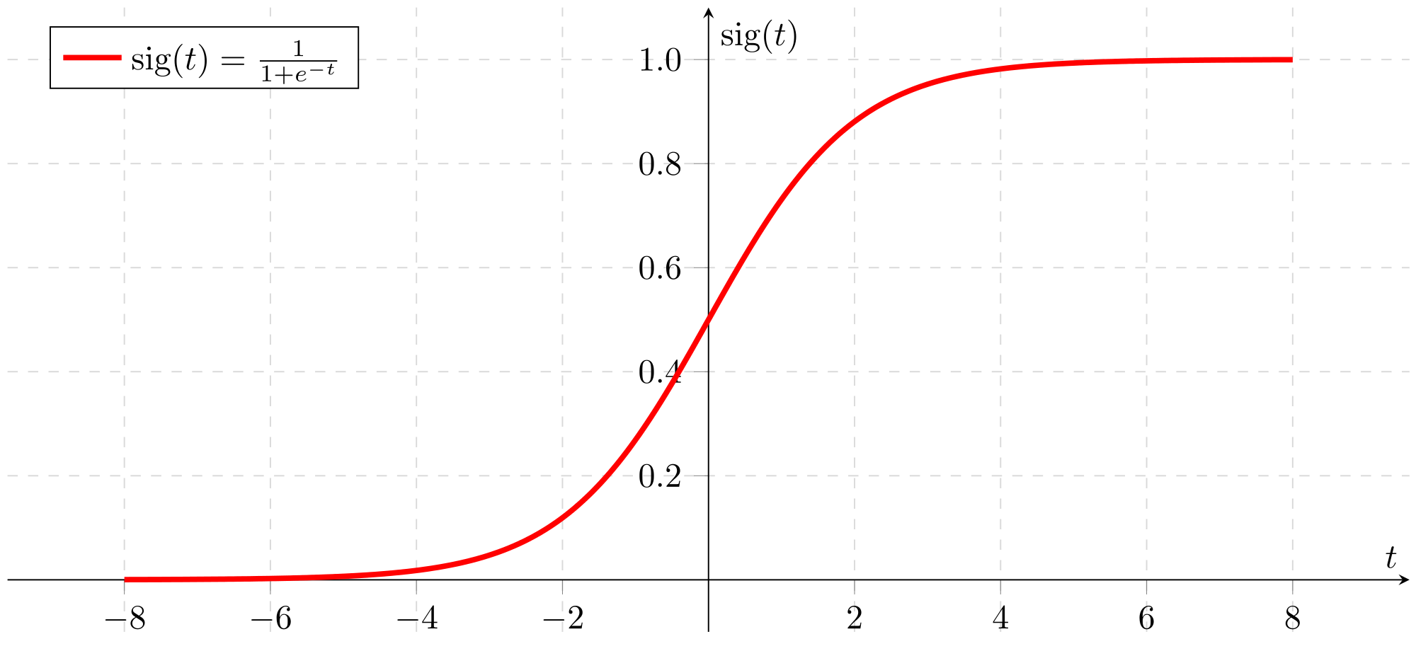
The process - modeling
What is a model?
An algorithm that “learns” and makes “decisions”
Tried seven during this process
Logistic Regression model
Makes a choice based on probability

Slide 6
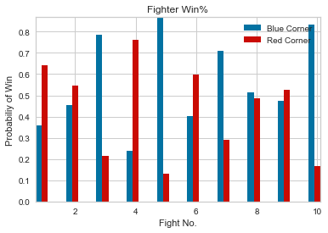
The results
My model fell short of my 80% accuracy goal
The best model performed at 66% accuracy
Successful at producing probabilities for each fighter

Slide 7
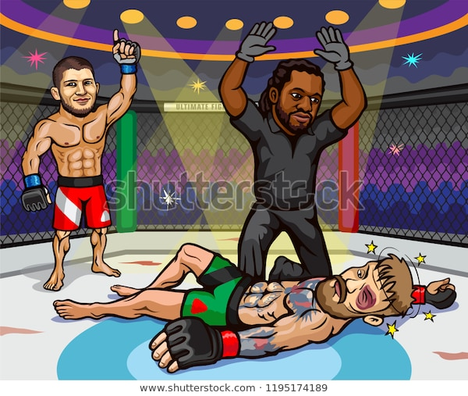
recommendation
Given my results, I recommend using the model I have created to show probabilities
Currently, it is too unreliable to make strong predictions
Can provide knowledge in terms of “how likely”
The closer the two are, easier it is to swing
Notes:
Add actionable recommendations and info about coeff

Slide 8

Future work(s)
More time working preprocessing
Find out how helpful AVGs are in prediction
Create a feature for 1st time UFC fighters
Find other metrics to add-in
Model tuning
Take time to combine more than one model (ensemble)
Play with model parameters longer

Slide 9
Thank you!

