Slide 1

The Tale of the tape: can you measure victory?
By Darius Fuller
Part-time cohort 100719

Slide 2
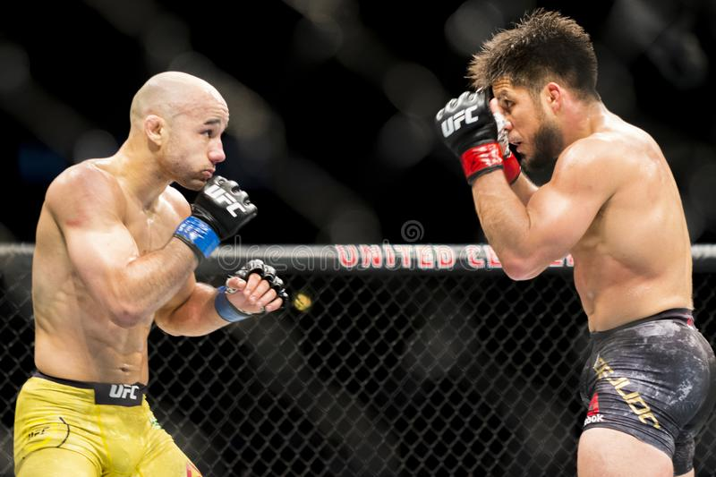
Target & Goal
Investigating whether I can create a machine learning model to predict the outcome of a UFC fight.
The ideal output will be a value representing the likelihood that either fighter will win.
The goal is that the model perform better than random chance (50% accuracy)
Notes:
Take out the 80%.

Slide 3

The dataset
The dataset I used in this project is found at: https://www.kaggle.com/rajeevw/ufcdata
There are:
145 features and over 5000 rows
Details from every UFC fight up until June of 2019
There is information about:
Fighter's Win/Loss/Draw record prior to fight
Fighter's method of winning fights
Fighting stance and physical attributes
Pre-calculated averages covering:
Significant strikes
Submissions
'Passing' on the ground
etc.

Slide 4

The process – the target
Creating the target
3 possible results:
Draw
Win (Blue corner)
Win (Red corner)
Can provide knowledge to:
Trainers / Fighters
Advertisers / TV Networks / Promoters
Combat sports organizers (e.g. UFC)
Notes:
Move ‘Can provide Knowledge’ from recommendation slide here and replace it with actionable insights on rec slide.

Slide 5
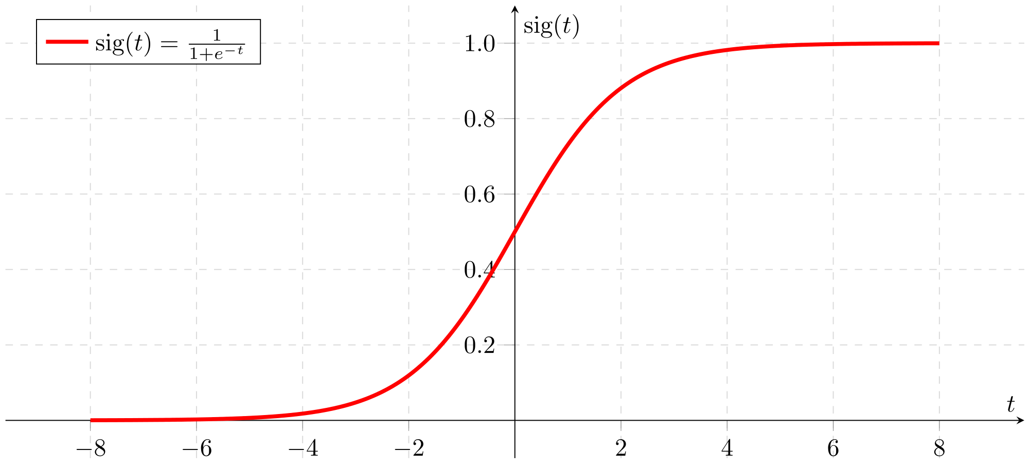
The process - modeling
What is a model?
An algorithm that “learns” and makes predictions
Tried seven different kinds during this process
Logistic Regression model
Single value output
Each feature carries a “weight”
Notes:
Think of logreg as a ‘simple’ function that has multiple coefficients that result in a value between 0 and 1. The value more or less represents the probability that the input falls into the positive category.

Slide 6
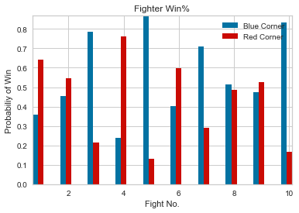
The results
The best model performed at 66% accuracy!
Successful at producing probabilities for each fighter

Slide 7
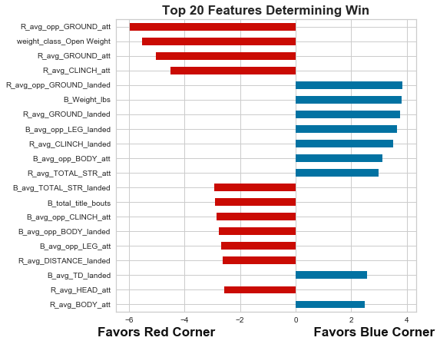
The results – What matters?
Top 20 values taken from final model
Ground game is important! (green dots)
Working the clinch/space control (purple dots)
Diversify your striking plan (orange dots)
Experience can help or hurt (pink dots)
Staying elusive and executing plan is key
Physical dominance always helps (cyan dots)
Open weight fights allow for cross-weight bouts
Notes:
Add title, axis labels to plot explain x-axis directions. Add feature names in () to bullet points. Add explicit

Slide 8

recommendations
Given my results, I recommend using the model to show probabilities primarily
Show before a fight along with basic info for fighters
Never ignore the ground game or the clinch, maintaining control of spacing is crucial
No evidence of a “one trick pony”
Regulating weight classes is important to keeping fights competitive

Slide 9

Future work(s)
More time working preprocessing
Find out how helpful AVGs are in prediction
Create a feature for 1st time UFC fighters
Find other metrics to add-in
Model tuning
Take time to combine more than one model (ensemble)
Play with model parameters longer

Slide 10
Thank you!

