Slide 1

The Tale of the tape: can you measure victory?
By Darius Fuller
Part-time cohort 100719

Slide 2
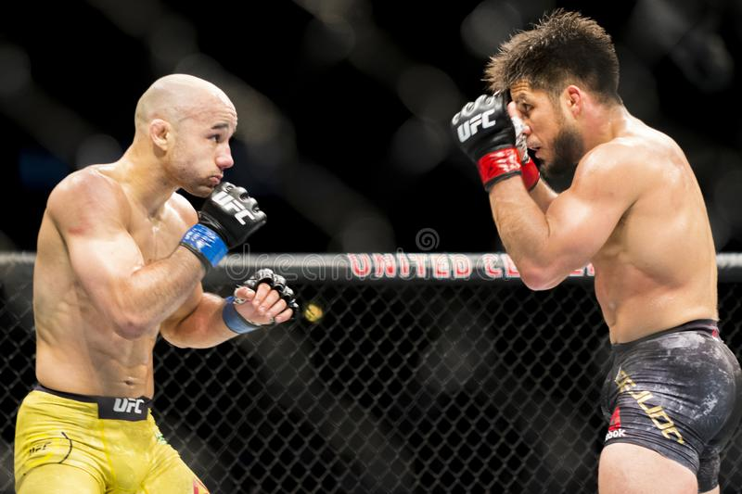
Target & Goal
Investigating whether I can create a machine learning model to predict the outcome of a UFC fight.
The ideal output will be a value representing the likelihood that either fighter will win.
The goal is that the model perform better than random chance (50% accuracy)
Notes:
Take out the 80%.

Slide 3

The dataset
The dataset I used in this project is found at: https://www.kaggle.com/rajeevw/ufcdata
There are:
145 features and over 5000 rows
Details from every UFC fight up until June of 2019
There is information about:
Fighter's Win/Loss/Draw record prior to fight
Fighter's method of winning fights
Fighting stance and physical attributes
Pre-calculated averages covering:
Significant strikes
Submissions
'Passing' on the ground
etc.

Slide 4
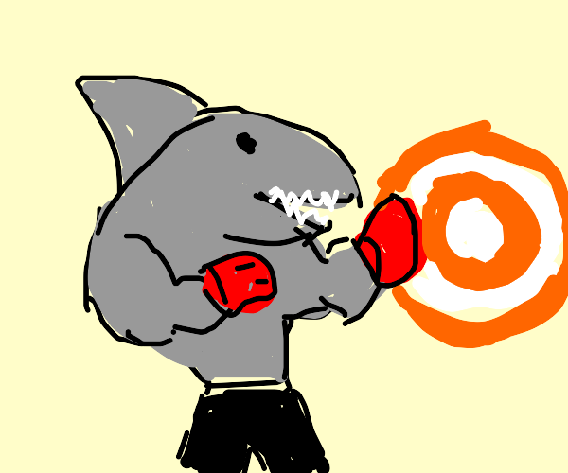
The process – the target
Creating the target
3 possible results:
Draw
Win (Blue corner)
Win (Red corner)

Slide 5
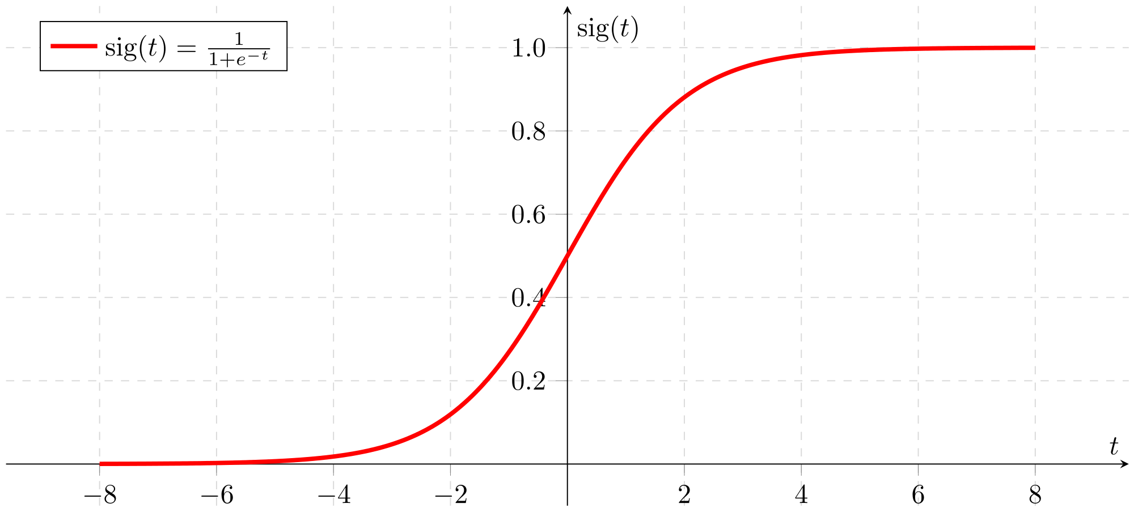
The process - modeling
What is a model?
An algorithm that “learns” and makes predictions
Tried seven different kinds during this process
Logistic Regression model
Single value output
Each feature carries a “weight”
Notes:
Think of logreg as a ‘simple’ function that has multiple coefficients that result in a value between 0 and 1. The value more or less represents the probability that the input falls into the positive category.

Slide 6
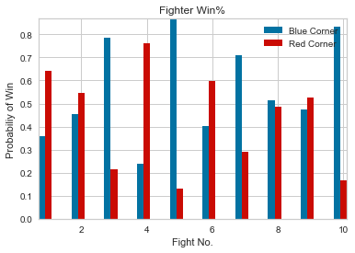
The results
The best model performed at 66% accuracy!
Successful at producing probabilities for each fighter

Slide 7
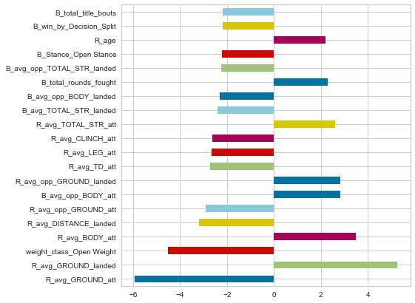
The results – What matters?
Top 20 values taken from final model:
The older/more weathered your opponent is
The more you’ve “finished”
The more you can stay elusive
The more you can stay active
The more in ring experience you have
Staying safe of course
Negative number favors Red to win
Positive number favors Blue to win

Slide 8
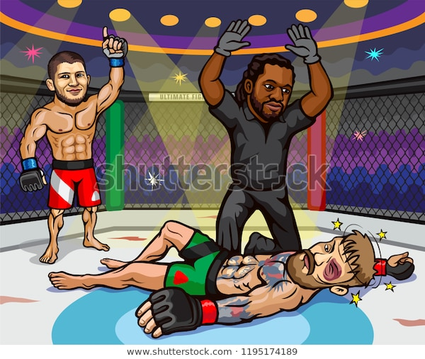
recommendations
Given my results, I recommend using the model I have created to show probabilities primarily
Currently, it is too unreliable to make strong predictions
Can provide knowledge to:
Trainers / Fighters
Advertisers / TV Networks / Promoters
Combat sports organizers (e.g. UFC)
Notes:
Add actionable recommendations and info about coeff

Slide 9
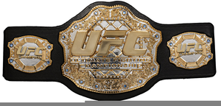
Future work(s)
More time working preprocessing
Find out how helpful AVGs are in prediction
Create a feature for 1st time UFC fighters
Find other metrics to add-in
Model tuning
Take time to combine more than one model (ensemble)
Play with model parameters longer

Slide 10
Thank you!

