Slide 1






Using LibreOffice Draw as a Sticky Note Whiteboard

Slide 2
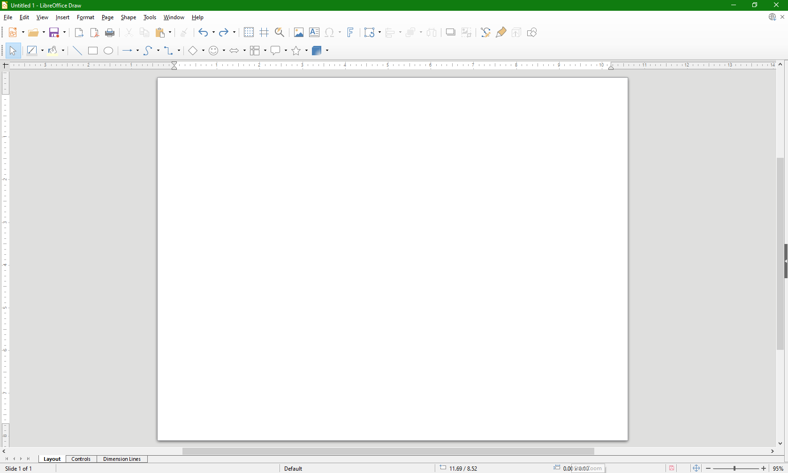


Setup
Create a note in a desired shape, size, color and font.
Copy the note and immediately paste it several times. Each new paste will be in the same position, resulting in a stack of notes.
Drag & drop the top note to a new position to start a new stack.
Select a different color for the dropped note.
Repeat step 2 to create the new stack.
Repeat steps 3 through 5 for other color note stacks as needed.
Once set up, the document may be saved as a template for repeated future use.

Slide 3
With everything set up, the notes can then be used like sticky notes to plan things out. Grab blank notes off of the stacks as things come to mind, drop them where desired, and write thoughts about those things…
Write some site content
Figure out what to write about
Implement site in HTML & CSS
…arrange the notes to organize the thoughts…
Implement content and organization in HTML
Implement site decorative style in CSS
Upload the site content
Figure out site organization
…and add or delete notes when needed.
Finally, remember to save the document with all of the notes for future reference!

Slide 4
Thanks For Viewing!
Attribution
The large LibreOffice Draw icon image on Slide 1 is a derivative of "File:LibreOffice 6.1 Draw Icon.svg" by The Document Foundation which is licensed under CC BY-SA 4.0.
Using LibreOffice Draw as a Sticky Note Whiteboard – Copyright © 2022 David Yockey
This document is licensed under CC BY-SA 4.0.

