Slide 1
DATA STRUCTURES AND ALGORITHMS using Java Course Introduction

Slide 2
Objectives
Instructor introduction
Course description
Text book(s) & Reference Recourses
Learing Tools
Requirements of the course
Grading policy
Academic policy

Slide 3
Instructor introduction
Name: Thân Văn Sử
Email: sutv@fpt.edu.vn
Your email should be used when sending me an email: @fpt.edu.vn

Slide 4
Course description
This course introduces the fundamental concepts of data structures and the algorithms that proceed from them. Topics include the basics of algorithmic analysis, fundamental data structures (including linked lists, stacks, queues, trees, hash tables), recursion, and some important applications of these data structures and algorithms.
Such data structures and algorithms as being implemented in Java are also given in this course.
Program
Data
Code
What should data structures be used to maintain problem’s data?

Slide 5
Text book(s) & Reference Recourses
Main books/resources:
1) Michael T. Goodrich, Roberto Tamassia, Michael H. Goldwasser: Data Structures and Algorithms in Java, 6th Edition, 2014 (eBook)
2) Link to the book: http://coltech.vnu.edu.vn/~sonpb/DSA/Data%20Structures%20and%20Algorithms%20in%20Java,%206th%20Edition,%202014.pdf
3) FU slides (ppt)
4) FU exercises (pdf)
5) Code files for students (java files)
6) FU CMS at http://lms-undergrad.fpt.edu.vn.

Slide 6
Objectives
Knowledge
The connection between data structures and their algorithms, including an analysis of algorithms' complexity
Data structures in the context of object-oriented program design
How data structures are implemented in an OO programming language such as Java

Slide 7
Objectives
Skills
Organize and manipulate basic structures: array, linked list, stack, queue, tree, heap, graph, heap, hash table.
Use algorithms for traversing, sorting, searching on studying structures
Select a suitable algorithm to solve a practical problem
➔ From problem description, you can decide what data structure must be used to store related data and why you choose this structure?

Slide 8
Objectives
Skills
Use JAVA programming language for solving some problems
Use NetBean/Eclipse tool for developing programs in JAVA
Implement some programs in JAVA to solve practical problems based on the studying algorithms

Slide 9
Learning Tools
JDK 1.7
JDK 1.7 Documentation
NetBeans 7.x

Slide 10
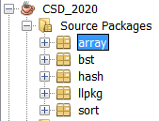
Requirements of the course
Following lessons in classrooms
Reading textbooks at home
Completing workshops in time
Completing and submitting assignment in time
Discussing actively in your teams and in classrooms
Presenting your presentations in classroom
All exercises are put in an only one project, exercises of each chapter are put in a package.

Slide 11
Grading policy
On-going assessment: - 2 Assignments (AS): 20% - 2 Progress tests (PT): 20%
Practical and Final Exams: - 1 Practical Exam (PE): 30% - 1 Final Exam (FE): 30%
Total score (TS) = 0.2*AS + 0.2*PT + 0.3*PE + 0.3*FE
Completion Criteria: 1) Every on-going assessment (average) component > 0 2) PE > 0 (no resit) 3) FE >= 4 & TS >= 5

Slide 12
FPT-University Academic policy
Cheating, plagiarism and breach of copyright are serious
offenses under this Policy.
Cheating
Cheating during a test or exam is construed as talking, peeking at another student’s paper or any other clandestine method of transmitting information.
Plagiarism
Plagiarism is using the work of others without citing it; that is, holding the work of others out as your own work.
Breach of Copyright
If you photocopy a textbook without the copyright holder's permission, you violate copyright law.

Slide 13
Tâm Tình
Chúng ta sẽ ở đâu trong bản đồ nghề nghiệp IT sau ba/bốn năm nữa?
Liệu chúng ta có đủ sức để ra trường không?
Tất cả đều phụ thuộc vào kiến thức và kỹ năng code của chúng ta thế nào?
Những yêu cầu để ra trường và đi làm:
Năng lực thiết kế dữ liệu
Năng lực chọn và đánh giá giải thuật
Năng lực hiện thực giải thuật ← Kỹ năng code
➔ Môn học này giúp các bạn cải thiện các năng lực này

Slide 14
Quy định về Đánh giá tại lớp
Các bài tập có hướng dẫn đầy đủ bảo đảm ai cũng làm được → Không cần lấy bài của khóa trước hay của bạn→ Có làm có ăn → Có cố gắng sẽ giỏi hơn và thành công.
Điều chúng ta không mong đợi: Bị phát hiện gian dối khi đánh giá:
→ 0 cho bài đó và trừ 50% cho bài sau.
Rất mong mọi sinh viên đều hứa sẽ tự giác, trung thực để chúng ta có thể sống với niềm tin là xã hội này còn tốt đẹp. Chúng ta cùng nhau cố gắng nhé.

Slide 15
Review
What is a problem?
A situation in which something is hidden.
What is algorithm?
A set of operations for finding down result of a problem – Hidden data is found.
Expectations on an algorithm:
Space (memory): small
Time consuming: short
Two requirements are usually opposing – đối kháng
Why?

Slide 16
Review
One problem may be solved by some algorithms.
Which of them should be chosen?
Space consuming/ memory size needed
Time cost
How to evaluate time cost of an algorithm?
Time cost, complexity, of an algorithm can be expressed using a function of number of input. It is a non-decreasing function.
How to measure time cost in experimental practical view?
How to find out complexity function?

Slide 17
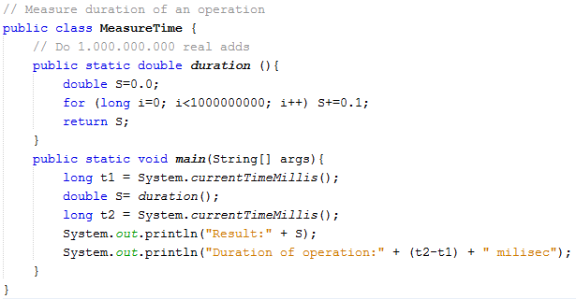
Evaluating algorithm: Experimental Practice View

Slide 18
Evaluating algorithm: complexity function
Basic operations: Comparisons, assignments, basic math operations + - * /
Each basic operation is evaluated as an execution unit
Based on counting basic operations, the complexity function is determined.
Basic operations in a specific algorithm:
Searching x in an array → comparisons
Computing sum of an array → Adding
Determining the maximum/ minimum value in an array → Comparisons.
Sorting an array → Assignments

Slide 19
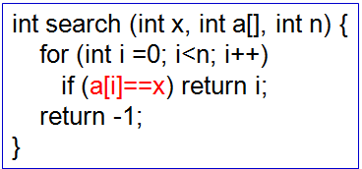
Evaluating algorithm: Complexity function
A demonstration: Linear searching x in an array of n integers. → Main operation is a comparison.
i | 0 | 1 | 2 | 3 | 4 | … | n-1
a[i] | 5 | 2 | 1 | 6 | 4 | … | 20
x | Comparisons | Evaluation | Complexity
5 | 1 | The best case | t(n) = 0*n + 1
2 | 2 |  | t(n) = 0*n + 2
1 | 3
6 | 4
4 | 5
… | …
20 | n | The worst case | t(n) = n
Sum | (n+1)*(n/2)
Avg. | (n+1)/2 | Average case | t(n) = (n+1)/2
The case is concerned is the worst case in which n is a large number (large scale problem)

Slide 20
Evaluating algorithm: Mathematical View Big O, Big omega, Big theta Notations
In general, basic functions ( n, n²,…, log(n), n!,…) are used to describe a algorithm’s complexity and all constants are omitted.
t
g2(n), basic function
Upper bound
g1 (n),
basic function
0*n + constant <= t(n) <= 1*n
g1(n) = g2(n) = n
Ω(n) <= t(n) <= O(n)
t belongs to Ɵ(n)
Lower bound
n
a₁g₁(n) <= (t(n) <= a₂g₂(n)
Ω(g₁(n)) <= t(n) <= O(g₂(n)) upper bound
If g₁(n)=g₂(n), t belongs to Ɵ(g(n))

Slide 21
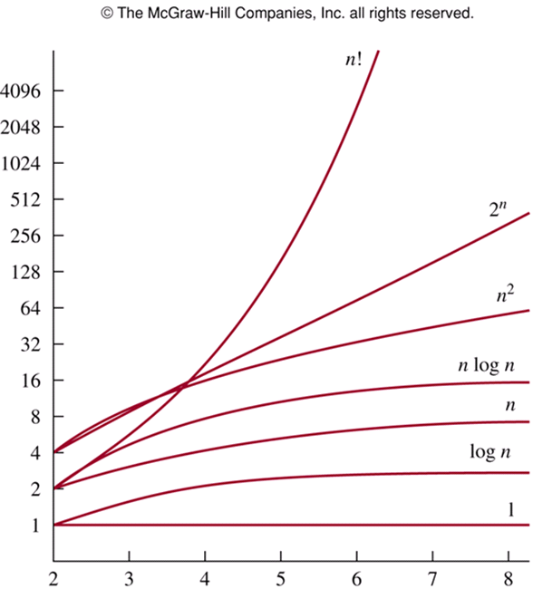
Evaluating algorithm: Mathematical View Big O, Big omega, Big theta Notations
Both algorithm 1 and algorithm 2 solve the same problem.
Algorithm 1 should be chosen if O(t1(n)) < O(t2(n))
Growths of basic functions
Notes:
Big- O notation is used to estimate the number of operations needed to solve a problem using a specified procedure or algorithm. The functions used in these estimates often include the following: 1, logn, n, nlogn, n², 2^{n}, n!
If n is large enough, 1 < logn < n < nlogn < n² < 2^{n} < n!
Note that (logn)¹⁰⁰ < n^{1/2} for large values of n. So, (logn)¹⁰⁰ is O(n^{1/2}).

Slide 22
Bài tập
F(n) = n³ + 6n² +7 <= n³ + 6n³ + 7n³ <= 14n³ → O(n³)
F(n) = n³/8 + 6n² +7 → O(?)
F(n) = n + log(n) <= n + n <= 2n→ O(n)
F(n) = log(n) + 1000000 → 1000000xO(1) → O(1)
Hai giải thuật cho cùng một mục đích có hai hàm chi phí:
GT1: F(n) = 8n² – 2000n -7 → O(n²)
GT2: G(n) = 6nlog(n) + 8000 → O(nlogn)
Giải thuật nào tốt hơn?

Slide 23
Evaluating algorithm: Code View
How to find Big O in codes?
Each simple statement (assignment, comparison, function call) is an execution unit.
We can see on loops to determine Big O of a specific code.
Example: for (i=0; i<n; i++) input a[i]; → O(n)
An assignment is an execution unit
A comparison is an execution unit
An access on a device is an execution unit

Slide 24
Evaluating algorithm: Code View
How to find Big O in codes: Adding Principle
Nếu một giải thuật bao gồm 2 bước rời nhau, bước 1 có O(f(n), bước 2 có O(g(n)) thì giải thuật có O(max(f(n),g(n))
Discrete Mathematic
for (i=0; i<n; i++)
nhập a[i];
S=0;
for (i=0;i<n;i++)
S += a[i];
for (i=0; i<n; i++)
xuất a[i];
Chặn trên của i là n → Bước này: O(n)
Chặn trên của i là n → Bước này: O(n)
Chặn trên của i là n → Bước này: O(n)
Complexity = O(max (n,n,n)) = O(n)

Slide 25
Evaluating algorithm: Code View
How to find Big O in codes: Multiply principle
Nếu một giải thuật cần lặp nhiều lần với độ phức tạp O(f(n)), mỗi bước lặp lại có độ phức tạp O(g(n)) thì giải thuật có O(f(n).g(n))
Discrete Mathematic
for (i=0; i<n-1; i++) {
for (j=n-1; j>I; j---) {
if (a[j] < a[j-1])
Hoán vị (a[j], a[j-1])
{
}
Chặn trên của i là n → Bước này: O(n)
Chặn trên của j là n → Bước này: O(n)
Complexity = O(n x n)) = O(n²)

