Slide 1
Linked Structure & Linked Lists
Lecturer: Thân Văn Sử

Slide 2
Learning Outcomes
LO1.1 Demonstrate the list data structure with basic operations: insert, remove, edit, search, sort,...
LO1.2 Explain two ways of implementing a list: using arrays and using linked lists.
LO1.3 Write programs to implement the singly linked list with basic operations: add (last, first, before, after, at position), search, edit, remove, reverse, sort... )
LO1.4 Understand the doubly linked-list data structure with basic operations.
LO1.5 Write code snippets which manipulate operations on doubly linked list, and use diagrams to illustrate the effect.
LO1.6 Describe the circularly linked-list data structure with some basic operations like add, remove.
LO1.7 Explain why the Java code library provides the ArrayList and LinkedList classes

Slide 3
Contents
1- Basic operations on a group
2- Drawbacks of arrays
3- Introduction to Linked Data Structure
4- Linked List
Singly Linked Lists
Double Linked Lists
Circular Linked Lists
5- Basic Operations on Singly Linked Lists
6- Demonstration
7- Managing groups using the Java API
8- When linked Lists are used?
Summary
Assignment: Re-implement demonstrative algorithms in this lecture

Slide 4
1- Basic operations on a group
Add new element
Search an element
Remove an element
Traverse all elements
Update an element ← Search + re-assign new value
Sort

Slide 5
2: Review on Arrays
Array is a group of elements (nodes)
which belong to the same data type
They are stored in contiguous memory blocks
Each element can be accessed using its positional index.
0 | 1 | 2 | 3 | 4 | 5 | 6 | 7 | 8 | 9
9 | 3 | 1 | 6 | 7 | 8 | 8 | 5 | 6 | 4
a
No empty block is allowed!!!
MAXN=15
n = 10

Slide 6
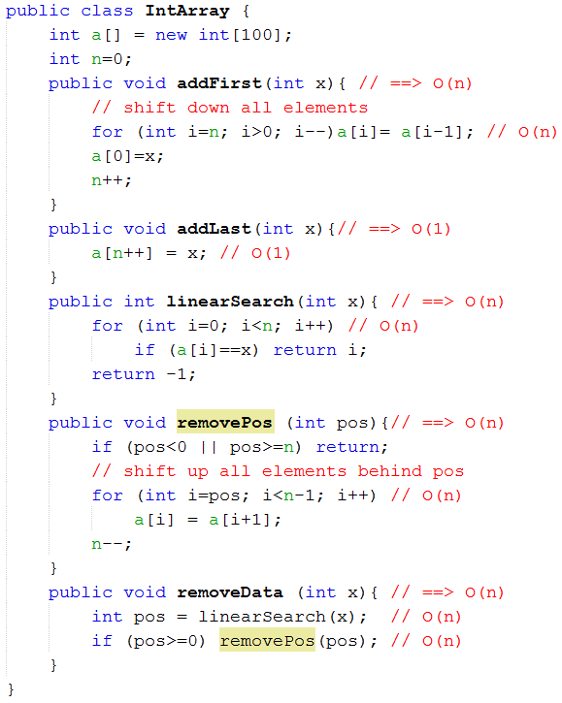
2: Review on Arrays
Memory for elements must be allocated in advance.

Slide 7
2: Review on Arrays
Expectations:
Operation | Complexity | Expectation
Memory allocation | Allocated memory size can be redundant/ lack | To optimize memory use, memory for storing elements will be allocated when needed.
Add x to the end | O(1) → Good
Add x to the position pos | O(n) | < O(n)
Search x | O(n) | < O(n)
Remove element at the position pos | O(n) | < O(n)
Linked Data Structures are introduced.

Slide 8





3: Linked Data Structures
Linked Data structure: A data organization in which each node includes itself data and links to others.
Linear data structure: Links establish only one line to access elements ← Array, linked lists
400
1000
3000
8000
200
10000
Jame
Linda
Jane
Tom
Jack
Paul
42
25
10
22
22
8
Manager
Officer
student
student
Designer
Kid
1000
3000
8000
200
10000
0 (NULL)
Element
structure
name
Info of an element
age
role
next
next

Slide 9
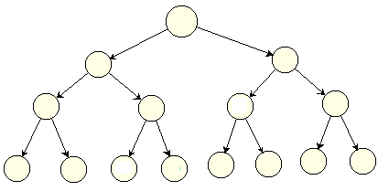
3: Linked Data Structures
Linked Data structure: A data organization in which each node includes itself data and links to others.
Non linear data structure: Links establish multiple lines to access elements ← Trees

Slide 10
4: Linked Lists
Linked list: A group of nodes, each node contains its data and links to others. Links form a linear path to access elements.
700
1000
800
400
600
head: 700
obj1
obj2
obj3
obj4
obj5
Singly Linked list
(SLL)
tail: 600
1000
800
400
600
null
700
1000
800
400
600
head: 700
obj1
obj2
obj3
obj4
obj5
Circularly Singly
Linked list
tail: 600
1000
800
400
600
700
Object data
head
Item
List
Item next
tail

Slide 11
4: Linked Lists…
Linked list: A group of nodes, each node contain its data and links to others. Links form a linear path to access elements.
700
1000
800
400
600
head: 700
obj1
obj2
obj3
obj4
obj5
Doubly Linked list
tail: 600
1000
800
400
600
null
null
700
1000
800
400
700
1000
800
400
600
head: 700
obj1
obj2
obj3
obj4
obj5
Circularly Doubly
Linked list
tail: 600
1000
800
400
600
700
600
700
1000
800
400
Object data
head
Item
List
Item next
tail
Item previous

Slide 12
5: Operations on SLL
Add data x to the beginning of SLL
Item p = new Item(x);
if (head==null) head=tail = p;
else {
p.next = head;
head = p;
}
p = 700
x
null
Complexity: O(1)
head: null → 700
tail: null → 700
p = 700
1000
800
400
600
x
obj1
obj2
obj3
obj4
null→1000
800
400
600
null
head: 1000 → 700
tail: 600

Slide 13
5: Operations on SLL…
Add data x to the end of SLL
Item p = new Item(x);
if (head==null) head=tail = p;
else {
tail.next = p;
tail = p;
}
p = 700
x
null
Complexity: O(1)
head: null → 700
tail: null → 700
1000
800
400
600
p = 700
obj1
obj2
obj3
obj4
x
800
400
600
null → 700
null
head: 1000
tail: 600 → 700

Slide 14
5: Operations on SLL…
Add data x to the position after the reference ref of SLL
if (ref==tail) Add x to the end of the list;
else {
Item p = new Item(x);
p.next = ref.next;
reft.next = p;
}
p = 700
x
null
Complexity: O(1)
head: null → 700
tail: null → 700
1000
800
ref= 400
600
obj1
obj2
obj3
obj4
800
400
600 → 700
null
p = 700
x
head: 1000
tail: 600
null → 600

Slide 15
5: Operations on SLL…
Search the first existence of data x in the SLL
If (head==null) return null;
for (Item t = head; t!=null; t = t.next)
if (t.data==x) return t;
return null;
Linear search → O(n)
x= 8
t= 1000 → 800 → 400 → 600
1000
800
400
600
700
head: 1000
7
6
5
8
30
tail: 700
800
400
600
700
null

Slide 16
5: Operations on SLL…
Remove the first existence of data x in the SLL
If (head==null) return null;
Item tAfter = null, tDel = head;
// Determine the reference which can be removed
While (tDel!=null && tDel.data!=x) {
tAfter=tDel;
tDel = tDel.next
}
// If removed data existed
If (tDel != null) {
if (tDel==head) { // remove head
head = head.next;
if (head==null) tail= null; // if the list is empty
}
else {
tAfter.next = tDel.next;
if (tDel==tail) tail= tAfter; // update tail
}
}
return tDel;
x= 8
tAfter= null → 1000 → 800 → 400
tDel= 1000 → 800 → 400 → 600
1000
800
400
600
700
Linear search
→ O(n)
7
6
5
8
30
800
400
600
700
null
→700
head: 1000
tail: 700

Slide 17
5: Operations – Attention!
Operations on doubly linked lists (DLL) and circular linked lists (CLL)
They are similar to operations on SLL
Pay attentions:
Update the reference previous in DLL
In CLLs, the tail item links to the head item.
700
1000
800
400
600
head: 700
obj1
obj2
obj3
obj4
obj5
Doubly Linked list
tail: 600
1000
800
400
600
null
null
700
1000
800
400
700
1000
800
400
600
head: 700
obj1
obj2
obj3
obj4
obj5
tail: 600
1000
800
400
600
700

Slide 18
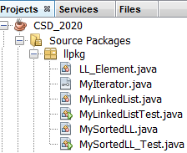
6- Demonstration
Package Structure
Class for an element in a doubly linked list
Interface for traversing elements in the list
Class for a doubly linked list
Program will test the MyLinkedList class
Class for a sorted doubly linked list
Program will test the MySortedLL class

Slide 19
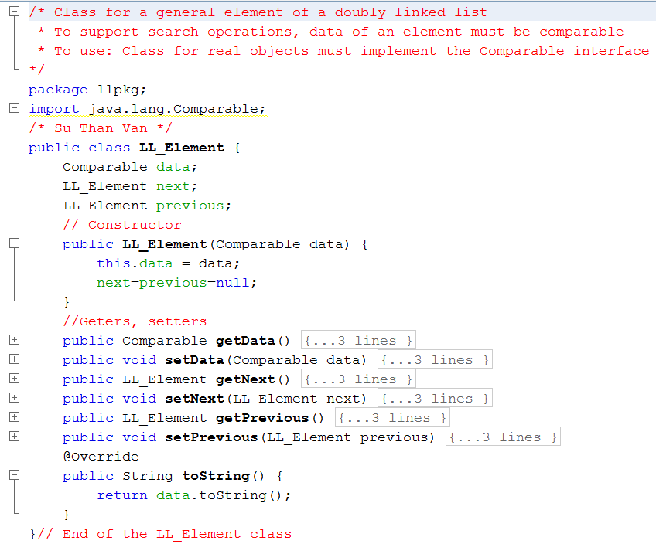
6- Demonstration: Class LL_Element

Slide 20
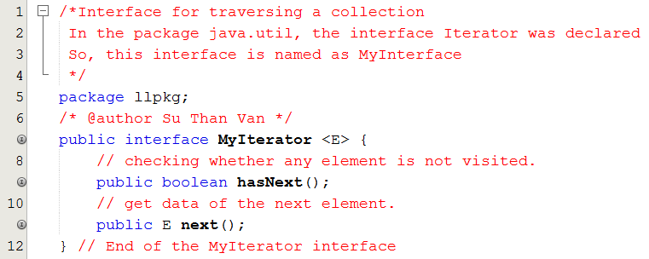
6- Demonstration: Interface MyIterator

Slide 21
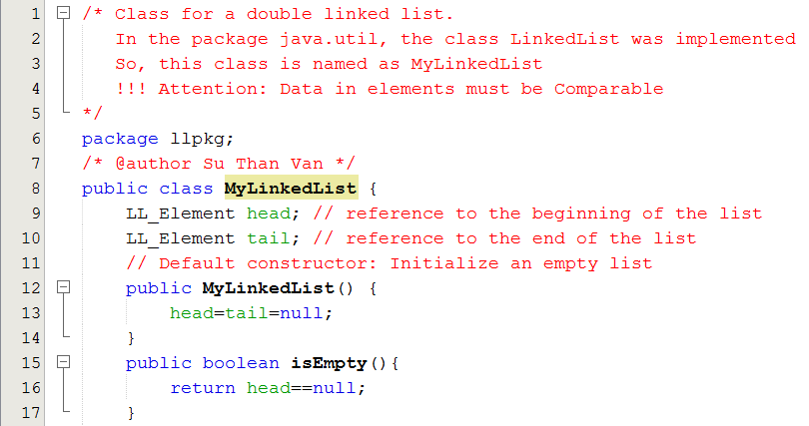
6- Demonstration: Class MyLinkedList

Slide 22
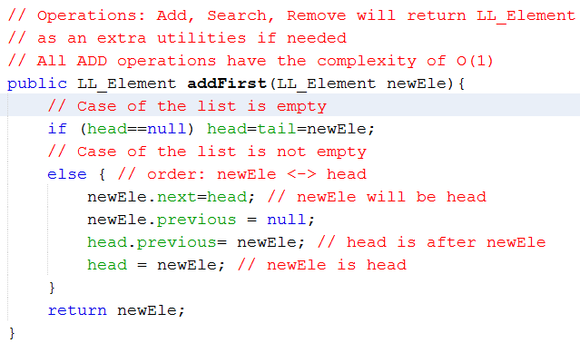
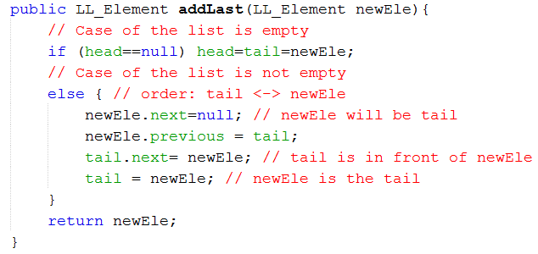
6- Demonstration: Class MyLinkedList…
newEle
head
data
data
next
next
previous
previous
tail
newEle
data
data
next
next
previous
previous

Slide 23
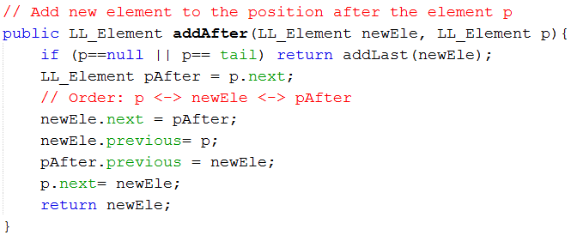
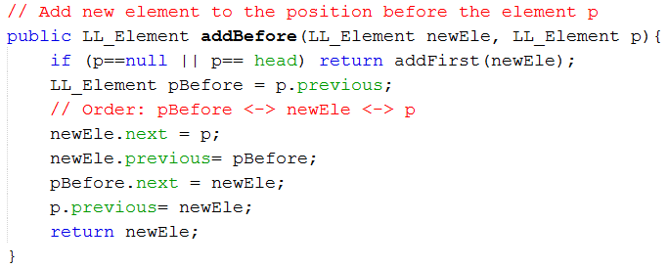
6- Demonstration: Class MyLinkedList…
p
pAfter
newEle
pBefore
p
newEle

Slide 24
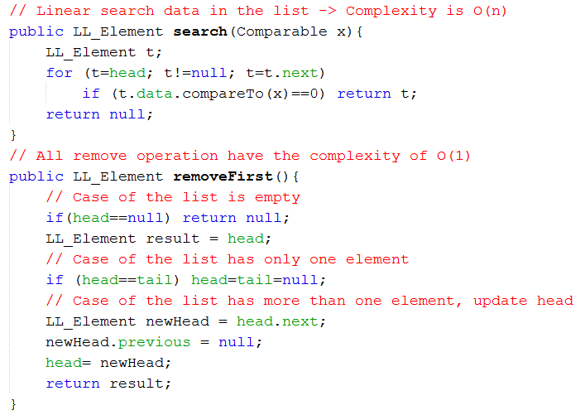
6- Demonstration: Class MyLinkedList…
head
newHead

Slide 25
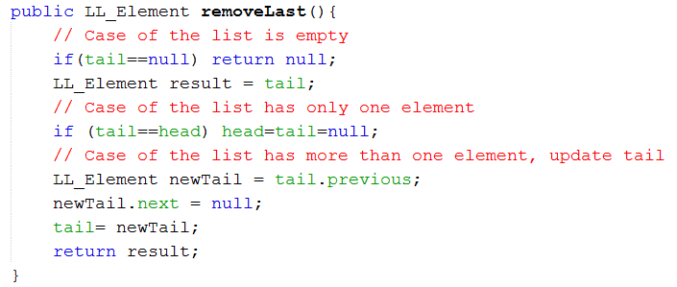
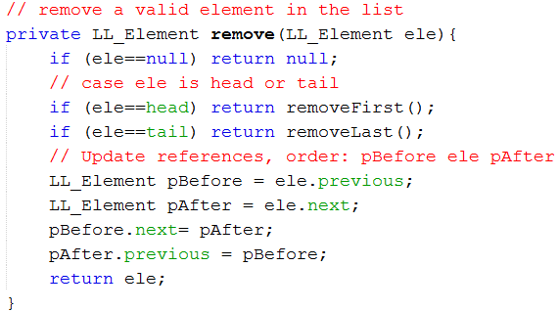

6- Demonstration: Class MyLinkedList…
newTail
tail
pBefore
ele
pAfter

Slide 26
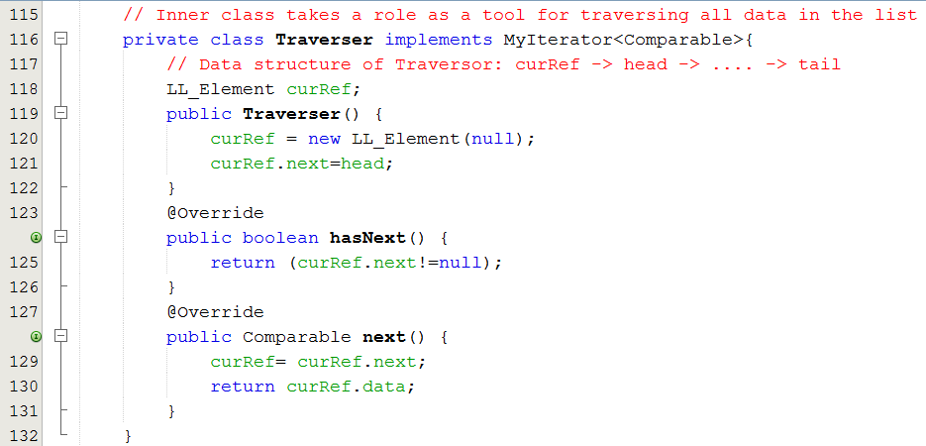
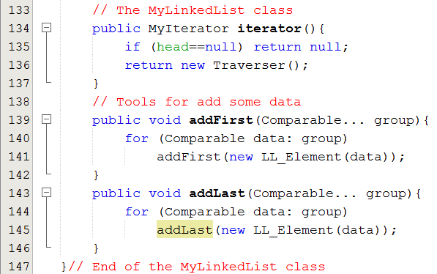
6- Demonstration: Class MyLinkedList…

Slide 27
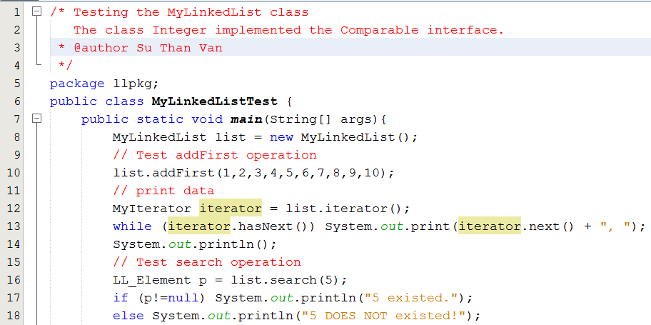
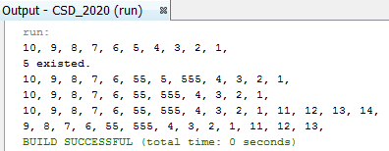
6- Demonstration: class MyLinkedListTest

Slide 28
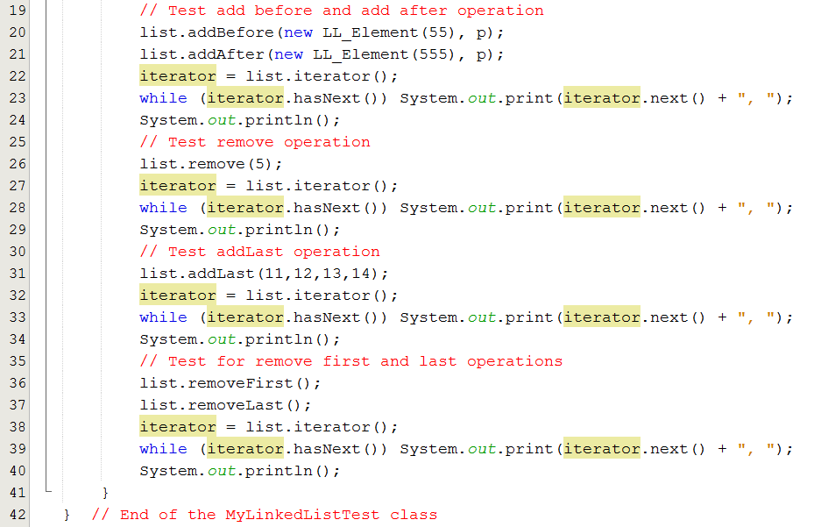
6- Demonstration: class MyLinkedListTest

Slide 29
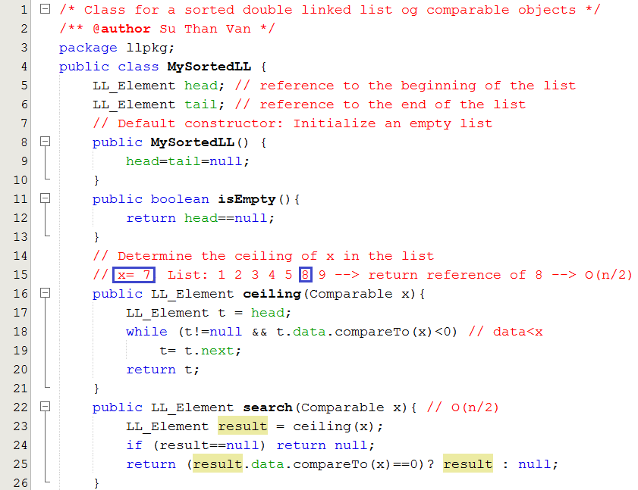
6- Demonstration: class MySortedLL

Slide 30
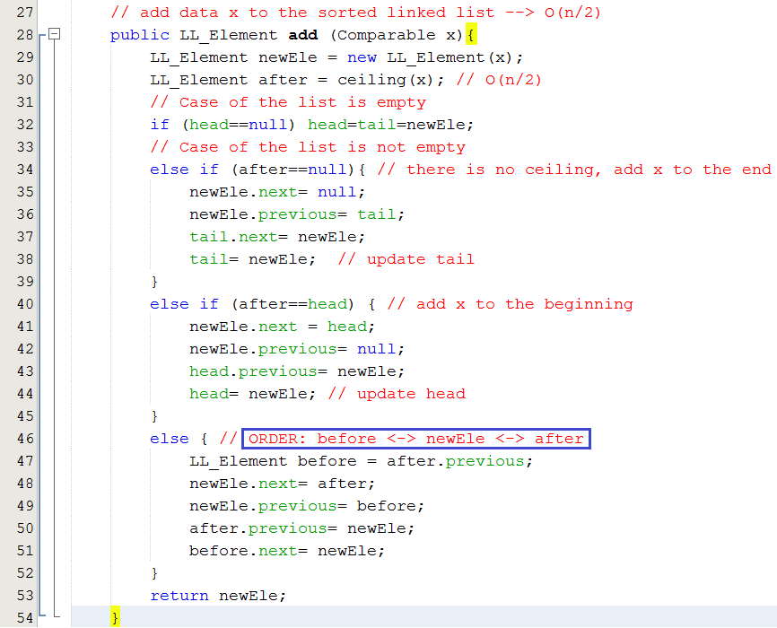
6- Demonstration: class MySortedLL…
Add to position | Number of steps
1 | 1
2 | 2
3 | 3
4 | 4
… | …
n | n
Sum | n(n+1)/2
Average | (n(n+1)/2)/n → O(n/2)
Average complexity of the add/search operation

Slide 31
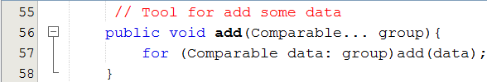
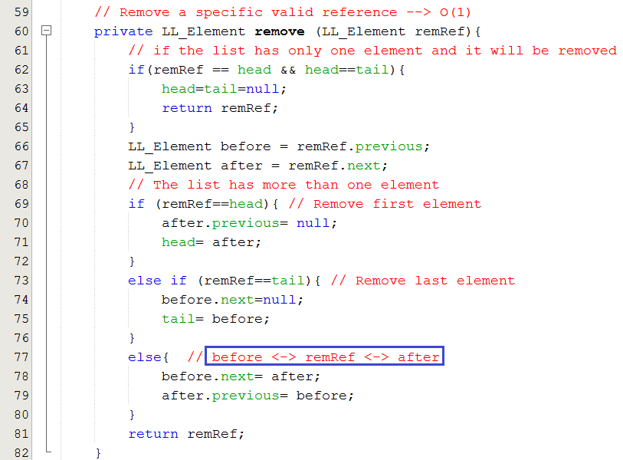
6- Demonstration: class MySortedLL…

Slide 32
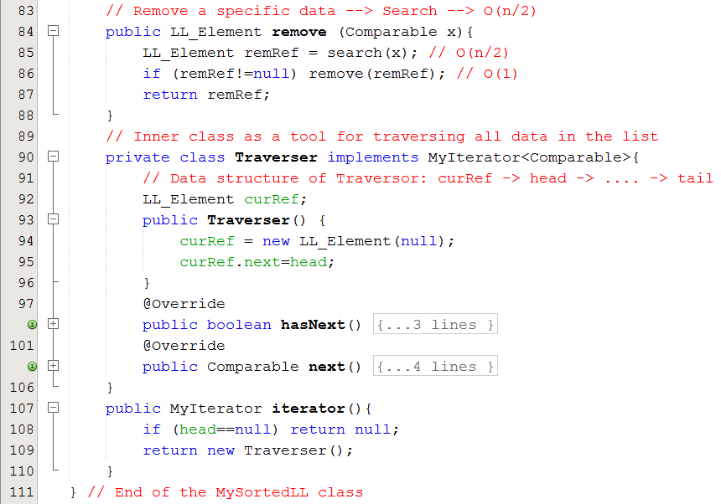
6- Demonstration: class MySortedLL…
This inner class is the same as those in the MyLinkedList class

Slide 33
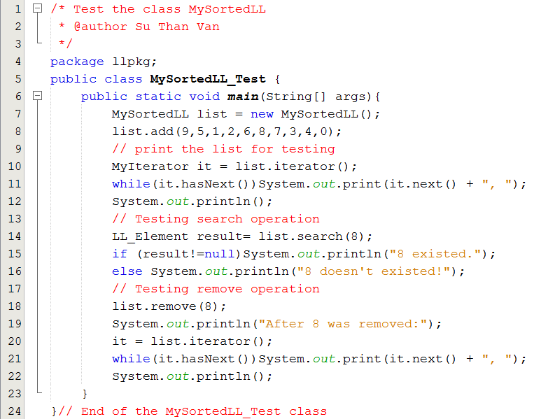
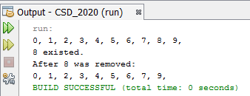
6- Demonstration: class MySortedLL_Test

Slide 34
7: Managing groups using the java API
The java.util package
Data structure | Class | Characteristics | When is it used?
Dynamic Array | Vector | Accessing an element using its index. Thread safe is supported All basic operations are implemented. | Data group for single or multi-thread applications
Dynamic Array | ArrayList | Accessing an element using its index. Thread safe (synchronized technique) is NOT supported All basic operations are implemented. | Single -thread application
Double linked list | LinkedList | Thread safe (synchronized technique) is NOT supported. All basic operations are implemented. | Single -thread application

Slide 35
8- Where a linked list should be used?
(1) A list with:
Number of items is not known in advance ← Memory can not be allocated in advance
Add and remove operations are frequently used
(2) Sparse table/ sparse matrix
Number of valuable values is very small against the whole number of elements in the table/ matrix of a graph is an example.
 | 0 | 1 | 2 | 3 | 4 | … | … | 9999
0 | 0 | 0 | 1 | 1 | 0 | 0 | 0 | 0
1 | 1 | 0 | 0 | 0 | 0 | 0 | 1 | 0
2
3
…
9999
1s are valuable but 0s.
Almost of values in the table is 0.
0s need not to be stored.
Linked list is suitable.

Slide 36
8- Where a linked list should be used?
Sparse matrix:
 | 0 | 1 | 2 | 3 | 4 | … | 9999
0 | 0 | 0 | 1 | 1 | 0 | 0 | 0
1 | 1 | 0 | 0 | 0 | 0 | 0 | 0
2
3
…
9999
head0
Val,col
Val,col
Val,col
Val,col
head1
Val,col
Val,col
Val,col
head2
Val,col
head3
Val,col
Val,col
headi
Val,col
Val,col
Val,col
headn
Val,col
Val,col
Val,col
Val,col
Sorted lists based on column
N rows → n lists

Slide 37
Summary
Complexities: Linked list vs Array
Operation | Arrays | Linked lists | Sorted Linked lists
Add new element to the beginning | O(n) | O(1) | Add to the right position ➔ O(n/2)
Add new element to the end | O(1) | O(1)
Add new element to a specific position | O(n) | O(1)
Linear Searching | O(n) | O(n) | O(n/2)
Remove an element at a specific position | O(n) | O(1) | O(1)
Sort | O(n²) | O(n²) | The list is sorted
When a linked list should be used?
Number of items is not known in advance.
Add and remove operations are frequently used
Sparse table/ sparse matrix ← number of valuable values is very small against the whole number of elements in the table/ matrix of a graph is an example.

Slide 38
Summary
A linked structure is a collection of nodes storing data and links to other nodes.
A linked list is a data structure composed of nodes, each node holding some information and a reference to another node in the list.
In a singly linked list, each node has a link only to its successor in this sequence.
A list is called as circular list when nodes form a ring.
LL Advantages: Insert, remove operations are performed efficiently.
LL Disadvantages: Search operation is not performed effectively because of sequential scanning.

Slide 39
Summary (continued)
A sparse table refers to a table that is populated sparsely by data and most of its cells are empty.
Linked lists allow easy insertion and deletion of information because such operations have a local impact on the list.
The advantage of arrays over linked lists is that they allow random accessing.
Random access: given address, data at that address will be accessed → very fast.

Slide 40
Summary

LO1.1 Demonstrate the list data structure with basic operations: insert, remove, edit, search, sort,...
LO1.2 Explain two ways of implementing a list: using arrays and using linked lists.
LO1.3 Write programs to implement the singly linked list with basic operations: add (last, first, before, after, at position), search, edit, remove, reverse, sort... )
LO1.4 Understand the doubly linked-list data structure with basic operations.
LO1.5 Write code snippets which manipulate operations on doubly linked list, and use diagrams to illustrate the effect.
LO1.6 Describe the circularly linked-list data structure with some basic operations like add, remove.
LO1.7 Explain why the Java code library provides the ArrayList and LinkedList classes







Slide 41
Ôn tập
Viết vào vở theo mẫu sau:
1- Cấu trúc dữ liệu liên kết là gì?
Là một nhóm phần tử trong đó mỗi phân tử có liên kết với các phần tử khác.
Slide tham khảo: 8

Slide 42
Ôn tập
2-Tại sao lại cần cấu trúc liên kết?
3- Cấu trúc liên kết tuyến tính là gì?
4- Cấu trúc liên kết phi tuyến là gì?
5- Danh sách liên kết là gì?
6- Danh sách liên kết vòng là gì?
7- Làm sao mô tả một nút trong danh sách liên kết. Cho một thí dụ.
8- Tại sao một DSLK nên được quản lý bằng 2 tham chiếu head và tail?
9- Hãy so sánh độ phức tạp thời gian giữa DSLK và mảng trên các tác vụ thêm/ tìm/ xoá phần tử.
10- Để cải tiến hiệu quả của tác vụ tìm kiếm trên DSLK, DSLK nên được tổ chức như thế nào và hiệu quả ra sao?
11- Khi nào DSLK được khuyên dùng?
12- Bảng thưa là gì? Mô tả bảng thưa như thế nào để tiết kiệm bộ nhớ.
13- Lớp java.util.LinkedList thuộc loại DSLK nào? Có hỗ trợ kỹ thuật an toàn về luồng hay không?

