Slide 1
Stacks and Queues

Slide 2
Learning Outcomes
LO2.1 Define stack and queue.
LO2.2 List and demonstrate the operations common to stacks and queues.
LO2.3 Describe specific tasks to which stacks and queues are suited.
LO2.4 Apply stacks to a specific application.
LO2.5 Apply queues to a specific application.
LO2.6 Write programs to implement stack and queue in Java programming language.
LO2.7 Define and explain the need of priority queue.

Slide 3
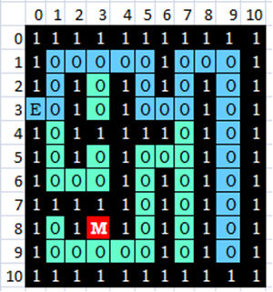
Intro: How to Find a Treasure (Money) or To Exit a maze
To proceed by trial and error (THỬ VÀ SAI-mò) using a Stack
At each crossroad, a position is chosen and OTHERS must be saved.
Example:
From the Entry (3,0), going to the position (3,1). There are two options, the position (2,1) is chosen and the position (4,1) is saved.
If the blue path is chosen, positions must be saved are:
(4,7)
(2,3)
(4,1)
At the dead position, (9,9), the next examined position is chosen is (4,7)

Slide 4
Objectives
Discuss the following topics:
1- Stacks
2- Queues
3- Priority Queues
Case Study: Exiting a Maze ← In the textbook
They are restricted lists:
Restricting their number of elements and/or
Restricting operations on them
Notes:
Maze: mê cung

Slide 5
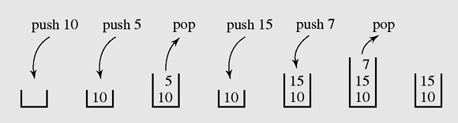
1- Stacks
A stack is a linear data structure that can be accessed only at one of its ends for storing and retrieving data.
A stack is called an LIFO structure: last in/first out
Figure 4-1 A series of operations executed on a stack

Slide 6
1- Stacks…
Where a stack should be used?
Stack should be used when processing order of data is opposed to creating order.
n= 12 : 2
0 6 : 2
0 3 : 2
1 1 : 2
1
base=2
Convert an positive number to a binary string.
1100
1
1
Số 1 → 00000001 (số hệ 2)
Ký số 1: 00110001 (mã ASCII nhị phân)
0
0

Slide 7
1- Stacks (continue)
The following operations are needed to properly manage a stack:
clear() — Clear the stack
isEmpty() — Check to see if the stack is empty
push(el) — Put the element el on the top of the stack
pop() — Take the topmost element from the stack
topEl() — Return the topmost element in the stack without removing it

Slide 8
How to Implementation a Stack
Select a linear storage → array/ linked list
Implement all basic operations:
clear() , isEmpty() , push(el) , pop() , topEl()
List | Using array → linear group | Using linked list → linear group
Stack push(x) pop() | Add to end → push(x) → O(1) Remove from end → pop() →O(1) | Add to end → O(1) Remove from end → O(1) OR Add to head → O(1) Remove from head → O(1)

Slide 9
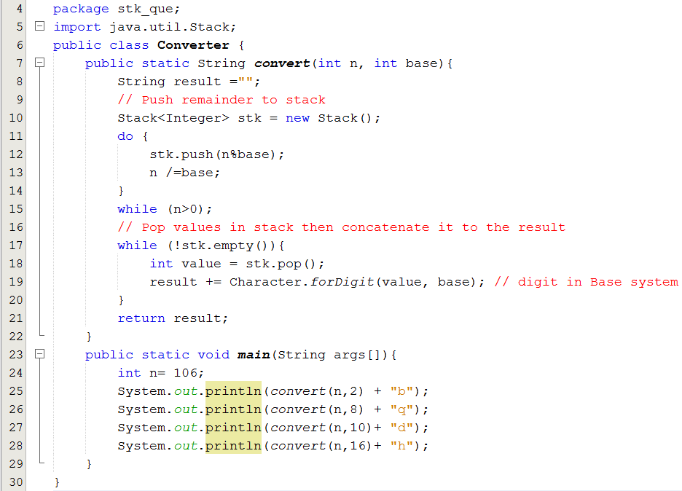
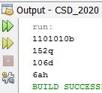
1- Stacks: Demo 1.
Using the java.util.Stack class

Slide 10
1- Stacks (continued)
Matching delimiters- A way to use stacks
a = b + (c – d ) * (e – f);
g[10] = h[i[9]] + (j + k) * l;
while (m < (n[8] + o)) { p = 7; r = 6; }
a = b + (c – d) * (e – f));
g[10] = h[i[9]] + j + k) * l;
while (m < (n[8] + o]) { p = 7; r = 6; }
while (m < (n[8] + o))
Matched
Mismatched
Nested matched
Algorithm for delimiter matching : refer to the page 142.

Slide 11
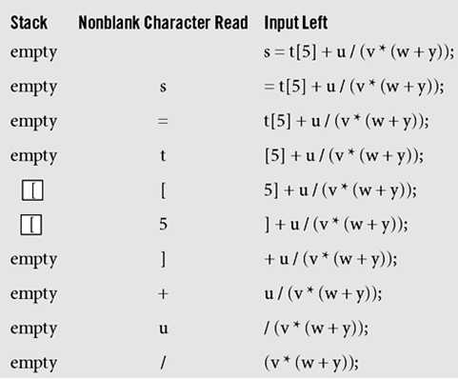
1- Stacks (continued)
Push to the stack an open delimiter and pop it from the stack when appropriate close delemiter is detected in input string
Figure 4-2 Processing the statement s=t[5]+u/(v*(w+y));
with the algorithm delimiterMatching()

Slide 12
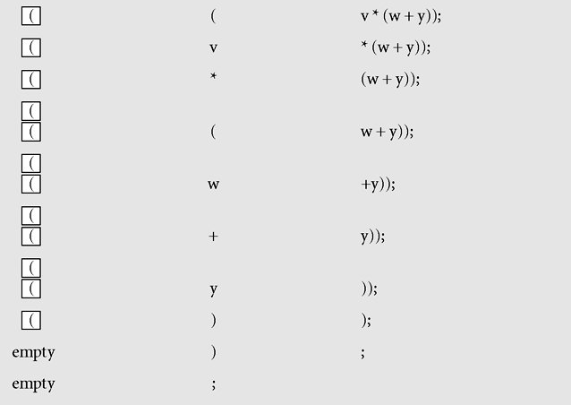
1- Stacks (continued)
Figure 4-2 Processing the statement s=t[5]+u/(v*(w+y));
with the algorithm delimiterMatching()

Slide 13
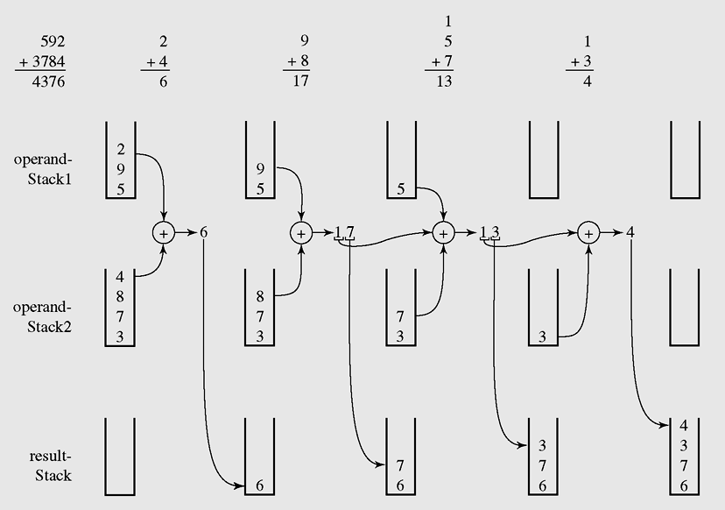
1- Stacks (continued)
Carry=0
Carry=0
Carry=1
Carry=1
Pop all elements in this stack to make the result
An example of adding string numbers “592” and “3784”
using stacks

Slide 14
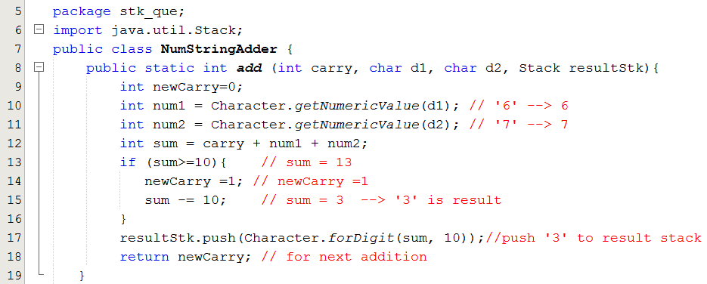
1- Stacks (continued) – Demo 2.
Adding 2 positive integral strings using stacks

Slide 15
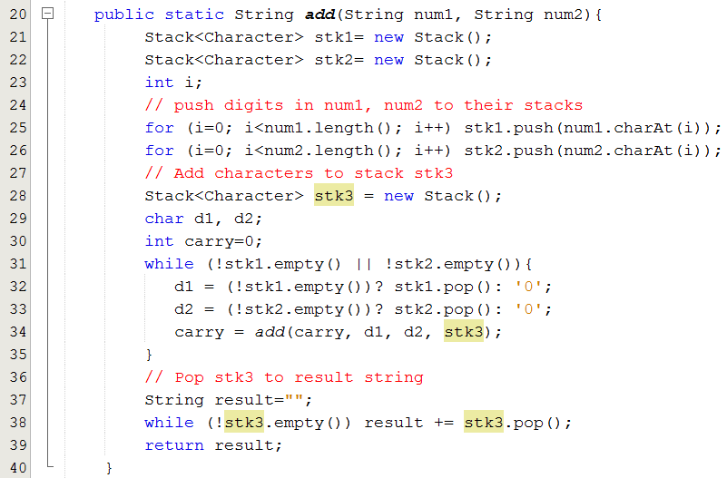
1- Stacks (continued) – Demo 2.

Slide 16
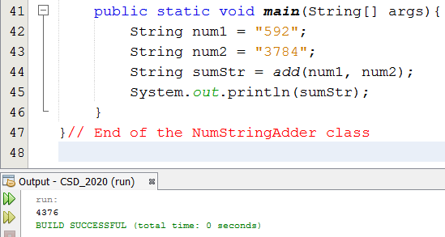
1- Stacks (continued) – Demo 2.

Slide 17
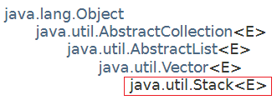
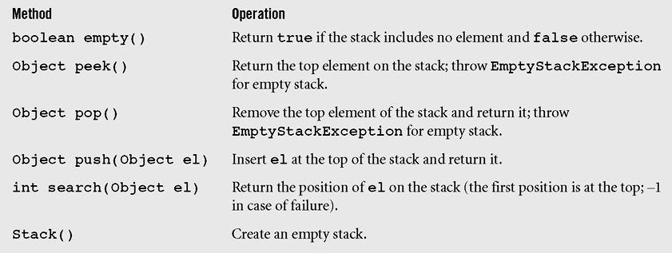
Stacks in java.util
It is a subclass of the Vector class, a dynamic array.
A list of methods in java.util.Stack; all methods from Vector are inherited

Slide 18
Stacks in java.util
We can create a stack using the java.util.LinkedList with attentions:
Use the method addFirst(x) and remove(), removeFirst() only
OR
Use the method add(x), addLast(x) and removeLast() only

Slide 19
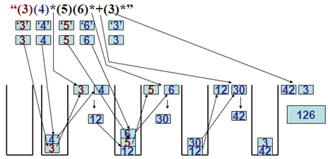
1- Stack: Demo 3.
Evaluating a simple postfix expression using stack.
StringTokenizer:
3
4
*
5
6
*
+
3
*

Slide 20
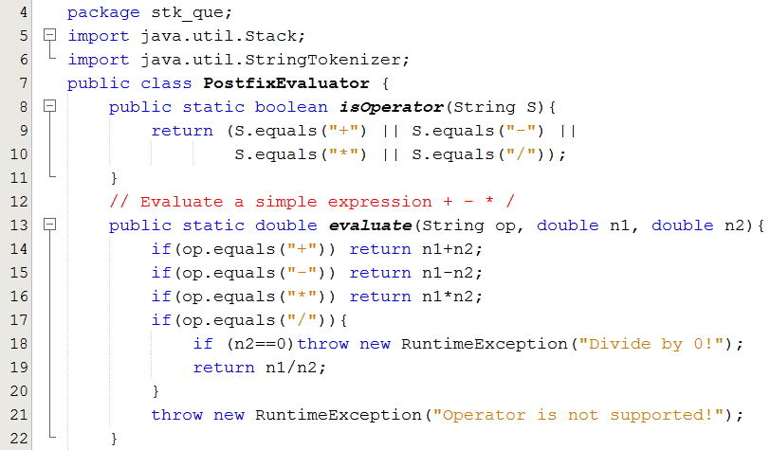
1- Stack: Demo 3…

Slide 21
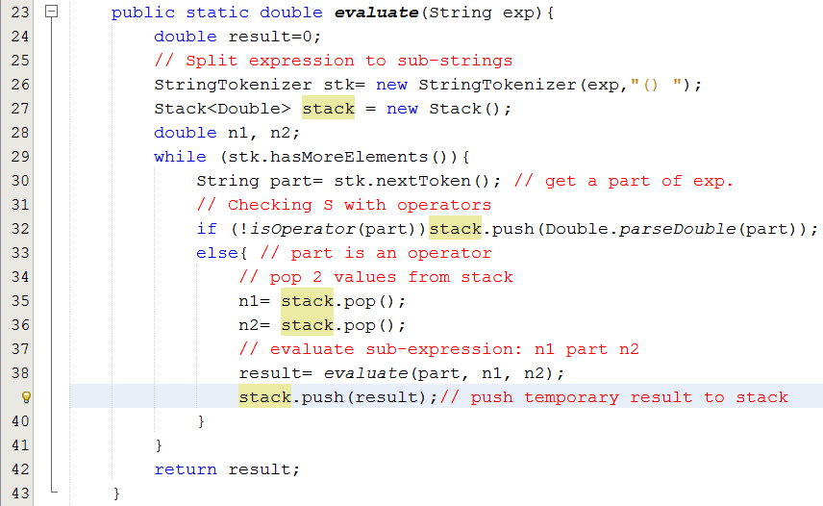
1- Stack: Demo 3...

Slide 22
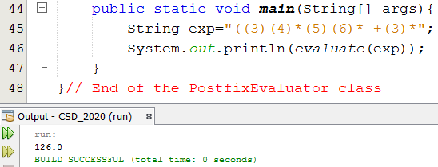
1- Stack: Demo 3.
Evaluating a simple postfix expression.
Do yourself:
Implement a program that will evaluate a prefix expression(Class PrefixEvaluator)
Implement a program for exiting a maze (refer to the textbook)

Slide 23
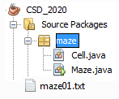
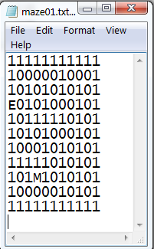
1- Stack: Demo 4: The Maze Problem
Result:
11111111111
10000010001
10101010101
E0101000101
10111110101
10101000101
10001010101
11111010101
101M1010101
10000010101
11111111111
Result path :
[(3,0, E), (3,1, 0), (2,1, 0), (1,1, 0), (1,2, 0), (1,3, 0), (1,4, 0), (1,5, 0), (2,5, 0), (3,5, 0), (3,6, 0), (3,7, 0), (4,7, 0), (5,7, 0), (5,6, 0), (5,5, 0), (6,5, 0), (7,5, 0), (8,5, 0), (9,5, 0), (9,4, 0), (9,3, 0), (8,3, M)]
BUILD SUCCESSFUL (total time: 0 seconds)

Slide 24

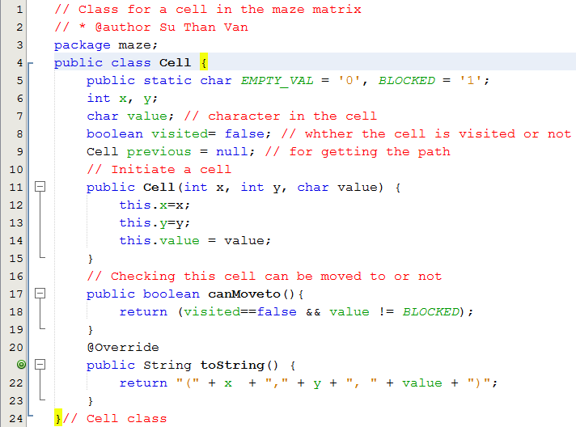
1- Stack: Demo 4: The Maze Problem…

Slide 25

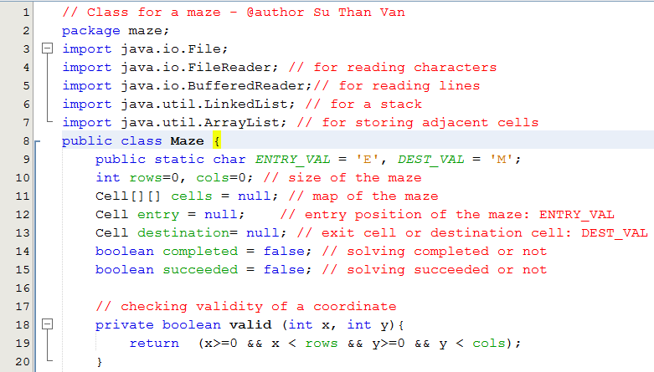
1- Stack: Demo 4: The Maze Problem…

Slide 26
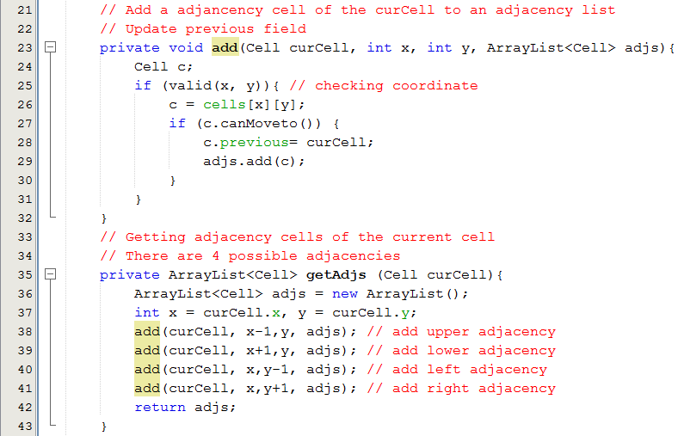
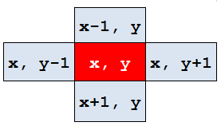
1- Stack: Demo 4: The Maze Problem…

Slide 27
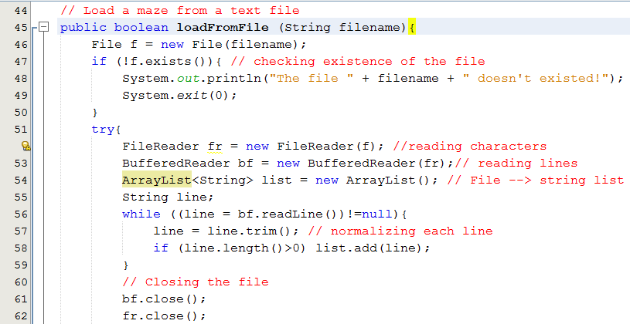
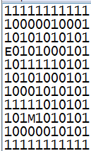
1- Stack: Demo 4: The Maze Problem…
Đọc file vào list

Slide 28
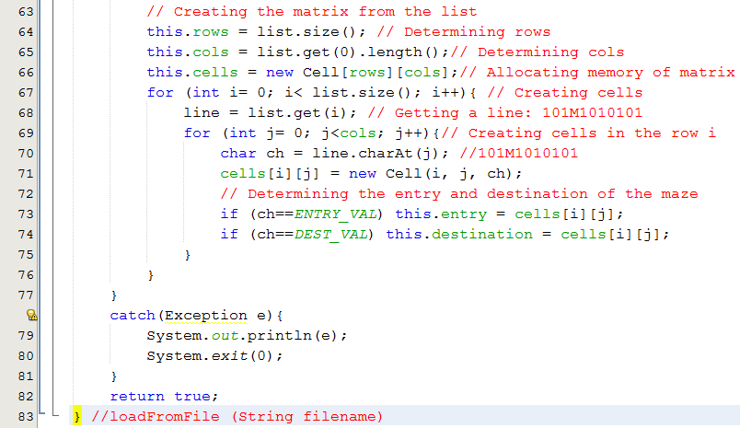
1- Stack: Demo 4: The Maze Problem…
Đổ list vào ma trận cells

Slide 29
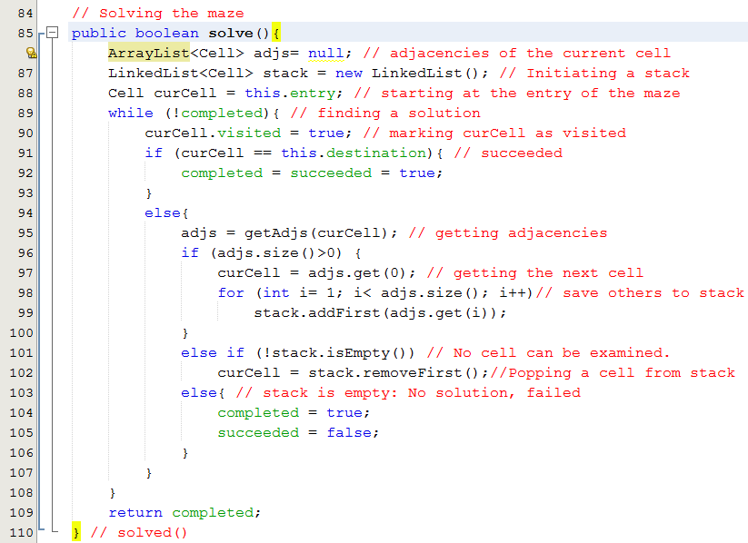
1- Stack: Demo 4: The Maze Problem…

Slide 30
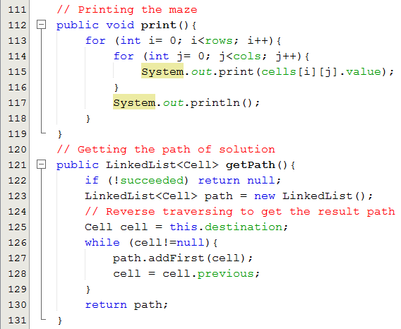
1- Stack: Demo 4: The Maze Problem…

Slide 31
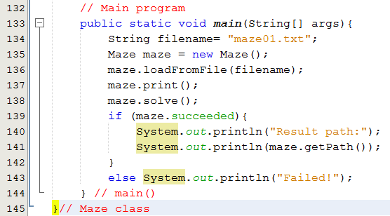
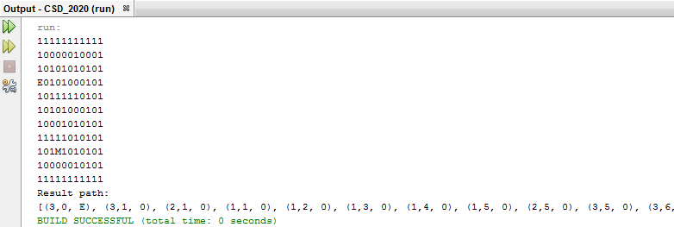
1- Stack: Demo 4: The Maze Problem…
11111111111
10000010001
10101010101
E0101000101
10111110101
10101000101
10001010101
11111010101
101M1010101
10000010101
11111111111

Slide 32
2- Queues
In queuing theory, various scenarios are analyzed and models are built that use queues for processing requests or other information in a predetermined sequence (order)
An example: A queue in a shop depicts the mechanism “First In First Out, FIFO”.

Slide 33
2- Queues
Where a queue should be used?
A queue should be used when processing order of data is the same as creating order.
Examples:
Queue for customers paying money in a store.
Printing server: A program receives all printing requirements in a network environment.
Traversing a tree, a graph (next lectures).

Slide 34
2- Queues
A queue is a waiting line that grows by adding elements to its end and shrinks by taking elements from its front
A queue is a structure in which both ends are used:
One for adding new elements
One for removing them
A queue is an FIFO structure: first in/first out
Where a queue should be used?

Slide 35
Queues (continued)
The following operations are needed to properly manage a queue:
clear() — Clear the queue
isEmpty() — Check to see if the queue is empty
enqueue(el) — Put the element el at the end of the queue
dequeue() — Take the first element from the queue
firstEl() — Return the first element in the queue without removing it

Slide 36
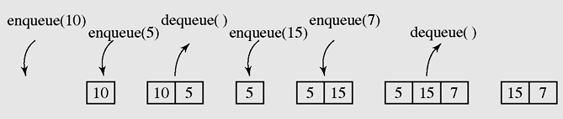
Queues (continued)
Figure 4-8 A series of operations executed on a queue

Slide 37
How to Implementation a Queue
Select a linear storage → array/ linked list
If an array is used: To avoid shift elements when an element is pick out, use circular mechanism for pushing in and picking out an element.
If a linked list is used:
Enqueue: Add to the last
Dequeue: Remove first
Inplement all basic operations:
clear() , isEmpty() , enqueue(el) , dequeue() , firstEl()
The follwing slides will depict queues using a circular array and a linked list as a pool for storing its elements.

Slide 38
How to Implementation a Queue
List | Using array → linear group | Using linked list → linear group
Queue enqueue(x) dequeue() | Add to end → enqueue(x) →O(1) Remove from beginning → dequeue() → Shift up → O(n) → Improvement: circular array → O(1) | Add to the end → O(1) Remove from beginning → O(1)
(1) Use the java.util.LinkedList object as a queue:
Use addFirst(x) and removeLast() only OR addLast(x), removeFirst() only
(2) Use the java.util.ArrayDeque

Slide 39
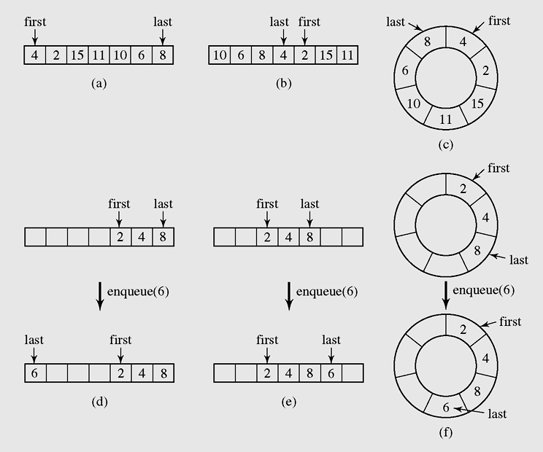
Queues (continued)
If an array is used to store elements of a queue the 2 indexes must be used to mark the beginning and the last positions.
If we do not want to shift elements when an element is pick out the queue then a circular mechanism is used.
➔ What configuration will describe the queue is full?
remove
Add
Circular array
remove
Add
Add
remove
Figure 4-9 Two possible configurations in an array implementation of a queue when the queue is full

Slide 40
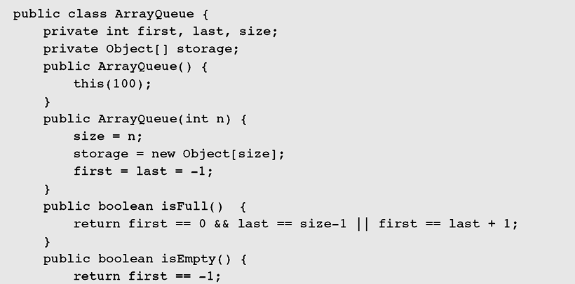

Queues (continued)
Read by yourself
Figure 4-10 Array implementation of a queue

Slide 41
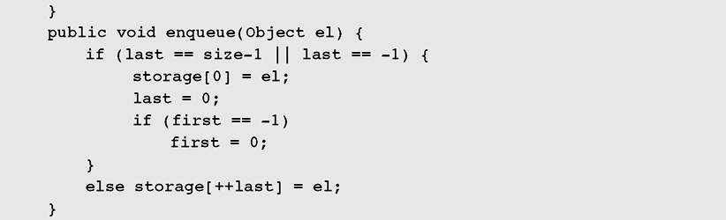
Queues (continued)
Read by yourself
The queue is full or empty → Add to the position 0, circular adding
Figure 4-10 Array implementation of a queue (continued)

Slide 42
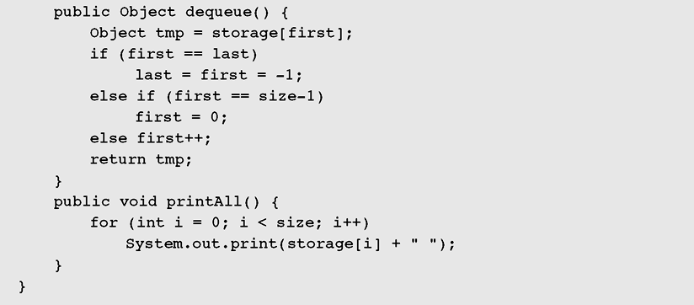
Queues (continued)
Read by yourself
In case of only one element
In case of first in the end of array → circular increaseing
Normal case
Figure 4-10 Array implementation of a queue (continued)

Slide 43
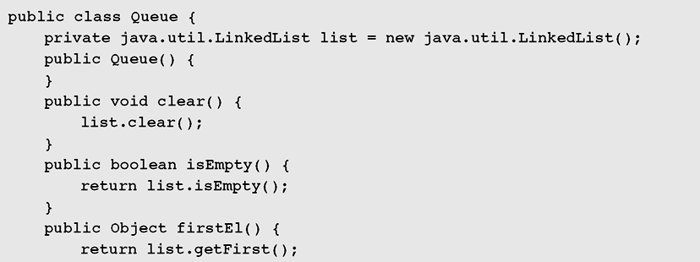
Queues (continued)
Read by yourself
Figure 4-11 Linked list implementation of a queue

Slide 44
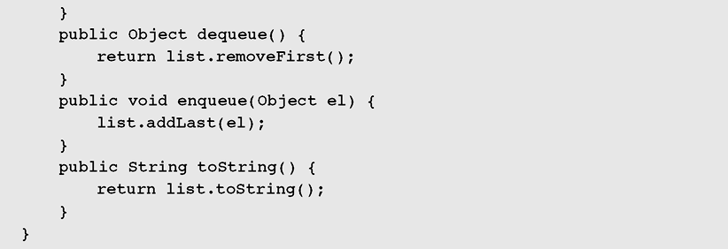
Queues (continued)
Read by yourself
Figure 4-11 Linked list implementation of a queue (continued)

Slide 45
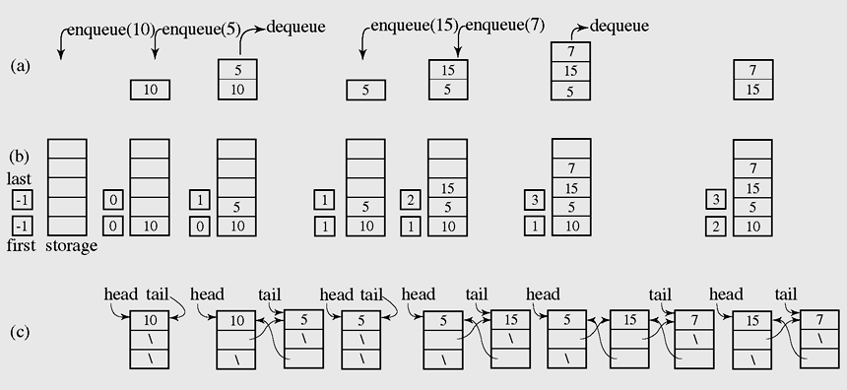
Queues (continued)
Read by yourself
Figure 4-12 A series of operations executed on an abstract queue (a) and the stack implemented with an array (b) and with a linked list (c)

Slide 46
Queue Demonstration
Introduction to multi-threading:
CPU has some processors and it is multi-core. A core is a processor.
A core may contain some instruction pipelines. Each pipeline can run a method independently. So, in a process (program in running), some methods can really performed concurrently
A thread is a method in running. Each language supports it’s own way to make an object being a thread.
A process can have some threads. As default, a process has ONE thread of the main(…) method.
Threads in a process are managed by a scheduler implemented in operating system or run-time environment (Java Virtual Machine, java.exe)

Slide 47
Queue Demonstration
Multi-threading in Java:
Java supports multi-threading. The java.lang.Runnable interface declares a method of a Java thread, public void run(void).
The topmost class of Java thread is the java.lang.Thread. This class implemented the Runnable interface.
2 ways to create threads in Java
(1) Create a class implementing the Runnable interface
(2) Create a sub-class of the Thread class should be defined in which the run() method should be overridden appropriately.
The following demonstration depicts both of two ways above.

Slide 48
Queue Demonstration
Multi-threading in Java:
Each thread has a name and common use methods of threads are:
start() : register the thread with the scheduler than it’s run() method is called when it is chosen by the scheduler.
stop(): un-register the thread from the scheduler. This method is not safe in case of there is common resource between threads.
yield(): inform to the scheduler that it want to stop using CPU → Yielding CPU to other threads.
sleep(milliSec) : Pause the thread a duration
isAlive(): checking existence of a thread .
For more details:
https://docs.oracle.com/en/java/javase/16/docs/api/java.base/java/lang/package-summary.html

Slide 49

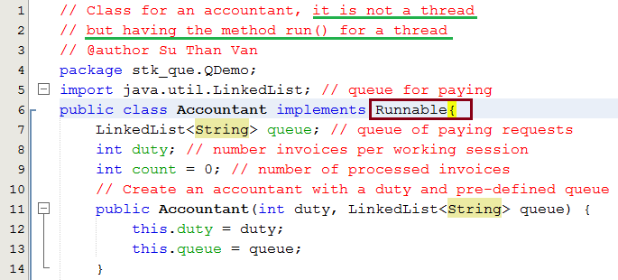
Queue Demonstration

Slide 50
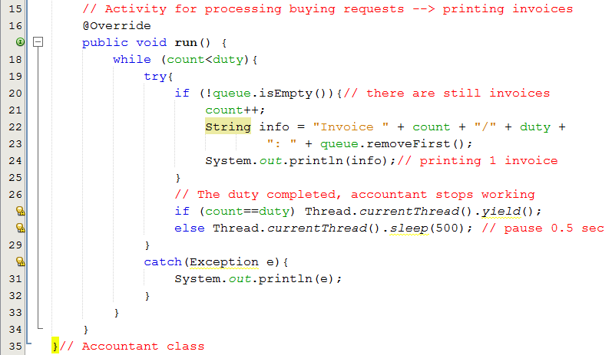
Queue Demonstration

Slide 51

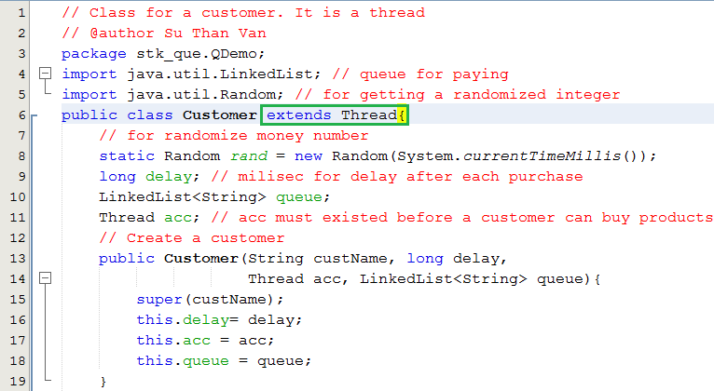
Queue Demonstration

Slide 52
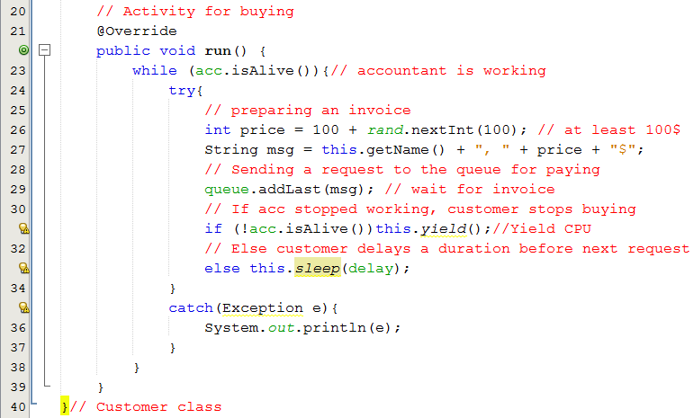
Queue Demonstration

Slide 53

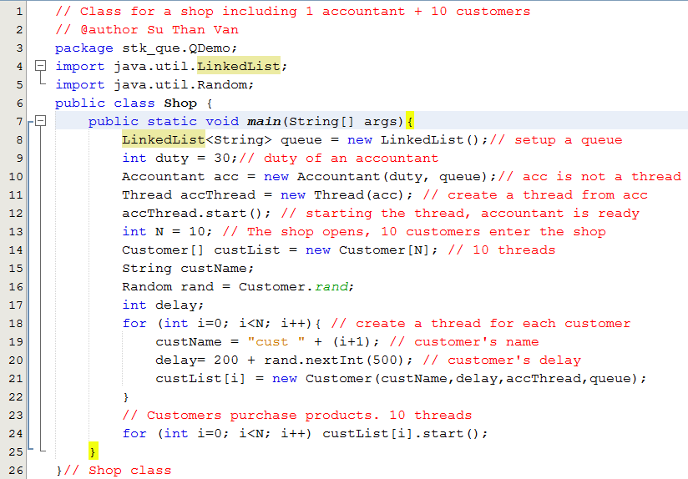
Queue Demonstration

Slide 54
3- Priority Queues
Priority: External factor is applied on each data object. It is commonly an integer.
Priority queue is a queue containing priority-assigned objects
When an data object is en-queued, it will be put to a suitable position and the object with highest priority will be de-queued.
Priority queue is viewed as an ordered list.
A priority queue can be assigned to enable a particular process, or event, to be executed out of sequence without affecting overall system operation (operating systems)
In priority queues, elements are de-queued according to their priority and their current queue position.

Slide 55
Priority Queues (continued)
Priority queues can be represented by two variations of linked lists:
All elements are entry ordered based on their priorities.
Order is maintained by putting a new element in its proper position according to its priority ( the enqueue operation must be modified to satisfy this criterion.)

Slide 56
Learning Outcomes
►
LO2.1 Define stack and queue.
LO2.2 List and demonstrate the operations common to stacks and queues.
LO2.3 Describe specific tasks to which stacks and queues are suited.
LO2.4 Apply stacks to a specific application.
LO2.5 Apply queues to a specific application.
LO2.6 Write programs to implement stack and queue in Java programming language.
LO2.7 Define and explain the need of priority queue.
►
►
►
►
►
►

Slide 57
Summary
A stack is a linear data structure that can be accessed at only one of its ends for storing and retrieving data.
A stack is called an LIFO structure: last in/first out.
A queue is a waiting line that grows by adding elements to its end and shrinks by taking elements from its front.
A queue is an FIFO structure: first in/first out.

Slide 58
Summary (continued)
In queuing theory, various scenarios are analyzed and models are built that use queues for processing requests or other information in a predetermined sequence (order).
A priority queue can be assigned to enable a particular process, or event, to be executed out of sequence without affecting overall system operation.
In priority queues, elements are dequeued according to their priority and their current queue position.

Slide 59
Review: Stacks and Queues…
LO2.1 Define stack and queue.
They are restricted lists in which add/remove operations are implemented in a specific way in which random accesses are not allowed.
Stacks: Last In First Out lists (LIFO)
Queues: First In First Out lists (FIFO)
LO2.2 List and demonstrate the operations common to stacks and queues.
List | Using array → linear group | Using linked list → linear group
Stack push(x) pop() | Add to end → push(x) → O(1) Remove from end → pop() →O(1) | Add to end → O(1) Remove from end → O(1) OR Add to head → O(1) Remove from head → O(1)
Queue enqueue(x) dequeue() | Add to end → enqueue(x) →O(1) Remove from beginning → dequeue() → Shift up → O(n) → Improvement: circular array → O(1) | Add to the end → O(1) Remove from beginning → O(1)

Slide 60
Review : Stacks and Queues…
LO2.3 Describe specific tasks to which stacks and queues are suited.
A stack is used when some data are processed in opposite order to created order.
Ex: Calculating a postfix expression, reverse printing an integral number, Exiting a maze,…
A queue is used when some data are processed in the same order with created order but processing rate is slower than creating rate.
Ex: A printing server can receive printing requests from some clients but they can not server concurrently and immediately. All waiting requests are stored in a queue.

Slide 61
Review : Stacks and Queues…
LO2.7 Define and explain the need of priority queue.
Priority: External factor is applied on each data object. It is commonly an integer.
Priority queue is a queue containing priority-assigned objects
When an data object is en-queued, it will be put to a suitable position and the object with highest priority will be de-queued.
Priority queue is viewed as an ordered list.

Slide 62
Ôn tập – Viết vào vở
1- Danh sách hạn chế là gì?
2- Stack được gọi là danh sách hạn chế vì lý do gì?
3- Hai tác vụ cơ bản nhất trên stack là gì?
4- Nếu DSLK được dùng để hiện thực stack, hai tác vụ cơ bản trên stack có độ phức tạp thời gian là bao nhiêu?
5- Khi nào stack được khuyên dùng?

Slide 63
Ôn tập – Viết vào vở
6- Queue được gọi là danh sách hạn chế vì lý do gì?
7- Hai tác vụ cơ bản nhất trên queue là gì?
8- Nếu DSLK được dùng để hiện thực queue, hai tác vụ cơ bản trên queue có độ phức tạp thời gian là bao nhiêu?
9- Khi nào queue được khuyên dùng?
10- Với bài toán đổi số hệ 10 sang hệ 2, stack hay queue được khuyên dùng?
11- Sử dụng lớp java.util.LinkedList như là một queue có được không? Tại sao?
12- Hàng đợi ưu tiên được hiện thực bằng gì?

