Slide 1
Chapter 5 Recursion Đệ: đưa ra/ Quy: quay về

Slide 2
Objectives
LO3.1 Describe the basic ideas of recursion and how to set up recursive systems that represent certain real-world phenomena.
LO3.2 Know how to develop recursive algorithms and programs
LO3.3 Write programs in Java using recursion to solve some problems, like creating the Fibonacci sequence.
LO3.4 Analyse a recursive function to find out its’ ouput without running.
LO3.5 Explain type of recursive functions, give examples and comparing them.
LO3.6 Compare recursion with iteration, analyzes their pros and cons

Slide 3
Contents
Questions:
What is recursion? Some examples
How to understand a recursion?
Where to use recursive definitions?
How to describe a recursive operation?
How to analyse an operation using recursive view?
How to implement recursive function?
How to manage running functions?
Anatomy of a Recursive Call
Evaluating performance of recursive methods.
How to classify recursive functions?
Evaluating recursive implementation

Slide 4
What is recursion?
A technique in which a concept/an operation is defined by itself
Person = a child of other two persons
A technique to present an operation using itself
Factorial : n! = n* (n-1)!
Sequence of numbers:
F(n) = F(n-1) + F(n-2) // Fibonacci
a(n) = a(n-1)+ d: Arithmetic progression – CS cộng
b(n) = q*b(n-1) // geometric progression- CS nhân

Slide 5
What is recursion? ….
Recursive implementation is a function/ method whose body containing one or more calls to itself.
public static int fibo ( int n){
if (n<2) return 1;
return fibo(n-1) + fibo(n-2);
}

Slide 6
How to understand a recursion?
We agree/define initial data.
Rules for deduction (suy diễn)
Examples:
Person = a child of other two persons
Initial persons: Adam, Eve
1 3 5 7 9 ….. A(n) = 1, n=1
A(n) = A(n-1) + 2, n> 1
1, 1, 2, 3, 5, 8, 13, … F(n) = 1, n<2
F(n) = F(n-1) + F(n-2)

Slide 7
Where to use Recursive Definitions
Recursive definitions serve two purposes:
Generating new elements
Testing whether an element belongs to a set
Recursive definitions are frequently used to define functions and sequences of numbers
A way to express a loop when number of executions is not known in advance.

Slide 8
How to describe a recursive operation?
A recursive definition consists of two parts:
The anchor or ground case or base case, the basic elements that are the building blocks of all other elements of the set
Rules that allow for the construction of new objects out of basic elements or objects that have already been constructed

Slide 9
How to analyse an operation using recursive view?
Divide and conquer – chia để trị
Data: d1, d2, d3, d4, d5, ………, dn
Method:
1 1 2 3 5 8 13 21 34
Splitting one or some elements at one side. This helps to identify ground case.
1
Exploring relation between an element with previous others
→ Deductive rules:F(n) = F(n-2) + F(n-1)

Slide 10
How to implement recursive function?
Analyse operation using recursive view then express it using pseudo-code.
Implementing exactly pseudo-code.
Example: Calculate factorial of the integer n
Analysis: n! = 1*2*3*4*5* …. * (n-2)*(n-1) * n
(n-1)!
Pseudo-code
factorial ( n) = 1, n<2
= n* factorial(n-1)

Slide 11
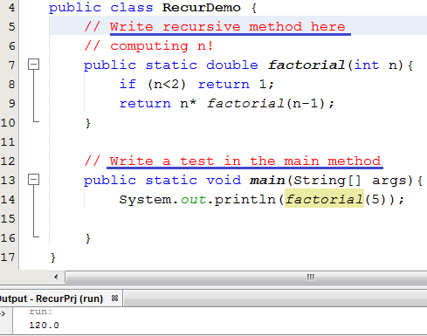
How to practice recursive function efficiently?
package recur;
Pseudo-code
n! = 1, n<2
= n* (n-1)!, n>=2
2 lines
// Other recursive method
// Other test
Để dễ tiếp thu bài học, xin đừng thắc mắc “Hàm đệ quy chạy như thế nào?”. Câu hỏi này sẽ được trả lời ở phần sau của chương.
Ở đây, chúng ta chú tâm vào cách suy nghĩ đệ quy, diễn đạt đệ quy và viết hàm đệ quy cho quen đã nhé.

Slide 12
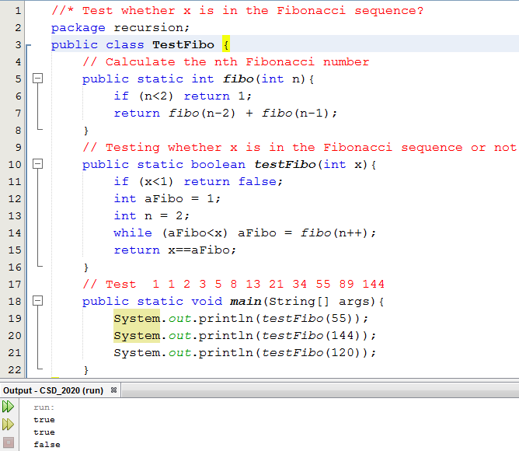
Practice: (9 exercises)
Recursive definitions serve two purposes:
Generating new elements
Testing whether an element belongs to a set
Demo: The Fibonacci sequence

Slide 13
Practice:
1.5 3.5 5.5 7.5 9.5 11.5
Compute the n^{th} item of an arithmetic progression having the first item a and common difference d:
ap(n, a, d) = a, n=1
= ap(n-1, a, d) + d, n>1
public static double ap( int n, double a, double d) {
<Code yourself>
}
// Test 1.5 3.5 5.5 7.5 9.5 11.5
System.out.println( ap(6, 1.5, 2 )); // → 11.5

Slide 14
Practice:
Compute the n^{th} item of a geometric progression having the first item a and common multiplier q:
Gp (n, a, q) = a , n=1
= Gp(n-1, a, q) * q, n>1
public static double gp( int n, double a, double q) {
<Code yourself>
}
// Test 1.5 3 6 12 24 48
System.out.println( gp(6, 1.5, 2)); // → 48

Slide 15
Practice:
Calculate sum of integral array having n elements
Sum(a,n) = 0 + a[0] + a[1] + …….. + a[n-2] + a[n-1]
Sum(a, n) = 0, n=0;
= Sum(a, n-1) + a[n-1], n>1
public static double sum( double[] a, int n) {
<Code yourself>
}
// Test :
double a[] = { 1.5, 2, 4, 5, 2, 6.5 };
System.out.println( sum(a, 6)); // → 21

Slide 16
Practice:
Calculate the maximum value in an integral array having n elements
1 5 9 7 2 10 19
max(a, n) := if (n==1) return a[0]
int m= max(a, n-1) // 10
return m>a[n-1]? m : a[n-1]
public static double max( int[] a, int n) {
<Code yourself>
}
// Test :
int b[] = { 1, 5, 9, 7, 2, 19,10 };
System.out.println( max(b, 7)); // → 19

Slide 17
Practice:
- Calculate the minimum value in an integral array having n elements
min (a,n) = (Do yourself)
public static double min( int[] a, int n) {
<Code yourself>
}
// Test : int b[] = { 1, 5, 9, 7, 2, 19,10 };
System.out.println( min(b, 7)); // → 1

Slide 18
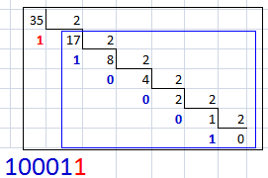

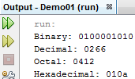
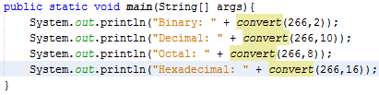
Practice:
Convert a decimal integer to a numeric string in specific base number system
n= 35, base=2 ➔ 100011
“100011” = “10001” + “1”
convert(35,2) = convert(17,2) + digit of 35%2
convert(n,base) = convert(n/base,base) + digit of n%base
Anchor: If n==0 return “0”

Slide 19
How to manage running functions?
How to manage a thing? ➔ We need its data.
How to manage a running method? ➔ … ?
Data of a method:
Its parameters (data type, value)
Its return data type
Its extra local variables
Return address in its caller
Dynamic link: Address of its caller activation record
Activation record:
Data which are used to manage running methods

Slide 20
More details:
Activation records contain the following:
Values for all parameters to the method, location of the first cell if an array is passed or a variable is passed by reference, and copies of all other data items
Local (automatic) variables that can be stored elsewhere
The return address to resume control by the caller, the address of the caller’s instruction immediately following the call

Slide 21
Method Calls and Recursion Implementation (continued)
A dynamic link, which is a pointer to the caller’s activation record
The returned value for a method not declared as void
The following slide depicts the mechanism for managing called methods.

Slide 22
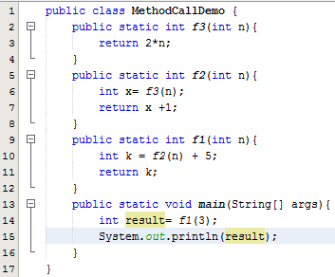

Anatomy of Called Methods Demonstration
Parameters and Local variables ( n )
Activation record of
f3(…)
Dynamic link (4000)
=
Return Address ( = )
5000
Return value ( int )
Parameters and Local variables ( n, x )
Activation record of
f2(…)
+
Dynamic link (3000)
Return Address ( + )
4000
Return value ( int )
Parameters and Local variables (n, k)
Activation record of
f1(…)
=
Dynamic link (2000)
Return Address ( = )
3000
Return value ( int )
Parameters and Local variables (args, result)
Activation record of
main(…)
Figure 5-1 Contents of the run-time stack when main() calls method f1(), f1() calls f2(), and f2() calls f3()
Dynamic link (1000)
Return Address ( null )
2000
Return value (void)
Constants
1000
All methods use Dynamic links to access constants.

Slide 23
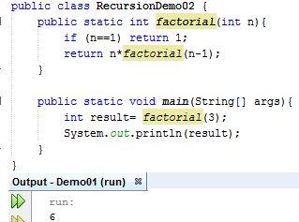
Anatomy of a Recursive Call
AR of factorial(1)
AR of factorial(2)
AR of factorial(2)
AR of factorial(2)
AR of factorial(3)
AR of factorial(3)
AR of factorial(3)
AR of factorial(3)
AR of factorial(3)
AR of main
AR of main
AR of main
AR of main
AR of main
AR of main
AR of main

Slide 24
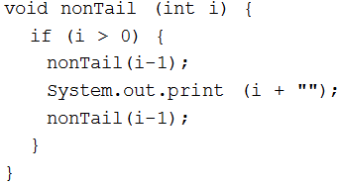
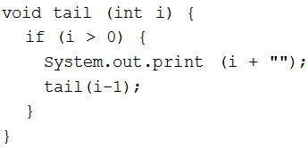

How to classify recursive functions?
Based on the place where a recursive method is called → Tail recursion and non-tail recursion.
Tail recursion is characterized by the use of only one recursive call at the very end of a method implementation
The last operation is a multiplication.
→ It is not a tail recursion
Head recursion?

Slide 25
How to classify recursive functions?
Based on number of recursive calls: Linear, non-linear recursion.
int factorial ( int n) {
if (n==1) return 1;
return n*factorial(n-1);
}
int fibo ( int n) {
if (n<3) return 1;
return fibo(n-2) + fibo(n-1);
}

Slide 26
How to classify recursive functions?
Based on number of functions included in recursive call: → Indirect recursion.
Direct recursion? → Recursice call is put in the body of itself
receive(buffer)
while buffer is not filled up
if information is still incoming
get a character and store it in buffer;
else exit();
decode(buffer);
decode(buffer)
decode information in buffer;
store(buffer);
store(buffer)
transfer information from buffer to file;
receive(buffer);

Slide 27
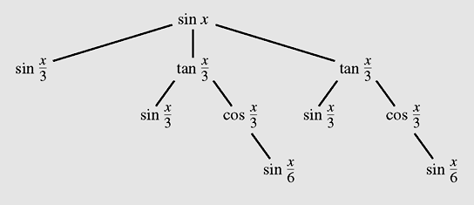
Indirect Recursion (continued)
Figure 5-7 A tree of recursive calls for sin (x)

Slide 28
Evaluating performance of recursive methods.
Space: Need more memory for activation records.
Time: Call functions many time → More overhead task must be perform → low
If you can, you should not use recursion.
How to remove recursion?
Use loop + stack/ queue data structure

Slide 29
Evaluating performance of recursive methods.
double fact1(int n) {
if (n<2) return 1;
return n*fact1(n-1);
}
double fact2 (int n) {
double result =1;
for (int i=2; i<=n; i++)
result *= i;
return result;
}
fact1(100); // ➔ 100 activation records
fact2(100); // ➔ 1 activation record

Slide 30
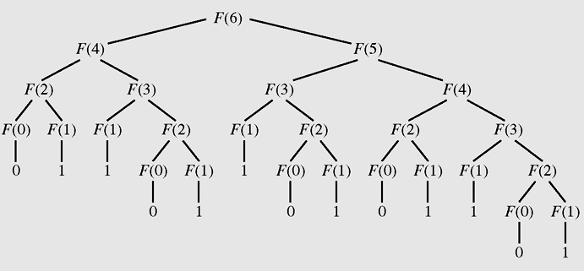
Evaluating: Excessive Recursion
Figure 5-8 The tree of calls for Fib(6)
One operation must be performed many times.

Slide 31
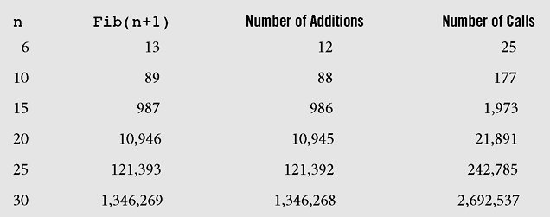
Evalating: Excessive Recursion
Figure 5-9 Number of addition operations and number of recursive calls to calculate Fibonacci numbers

Slide 32
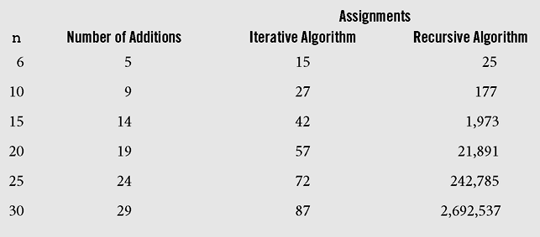
Evaluating: Excessive Recursion
Figure 5-10 Comparison of iterative and recursive algorithms for calculating Fibonacci numbers

Slide 33
Eliminating Tail Recursion
Recursion → High cost including space and time → We should eliminate (khử bỏ) recursion using loop and stack.
In some cases, tail recursion can be eliminated without any use of auxiliary memory (space).
Attention: the factorial() is not a tail recursion.
If (n==1) return 1;
return n * factorial(n-1);
The last instruction is a multiplication.

Slide 34
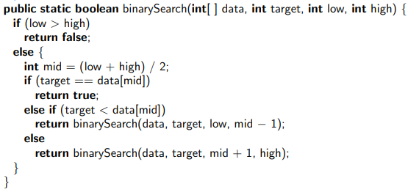
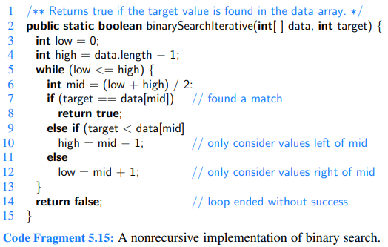
Eliminating Tail Recursion
Example:
Recursive version
No additive memory is needed.

Slide 35
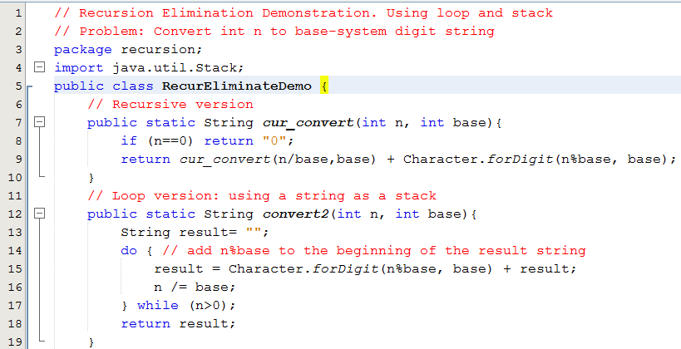
Eliminating Recursion Demo.

Slide 36
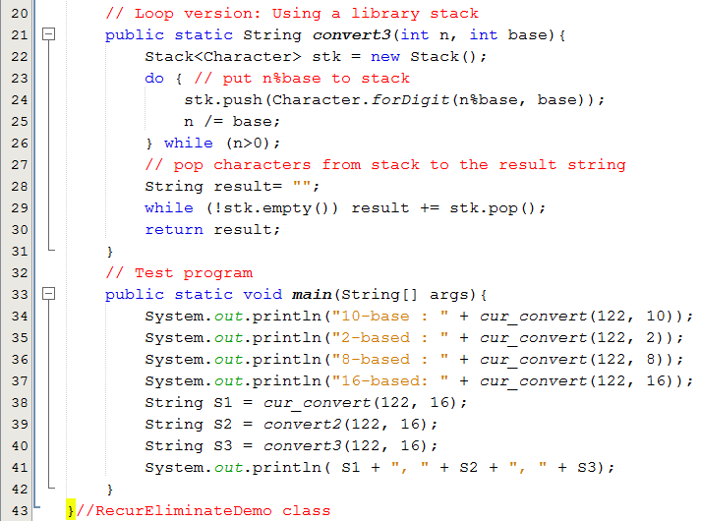

Eliminating Recursion Demo.

Slide 37
Backtracking
Backtracking is a technique for returning to a given position (e.g., entry point) after trying other avenues that are unsuccessful in solving a particular problem.
Backtracking is a technique for finding solutions of a multiple-variable problem.
One-Step Backtracking: The simplest and common-use backtracking. If there is no suitable value which can be assigned to the i^{th} variable, backtrack to the (i-1)^{th} variable.
K-step Backtracking: If there is no suitable value which can be assigned to the i^{th} variable, backtrack to the (i-k)^{th} variable.
Backtracking is a greedy algorithm for finding all solutions of a problem.

Slide 38
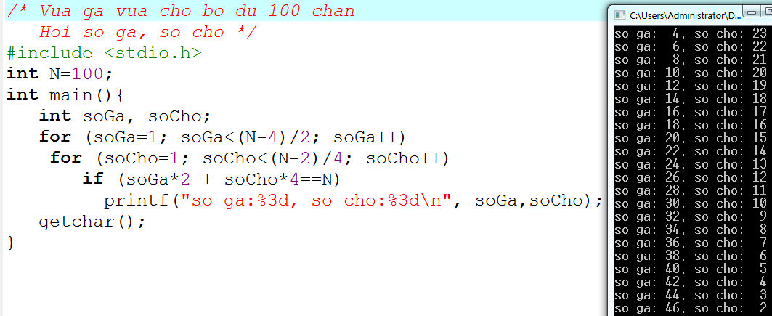
Backtracking
Example: One-step backtracking in C.
2 loại → 2 vòng lặp lồng nhau
Với n loại bất kỳ thì làm sao để giải? ➔ Đệ quy (vét cạn/hồi quy)

Slide 39
Backtracking
Definitions:
Problem: a set of variables (V), each variable has a distinct domain (D, set of domains).
Problem’s Constraints: Conditions (C) on values of variables.
A solution: set of specific values of variables (configuration) which satisfy the problem’s constraints.
Example 1: Vừa gà vừa chó bó đủ trăm chân. Hỏi có bao nhiêu gà bao nhiêu chó:
V: 2 variables, 2 domains:
sốGà: [1, (100-4)/2] , ít nhất có 1 con chó
sốChó: [ 1, (100-2)/4], ít nhất có 1 con gà
→ C: sốGà * 2 + sốChó *4 =100

Slide 40
Backtracking
Example 2: Bài toán sinh chuỗi 4 bít
V: 4 biến: [0,1]
C: không có điều kiện cần kiểm tra
Example 3: Bài toán trâu
Trăm trâu trăm cỏ, con nhỏ ăn một, con lớn ăn hai, con già hai con một bó. Hỏi số trâu trong mỗi loại.
V: 3 variables, 3 domains.
sốNhỏ: [0, 100] ← Tối đa có 100 bó cỏ và 100 con trâu
sốLớn: [0, 50] ← Tối đa có 100 bó cỏ và trâu lớn ăn 2 bó
số Già: [0, 100] ← Tối đa có 100 con trâu
C: sốGià là số chẵn AND
sốNhỏ + sốLớn + số Già = 100 AND
sốNhỏ * 1+ sốLớn * 2+ sốGià/2 = 100

Slide 41
Backtracking
Example 4: A customer likes to buy 3 TVs, 2 refrigerators, 1 fan with budget less than or equals 30,000,000$ (budget)
V: 6 variables, 3 domains.
v0: { TVs }, v1: { TVs }, v2: { TVs }
v3: { Refs }, v4: { Refs }, v5: { Fans }
C: v0.price + v1.price + v2.price +
v3.price + v4.price + v5.price <= budget
Backtracking implementations:
Using recursive approach
Using a generator which will generates values (CONFIGURATION) for checking constraints.

Slide 42
Backtracking Implementation: Recursive Approach
At a time, a variable is examined to assign a value to it
Procedure backtrack (index, V, D, C, solutions)
Input: index, index of current variable
V: Set of variables
D: Set of domains of variables respectively
C: set of constraints
Output: solutions
For each value in D_{index} {
v_{index} = value;
if (index = n-1) { //the last variable was assigned
if (new configuration satisfied C) // new solution is detected
Add new configuration to solutions
}
else backtrack (index+1, V, D, C, solutions) // One-step backtracking
}
Procedure backtrack (V, D, C) {
solutions = empty set; backtrack (0, V, D, C, solutions);
return solutions:
}
V0
V1
V2
V…
Vindex
Vindex+1
Recursive implementation: Memory cost? Time cost?

Slide 43

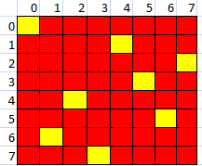
Demo: The Eight-Queen Problem
With size=8, → 64 cells
No. of queens = 8
Complexity: 64⁸
^{(64.63.62.61.60,59.58.57)}
We need a very very long time to find all solutions of the problem using greedy algorithm (our generator)
We should use recursive backtracking approach and stop immediately when a solution is detected.

Slide 44

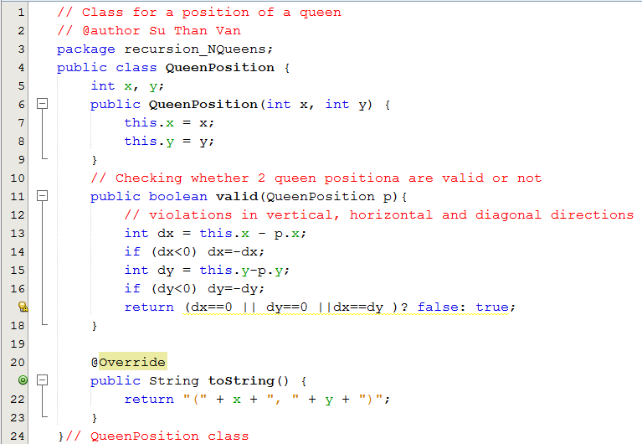
Demo: The Eight-Queen Problem
On the same row → dx=0
On the same column → dy=0
On the diagonal → dx=dy

Slide 45

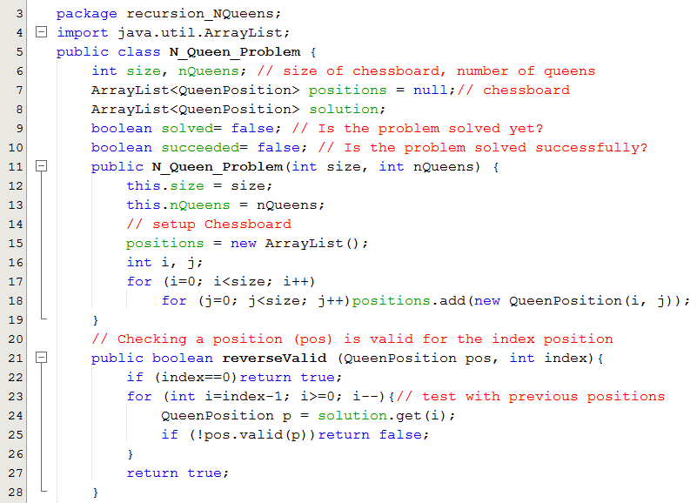
Demo: The Eight-Queen Problem
Q0
Q1
Q2
Q…
Qindex

Slide 46
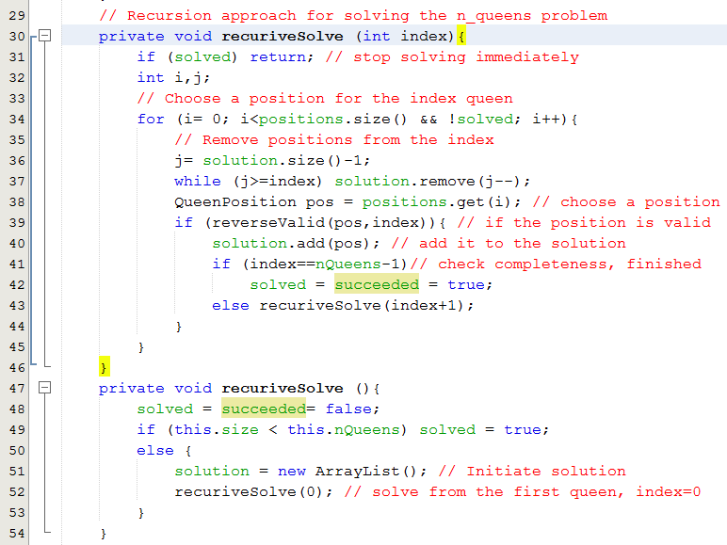
Demo: The Eight-Queen Problem

Slide 47
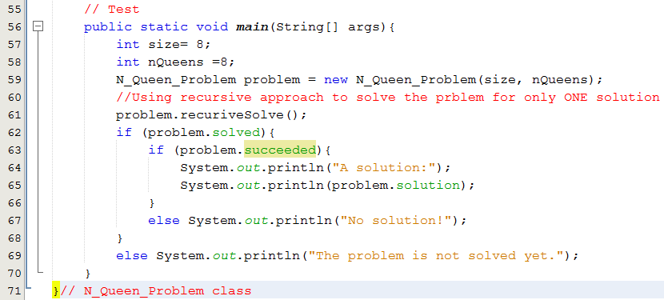

Demo: The Eight-Queen Problem

Slide 48
Backtracking Implementation: Generator Approach Generator in the Product consulting Problem
tvDom
tvDom
tvDom
rfDom
rfDom
fanDom
0
1
2
3
4
5
TV1
TV2
TV3
TV4
TV5
TV6
TV1
TV2
TV3
TV4
TV5
TV6
TV1
TV2
TV3
TV4
TV5
TV6
RF1
RF2
RF3
RF4
RF5
RF1
RF2
RF3
RF4
RF5
F1
F2
F3
Get a
suggestion
iDom0
iDom1
iDom2
iDom3
iDom4
iDom5
0, 5
0, 5
0, 5
0, 4
0, 4
0, 2
MinMaxSet
Backtrack
Generator
0
0
1
3
2
0
000000
000001
000002
000010
…..
555442
0
0
1
3
2
0
Current Configuration
Configuration is a set of specific generated values.
0
0
0
0
0
0
First configuration
5
5
5
4
4
2
Last configuration

Slide 49
Backtracking Implementation: Generator Approach
Procedure Solve-Problem (D₀, D₁, …, D_{n}, C)
Input: Set of domains, C: problem condition
Output: Solutions
Begin
Solutions = empty set;
Setup generator from domains;
suggestion = The first configuration of the generator;
while still having a suggestion {
if the suggestion meets C the add the suggestion to solutions;
suggestion = next configuration of the generator;
}
return solutions;
End

Slide 50
Backtracking: Complexity
N: average quantity of each domain. There are n options which can be used to assign a value to each variable
|V|: number of variables ( a configuration has V values)
Product principal ➔Complexity of backtracking algorithm: N^{|V|} ➔Hard problem
N-1 … 0 | N-1 … 0 | N-1 … 0 | N-1 … 0 | … | N-1 … 0
var₀ | var₁ | var₂ | … |  | var_{|V|-1}

Slide 51

Backtracking Implementation: Generator Approach

Slide 52
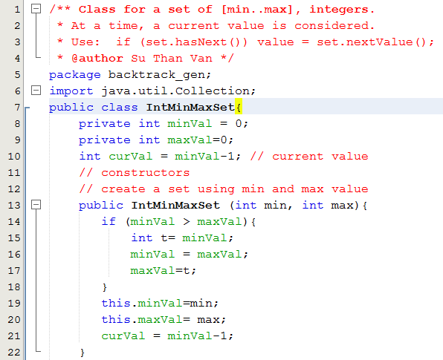

Backtracking Implementation: Generator Approach

Slide 53
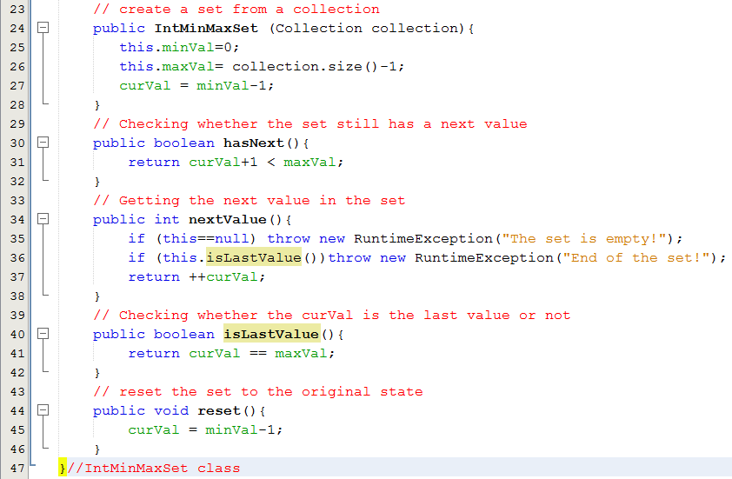
Backtracking Implementation: Generator Approach

Slide 54

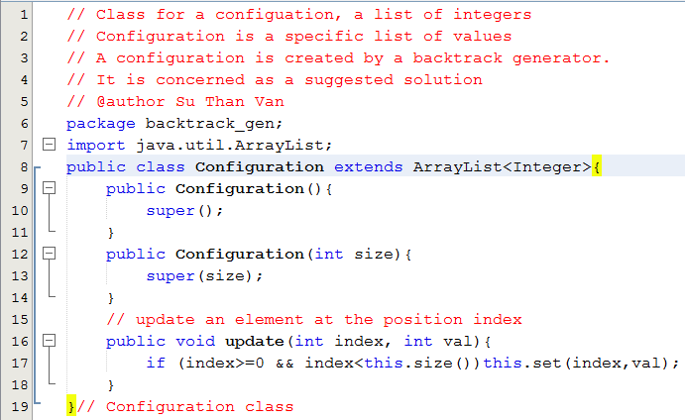
Backtracking Implementation: Generator Approach

Slide 55
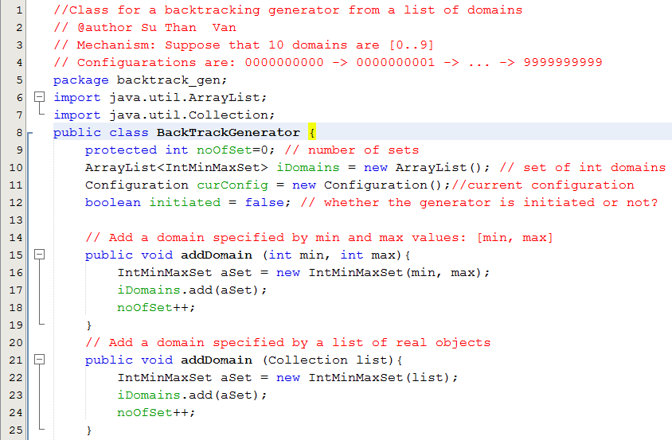

Backtracking Implementation: Generator Approach

Slide 56
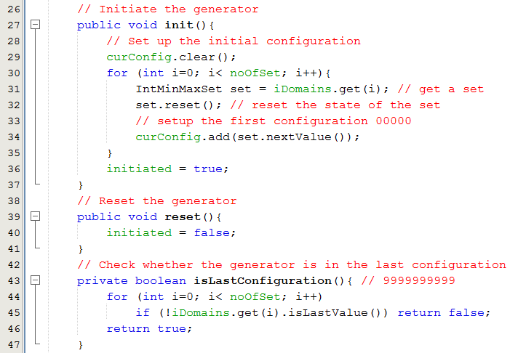
Backtracking Implementation: Generator Approach

Slide 57
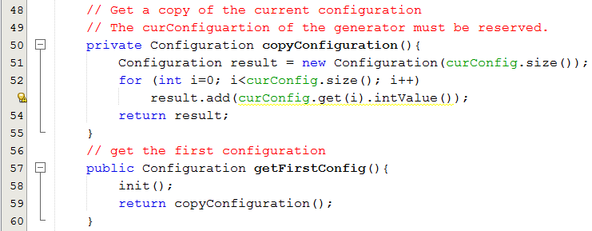
Backtracking Implementation: Generator Approach

Slide 58
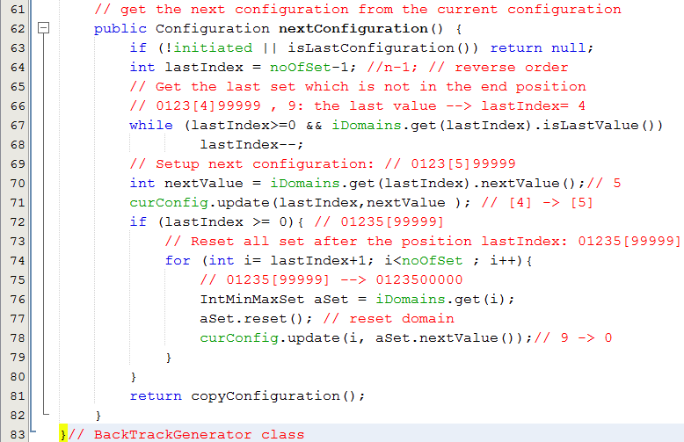
Backtracking Implementation: Generator Approach
One-step backtracking

Slide 59
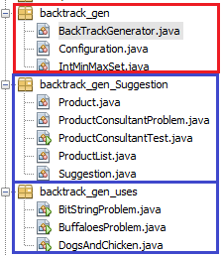
Backtracking Implementation: Using Backtracking Generator

Slide 60

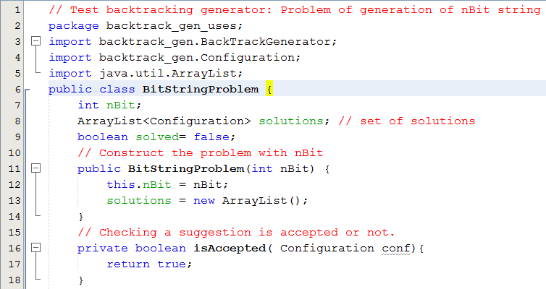
Using Backtracking Generator

Slide 61
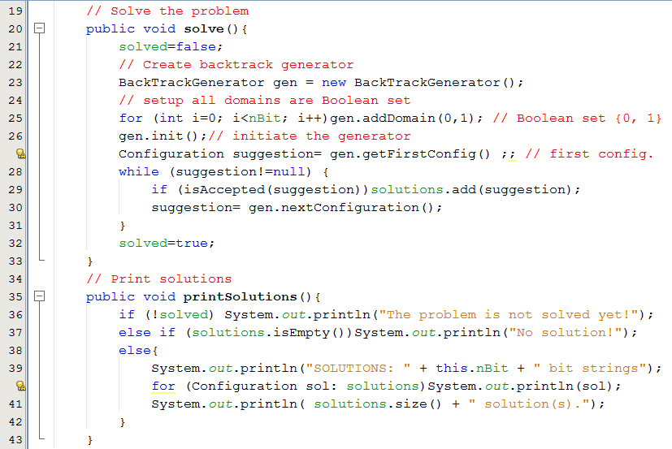
Using Backtracking Generator

Slide 62
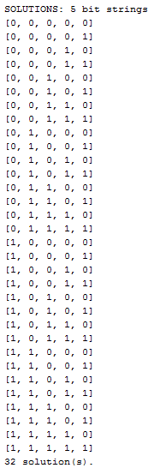
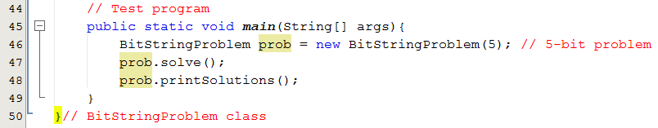
Using Backtracking Generator

Slide 63

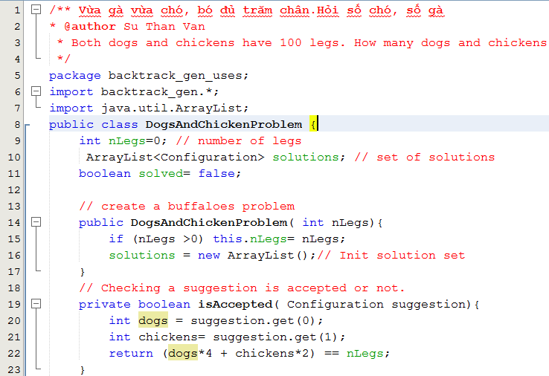
Using Backtracking Generator

Slide 64
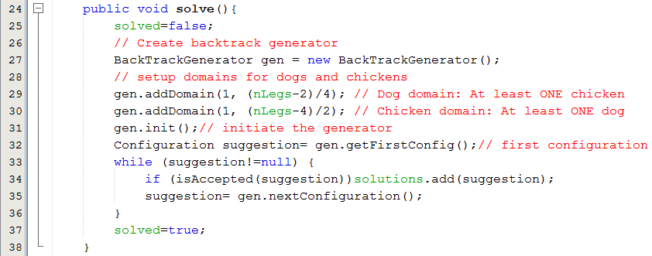
Using Backtracking Generator

Slide 65
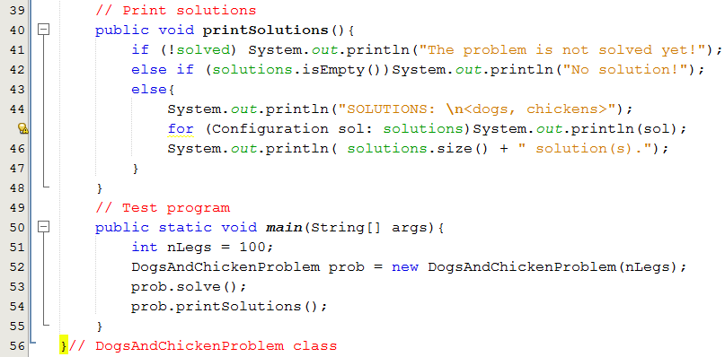
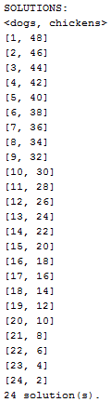
Using Backtracking Generator

Slide 66

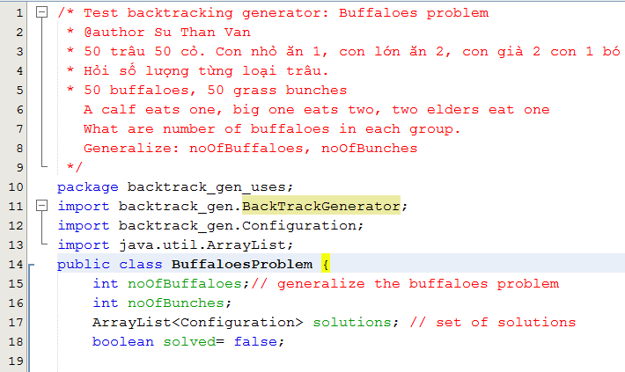
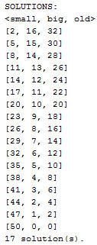
Using Backtracking Generator

Slide 67
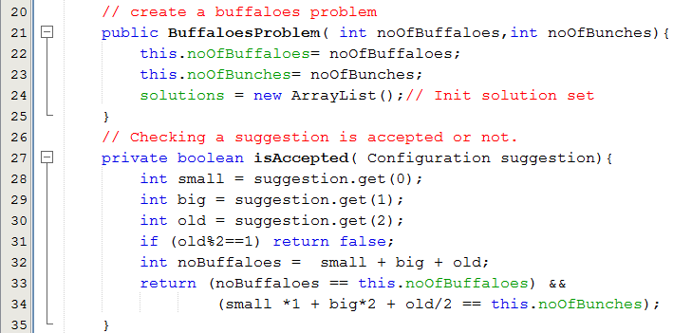
Using Backtracking Generator

Slide 68
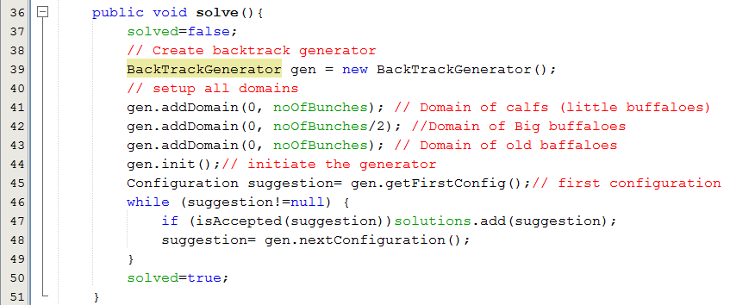
Using Backtracking Generator

Slide 69
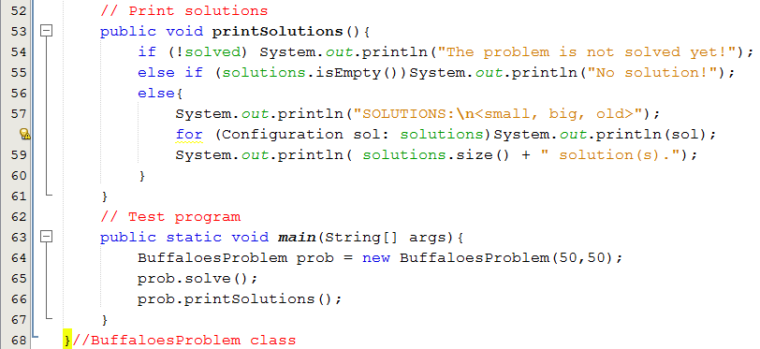
Using Backtracking Generator

Slide 70
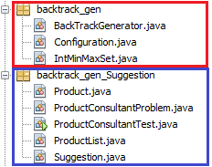
Using Backtracking Generator
Situation:
A customer likes to buy 3 TVs, 2 refrigerators, 1 fan with maximum budget of 30,000,000$

Slide 71

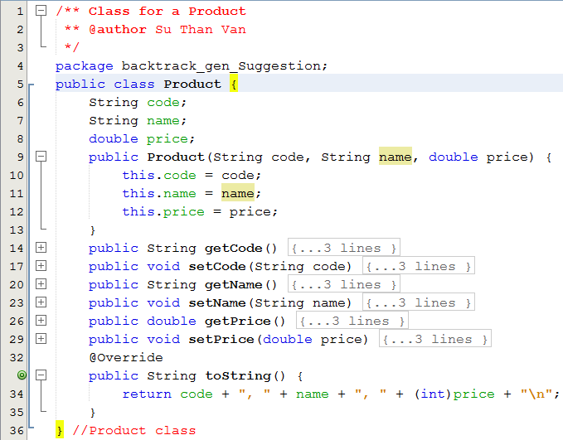
Using Backtracking Generator

Slide 72
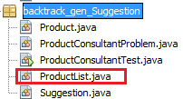
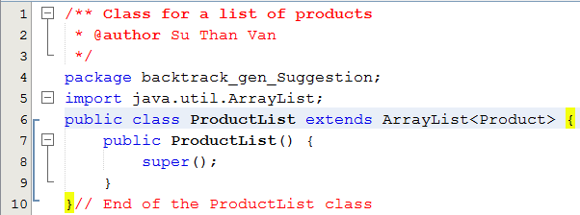
Using Backtracking Generator

Slide 73
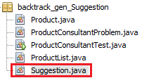
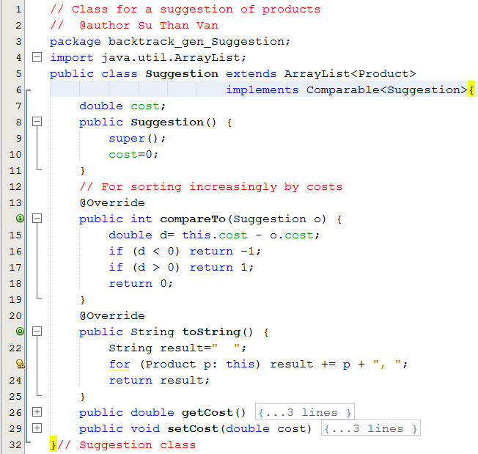
Using Backtracking Generator

Slide 74


Using Backtracking Generator

Slide 75

Using Backtracking Generator

Slide 76

Using Backtracking Generator

Slide 77

Using Backtracking Generator

Slide 78


Using Backtracking Generator

Slide 79

Using Backtracking Generator

Slide 80


Using Backtracking Generator

Slide 81
Backtracking
Steps to use backtrack Generator:
From the problem:
1- Determine related real domains.
2- Create a generator
3- Add domains to the generator in suitable order.
4- Initiate the generator (make the generator ready)
5- Get a suggestion from the first configuration of the generator
6- do {
if (suggestion is accepted) Add suggestion to solution set
suggestion = get the next configuration of the generator
} while(still having a suggestion)

Slide 82
Review

LO3.1 Describe the basic ideas of recursion and how to set up recursive systems that represent certain real-world phenomena.
LO3.2 Know how to develop recursive algorithms and programs
LO3.3 Write programs in Java using recursion to solve some problems, like creating the Fibonacci sequence.
LO3.4 Analyse a recursive function to find out its’ ouput without running.
LO3.5 Explain type of recursive functions, give examples and comparing them.
LO3.6 Compare recursion with iteration, analyzes their pros and cons






Slide 83
Review
LO3.4 Analyse a recursive function to find out its’ ouput without running.
int T (int n) {
if(n<2) return 2;
return T(n-2) + 2*T(n-1) + 3;
}
T(4)=?
T(n) = 2, n<2
= T(n-2) + 2T(n-1) +3, n>=2
T(4)=?
n | 0 | 1 | 2 | 3 | 4
T(n) | 2 | 2 | 9 | 23 | 58
Testing whether the value 60 is an element of the T sequence?
→ NO
How to use recursion for testing whether a value belongs to a group? Please refer to Recursion Review → LMS/ CSD201-SuVan.

Slide 84
Summary
Recursive definitions are programming concepts that define themselves
Recursive definitions serve two purposes:
Generating new elements
Testing whether an element belongs to a set
Recursive definitions are frequently used to define functions and sequences of numbers
Recursive thinking: Use divide and conquer technique.

Slide 85
Summary (continued)
Tail recursion is characterized by the use of only one recursive call at the very end of a method implementation.
Backtracking is a technique for returning to a given position (e.g., entry point) after trying other avenues that are unsuccessful in solving a particular problem.

Slide 86
Ôn tập – Viết vào vở
1- Đệ quy là gì?
2- Con người có dùng kỹ thuật đệ quy hay không? Cho hai thí dụ.
3- Làm sao con người hiểu được đệ quy?
4- Tác vụ đệ quy được mô tả như thế nào? Cho thí dụ.
5- Làm sao có được kỹ năng diễn đạt đệ quy?
6- Đệ quy được dùng để làm gì?
7- Đệ quy đuôi là gì?
8- Đệ quy đầu là gì?

Slide 87
Ôn tập – Viết vào vở
9- Đệ quy tuyến tính là gì?
10- Đệ quy phi tuyến là gì?
11- Đệ quy gián tiếp là gì?
12- Đệ quy hỗ tương là gì?
13- Làm sao hệ thống có thể quản lý các hàm đang thực thi?
14- Hãy cho biết activation record của một hàm gồm có những gì cùng với ý nghĩa của từng thành phần.
15- Tại sao hàm đệ quy khi thực thi lại tốn bộ nhớ?
16- Tại sao hàm đệ quy thực thi lại chậm?

Slide 88
Ôn tập – Viết vào vở
17- Khử đệ quy là gì? Tại sao lại nên khử đệ quy?
18- Khử đệ quy bằng cách nào?
19- Hồi quy là gì?
20- Kỹ thuật hồi quy có thể được dùng trong những bài toán nào? Cho ví dụ.

