Slide 1
Chapter 6 Trees and Binary Trees

Slide 2
Why are Trees needed?
Linked lists vs Arrays: LLs support some more efficient algorithms including operations: memory allocating, add new elements (O(1)), remove elements(O(1)) but they do not improve search operations (O(n)).
Relations between nodes must be described such as: Parent-Child relation in family problem. Generated/created-from in chess problem.
Performance of search operation needs to be improved.
➔ Tree structure is introduced.

Slide 3
Objectives of this chapter
LO4.1 Define general tree, Binary Tree and Binary Search Tree (BST).
LO4.2 Given a BST , draw resulted tree after an insert/ delete operations
LO4.3 Find the smallest and largest elements, number of nodes in a
tree and its’ height.
LO4.4 Write code to implement features of a binary search tree, such as insertion, deletion, searching, traversals, nodes and height calculation, rotation ...
LO4.5 Derive the time complexities for the above operations on a BST.
LO4.6: Compare a BST over other data structures
LO4.7: Identify applications where a binary search tree will be useful.
LO4.8: Define balanced BST and explain simple balancing algorithm
LO4.9: Define AVL Tree and explain by examples the insertion and deletion operations in it.
LO4.10: Define heap and explain its’ application.

Slide 4
Contents (from textbook)
Part 1: General Trees
8 Trees 307
8.1 General Trees - 308
8.1.1 Tree Definitions and Properties - 309
8.1.2 The Tree Abstract Data Type - 312
8.2 Binary Trees - 317
8.2.1 The Binary Tree Abstract Data Type - 319
8.2.2 Properties of Binary Trees - 321
8.3 Implementing Trees - 323
8.4 Tree Traversal Algorithms - 334

Slide 5
Contents (from textbook)
Part 2: Binary Search Trees
11.1 Binary Search Trees - 460
11.1.1 Searching Within a Binary Search Tree - 461
11.1.2 Insertions and Deletions - 463
11.2 Balanced Search Trees - 472
11.3 AVL Trees - 479
9.3 Heaps - 370
9.3.1 The Heap Data Structure - 370
9.3.2 Implementing a Priority Queue with a Heap - 372
Part 3: Heaps

Slide 6
Chapter 6 Part 1: Trees and General Binary Trees

Slide 7
Objectives
What is tree?
What are tree’s properties?
How to describe a node?
How to manager a tree?
How to used binary tree instead of n-ary tree
Algorithms:
Add new node
Traversals and applications:
Getting minimum, maximum value stored in a binary tree
Getting tree’s height
Searching a specific data

Slide 8
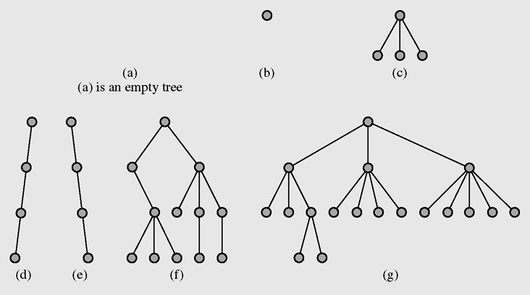
General Trees: Definitions
A tree is a data type that consists of nodes and arcs (edges)
These trees are depicted upside down with the root at the top and the leaves (terminal nodes) at the bottom
A tree can be managed using the reference root
An arc describes the father-child relation between 2 nodes
The root is a node that has no parent; it can have only child nodes
Leaves have no children (their children are null)
Non-terminal: Node having at least one child

Slide 9
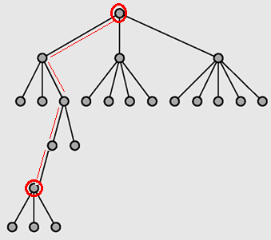
General Trees: Definitions
Each node has to be reachable from the root through a unique sequence of arcs, called a path
Path length = The number of arcs in a path = number of nodes of a path -1 = number of moving steps to a specific node
Level 1
Level of a node = Path length from the root to this node +1
Level 2
Level 3
Level 4
In some textbooks, level of the root is defined as 0. So, node level = path length
Hierachical Structure
Level 5
Level 6

Slide 10
General Trees: Definitions
Tree Height: maximum level of nodes
The height of following tree is 6
Level 1
Level 2
Level 3
Level 4
Tree Height give us complexity of search operation
Level 5
Level 6

Slide 11
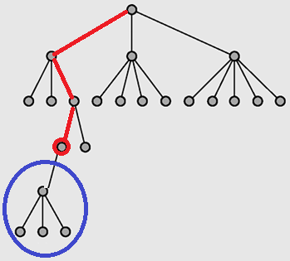
General Trees: Definitions
Ancestors/ predecessors of current node
Current node
Descendants/ successors of current node

Slide 12
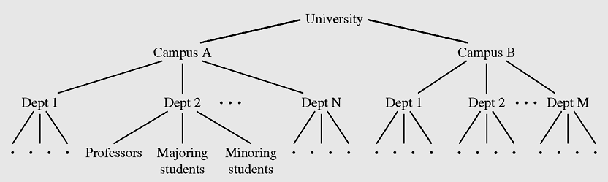
General Trees: Application Demo.
Hierarchical structure of a university shown as a tree
You can draw your family
- You can draw states of 3-checker game, two-player board chess game, China chess, …
In a tree, there are many dimensions which can be used to move from one node ➔ Non-linear data structure.

Slide 13
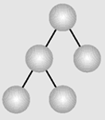
General Trees: Definitions
Deg. | Tree
n | N-ary tree
2 | Binary tree
3 | Ternary tree
Degree of a tree: Maximum number of children of each node → Branching factor
class TreeNode {
Object data;
TreeNode child1;
TreeNode child2;
TreeNode child3;
….
TreeNode childn;
}
class BinTreeNode {
Object data;
BinTreeNode left;
BinTreeNode right;
}
More child references more memory areas must be allocated. How to save memory?

Slide 14
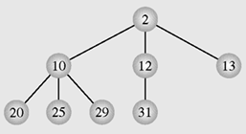
General Trees: Orderly Trees
An orderly tree is where all elements are stored according to some predetermined criterion of ordering
Ternary tree
Criterion: value in father node must be less than those in children.

Slide 15
General Trees: Binary tree is used instead of n-ary tree
class BinTreeNode{
Object data;
BinTreeNode left; ← The first child
BinTreeNode right; ← The next sibling
}
t = root.left; // con ca cua ong to
while( t!= null) {
process (t); // xu ly nut con
t = t.right; // sang nguoi con ke tiep
}
So, algorithms on binary tree will be introduced.

Slide 16
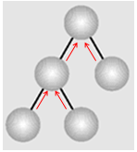
General Trees: Improved Binary tree
class BinTreeNode{
Object data;
BinTreeNode left;
BinTreeNode right;
BinTreeNode father;
}
More memory accepted,
higher performance gained in operations

Slide 17
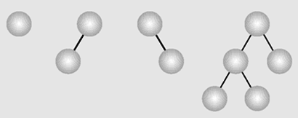
General Binary Tree (Binary Trees)
A binary tree is a tree whose nodes have two children (possibly empty), and each child is designated as either a left child or a right child
→ In Binary tree, each node may have at most two children.
class BinTreeNode{
Object data;
BinTreeNode left;
BinTreeNode right;
}
Examples of binary trees

Slide 18
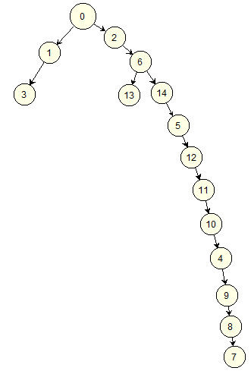
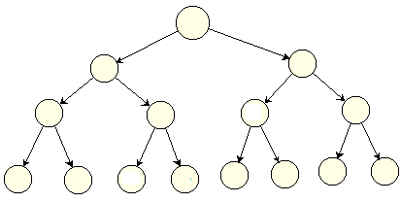
Binary Trees: Complete BT
In a complete binary tree, all non-terminal nodes have both their children, and all leaves are at the same level → Shortest tree, all path lengths from the root to leaves are the same.
Degraded tree
Cây suy biến
What do you think about search operations which are applied to complete binary trees?

Slide 19
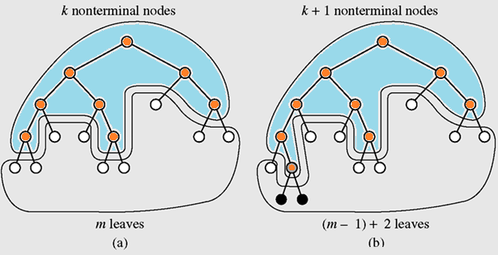
Binary Trees: Complete BT
In full binary tree:
leaves= nonterminals + 1

Slide 20
Bài tập (đề thi)
Cây BT có 15/30/52/100/110 nút, hỏi chiều cao tối thiểu?
Cây nhị phân Complete có số nút 5, 10, 15, 20, 25, 30 nút. Hỏi chiều cao của cây. Suy ra công thức giữa chiều cao của cây với số nút.

Slide 21
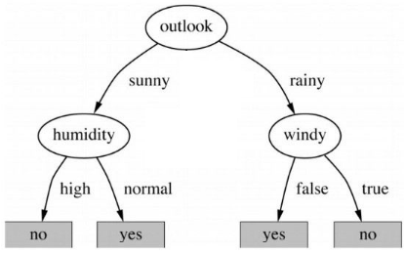
Binary Trees: Decision Trees
A decision tree is a binary tree in which all nodes have either zero or two nonempty children.
Model for giving a decision
https://techblog.vn/cay-quyet-dinh-decision-tree

Slide 22
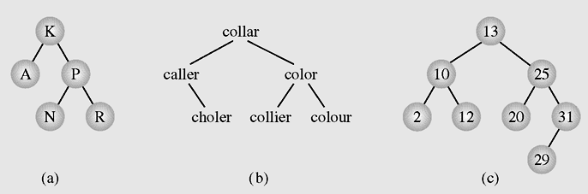
Binary Search Trees (BST)
BST is a binary tree in which all nodes are designated at exact positions based on pre-defined comparisonal criteria.
Examples of binary search trees
Notes:
at

Slide 23
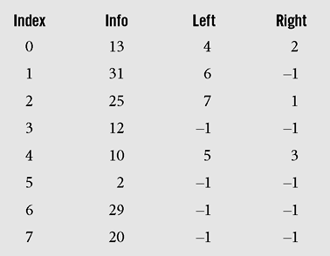
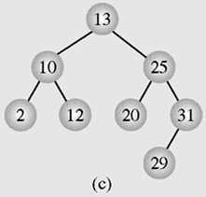
Binary Tree: Implementing using arrays
3 parallel arrays are used.

Slide 24
Binary Tree: Implementing using Linked Structure
class BTreeNode <T>{
T data;
BTNode left;
BTNode right;
}
class BTree <T>{
BTNode root;
……..
}

Slide 25
Binary Tree: Add new node
BTNode newNode = new BTNode(data);
If (root==null) root = newNode;
Else {
Determine the node p which will have new child
Determine direction;
if (direction==left) p.left = newNode;
else p.right= newNode;
}
Adding a new node to a general binary tree depends on problem data property

Slide 26
Binary Tree: Traversals
Tree traversal is the process of visiting each node in the tree exactly one time → O(number of nodes)
Breadth-first traversal is visiting each node starting from the lowest (or highest) level and moving down (or up) level by level, visiting nodes on each level from left to right (or from right to left)
Depth-first traversal proceeds as far as possible to the left (or right), then backs up until the first crossroad, goes one step to the right (or left), and again as far as possible to the left (or right)

Slide 27
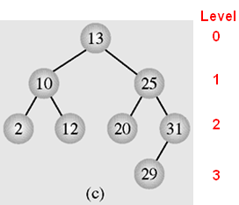
Binary Tree: Breadth-First Traversals
Using the queue q to contain nodes which will be visited based on their levels.
q = new Queue();
q.enqueue(root);
while (!q.empty){
BTNode v = q.dequeue();
if (v.left!=null) q.enqueue(v.left);
if (v.right!=null) q.enqueue(v.right);
visit(v);
}
1000
500
2000
200
100
800
300
3000
1000 500 2000 200 100 800 300 3000
Queue
Result:
13, 10, 25, 2, 12, 20, 31, 29

Slide 28
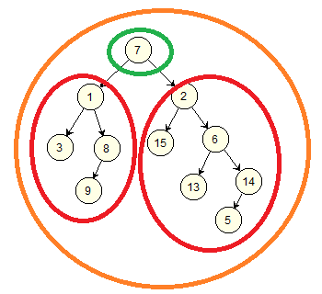
Binary Tree: Depth-First Traversals, Recursive implementations
Traversing the tree root p
Visiting the node p: (V)
Condition:
p != null
Traversing the tree root p.left
(L)
Traversing the tree root p.right
(R)

Slide 29
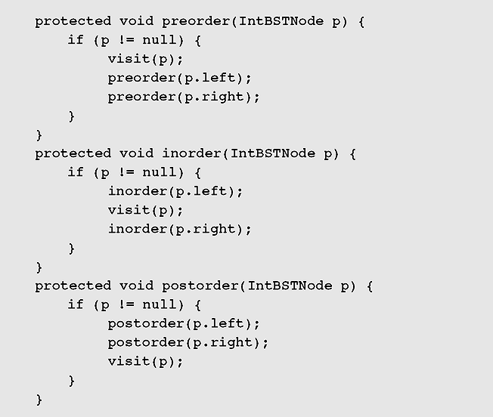
Binary Tree: Depth-First Traversals
Recursive implementations
VLR
LVR
LRV

Slide 30
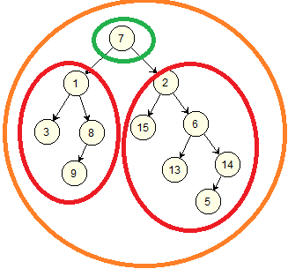
Binary Tree: Depth-First Traversals
Results:
VLR: 7, 1, 3, 8, 9, 2, 15, 6, 13, 14, 5
LVR: 3, 1, 9, 8, 7, 15, 2, 13, 6, 5, 14
LRV: 3, 9, 8, 1, 15, 13, 5, 14, 6, 2, 7

Slide 31
Binary Tree: Depth-First Traversals
Give yourself 3 binary trees then write down results of:
Breadth-First traversals
Depth-First traversals

Slide 32
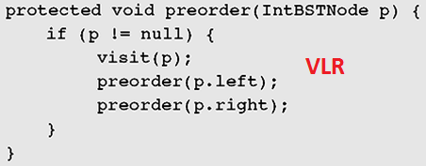
Binary Tree: Depth-First Traversals Implementation using stacks
If (root==null) return;
Stack stk= new Stack();
BTNode node;
stk.push(root);
While (!stk.empty()) {
node= stk.pop();
visit (node);
if (node.right!=null)
stk.push(node.right);
if (node.left!=null)
stk.push(node.left);
}
Give yourself algorithms for in-order and post-order traversals

Slide 33
Binary Tree: Counting number of nodes
Modifying a traversal algorithm to count number of nodes. For example: Modifying the breadth-first traversal.
int countNodes() {
int count=0;
if (root != null) {
Queue q = new Queue();
BTNode v;
q. enqueue (root);
while (! q.empty()) {
v = q.dequeue();
count = count +1;
if (v.left != null) q.enqueue(v.left);
if (v.right != null) q.enqueue(v.right);
}
}
return count;
}

Slide 34
Binary Tree: Get maximum/minimum data
Modifying a traversal algorithm to get maximum data of a binary tree. For example: Modifying the breadth-first traversal.
<T> getMax() {
if (root == null) throws new Exception (“Empty tree”);
<T> result = root.data;
Queue q = new Queue();
BTNode v;
q. enqueue (root);
while (! q.empty()) {
v = q.dequeue();
if (result < v.data) result = v.data;
if (v.left != null) q.enqueue(v.left);
if (v.right != null) q.enqueue(v.right);
}
return result;
}
Give yourself the algorithm for getting minimum data in a tree.

Slide 35
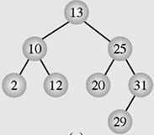
Binary Tree: Get Tree’s Height
Modifying a traversal algorithm to get the height of a binary tree. For example: Modifying the breadth-first traversal.
int <T> getHeight() {
if (root == null) return 0;
Queue q = new Queue<Node_Level>();
Node_Level v; int result=0;
q. enqueue (new Node_Level(root, 1));
while (! q.empty()) {
v = q.dequeue(); int curL = v.level;
if ( result < curL) result = curL;
BTNode left = v.node.left, right = v.node.right;
if (left != null)
q.enqueue(new Node_Level (left, curL +1));
if (right != null)
q.enqueue(new Node_Level(right, curL +1));
}
return result;
}
class Node_Level { // utility
BTNode node
int level;
Node_Level (BTNode p, int L) {
node = p;
level = L;
}
}
(13,1), (10,2), (25,2), (2,3), (12,3), (20,3), (31,3), (29,4)
Queue

Slide 36
Binary Trees: Searching data x
Based on previous demonstrations you may do yourself the algorithm for searching data x in a binary tree.

Slide 37
Binary Trees: Deleting a node
When a node is removed, references to it’s father and children may be updated. Deleting operation depends on the specific problem. There is no common way to implement this operation.

Slide 38
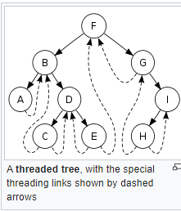
BT: Stackless Depth-First Traversal
Threads (xâu chuỗi) are references to the predecessor and successor of the node according to an inorder traversal
Trees whose nodes use threads are called threaded trees ➔ Improving traversals.
The left reference is either a reference to the left child or to the predecessor. Analogously (similarly), the right reference refers either to the right subtree or to the successor.
Threaded trees can used for preorder, inorder and post order traversals

Slide 39
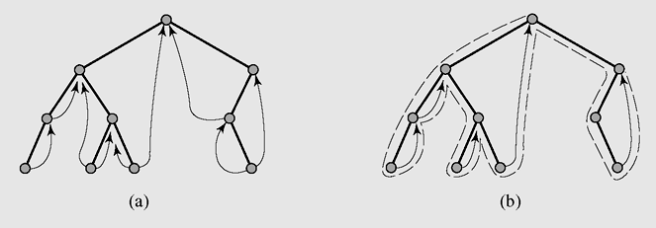
BT: Stackless Depth-First Traversal
A threaded tree and
(b) an inorder traversal’s path in a threaded tree with right successors only
Implementing threaded tree: Refer to the textbook

Slide 40
Summary

LO4.1 Define general tree, Binary Tree (and Binary Search)
Tree: Trees are a non-linear data structures including nodes and arcs and they are usually implemented using linked structures.
A tree node is described: data + references to related others. References describe relationship between some nodes.
A tree can be managed using only one reference to the root of the tree.
Definitions: root, leaf, father, child, accessors/predecessor, descendants/ successor, path, path length, node level, tree’s height, tree’s degree, complete tree
We can use binary tree instead of n-ary tree.

Slide 41
Summary
Tree can be used to manage unorderly related nodes. Problems in which data in current state are created from previous state (chess, human family, manager-staff relations,…)
Orderly tree is a tree whose nodes are designated their positions based on a pre-defined comparisional criteria.
LO4.3 Find the smallest and largest elements, number of nodes in a tree and its’ height.
Tree traversal is central algorithm of almost all algorithms applied to trees ➔ O(n) → General binary tree do not improve any operations when it is compared over other structures including arrays, linked lists.
2 traversals: breadth-first (level-based, using queue) traversal, depth-first traversal (recursive or using stack implementations).
Threaded tree is a tree in which node’s references are used to point to node’s predecessor or successor. So, stack is not needed in depth-first traversals.


Slide 42
Ôn tập- Viết vào vở
1- Cây là gì?
2- Tại sao cây được gọi là cấu trúc liên kết phi tuyến?
3- Tại sao cây được gọi là cấu trúc phân lớp (hierachical structure)?
4- Hãy định nghĩa các khái niệm cơ bản liên quan đến cây: nút, cạnh, nút gốc, nút lá, nút trung gian, mức của nút, chiều cao của cây.
5- Mô tả một nút trong cây bằng những gì?
6- Với góc nhìn hiệu suất, chiều cao của cây có ý nghĩa gì?
7- Với góc nhìn thực hành, mức độ phân nhánh của một nút (bậc của cây- cây n-phân) có ý nghĩa gì?
8- Làm thế nào để cây nhị phân có thể biều diễn được cây n-phân?
9- Duyệt cây là gì?
10- Hãy vẽ 1 cây nhị phân tuỳ ý rồi cho kết quả của phép duyệt theo chiều rộng.
11- Hãy vẽ 1 cây nhị phân tuỳ ý rồi cho kết quả của phép duyệt theo chiều sâu theo thuật toán pre-order traversal.
12- Hãy vẽ 1 cây nhị phân tuỳ ý rồi cho kết quả của phép duyệt theo chiều sâu theo thuật toán in-order traversal.
13- Hãy vẽ 1 cây nhị phân tuỳ ý rồi cho kết quả của phép duyệt theo chiều sâu theo thuật toán post-order traversal.

Slide 43
Next part: Binary Search Trees

