Slide 1
Chapter 6: Trees Part 3: Balanced BSTs- Heaps

Slide 2
Learning outcomes of this part
LO4.8: Define balanced BST and explain simple balancing algorithm
LO4.9: Define AVL Tree and explain by examples the insertion and deletion operations in it.
LO4.10: Define heap and explain its’ application.

Slide 3
Introduction
BST advantages:
Operations including Adding, searching, removing :
O(tree’s height) < O(n),number of items.
Data in the tree are always sorted.
BST disadvantages
Tree’s height depends mainly on order of data added. ← Hard
If the BST is degraded, almost of data are at one direction: O(number of nodes)
Perhaps, we like a complete BST in which its height is lowest. How can we make it?

Slide 4
Objectives & Contents
What is balanced binary search tree?
Characteristics of balanced BST.
How to create balanced BST from inputted array?
How to balance a given BST?
How to create a self-balanced BST? ← AVL Trees
What is a heap?
What are heaps used for?
Your work: Implement the demo. in these slides.

Slide 5
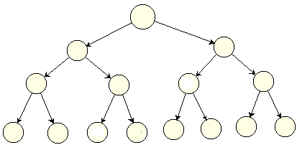
What is balanced BST?
Perfect Complete Binary Tree is a BT in which all nonterminal nodes have both their children, and all leaves are at the same level → Shortest tree, all path lengths from the root to leaves are the same. ← Ideal case

Slide 6
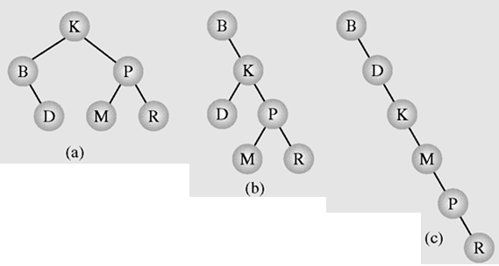
What is balanced BST?
A binary tree is height-balanced or balanced if the difference in height of both subtrees of any node in the tree is either zero or one.
A tree is considered perfectly balanced if it is balanced and all leaves are to be found on one level or two levels.
Different binary search trees with the same information
M1d1= M2d2

Slide 7
Characteristics of balanced BST
Advantages:
Its height is small → Search operation is faster and predictable.
In the worst case, the complexity of the search operation in a tree is O(height).
Disadvantages
Cost of balancing the tree: memory, time

Slide 8
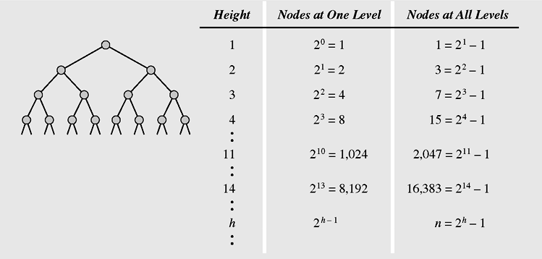
Characteristics of balanced BST
Maximum number of nodes in binary trees of different heights

Slide 9
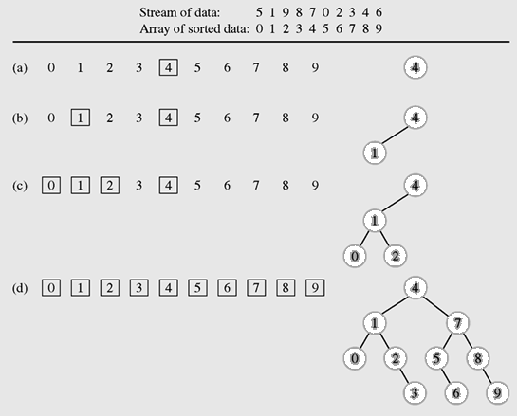
How to create balanced BST from inputted array?
(1) Sort array → O(n²)
(2) Loop Adding the middle element of each group to the tree,
Additional storage is needed

Slide 10
How to create balanced BST from sorted array?
Recursive Algorithm: Add the middle from position i to j of the ordered array a[] to the tree.
void addMid (int i, int j, int a[]){
if (i<=j){
int mid= (i+j)/2;
add (a[mid]);
addMid (i, mid-1, a);
addMid (mid+1, j, a);
}
}
void add (int a[], int n){
addMid (0, n-1, a);
}
}

Slide 11
How to balance a given BST?
Basic simple Algorithm
Step 1: Copying data in the tree to an array → O(n) → Extra memory block is needed (memory x 2)
Step 2: De-allocating memory of the initial tree (clearing the tree) → System-level cost
Step 3: Sorting the array ➔O(nlogn) or O(n²).
Step 4: Creating balanced tree using introduced basic simple algorithm.

Slide 12
How to balance a given BST? DSW Algorithm
Colin Day, Quentin F. Stout, Bette L.Warren introduced this algorithm which will transform a BST to balanced BST based on rotations with NO EXTRA MEMORY BLOCK
There are two types of rotation, left and right, which are symmetrical to one another
Step 1: Using right rotations to transform a BST to right-degraded BST → create backbone
Step 2: Using left rotations to transform it to balanced BST → create balanced tree

Slide 13
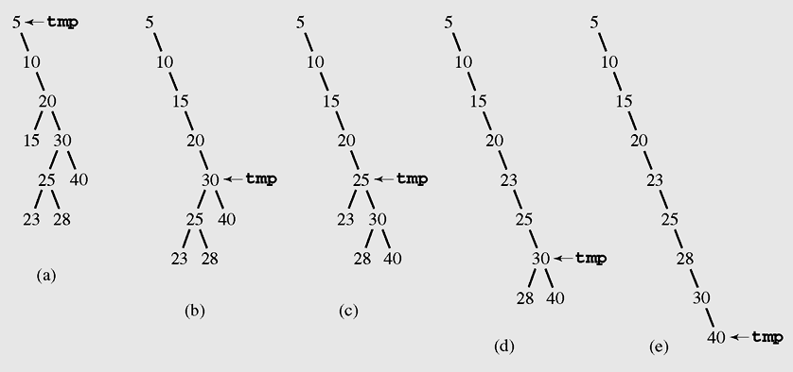
How to balance a given BST?
Step 1: Create backbone- From the root, right rotating all left children to make the backbone (BST right-degraded) → O(n)
Father node is center of rotation

Slide 14
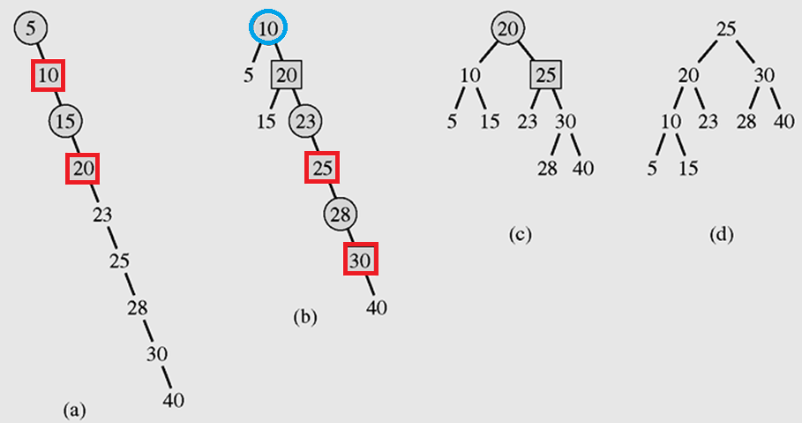
How to balance a given BST?
Step 2: create balanced tree- Left rotating will create the balanced BST → O(n)
Right child node is center of rotation

Slide 15
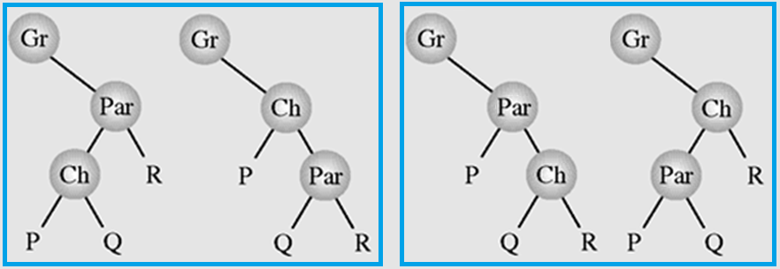
How to balance a given BST?
rotateRight (Gr, Par, Ch)
if Par is not the root of the tree // i.e., if Gr is not null
grandparent Gr of child Ch becomes Ch’s parent;
right subtree of Ch becomes left subtree of Ch’s parent Par;
node Ch acquires Par as its right child;
Update references
Similarly to rotateLeft

Slide 16
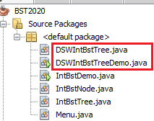
DSW Algorithm Demo.
The DSWIntBstTree class extends the IntBstTree which was introduced in the previous part.
The DSW algorithm is implemented in the class DSWIntBstTree.
The DSWIntBstTreeDemo class helps testing the implemented DSW algorithm.

Slide 17
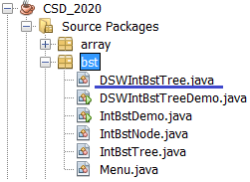
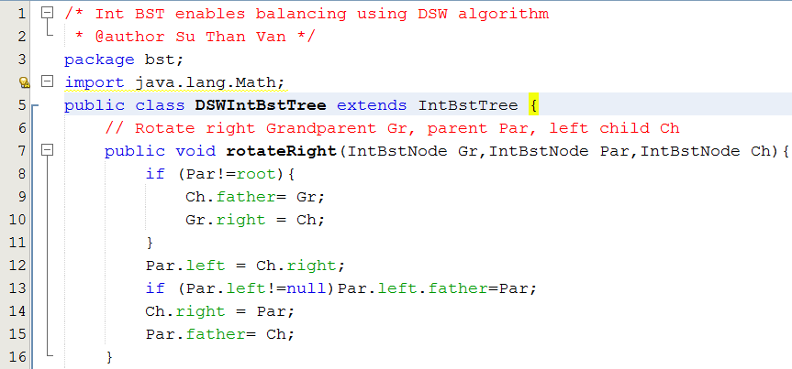
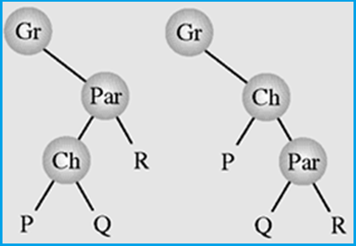
DSW Algorithm Demo.

Slide 18
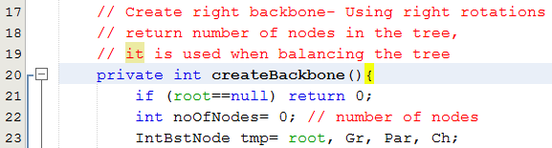
DSW Algorithm Demo.

Slide 19
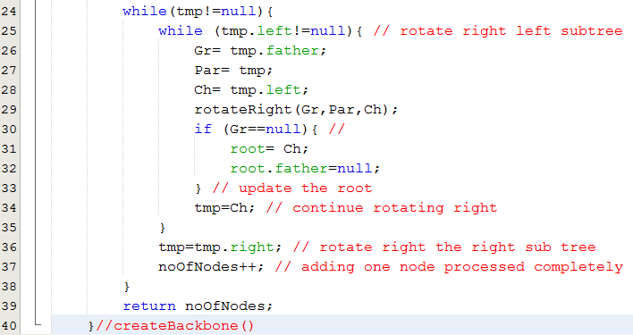
DSW Algorithm Demo.
O(n)

Slide 20
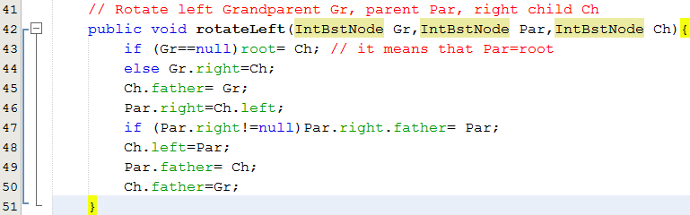
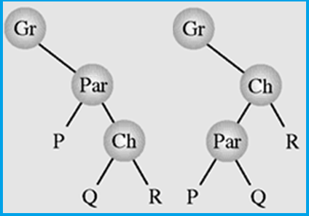
DSW Algorithm Demo.

Slide 21
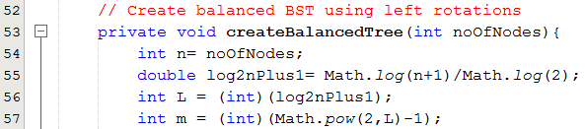
DSW Algorithm Demo.
Loop n-m times
n = 9
m= 7
O(n)

Slide 22
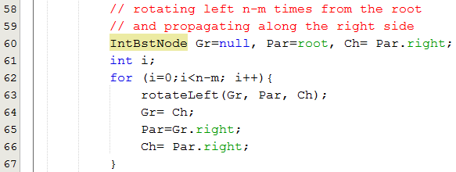
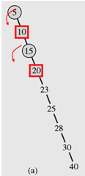
DSW Algorithm Demo.
n = 9
m= 7

Slide 23
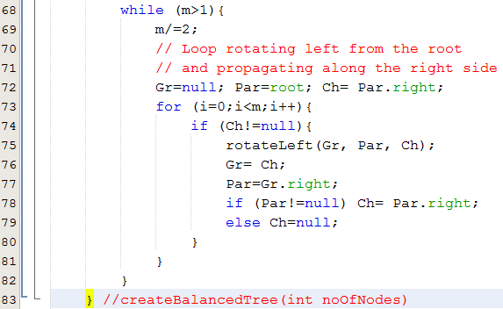
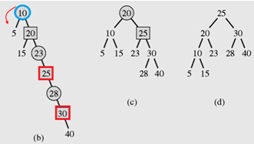
DSW Algorithm Demo.

Slide 24
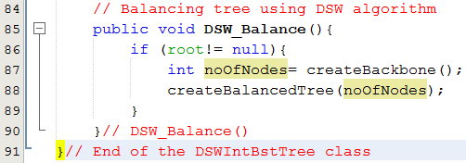
DSW Algorithm Demo.
2 steps to balance a given BST:
Step 1- Create a backbone from the tree, O(n)
Step 2- Create the balanced BST from backbone, O(n)

Slide 25
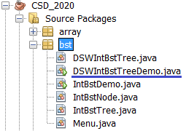
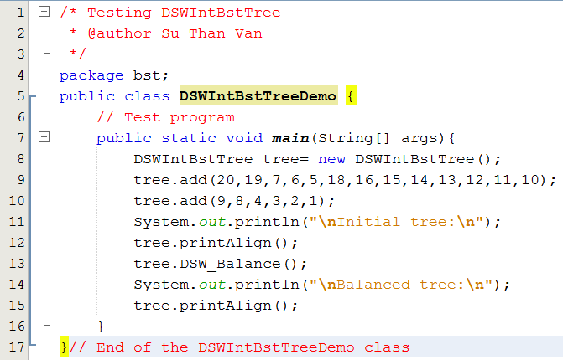
DSW Algorithm Demo.

Slide 26
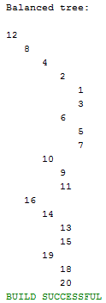
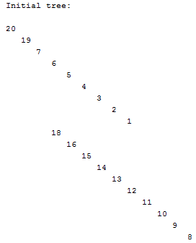
DSW Algorithm Demo.
Result

Slide 27
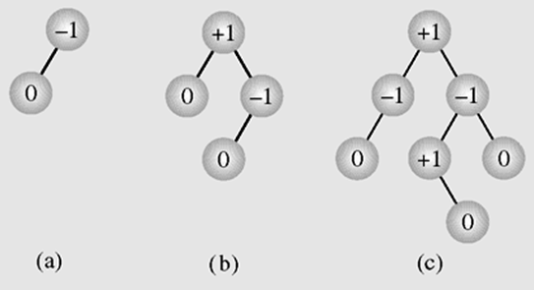
How to create a self-balanced BST? AVL Trees
Two Soviet inventors, Georgy
Adelson-Velsky and Evgenii Landis introduced a self-balancing BST in 1962.
An AVL tree is one in which the height of the left and right subtrees of every node differ by at most one
A balance factor/state is the height of the right subtree minus the height of the left subtree → Memory cost

Slide 28
How to create a self-balanced BST? AVL Trees
Node
data
state
left
right
A balance factor (int state) is the height of the right subtree minus the height of the left subtree.
Add/remove operations cause the tree un-balanced (state changes). In this case, the tree needs re-balance using rotations.

Slide 29
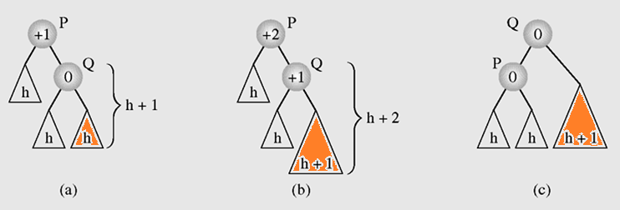
Self-Balancing AVL Trees…
Add x
Balancing a tree after insertion of a node in the right subtree of node Q

Slide 30
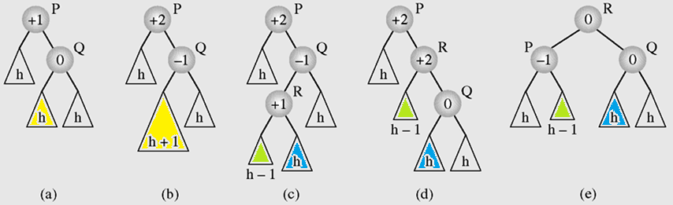
Self-Balancing AVL Trees…
Balancing a tree after insertion of a node in the left subtree of node Q

Slide 31
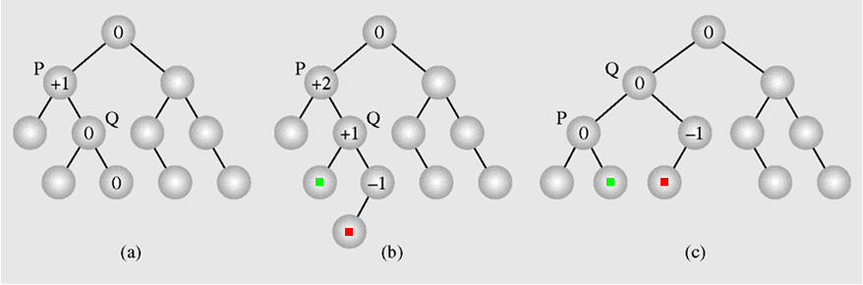
Self-Balancing AVL Trees…
An example of inserting a new node (b) in an AVL tree (a), which requires one rotation (c) to restore the height balance

Slide 32
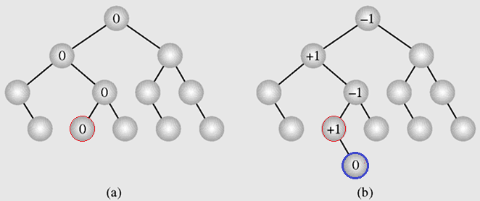
Self-Balancing AVL Trees…
In an AVL tree (a) a new node is inserted
(b) requiring no height adjustments

Slide 33
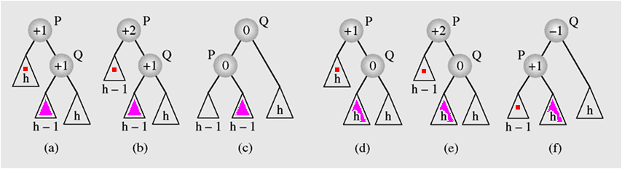
Self-Balancing AVL Trees…
Rebalancing an AVL tree after deleting a node

Slide 34
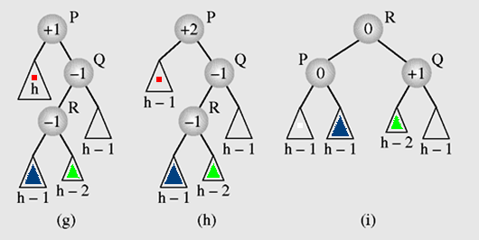
Self-Balancing AVL Trees…
Rebalancing an AVL tree after deleting a node (continued)

Slide 35
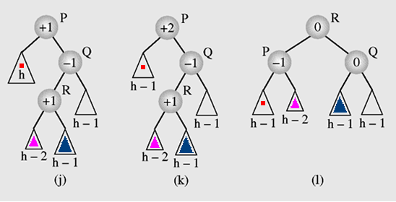
Self-Balancing AVL Trees…
Rebalancing an AVL tree after deleting a node (continued)

Slide 36
What is a heaps?
Collection whose items are layered.
A particular kind of binary tree, called a heap, has two properties:
The value of each node is greater (max heap)/less (min heap) than or equal to the values stored in each of its children
The tree is perfectly balanced, and the leaves in the last level are all in the leftmost positions
These two properties define a max heap
If “greater” in the first property is replaced with “less,” then the definition specifies a min heap

Slide 37
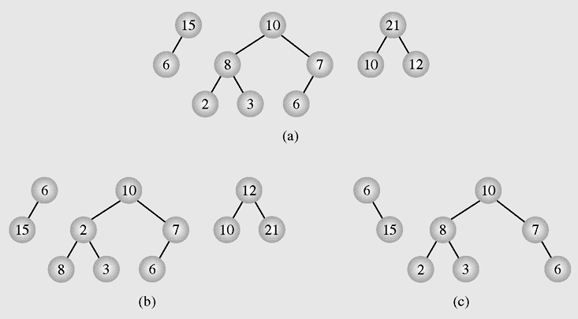
Heaps (continued)
With the view of Max heaps
Examples of (a) heaps and (b–c) nonheaps

Slide 38
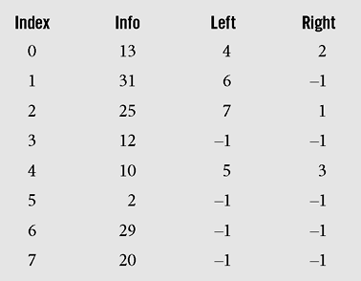
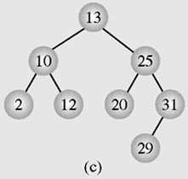
Review: Implementing using arrays
3 parallel arrays are used.
We can not find out an expression connecting father index and child index → Child indices must be stored.

Slide 39
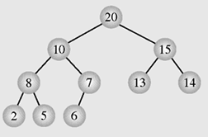
Heap vs Array
Values are put based on layer in left-to-right direction
Values are copied based on top-down layer then add to the array from the beginning
Index | 0 | 1 | 2 | 3 | 4 | 5 | 6 | 7 | 8 | 9
Value | 20 | 10 | 15 | 8 | 7 | 13 | 14 | 2 | 5 | 6

Slide 40
Heap vs Array
Index | 0 | 1 | 2 | 3 | 4 | 5 | 6 | 7 | 8 | 9
Value | 20 | 10 | 15 | 8 | 7 | 1 | 14 | 2 | 5 | 6
Value | Father Index | Left child | Right child
20 | 0 | 1 | 2
10 | 1 | 3 | 4
15 | 2 | 5 | 6
8 | 3 | 7 | 8
7 | 4 | 9 | X
13 | 5 | x | X
14 | 6 | x | X
2 | 7 | x | X
5 | 8 | x | X
6 | 9 | x | x
Left = 2.Father +1
Right= 2.Father+2

Slide 41
Heap vs Array
Father Index | Left index | Father Index | Right index | Father Index
(1-1)/2 | 1 | 0 | 2 | (2-1)/2
(3-1)/2 | 3 | 1 | 4 | (4-1)/2
(5-1)/2 | 5 | 2 | 6 | (6-1)/2
(7-1)/2 | 7 | 3 | 8 | (8-1)/2
(9-1)/2 | 9 | 4 | X
 | x | 5
 | x | 6
 | x | 7
 | x | 8
 | x | 9
Father index = (child index -1) /2
Child index -1
Father index =
2

Slide 42
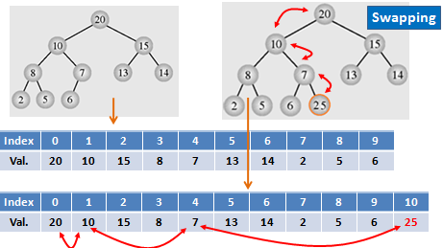
How to maintain a heap after insert new item?

Slide 43
What can Heap be used?
1- It can be used as a priority queue
- With respect to max heap, the maximum value must be at the beginning of the queue where an item can be de-queued.
- When a new item is en-queued, add operation will destroy max heap property. A bottom-up transformation must be carried out to preserve this property.

Slide 44
What can Heap be used?...
2- It can be used as a tool for sorting
→ Heap sort.
Algorithm:
for (i= n-1 ; i>0; i--) {
tranform a[0] … a[i] to max heap;
swap a[0], a[i] → move the max value to the end of the group
}

Slide 45
Heaps: Change an array to Max Heap
Move reversely from the end of the array.
If it’s value > it’s father value then swap them.
Father index = (child index -1) /2
Child index -1
Father index =
2

Slide 46
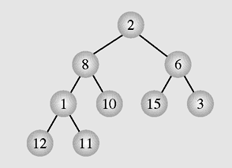
Heaps: An array may not be a heap
The array [2 8 6 1 10 15 3 12 11] seen as a tree

Slide 47
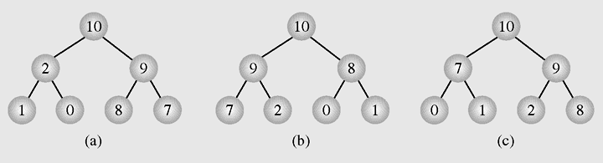
Heaps: Some heaps for a collection
Different heaps constructed with the same elements

Slide 48
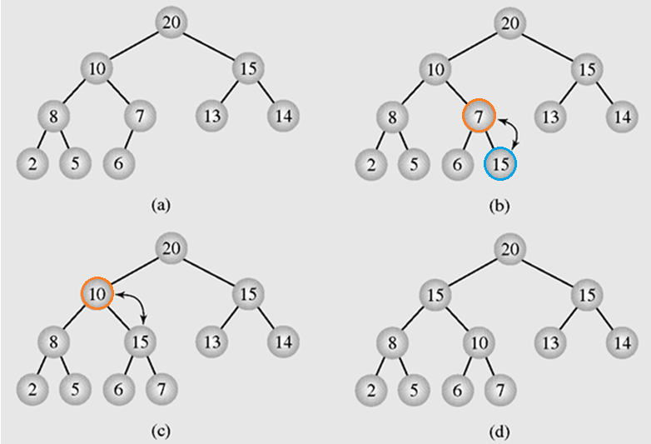
Heaps as Priority Queues
Enqueuing an element to a heap

Slide 49
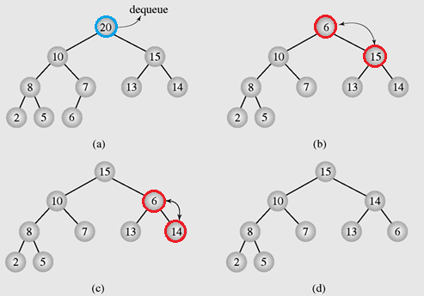
Heaps as Priority Queues (continued)
Dequeuing an element from a heap

Slide 50
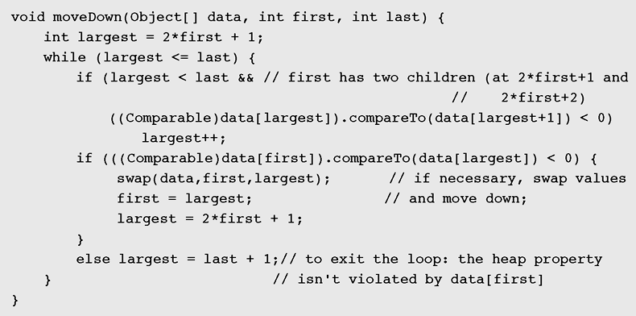
Heaps as Priority Queues (continued)
Implementation of an algorithm to move the root element down a tree

Slide 51
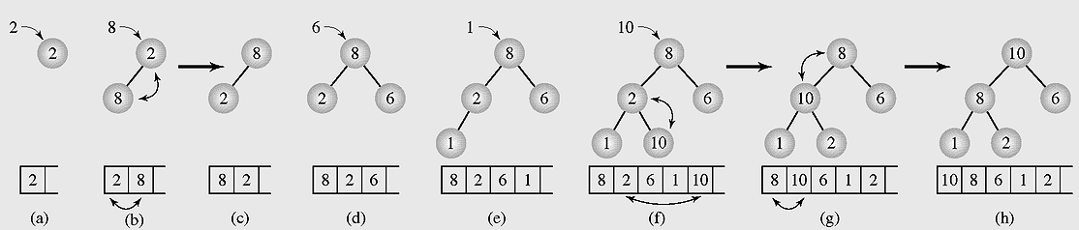
Organizing Arrays as Heaps
Figure 6-57 Organizing an array as a heap with a top-down method

Slide 52
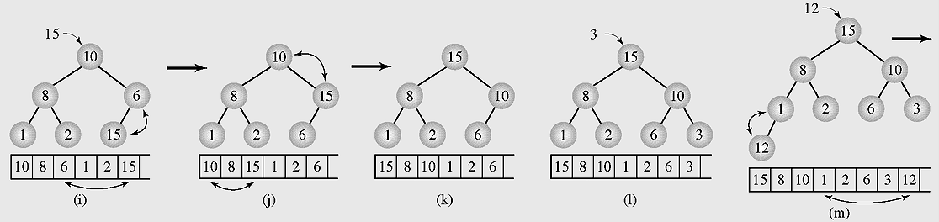
Organizing Arrays as Heaps
Figure 6-57 Organizing an array as a heap with a top-down method (continued)

Slide 53
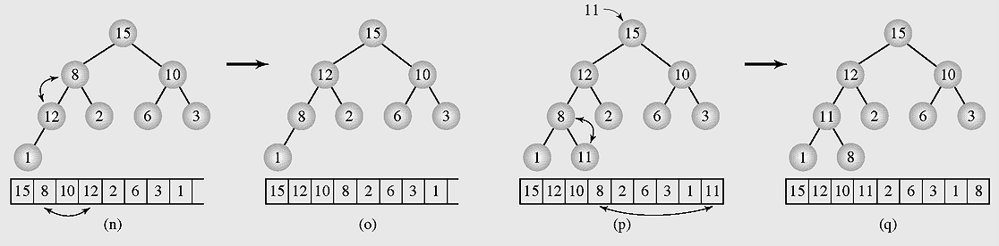
Organizing Arrays as Heaps
Figure 6-57 Organizing an array as a heap with a top-down method (continued)

Slide 54
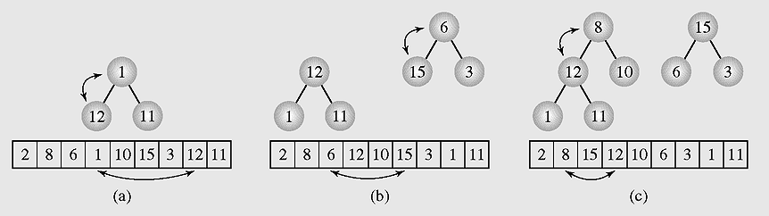
Organizing Arrays as Heaps (continued)
Figure 6-58 Transforming the array [2 8 6 1 10 15 3 12 11] into a heap with a bottom-up method

Slide 55
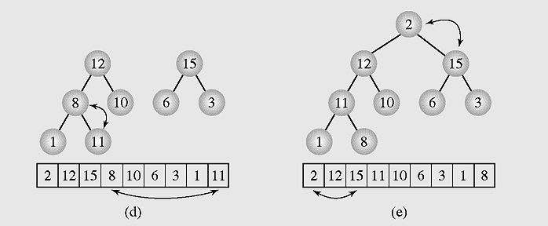
Organizing Arrays as Heaps (continued)
Figure 6-58 Transforming the array [2 8 6 1 10 15 3 12 11] into a heap with a bottom-up method (continued)

Slide 56
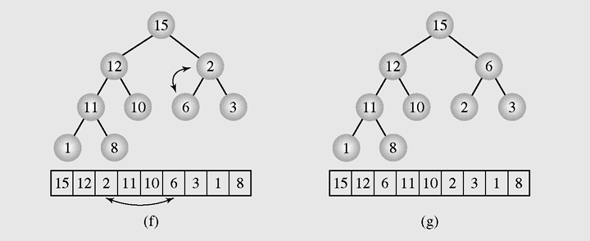
Organizing Arrays as Heaps (continued)
Figure 6-58 Transforming the array [2 8 6 1 10 15 3 12 11] into a heap with a bottom-up method (continued)

Slide 57
Polish Notation and Expression Trees
Polish notation (postfix notation) is a special notation for propositional logic that eliminates all parentheses from formulas
The compiler rejects everything that is not essential to retrieve the proper meaning of formulas rejecting it as “syntactic sugar”
Notes:
Syntactic sugar: gia vị trong cú háp

Slide 58
Summary

LO4.8: Define balanced BST and explain simple balancing algorithm
LO4.9: Define AVL Tree and explain by examples the insertion and deletion operations in it.
LO4.10: Define heap and explain its’ application.



Slide 59
Summary- Viết vào vở
What is a complete binary tree?
What is a height-based balanced tree?
What are advantages of balanced tree?
What are disadvantages of balanced tree?
How to create a balanced BST from an array?
What is the main idea of the DSW algorithm when it is applied to balance a BST?
What is a self-balanced BST?
What is the cost of self-balanced tree?
What is a max heap?
What are applications of heaps?
Cây cân bằng hoàn toàn có 15 nút. Hỏi chiều cao của cây này?
Cây cân bằng hoàn toàn có 1023 nút. Hỏi chiều cao của cây này?
Cây cân bằng hoàn toàn có 511 nút. Hỏi chiều cao của cây này?
Cây cân bằng hoàn toàn có 611 nút. Hỏi chiều cao của cây này?

