Slide 1
Chapter 9: Sorting
Các SV nhớ làm phiếu khảo sát của phòng Đào tạo nhé.
(Các GV sẽ nhận góp ý từ phiếu này để hiệu chỉnh cách dạy. Cám ơn các SV)

Slide 2
Objectives
Sorting: a process that will swap elements in a group such that all element’s positions satisfy pre-defined order based on some criteria.
Natural orders: numerical order, dictionary order
Discuss the following topics:
1- Elementary Sorting Algorithms
2- Decision Trees
3- Efficient Sorting Algorithms (shell, heap, quick, merge, and radix sorts)
4- Sorting in java.util

Slide 3
Learning Outcomes
LO6.1 Explain the operation and performance of selection sort applying to arrays.
LO6.2 Explain the operation and performance of insertion sort applying to arrays.
LO6.3 Explain the operation and performance of bubble sort applying to arrays.
LO6.4 Explain the operation and performance of quick sort applying to arrays.
LO6.5 Explain the operation and performance of merge sort applying to arrays.
LO6.6 Explain the operation and performance of heap sort applying to arrays.
LO6.7 Demonstrate the operation and performance of radix sort.

Slide 4
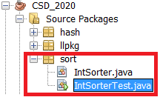
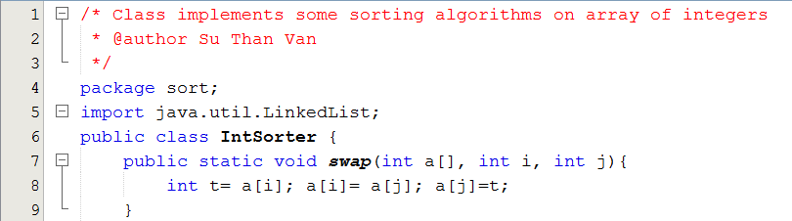
Your work
Implement sorting algorithms
Project structure:
IntSorter: class implements sort algorithms on an array of integers.
IntSorterTest: Class for testing sort algorithms

Slide 5
1- Elementary Sorting Algorithms
Why are they elementary?
What are they?
Insertion Sort
Selection Sort
Bubble Sort

Slide 6
1- Elementary Sorting Algorithms…
minIndex
Selection Sort
0 | 1 | 2 | 3 | 4 | 5 | 6 | 7 | 8
4 | 3 | 7 | 5 | 1 | 6 | 8 | 9 | 2
Swapping the element having minimum value in each group and the first element of the group.
0 | 1 | 2 | 3 | 4 | 5 | 6 | 7 | 8
1 | 3 | 7 | 5 | 4 | 6 | 8 | 9 | 2
0 | 1 | 2 | 3 | 4 | 5 | 6 | 7 | 8
1 | 2 | 7 | 5 | 4 | 6 | 8 | 9 | 3
0 | 1 | 2 | 3 | 4 | 5 | 6 | 7 | 8
1 | 2 | 3 | 5 | 4 | 6 | 8 | 9 | 7
0 | 1 | 2 | 3 | 4 | 5 | 6 | 7 | 8
1 | 2 | 3 | 4 | 5 | 6 | 8 | 9 | 7
Continue…

Slide 7
1- Elementary Sorting Algorithms…
Selection Sort
Selection sort is an attempt to localize the exchanges of array elements by finding a misplaced element first (ex: minimum value) and putting it in its final place.
Selectionsort(a[]){
L = a.length
for i = 0 to L-2 {
choose the smallest element among {a[i],a[L-1]}
swap it with a[i];
}
}

Slide 8
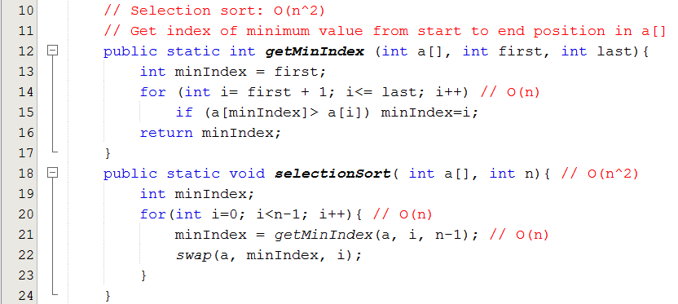
1- Elementary Sorting Algorithms…
Selection Sort

Slide 9
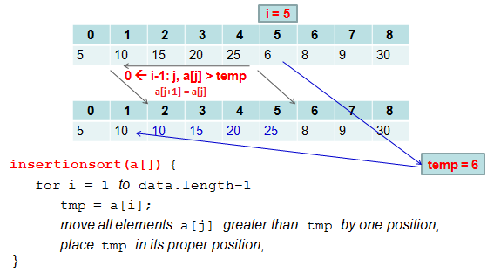
1- Elementary Sorting Algorithms
Insertion Sort
O(n²)
O(n)
O(n)

Slide 10
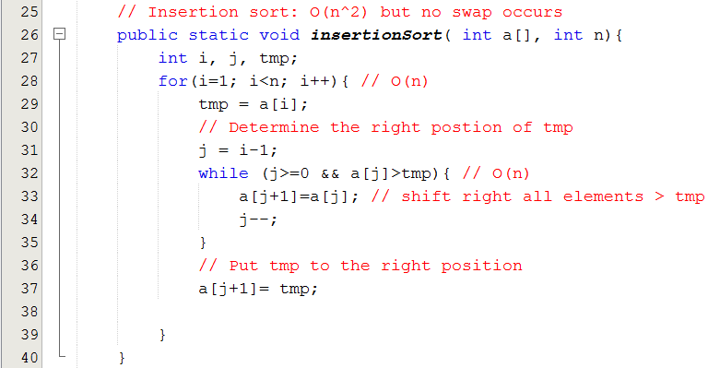
1- Elementary Sorting Algorithms
Insertion Sort

Slide 11
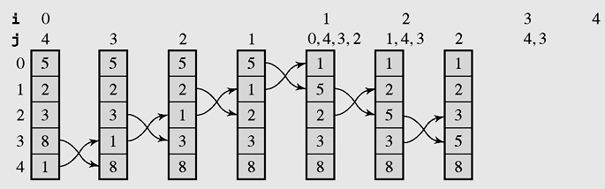
1- Elementary Sorting Algorithms…
Bubble Sort
Figure 9-3 The array [5 2 3 8 1] sorted by bubble sort

Slide 12
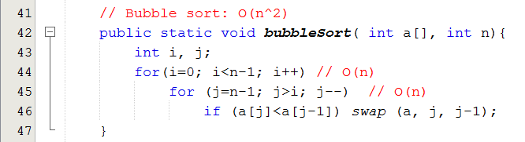
1- Elementary Sorting Algorithms…
Bubble Sort

Slide 13
2- Decision Trees
Every sorting algorithm can be expressed in terms of a binary tree in which nodes are comparisonal operations, and arcs carry the labels Y(es) or N(o)
A decision tree is when non-terminal nodes of the tree contain conditions or queries for labels, and the leaves have all possible orderings of the array to which the algorithm is applied.

Slide 14
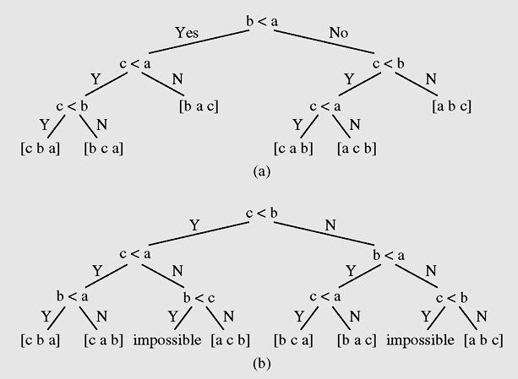
2- Decision Trees …
Decision trees for insertion sort as applied to the array [a b c]
Decision trees for bubble sort as applied to the array [a b c]

Slide 15
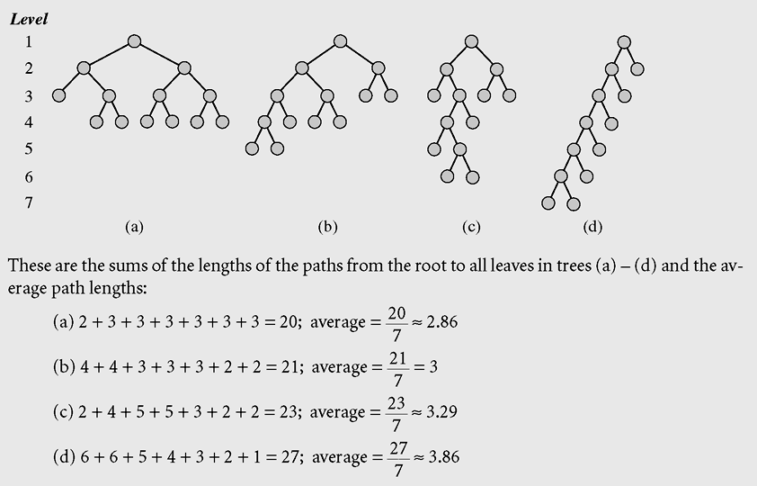
2- Decision Trees …
Examples of decision trees for an array of three elements

Slide 16
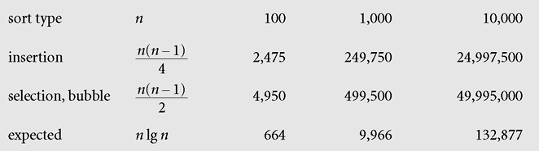
2- Decision Trees …
Evaluating elementary sorting algorithms
O(n²)
What are efficient sorting algorithms?

Slide 17
3- Efficient Sorting Algorithms
Common Principle: Divide and Conquer:
Divide: The initial large scale problem is divided into smaller scale similarly sub-problems. Solve these sub-problems.
- Conquer: Extra operations must be performed to connect sub-solutions.
There are about a dozen efficient sorting algorithms. Followings will be introduced:
Quick Sort
Merge Sort
Heap Sort
Radix sort
Shell sort (optional)

Slide 18
Theorem 2: Master Theorem
Let f be an increasing function that satisfies the recurrence relation f(n) = af(n/b) + cn^{d}
Whenever n= b^{k}, where k is a positive integer, a ≥ 1, b is an integer greater than 1, and c and d are real numbers with c positive and d nonnegative. Then
Notes:
The Master theorem is useful in analyzing the complexity of many important divide-and-conquer algorithms.
Theorem 1 is a special case of this theorem.

Slide 19
3- Efficient Sorting Algorithms…
Quick Sort
It is introduced by C. A. R. Hoare
Main idea:
Choose an element of array, called as bound/pivote (trị cầm canh) to divide(partition) the array to 2 subarrays. Left subarray contains values< pivote, right subarray contains values >= pivote.
Recursively performing on left subarray and right subarray.

Slide 20
3- Efficient Sorting Algorithms…
Quick Sort
i →
← j
9 | 6 | 2 | 1 | 5 | 3 | 4 | 8 | 7 | 0
bound= 5
0 | 6 | 2 | 1 | 5 | 3 | 4 | 8 | 7 | 9
0 | 4 | 2 | 1 | 5 | 3 | 6 | 8 | 7 | 9
j
i
0 | 4 | 2 | 1 | 3 | 5 | 6 | 8 | 7 | 9
Best case: O(nlogn)
Recursively partitioning on this subarray
Recursively partitioning on this subarray

Slide 21
3- Efficient Sorting Algorithms…
Quick Sort
Worst case
9 | 6 | 2 | 1 | 5 | 3 | 4 | 8 | 7 | 0
bound= 9
0 | 6 | 2 | 1 | 5 | 3 | 4 | 8 | 7 | 9
Recursively partitioning on this subarray
Recursively partitioning on this subarray
Low performace
How to choose bound (pivote):
It can be first / last/ mid / random element
Median (phần tử trung vị, phần tử nằm giữa trong 3 trị đầu-cuối-giữa)
a [0] = 9
a [9] = 0
a [4] = 5
➔ Pivote = 5

Slide 22
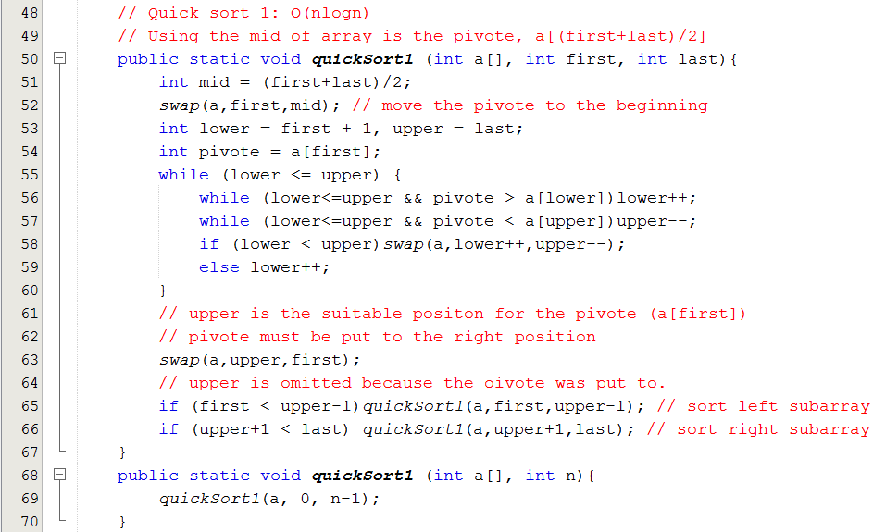
3- Efficient Sorting Algorithms…
Quick Sort
< pivote
>= pivote

Slide 23
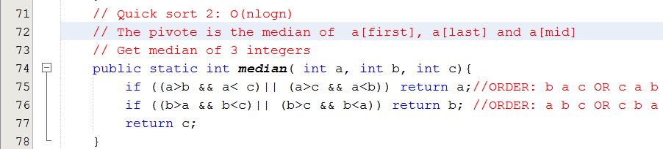
3- Efficient Sorting Algorithms…
Quick Sort

Slide 24
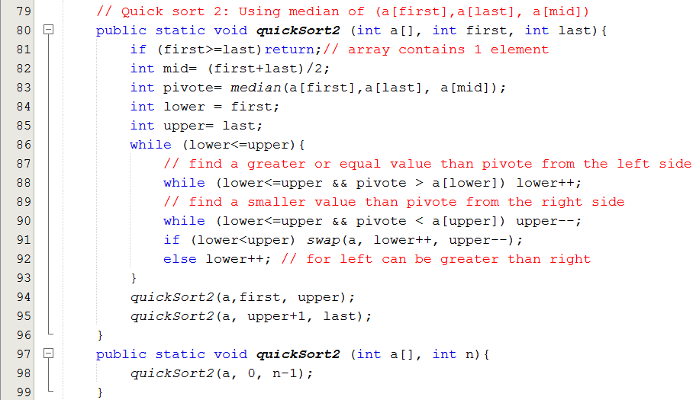
3- Efficient Sorting Algorithms…
Quick Sort
< pivote
>= pivote

Slide 25
3- Efficient Sorting Algorithms…
Merge Sort
It was one of the first sorting algorithms used on a computer and was developed by John von Neumann.
Mergesort makes partitioning as simple as possible and concentrates on merging sorted halves of an array into one sorted array
mergesort(data)
if data have at least two elements
mergesort(left half of data); // recursion
mergesort(right half of data);
merge(both halves into a sorted list);

Slide 26
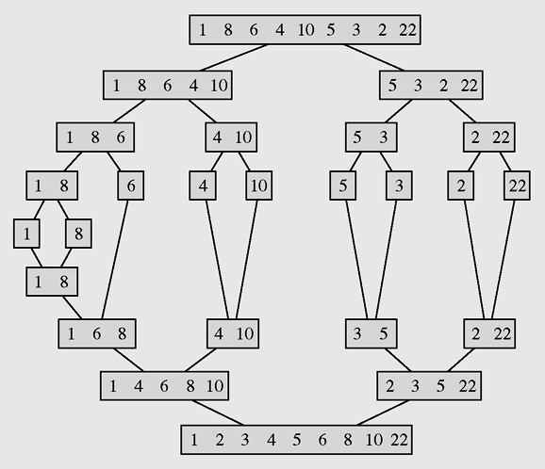
3- Efficient Sorting Algorithms…
Merge Sort
Partition until subarray contains 1 element
Merge
The array [1 8 6 4 10 5 3 2 22] sorted by mergesort

Slide 27
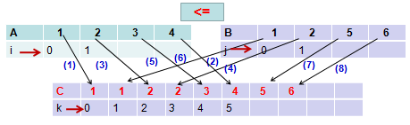
3- Efficient Sorting Algorithms…
Merge Sort
Merge 2 ordered arrays to one ordered array

Slide 28
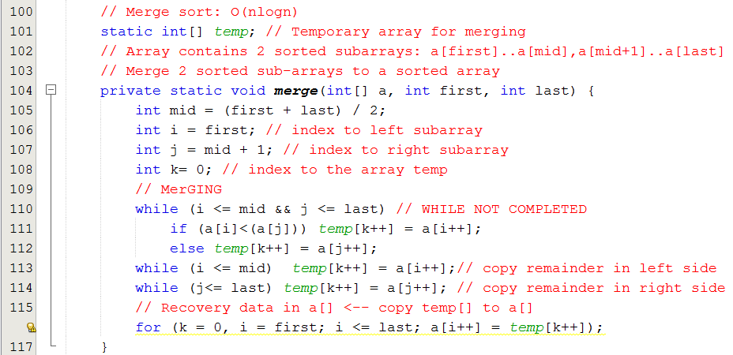
3- Efficient Sorting Algorithms…
Merge Sort

Slide 29
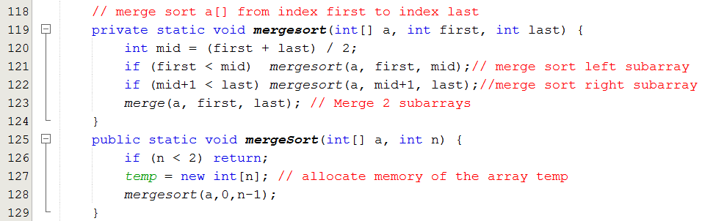
3- Efficient Sorting Algorithms…
Merge Sort

Slide 30
3- Efficient Sorting Algorithms…
Heap Sort
A heap is a binary tree, stored in an array, with the following two properties (it is introduced in the chapter Trees):
The value of each node is not less than the values stored in each of its children.
The tree is perfectly balanced and the leaves in the last level are all in the leftmost positions.
Elements in a heap are not perfectly ordered

Slide 31
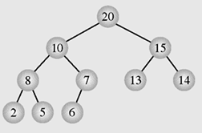
3- Efficient Sorting Algorithms…
Heap Sort
The largest element is in the root node and that, for each other node, all its descendants are not greater than the element in this node- Max heap
Index | 0 | 1 | 2 | 3 | 4 | 5 | 6 | 7 | 8 | 9
Value | 20 | 10 | 15 | 8 | 7 | 13 | 14 | 2 | 5 | 6

Slide 32
3- Efficient Sorting Algorithms…
Heap Sort
The largest element is in the root node and that, for each other node, all its descendants are not greater than the element in this node
Index | 0 | 1 | 2 | 3 | 4 | 5 | 6 | 7 | 8 | 9
Value | 20 | 10 | 15 | 8 | 7 | 13 | 14 | 2 | 5 | 6
Child index -1
Left = 2.Father +1
Right= 2.Father+2
Father index =
2

Slide 33
3- Efficient Sorting Algorithms…
Heap Sort
heapsort(data[])
transform data into a heap;
for i = data.length-1 downto 2 //reverse consideration
swap the root with the element in position i;
restore the heap property for the tree data[0], . . . , data[i-1];

Slide 34
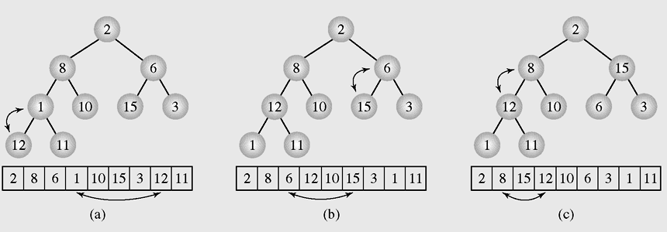
3- Efficient Sorting Algorithms…
Heap Sort
Figure 9-9 Transforming the array [2 8 6 1 10 15 3 12 11] into a heap

Slide 35
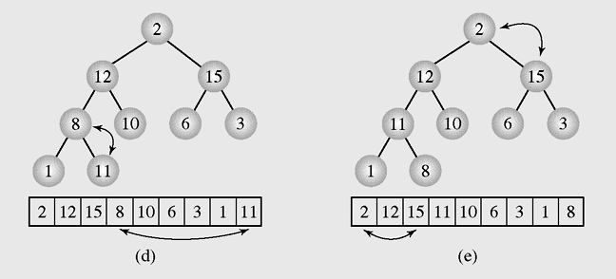
3- Efficient Sorting Algorithms…
Heap Sort
Figure 9-9 Transforming the array [2 8 6 1 10 15 3 12 11] into a heap (continued)

Slide 36
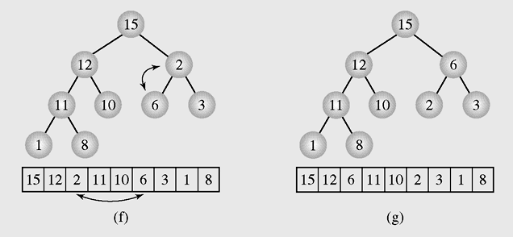
3- Efficient Sorting Algorithms…
Heap Sort
Figure 9-9 Transforming the array [2 8 6 1 10 15 3 12 11] into a heap (continued)

Slide 37
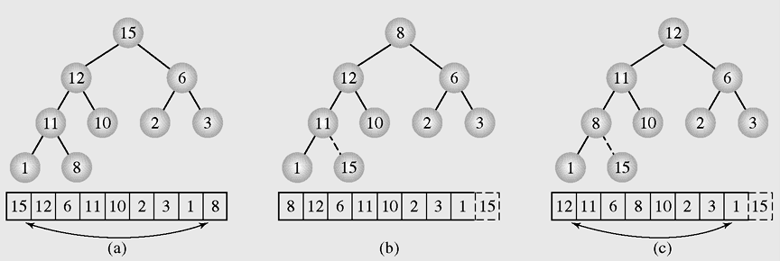
3- Efficient Sorting Algorithms…
Heap Sort
Figure 9-10 Execution of heap sort on the array [15 12 6 11 10 2 3 1 8], which is the heap constructed in Figure 9.9

Slide 38
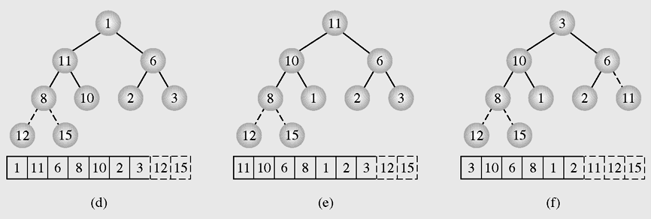
3- Efficient Sorting Algorithms…
Heap Sort
Figure 9-10 Execution of heap sort on the array [15 12 6 11 10 2 3 1 8], which is the heap constructed in Figure 9.9 (continued)

Slide 39
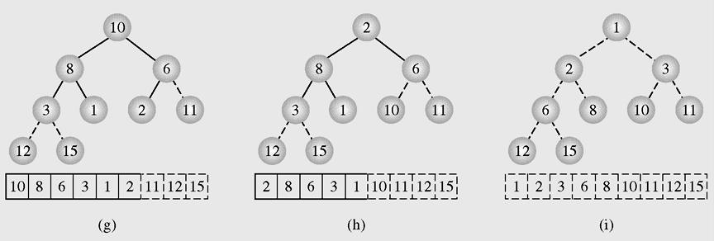
3- Efficient Sorting Algorithms…
Heap Sort
Figure 9-10 Execution of heap sort on the array [15 12 6 11 10 2 3 1 8], which is the heap constructed in Figure 9.9 (continued)

Slide 40
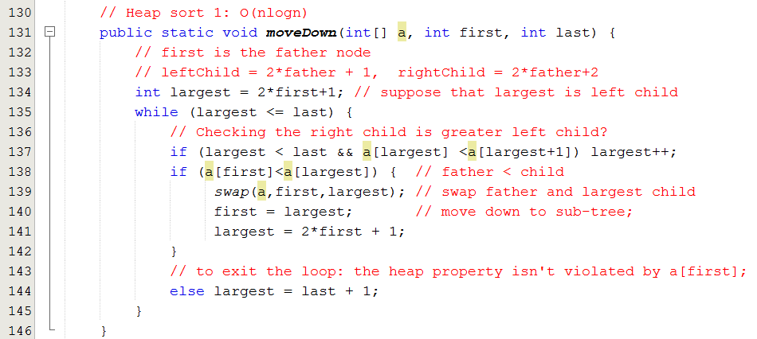
3- Efficient Sorting Algorithms…
Heap Sort

Slide 41
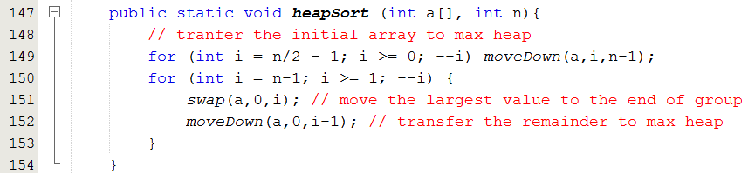
3- Efficient Sorting Algorithms…
Heap Sort

Slide 42
3- Efficient Sorting Algorithms…
Radix Sort
A technique to sort integers by proceeding right to left
A technique that looks at each number as a string of bits so that all integers are of equal length
radixsort()
for d = 1 to the position of the leftmost digit of longest number
distribute all numbers among piles 0 through 9 according to the dth digit;
put all integers on one list;

Slide 43
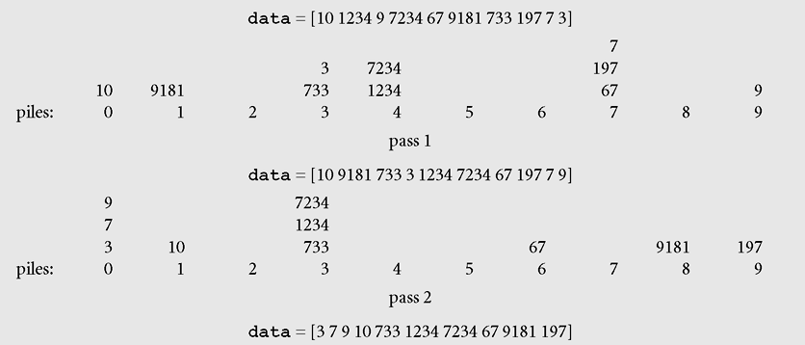
3- Efficient Sorting Algorithms…
Radix Sort → O(An), it may be greater than O(nlogn)
queues
The biggest of rightmost digit of longest numbers
O(n)
d= 1, units digits
O(n)
d= 2, tens digits
Sorting the list 10, 1234, 9, 7234, 67, 9181, 733, 197, 7, 3 with radix sort

Slide 44
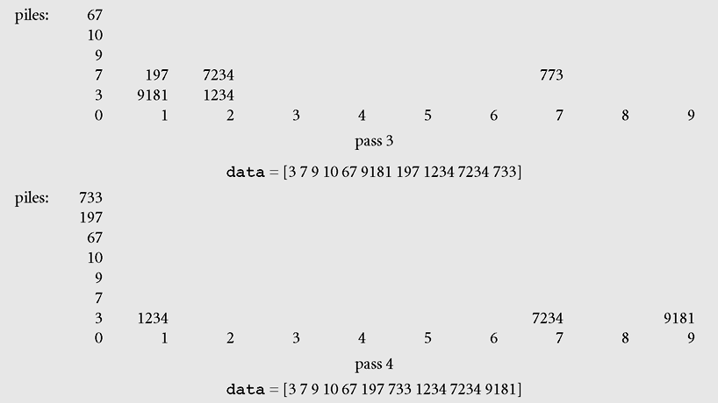
3- Efficient Sorting Algorithms…
Radix Sort
d= 3, hundreds digits
d= 4, thousands digits
Sorting the list 10, 1234, 9, 7234, 67, 9181, 733, 197, 7, 3 with radix sort

Slide 45
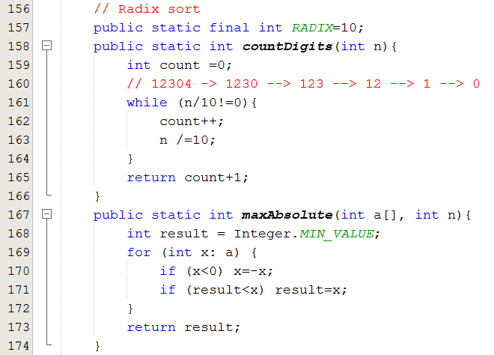
3- Efficient Sorting Algorithms…
Radix Sort
N | Digits
1..9 | 1
10..99 | 2
100..999 | 3
1000..9999 | 4
Digits = (int) log₁₀(N) +1

Slide 46
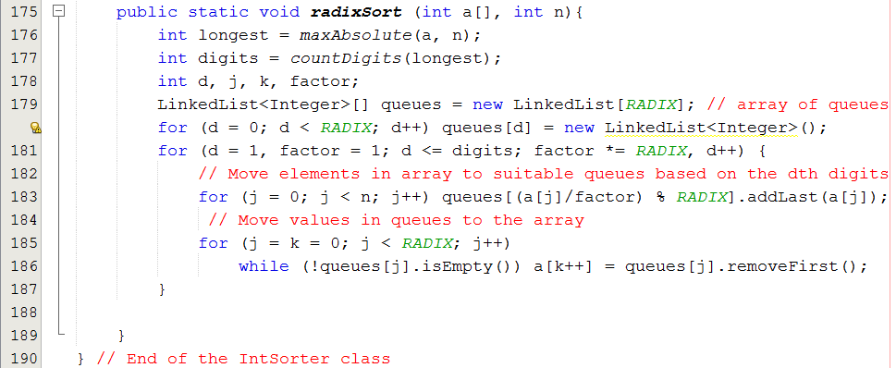
3- Efficient Sorting Algorithms…
Radix Sort

Slide 47
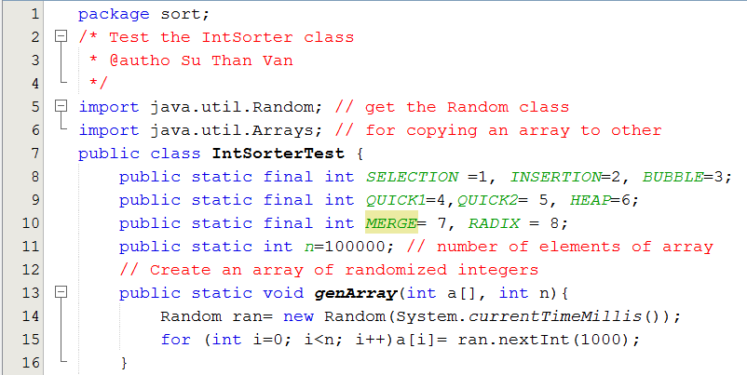
The IntSorterTest class

Slide 48
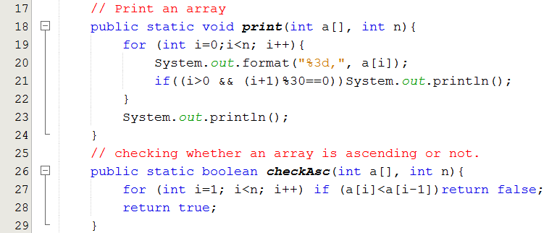
The IntSorterTest class

Slide 49
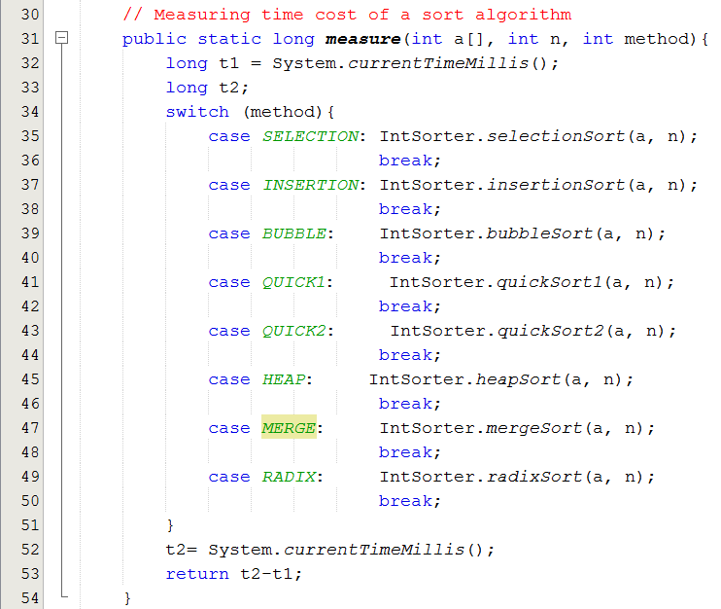
The IntSorterTest class

Slide 50
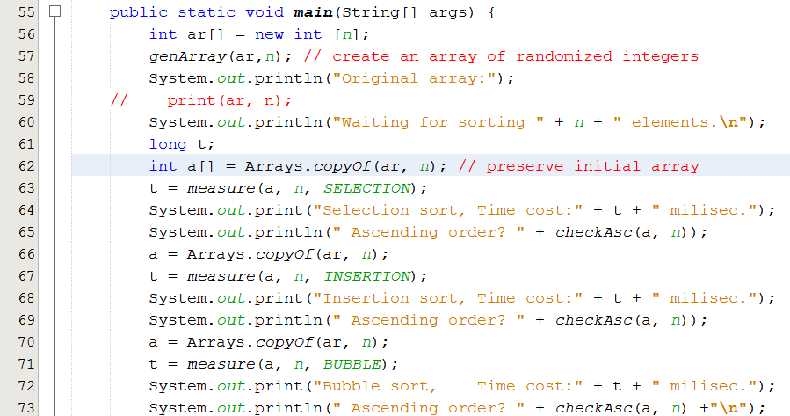
The IntSorterTest class

Slide 51
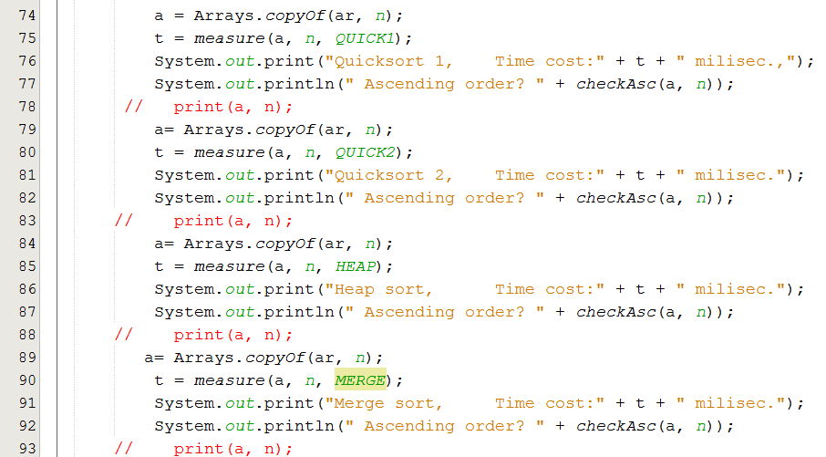
The IntSorterTest class

Slide 52
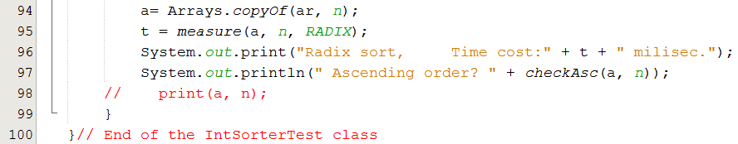
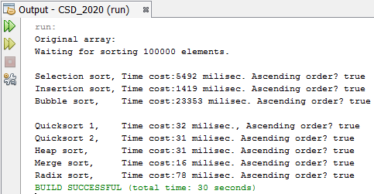
The IntSorterTest class

Slide 53
3- Efficient Sorting Algorithms
Shell Sort
Study yourself
It is introduced by Donall L. Shell
Shell sort divides the original array into subarrays, sorting them separately, and then dividing them again to sort the new subarrays until the whole array is sorted
Example:
Divide 5-step (5 subarrays) -> Sort sub-arrays using an elementary sort algorithm
Divide 3-step (3 subarrays) -> Sort sub-arrays
Divide 1-step (1 array) -> Final Sort
h-step

Slide 54
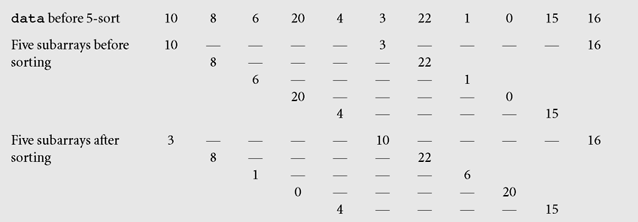
3- Efficient Sorting Algorithms…
Shell Sort
h=5
The array [10 8 6 20 4 3 22 1 0 15 16] sorted by Shell sort
1000^2= 10^6
200^2 * 5= 20. 10^4

Slide 55
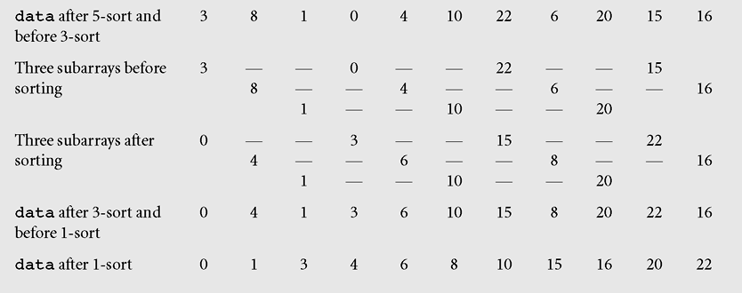
3- Efficient Sorting Algorithms…
Shell Sort
h=3
h=1
The array [10 8 6 20 4 3 22 1 0 15 16] sorted by Shell sort (continued)

Slide 56
3- Efficient Sorting Algorithms…
Shell Sort
divide data into h subarrays;
for i = 1 to h; // h is the difference of indexes in initial h-step array, data_{i}
sort subarray data_{i} using any simple method;
// ( insertion is usually used)
sort array data;
Shell Sort
determine numbers h_{t} … h₁ of ways of dividing array data into subarrays;
for (h=h_{t}; t > 1; t--, h=h_{t})
divide data into h subarrays;
for (i = 1 to h) sort subarray data_{i};
sort array data

Slide 57
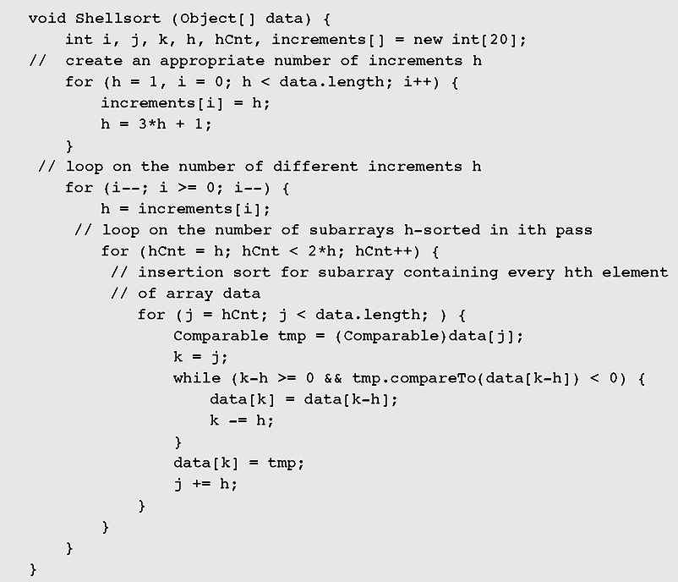
3- Efficient Sorting Algorithms…
Shell Sort
Implementation

Slide 58
3- Efficient Sorting Algorithms…
Radix Sort
private final int radix = 10;
private final int digits = 10;
public void radixsort(int[] data) {
int d, j, k, factor;
Queue<Integer>[ ] queues = new Queue[radix]; // array of queues
for (d = 0; d < radix; d++) queues[d] = new Queue<Integer>();
for (d = 1, factor = 1; d <= digits; factor *= radix, d++) {
// Move elements in array to suitable queues base on the d^{th} digits
for (j = 0; j < data.length; j++) queues[(data[j] / factor) % radix].enqueue(data[j]);
// Move values in queues to the array
for (j = k = 0; j < radix; j++)
while (!queues[j].isEmpty()) data[k++] = queues[j].dequeue();
}
}
Read yourself
Click to next part
Evaluation
Time for divide and division modulo are not appropriate.
More additional space for queues
Move elements: digits * 2 * O(n)

Slide 59
4- Sorting in java.util
Java provides two sets of versions of sorting methods: one for arrays (Arrays) and one for lists (Collections)
The utility class Arrays includes a method for:
Searching arrays for elements with binary search
Filling arrays with a particular value
Converting an array into a list, and sorting methods
The sorting methods are provided for arrays with elements of all elementary types except Boolean

Slide 60
4- Sorting in java.util…
For each type of sorting method there are two versions:
One for sorting an entire array
One for sorting a subarray
public static void sort(int[] a);
public static void sort(int[] a, int first, int last);

Slide 61
4- Sorting in java.util…
How to use Java library to sort your array of objects?
The Comparator Interface
A comparison function, which imposes a total ordering on some collection of objects
The following demonstration will show you the way to sort a list based on different criteria: A list of employees will be sorted based on
(1) Ascending IDs
(2) Descending salaries then ascending IDs.

Slide 62
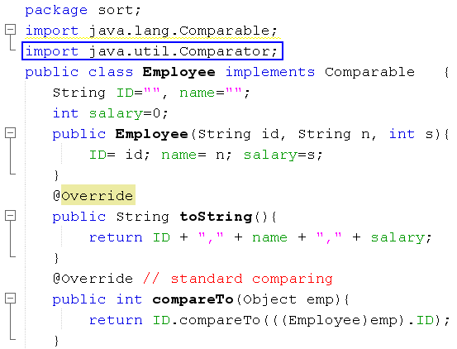
4- Sorting in java.util…
Java.lang is default package
Default Comparision based on IDs (Comparable interface)

Slide 63
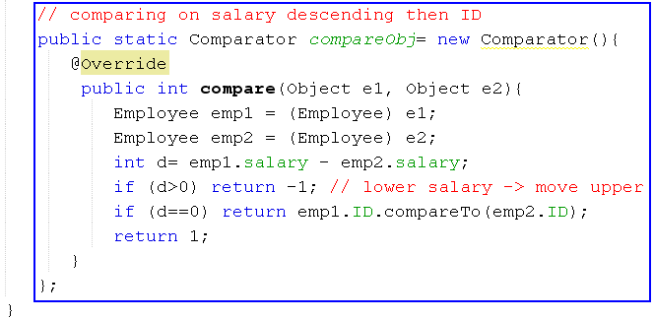
4- Sorting in java.util…
Comparing 2 employees based on descending salaries then ascending IDs → Use the Comparator interface.
Create an anonymous object for comparing 2 employees

Slide 64
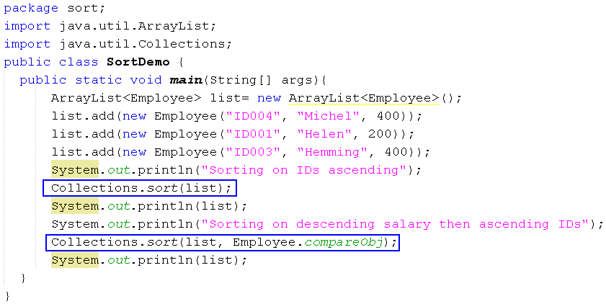

4- Sorting in java.util…

Slide 65
Summary
Sorting is a two step process: Choose the criteria that will be used to order data and determine how to put a set of data in order using that criterion
An insertion sort starts by considering the two first elements of the array data, which are data[0] and data[1]
Selection sort is an attempt to localize the exchanges of array elements by finding a misplaced element first and putting it in its final place

Slide 66
Summary (continued)
A decision tree is when nonterminal nodes of the tree contain conditions or queries for labels, and the leaves have all possible orderings of the array to which the algorithm is applied
Shell sort divides the original array into subarrays, sorting them separately, and then dividing them again to sort the new subarrays until the whole array is sorted

Slide 67
Summary (continued)
Mergesort makes partitioning as simple as possible and concentrates on merging sorted halves of an array into one sorted array
Radix sort is a a technique to sort integers by proceeding right to left
Java provides two sets of versions of sorting methods: one for arrays and one for lists

Slide 68
Summary: Learning Outcomes

LO6.1 Explain the operation and performance of selection sort applying to arrays.
LO6.2 Explain the operation and performance of insertion sort applying to arrays.
LO6.3 Explain the operation and performance of bubble sort applying to arrays.
LO6.4 Explain the operation and performance of quick sort applying to arrays.
LO6.5 Explain the operation and performance of merge sort applying to arrays.
LO6.6 Explain the operation and performance of heap sort applying to arrays.
LO6.7 Demonstrate the operation and performance of radix sort.






Next session: Hashing

