Slide 1
Chapter 10 Hashing

Slide 2
Introduction
Structure | Array | Linked list | BST
Add first | O(n) | O(1) | O(height)
Add last | O(1) | O(1) | O(height)
Search | O(n) | O(n) | O(height) -> O(logn)
Remove | O(n) | O(1) | O(height)
What we have to do if requirements in search and remove operations needs higher efficiency?
Hashing
It still be “Divide and Conquer principle”

Slide 3
Introduction
Function/ Mapping: a process which accepts input then give ONLY ONE output
Hashing
h
Sub set 0
x
y
Sub set 1
Domain of h
Codomain of h
Sub set 2
( Integers )
position
…..
Sub set i
Hash
function
item
….
Sub set n-1
O(1)

Slide 4
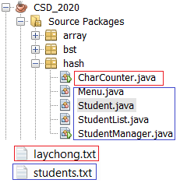
Contents
Discuss the following topics:
Basic of Hashing
Common Hash Functions
Collision Resolution
Deletion
Perfect Hash Functions
Hash Functions for Extendible( extensible) Files
Hashing in java.util
Your works: Re-implement project
( At the end of the slides)

Slide 5
Objectives
LO7.1 Explain the concept of "hash". Define concepts hash function and hash table and their application.
LO7.2 Demonstrate the types of hash functions: Division, Folding,...
LO7.3 Explain the collision and collision-handling.
LO7.4 Explain the open addressing method for collision-resolution: linear and quadratic probing.
LO7.5 Explain the chaining method for collision-resolution: separate chaining and Coalesced chaining.
LO7.6 Define perfect hash function and extendible hashing.

Slide 6
1- Basic of Hashing …
What is hashing? → A process in which a large data set will be partitioned to some data subsets.
What is the tool for hashing? → hash function
What will hash function do? → This function is constructed by implementer which accepts input data ( whole initial data or a chunk of initial data or memory address of data) and an unique index is it’s output → index of a subset.
Who will implement hash function? → Hashing implementer.

Slide 7
1- Basic of Hashing …
Array vs Hash table:
Similarities:
Contiguous memory blocks
Differences:
Property | Array | Hash table
Index | Direct a[i] | Output of hash function
Storing position | contiguous | May not be contiguous
Content of an item | Data object only | Data object + extra information
Memory efficiency | The best | Extra memory is it’s cost
Add operation | O(n) | O(1) + a little
Search operation | O(n) | O(1) + a little
Remove | O(n) | O(1) + a little

Slide 8
1- Basic of Hashing …
To find a function (h) that can transform a particular key (K) (a string, number or record) into an index in the table used for storing items of the same type as K, the function h is called a hash function
If h transforms different keys into different numbers, it is called a perfect hash function
To create a perfect hash function, the table has to contain at least the same number of positions as the number of elements being hashed

Slide 9
1- Basic of Hashing …
Data structure of a hash table entry:
Whether this memory stored data or not
Used?
Data object
Data for collission resolution
Why conflict resolution is needed? → Because some data objects are mapping to only one index.
Ex:
K1= 1025 → h(K1) = 1025%100 = 25
K2= 125 → h(K2) = 125%100 = 25
K3= 25 → h(K3) = 25%100 = 25

Slide 10
1- Basic of Hashing…
Data
index
Storage
K1, val1
K2, val2
K3, val3
…
Kn, valn
0
1
Hash function
h: Key → index
➔ Search: O(1)
2
3
4
5
6
7
There are m^{n} functions
→ What function should we select?
m: number of needed blocks for storing items.
A key can be any value in the set of keys
→ There is a situation in which some keys are mapped to one index? How to resolve this collision?
…
…
…
…
m-1

Slide 11
2- Common Hash Functions
The division method is the preferred choice(%, modulo).
TSize =sizeof(table), as in h(K) = K mod Tsize→(K%Tsize)
Folding method: h(K) = sum of parts mod Tsize
Ex: K= 123-45-6789 → sum 3 parts:123 + 45 + 6789= 6957
→ h(K)=6957 mod TSize
Ex: K= 123-45-6789 → Sum 5 parts:12 + 34+56+78+9 = 189
Mid-square method :
Ex: TSize= 1024= 2¹⁰, K= 3121 → K²=9 740 641
K²= 1001010 0101000010 1100001 → h(K) = 0101000010₂ = 32
Extraction method: Only a part of the key is used to compute the address
Ex: K = 123-45-6789, h(K) = 1289 mod Tsize
Radix transformation method:
K = 345₁₀ → 423₉ ➔ h(K) = 423 mod Tsize ( =23 if Tsize=100 )
Hash table designer will decide an approach for hash function

Slide 12
3- Collision Resolution
Collision: A situation in which 2 distinct inputs but the hash function gives the same output → Same positions
Common methods are used as solutions:
Open Addressing Method – Dò tìm vị trí kế cận
Chaining Method/ Coalesced chaining – băm theo nhóm
Bucket Addressing : Một phần tử là một khối data
Ex:
K1= 1025 → h(K1) = 1025%100 = 25
K2= 125 → h(K2) = 125%100 = 25
K3= 25 → h(K3) = 25%100 = 25

Slide 13
3- Collision Resolution…
Open Addressing Method: when a key collides with another key, the collision is resolved by finding an available table entry other than the position (address) to which the colliding key is originally hashed. Common methods:
if no collision, using h(k).
If collision, using h’(k) = h(k) + f(i): i varies from 1, 2, 3, 4, 5,…. until an empty position is found
f(i): probing function. It can be linear (bậc 1 – dò tuyến tính- simplest method) or quadratic function (bậc 2 – dò bậc 2)

Slide 14
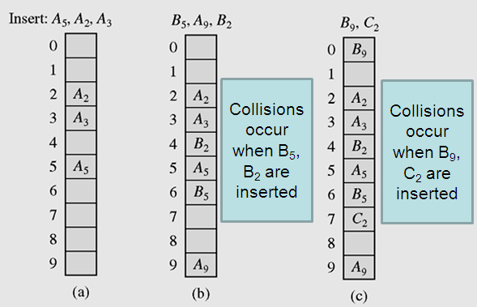
3- Collision Resolution…
Open Addressing Method:
Linear Probing, p(i) =i, h’(K) = (h(K) + i) mod TSize
i= 1, 2, 3…
Resolving collisions with the linear probing method. Subscripts indicate the home positions of the keys being hashed.

Slide 15
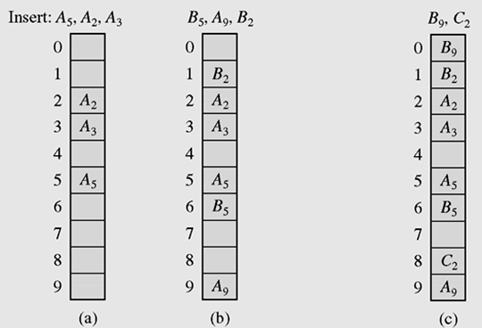
3- Collision Resolution…
Open Addressing Method:
Quadratic method: p(i)= ± i², h’(K) = (h(K) ± i²) mod TSize
Insert B₉
→Collision
probe: i=1
h(9+1)=h(10)=0 →OK
Insert C₂
→Collision
probe: i=1
h(2+1)=h(3)=3 →No OK
h(2-1)=h(1)=1 → No OK
probe: i=2, i²=4
h(2+4)= 6 → No OK
h(2-4), -2<0 → No OK
probe: i=3, i²=9
h(2+9)= 1 → No OK
h(2-9)= 2-9<0→ No OK
probe: i=4, i²=16
h(2+16)= 8 → OK
Insert B₅
→Collision
probe: i=1
h(5+1)=h(6)=6 →OK
Insert B₂
→Collision
probe: i=1
h(2+1)=h(3)=3 →No OK
h(2-1)=h(1)=1
OK
Using quadratic probing for collision resolution
h’(K) = (h(K) ± i²) mod 10

Slide 16
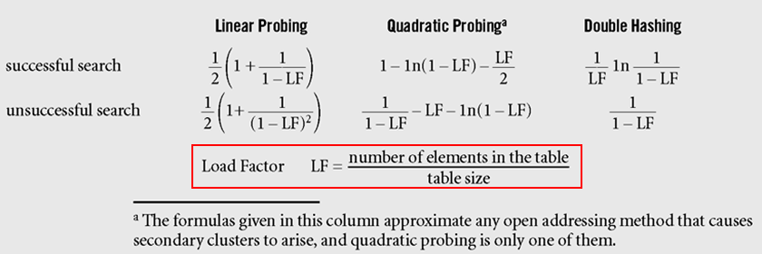
3- Collision Resolution…
Evaluation:
Formulas approximating, for different hashing methods, the average numbers of trials for successful and unsuccessful searches (Knuth, 1998)

Slide 17
3- Collision Resolution…
Chaining Method
Keys do not have to stored in table itself, each position of the table is associated with a linked list or chain of structures whose info fields store keys or references to keys
This method is called separate chaining, and a table of references (pointers) is called a scatter table (bảng phân phối)

Slide 18
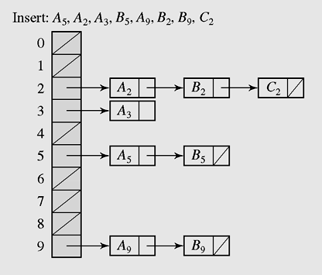
3- Collision Resolution…
Chaining Method
h(K) → index of a linked list of elements having the same value of hash function.
K→ h(K) → index →traverse the appropriate list to find the element having this key.
In chaining, colliding keys are put on the same linked list
(The most flexible hash format)

Slide 19
3- Collision Resolution…
Coalesced chaining
A version of chaining called coalesced hashing- băm theo nhóm sử dụng array- (or coalesced chaining) combines linear probing with chaining
An overflow area (vùng tràn, hầm chứa) known as a cellar can be allocated to store keys for which there is no room in the table

Slide 20
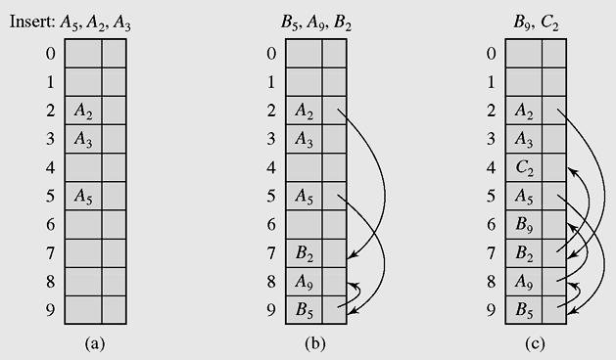
3- Collision Resolution…
Coalesced chaining
Index of next element in the same group
7
9
8
Coalesced hashing puts a colliding key in the last available position of the table

Slide 21
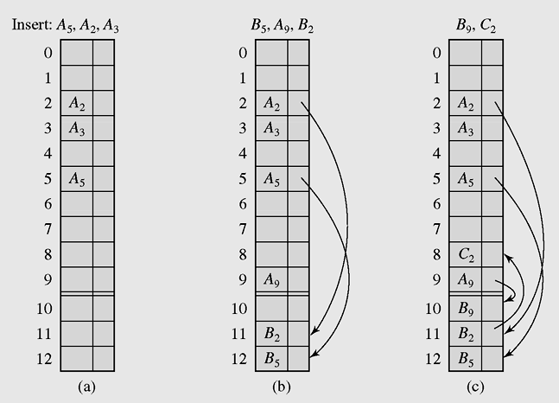
3- Collision Resolution…
Coalesced chaining
Main area
When cellar is full, inserted element will be put to the main region
Cellar: overflow area
Mechansm: bottom-up
Coalesced hashing that uses a cellar

Slide 22
3- Collision Resolution…
Bucket Addressing Method
To store colliding elements in the same position in the table can be achieved by associating a bucket with each address
A bucket (khối) is a block of space large enough to store multiple items

Slide 23
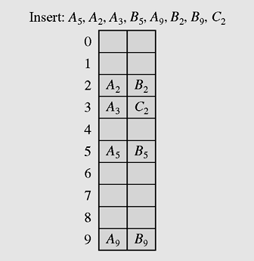
3- Collision Resolution…
Bucket Addressing
bucket
Insert C₂
→ Collision
Use linear probing
Bucket 3 containing a space
Insert C₂ to bucket 3
Collision resolution with buckets ( bucket=2)
and linear probing method

Slide 24
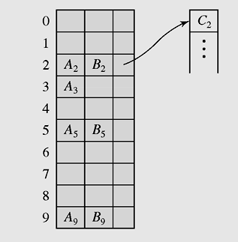
3- Collision Resolution…
Bucket Addressing
bucket
Reference to separate overflow area
Collision resolution with buckets and overflow area

Slide 25
4- Deletion
Begin
Deleted data (k)
h(k)
index
Search and delete k
Group k
End

Slide 26
4- Deletion
Structure and collision resolution of the hash table will decide the way by which its elements are deleted. They can be
Linear search for deletion
Linear search to locate the linked list of the subgroup then delete an element in this linked list.
Linear search to locate the subgroup then delete an element in this subgroup, update references to next elements in the same subgroup.

Slide 27
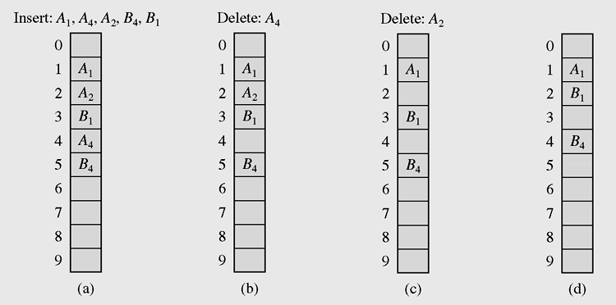
4- Deletion…
H’(k) = H(k) + i
Update locations
Delete A4
Linear search in the situation
where both insertion and deletion of keys are permitted

Slide 28
5- Perfect Hash Functions (*)
Hash table
Key set K
|K| = |I|
Index set I
One-to-one and onto mapping
k
i
h
Ideal situation
h(k1) != h(k2), if k1 !=k2
h = ?
Memory is available for storing all items and no overflow area (cellar) is needed.

Slide 29
5- Perfect Hash Functions (*)…
If a function requires only as many cells in the table as the number of data so that no empty cell remains after hashing is completed, it is called a minimal perfect hash function → Vừa đủ để lưu trữ
(*) You need to know essential features on this part only.

Slide 30
Perfect Hash Functions…
Cichelli’s method
Cichelli's Method is implemented to minimize the number of collisions when mapping values to a hash table, using a hash function. This program reads key words from a text file and inserts these key words into a hash table by following Cichelli's method.
Cichelli’s method is an algorithm to construct a minimal perfect hash function
It is used to hash a relatively small number of reserved words
Where g is the function to be constructed
h(word) = (length(word) + g(firstLetter(word)) + g(lastLetter(word))) mod Tsize
The algorithm has three parts:
Computation of the letter occurrences
Ordering the words
Searching

Slide 31
5- Perfect Hash Functions…
Cichelli’s method
Choose a value of max;
Compute the number of occurrences of each first letter and last letter in the set of all words.
Order all words in accordance to the frequency of occurrence of the first and the last letters;

Slide 32
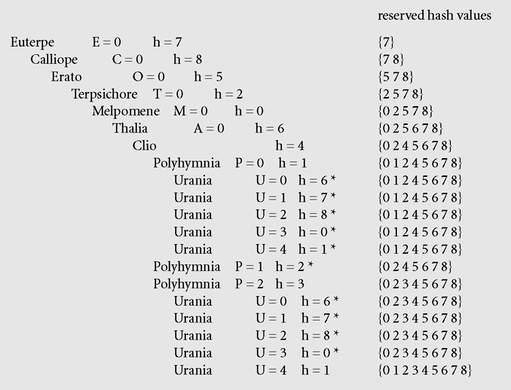
5- Perfect Hash Functions…
Cichelli’s method
Set of nine Muses – 9 nhà thơ
Calliope, Clio, Erato, Euterpe, Melpomene, Polyhymia, Terpsichore, Thalia, Urania
Occurrence of each letter at the first and the last position:
E (6), A(3), C(2), O(2), T(2), M(1), P(1), U(1).
According to frequencies, list may be ordered as :
Euterpe, Calliope, Erato, Terpsichore,
Melpomene, Thalia, Clio, Polyhymnia, Urania
Figure 10-11 Subsequent invocations of the searching procedure with Max = 4 in Cichelli’s algorithm assign the indicated values to letters and to the list of reserved hash values. The asterisks indicate failures.

Slide 33
5- Perfect Hash Functions…
The FHCD Algorithm
The FHCD algorithm, an extension of Cechelli’s approach, devised by Thomas Sager, searches for a minimal perfect hash function of the form (modulo TSize), where g is the function to be determined by the algorithm
h(word) = h₀(word) + g(h₁(word)) + g(h₂(word))

Slide 34
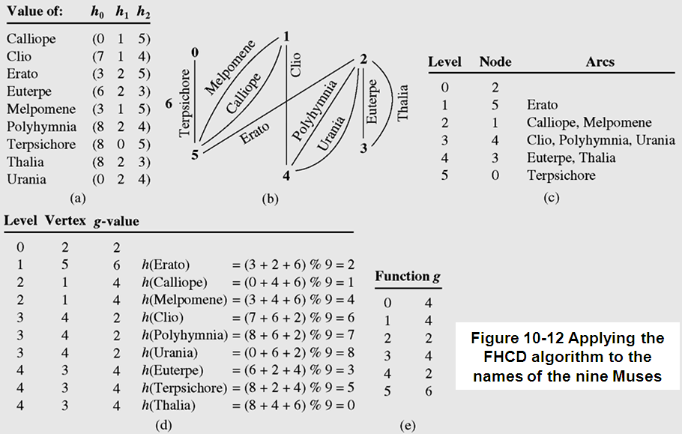
5- Perfect Hash Functions…
The FHCD Algorithm

Slide 35
6- Hash Functions for Extendible Files (*)
File=table.
Expandable hashing, dynamic hashing, and extendible hashing methods distribute keys among buckets in a similar fashion
Data → h(Data) → index → buckets[index]
The main difference is the structure of the index (directory)
In expandable hashing and dynamic hashing, a binary tree is used as an index of buckets
In extendible hashing, a directory of records is kept in a table

Slide 36
6- Hash Functions for Extendible Files …
Extendible hashing accesses the data stored in buckets indirectly through an index that is dynamically adjusted to reflect changes in the file
Extendible hashing allows the file to expand without reorganizing it, but requires storage space for an index
Values returned by such a hash function are called pseudokeys

Slide 37
6- Hash Functions for Extendible Files …
It is commonly used in database files, file = hash table
Record = <key, value>
A bucket contains some records, a bucket has a unique index and new buckets can be created.
Bucket indexes are stored in an distinct area and it is called as directory→ file = {directory, bucket1, bucket 2, ……}
Extendible hashing allows the file to expand without reorganizing it, but requires storage space for an index
Multi-level / extendible hashing can be used
Values returned by such a hash function are called pseudokeys
Data → h(key) → index → access directory → file position of buckets[index]
Cluster = 4KB

Slide 38
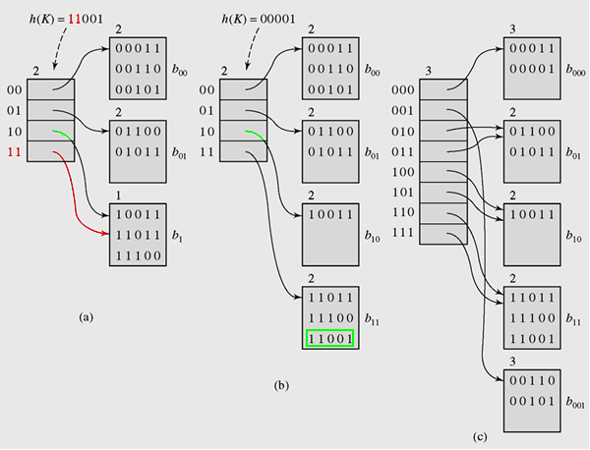
6- Hash Functions for Extendible Files…
Function h generates patterns of 5 bits
2 leftmost bits present the position in the directory containing the reference to the bucket containing the key. Number of bits is called local depth (2 in this example).
11001 arrives.
Case of splitting a bucket
Case of increase depth, expand the directory
An example of extendible hashing

Slide 39
6- Hash Functions for Extendible Files…
With this method, no index is necessary because new buckets generated by splitting existing buckets are always added in the same linear way, so there is no need to retain indexes
A bucket is full when its loading factor exceeds a certain level. This bucket will be splitted.
A reference split indicates which bucket is to be split next
After the bucket is divided, the keys in this bucket are distributed between this bucket and the newly created bucket, which is added to the end of the table

Slide 40
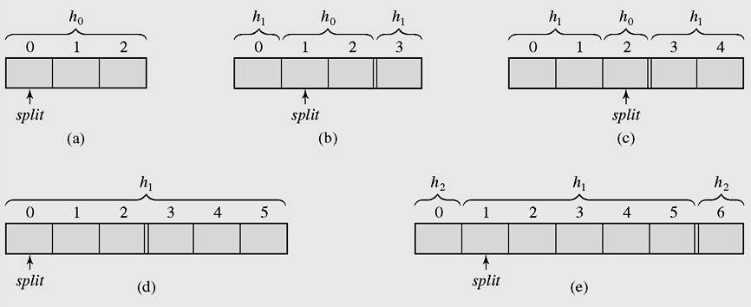
6- Hash Functions for Extendible Files…
Linear Hashing…
TSize=3
Some hash functions may be applied.
Splitting buckets in the linear hashing technique

Slide 41
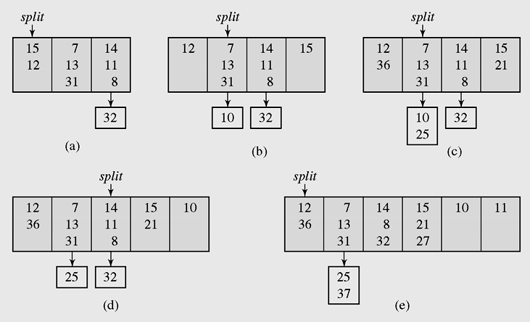
6- Hash Functions for Extendible Files…
Linear Hashing…
TSize=3
H₀(K) = K mod TSize
H₁(K) = K mod 2*Tsize
Figure 10-15 Inserting keys to buckets and overflow areas with the linear hashing technique

Slide 42
7- Hashing in java.util
Main classes implement hashing technique
The HashMap class
The HashSet class
The HashTable class

Slide 43
Using The HashMap class
HashMap is an implementation of the interface Map
A map is a collection that holds pairs (key, value) or entries
A hash map is a collection of singly linked lists (buckets); that is, chaining is used as a collision resolution technique
In a hash map, both null values and null keys are permitted

Slide 44
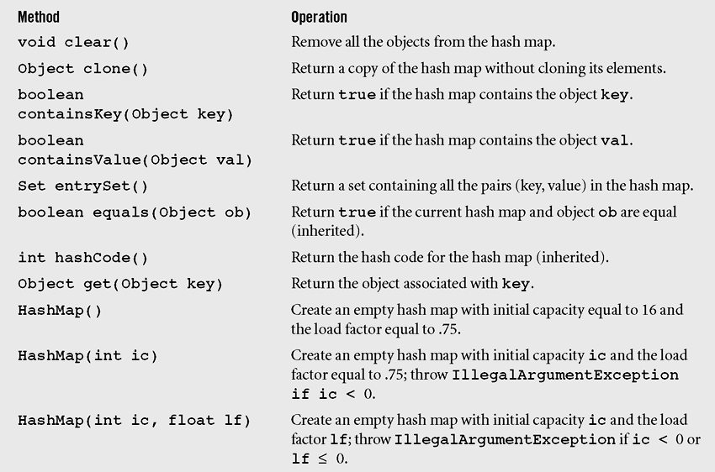
Using The HashMap class…
Methods in class HashMap including three inherited methods

Slide 45
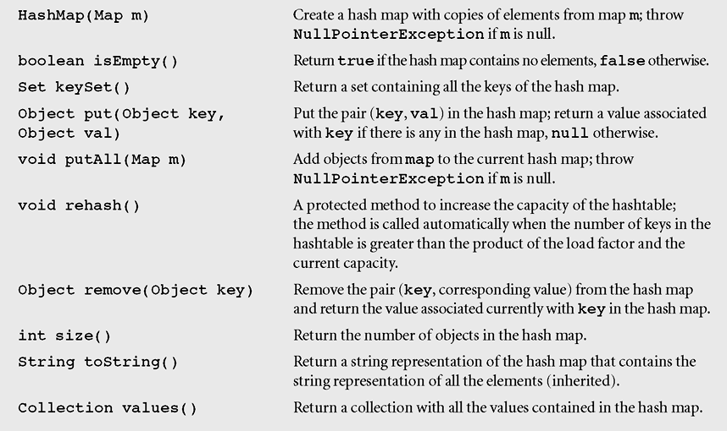
Using The HashMap class…
Methods in class HashMap including three inherited methods

Slide 46
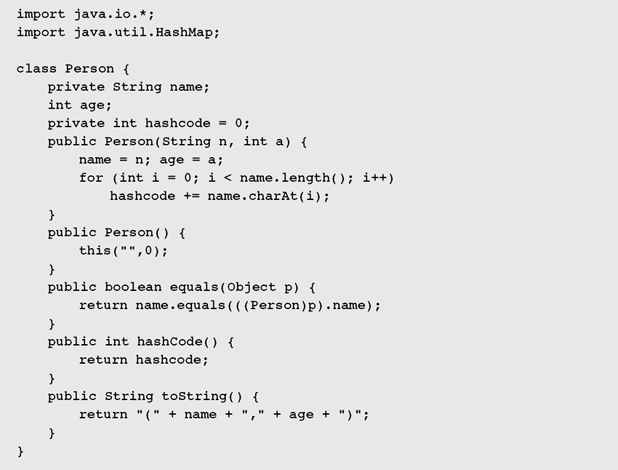
Using The HashMap class…
This example (in textbook) demonstates how to use the HashMap class to manage a list of person
< name, age,hashCode> in which the hasCode is the sum of charcter codes in the field name.
Click to go the HashSet class
Figure 10-17 Demonstrating the operation of the methods in class HashMap

Slide 47
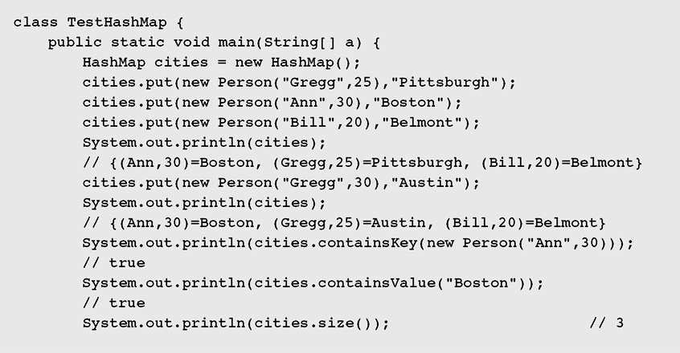
Using The HashMap class…
Demonstrating the operation of the methods in class HashMap

Slide 48
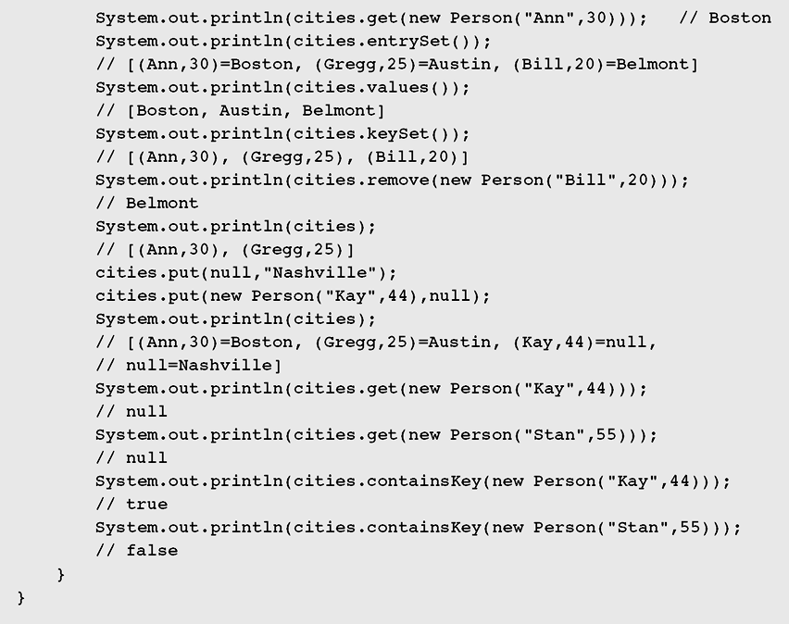
Using The HashMap class…
Demonstrating the operation of the methods in class HashMap

Slide 49
Using The HashSet class
HashSet is another implementation of a set (an object that stores unique elements)
Class hierarchy in java.util for HashSet is:
Object → AbstractCollection → AbstractSet → HashSet
HashSet is implemented in terms of HashMap
public HashSet() {
map = new HashMap();
}

Slide 50
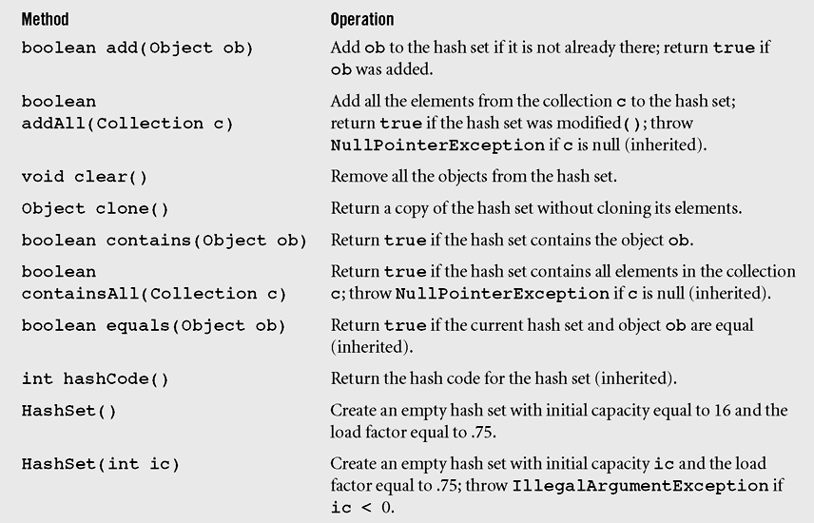
Using The HashSet class…
Methods in class HashSet including some inherited methods

Slide 51
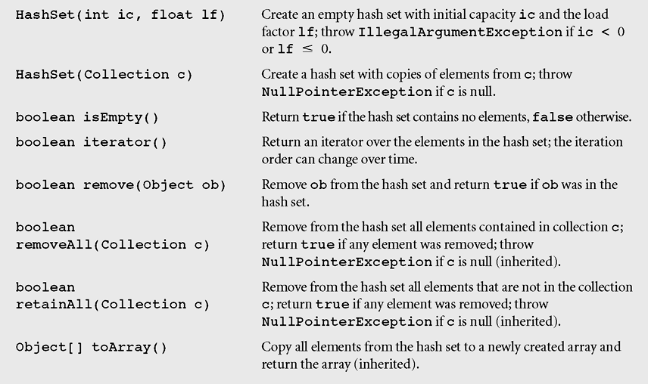
Using The HashSet class…
Methods in class HashSet including some inherited methods

Slide 52
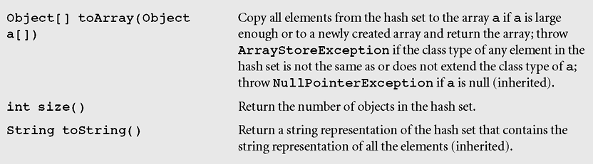
Using The HashSet class…
Methods in class HashSet including some inherited methods

Slide 53
Using The HashTable
A Hashtable is roughly equivalent (gần tương đương) to a HashMap except that it is synchronized and does not permit null values with methods to operate on hash tables
The class Hashtable is considered a legacy class, just like the class Vector
Class hierarchy in java.util is:
Object → Dictionary → Hashtable

Slide 54
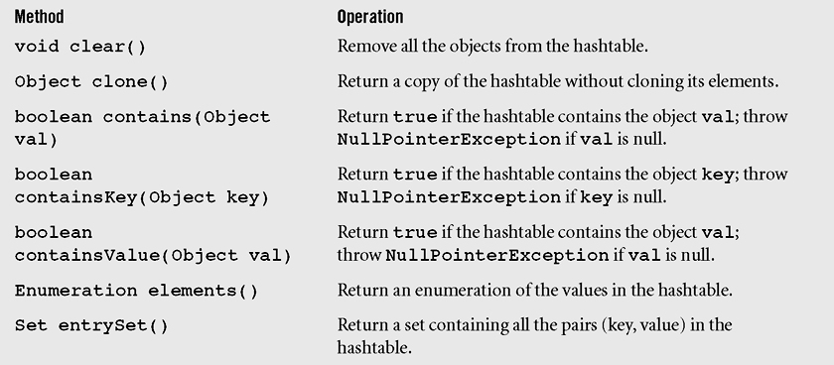
Using The Hashtable class…
Figure 10-20 Methods of the class Hashtable including three inherited methods

Slide 55
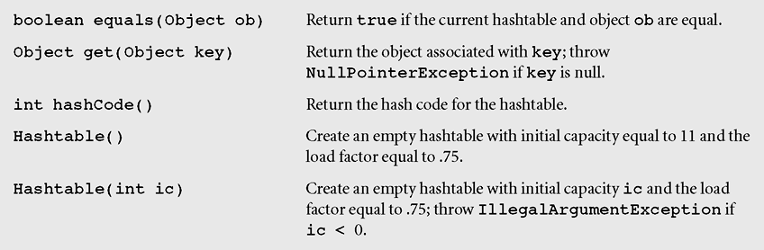
Using The Hashtable class…
Figure 10-20 Methods of the class Hashtable including three inherited methods (continued)

Slide 56
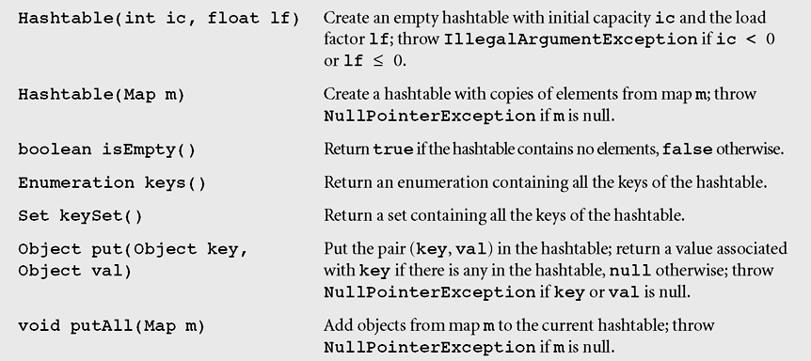
Using The Hashtable class…
Figure 10-20 Methods of the class Hashtable including three inherited methods (continued)

Slide 57
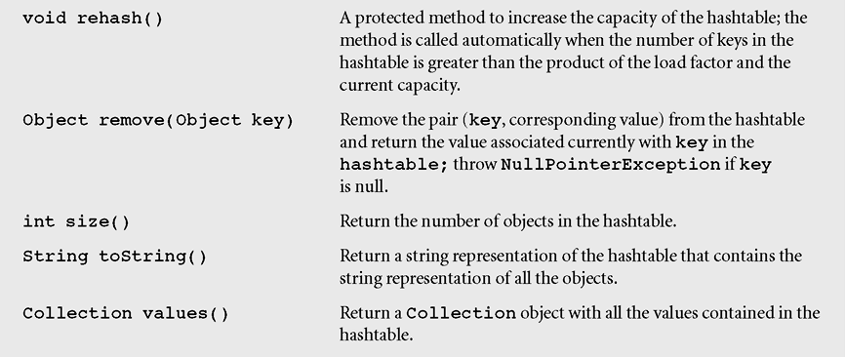
Using The Hashtable class…
Figure 10-20 Methods of the class Hashtable including three inherited methods (continued)

Slide 58
Summary: Objectives

LO7.1 Explain the concept of "hash". Define concepts hash function and hash table and their application.
LO7.2 Demonstrate the types of hash functions: Division, Folding,...
LO7.2 Explain the collision and collision-handling.
LO7.3 Explain the open addressing method for collision-resolution: linear and quadratic probing.
LO7.4 Explain the chaining method for collision-resolution: separate chaining and Coalesced chaining.
LO7.5 Define perfect hash function and extendible hashing.





Slide 59
Summary
Common hash functions include the division, folding, mid-square, extraction and radix transformation methods.
Collision resolution includes the open addressing, chaining, and bucket addressing methods.
Cichelli’s method is an algorithm to construct a minimal perfect hash function

Slide 60
Summary (continued)
The FHCD algorithm searches for a minimal perfect hash function of the form (modulo TSize), where g is the function to be determined by the algorithm
In expandable hashing and dynamic hashing, a binary tree is used as an index of buckets
In extendible hashing, a directory of records is kept in a table

Slide 61
Summary (continued)
A hash map is a collection of singly linked lists (buckets); that is, chaining is used as a collision resolution technique
HashSet is another implementation of a set (an object that stores unique elements)
A Hashtable is roughly equivalent to a HashMap except that it is synchronized and does not permit null values with methods to operate on hash tables

Slide 62
Notices about using hash tables
When should hashtables be used:
Elements in a group are different and insertion and search are main operations.
What are things to be concerned before a hashtable is implemented?
Choose a key for each element: number/string?
Choose a hash function
Choose a collision resolution
because these things will affect on algorithms that will be selected in our hashtable.

Slide 63
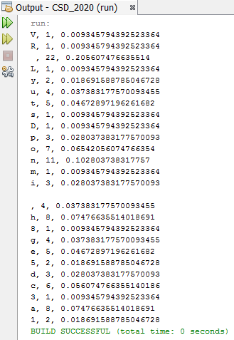
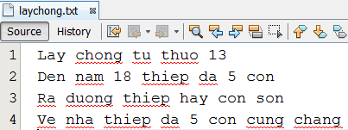
Demo 1: Using HashMap to compute probabilities of characters in a text file

Slide 64
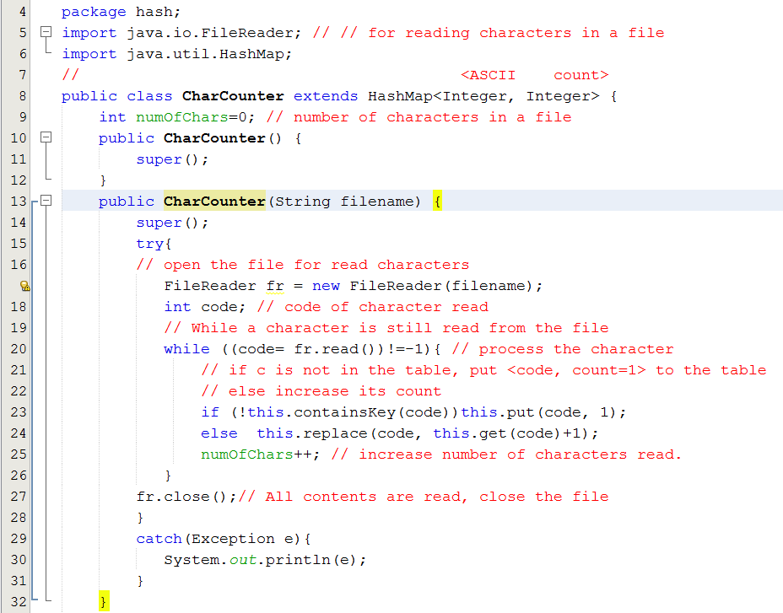
Demo 1: Using HashMap to compute probabilities of characters in a text file

Slide 65
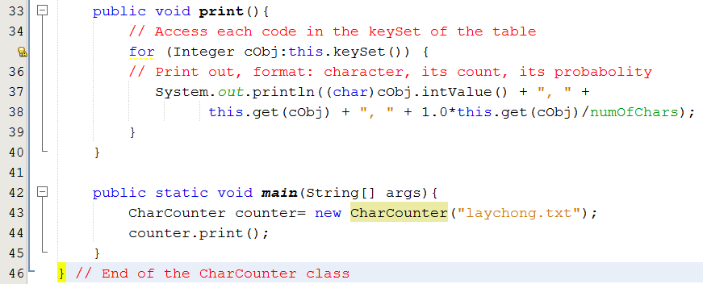
Demo 1: Using HashMap to compute probabilities of characters in a text file

Slide 66
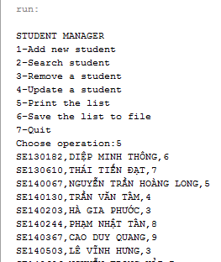
Demo 2: Using HashTable to manage a student list
SE140606,NGUYỄN TRỌNG HẢI,7
SE141127,VÕ TRỌNG ĐẠT,4
SE140913,TRẦN MINH HIẾU,7
SE62440,ĐOÀN LƯƠNG PHÚ,6
SE141153,THÁI ĐỨC THẢO,5
SE140244,PHẠM NHẬT TÂN,8
SE140861,PHẠM ĐĂNG HẢI,5
SE140929,NGUYỄN LÊ ANH LONG,9
SE140755,LÊ ANH DUY,8
SE140618,LÝ GIA HUY,8
SE63394,VŨ VĂN KHẢI,9
SE63391,BÙI LÊ QUỐC THẮNG,4
SE140367,CAO DUY QUANG,9
SE140130,TRẦN VĂN TÂM,4
SE140923,NGUYỄN VĂN TÂN,5
SE130182,DIỆP MINH THÔNG,6
SE140877,NGUYỄN HỒNG SƠN,6
SE140813,NGUYỄN ĐĂNG HUY,6
SE140503,LÊ VĨNH HƯNG,3
SE140874,LÊ HỮU HIẾU,6
SE141086,NGUYỄN MẠNH LỰC,9
SE140873,TÔN THẤT BẢO,4
SE140067,NGUYỄN TRẦN HOÀNG LONG,5
SE140855,TRẦN HOÀNG HẢI DUY,5
SE140885,CAO HOÀNG QUY,7
SE140203,HÀ GIA PHƯỚC,3
SE130610,THÁI TIẾN ĐẠT,7
SE151525,TẠ MINH TIẾN,3
Use Notepad++ or Wordpad or Netbean editor to edit Unicode text.
→ Do not use Notepad

Slide 67
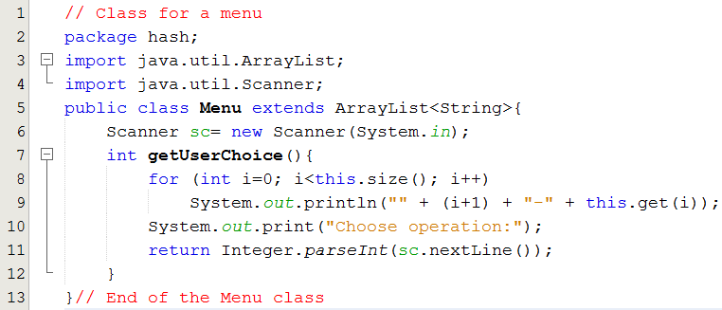
Demo 2: Using HashTable to manage a student list

Slide 68
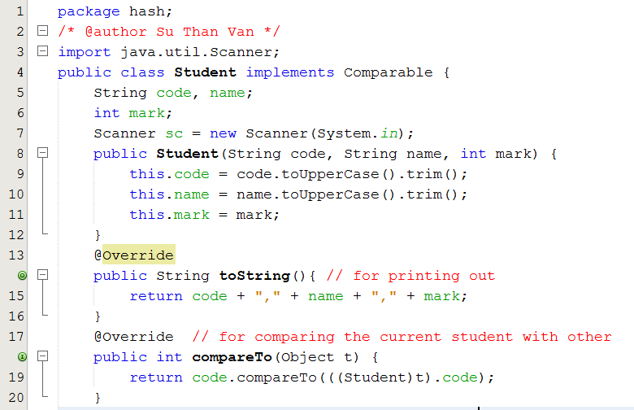
Demo 2: Using HashTable to manage a student list

Slide 69
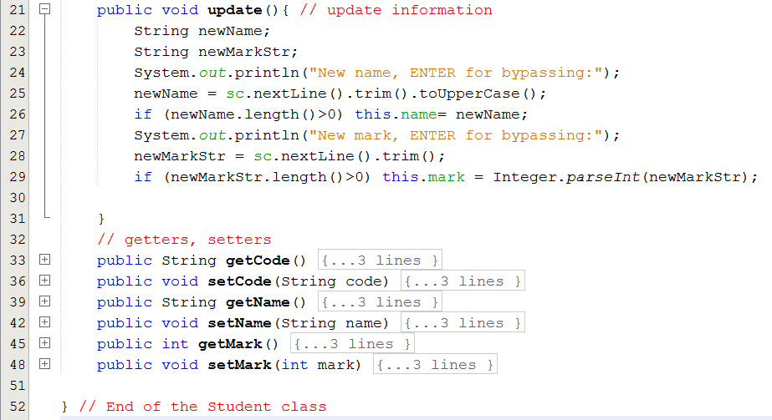
Demo 2: Using HashTable to manage a student list

Slide 70
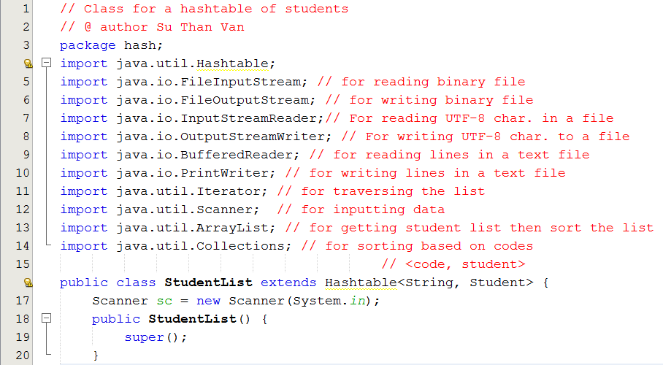
Demo 2: Using HashTable to manage a student list

Slide 71
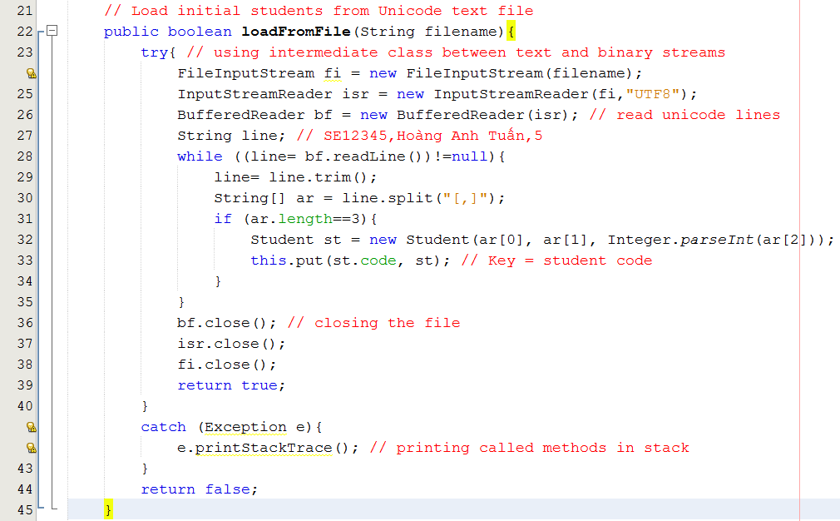
Demo 2: Using HashTable to manage a student list

Slide 72
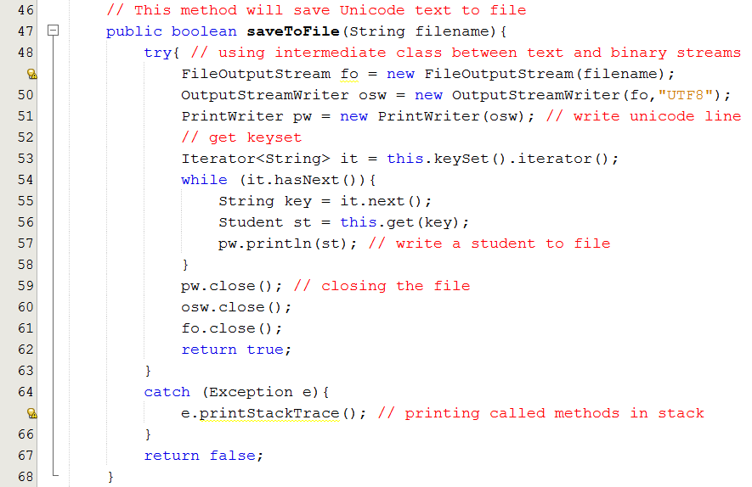
Demo 2: Using HashTable to manage a student list

Slide 73
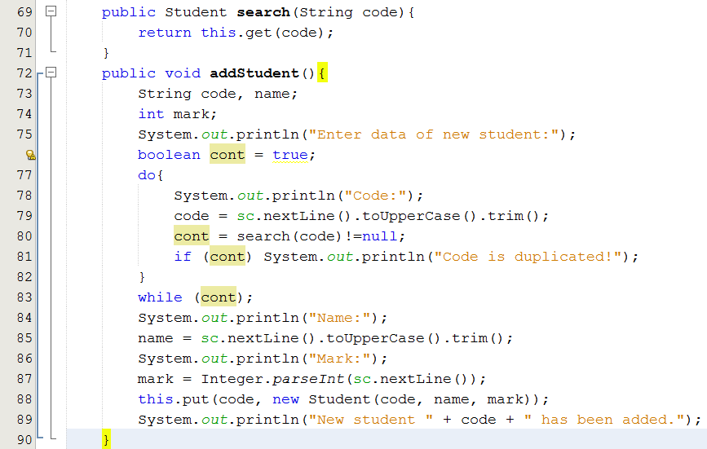
Demo 2: Using HashTable to manage a student list

Slide 74
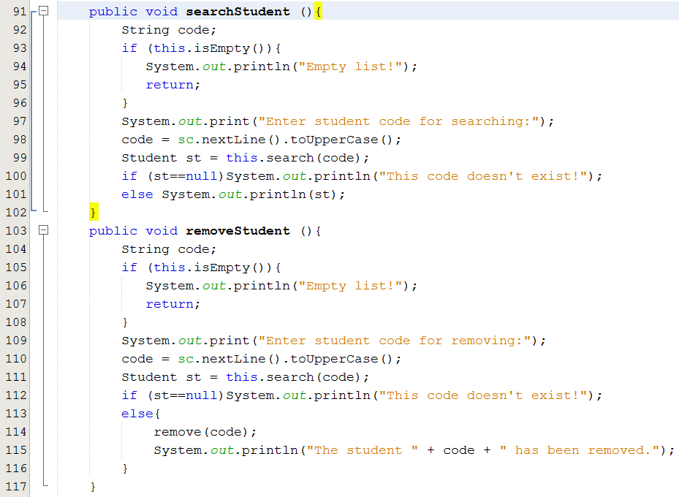
Demo 2: Using HashTable to manage a student list

Slide 75
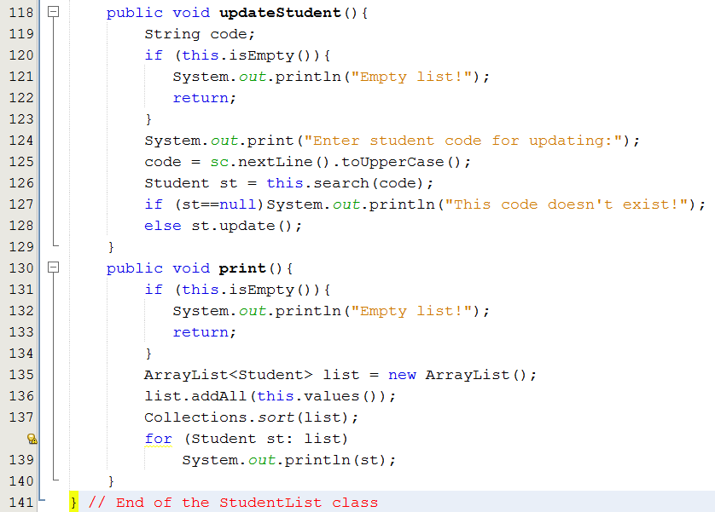
Demo 2: Using HashTable to manage a student list

Slide 76
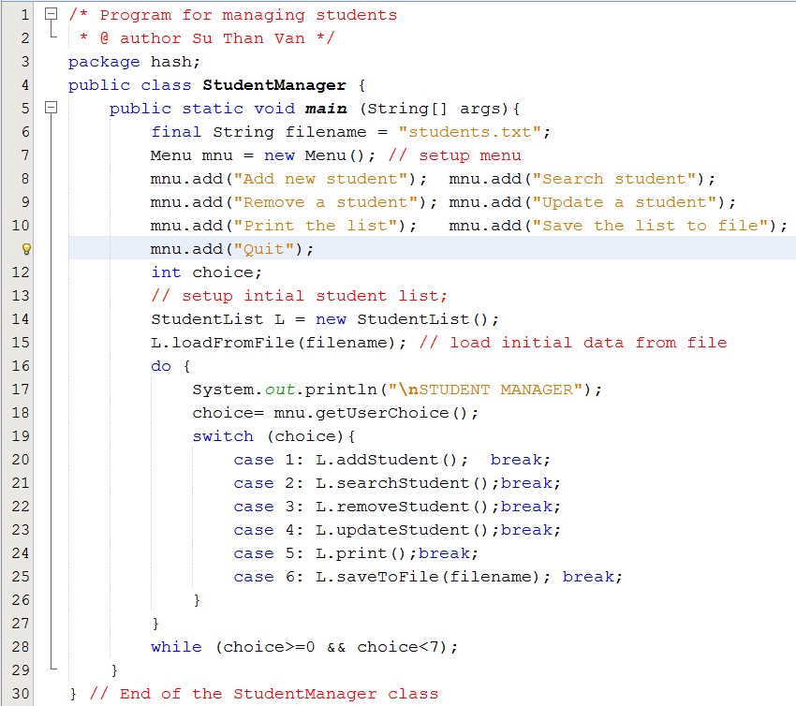
Demo 2: Using HashTable to manage a student list

Slide 77
Case Study: Hashing with Buckets in a file
This example(in the textbook) depicts how to implement hashing data in a file.
Do yourself

Slide 78
Thank you.

