Slide 1
Text Processing
Chào các sinh viên sau tuần nghỉ nhé.
Các sinh viên có khỏe không?

Slide 2
Review: Digits and Numbers
%d, parseInt
‘6’ -> 36h -> 0011 0110 -> 0000 0110
‘2’ -> 32h -> 0011 0010 -> 0000 0010
+ 0110 1000 0000 1000
‘8’ -> 38h -> 0011 1000

X
Numbers
Digits

Slide 3
Objectives: Learning Outcomes
3
LO8.1 Describe the Text Processing problem and its’ application.
LO8.2 Explain the Brute Force Text Pattern-Matching algorithm.
LO8.3 Describe the main idea of The Knuth-Morris-Pratt Algorithm.
LO8.4 Explain The Huffman Coding Algorithm.
LO8.5 Explain steps needed to use The Huffman Coding Algorithm for compressing a text file.
LO8.6 Explain the LZW encoding algorithm.
LO8.7 Explain the Run-length encoding algorithm.
Notes:
3

Slide 4
Contents
4
1- Abundance (sự phong phú) of Digitized Text
2- String Matching
Brute-Force algorithm
Knuth-Morris-Pratt Algorithm
3- Data Compression
Condition for Data Compression
Huffman Coding Algorithm
LZW Algorithm
Run-length Encoding
Your work: Re-implement demonstrations in this lecture.
Notes:
4

Slide 5
1- Abundance of Digitized Text
Despite the wealth of multimedia information, text is still main data format in computers
Text is digitalized (ASCII, EBCDIC,… or a pre-defined code table)
WWW → HTML, XML, text documents, email,…
Many data sets are stored in text format (String)
Two basic problems on text data:
Matching a substring (search operation)
Compressing a document

Slide 6
2- String Matching
Given a string S, the problem of string matching deals with finding whether a pattern p occurs in S and if p does occur then returning position in S where p occurs.
S= “ssdf egeg h5yh r5h45h j 6rhr”
P=“h5y”
➔ position = 10
2 algorithms are introduced:
The Brute Force Algorithm
The Knuth-Morris-Pratt (KMP) Algorithm

Slide 7
2- String Matching…
The Brute-Force Algorithm
Brute Force approach: A way for proving/programming in which a problem will be evaluated in all cases – vét cạn, exhausted searching.
S ( length n=10)
D | B | C | D | E | F | A | T | H | E
D | E | F | E
 | D | E | F | E
 |  | D | E | F | E
 |  |  | D | E | F | E
 |  |  |  | D | E | F | E
 |  |  |  |  | D | E | F | E
 |  |  |  |  |  | D | E | F | E
p (length m=4)
Loop (n-m+1) times
Loop matching m pairs of characters
O((n-m+1)(m)) ➔ O(nm)
Drawback: SLOW

Slide 8

2- String Matching…
The Bruth Force Algorithm
Project for demonstration

Slide 9
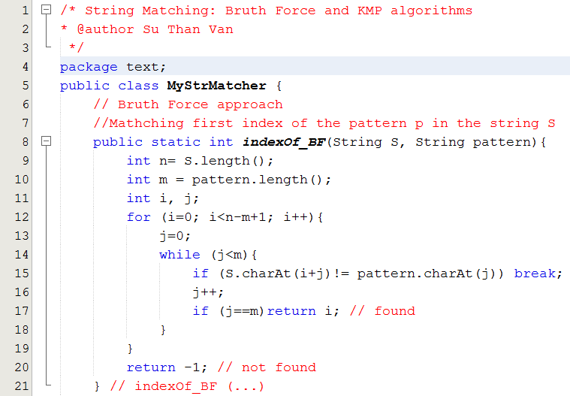
2- String Matching…
The Bruth Force Algorithm

Slide 10
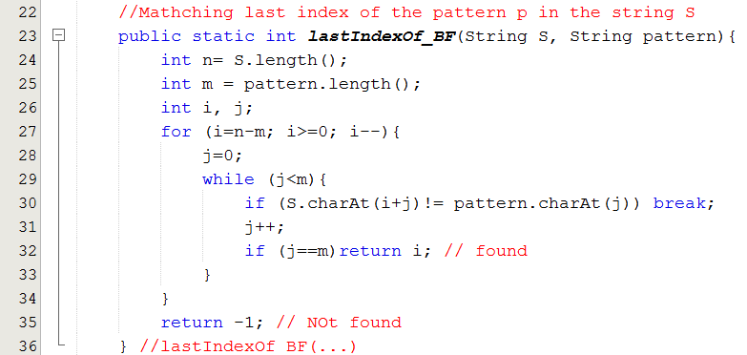
2- String Matching…
The Bruth Force Algorithm

Slide 11
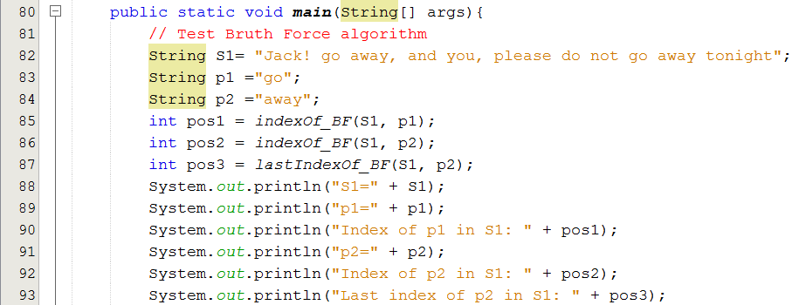
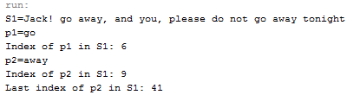
2- String Matching…
The Bruth Force Algorithm

Slide 12
2- String Matching…
The Knuth-Morris Pratt Algorithm
Knuth, Morris and Pratt proposed a linear time algorithm for the string matching problem.
A matching time of O(n+m) is achieved by avoiding comparisons with elements of S that have previously been involved in comparison with some element of the pattern p to be matched. i.e., backtracking on the string S never occurs.
Main idea: Pattern may be shifted MORE THAN ONE position in the source string.

Slide 13
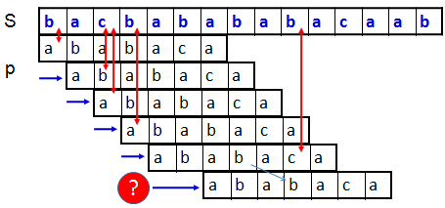
2- String Matching…
The Knuth-Morris Pratt Algorithm

Slide 14
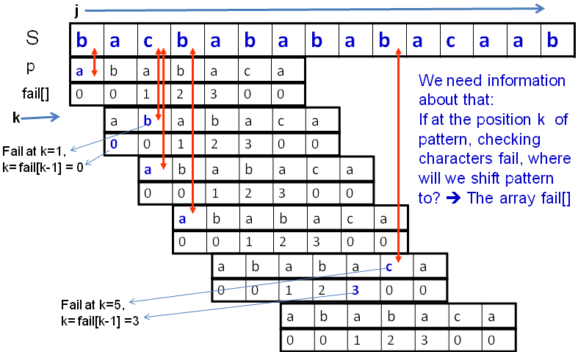
2- String Matching…
The Knuth-Morris Pratt Algorithm

Slide 15
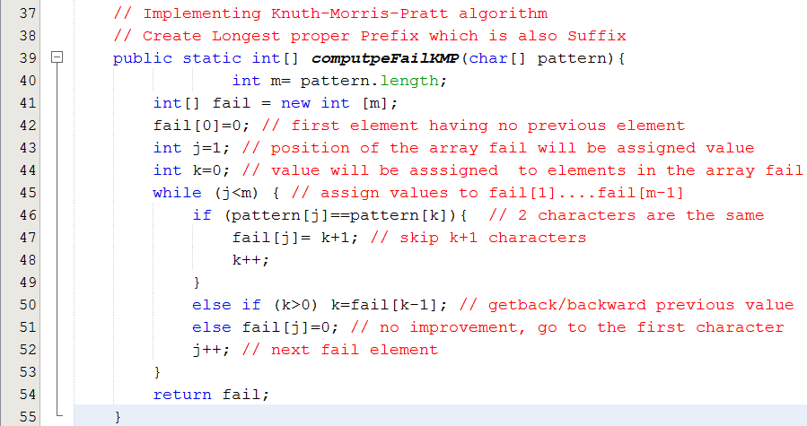
2- String Matching…
The Knuth-Morris Pratt Algorithm

Slide 16
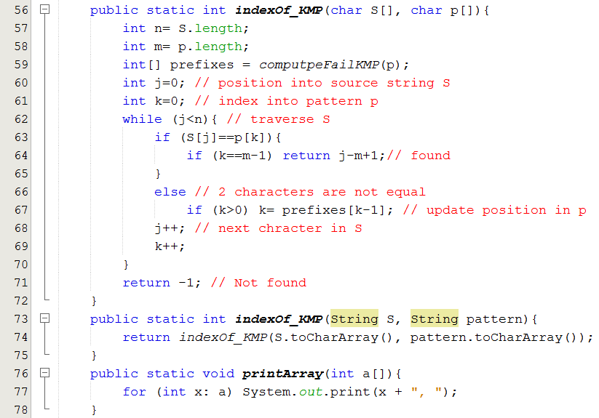
2- String Matching…
The Knuth-Morris Pratt Algorithm

Slide 17
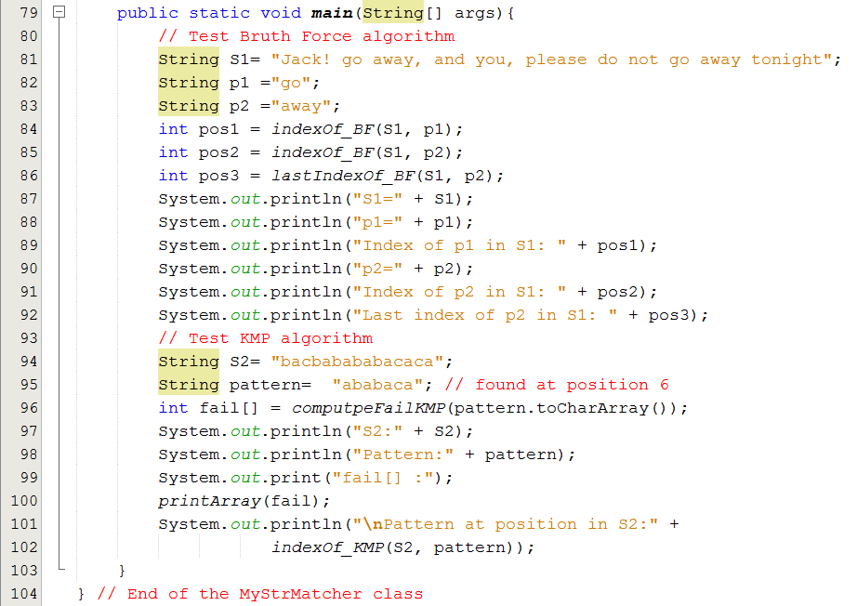

2- String Matching…
The Knuth-Morris Pratt Algorithm

Slide 18
3- Data Compression
Introduction to data compression
Some Compression Algorithms:
Huffman Encoding
Lempel-Ziv
RLE: Run Length Encoding

Slide 19
3- Data Compression…
Introduction
encoding
Raw data (10KB)
Compressed data (2KB)
decoding
Data compression or source coding is the process of encoding information using fewer bits (or other information-bearing units) than an un-encoded representation would use through use of specific encoding schemes.” (Wikipedia)
Advantages: It reduces the consumption of storage (disks) or bandwidth (băng thông, tốc độ truyền- bits/sec).
Disadvantages: it needs processing time to restore or view the compressed code.

Slide 20
3- Data Compression…
Introduction
Classification:
Lossy: MP3 ← → WAV, JPG ←→ BMP
Lossless: ZIP, GZ
Compression Algorithms:
Huffman Encoding
Lempel-Ziv
RLE: Run Length Encoding
→ Performance of a compression method depends on file type.

Slide 21
3- Data Compression…
Introduction
Basic of Lossless compression:
Use smaller number of bits to store a data unit (8 bit-character- symbol).
Codeword: sequence of bits corresponding to a symbol. Codeword of a symbol is unique.
Average codeword length indicates efficiency of a compression .
Compression rate
length(input) – length (output) → dL
length(input) → L
Compression rate is used to compare the efficiency of different data compression methods when applied to the same data.

Slide 22
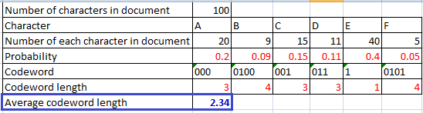
3- Data Compression…
Introduction
Basic of Lossless compression:
How to compute average of average codeword length? → Use the entropy formula – trung bình mức độ lộn xộn
L_{ave} = H = P(x₁)L(x₁) + · · · + P(x_{n})L(x_{n})
In which:
P(X_{i}): probability of the symbol X_{i}.
L(X_{i}): Codeword length of the symbol X_{i}.
Sum of products

Slide 23
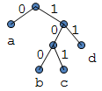
3- Data Compression…
Introduction
Basic of Lossless compression:
Properties of a set of codewords:
A variable length code assigns a bit string
(codeword) of variable length to every message value
a = 0, b = 100, c = 101, d = 11
A uniquely decodable code is a variable length code in which bit strings can always be uniquely decomposed into its codewords.
A prefix code is a variable length code in which no codeword is a prefix of another codeword. It can be viewed as a binary tree with message values at the leaves and 0 or 1s on the edges.

Slide 24
3- Data Compression…
Introduction
A
D
Prefix code: Exercises
Given codeword sets. What set are invalid? And why they are not?
a = 0, b = 100, c = 101, d = 11
A: 000, B: 0100, C: 001, D: 011, E: 1, F: 0101
A: 00, B: 010, C: 001, D: 011, E: 1, F: 0101
A: 001, B: 010, C: 001, D: 011, E: 1, F: 0101
A: 01, B: 001, C: 011, D: 011, E: 10, F: 0101

Slide 25
3- Data Compression…
Introduction
Prefix code: Exercises
Given codeword set:
a = 0, b = 100, c = 101, d = 11
(1) String “bacadaba” will be encoded to 100010101101000 →compression rate = (64-15)/64 ?
(2) String “cadcaadacba” will be encoded to ____
(3) Encoded string “100,11,0,11100100” will be decoded to _____
(4) Encoded string “10111000100101” will be decoded to _______

Slide 26
3- Data Compression…
Introduction
For a code C with associated probabilities p(c) the average length is defined as
We say that a prefix code C is optimal if for all prefix codes C, l_{a}(C) ≤ l’_{a}(C), l’_{a}(C) is average codeword length of other code set.
The Huffman code is known to be probably optimal under certain well-defined conditions for data compression.

Slide 27
3- Data Compression: Huffman Alg.
Main idea: Encode higher probability symbols with fewer bits
Huffman Coding Algorithm
Example: Character (or symbol) frequencies
A : 20% (.20)
B : 9% (.09)
C : 15% (.15)
D : 11% (.11)
E : 40% (.40)
F : 5% (.05)
(Step 1) Doing preparation: Determine frequency of each character then compute probability of each character.
Prob. = char. count/ number of chars. in document
You have to complete the Huffmann tutorial.

Slide 28
3- Data Compression: Huffman Alg…
Huffman Coding Algorithm
(Step 2) Constructing Codeword tree
Symbols and their associated frequencies in descending order based on probabilities.
Now we combine the two least common symbols (those with the smallest frequencies) to make a new symbol string and corresponding frequency.
0.14
E
.40
A
.20
C
.15
D
.11
B
.09
F
.05
Notes:
28

Slide 29
3- Data Compression: Huffman Alg…
Huffman Coding Algorithm
Here’s the result of combining symbols once.
Now repeat until youve combined all the symbols into a single string.
E
.40
A
.20
C
.15
BF
.14
D
.11
B
.09
F
.05
<
<=
Notes:
29

Slide 30
3- Data Compression: Huffman Alg…
Huffman Coding Algorithm
Here’s the result of combining symbols once.
Now repeat until youve combined all the symbols into a single string.
E
.40
BFD
.25
A
.20
C
.15
BF
.14
D
.11
B
.09
F
.05

Slide 31
3- Data Compression: Huffman Alg…
Huffman Coding Algorithm
Here’s the result of combining symbols once.
Now repeat until youve combined all the symbols into a single string.
E
.40
AC
.35
BFD
.25
A
.20
C
.15
BF
.14
D
.11
B
.09
F
.05
Notes:
31

Slide 32
3- Data Compression: Huffman Alg…
Huffman Coding Algorithm
BFDAC
.60
E
.40
AC
.35
BFD
.25
A
.20
C
.15
BF
.14
D
.11
B
.09
F
.05
Notes:
32

Slide 33
3- Data Compression: Huffman Alg…
Huffman Coding Algorithm
BFDACE
1.00
0
1
BFDAC
.60
E
.40
(Step 3) Generating Prefix Codewords:
A: 000
B: 0100
C: 001
D: 011
E: 1
F: 0101
0
1
AC
.35
BFD
.25
0
1
0
1
A
.20
C
.15
BF
.14
D
.11
0
1
B
.09
F
.05
Notes:
33

Slide 34
3- Data Compression: Huffman Alg…
Huffman Coding Algorithm
34
Make a leaf node for each code symbol
Add the generation probability or the frequency of each symbol to the leaf node (arrange them from left to right in descending order by probability)
Take the two leaf nodes with the smallest probability and connect them into a new node
Add 1 or 0 to each of the two branches
The probability of the new node is the sum of the probabilities of the two connecting nodes
If there is only one node left, the code construction is completed. If not, go back to (2)

Slide 35
3- Data Compression: Huffman Alg…
Average code length:
Character | Code | Length | Probability
A | 000 | 3 | .20
B | 0100 | 4 | .09
C | 001 | 3 | .15
D | 011 | 3 | .11
E | 1 | 1 | .40
F | 0101 | 4 | .05
Average Code Length:
(3 x 0.20) + (4 x 0.09) + (3 x 0.15) + (3 x 0.11) + (1 x 0.40) + (4 x 0.05)
= 2.34 digits
Notes:
35

Slide 36
3- Data Compression…
Huffman Coding Algorithm
Notes:
There is no unique Huffman code
Assigning 0 and 1 to the branches is arbitrary
If there are more nodes with the same probability, it doesn’t matter how they are connected. However, if the probability in each node is unique and the left nodes probability is always larger than the rights one, then the code is unique.
When some sub-trees having the same probabilities, the position will add a sub-tree will affect to result.
Notes:
36

Slide 37
Huffman Algorithm Mechanism
Data source will be read 2 times → SLOW
Compressing
Source
File
HuffmanEncoder
obj
FreqCounter obj
HuffmanTree
obj
CodewordGenerator
obj
Data source
Freq. table
Huffman Tree
Codeword
Table
Zipped Data
(code table)
HuffmanDecoder
obj
Zipped
File
Decompressing
Codeword table must be written to result → Result size may be rather large
Zipped source is read ONE time → FAST

Slide 38
3- Data Compression… Lempel-Ziv Compression
38
This coding method is lossless coding and it is originated by Abraham Lempel and Jacob Ziv, improved by Tery Welch in 1984 (that is why it gets name LZW)
Files are commonly used: GIF, TIFF
Algorithms versions: LZ77, LZ78 and LZW
Hôm nay sẽ xong nội dung môn học
Thứ sáu tới: Ghi nhận bài tập chương TEXT
Xem trong LMS để nộp bài tập TEXT (deadline đêm mai) và làm Quiz cuối. PWD để trong LMS rồi.

Slide 39
Data Compression… Lempel-Ziv Compression
39
Using dictionaries for encoding and decoding
LZW will encode sequences of symbols with location of sequence in a dictionary → dictionary coder
Encoding: Characters → integers
Decoding: Integers → characters
Dictionaries are constructed from the set of characters which are used in the source string. For example. If the source is “AABAABBCCACC”, the character set to be used to initiated the dictionary can be { A, B, C }. In practice, they are ASCII characters because all bytes from 0 to 255 are used in the source.
When compression/de-compression performs, if a new substring is detected, it is added to dictionary.

Slide 40
LZW Compression…
40
An example:
Original dictionary: {A=0, B=1,C=2}
Source string: AABAABBCCACC
Compressed data: [0,0,1,3,1,1,2,2,0,9]
Steps for compressing and de-compressing are depicted in slides below.

Slide 41
LZW Compression: AABAABBCCACC → [0,0,1,3,1,1,2,2,0,9]
C | curSub | newSub = curSub +c | Compressing Dictionary | Code
A | “” | A | {A=0, B=1,C=2}
A | A | AA | {A=0, B=1,C=2}, add AA to dict, : A → 0 | 0
B | A | AB | {A=0, B=1, C=2, AA=3}, add AB to dict, : A → 0 | 0
A | B | BA | {A=0, B=1, C=2, , AA=3,AB=4} , add BA to dict, B → 1 | 1
A | A | AA(existed) | {A=0,B=1,C=2, AA=3,AB=4, BA=5 }, AA existed, read more
B | AA | AAB | {A=0,B=1,C=2, AA=3,AB=4, BA=5 }, add AAB to dict, AA → 3 | 3
B | B | BB | {A=0,B=1,C=2, AA=3,AB=4, BA=5 , AAB=6}, do similarly | 1
C | B | BC | {A=0,B=1,C=2, AA=3,AB=4, BA=5 , AAB=6,BB=7} | 1
C | C | CC | {A=0,B=1,C=2, AA=3,AB=4, BA=5 , AAB=6,BB=7, BC=8} | 2
A | C | CA | {A=0,B=1,C=2, AA=3,AB=4, BA=5 , AAB=6,BB=7, BC=8, CC=9} | 2
C | A | AC | {A=0,B=1,C=2, AA=3,AB=4, BA=5 , AAB=6,BB=7, BC=8, CC=9, CA=10} | 0
C | C | CC(existed) | {A=0,B=1,C=2, AA=3,AB=4, BA=5 , AAB=6,BB=7, BC=8, CC=9, CA=10,AC=11}
 | CC |  | {A=0,B=1,C=2, AA=3,AB=4, BA=5 , AAB=6,BB=7, BC=8, CC=9, CA=10,AC=11} | 9

Slide 42
LZW De-Compression:
[0, 0, 1, 3, 1, 1, 2, 2, 0, 9] → AABAABBCCACC
CurCode | Dict | Output | cur Trans | next Trans | newSub = preTrans + first char of nextTrans
[0, | {0=A,1=B,2=C} | 0→A | A
0, | {0=A,1=B,2=C} | 0→A | A | A | AA
1, | {0=A,1=B,2=C,3=AA} | 1→B | A | B | AB
3, | {0=A,1=B,2=C,3=AA,4=AB} | 3→AA | B | AA | BA
1, | {0=A,1=B,2=C,3=AA,4=AB,5=BA} | 1→B | AA | B | AAB
1, | {0=A,1=B,2=C,3=AA,4=AB,5=BA,6=AAB} | 1→B | B | B | BB
2, | {0=A,1=B,2=C,3=AA,4=AB,5=BA,6=AAB,7=BB} | 2→C | B | C | BC
2, | {0=A,1=B,2=C,3=AA,4=AB,5=BA,6=AAB,7=BB ,8=BC} | 2→C | C | C | CC
0, | {0=A,1=B,2=C,3=AA,4=AB,5=BA,6=AAB,7=BB ,8=BC,9=CC} | 0→A | C | A | CA
9] | {0=A,1=B,2=C,3=AA,4=AB,5=BA,6=AAB,7=BB ,8=BC,9=CC,10=CA} | 9→CC | A | CC | AC

Slide 43
Summary: LZW Data Compression/Decompression
43
Compressing
Zipping Dictionary:
<subString, intCode>
{ A=0, B,=1 C =2}
List of integral codes
Characters
Add newSubStr
Extract subStr code
Data source
subStr
int code
Zipped result
AABAABBCCACC
Extract subStr
Add new subStr
[0,0,1,3,1,1,2,2,0,9]
Unzipping Dictionary:
<intCode, subString>
{ 0=A, 1=B, 2=C }
Read data-source and write result only one time → Fast
To decrease file size, codes are divided into some groups using different code-lengths
De-compressing

Slide 44

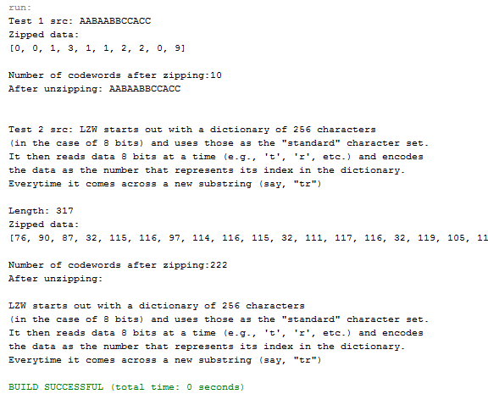
LZW Encoding Algorithm: Demo
44
Notes:
GIF file
44

Slide 45

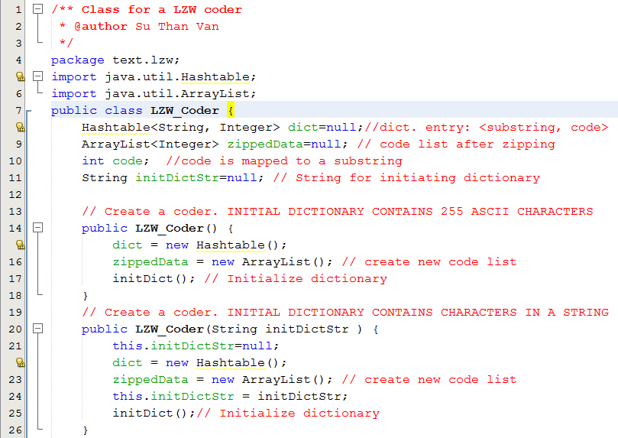
LZW Encoding Algorithm: Demo
45
Notes:
GIF file
45

Slide 46
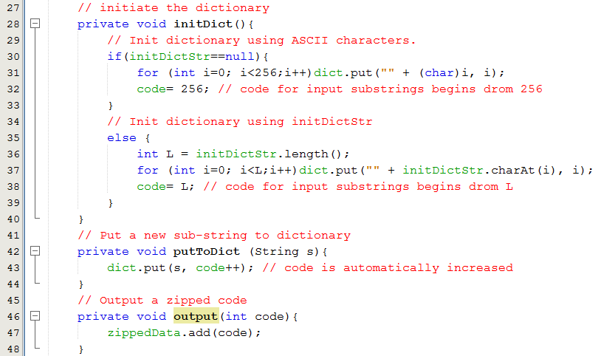
LZW Encoding Algorithm: Demo
46
Notes:
GIF file
46

Slide 47
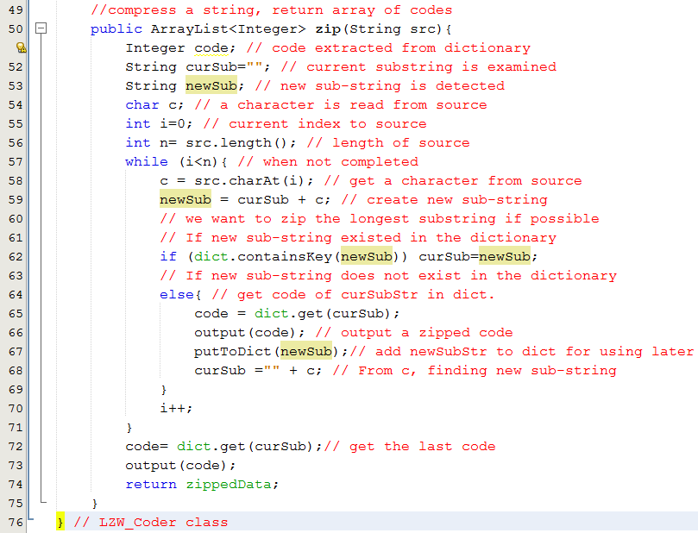
LZW Encoding Algorithm: Demo
47
Notes:
GIF file
47

Slide 48

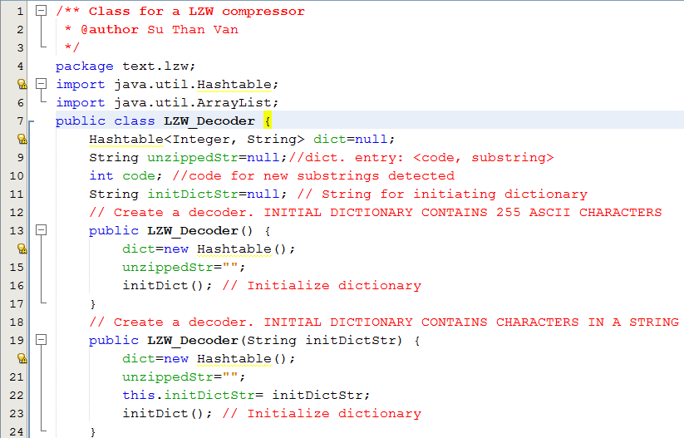
LZW Decoding Algorithm: Demo
48
Notes:
GIF file
48

Slide 49
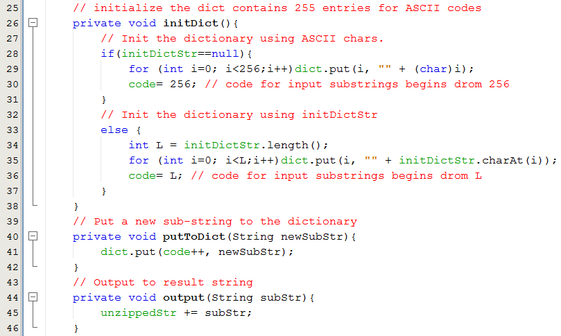
LZW Decoding Algorithm: Demo
49
Notes:
GIF file
49

Slide 50
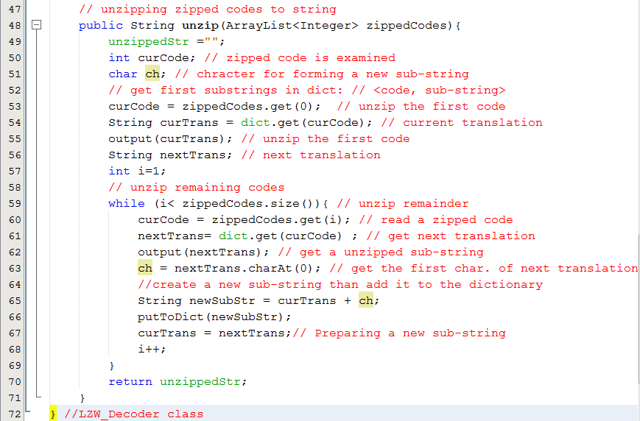
LZW Decoding Algorithm: Demo
50
Notes:
GIF file
50

Slide 51
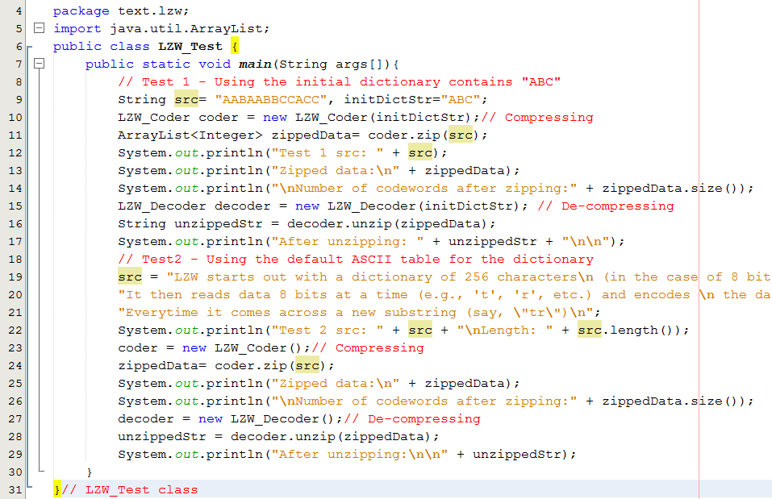

LZW Encoding/Decoding Algorithms Test
51
"LZW starts out with a dictionary of 256 characters\n (in the case of 8 bits) and uses those as the \"standard\" character set.\nIt then reads data 8 bits at a time (e.g., 't', 'r', etc.) and encodes \n the data as the number that represents its index in the dictionary.\nEverytime it comes across a new substring (say, \"tr\")\n"
Notes:
GIF file
51

Slide 52
LZW Question
Suppose that initial dictionary is {A=1, B=2, C= 3, D=4}. What is the result data when the LZW compressing algorithm is applied on the source string “CDAAACABADAAA”

Slide 53
3- Data Compression… Run-Length Encoding
Numeric run: Group of non-decreasing contiguous numbers.
1 2 8 5 5 6 7 9 8 3 4 6 → 4 runs
Character run: Group of the same contiguous characters.
AAABCDDDE : 5 runs

Slide 54
3- Data Compression… Run-Length Encoding
FFFFOOOOFFFOOFFFFFOOOOOOOO
Raw :
4
4
3
2
5
7
Compressed:
4F4O3F2O5F7O
Compression Rate = (25-12)/25 = 52%
“ABCDEF” → “1A1B1C1D1E1F”

Slide 55
Summary
Digitalized text: Text in which each it’s character is coded as a bit string.
Abundance of Digitized Text: Text is still main data in computer programs
Brute-Force algorithm helps searching a short string in a long string using exhaustive approach and it’s complexity O(mxn). m is the length of long string and m is the length of short string.
Knuth-Morris-Pratt Algorithm helps matching a short string in a long string using improvement in shift steps and it has complexity of O(n+m).

Slide 56
Summary
Data Compression is a process to shorten initial data in order to reduce storage or bandwidth of communication.
Condition for Data Compression is codeword table of initial data unit.
Huffman Coding Algorithm is a lossless compression technique in which each initial source character will be expressed using number of bits less than 8. Codewords are generated based on character’s frequencies.
LZW Algorithm is a lossless compression technique based on a dictionary of input string.
Run-length Encoding is a lossless compression technique based on run of characters in input string.

Slide 57
Objectives: Learning Outcomes

LO8.1 Describe the Text Processing problems and its’ application.
LO8.2 Explain the Brute Force Text Pattern-Matching algorithm.
LO8.3 Describe the main idea of The Knuth-Morris-Pratt Algorithm.
LO8.4 Explain The Huffman Coding Algorithm.
LO8.5 Explain steps needed to use The Huffman Coding Algorithm for compressing a text file.
LO8.6 Explain the LZW encoding algorithm.
LO8.7 Explain the Run-length encoding algorithm.






Notes:
57

