Slide 1
Deep Reservoir Computing: A Critical Experimenta Analysis
Claudio Gallicchio1,∗, Alessio Micheli1, Luca Pedrelli1Department of Computer Science, University of PisaLargo Bruno Pontecorvo 3 - 56127 Pisa, Italy
2017 - neuro computing
한국과학기술연구원 뇌과학연구소 LCNP연구실 - 김동규

Slide 2
Deep Reservoir Computing: A Critical Experimenta Analysis
Claudio Gallicchio1,∗, Alessio Micheli1, Luca Pedrelli1Department of Computer Science, University of PisaLargo Bruno Pontecorvo 3 - 56127 Pisa, Italy
2017 - neuro computing
한국과학기술연구원 뇌과학연구소 LCNP연구실 - 김동규

Slide 3
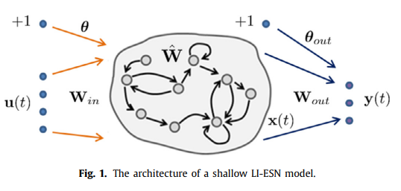


Slide 4
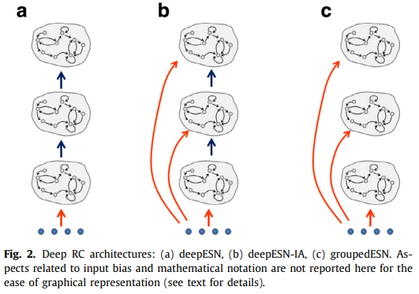

Slide 5
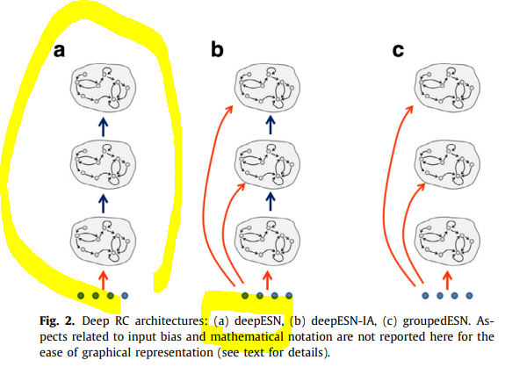




Slide 6
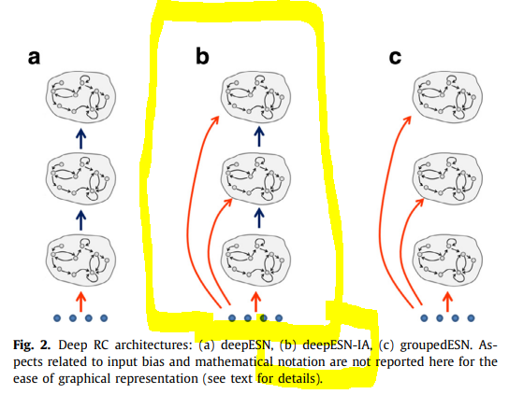



Slide 7
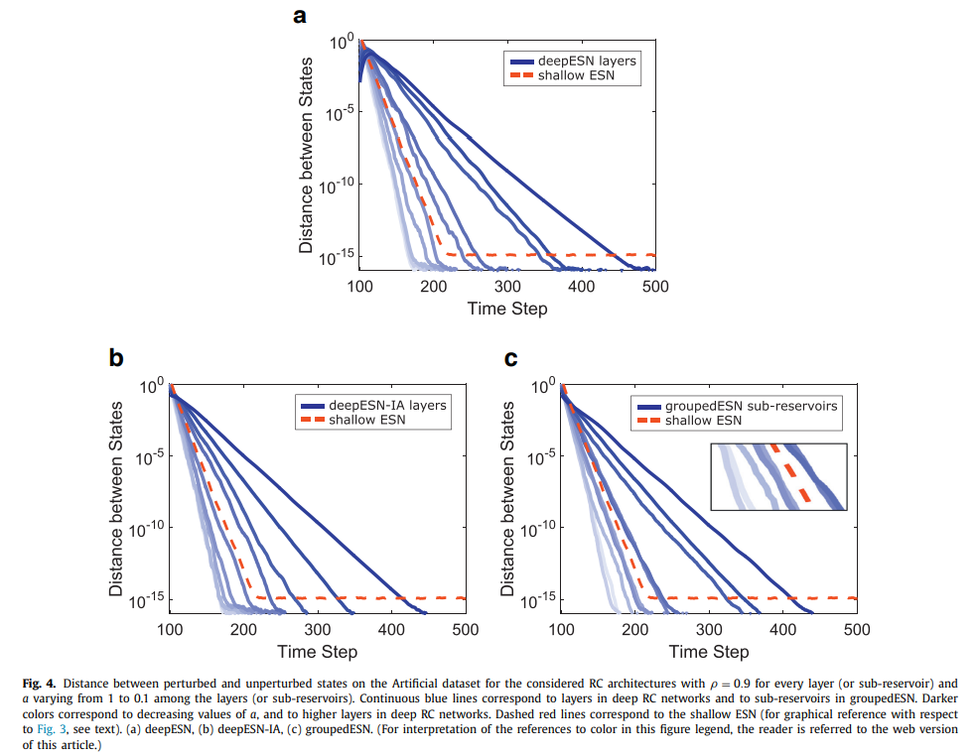

Slide 8
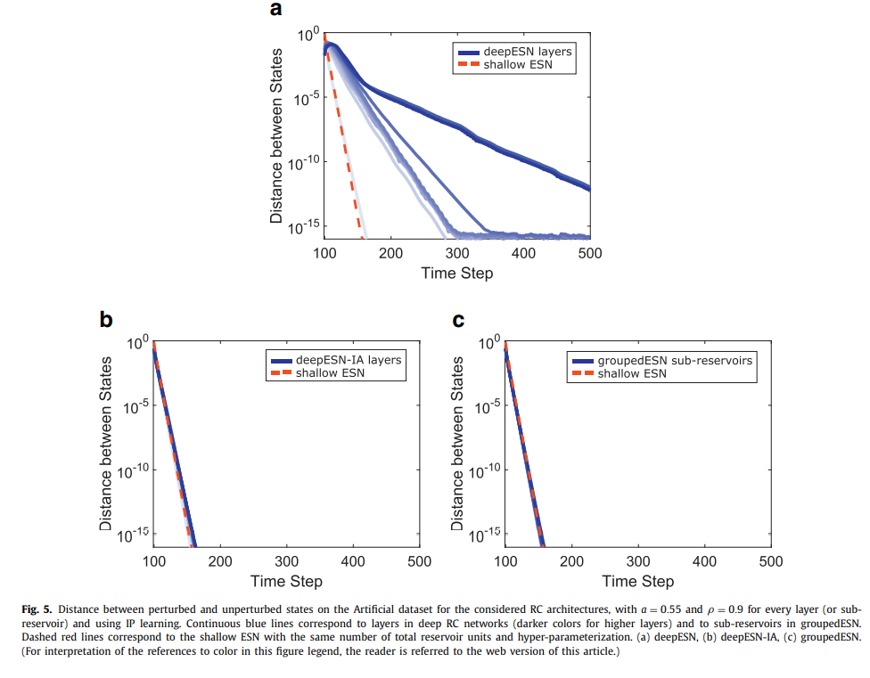

Slide 9
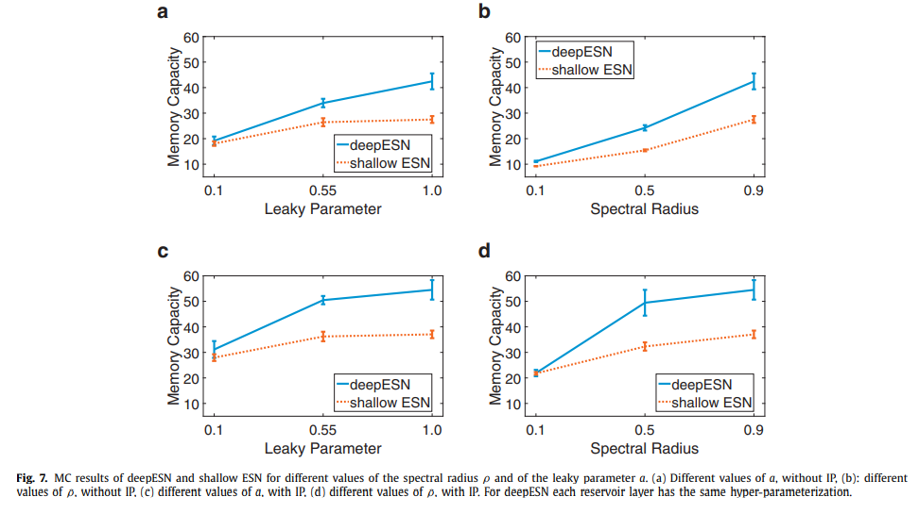

Slide 10
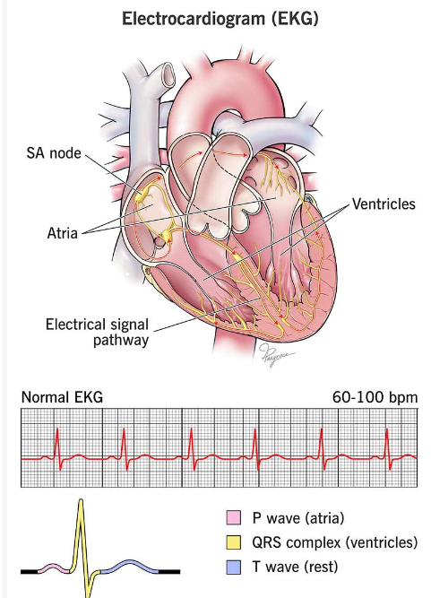
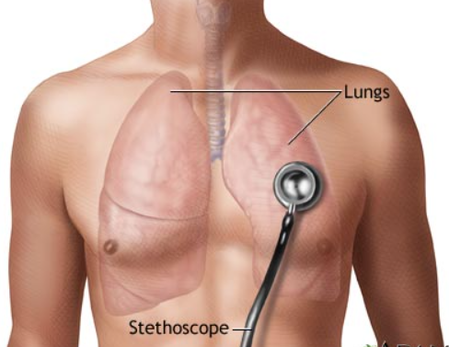

Slide 11
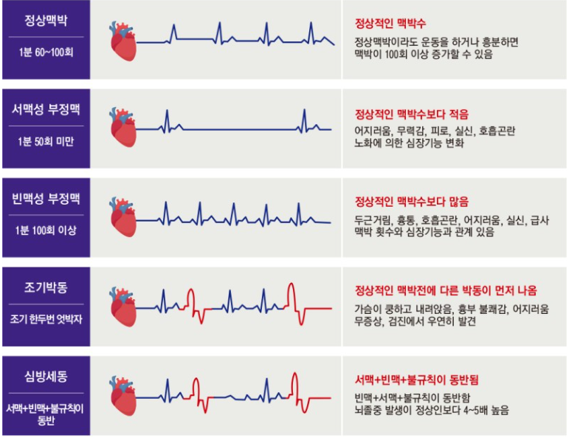

Slide 12
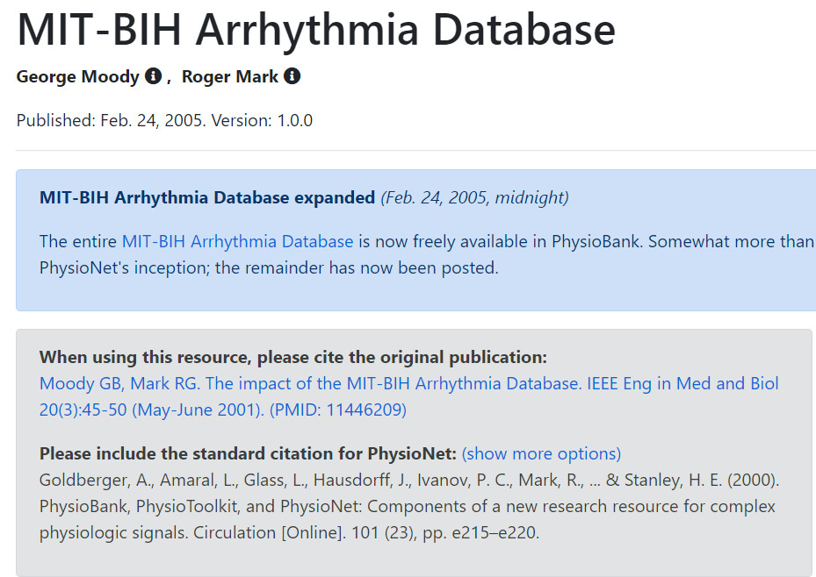
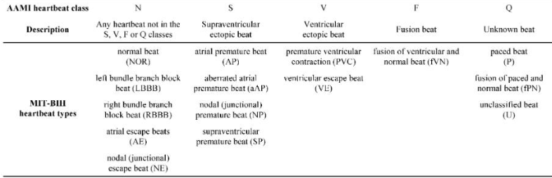

Slide 14
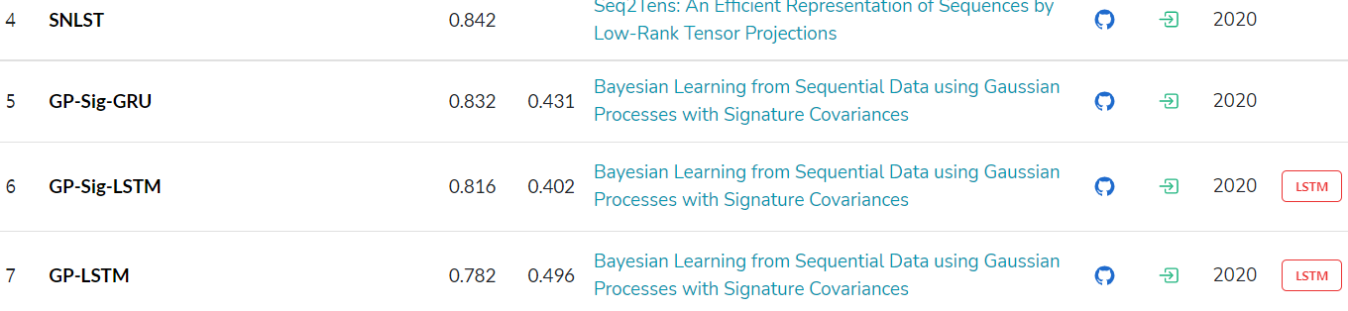
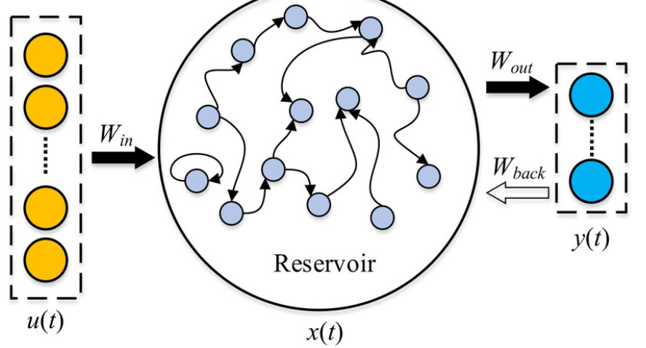
Basice ESN 모델 100번 평균 0.83~0.84

Slide 15
