Slide 2

Balance Study and Leisure

Slide 3
Question
How much time of your day is devoted to study?

Slide 4
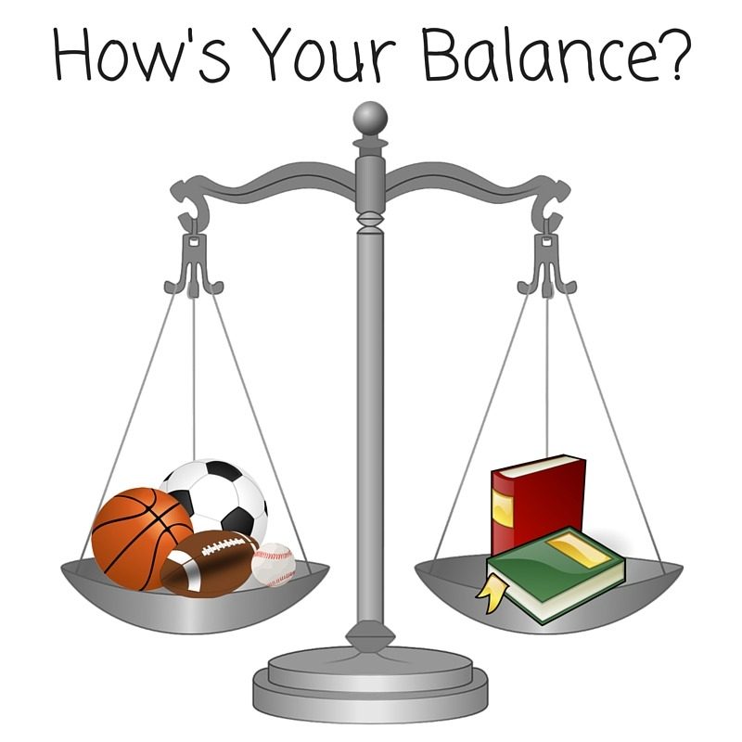
Question

Slide 5
Source
A study in Germany found that over 88% of adolescents experienced a conflict between schoolwork and leisure activities at least once a day.
(https://doi.org/10.1016/j.lindif.2008.09.007)

Slide 6
Question
What are the causes of this imbalance?

Slide 7
Causes
Digital Media - (passive leisure)
Gender - girls seems to be engaged in passive leisure more than boys
Age - older students spend more time in passive leisure

Slide 8
Causes
Procrastination
Lazyness
Fear

Slide 9
Question
Why is it important to maintain a balance between study and leisure?

Slide 10
Negative
Negative Impact on Performance: An imbalance can lead to reduced academic performance and a lack of essential skill development.
Stress and Poor Well-being: Lack of a good balance can lead to poorer emotional adjustment and lower quality of life.

Slide 11
Positive
Improved Academic Performance: A good balance creates a "circle of positivity," leading to better academic performance and skill development.
Better Quality of Life: Students who effectively manage their free time report higher satisfaction and an improved quality of life.

Slide 12
Quality
Quality

Slide 13
Quality of study
Remove distractions
Schedule a time for studying
Break your schedule in small chunks
Take a small break between each chunk
Avoid multitasking. Focus on one thing at a time

Slide 14
Time Management
Create a Daily Schedule
Use Time-Management Tools
Prioritize

Slide 15
Studying techniques
Pomodoro technique
Active learning (spaced repetitions, flashcards)
Break down large tasks

Slide 16
Quality of Leisure
Prioritise active leisure
Avoid mobile phones and TV
Socialize (not on social media)
Cultivate a hobby, if do no have one, find it.
Gratify yourself

Slide 17
Relaxation and self-care
Meditation
Physical activities
Quality sleep

Slide 18
Benefits
Enhances memory and problem-solving: Leisure activities can improve memory and problem-solving skills.
Boosts mental health: Leisure is linked to better overall mental health, a crucial factor for academic performance and a greater sense of life satisfaction
Improves concentration: Taking breaks for recreational activities can improve a student's ability to focus when they return to their studies.
Improves physical and sleep habits: Leisure is associated with good physical and eating habits and regular sleep, which are foundational for academic success.

Slide 19
Thank you!

Slide 20
Question
Do you think that study is taking too much of your time?

