Slide 1
U.S. Covid-19 Cases and Deaths
Donald Jackson

Slide 2
Data

Slide 3
Data
Using state-level case data downloaded from https://raw.githubusercontent.com/nytimes/covid-19-data/master/us-states.csv at May 04 2020 10:27:15 and county-level case data downloaded from https://raw.githubusercontent.com/nytimes/covid-19-data/master/us-counties.csv at 2020-05-04 10:27:17.

Slide 4
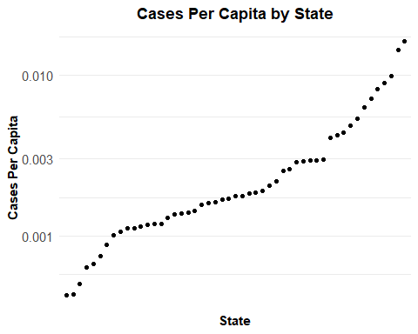
Current Cases Per State

Slide 5
New Cases Per State
## Warning in self$trans$transform(x): NaNs produced
## Warning: Transformation introduced infinite values in continuous y-axis
## Warning: Removed 330 row(s) containing missing values (geom_path).

Slide 6
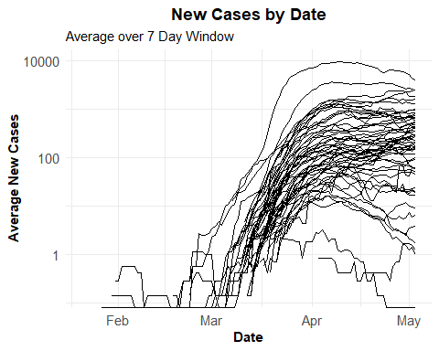

Slide 7
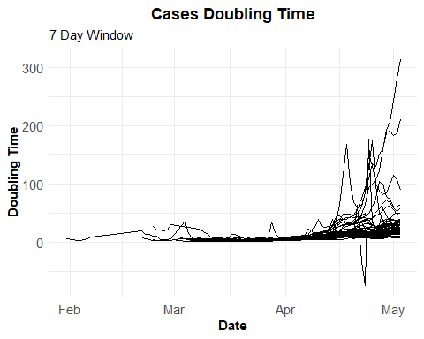
Case Doubling Times

