Slide 1
Apprehensions of Undocumented Immigrants in the US (2000-2019)
Data Bootcamp Final Project
Name: Diego Giuseppe Gonzalez Arciniega
Net ID: dga263

Slide 2
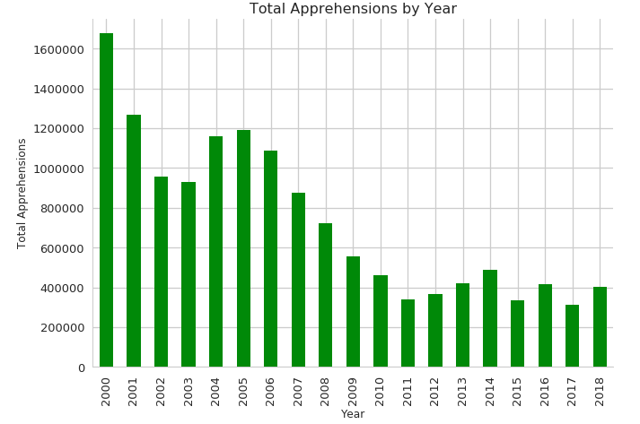
Figure 1
From 2000 to 2018 unauthorized migration flows –measured in this project by number of apprehensions– had been generally declining.

Slide 3
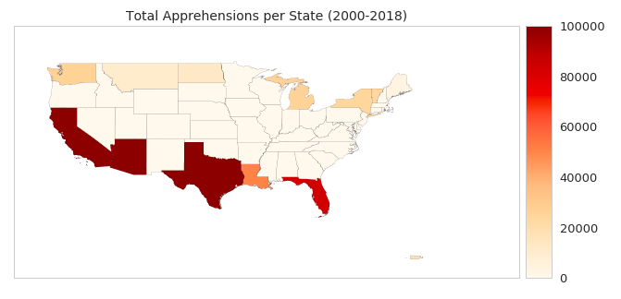
Figure 2
The states in the South have the highest number of apprehensions.

Slide 4
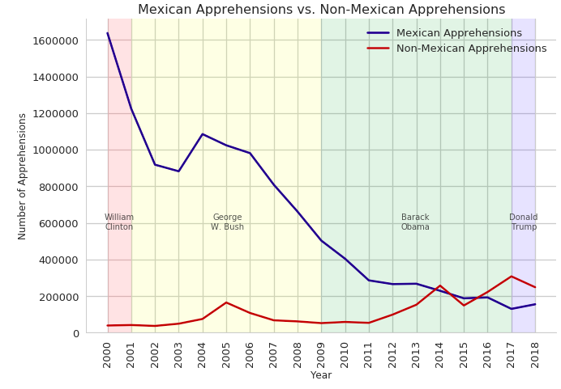
Figure 3
The share of Mexican apprehension has decreased significantly. Non-Mexican apprehensions have increased (particularly from Central America)
Notes:
the portion of non-Mexican apprehensions continues to increase, particularly from Central America.

Slide 5
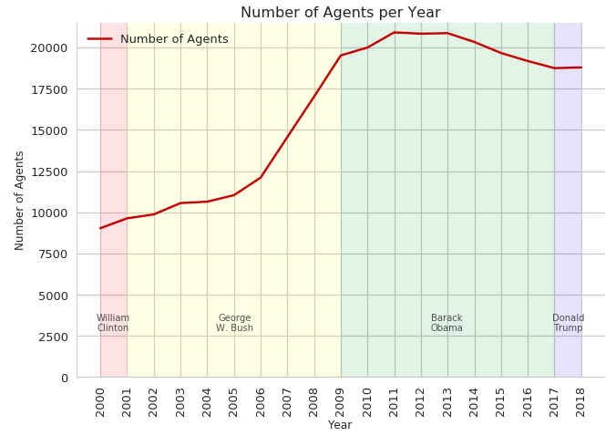
Figure 4
The number of Border Patrol Agents increased significantly during Bush’s presidency, evened out during Obama’s and Trump’s.

Slide 6
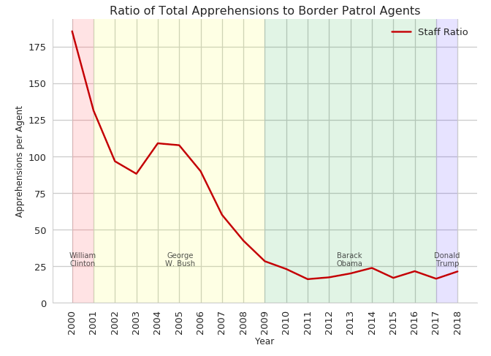
Figure 5
In 2000, there were over 175 apprehensions per agent; in 2018, there were less than 25 apprehensions per agent.

