Slide 1
Project Layout: My Journal
A basic idea

Slide 2
Features
Notification features
Mess Menu
Event Management
Connectivity with blue-tooth
Photos
Time table
Synchronize with Google Calendar
Notes

Slide 3
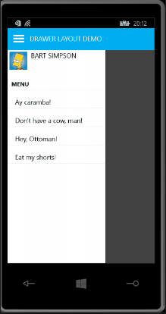


Activity 1
Login feature/signup feature for new users
This leads them to their dashboard.
Username
Password
Login
New user

Slide 4

Activity2
Today
Buttons
Button1: Check today’s schedule
Button2: Check schedule
Button3: Create events
Button4: Storage
Events
Time table
Mess Menu
Notes

Slide 5
Activity3
Events
Time Table
Mess Menu
All these will be fragments in flip mode.

