Slide 1

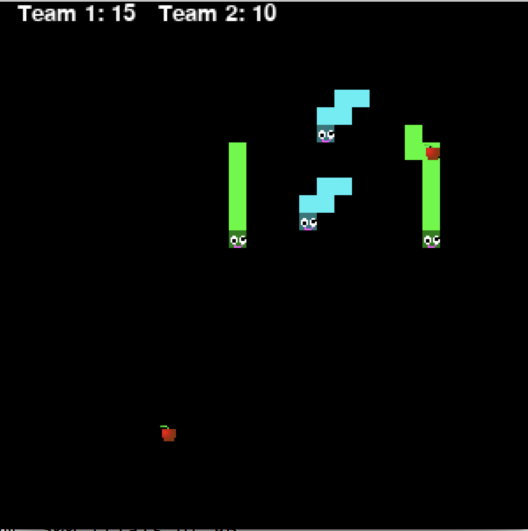
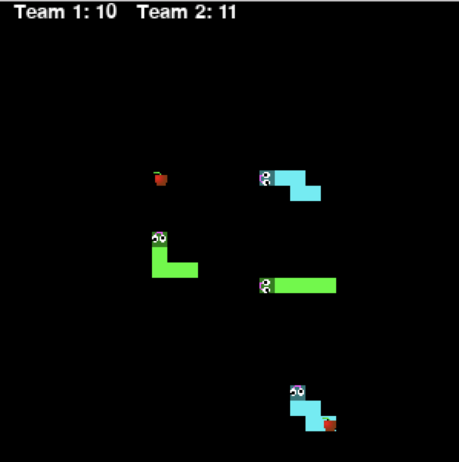
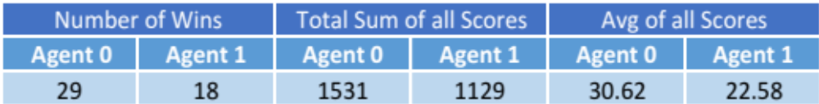
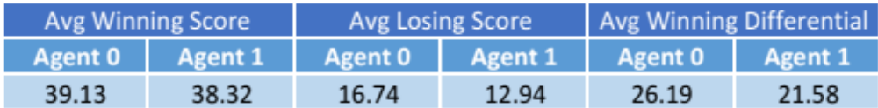
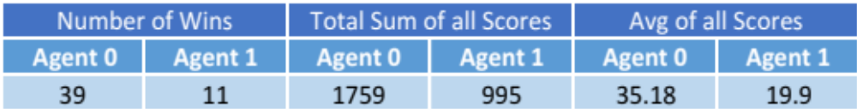
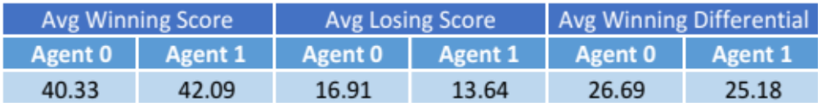
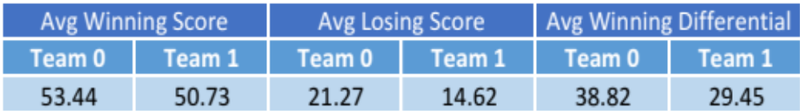
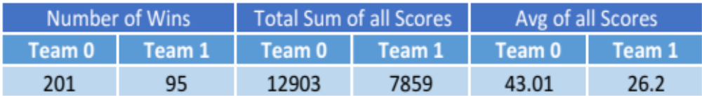
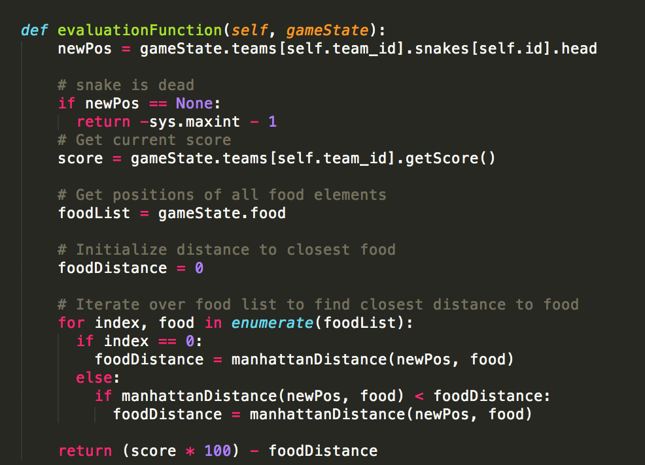
Brian Ge ‘18 | Frances Shapiro ‘18 | Daniel Galindo-Navarro ‘18
bge@college.harvard.edu | fshapiro@college.harvard.edu | dgalindonavarro@college.harvard.edu
CS182 Fall 2017
Introduction
Our project is an extension of the classic game Snake by adding multiple snake agents and teams. Instead of one snake agent attempting to eat food that appears on the board while avoiding crashing into walls or itself, our project explores how multiple snakes on competing teams with different ways of producing optimal strategies would function, and which strategies prevail. These snakes are separate AI agents, and we were interested to see how the different kinds of algorithms we’ve studied throughout the semester, such as Minimax and Q-Learning, perform as strategy producers in this kind of setting. We found that Alpha-Beta Pruning agents vs Greedy Agents performed better individually and on teams, and are continuing to look into how different evaluation functions, and different strategy algorithms (including reinforcement learning) affect the gameplay. We are also investigating how these strategy algorithms will adapt to team play rather than individual play.
The classic snake game involves one player controlling a line (snake) in a grid world, attempting to grow as long as possible without colliding with one’s tail or the grid walls. Usually the snake grows by eating randomly spawned food, incrementing its score by one with each food eaten. Our version of the game introduces more than one snake agent in a competitive game; each agent has its own score, and follows the same rules as the simple version of the game. The snakes are now competing to eat the same food, creating an adversarial condition in which a finite amount of utility can be gained by both teams. This presents additional strategy decisions for a snake to make, including deciding what food is worth attempting to eat, and more interestingly, ways to block the opposing team. This makes a simple greedy search agent perhaps not the most optimal way to play this game.
In our standard example, we examine two teams; each team has a shared score, and is comprised of two snakes which act as individual agents. Each agent can observe the location of the other agents on the grid as well as the locations of food, but chooses its actions independently. This creates interesting opportunities for snake agents on the same team to have collaborative policies, even given that they cannot predict the moves of their teammates. Our hypothesis was that if we use Minimax agents and trained q-learning agents to play the game described, they will both be able to outperform simple greedy agents with only one-step look ahead. Additionally, we expected to see some type of complex policy form within teams which use reinforcement learning to learn desirable actions from certain situations, using features of the game state to simplify the state space, such as average distance of team to food, and average distance from an agent to the other agents. At the end, we wanted to observe a team of trained Q-learning agents play the game against a team of optimized Minimax agents.
blah blah blah
Data
Gameboard Examples
Individual Adversarial Play
1 Alpha-Beta Agent v. 1 Greedy Agent
Agent 0: Alpha-Beta, Agent 1: Greedy
Evaluation Function: Only takes into account team score and food distance, same as “greedy” method
Alpha-Beta Depth = 2
Approach
1 Alpha-Beta Agent v. 1 Greedy Agent
Agent 0: Alpha-Beta, Agent 1: Greedy
New Evaluation Function: Tries to maximize score differential rather than team score, and tries to maximize the number of snakes alive on its own team and minimize opponent snakes alive
Alpha-Beta Depth = 2
Conclusions
State Representation:
List of teams, and each team’s score
List of snakes
Snake is a queue of tuple positions with a head and a direction
Location of food
Snake Actions:
Forward, left and right.
Snakes cannot move backward from head.
Turning into the grid wall, itself, or snakes on other teams causes death
Moving forward, we would like to collect data with a wider variety of evaluation functions for the Minimax agent. As can be expected with a simple evaluation function and only minimal look ahead, the Minimax agents tend to be better at avoiding death by opponent than the greedy agents since the Minimax agents take into account the most likely future moves of its opponents. However, there isn’t as much collaboration with teammates as we would like to see from the Minimax agents, and this is something we will aim for by varying the evaluation function as we continue to collect data. This will hopefully lead to an even higher percentage of wins and higher scores for the Minimax agent as well.
In sum, we’ve seen a trend for our “smarter” agents to be better at playing the game, but we want to collect more data and try different approaches. One of our main goals is to use the concepts we learned in class and apply these to playing in teams, which is a new concept, and we will continue to dig deeper into that type of game play for the duration of our project, as well as implement Q-Learning as a new strategy mechanism for our agents.
Team Adversarial Play
Ways to Evaluate Actions
Simple Greedy Agent:
This agent looks at all three possible actions and takes the action that results in the highest value from an evaluation function (takes into account only its team’s score, the closest food, and whether or not an action will cause death at the next time-step, not the opponent’s moves)
Evaluation Function: We are working on a variety of evaluation functions; the most simple one is the same as that of the greedy algorithm. Other variations include more information about the game state, such as the opposing team’s score, both teams’ average distance to the food, and the number of snakes on each team remaining alive. By including these other variables, we hope to encourage more collaborative approaches to winning games against the greedy agents.
Example Code:
This is the greedy
evaluation function used
in some of our trials
(see Data section for
more information)
Minimax with Alpha-Beta Pruning:
This agent looks at the next moves of all agents on the board, including its own teammates and the opposing team’s agents. It looks ahead a specified number of moves based on the depth we provide for the algorithm.
Expectimax:
This agent looks at the next moves of all agents on the board just like the Minimax agent. However, while it treats its own teammates and itself as a max agent, it doesn’t assume that the opponents will be optimal minimizing agents. Instead, it uses an expected value to try and determine which actions to take.
Approach for Q-Learning Training:
Training parameters (other snakes, what policies these snakes follow)
2 Alpha-Beta Agents v. 2 Greedy Agents
Team 0: Alpha-Beta, Team 1: Greedy
Evaluation Function: Only takes into account team score and food distance, same as “greedy” method
Alpha-Beta Depth = 2
blah blah blah
Results
Interpreting the Data
While we have finished implementing our simple greedy agent, Minimax agent, and Expectimax agent (data not shown), we have collected data specifically for the Minimax agent with Alpha-Beta Pruning vs. the greedy agent. Even with the pruning implemented, the Minimax algorithm tends to be incredibly slow, as can be expected with the number of nodes in the Minimax tree, which grows exponentially for every level in the tree. So far, we have only been able to collect data for a Minimax algorithm with a depth of 2, since the slowdown further down into the tree for a 2v2 game is quite bad. To even be able to go to a depth of 2 we had to switch from copying the entire state to generate a successor and instead alter the current state while storing important old values to be able to “undo” the changes. Furthermore, we have only collected data for a Minimax agent with the simplest evaluation function (i.e. the same as that of the greedy agent) so far with team play.
Based on the data we collected, the Minimax Agent with Alpha-Beta pruning (also referred to as Alpha-Beta Agent) is shown to have significantly more instances of winning compared to the base greedy agent, individually and on teams and across evaluation functions.
Citations and Links
Kuindersma, Scott. Harvard CS182 Lectures 3, 4, 8, 9, 10, 11. Problem Sets 1 and 3.
Littman, Michael L. "Markov games as a framework for multi-agent reinforcement learning." Proceedings of the eleventh international conference on machine learning. Vol. 157. 1994.
Felix Crevier, Sebastien Dubois, Sebastien Levy. “Multiplayer Snake AI CS221 Project Final Report”. Stanford.edu.
Shu Kong, Joan Aguilar Mayans. “Automated Snake Game Solvers via AI Search Algorithms.” Uci.edu.
John A. Paulson School of Engineering and Applied Sciences

