Slide 1
ARRISK
DRAGOMIR GALINOV DRAGANOV

Slide 2

INTRODUCTION

Slide 3
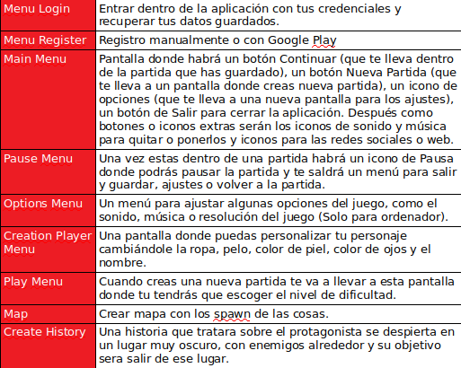
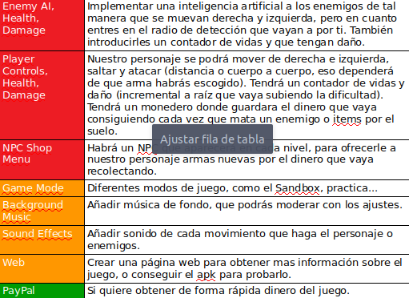
RELEASE PRODUCT BACKLOG
Notes:
CAMBIAR BACKLOG!!!!

Slide 4
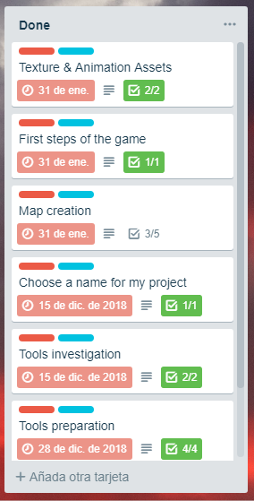
ROADMAP – COMPLETED SPRINTS
SPRINT 1:
Tools Investigation
Choose name for my project
SPRINT 2:
Tools preparation
SPRINT 3:
UML DB & Creation of it
SPRINT 4:
Texture & Animation Assets
First Steps of the Game
Map Creation

Slide 5
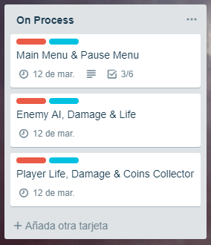
ROADMAP – SPRINTS ON MY WAY
SPRINT 6:
Main Menu
Pause Menu
SPRINT 4:
Enemy AI
Enemy Damage + Life
Player Damage + Life
Player Pocket(Coins Collect)

Slide 6
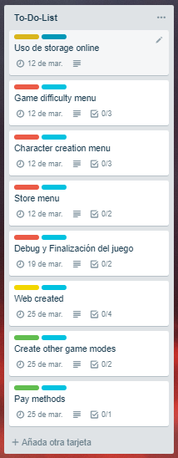
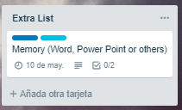
ROADMAP – SPRINTS TO COMPLETE
SPRINT 5:
Google Play Save Data
SPRINT 6:
Store Menu(Doubt)
Character Creation Menu
Game Difficulty Menu
SPRINT 7:
Debbug & Fix Errors
SPRINT 8:
Web Creation

Slide 7






SOFTWARE & LANGUAGE

Slide 8
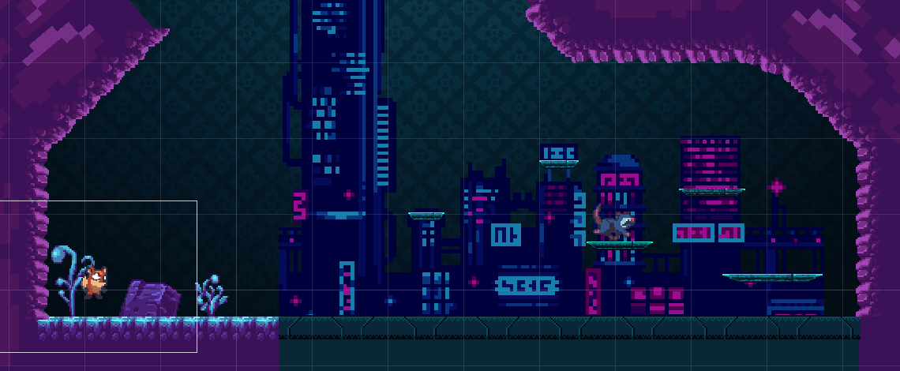
PROTOTIPO

Slide 9
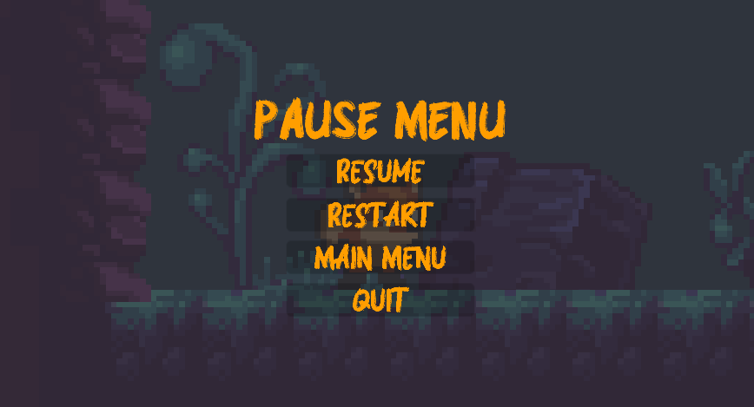
PROTOTIPO

Slide 10

PROTOTIPO

Slide 11
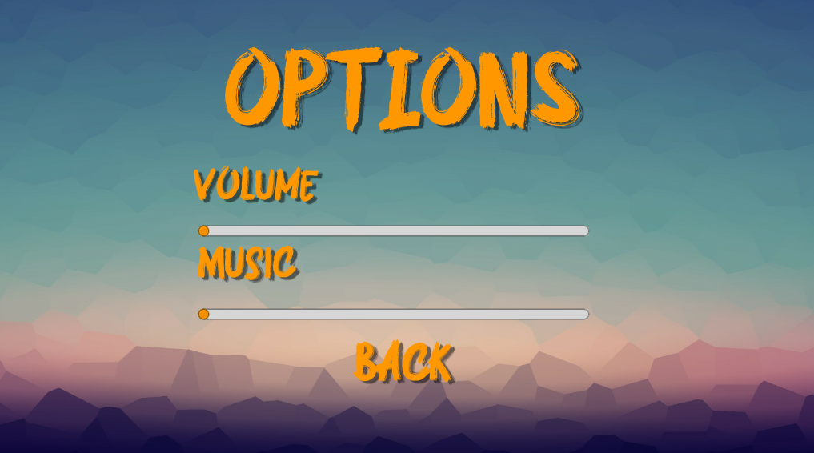
PROTOTIPO

Slide 12
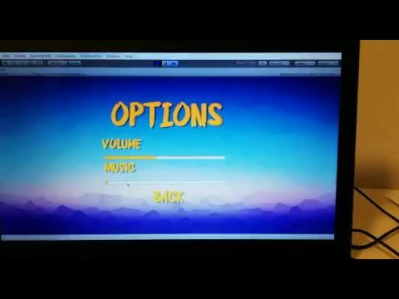
PROTOTIPO

