Slide 1
Hands on with Apache MXNet
On the Amazon Deep Learning AMI
Andrew Kane - Senior Solutions Architect
@drandrewkane

Slide 2
AI and ML
Artificial Intelligence: design software applications which exhibit human-like behavior, e.g. speech, natural language processing, reasoning or intuition
Machine Learning: teach machines to learn without being explicitly programmed
Deep Learning: using neural networks, teach machines to learn from complex data where features cannot be explicitly expressed

Slide 3
Deep learning
Deep Learning is a subfield of machine learning concerned with algorithms inspired by the structure and function of the brain called artificial neural networks.
Data is passed through multiple non-linear transformations to generate a prediction, models use a cascade of multiple layers of nonlinear processing units for feature extraction and transformation. Each successive layer uses the output from the previous layer as input.
Objective: Learn the parameters of the transformations that minimize a cost function

Slide 4
The advent of Deep Learning
Algorithms
Programming
Models
Data
Acceleration (GPU’s)

Slide 5
Uses of Deep Learning
Image understanding
Speech recognition
Natural language processing
Autonomy
Expedia have 10M+ images from 300K+ hotels
Images boost the conversation around a hotel
So having the best images matter
They used Keras and EC2 GPU instances and fine tuned a retrained model
Object Segmentation
Last June, tuSimple drove an autonomous truck for 200 miles from Yuma, AZ to San Diego
Key word trigger
Intents….

Slide 6














Customers Running AI on AWS
And many more…

Slide 7
How does Deep Learning work?

Slide 8
Human Neuron
Inputs
Output
Notes:
What is an Artificial Neural Network?
- A mathematical model inspired by biological neural networks
- An interconnected group of artificial “neurons”
- Structure changes during “learning” to find complex patterns in I/O data

Slide 9
Artificial Neuron and Perception
Input
Vector training of data set (x)
Output
Linear function of input
Nonlinearity
Transformation of output into value range
Training
Learn the weights (w) and bias (b) by minimising loss
b
X0
X1
Inputs (x)
Neuron
Output
X2
Weights (w)
Xn
f(x) = 𝜎 (⟨w, x⟩ + b)
Notes:
Primary activation function f(x) tends to be very expensive computationally

Slide 10
Models of Neural Networks
Lots of types, feed forward, recurrent neural network, radial based function, regulatory feedback and so on….
Convolution Neural Network (CNN)
Feedforward network
Inspired by the visual cortex and responds to stimuli in a restricted area
Good for image processing
Long Short Term Memory (LSTM)
Propagates data forward and also backwards from later stages to earlier
LSTM out performed every other RNN model

Slide 11
Apache MXNet

Slide 12
https://mxnet.apache.org/

Slide 13
Features
Flexible: Supports both imperative and symbolic programming
Portable: Runs on CPUs or GPUs, on clusters, servers, desktops, or mobile phones
Multiple Languages: C++, Python, R, Scala, Julia, Matlab, Javascript, and Perl
Distributed on Cloud: Supports distributed training on multiple CPU/GPU machines
Performance Optimized: Optimized C++ backend engine parallelizes both I/O and computation
Broad Model Support: CNN, RNN/LSTM

Slide 14
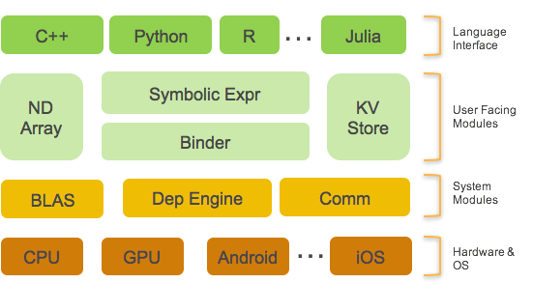
MXNet architecture

Slide 15
MXNet API Components
NDArray: Provides imperative tensor operations
Symbol: Provides neural network graph and auto-differentiation
RNN Cell: Tools for building RNN symbolic graph
Module: Provides interface for performing computation with Symbol
Data Loading: Provides iterators for reading data
Metric: Evaluation metric to evaluate performance of trained model

Slide 16
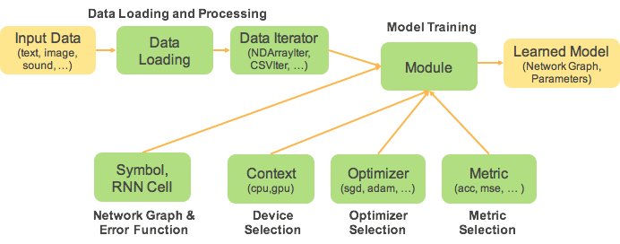
Model training flow in MXNet

Slide 17
Workshop
MXNet with a pre-trained model

Slide 18


Exercise
Use the Amazon Deep Learning AMI to identify whats in these pictures and compare pre-trained models.

Slide 19
Conclusion

Slide 20
Model Comparison
How much memory does it use?
We can take an educated guess by looking at the size of the parameters file
VGG16: 528MB (about 140 million parameters)
ResNet-152: 230MB (about 60 million parameters)
Inception v3: 43MB (about 25 million parameters)
How fast can it predict?
This is more difficult and can depend on batch size but in our example, lets look at the average over a few calls
*** VGG16 - Predicted in 0.30 millisecond
*** ResNet-152 - Predicted in 0.90 millisecond
*** Inception v3 - Predicted in 0.40 millisecond

Slide 21
Summary
In these tests
ResNet-152 has the best accuracy of all three networks (by far) but it’s also 2–3 times slower.
VGG16 is the fastest — due its small number of layers? — but it has the highest memory usage and the worst accuracy.
Inception v3 is almost as fast, while delivering better accuracy and the most conservative memory usage. This last point makes it a good candidate for constrained environments.

