Slide 1
Growth-rate Functions
O(1) – constant time, the time is independent of n, e.g. array look-up
O(log n) – logarithmic time, usually the log is base 2, e.g. binary search
O(n) – linear time, e.g. linear search
O(n*log n) – e.g. efficient sorting algorithms
O(n²) – quadratic time, e.g. selection sort
O(n^{k}) – polynomial (where k is some constant)
O(2^{n}) – exponential time, very slow!
Order of growth of some common functions
  O(1) < O(log n) < O(n) < O(n * log n) < O(n²) < O(n³) < O(2^{n})
Notes:
Show that the order of function is strict.
Another example: which one is bigger n^1.001 or n*log n?

Slide 2
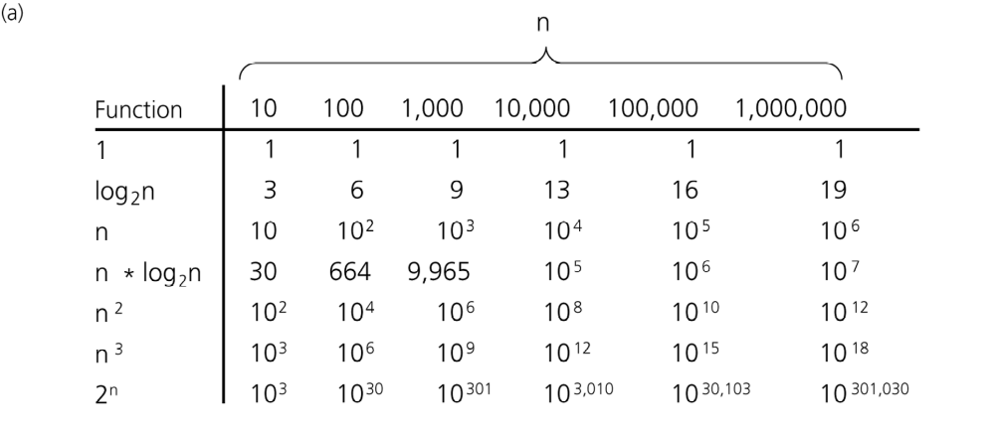
Order-of-Magnitude Analysis and Big O Notation
A comparison of growth-rate functions: a) in tabular form

Slide 3
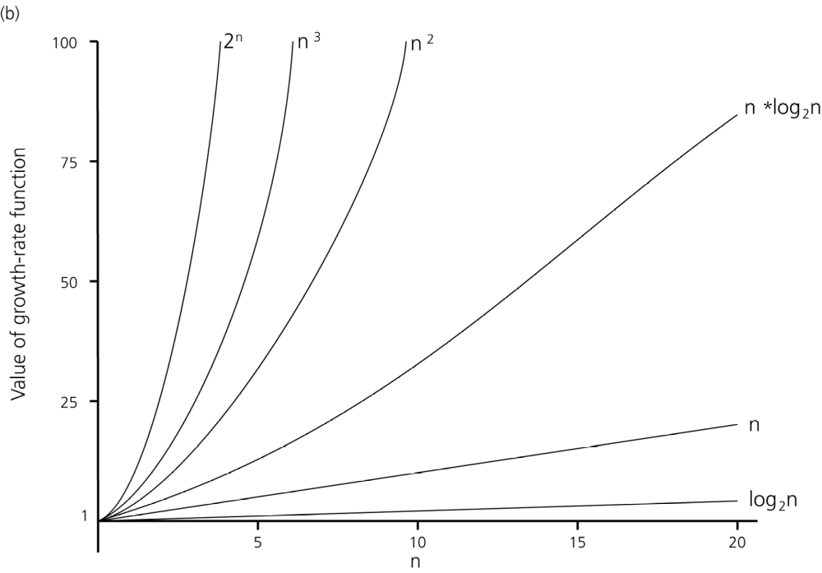
Order-of-Magnitude Analysis and Big O Notation
A comparison of growth-rate functions: b) in graphical form

Slide 4
Note on Constant Time
We write O(1) to indicate something that takes a constant amount of time
  E.g. finding the minimum element of an ordered array takes O(1) time, because the min is either at the beginning or the end of the array
  Important: constants can be huge, and so in practice O(1) is not necessarily efficient --- all it tells us is that the algorithm will run at the same speed no matter the size of the input we give it

Slide 5
Arithmetic of Big-O Notation
If f(n) is O(g(n)) then c.f(n) is O(g(n)), where c is a constant.
  Example: 23*log n is O(log n)
If f₁(n) is O(g(n)) and f₂(n) is O(g(n)) then also f₁(n)+f₂(n) is O(g(n))
  Example: what is order of n²+n?
  n² is O(n²)
  n is O(n) but also O(n²)
  therefore n²+n is O(n²)
Notes:
Example: log_a(n) and log_b(n) -> base usually omitted.
2) f_i(n) is O(g_i(n)), then f_1(n)+f_2(n) is O(max{g_1(n),g_2(n)})
2) Example: sum_{i=0}^n c_i x^i is O(x^n)

Slide 6
Arithmetic of Big-O Notation
If f₁(n) is O(g₁(n)) and f₂(n) is O(g₂(n)) then f₁(n)*f₂(n) is O(g₁(n)*g₂(n)).
  Example: what is order of (3n+1)*(2n+log n)?
  3n+1 is O(n)
  2n+log n is O(n)
  (3n+1)*(2n+log n) is O(n*n)=O(n²)
Notes:
3) Example: (n+1)^5
Example: log(poly(n)) is O(log(n))
Question: is 3^n of order O(2^n)?
CONCLUSION: some constants are important! n^c and n^d, c^n and d^n, even c^an and c^bn

Slide 7
Using Big O Notation
It’s not correct to say:
f(n) · O(g(n)),
f(n) = O(g(n))
It’s completely wrong to say:
f(n) ¸ O(g(n))
f(n) > O(g(n))
Just use:
f(n) is (in) O(g(n)), or
f(n) is of order O(g(n)), or
f(n) 2 O(g(n))

Slide 8
Using Big O Notation
Sometimes we need to be more specific when comparing the algorithms.
For instance, there might be several sorting algorithms with time of order O(n.log n). However, an algorithm with cost function
2n.log n + 10n + 7log n + 40
is better than one with cost function
5n.log n + 2n +10log n +1
That means:
  We care about the constant of the main term.
  But we still don’t care about other terms.
In such situations, the following notation is often used:
2n.log n + O(n) for the first algorithm
5n.log n + O(n) for the second one

Slide 9
Searching costs using
O-notation
Linear search
  Best case: O(1)
  Average case: O(n)
  Worst case: O(n)
Binary search
  Best case: O(1)
  Average case: O(log n)
  Worst case: O(log n)

Slide 10
Sorting cost in O-notation
Selection sort
  Best case: O(n²) (can vary with implementation)
  Average case: O(n²)
  Worst case: O(n²)
Insertion sort
  Best case: O(n) (can vary with implementation)
  Average case: O(n²)
  Worst case: O(n²)

