Slide 1
CSE 341
Lecture 23
Introduction to JavaScript
slides created by Marty Stepp
http://www.cs.washington.edu/341/

Slide 2
Language timeline
category | 1960s | 1970s | 1980s | 1990s | 2000s
scientific | Fortran |  |  | Matlab
business | Cobol | DBMSes | SQL | VB
functional | Lisp | ML, Scheme | Erlang | Haskell | F#
imperative/ procedural | Algol | Pascal, C, Smalltalk | Ada, C++ | Java | C#
scripting | BASIC |  | Perl | Python, Ruby, PHP, JavaScript
logical |  | Prolog | CLP(R)

Slide 3
What is JavaScript?
created in 1995 by Brandon Eich of Netscape/Mozilla
  "JS had to "look like Java" only less so, be Java’s dumb kid brother or boy-hostage sidekick. Plus, I had to be done in ten days or something worse than JS would have happened." - Brandon Eich
  originally called "LiveScript" to match Netscape branding
  renamed to JavaScript to capitalize on popularity of Java
  submitted as a standard to ECMA in 1997 as "ECMAScript"
not directly related to Java
  Eich claims he was most influenced by Self and Scheme
  some JS syntax, libraries, etc. are ripped off by Java, C
  D. Crockford: "JavaScript is Lisp in C's clothing."

Slide 4
JavaScript today
possibly the most used programming language today (!!)
  mostly used for client-side web page scripting, but increasingly used to build server apps, other programs
  current standardized version: ECMAScript 5 (2009)
Is JavaScript a bad programming language??
  had bad browser behavior, slow, poor web coders, etc.
  recent implementations are faster, better, more stable
  JS in browser works with "DOM" (Document Object Model)
  related JS+web technologies: Ajax, JSON, jQuery, etc.
  spin-off languages: JScript (MS), ActionScript (Adobe), etc.

Slide 5
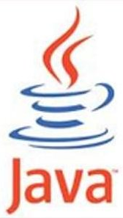

JavaScript vs. Java
interpreted, not compiled
  dynamic typing
  first-class functions; nested functions; closures
  a structured, imperative object-oriented, scripting lang.
  prototype-based object and inheritance system
  sophisticated first-class resizable array type
  first-class regular expression support
more relaxed syntax and rules
  fewer and "looser" data types
  variables don't always need to be declared
  key construct is first-class function rather than the class
+
= JavaScript

Slide 6
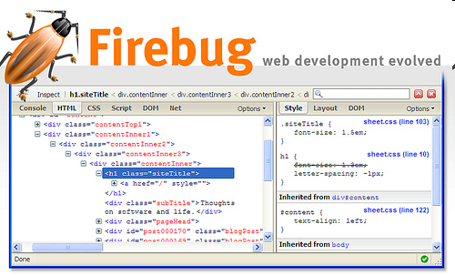
Running JS code in a browser
<html>
<head>
<script src="myfile.js"
type="text/javascript"></script>
</head>
<body>
<p>My web page</p> ...
</body>
</html>
  We won't be doing this!
    aside: Firebug extension

Slide 7
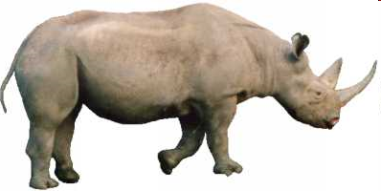
Running JS without a browser
CommonJS: project started in 2009 to create a standard library of JS types and functions for all non-web apps
  Rhino (Mozilla)
  V8 (Google / Chrome)
  Narwhal
  others: Ringo, Joyent, Sprout, Persevere
We support the Rhino runtime for this course.
  http://www.mozilla.org/rhino/
  java -jar rhino.jar JSFileName

Slide 8
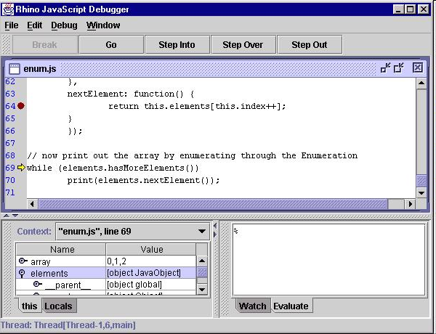
The Rhino debugger
java -classpath rhino.jar
org.mozilla.javascript.tools.debugger.Main filename.js
  http://www.mozilla.org/rhino/debugger.html

Slide 9
JavaScript syntax

Slide 10
print (CommonJS)
print(expr, expr, ..., expr);
provided by Rhino as part of CommonJS
  print("Hello, world!\n");
  print(1+1, 4, 3*2); // 2 4 6
  other shell variables/functions:
    arguments, environment, help, defineClass, deserialize, load(filename), loadClass, readFile(name), readURL, runCommand, seal, serialize, spawn, sync, quit, version
  doesn't work in web browsers (use alert instead)

Slide 11
Variables
var name = expression;
Examples:
  var age = 32;
  var weight = 127.4;
  var clientName = "Connie Client";
variables are declared with var keyword (case sensitive)
types not specified, but JS does have types
  Number, Boolean, String, Array, Object, Function, Null, Undefined
  can find out a variable's type by calling typeof

Slide 12
Numbers
var enrollment = 99;
var medianGrade = 2.8;
var credits = 5 + 4 + (2 * 3);
integers and real numbers are the same type
  (no int vs. double)
same operators: + - * / % ++ -- = += -= *= /= %=
  similar precedence to Java
  many operators auto-convert types: "2" * 3 is 6

Slide 13
Number properties/methods
Number object "static" properties
Number.MAX_VALUE | largest possible number, roughly 10³⁰⁸
Number.MIN_VALUE | smallest positive number, roughly 10⁻³²⁴
Number.NaN | Not-a-Number; result of invalid computations
Number.POSITIVE_INFINITY | infinity; result of 1/0
Number.NEGATIVE_INFINITY | negative infinity; result of -1/0
Number instance methods
.toString([base]) | convert a number to a string with optional base
.toFixed(digits) | fixed-point real with given # digits past decimal
.toExponential(digits) | convert a number to scientific notation
.toPrecision(digits) | floating-point real, given # digits past decimal
global methods related to numbers
isNaN(expr) | true if the expression evaluates to NaN
isFinite(expr) | true if expr is neither NaN nor an infinity

Slide 14
The Math object
var rand1to10 = Math.floor(Math.random() * 10 + 1);
var three = Math.floor(Math.PI);
Math methods: abs, ceil, cos, floor, log, max, min, pow, random, round, sin, sqrt, tan
properties: E, PI

Slide 15
Math properties/methods
Math.E | e, base of natural logarithms: 2.718...
Math.LN10, Math.LN2, Math.LOG2E, Math.LOG10E | natural logarithm of 10 and 2; logarithm of e in base 2 and base 10
Math.PI | π, circle's circumference/diameter: 3.14159...
Math.SQRT1_2, Math.SQRT2 | square roots of ¹/₂ and 2
Math.abs(n) | absolute value
Math.acos/asin/atan(n) | arc-sin/cosine/tangent of angle in radians
Math.ceil(n) | ceiling (rounds a real number up)
Math.cos/sin/tan(n) | sin/cosine/tangent of angle in radians
Math.exp(n) | e^{n}, e raised to the nth power
Math.floor(n) | floor (rounds a real number down)
Math.log(n) | natural logarithm (base e)
Math.max/min(a, b...) | largest/smallest of 2 or more numbers
Math.pow(x, y) | x^{y}, x raised to the yth power
Math.random() | random real number k in range 0 ≤ k < 1
Math.round(n) | round number to nearest whole number
Math.sqrt(n) | square root

Slide 16
Comments (same as Java)
// single-line comment
/*
multi-line comment
multi-line comment
*/
(identical to Java's comment syntax)

Slide 17
Strings
var s = "Connie Client";
var firstName = s.substring(0, s.indexOf(" "));
var len = s.length; // 13
var s2 = 'Melvin Merchant'; // can use "" or ''
String methods: charAt, charCodeAt, fromCharCode, indexOf, lastIndexOf, replace, split, substring, toLowerCase, toUpperCase
  charAt returns a one-letter string (there is no char type)
  length is a property (not a method as in Java)
concatenation with + : 1 + 1 is 2, but "1" + 1 is "11"
strings can be compared with <, <=, ==, !=, >, >=

Slide 18
String methods
String.fromCharCode(expr) | converts ASCII integer → String
.charAt(index) | returns character at index, as a String
.charCodeAt(index) | returns ASCII value at a given index
.concat(str...) | returns concatenation of string(s) to this one
.indexOf(str[,start]) .lastIndexOf(str[,start]) | first/last index at which given string begins in this string, optionally starting from given index
.match(regexp) | returns any matches for this string against the given string or regular expression ("regex")
.replace(old, new) | replaces first occurrence of old string or regular expr. with new string (use regex to replace all)
.search(regexp) | first index where given regex occurs
.slice(start, end) .substring(start, end) | substr. from start (inclusive) to end (exclusive)
.split(delimiter[,limit]) | break apart a string into an array of strings
.toLowerCase() .toUpperCase() | return new string in all upper/lowercase

Slide 19
More about Strings and numbers
escape sequences behave as in Java: \' \" \& \n \t \\
convert string to number with parseInt, parseFloat:
  var count = 10;
  var s1 = "" + count; // "10"
  var s2 = count + " bananas, ah ah ah!";
  var n1 = parseInt("42 is the answer"); // 42
  var n2 = parseInt("0x2A", 16); // 42
  var n3 = parseFloat("3.1415"); // 3.1415
  var bad = parseInt("booyah"); // NaN
access the letters of a String with [] or charAt:
  var firstLetter = s[0];
  var firstLetter = s.charAt(0);
  var lastLetter = s.charAt(s.length - 1);

Slide 20
The for loop (same as Java)
for (initialization; test; update) {
statements;
}
for (var i = 0; i < 10; i++) {
print(i + "\n");
}
var s1 = "hi, there!!!", s2 = "";
for (var i = 0; i < s1.length; i++) {
var c = s1.charAt(i);
if (c >= "a" && c <= "z") {
s2 += c + c;
}
}
// s2 stores "hhiitthheerree"

Slide 21
Logical operators
> < >= <= && || ! == != === !==
most logical operators automatically convert types:
  5 < "7" is true
  42 == 42.0 is true
  "5.0" == 5 is true
=== , !== are strict equality tests; checks type and value
  "5.0" === 5 is false

Slide 22
The if/else statement
if (test) {
statements;
} else if (test) {
statements;
} else {
statements;
}
identical structure to Java's if/else statement...
  but JavaScript allows almost any value as a test!

Slide 23

Boolean type
var iLike341 = true;
var ieIsGood = "IE6" > 0; // false
if ("JS is great") { ... } // true
if (0 || "") { ... } // false
any value can be used as a test
  "falsey" values: 0, 0.0, NaN, "", null, and undefined
  "truthy" values: anything else
converting a value into a boolean explicitly:
  var boolValue = Boolean(otherValue);
  var boolValue = !!(otherValue);

Slide 24
&& and || in depth
a && b is a binary operator that returns:
  if a is truthy, then b, else a
  (this turns out to be a truthy/falsey value in the right cases)
a || b is a binary operator that returns:
  if a is truthy, then a, else b
  (this turns out to be a truthy/falsey value in the right cases)
Examples:
  0 || 42 || 12 || -1 returns 42 (truthy)
  NaN || null || "" returns "" (falsey)
  1 + 1 && 6 && 9 returns 9 (truthy)
  3 && 4 && null && 5 && 6 returns null (falsey)

Slide 25
null vs. undefined
var ned = null;
var benson = 9;
var caroline;
at this point in the code:
  ned is null
  benson is 9
  caroline is undefined
undefined: has not been declared, does not exist
null: exists, but specifically assigned an empty value
  Why does JavaScript have both of these?

Slide 26
The while loop (same as Java)
while (test) {
statements;
}
do {
statements;
} while (test);
break and continue keywords also behave as in Java

Slide 27
Functions
function name(paramName, ..., paramName) {
statements;
}
function myFunction(name) {
print("Hello, " + name + "!\n");
print("How are you?\n");
}
  unlike in Java, functions are first-class (can be stored as variables, passed as parameters, returned, ...)

Slide 28
JavaScript keywords
  break case catch continue debugger
  default delete do else finally
  for function if in instanceof
  new return switch this throw
  try typeof var void while
  with
Reserved words (these don't do anything yet):
  class const enum export extends
  import implements interface let package
  private protected public static super yield

