Slide 1
Introduction to Computing
for the Social Sciences
Session 3 - Data Structures
David Garcia
Winter Semester 2024-25
06.11.2024
‹#›

Slide 2
Course Outline
Session 1: Introduction
Session 2: Information Coding
Session 3: Data Structures
Session 4: Programming
Session 5: Algorithms
Session 6: Recursion
Session 7: Sorting Algorithms
Session 8: Time Complexity
Session 9: Formal Languages and Automata
Session 10: Turing Machines and Complexity Classes
Session 11: Databases
Session 12: Parallel Programming
Session 13: Social Science Applications
Session 14: Exam Review
‹#›

Slide 3
Outline
Data Types
Arrays
Linked Lists
Binary Search Trees
Hash Tables
‹#›

Slide 4
Primitive Data Types
Python supports all primitive data types
Type | Bits | Coding | Minimum | Maximum
boolean | 1/8 | truth value | false | true
byte | 8 | two’s complement | -128 | 127
short | 16 | two’s complement | -32 768 | 32 767
int | 32 | two’s complement | -2 147 483 648 | 2 147 483 647
long | 64 | two’s complement | -9 223 372 036 854 775 808 | 9 223 372 036 854 775 807
char | 8-32 | UTF-8 (standard) | 0 (U+0000) | 1 114 112 (U+0010FFFF)
float | 32 | IEEE 754
double | 64 | IEEE 754
‹#›

Slide 5
Type Conversion
Expressions can turned into other types
general rules are:
conversion to “larger” data type can be done without loss of precision
conversion to a “smaller” data type usually leads to loss of precision
conversion of floating point number to integer cuts the decimal places
general type hierarchy:
byte ⊂ short = char ⊂ int ⊂ long
float ⊂ double
Python “hides” most of this complexity
you can, for example, add or multiply numbers of different type and the number formats are correctly managed
‹#›

Slide 6
Automatic Type Conversion
Automatic type conversion is especially important for arithmetic operations
binary operators are only defined for the same data type:
double + int, requires conversion of int to double e.g. 10.5 + 5 = 15.5
double + float, requires conversion of float to double e.g. 10.5f + 5.2 = 15.7
resulting type is always the “larger” type
‹#›

Slide 7
Operators
Simple mathematical operations +, −, ∗, /
Comparison operators <, >, < = , > = , = = , ! =
Brackets for mathematical operations
Modulo operator %
a % b yields the rest of the integer division of a and b
Logical operators (only for truth values)
not: logical negation
and: logical and (True and True = True, else False)
or : logical or (False or False = False, else True)
^ : exclusive or (False or True = True, True or False = True, else False)
‹#›

Slide 8
Operators
Bitwise operators (only for integers)
~ bitwise complement (~ 1 = 0; ~ 0 = 1 )
& bitwise and (1 & 1 = 1, else 0)
| bitwise or (0 | 0 = 0, else 1)
^ bitwise exclusive or (1^0 = 1, 0^1 = 1, else 0)
<< bitwise shift to the left (0010 << 2 = 1000)
>> bitwise shift to the right (0110 >> 2 = 0001)
Python Refresh: Try yourself with some binary or hexadecimal operations
‹#›

Slide 9
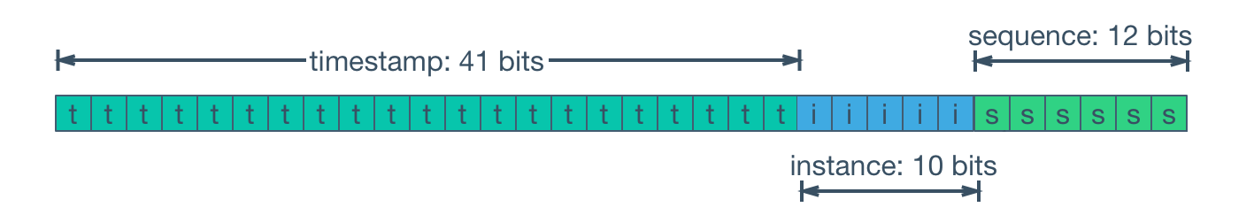
Social Science Application: the secret of Twitter snowflakes
"id": 10765432100123456789
def get_tweet_timestamp(tid):
offset = 1288834974657
tstamp = (tid >> 22) + offset
utcdttime = datetime.utcfromtimestamp(tstamp/1000)
print(str(tid) + " : " + str(tstamp) + " => " + str(utcdttime))
https://github.com/oduwsdl/tweetedat
https://ws-dl.blogspot.com/2019/08/2019-08-03-tweetedat-finding-tweet.html
‹#›

Slide 10
Overflow
Value ranges are limited by the data type
If the extend of the value range is reached arithmetic overflow occurs
In Python overflow for int is automatically recognized and the number is cast to long
Overflow for floating point numbers yields ∞, e.g.: try 1e5000 in Python
Example
data type byte
90₁₀ = 0101 1010₂
+40₁₀ = 0010 1000₂
130₁₀ = 1000 0010₂
BUT: 1000 0010₂ = -126₁₀
‹#›

Slide 11
Arrays
Data Types
Arrays
Linked Lists
Binary Search Trees
Hash Tables
‹#›

Slide 12



Data Structures
We focus on data structures with particular relevance for information storage
Definition Data types together with operations defined on these data that enable and realize access to and management of these data.
‹#›

Slide 13
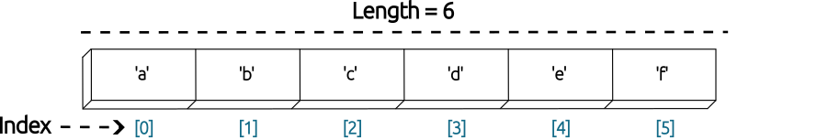
Arrays
Definition Systematic arrangement of similar objects, usually in rows and columns.
We address/ access elements using the index
in most programming languages indices range from 0 to n-1 for an array of length n
in MATLAB, R or in pseudo-code we use indices 1 to n
‹#›

Slide 14
Arrays: advantages and disadvantages
Advantages
Very fast access: if you know the index you only need one operation
Standard structure implemented in most languages
Disadvantages
Memory requirement depends on range of index values
If you have 7 entries for 7 indices between 1 and 1000000, you need 1000000 cells in memory
If just filling linearly, adding or removing in the middle leaves gaps or requires moving the rest of the content
What if you want indices that are not integers?
‹#›

Slide 15
Linked Lists and Dictionaries
Data Types
Arrays
Linked Lists
Binary Search Trees
Hash Tables
‹#›

Slide 16
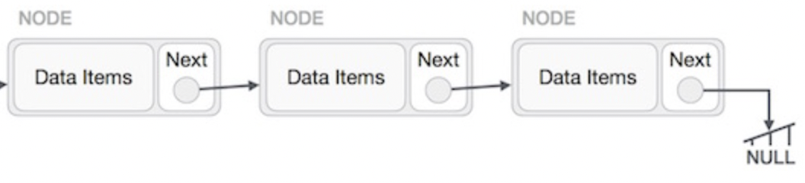
Linked Lists
Definition Linear collection of data elements, called nodes, each pointing to the next node by means of a pointer.
Source: https://www.tutorialspoint.com/
‹#›

Slide 17
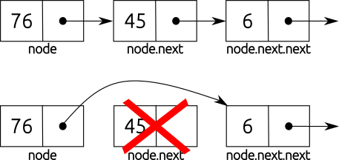
Linked Lists: advantages and disadvantages
Advantages
can be easily and dynamically edited
only requires changing the pointers of adjacent element(s)
memory requirements only grow with number of nodes
Disadvantages
difficult to index
slow to iterate through
need to save pointers
Why is this not optimal?
‹#›
Source: Wikipedia

Slide 18
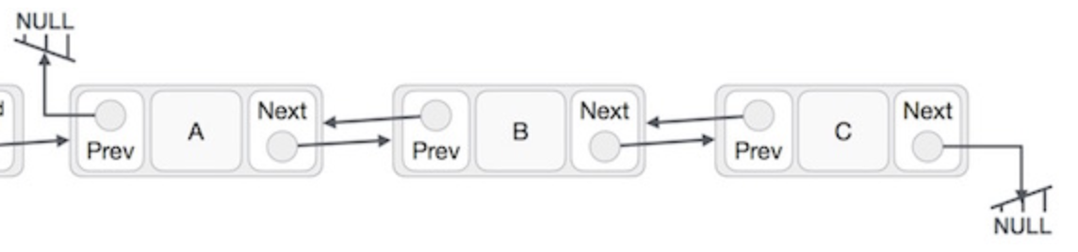
Doubly Linked Lists
Definition Linear collection of data elements, called nodes, each pointing to the next and previous node by means of a pointer.
Doubly linked lists make editing simpler. How?
Source: https://www.tutorialspoint.com/
‹#›

Slide 19
Binary Search Trees
Data Types
Arrays
Linked Lists
Binary Search Trees
Hash Tables
‹#›

Slide 20
The question of editing vs search
Linked lists have efficient editing but very slow (linear) search
Arrays have fast search but inefficient editing
Can we have some kind of search that is faster than linear but allows editing without moving all the data?
When lists are sorted but we cannot directly index: binary search
‹#›

Slide 21
Background: Binary Search
Procedure BinarySearch(A, n, x)
Inputs:
A: a sorted array
n: length of the array A
x: number to find
Result: index of number x if exist in A else ‘NOT-FOUND’
p ←1; r ←n While p ≤ r do:
q ← ⌊(p + r)/2⌋
if A[q] = x
then return q
else if A[q] > x
then r ←q - 1
else
p ← q + 1
return NOT-FOUND
In ordered array A of size n, search for the value x
See (Cormen, 2013) for more on this algorithm
‹#›

Slide 22
Background: Binary Search
Use binary search to find 43:
Procedure BinarySearch(A, n, x)
Inputs:
A: a sorted array
n: length of the array A
x: number to find
Result: index of number x if exist in A else ‘NOT-FOUND’
p ←1; r ←n While p ≤ r do:
q ← ⌊(p + r)/2⌋
if A[q] = x
then return q
else if A[q] > x
then r ←q - 1
else
p ← q + 1
return NOT-FOUND
15 | 28 | 30 | 34 | 36 | 43 | 62 | 73 | 81 | 82
1 | 2 | 3 | 4 | 5 | 6 | 7 | 8 | 9 | 10
15 | 28 | 30 | 34 | 36 | 43 | 62 | 73 | 81 | 82
1 | 2 | 3 | 4 | 5 | 6 | 7 | 8 | 9 | 10
15 | 28 | 30 | 34 | 36 | 43 | 62 | 73 | 81 | 82
1 | 2 | 3 | 4 | 5 | 6 | 7 | 8 | 9 | 10
15 | 28 | 30 | 34 | 36 | 43 | 62 | 73 | 81 | 82
1 | 2 | 3 | 4 | 5 | 6 | 7 | 8 | 9 | 10
‹#›

Slide 23
Background: Binary Search
Use binary search to find 43:
Procedure BinarySearch(A, n, x)
Inputs:
A: a sorted array
n: length of the array A
x: number to find
Result: index of number x if exist in A else ‘NOT-FOUND’
p ←1; r ←n While p ≤ r do:
q ← ⌊(p + r)/2⌋
if A[q] = x
then return q
else if A[q] > x
then r ←q - 1
else
p ← q + 1
return NOT-FOUND
15 | 28 | 30 | 34 | 36 | 43 | 62 | 73 | 81 | 82
1 | 2 | 3 | 4 | 5 | 6 | 7 | 8 | 9 | 10
15 | 28 | 30 | 34 | 36 | 43 | 62 | 73 | 81 | 82
1 | 2 | 3 | 4 | 5 | 6 | 7 | 8 | 9 | 10
15 | 28 | 30 | 34 | 36 | 43 | 62 | 73 | 81 | 82
1 | 1 | 3 | 4 | 5 | 6 | 7 | 8 | 9 | 10
15 | 28 | 30 | 34 | 36 | 43 | 62 | 73 | 81 | 82
1 | 2 | 3 | 4 | 5 | 6 | 7 | 8 | 9 | 10
‹#›

Slide 24
Binary Trees
Definition: Binary Tree A binary tree is a tree data structure that is either empty or it consists of a node (or root) S that has at most two children, which are referred to as the left child L and the right child R, both of which are also binary trees.
Root
A
Leaf Node
B
C
Parent-Child
D
E
F
G
Siblings
H
I
J
Sub-tree
‹#›

Slide 25
Binary Search Trees
Definition: Binary Search Tree A binary search tree is a binary tree with comparable keys where the key in the root has to be larger or equal to all keys in the left sub-tree and strictly smaller than all keys in the right sub-tree.
10
Remember that every element in the tree has a key but also contains data
Here we assume here that no duplicate keys are allowed
4
13
2
9
11
21
1
3
12
‹#›

Slide 26
Binary Search Trees
10
4
13
2
9
11
21
1
3
12
‹#›

Slide 27
Binary Search Trees
the root has to be larger or equal to all keys in the left sub-tree and …
… strictly smaller than all keys in the right sub-tree
≤
10
>
4
13
2
9
11
21
1
3
12
‹#›

Slide 28
Binary Search Trees
the root has to be larger or equal to all keys in the left sub-tree and …
… strictly smaller than all keys in the right sub-tree
10
4
13
≤
>
≤
>
2
9
11
21
1
3
12
‹#›

Slide 29
Binary Search Trees
the root has to be larger or equal to all keys in the left sub-tree and …
… strictly smaller than all keys in the right sub-tree
10
4
13
2
9
11
21
≤
>
>
1
3
12
‹#›

Slide 30
Binary Search Trees
Is this a binary search tree?
10
4
13
2
9
15
21
5
3
11
‹#›

Slide 31
Binary Search Trees
Is this a binary search tree?
No!
10
4
13
2
9
15
21
5
3
11
‹#›

Slide 32
Binary Search Trees
Searching for a given key:
compare the key you are looking for with the root
depending on whether it is smaller (larger) continue searching in left (right) sub-tree
return the value or key not found
10
4
13
2
9
11
21
1
3
12
‹#›

Slide 33
Binary Search Trees
Search for 11:
1.
Searching for a given key:
compare the key you are looking for with the root
depending on whether it is smaller (larger) continue searching in left (right) sub-tree
return the value or key not found
Remember the Binary Search Algorithm
10
2.
4
13
3.
2
9
11
21
1
3
12
1.
11 > 10 (root) → search on the right
2.
11 < 13 → search on the left
3.
11 = 11 → Found 11
‹#›

Slide 34
Binary Search Trees
Adding a new key at the correct position
assumption: key to be added is not yet in the tree
simply find appropriate empty slot and add the key as a “leaf”
only way to add keys and preserve binary search tree structure
10
Add key with value 6:
10
4
13
4
13
2
9
11
21
2
9
11
21
1
3
12
1
3
6
12
‹#›

Slide 35
Binary Search Trees
Delete specific key while preserving a binary search tree structure
three cases:
node has no children, i.e. a “leaf” node
node has one child
node has two children
10
4
13
2
9
11
21
1
3
6
12
‹#›

Slide 36
Binary Search Trees
Delete specific key while preserving a binary search tree structure
deleting a leaf node is simple:
search for key
in preceding node, remove reference to child
Delete key with value 6:
10
4
13
2
9
11
21
1
3
6
12
‹#›

Slide 37
Binary Search Trees
Delete specific key while preserving a binary search tree structure
deleting a leaf node is simple:
search for key
in preceding node, remove reference to child
10
4
13
2
9
11
21
1
3
12
‹#›

Slide 38
Binary Search Trees
Delete specific key while preserving a binary search tree structure
deleting a node with one child is still relatively simple
replace it with its only child
Delete key with value 11:
10
10
4
13
4
13
2
9
11
21
2
9
12
21
1
3
6
12
1
3
6
‹#›

Slide 39
Binary Search Trees
Delete specific key while preserving a binary search tree structure
deleting a node with two children is most complicated
replace it with most left child in the right sub-tree or the most right child in the left sub-tree
if necessary, restore the tree structure
remember the one-child delete case
Delete (root) 10:
10
11
11
4
13
4
13
4
13
2
9
11
21
2
9
11
21
2
9
11
21
1
3
12
1
3
12
1
3
12
‹#›

Slide 40
Binary Search Trees: advantages and applications
Advantages
lookup for keys is much faster than in an unsorted array
same efficiency as sorted array with binary search
adding/removing values is much faster than in a sorted array
just pointers are updated similarly to what is done in a linked list
in a sorted array all values to the “right” of the key have to be shifted
Practical applications
used in look-up tables or dynamic sets
can vary in size but still efficient “housekeeping” of index keys
it is ultimately most useful when paired up with data
fast look-up of data paired with each key, e.g. in database indices
‹#›
Binary Search Trees
‹#›

Slide 41
Binary Search Trees: disadvantages
Disadvantages of binary search trees
lookup takes a number of steps that depends on tree depth
if we add keys in an impractical order
many operations for deleting and adding
may arrive at a very unbalanced structure
in such a case no better than sequential search
need algorithms for balancing trees etc.
3
5
7
8
‹#›

Slide 42
Hash Tables
Data Types
Arrays
Linked Lists
Binary Search Trees
Hash Tables
‹#›

Slide 43
Hashing
Can we have very fast lookup (about one operation per access) but not to have the index range problem of arrays?
Can we use other indices besides integers?
Examples:
student ID numbers
6-digit number, i.e. 1,000,000 possible values
BUT only of 10,000 are used at the same time
can map all numbers onto 10,000 slots, no need for 1,000,000
books in the library
book titles have maybe 100 characters that means 30¹⁰⁰ possible titles
BUT the library has “only” about ~2 million books
‹#›

Slide 44
Hash Functions
Definition: hash function A hash function h: K → {0,1, ... , m−1} assigns to any given
key k an index 0 ≤ h(k) ≤ m−1.
requirements:
|K| = n >> m, i.e. many more possible keys k than values h(k) maps to
easy and fast to compute
balanced distribution to available indices to avoid collisions
fully deterministic calculation
(dynamically) adjustable to the number of free slots m
hash functions are usually based on natural numbers (with 0), i.e., usually direct calculation of the hash value of a given key (e.g., as a character string)
‹#›

Slide 45
Hash Tables
Operations on hash tables:
searching for an entry:
calculate hash function h(k)
adding an entry:
calculate hash function h(k)
deleting an entry:
calculate hash function h(k)
Time required for operations: just one step in the best case
‹#›

Slide 46
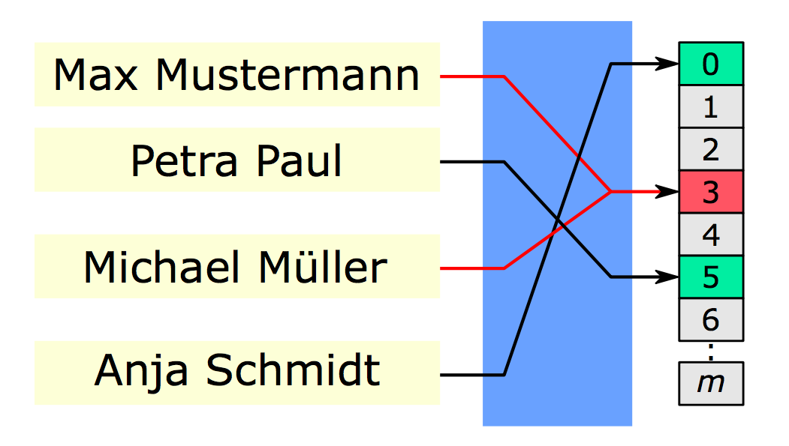
Hash Collisions
Hash collisions happen when two keys are mapped to the same position by the hash function
hash function
hash value
key
‹#›

Slide 47
Hash Tables
Modulo operation
automatically yields values in the range 0 to m-1
ideal hash function since it homogeneously distributes values
important to select the “right” m to avoid hash collisions
best choice are prime numbers
worst choice are powers of the base of the number system used
Example:
dates represented as numbers
key k | k mod 97 | k mod 100
20100101 | 52 | 1
20100227 | 81 | 27
20100427 | 87 | 27
20110527 | 2 | 27
20090811 | 74 | 11
‹#›

Slide 48
Hash Collisions - Separate Chaining
Operations on hash tables:
searching for an entry:
calculate hash function h(k)
search through linked list associated with hash entry from front to end
adding an entry:
calculate hash function h(k)
search through linked list associated with hash entry from front to end and append new element as appropriate
deleting an entry:
calculate hash function h(k)
search through linked list associated with hash entry from front to end and remove element from list as appropriate
Time required for operations: just one step in the best case, n steps in the worst case
‹#›

Slide 49
Hash Collisions - Separate Chaining
Dealing with hash collisions through separate chaining:
entry in the hash table is a linked list
colliding entries are appended to the list
Example: m = 7, h(k) = k mod 7
Linked List
0
1
2
3
4
5
6
0
1 | 50
2
3
4
5
6
0 | 700
1 | 50
2
3
4
5
6
0 | 700
1 | 50
2
3
4
5
6 | 76
0 | 700
1 | 50
2
3
4
5
6 | 76
0 | 700
1 | 50
2
3
4
5
6 | 76
0 | 700
1 | 50
2
3 | 73
4
5
6 | 76
85
85
92
85
92
101
initial array
insert 50
insert 700
insert 76
insert 85
insert 92
insert 73 and then 101
‹#›

Slide 50
Hash Tables
Key applications:
associative arrays
Python: the dictionary dict with (key, value) pairs uses hash-tables
default in languages like AWK
database indexing
cryptography
caches
pseudonymization of datasets
‹#›

Slide 51
Dictionaries
Definition Abstract data type composed of a collection of (key, value) pairs, such that each possible key appears at most once in the collection.
Generalized keys (not just indices):
characters, words, names etc.
Characteristics
keys are not necessarily homogeneously distributed
using an array spanning the whole range of values would be a waste of memory
use list of keys to index the dictionary
if no further conditions applied: sequential search
worst case: have to search through ALL n entries
‹#›

Slide 52
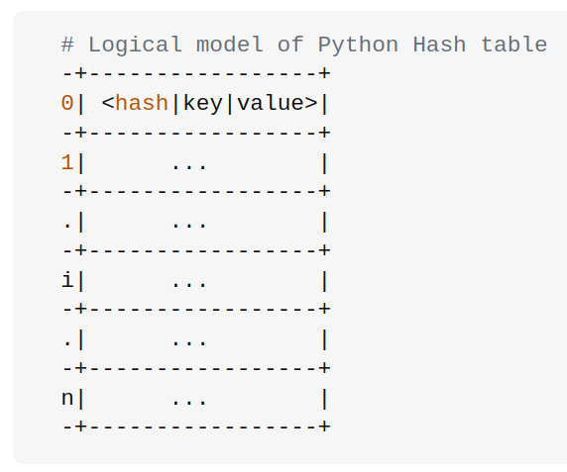
Dictionaries in Python
Python uses hash tables to store dictionaries
Collisions are solved with probing: moving forward in a predictable manner when a slot is full
Linear probing: move to next
Random probing: move pseudorandomly
Hashes start with 8 slots and are resized when ⅔ of entries are full
https://stackoverflow.com/questions/327311/how-are-pythons-built-in-dictionaries-implemented/
‹#›

Slide 53
Looking up a Python dictionary the right way
N = 20000000
v = list(range(N))
random.shuffle(v)
d = dict(zip(range(N),range(N)))
for i in range(N):
if i in d.keys():
continue
N = 20000000
v = list(range(N))
random.shuffle(v)
d = dict(zip(range(N),range(N)))
for i in range(N):
if i in d:
continue
What is the difference between the two codes above?
Which will run faster?
‹#›

Slide 54
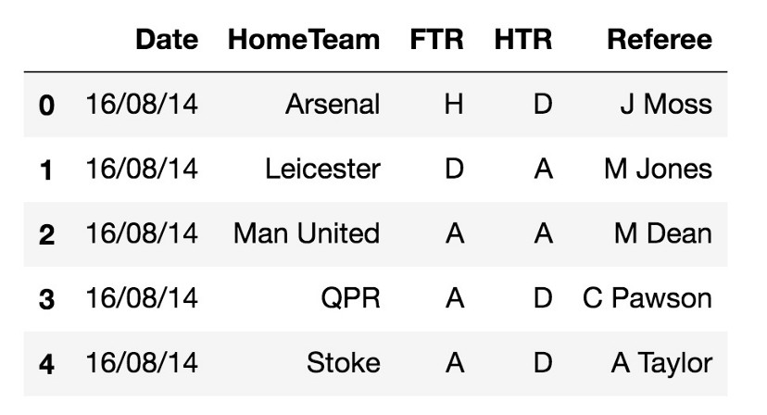
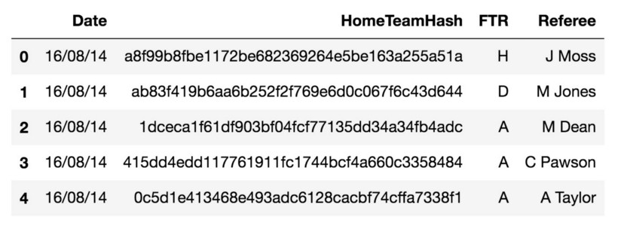
Dataset pseudonymization
h(HomeTeam)
https://medium.com/luckspark/hashing-pandas-dataframe-column-with-nonce-763a8c23a833
‹#›

Slide 55

Brian Kernighan and AWK
The AWK language is a specialized language for string processing: a secret tool of many data scientists
key component of UNIX, co-created by Brian Kernighan at Bell Labs
AWK: Alfred Aho, Peter Weinberger and Brian Kernighan
Extremely efficient thanks to the use of regular expressions (we will learn them in session 8) and hash tables
The default array structure is an associative memory (dictionary) based on a hash table
MAWK: faster implementation and more memory efficient
Brian Kernighan on hash tables: https://www.youtube.com/watch?v=qTZJLJ3Gm6Q
‹#›

Slide 56
Outtake – Social Science Applications
Why is hashing relevant for us?
allows for data structures with very fast access t and efficient storage of data
efficient data access is a fundamental precondition for many practical data analysis tasks. When data goes big, you will need hashing
Python uses hashing for dict implementation
Lookup of the content is much faster than in operation in keys()
Storing data in Python – list or dict?
Typical cases for using lists
storing an ordered sequence of items
includes case of layered lists, e.g., tables
Typical cases for using dictionaries
storing information for efficient lookup via (key, value) pairs
often suitable for storage “super” structure, e.g., store specific ordered items as lists within a dictionary structure
‹#›

Slide 57
Next Session
Programming Fundamentals
Different Programming Paradigms
‹#›

