Slide 1
Introduction to Computing
for the Social Sciences
Session 7 - Sorting Algorithms
David Garcia
Winter Semester 2024-25
04.12.2024

Slide 2
Course Outline
Session 1: Introduction
Session 2: Information Coding
Session 3: Data Structures
Session 4: Programming
Session 5: Algorithms
Session 6: Recursion
Session 7: Sorting Algorithms
Session 8: Time Complexity
Session 9: Formal Languages and Automata
Session 10: Turing Machines and Complexity Classes
Session 11: Databases
Session 12: Parallel Programming (22.01 - to reschedule)
Session 13: Social Science Applications
Session 14: Exam Review

Slide 3
Outline
Sorting
Iterative sorting: Selection sort
Divide and Conquer: Mergesort and Quicksort
Data structures for sorting: Heapsort

Slide 4
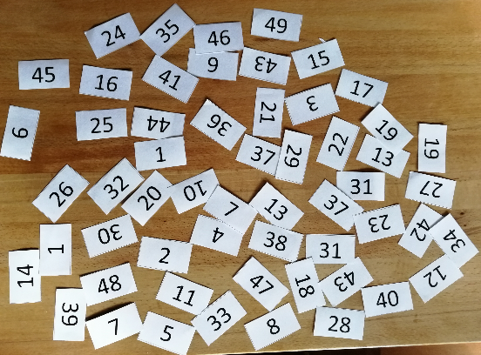
Sorting
Which numbers are duplicates?

Slide 5
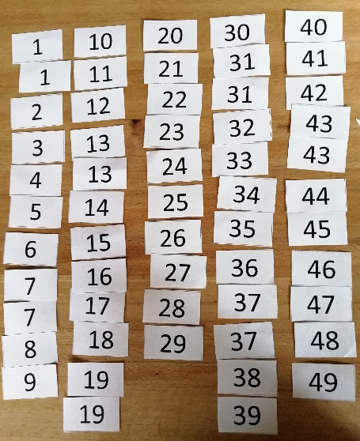
Sorting
Which numbers are duplicates?

Slide 6
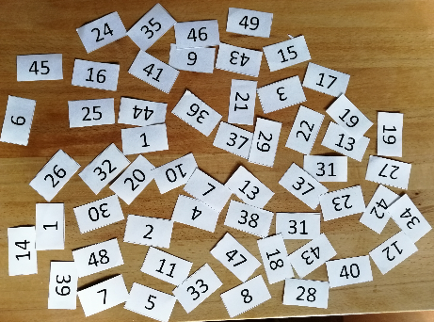
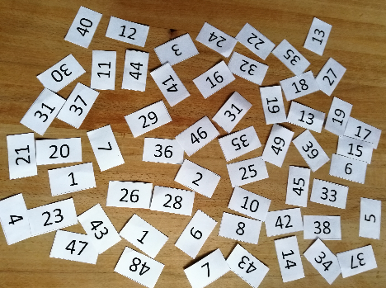
Sorting
Are the numbers sets different?

Slide 7

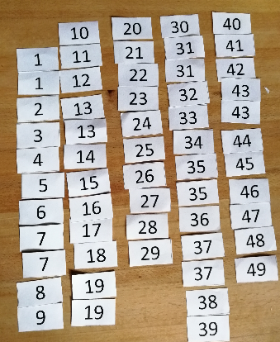
Sorting
Are the numbers sets different?

Slide 8
Sorting
Are the numbers sets different?

Slide 9
Sorting
Fundamentals
we are operating on:
set of objects U
set of keys S with linear order relation ≤ (i.e., a linearly ordered set)
sorting function that maps all objects U to S (i.e., s: U → S)
we are searching for a permutation of indices i₁… i_{n} of the objects in U, such that:
∀ 1 ≤ i ≤ n − 1: s(u_{i} ) ≤ s(u_{i+1} )

Slide 10
Stable vs. unstable sorting
Stable sorting methods
different objects can have the same key value used for sorting. e.g., students with the exact same name
If a sorting algorithm, after sorting the contents, does not change the sequence of similar content in which they appear, it is called stable sorting. Otherwise it is unstable sorting.
stable sorting methods ensure that
objects with the same value for a given sorting function s₁, have different values for another function s₂
sorting according to s₁ in this case does not change the order of the objects
example: sort by first name
123456 Christina 456789 Carl 456789 Carl
234567 Sandra 123456 Christina 123456 Christina
345678 Sandra 234567 Sandra 345678 Sandra
456789 Carl 345678 Sandra 234567 Sandra
stable unstable

Slide 11
Iterative sorting
Sorting
Iterative sorting: Selection sort
Divide and Conquer: Mergesort and Quicksort
Data structures for sorting: Heapsort

Slide 12
Iterative Sorting: Repeated Minimum Search
Sorting through selection as fundamental principle
intuitive strategy:
find maximum/minimum of a set and move it to front
iteratively apply the logic to remaining set
algorithmic strategy (Repeated minimum search)
split list into two parts
sorted part on left, L
unsorted part on right, R
at start: sorted part is empty, i.e. L = ∅, unsorted part R is the entire list
find minimum in unsorted R and append to sorted L
stop if length(R) = 1

Slide 13
Repeated minimum search
L: sorted
R: to sort
3 6 8 4 1 2 7
1 3 6 8 4 2 7
1 2 3 6 8 4 7
1 2 3 6 8 4 7
1 2 3 4 6 8 7
1 2 3 4 6 8 7
1 2 3 4 6 7 8
smallest
smallest
: insert
smallest
smallest
smallest
smallest

Slide 14
Recap: Selection sort
Procedure SELECTION-SORT(A, n)
Inputs:
A: an array
n: the number of elements in A to sort
Result: The elements of A are sorted into nondecreasing order
For i = 1 to n - 1:
smallest ← i
For j = i + 1 to n:
If A[j] < A[smallest], then smallest ← j.
Swap A[i] with A[smallest]
From Algorithms Unlocked. Thomas Cormen, 2013, p. 33-34

Slide 15
Recap: Selection sort
Procedure SELECTION-SORT(A, n)
Inputs:
A: an array
n: the number of elements in A to sort
Result: The elements of A are sorted into nondecreasing order
For i = 1 to n - 1:
smallest ← i
For j = i + 1 to n:
If A[j] < A[smallest], then smallest ← j.
Swap A[i] with A[smallest]
Find the smallest in R
Swap it to be the last of L
From Algorithms Unlocked. Thomas Cormen, 2013, p. 33-34

Slide 16
Selection sort example
L: sorted
R: to sort
3 6 8 4 1 2 7
1 6 8 4 3 2 7
1 2 8 4 3 6 7
1 2 3 4 8 6 7
1 2 3 4 8 6 7
1 2 3 4 6 8 7
1 2 3 4 6 7 8
smallest
smallest
: swap
smallest
smallest
smallest
smallest

Slide 17
Minimum search vs selection sort
Characteristics of iterative sorting algorithms
both algorithms are partially correct
any element still in R is larger or equal to any in L, L is sorted
both algorithms terminate
remaining part R shrinks in every step, eventually it has to have length 1
different use depending on data structure of list:
repeated minimum appends in the middle of the list: better for linked lists
selection sort uses swaps: better for arrays
stability:
repeated minimum is stable:
in case of ambiguity, takes the first minimum in R
this always correctly preserves any other ordering
selection sort is unstable:
swapping does not necessarily preserve other ordering in R

Slide 18
Outtake – Social Science Applications
Why should we care about sorting?
Sorting for the sake of sorting
we are sorting data more often than we think
especially for data science applications complex data often needs to be sorted to be analyzed or shown
in practice, speed matters here for analysts and users.
sorting is healthy: it helps to notice data issues
Sorting for searching
many search algorithms require sorted sets of data to work (e.g., binary search)
it is in practice much easier to find items in an ordered than an unordered list
Exercise: write the pseudocode of repeated minimum search

Slide 19
Divide and Conquer
Sorting
Iterative sorting: Selection sort
Divide and Conquer: Mergesort and Quicksort
Data structures for sorting: Heapsort

Slide 20
Divide and Conquer
Fundamental algorithmic principle inspired in military history: divide et impera
separate a problem into separate sub-problems
continue until those sub-problems are solvable
then recombine partial results to full solution
Divide
problem
sub-problem
sub-problem
Conquer
solution to
sub-problem
Combine
solution to
sub-problem
solution to problem

Slide 21
Divide and Conquer
Divide and conquer ≠ recursion
it is not the same as recursion, i.e., recursive calls of the same function
recursion is a natural implementation strategy for algorithms following a divide and conquer approach
by definition, the sub-problems in divide and conquer are self-similar
generate overall solution by combining solutions of sub-problems
BUT we can also implement divide and conquer strategy iteratively

Slide 22
Mergesort
Mergesort first divides the list into equal halves and then combines them in a sorted manner. Mergesort sorts by merging (sub-)lists
principle:
a list with one element is trivially sorted
merging two sorted lists is simple:
compare first element of each sub-list
append smaller of the two to merged list and remove from sub-list
continue with remaining sub-lists
algorithmic strategy
repeated division of list until just one element is remaining per list
repeated merging of sorted sub-lists until only one sorted list remains

Slide 23
Mergesort
Procedure MERGE-SORT(A, p, r)
Inputs:
A: an array
p, r: the starting index of the subarray
Result: The elements of the subarray A[p..r] are sorted into nondecreasing order
If p ≥ r,
then the subarray A[p..r] has at most one element and is already sorted. Just return without doing anything.
else
q ← ⌊(p + r) / 2⌋.
Recursively call MERGE-SORT(A, p, q).
Recursively call MERGE-SORT(A, q + 1, r).
MERGE(A, p, q, r).
From Algorithms Unlocked. Thomas Cormen, 2013, p.42-43

Slide 24
The MERGE function
Procedure MERGE(A, p, q, r)
Inputs:
A: an array
p,q,r: Indices of sorted subarrays A[p … q], A[q+1 … r]
Result: A[p … r] contains both sorted subarrays fully sorted
B ←copy(A[p … q]); C ←copy(A[q+1 … r]);
i ← 1; j ← 1;
For k = p to r:
If B[i] ≤ C[j], then A[k] ← B[i];
i ← i+1
else A[k] ← C[j];
j ← j+1

Slide 25
MERGE example
B
2 3 4 6
C
1 5 7 8
i
j
1
1 2
1 2 3
1 2 3 4

Slide 26
MERGE example
B
2 3 4 6
C
1 5 7 8
i
j
1 2 3 4 5
1 2 3 4 5 6
1 2 3 4 5 6 7
1 2 3 4 5 6 7 8

Slide 27
Mergesort
Mergesort split: first divides the whole list iteratively into equal halves (no change in sequence of items in the original) until atomic values are achieved.
4 2 3 6 8 5 1 7
4 2 3 6
8 5 1 7
4 2
3 6
8 5
1 7
4
2
3
6
8
5
1
7

Slide 28
Mergesort
Mergesort algorithm – merge them into another list in a sorted manner
4
2
3
6
8
5
1
7
2 4
3 6
5 8
1 7

Slide 29
Mergesort
Mergesort algorithm – merge them into another list in a sorted manner
4
2
3
6
8
5
1
7
2 4
3 6
5 8
1 7
2 3 4 6
1 5 7 8

Slide 30
Mergesort
Mergesort algorithm – merge them into another list in a sorted manner
4
2
3
6
8
5
1
7
2 4
3 6
5 8
1 7
2 3 4 6
1 5 7 8
1 2 3 4 5 6 7 8

Slide 31
Mergesort
Mergesort as a divide and conquer strategy
Divide: splitting into two sub-lists (with half the size)
recursive implementation of sub-list sorting
call mergesort on itself
assume that output is a sorted list in each recursion step
requires well-defined base case (= list with one element)
Combine: merging two lists preserving order
systematic and efficient merger of partial lists to one large sorted list
see Algorithms Unlocked (Cormen, 2013) for MERGE pseudocode

Slide 32
Mergesort
Characteristics of mergesort
correctness
merge steps sort correctly
no changing of order outside of merging
all elements are sorted and algorithm terminates
memory and stability
need additional memory (in addition to list) for handling sub-lists
stable algorithm because other ordering structure is preserved during merging

Slide 33
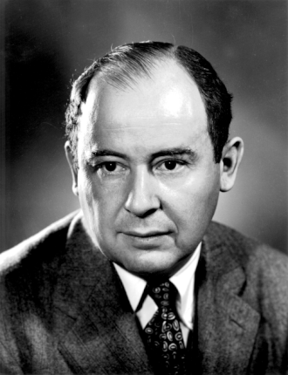
John von Neumann: more than mergesort’s father
John von Neumann (Neumann János Lajos, Budapest, 1903-1957)
One of the most influential figures of Computer Science, Math, and Physics in the 20th century
Inventor of the mergesort algorithm
Among the first to talk about the time complexity of algorithms in the 1950s
Popularized the modern computer architecture with main memory, ALU, registries, etc
Proposed cellular automata that self-replicated
Warned about anthropogenic global warming as early as 1955

Slide 34
Quicksort
Similar divide and conquer logic to mergesort but division into sub-lists not necessarily regular
Quicksort rationale:
pick pivot element from list
sort list such that all elements left (right) of pivot are smaller (larger) than its value
after this partition operation the pivot element is already in its final (sorted) position, sorting now occurs only right/left of the pivot element
split list at pivot and apply logic recursively to left and right sub-list

Slide 35
Quicksort
Procedure QUICK-SORT(A, p, r)
Inputs and Result: Same as MERGE-SORT
If p ≥ r,
then return without doing anything
else
q ← PARTITION(A, p, r)
Recursively call QUICK-SORT(A, p, q - 1)
Recursively call QUICK-SORT(A, q + 1, r)

Slide 36
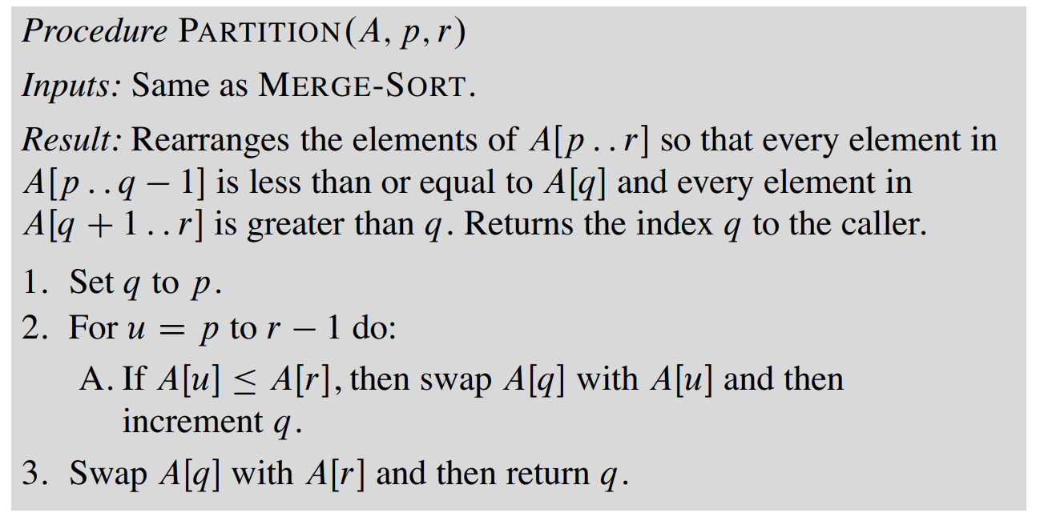
The PARTITION function
Exercise: Run quicksort on pen and paper on the same example as mergesort

Slide 37
Quicksort: properties
advantages
very memory efficient
in-place procedure: is (usually) faster than merge sort
disadvantages
efficiency depends on choice of pivot and the partition scheme chosen (more next week)
differences from mergesort :
in quick sort all the heavy lifting is done while dividing the array into subarrays, while in merge sort, all the real work happens during merging the subarrays.
In quicksort, the combine step does absolutely nothing.

Slide 38
Data structures for sorting
Sorting
Iterative sorting: Selection sort
Divide and Conquer: Mergesort and Quicksort
Data structures for sorting: Heapsort

Slide 39
Heaps
Search algorithms can use data structures for help: Heaps as an example
partially ordered binary trees without gaps (or holes)
children of any node not larger than the node
not a binary search tree, i.e., just require local ordering of nodes and children. All levels filled, last filled from the left
example: does this tree satisfy the heap property?
7
4
5
8
3
2
6
1

Slide 40
Heaps
partially ordered binary trees without gaps (or holes)
children of any node not larger than the node
not a binary search tree, i.e., just require local ordering of nodes and children. All levels filled, last filled from the left
example: does this tree satisfy the heap property?
7
4
5
8
3
2
6
1

Slide 41
Heaps
partially ordered binary trees without gaps (or holes)
children of any node not larger than the node
not a binary search tree, i.e., just require local ordering of nodes and children. All levels filled, last filled from the left
Heap property can be efficiently “recovered"
7
4
5
7
7
8
3
2
6
4
6
8
5
1
8
3
2
5
4
3
2
6
1
1

Slide 42
Min-Heaps
Same as heap but:
children of any node not smaller than the node
All levels filled, last filled from the left
2
4
14
10
8
15
18
17
11
16

Slide 43
Min-Heaps
Same as heap but:
children of any node not smaller than the node
All levels filled, last filled from the left
2
1
4
14
2
3
10
8
15
18
4
5
6
7
17
11
16
8
9
10
Min-heap as an array:
2
4
14
10
8
15
18
17
11
16
1
2
3
4
5
6
7
8
9
10

Slide 44
Heapsort
conceptual foundation:
in a min-heap the smallest element is on top
children are not smaller because of heap property
same is recursively true for entire tree
we can start by building a heap of the list
idea:
remove the top (smallest) element from tree
replace it with the last element of the tree
recover the heap property through permuting elements

Slide 45
Heapsort: Example
Extract top (minimum)
and place it first
2
4
14
10
8
15
18
17
11
16
2

Slide 46
Heapsort: Example
Move last to top
16
4
14
10
8
15
18
17
11
2

Slide 47
Heapsort: Example
Recover min-heap
property
4
16
14
10
8
15
18
17
11
2

Slide 48
Heapsort: Example
Recover min-heap
property
4
8
14
10
16
15
18
17
11
2

Slide 49
Heapsort: Example
Extract min
4
8
14
10
16
15
18
17
11
2
4

Slide 50
Heapsort: Example
Move last to top
11
8
14
10
16
15
18
17
2
4

Slide 51
Heapsort: Example
Recover
min-heap
property
8
11
14
10
16
15
18
17
2
4

Slide 52
Heapsort: Example
Recover
min-heap
property
8
10
14
11
16
15
18
17
2
4

Slide 53
Heapsort: Example
Extract min
8
10
14
11
16
15
18
17
2
4
8

Slide 54
Heapsort: Example
Move last to top
17
10
14
11
16
15
18
2
4
8

Slide 55
Heapsort: Example
Recover
min-heap
property
10
17
14
11
16
15
18
2
4
8

Slide 56
Heapsort: Example
Recover
min-heap
property
10
11
14
17
16
15
18
2
4
8

Slide 57
Heapsort: Example
Extract min
10
11
14
17
16
15
18
2
4
8
10

Slide 58
Heapsort: Example
Move last to top
18
11
14
17
16
15
2
4
8
10

Slide 59
Heapsort: Example
Recover
min-heap
property
11
18
14
17
16
15
2
4
8
10

Slide 60
Heapsort: Example
Recover
min-heap
property
11
16
14
17
18
15
2
4
8
10

Slide 61
Heapsort: Example
Extract min
11
16
14
17
18
15
2
4
8
10
11

Slide 62
Heapsort: Example
Move last to top
15
16
14
17
18
2
4
8
10
11

Slide 63
Heapsort: Example
Recover min-heap property
14
16
15
17
18
2
4
8
10
11

Slide 64
Heapsort: Example
Extract min
14
16
15
17
18
2
4
8
10
11
14

Slide 65
Heapsort: Example
Move last to top
18
16
15
17
2
4
8
10
11
14

Slide 66
Heapsort: Example
Recover min-heap property
15
16
18
17
2
4
8
10
11
14

Slide 67
Heapsort: Example
Extract min
15
16
18
17
2
4
8
10
11
14
15

Slide 68
Heapsort: Example
Move last to top
17
16
18
2
4
8
10
11
14
15

Slide 69
Heapsort: Example
Recover min-heap property
16
17
18
2
4
8
10
11
14
15

Slide 70
Heapsort: Example
Extract min
16
17
18
2
4
8
10
11
14
15
16

Slide 71
Heapsort: Example
Move last to top
18
17
2
4
8
10
11
14
15
16

Slide 72
Heapsort: Example
Restore min-heap property
17
18
2
4
8
10
11
14
15
16

Slide 73
Heapsort: Example
Extract min
17
18
2
4
8
10
11
14
15
16
17

Slide 74
Heapsort: Example
Move last to top
18
2
4
8
10
11
14
15
16
17

Slide 75
Heapsort: Example
Extract min
18
2
4
8
10
11
14
15
16
17
18

Slide 76
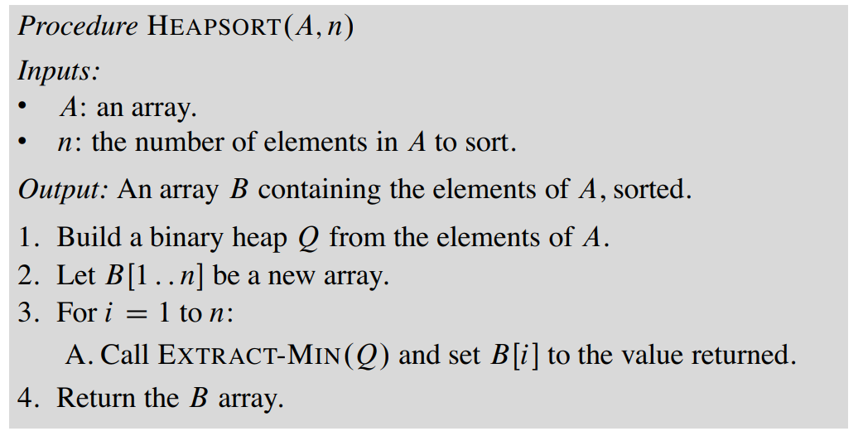
Heapsort: Pseudocode
See Algorithms Unlocked (2013, p98)
Exercise: what is the pseudocode to build a heap and of EXTRACT-MIN?
Exercise: is Heapsort stable?

Slide 77
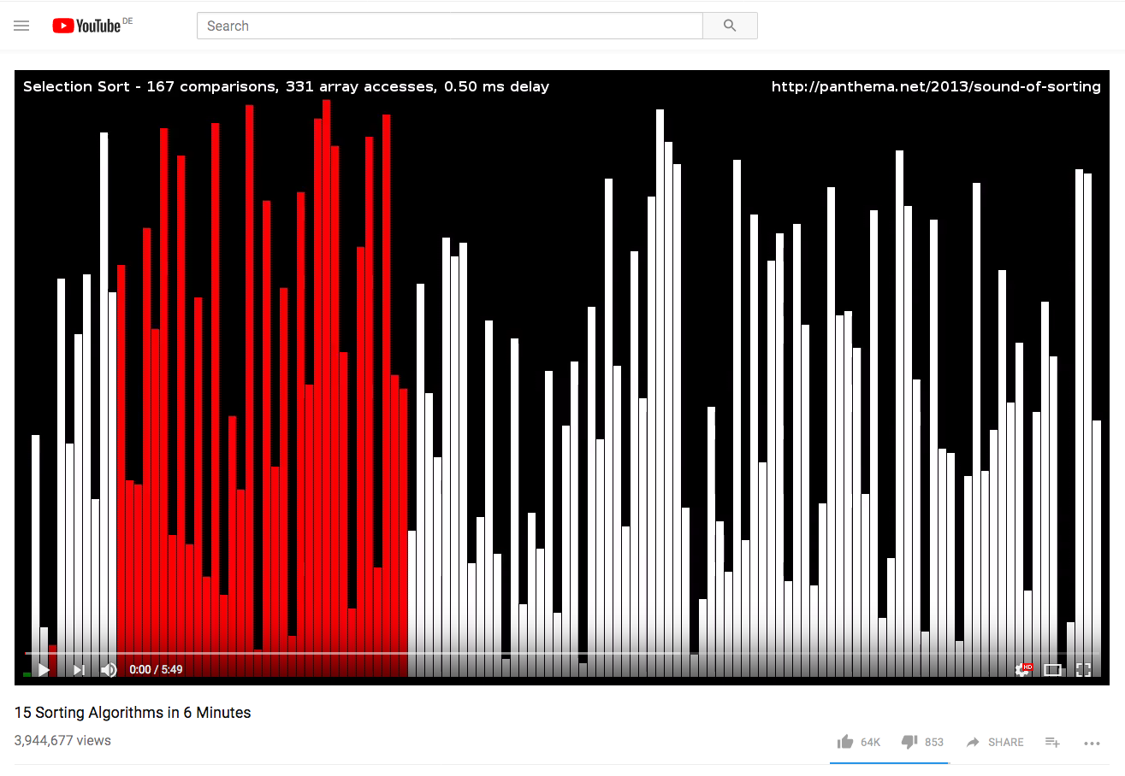
To learn more about sorting
Procedure ICan’tBelieveItCanSort(A, n)
Inputs:
A: an array
n: the number of elements in A to sort
Result: The elements of the array are sorted into nondecreasing order
For i = 1 to n:
For j = 1 to n:
If A[i] < A[j],
then swap A[i] with A[j].
ICan'tBelieveItCAnSort(A[1,..n])
for i = 1 to n do
for j = 1 to n do
if A[i] < A[j] then
swap A[i] with A[j]
https://www.youtube.com/watch?v=kPRA0W1kECg
Is this the simplest (and most surprising) sorting algorithm ever?. Stanley Fung, 2021

Slide 78
Next Session
Time complexity
O-notation

