Slide 1
Introduction to Computing
for the Social Sciences
Session 8 - Time Complexity
David Garcia
Winter Semester 2024-25
11.12.2024

Slide 2
Course Outline
Session 1: Introduction
Session 2: Information Coding
Session 3: Data Structures
Session 4: Programming
Session 5: Algorithms
Session 6: Recursion
Session 7: Sorting Algorithms
Session 8: Time Complexity
Session 9: Formal Languages and Automata
Session 10: Turing Machines and Complexity Classes
Session 11: Databases
Session 12: Parallel Programming
On Friday 17.01, 10:00-13:15, room D406
Session 13: Social Science Applications
Session 14: Exam Review

Slide 3
Time Complexity
Time complexity
O-notation

Slide 4
Recap: Selection sort
Procedure SELECTION-SORT(A, n)
Inputs:
A: an array
n: the number of elements in A to sort
Result: The elements of A are sorted into nondecreasing order
For i = 1 to n - 1:
smallest ← i
For j = i + 1 to n:
If A[j] < A[smallest], then smallest ← j.
Swap A[i] with A[smallest]

Slide 5
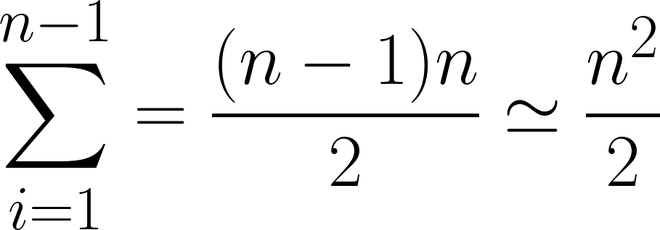
Selection sort
Efficiency of selection sort:
for list of length n we have to search n times for the minimum on a list of decreasing length
first search: n-1 elements
after first swap: n-2 elements
after second swap: n-3 elements, etc.
in total:
What does that mean?
sorting a list of double the size, takes four times as long
sorting a list of ten times the size, takes 100 times as long

Slide 6
Complexity
What do we mean by complexity in Computer Science?
algorithmic complexity
typically, refers to time complexity of a given algorithm
depends on a particular implementation
memory complexity
required memory during calculation
mergesort: stack (due to recursion) and temporary second list
quicksort: optimal implementation only requires stack
problem complexity
minimal effort needed to solve a problem
analyzed for typical cases
classification is independent of the specific algorithm - but depends on the algorithms known to solve a problem (more in Session 10)

Slide 7
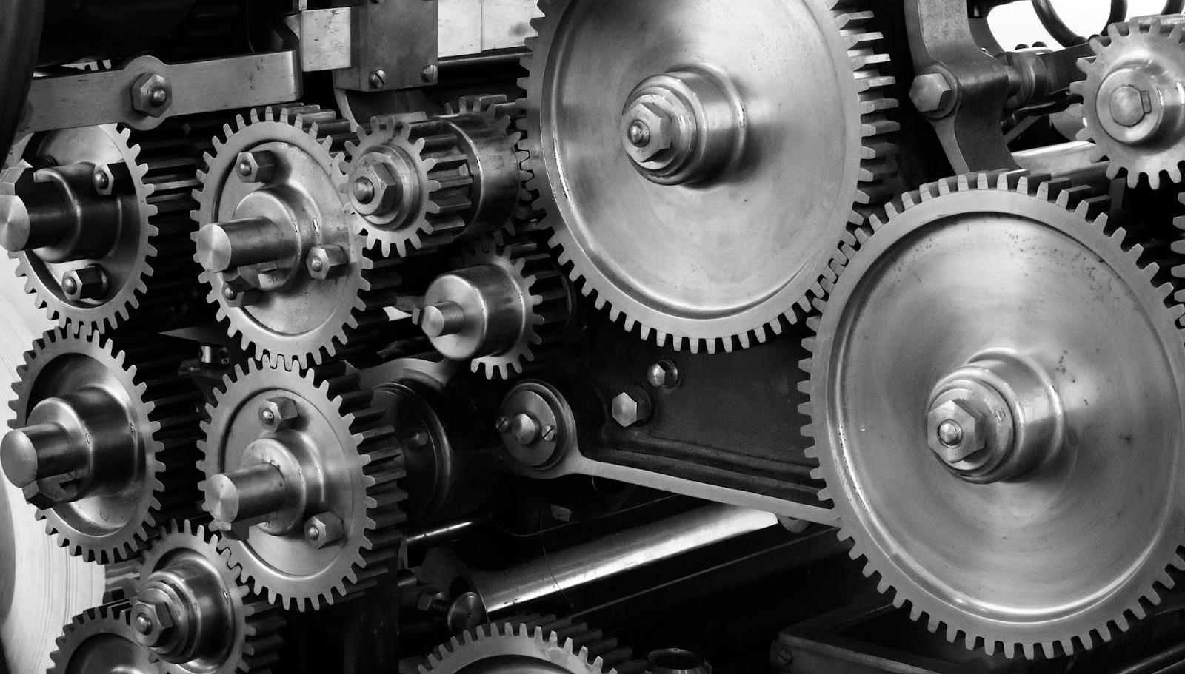

A more general meaning of Complexity
A complicated system has many pieces with specific functions and well-defined relationships. It has been carefully engineered or designed
A complex system is composed of many particles that interact following some forces or dynamics. Its behavior follows from natural principles
A program with lots of lines of code, functions, objects, etc is complicated.
A problem with elements that depend on each other (e.g. a graph) can be complex – the time required to solve a problem depends on its complexity and our algorithms to solve it

Slide 8
Complexity
Why do we care about complexity?
problem complexity decides whether we can in principle solve a problem in a reasonable amount of time
algorithmic and memory complexity determine whether solutions are feasible to implement with the available memory of computers
example: run time estimates (algorithmic complexity)
home computer executes 10⁸ operations per second
supercomputer executes 10¹² operations per second
selection sort (n²)
mergesort (n log(n))
computer | thousand | million | billion
home | instant | 2.8 hours | 317 years
super | instant | 1 second | 1.6 weeks
computer | thousand | million | billion
home | instant | 1 sec | 18 min
super | instant | instant | instant

Slide 9
Complexity
memory complexity and time complexity could be different
tradeoff between memory and time needs is often relevant in practice
today we focus on time complexity
time complexity varies in how it changes with the number of elements N
e.g., slowly rising, then sharp increase vs. sharp increase then slowly rising
makes certain algorithms more favorable for small N or for large N
depending on data, complexity may vary; distinguish between
worst case complexity | average case complexity | best case complexity
simplified analysis of an algorithm’s efficiency
approximate calculation of time complexity in terms of input size N
machine independent, it is a property of the algorithm
time is measured in number of basic computer steps

Slide 10
Runtime Analysis
The runtime sums up time units needed per instruction
primitive operations
assignments, comparisons, arithmetic operations, …
simplified measure as 1 time unit
loops
(number of iterations) x (time units per iteration)
method calls
time units for method
recursive calls
sum of all calls inside the recursion

Slide 11
Runtime Analysis Example: Selection Sort
Algorithm in Python
def selectionsort(seq):
for i in range(len(seq) – 1):
k = i
for j in range(i + 1, len(seq)):
if seq[j] < seq[k]:
k = j
seq[i], seq[k] = seq[k], seq[i]
return seq
1
2
3
4
5
6
range, get length & arithmetic operation = 3 time units
assignment = 1 time unit
range, arithmetic operation, get length = 3 time units
comparison = 1 time unit
assignment = 1 time unit
double assignment = 2 time units

Slide 12
Runtime Analysis Example: Selection Sort
Algorithm in Python
def selectionsort(seq):
for i in range(len(seq) – 1):
k = i
for j in range(i + 1, len(seq)):
if seq[j] < seq[k]:
k = j
seq[i], seq[k] = seq[k], seq[i]
return seq
1
2
loop with a maximum of n-1 iterations
nested loop with a maximum of n-1 iterations
Upper bound
approximation

Slide 13
Runtime Analysis Example: Selection Sort
Algorithm in Python
def selectionsort(seq):
for i in range(len(seq) – 1):
k = i
for j in range(i + 1, len(seq)):
if seq[j] < seq[k]:
k = j
seq[i], seq[k] = seq[k], seq[i]
return seq
1
1
2
2
3
4
5
6
range, length & arithmetic = 3 time units
assignment = 1 time unit
range, arithmetic & length = 3 time units
comparison = 1 time unit
assignment = 1 time unit
double assignment = 2 time units
loop with a maximum of n-1 iterations
nested loop with a maximum of n-1 iterations
worst-case running time: (n-1) × (3 + 1 + (n-1) × (3 + 1 + 1) + 2)

Slide 14
Runtime Analysis Example: Selection Sort
range, get length & arithmetic operation = 3 time units
assignment = 1 time unit
range, arithmetic operation, get length = 3 time units
comparison = 1 time unit
assignment = 1 time unit
double assignment = 2 time units
loop with a maximum of n-1 iterations
nested loop with a maximum of n-1 iterations
(n-1) × (3 + 1 + (n-1) × (3 + 1 + 1) + 2) = 6n - 6 + 5 × (n-1)² = 5n² - 4n - 1
the asymptotically dominant term is n²
constant terms and lower order terms asymptotically influence runtime only marginally: O-Notation

Slide 15
Average, best and worst running time
The average running time is the mean over all possible problem cases, assuming that they are all equally likely
Worst-case running time: total maximum over any possible problem case
Best-case running time: total minimum over any possible problem case
For sorting:
Problem cases are possible initial orders of the list
When selecting algorithms: we should have an idea of the distribution of problem cases to measure average running time
We mostly care about the average but should check that the worst-case is not too bad or too frequent

Slide 16
Example: Insertion sort
key
Procedure INSERTION-SORT (A, n)
Inputs:
A: an array; n: the number of elements in A to sort
Result: The elements of A are sorted into nondecreasing order.
For i = 1 to n:
key ← A[i], and j ← i - 1
While j ≥ 0 and A[j] > key:
A[j + 1] ← A[j]
j ← j - 1
A[j + 1] ← key
96 | 57 | 6 | 12 | 44
0 | 1 | 2 | 3 | 4
57 | 96 | 6 | 12 | 44
0 | 1 | 2 | 3 | 4
6 | 57 | 96 | 12 | 44
0 | 1 | 2 | 3 | 4
6 | 12 | 57 | 96 | 44
0 | 1 | 2 | 3 | 4
6 | 12 | 44 | 57 | 96
0 | 1 | 2 | 3 | 4
Rationale: incrementally sort by pushing value to the position where it belongs

Slide 17
Insertion sort: worst-case runtime analysis
Procedure INSERTION-SORT (A, n)
Inputs:
A: an array; n: the number of elements in A to sort
Result: The elements of A are sorted into nondecreasing order.
For i = 1 to n:
key ← A[i], and j ← i - 1
While j ≥ 0 and A[j] > key:
A[j + 1] ← A[j]
j ← j - 1
A[j + 1] ← key
Loop n times
Loop backwards potentially until j=0:
n iterations
worst-case running time: (n) × (2+ (n-1) × (2 + 2) + 2) – grows with n²

Slide 18
Insertion sort: best case
key
Procedure INSERTION-SORT (A, n)
Inputs:
A: an array; n: the number of elements in A to sort
Result: The elements of A are sorted into nondecreasing order.
For i = 1 to n:
key ← A[i], and j ← i - 1
While j ≥ 0 and A[j] > key:
A[j + 1] ← A[j]
j ← j - 1
A[j + 1] ← key
10 | 20 | 30 | 40 | 50
0 | 1 | 2 | 3 | 4
10 | 20 | 30 | 40 | 50
0 | 1 | 2 | 3 | 4
10 | 20 | 30 | 40 | 50
0 | 1 | 2 | 3 | 4
10 | 20 | 30 | 40 | 50
0 | 1 | 2 | 3 | 4
10 | 20 | 30 | 40 | 50
0 | 1 | 2 | 3 | 4
For an already sorted list: inner loop always stops at first iteration

Slide 19
Insertion sort: best case
Procedure INSERTION-SORT (A, n)
Inputs:
A: an array; n: the number of elements in A to sort
Result: The elements of A are sorted into nondecreasing order.
For i = 1 to n:
key ← A[i], and j ← i - 1
While j ≥ 0 and A[j] > key:
A[j + 1] ← A[j]
j ← j - 1
A[j + 1] ← key
Average and worst-case: n²
Best case: n
Input is already sorted
Exercise: what is the best and
worst-case runtime for quicksort?

Slide 20
Another example: Complexity of BFS
Procedure BFS(G, s)
Inputs: …
Result: …
InitialiseBFS(G,s)
Q ← ∅
Enqueue (Q, s)
While Q ≠ ∅:
u ← Dequeue (Q)
For each vertex v in neighbors(u):
if color [v] = WHITE
then color [v] ← GRAY
d [v] ← d [u] + 1
π [v] ← u
Enqueue (Q, v)
color [u] ← BLACK
The size of a graph is measured by two quantities:
Number of vertices |V|
Number of edges |E|

Slide 21
Another example: Complexity of BFS
Procedure BFS(G, s)
Inputs: …
Result: …
InitialiseBFS(G,s)
Q ← ∅
Enqueue (Q, s)
While Q ≠ ∅:
u ← Dequeue (Q)
For each vertex v in neighbors(u):
if color [v] = WHITE
then color [v] ← GRAY
d [v] ← d [u] + 1
π [v] ← u
Enqueue (Q, v)
color [u] ← BLACK
The size of a graph is measured by two quantities:
Number of vertices |V|
Number of edges |E|
We enqueue and dequeue each vertex exactly once

Slide 22
Another example: Complexity of BFS
Procedure BFS(G, s)
Inputs: …
Result: …
InitialiseBFS(G,s)
Q ← ∅
Enqueue (Q, s)
While Q ≠ ∅:
u ← Dequeue (Q)
For each vertex v in neighbors(u):
if color [v] = WHITE
then color [v] ← GRAY
d [v] ← d [u] + 1
π [v] ← u
Enqueue (Q, v)
color [u] ← BLACK
The size of a graph is measured by two quantities:
Number of vertices |V|
Number of edges |E|
We enqueue and dequeue each vertex exactly once
We check the adjacent nodes of each node. Each edge is checked exactly twice

Slide 23
Another example: Complexity of BFS
Procedure BFS(G, s)
Inputs: …
Result: …
InitialiseBFS(G,s)
Q ← ∅
Enqueue (Q, s)
While Q ≠ ∅:
u ← Dequeue (Q)
For each vertex v in neighbors(u):
if color [v] = WHITE
then color [v] ← GRAY
d [v] ← d [u] + 1
π [v] ← u
Enqueue (Q, v)
color [u] ← BLACK
The size of a graph is measured by two quantities:
Number of vertices |V|
Number of edges |E|
We enqueue and dequeue each vertex exactly once
We check the adjacent nodes of each node. Each edge is checked exactly twice
Running time of of BFS grows with |V|+2|E|

Slide 24
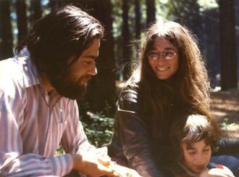
A mentor on algorithms: Manuel Blum
Born in Venezuela, 1938
CS prof at UC Berkeley
Inventor of the k-minimum selection algorithm (and the calculation of its complexity)
Turing Award for his contributions to the foundations of computational complexity theory and its application to cryptography and program checking
Inventor of CAPTCHA as a Turing test
Know for being the mentor of very influential computer scientists: 3 Turing Awards, various Gödel and Knuth Prizes, 20 CS professors in top US universities
https://www.technologyreview.com/2023/10/24/1081478/manuel-blum-theoretical-computer-science-turing-award-academic-advisor/

Slide 25
O-notation
Time complexity
O-notation

Slide 26
Asymptotic behavior of functions
The asymptotic behavior of a function f(x) describes its value towards infinity
values of f(x) when x→∞ or x→-∞
values of x where f(x)→∞ or f(x)→-∞
?
f(x)
x

Slide 27
O-Notation
Definition:
O-Notation describes classes of functions with specific asymptotic properties
also referred to as Big O notation (pronounced big-oh, Landau’s symbol)
values of a given function are after a given (large) value n₀
always larger or equal, or
always smaller or equal to a given function
constants are not considered or expressed by an (arbitrary) chosen pre-factor
separates into three different notations, where O is the most commonly used
O refers to the upper bound
Ω to the lower bound
Θ to the tight bound

Slide 28
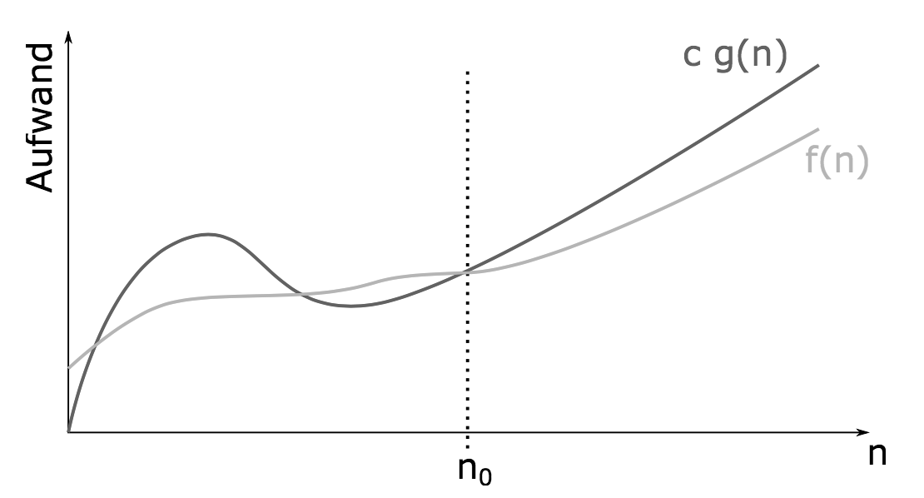
Upper Bound: O
running time

Slide 29
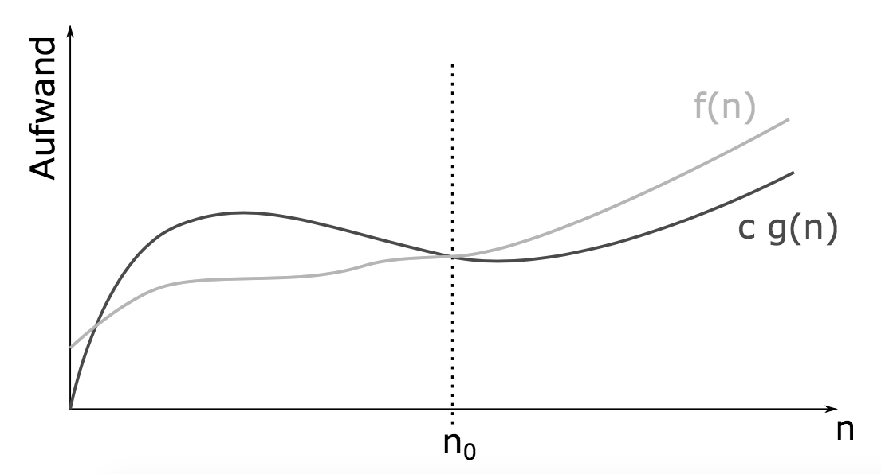
Lower Bound: Ω
running time

Slide 30
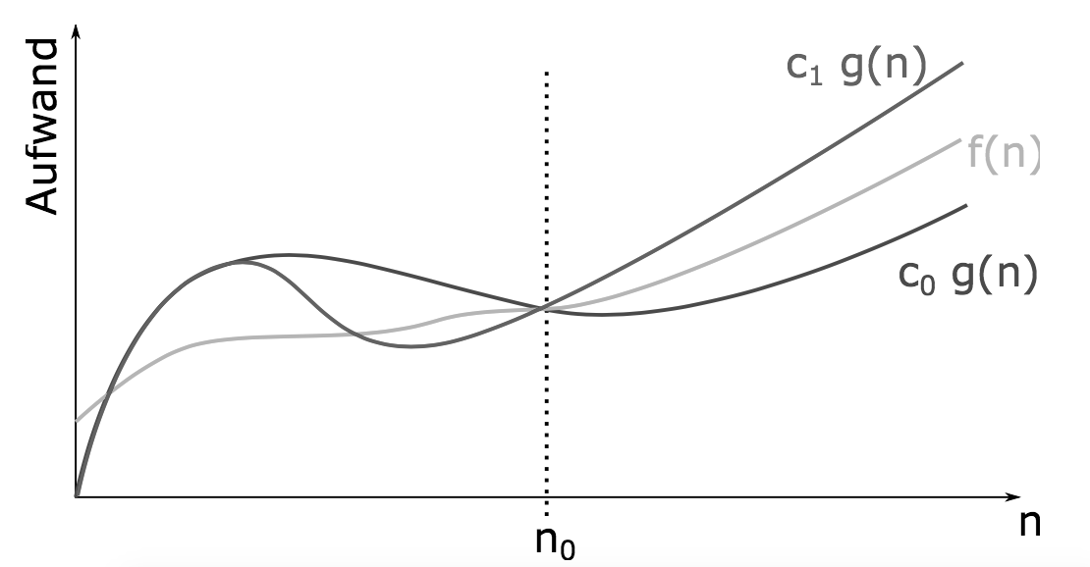
Exact Bound: Θ
f(n)
running time

Slide 31
O-Notation
Use of the O-Notation for classification of functions:
people often write f = O(g) instead of f ∈ O(g)
this is a tolerated abuse of notation
describes asymptotic upper, lower and exact bounds of a given function for large values
interest is in dominant terms for large values only
more precise analyses are often very cumbersome and unnecessary
constant factors may often not be of interest
linear acceleration is typically easy to achieve (new hardware, …)
goal: description of complexity through classes of functions
literally: “it can not get worse than f” if complexity is O(f)

Slide 32
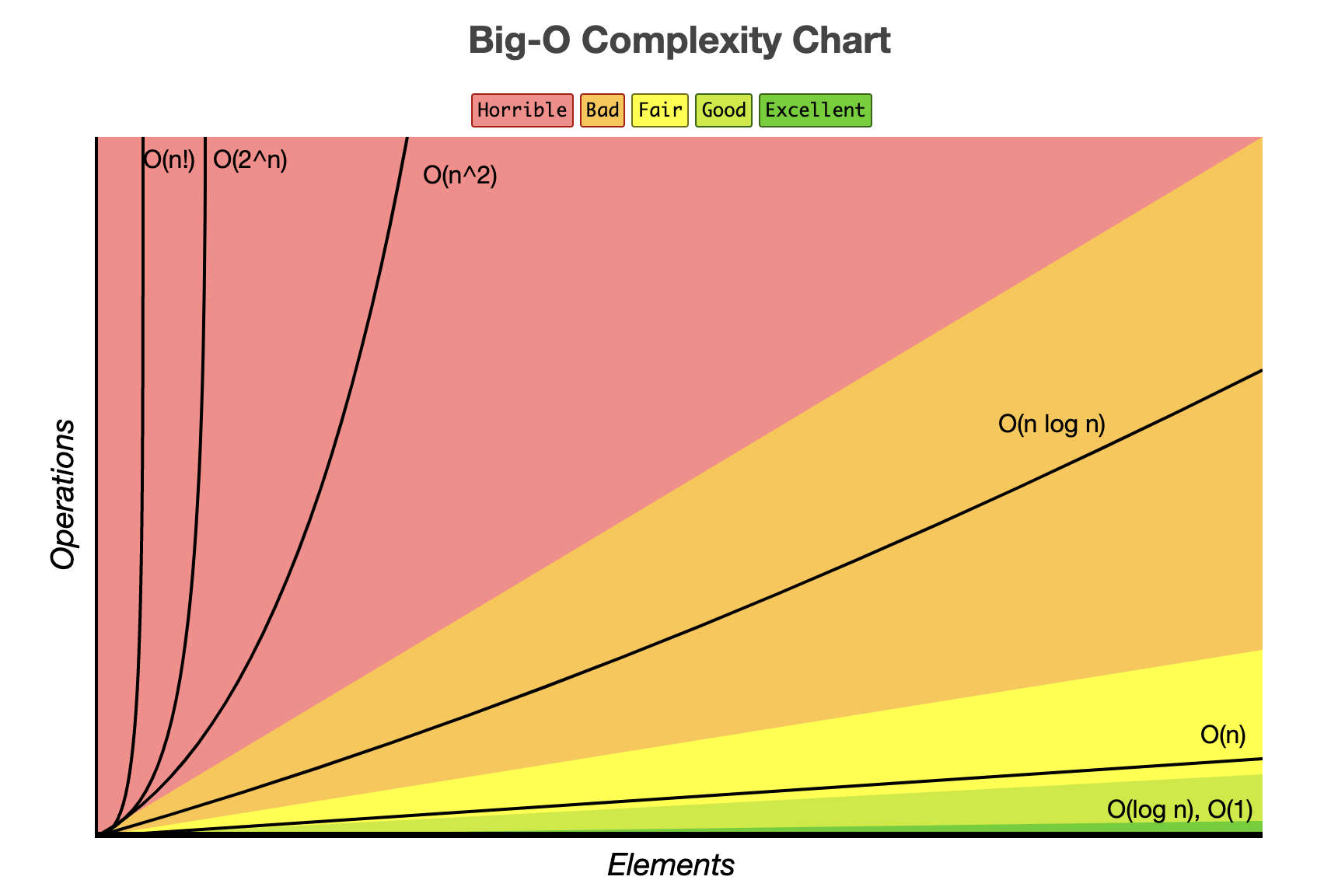
O-Notation - General rules
Ignore constants
Certain terms “dominate” others
O(1) < O(log(n)) < O(n)
O(n) < O(n log(n)) < O(n²)
O(n²) < O(2^{n}) < O(n!)
i.e., ignore lower order terms

Slide 33
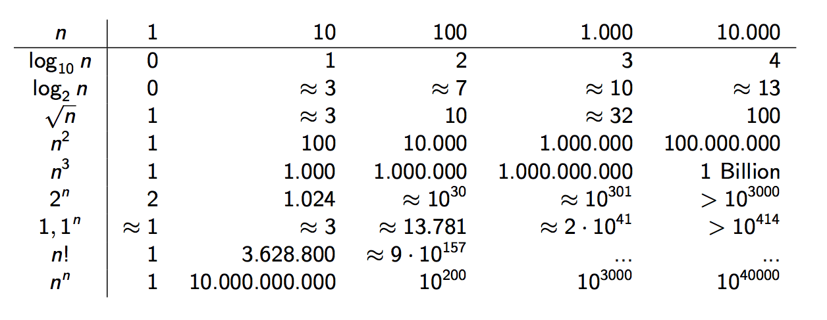
Growth of Functions
Trillion

Slide 34
0-Notation
What does this imply?
remember our earlier examples:
selection sort O(n²)
computer | thousand | million | billion
home | instant | 2.8 hours | 317 years
super | instant | 1 second | 1.6 weeks
mergesort O(n log(n))
computer | thousand | million | billion
home | instant | 1 sec | 18 min
super | instant | instant | instant
Using your laptop for a O(n²) algorithm will be unfeasible for n above a few million

Slide 35
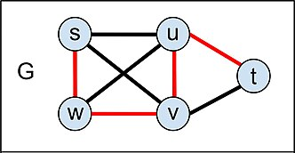
Common use of 0-Notation
O-notation is a language to describe upper bounds on complexity
The complexity of BFS is O(|V|+|E|) because the runtime of BFS grows with |V|+2|E|
Mergesort is much better than selectionsort because Mergesort’s complexity is O(N log(N)) and Selectionsort’s complexity is O(N²)
Inverting matrices with the method we learn in high school is O(N³)
Testing if a number k is prime with a brute-force algorithm (dividing by all numbers up to k-1) is O(k)
Finding a Hamiltionian path in a graph with a brute-force algorithm (explore all paths) is O(|V|!)

Slide 36
Outtake – Social Science Applications
Why do we care about complexity?
Practical considerations
algorithmic efficiency is often a precondition to doing any kind of data analysis in a reasonable time
understanding which implementation choices make an algorithm inefficient is thus basic tradecraft
there are often simple problems in day-to-day code that can lead to massive slow-downs
constants can matter, be cognizant of best case and average case (vs. worst case)
“Hard” social science problems
there are a number of rather common social science applications that have very high problem complexity
many of those examples are related to graphs/networks, e.g., the “traveling salesman” problem, graph isomorphisms

Slide 37
Next Session
Formal Languages
Finite state Automata
Push-down Automata

Slide 38
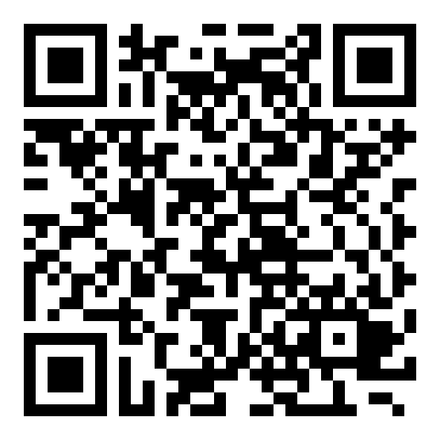
Student course evaluation
Help us improving ICSS! - we will discuss results and ideas afterwards
Please take time to fill the survey today
https://evasys.uni-konstanz.de/evasys/online.php?pswd=VGR4Y

