Slide 1
Introduction to Computing
for the Social Sciences
Session 10 - Turing Machines and Complexity Classes
David Garcia
Winter Semester 2024-25
08.01.2025

Slide 2
Course Outline
Session 1: Introduction
Session 2: Information Coding
Session 3: Data Structures
Session 4: Programming
Session 5: Algorithms
Session 6: Recursion
Session 7: Sorting Algorithms
Session 8: Time Complexity
Session 9: Formal Languages and Automata
Session 10: Turing Machines and Complexity Classes
Session 11: Databases
Session 12: Parallel Programming
On Friday 17.01, 10:00-13:15, room D406
Session 13: Social Science Applications
Session 14: Exam Review
Reminder: Slide comments and
support after pen-and-paper exercises

Slide 3
Outline
Turing Machines
Computability
Complexity Classes

Slide 4
Type 3 grammars and DFA
Definition of type 3 grammar: regular languages
A grammar is Type 3 or regular, if for all (production) rules w₁→ w₂ in P it is true that w₁ is a single variable, i.e., w₁ ∈ N, and w₂ ∈ Σ ∪ ΣN .
Type-3 grammars generate regular languages. These languages are exactly all
languages that can be accepted by a Finite-State Automaton.
Finite state automata are the simplest machines to recognize patterns

Slide 5
Context-free grammars
Definition of Type 2 grammar: context-free grammar
A grammar is Type 2 or context-free, if for all (production) rules w₁→ w₂ in P it is true that w₁ is a single variable, i.e., w₁ ∈ N .
the definition of a context-free language restricts all permissible words (commands) to variable assignments where the right-hand side can be arbitrarily complex
to process (execute) words of this grammar we need an explicit memory where, in order to process inputs, we can “stack” the complex commands
this is the simplest generalization of the previous language allowing for more complex, layered state structures
S → AB
A → a
B → b

Slide 6
Context-sensitive grammars
Definition of type 1 grammar: context-sensitive grammar
A grammar is Type 1 or context-sensitive, if for all (production) rules w₁→ w₂ in P, it holds that | w₁ | ≤ | w₂ |
left-hand side of a rule has to be at most as complex as the right-hand side
this is the logical next step in generalizing a grammar such that the production rules are explicitly context-dependent, i.e., it matters in which exact sequence non-terminal and terminal symbols occur for a certain rule to apply
closest model to complexity on an actual programming language that we can execute with finite RAM
S → AB
AB → abc
B → b

Slide 7
Unrestricted grammars
Definition of type 0 grammars: unrestricted grammars
Every grammar is automatically of Type 0. The rule of the Grammar are unrestricted. These languages are also known as recursively enumerable or Turing-recognizable.
this lifts the last restriction we imposed on how complex the left-hand side of a production rule can be
this implies that we need a memory that can keep track of, in principle, infinitely many steps needed to describe the left-hand side in order to execute the right hand side
should be structurally very similar to the Type 1 computing machine just has to be able to access infinite memory
Sab → ba
A → S

Slide 8
The Chomsky Hierarchy
Type | Type | Automaton | Applications | Rules | Rule | Recognizes
0 | Recursively enumerated | Turing machine infinite memory | All possible programs | α,β arbitrary Left at least one Non-term | α->β | all
1 | Context sensitive Language | Linear bounded Turing machine | Real programming language | Left at least one Non-term Left shorter | αAβ->αγβ | a^{n}b^{n}c^{n}
2 | Context free language | Pushdown automaton, stack | Programming language e.g. brackets | Left only one Non-term | A->α α is string of Term and Non-term | a^{n}b^{n}
3 | Regular expression | Finite state automaton | lexical structure, hardware implementations | Left only one Non-term | A-> aB Or A->Ba | a^{n}
More general grammars (i.e. Type 1 and Type 0) require more general computing machines to represent them. Turing machines are an abstract model for these.

Slide 9
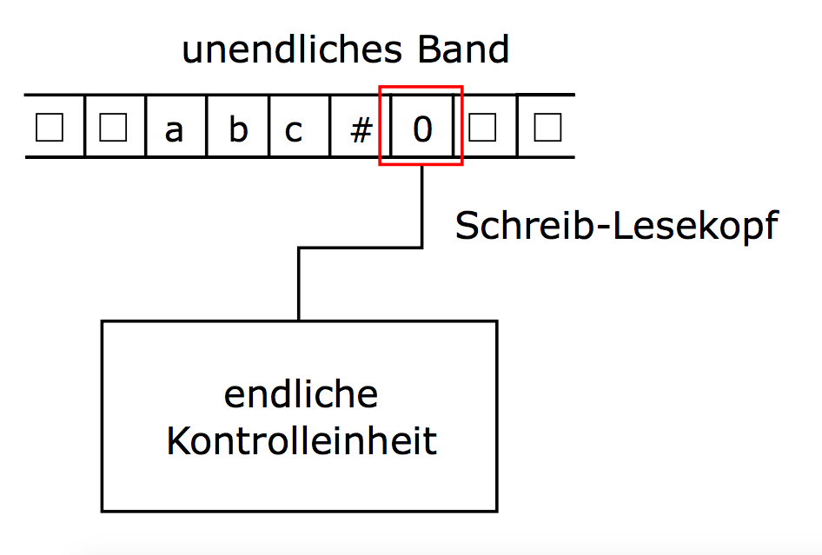
Turing Machines
Turing Machines (TM) have a tape consisting of infinite cells on which each cell either contains input symbol or a special symbol called blank
The machine can read and write those symbols, one at a time
The machine has a head pointer which points to cell currently being read and it can move in both directions
The tape head can move left and right
The state register that stores the current state of the machine
Set of states is finite
Table of (finite) instructions describing how the machine reads, writes and changes state
memory tape
tape head
finite state register

Slide 10
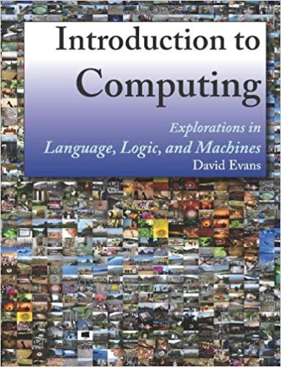
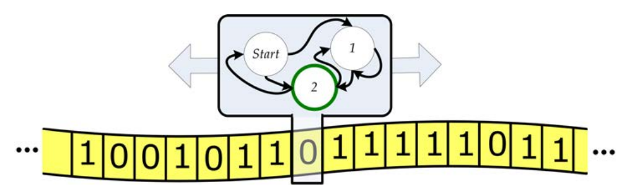
Turing Machines
Illustration of Turing Machine from Introduction to Computing by Evans (2011)
Recommended readings:
Chapter 6 for Turing Machines
Chapter 12 for Computability
Sipser (2012) Ch. 7 for Complexity Classes

Slide 11
Turing Machines: Formalization
Definition: Turing machine
A Turing machine is defined by a 7-tuple TM = (Q, Σ, Γ, δ, q₀, □, F) consisting of
Q: a finite set of states
Σ: a finite set of symbols called the input alphabet. Q ∩ Σ = ∅ (symbols which are part of input alphabet)
Γ: a finite set of symbols called the working alphabet. Σ ⊂ Γ (symbols which can be written on the Tape)
δ: Q × Γ → Q × Γ × {L, R, N}, the transition function in the deterministic case δ: Q × Γ → P(Q × Γ × {L, R, N}), in the nondeterministic case
q₀∈ Q: an initial or start state
□ ∈ Γ : the blank symbol (initially, tape is filled with □ except input)
F⊆ Q: the set of final states (if any state of F is reached, input is accepted)

Slide 12
Turing Machines: Formalization
Definition: Turing machine
A Turing machine is defined by a 7-tuple TM = (Q, Σ, Γ, δ, q₀, □, F) consisting of
Q: a finite set of states
Σ: a finite set of symbols called the input alphabet. Q ∩ Σ = ∅ (symbols which are part of input alphabet)
Γ: a finite set of symbols called the working alphabet. Σ ⊂ Γ (symbols which can be written on the Tape)
δ: Q × Γ → Q × Γ × {L, R, N}, the transition function in the deterministic case δ: Q × Γ → P(Q × Γ × {L, R, N}), in the nondeterministic case
q₀∈ Q: an initial or start state
□ ∈ Γ : the blank symbol (initially, tape is filled with □ except input)
F⊆ Q: the set of final states (if any state of F is reached, input is accepted)
From (state, tape symbol read) to (next state, tape symbol written,
movement of head)
Movements are Left, Right, None. it can have special operations like Halt and Error

Slide 13
Functioning of Turing Machines
Transition example: δ(z,a) = (z', b, x)
TM is in state z, and
a is underneath the tape head
TM transitions to state z'
and after that moves the tape ahead according to x = {R, L, N}
initial state
only the input is written on the tape
tape head on first input symbol/element
all unused places are marked with □. # is an alternative notation for this
memory tape
tape head
finite state register

Slide 14
Turing Machine example: checking parentheses
Problem: Check that parentheses in input are balanced
e.g. ()(())(()()) is balanced but ((()() is not
Input: tape contains the string of parentheses with # at the beginning and end to mark limits
Output: there is a 1 on the tape if input is balanced, or a 0 otherwise
Only what is written on the cell of the head matters
Strategy:
look for closing parenthesis and replace with X,
then find its matching opening parenthesis and replace with X
if you find # instead of a matching opening parenthesis: write 0
Repeat until you reach # when looking for closing parenthesis
If tape is all X between #, write 1

Slide 15
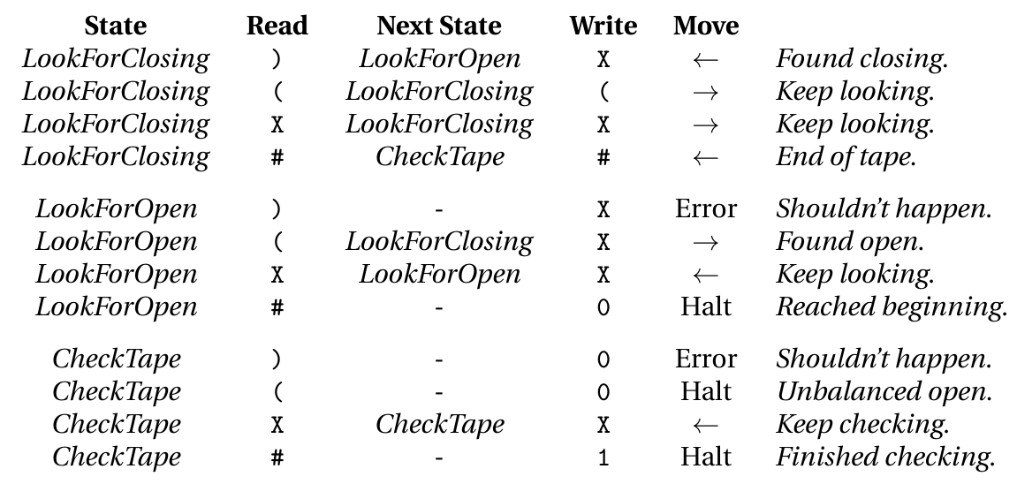
Turing Machine example: checking parentheses
From Introduction to Computing by Evans (2011)

Slide 16
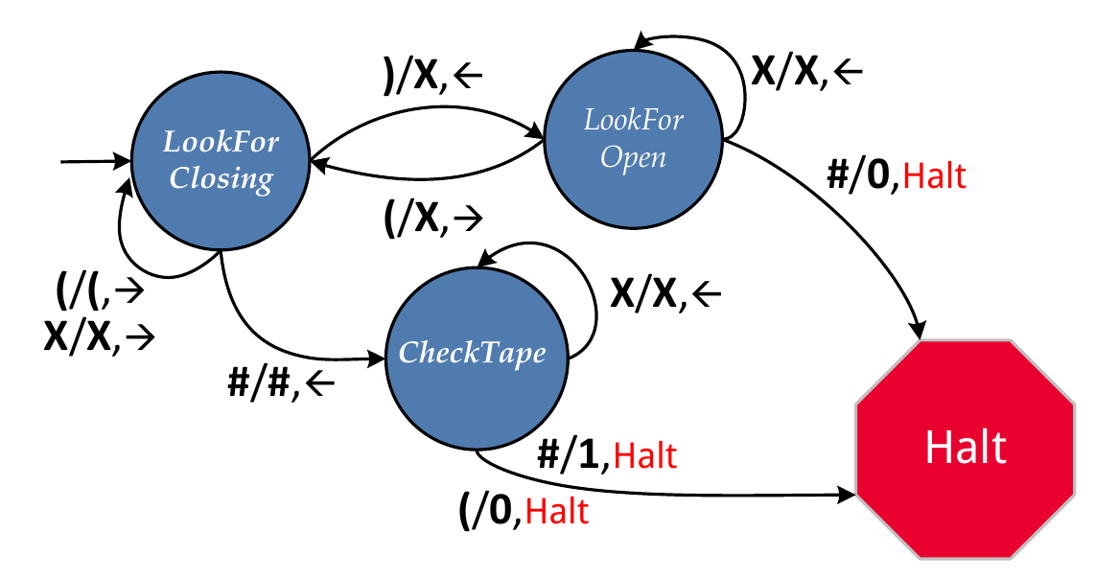
Turing Machine example: checking parentheses
From Introduction to Computing by Evans (2011)

Slide 17
Turing Machine tape trace example
# | ( | ( | ) | ( | ) | ) | #
Input string to process
TM starts in leftmost cell of input
TM starts in state LookForClosing
TM moves without rewriting until first )

Slide 18
Turing Machine tape trace example
# | ( | ( | ) | ( | ) | ) | #
# | ( | ( | X | ( | ) | ) | #
When ) is under the head:
change to LookForOpen
Write X
Move head to the right
TM keeps on moving to the right while it sees X under its head

Slide 19
Turing Machine tape trace example
# | ( | ( | ) | ( | ) | ) | #
# | ( | ( | X | ( | ) | ) | #
# | ( | X | X | ( | ) | ) | #
When ( is under the head:
change to LookForClosing
Write X
Move head to the left
TM keeps on moving to the left while it sees X or ( under its head

Slide 20
Turing Machine tape trace example
# | ( | ( | ) | ( | ) | ) | #
# | ( | ( | X | ( | ) | ) | #
# | ( | X | X | ( | ) | ) | #
# | ( | X | X | ( | X | ) | #
The process continues matching parentheses and switching between states LookForClosing and LookForOpen

Slide 21
Turing Machine tape trace example
# | ( | ( | ) | ( | ) | ) | #
# | ( | ( | X | ( | ) | ) | #
# | ( | X | X | ( | ) | ) | #
# | ( | X | X | ( | X | ) | #
# | ( | X | X | X | X | ) | #
# | ( | X | X | X | X | X | #
The process continues matching parentheses and switching between states LookForClosing and LookForOpen

Slide 22
Turing Machine tape trace example
# | ( | ( | ) | ( | ) | ) | #
# | ( | ( | X | ( | ) | ) | #
# | ( | X | X | ( | ) | ) | #
# | ( | X | X | ( | X | ) | #
# | ( | X | X | X | X | ) | #
# | ( | X | X | X | X | X | #
# | X | X | X | X | X | X | #
After the last ( is rewritten, TM is in LookForClosing state
TM goes to the right until it finds #
TM changes to CheckTape state
Head starts moving to the left while it sees X

Slide 23
Turing Machine tape trace example
# | ( | ( | ) | ( | ) | ) | #
# | ( | ( | X | ( | ) | ) | #
# | ( | X | X | ( | ) | ) | #
# | ( | X | X | ( | X | ) | #
# | ( | X | X | X | X | ) | #
# | ( | X | X | X | X | X | #
# | X | X | X | X | X | X | #
1 | X | X | X | X | X | X | #
TM finds # while in CheckTape state
overwrites it with a 1 (accept)
TM halts

Slide 24
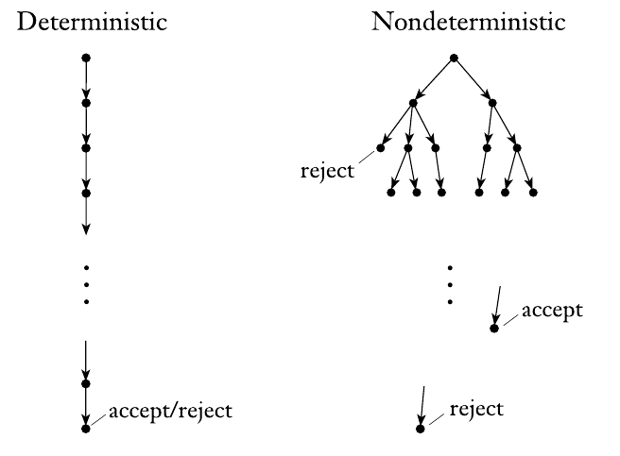
Nondeterministic Turing Machines
Transition function δ: Q × Γ → P(Q × Γ × {L, R, N})
A combination of state and tape symbol can go to more than one other state, symbol, and action triplet
All paths happen in parallel
alternative: TM takes the "smartest path" towards accept
Input is accepted if any path leads to an accepting state
Input is rejected if all paths lead to a rejecting state or are infinite (loops)

Slide 25
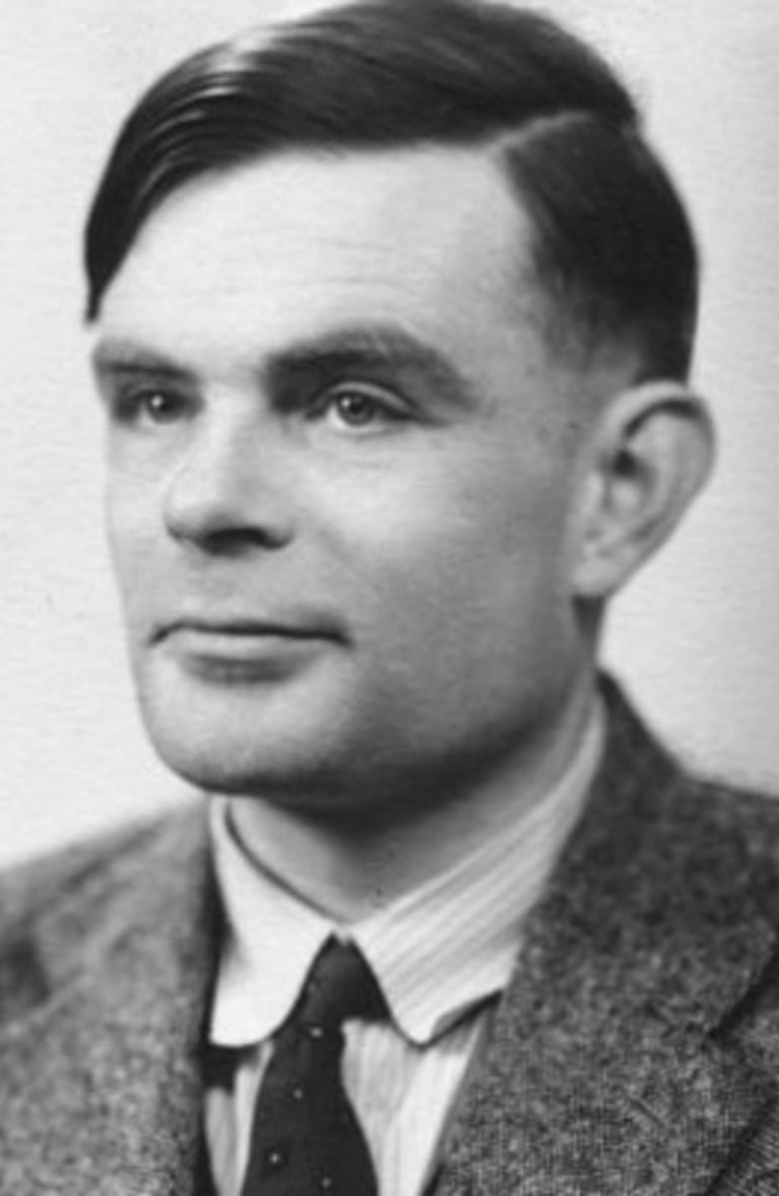
Alan Turing: the father of computation
Alan Mathison Turing (UK 1912 - 1954)
Designed the TM to formalize algorithms
Defined computation as problems that can be solved by algorithms and found examples of problems that cannot be computed
Famous for his work during WWII to crack the Enigma code with a computer called Bombe
Among the first to work on AI: the Turing test
AI as machines able to pass as human a given % of the time when chatting with people
Died of suicide in 1951 due to hormone treatments he suffered for his sexual orientation

Slide 26
Computability
Turing Machines
Computability
Complexity Classes

Slide 27
Computability
Definition of algorithm An algorithm is a self-contained step-by-step set of operations to solve a given problem. Algorithms perform calculation, data processing, and/or automated reasoning tasks.
Remember: algorithms always terminate. For correct inputs, the algorithm must always terminate in a finite number of steps.
A problem is computable if there exists an algorithm that solves the problem.
If we can prove that no algorithm can solve a problem in finite time, then the problem is noncomputable.

Slide 28
The Church-Turing thesis
Church-Turing thesis: Intuitive notion of algorithms = Turing Machines
Up to now, our definition of algorithms is intuitive: We can tell what is an algorithm and what is not, but we lack a mathematical definition
Alonzo Church and Alan Turing worked in parallel to formally define algorithms and reached equivalent definitions: an algorithm is what can be computed by a Turing Machine
It is a thesis: a statement from which the rest of Computer Science is derived but that has no formal proof or empirical evidence behind

Slide 29
A noncomputable problem: The halting problem
The Halting Problem
Input: A string representing a program (e.g. in Python)
Output: If evaluating the input program would ever finish, output True.
Otherwise, output False.
Assume that halts(X) is an algorithm that solves the halting problem, where X is the Python code that is the input
halts(X) returns True if the evaluation of X would finish in finite time, False otherwise
For example:
halts('(2 + 3)') = True
halts('while True: pass') = False

Slide 30
A noncomputable problem: The halting problem
The Halting Problem
Input: A string representing a program (e.g. in Python)
Output: If evaluating the input program would ever finish, output True.
Otherwise, output False.
Assume that halts(X) is an algorithm that solves the halting problem, where X is the Python code that is the input
halts(X) returns True if the evaluation of X would finish in finite time, False otherwise
For example:
halts('(+ 2 3)') = True
halts('while True: pass') = False
halts('n = 4;
while sumOfTwoPrimes(n):
n = n + 2') = ?
Notes:
Down on the rectangle, you have Goldbach’s conjecture.

Slide 31
Proof of non-computability
Proof by reduction to absurdity:
if we assume that halts(X) exists, do we reach a contradiction?
If halts(X) exist, then the following is a recursive algorithm:
def paradox():
if halts('paradox()'):
while True:
pass
if halts(‘paradox()’) = True, the algorithm goes into an infinite loop, so halts(‘paradox()’) cannot be True
if halts(‘paradox()’) = False, the algorithm skips the loop and terminates, so halts(‘paradox()’) cannot be False
Since it has to be either True or False, halts(X) cannot exist

Slide 32
Proof of non-computability
Proof by reduction to absurdity:
if we assume that halts(X) exists, do we reach a contradiction?
If halts(X) exist, then the following is a recursive algorithm:
def paradox():
if halts('paradox()'):
while True:
pass
Your knowledge of Python is a model of computing! Alan Turing showed this for Turing Machines as a general model of computing
if halts(‘paradox()’) = True, the algorithm goes into an infinite loop, so halts(‘paradox()’) cannot be True
if halts(‘paradox()’) = False, the algorithm skips the loop and terminates, so halts(‘paradox()’) cannot be False
Since it has to be either True or False, halts(X) cannot exist

Slide 33
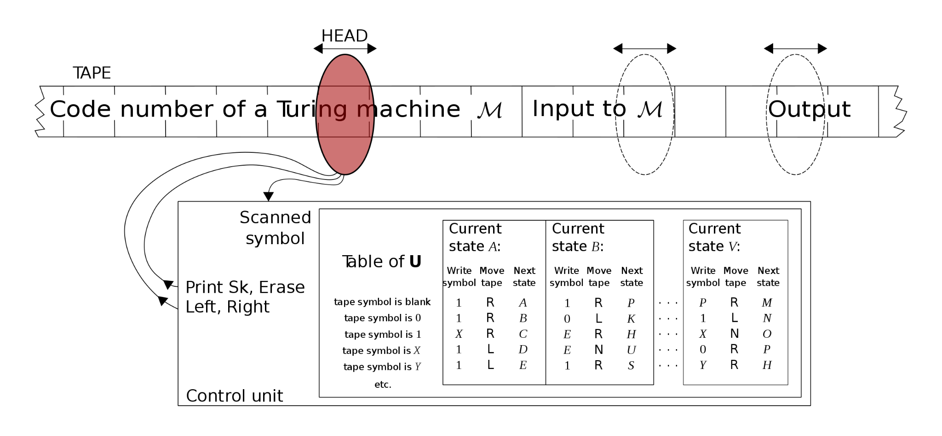
Universal Turing Machines
TMs can be encoded with finite codes: e.g. state list + transition table + alphabet, etc
A universal Turing Machine simulates a TM with a code written on the tape, followed by its input
The universal TM writes then the output of the simulated TM and stops if the simulated TM stops
https://en.wikipedia.org/wiki/Universal_Turing_machine

Slide 34
Turing completeness
Turing completeness
A model of computation (e.g. model of a machine or programming language) is Turing complete if it can be used to simulate a universal Turing Machine. Turing complete models can execute any algorithm.
For example, Python is Turing complete because you can write a code in Python that simulates any Turing Machine and thus, by definition, can execute any algorithm
In practice you can code any algorithm directly in Python without simulating a TM, the point is that you can simulate a TM, not that it is easy, understandable, or even efficient

Slide 35
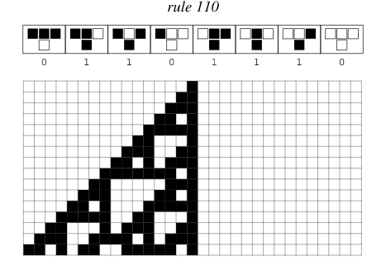
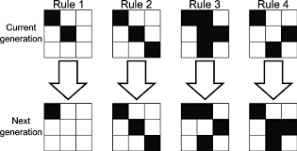
Examples of Turing complete models
Cellular automata: models of computation in which cells change state according to extremely simple rules
Structures emerge that, when interacting, can be set up to simulate any TM
Examples are Conway's Game of Life and rule 110
You can learn more in Computational Modelling of Social Systems (WS)

Slide 36
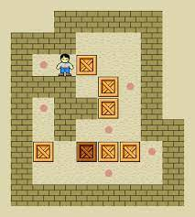

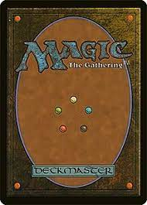
Examples of Turing complete models
Creative games can be used to build a system that simulates a Universal Turing Machine or other Turing complete models
Sokoban (Culberson, 1997)
Minecraft (Youtube video)
Magic the Gathering (Churchill, Biderman, & Herrick, 2019)

Slide 37
Computability
Turing Machines
Computability
Complexity Classes

Slide 38
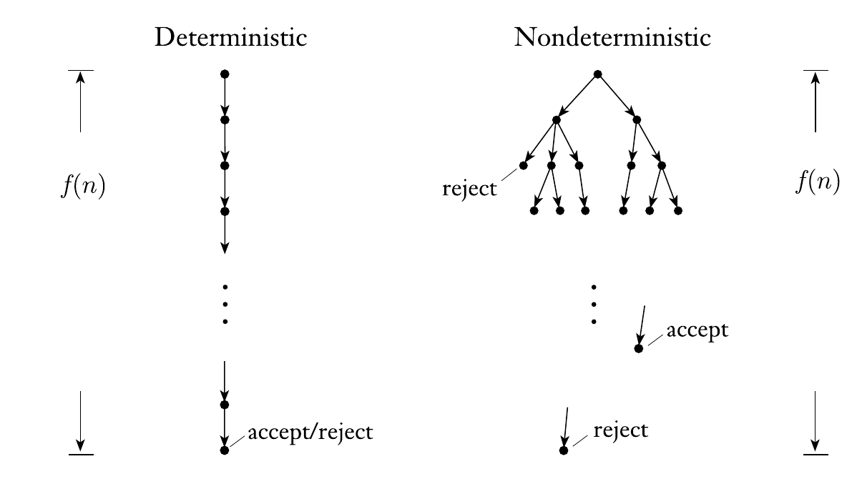
Time complexity of nondeterministic TM
O-notation to characterize scaling of time complexity:
O(1) ⊂ O(log(n)) ⊂ O(n)
O(n) ⊂ O(n log(n)) ⊂ O(n²)
O(n²) ⊂ O(2^{n}) ⊂ O(n!)
i.e., ignore lower order terms
Recap: previously, we talked about the time complexity of algorithms: how running time grows with input size
In terms of a TM, time complexity can be seen as the number of transitions the TM has to do to reach a final state. For a nondeterministic TM, it is the max depth among all execution branches

Slide 39
Problem complexity and decision problems
We can talk about the complexity of a problem regarding the time complexity of known algorithms to solve it
This defines a hierarchy: inefficient algorithms with long running time can be implemented for almost any problem, but some problems might not be solvable with faster algorithms
We can define sets of problems as complexity classes that relate the problems to the time complexity of the algorithms that can solve them
Decision problem
Decision problems have a binary output (true/false) as the solution. Decision problems can be very general, for example determining if a word belongs to a language is a decision problem

Slide 40
The P class
Problem class P
P contains all decision problems that can be solved by a deterministic Turing Machine using a polynomial amount of computation steps (time).
In other words: for each problem in P, there is at least one algorithm that decides its output in a number of steps that grows polynomially with the input size, e.g. O(n), O(n²), O(n⁹⁹), also subpolynomial O(log(n)) ⊂ O(n)
An example of P problem is deciding if there is a path between two vertices in a graph.
You can run DFS on the graph to find the path and since DFS running time is O(|V|+|E|), then the problem belongs to the P class
G
s
t
?

Slide 41
Problem verifiers
After solving a problem, you can verify if the solution is correct
A verifier is an algorithm (i.e. TM) that takes two inputs:
A description (encoding) of a problem p
A candidate solution for the problem c
Verifiers return True if c is a solution of p and False otherwise
c is also called certificate or proof that p has a solution (decision problem)
However, verifying a solution is always a decision problem
Example for finding path between s and t in G:
1 | 2 | … | # | 1 | 3 | x | y | … | # | s | t | # | s | a | … | t | # | T/F
Vertex list
edge list
indices s,t
sequence of nodes
V?
p
c

Slide 42
The NP class
Problem class NP
NP is the set of decision problems for which positive problem instances (the answer is True) have proofs verifiable in polynomial time by a deterministic Turing Machine
An equivalent definition of NP is the set of decision problems solvable in polynomial time by a nondeterministic Turing machine
The nondeterministic TM "guesses" the proof branching and then verifies it deterministically
NP stands for "Nondeterministic Polynomial time"
It does not stand for "Not Polynomial!"

Slide 43
NP problem example: Hamiltonian path
Hamiltonian path
A Hamiltonian path is a path in a graph that visits each vertex exactly once
G1
G2
has a Hamiltonian path
does not have a Hamiltonian path
In this definition of path, edges in the path sequence have to be distinct
Decision problem, we have to decide if G has a Hamiltonian path or not
also known as "is G traceable?"
Verifying that a path is Hamiltionian in G can be done in O(n) (polynomial)
Thus, the problem of deciding if a graph has a Hamiltonian path is NP

Slide 44
NP problem example: Hamiltonian path
Hamiltonian path
A Hamiltonian path is a path in a graph that visits each vertex exactly once
G1
Finding a Hamiltonian path in G is not that easy!
No known algorithm can find a Hamiltonian path in polynomial time
Known algorithms are pretty much like brute force, e.g. trying all combinations: O(|V|!)
G2
has a Hamiltonian path
does not have a Hamiltonian path
In this definition of path, edges in the path sequence have to be distinct
Decision problem, we have to decide if G has a Hamiltonian path or not
also known as "is G traceable?"
Verifying that a path is Hamiltionian in G can be done in O(|V|+|E|)
Thus, the problem of deciding if a graph has a Hamiltonian path is NP

Slide 45
P vs NP
NP
P = NP?
P
All problems in P are also in NP
if you can decide it in polynomial time, you can verify it in polynomial time
Verifying in polynomial time does not imply deciding in polynomial time
However, this is based on the algorithms known for each problem, an NP problem becomes P when a polynomial-time algorithm for it is invented
Proving that P=NP or P≠NP is arguably the most important question in CS
A Clay Millenium Problem: 1,000,000 USD prize for who solves it

Slide 46
Reducing problems
Problem A
Problem B
True
f
True
f
False
False
Reducing a decision problem A to another decision problem B is
to find a function f that maps:
all inputs of A that have output True to all inputs of B that have output True
all inputs of A that have output False to all inputs of B that have output False
An algorithm that solves problem B can be used to solve problem A
If f can be applied in polynomial time, we say that A is polynomial time reducible to B
In this case, if B is in class P, then A is in class P too

Slide 47
NP-complete problems
Some NP problems can be reduced in polynomial time to other NP problems
This determines a network between problems: if we find a polynomial time algorithm that solves one problem, we solve all problems that can be reduced to it
Some special NP problems have the property that any other NP problem can be reduced to them:
NP
NP-complete
Problem class NP-complete
A problem is NP-complete if:
it belongs to the NP class
every other NP problem is polynomial time reducible to it

Slide 48
NP-complete example: boolean satisfiability (SAT)
Boolean formulas in propositional logic use three operations: AND (∧), OR (∨), and negation (x̄)
Variables are boolean: they can take value True (1) or False (0)
The SAT problem takes a boolean formula as input and returns True if and only if there is some assignment of variables for which the formula is True
For example:
(x₁ ∨ x₂ ∨ x₃ ∨ x̄₄ ) ∧ (x̄₃ ∨ x₅ ∨ x̄₆ ) ∧ (x₃ ∨ x̄₆ ) Is satisfiable with x₁ = x₂ = x₄ = x₅ = True, x₃ = x₆ = False
(x₁ ∨ x₂) ∧ (x̄₁ ∨ x₂) ∧ (x₁ ∨ x̄₂) ∧ (x̄₁ ∨ x̄₂) is not satisfiable
Any NP problem can be reduced to SAT, making it the original NP-complete problem (proof not covered here)
Cook-Levin theorem: finding a halting execution of any nondeterministic TM can be reformulated as satisfying a logical formula, thus SAT is NP-complete
If you find a polynomial-time algorithm to solve SAT, then P=NP (and earn $1M)

Slide 49
NP-hard problems
Problem class NP-hard
A problem is NP-hard if:
every NP problem is polynomial time reducible to it
Note that NP-hard problems do not have to be NP
they don't even have to be decision problems
Informally, they are described as: at least as hard as the hardest problems in NP
NP-hard
Often mentioned to convey the lack of polynomial-time algorithms to solve problems that are not decision problems, for example finding a Hamiltonian path in a graph
NP
NP-complete
P

Slide 50
Summary
Turing Machines
The most general model of a computer we have seen
TM recognize grammars without restrictions
Computability
The Church-Turing thesis: Algorithms = TM
Some problems cannot be computed: the halting problem
A model of computation that can simulate a TM is Turing complete
Complexity classes
Problem class P: decision problems solvable in polynomial time
Problem class NP: problems with proofs verifiable in polynomial time
Polynomial-time reducibility between problems
NP-complete problems and their relationship to P vs NP
NP-hard: general problems without known efficient algorithms
Introduction to Computation for the Social Sciences

Slide 51
Next Session
Databases
Relational Databases
Structured Query Language (SQL)

