Slide 1
Introduction to Computing
for the Social Sciences
Session 11 - Databases
David Garcia
Winter Semester 2024-25
15.01.2025

Slide 2
Course Outline
Session 8: Time Complexity
Session 9: Formal Languages and Automata
Today: Session 11: Databases
17.01: Session 10: Turing Machines and Complexity Classes - ROOM D406
29.01: Session 12+13: Parallel Programming + Social Science Applications
05.02: Session 14: Exam Review

Slide 3
Overview
Databases
Relational Databases
Structured Query Language (SQL)

Slide 4
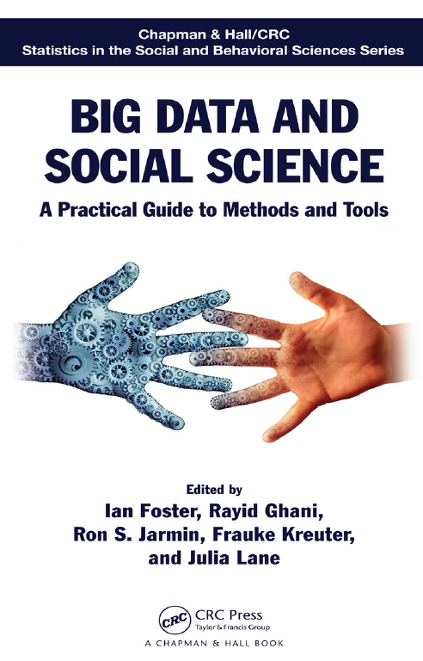
Overview
Databases
Relational Databases
Structured Query Language (SQL)
NoSQL databases
Recommended: Chapter 4

Slide 5


Database example: Flight reservations
Flight Reservation
Seat reservation
Special meals
Cancel reservation
Cancel flight
Checkin
Checkout
Payment
Security
Reduced mobility
Database/
DBMS
Customer on internet
Airline
Travel agency
Airport

Slide 6



Database example: Vaccine distribution
Projection of vaccines
Notify demands
Divide vaccines
Accept quota
Schedules for vaccination
Accept customer applications
Report number of vaccinations
Report remaining vaccines
Create summary
Database/
DBMS
3 Vaccine
manufacturers
80 Mio Customers on internet
Physicians
400 Vaccine
centers
Robert Koch Institute
Mobile vaccination teams

Slide 7
Database example: Vaccine distribution
Projection of vaccines
Notify demands
Divide vaccines
Accept quota
Schedules for vaccination
Accept customer applications
Report number of vaccinations
Report remaining vaccines
Create summary
Database/
DBMS
3 Vaccine
manufacturers
80 Mio Customers on internet
Physicians
400 Vaccine
centers
Robert Koch Institute
Mobile vaccination teams

Slide 8
Database example: Vaccine distribution
Projection of vaccines
Notify demands
Divide vaccines
Accept quota
Schedules for vaccination
Accept customer applications
Report number of vaccinations
Report remaining vaccines
Create summary
Database/
DBMS
3 Vaccine
manufacturers
80 Mio Customers on internet
Physicians
400 Vaccine
centers
Robert Koch Institute
Mobile vaccination teams

Slide 9
Database example: Vaccine distribution
Projection of vaccines
Notify demands
Divide vaccines
Accept quota
Schedules for vaccination
Accept customer applications
Report number of vaccinations
Report remaining vaccines
Create summary
Database/
DBMS
3 Vaccine
manufacturers
80 Mio Customers on internet
Physicians
400 Vaccine
centers
Robert Koch Institute
Mobile vaccination teams

Slide 10
Database example: Vaccine distribution
Projection of vaccines
Notify demands
Divide vaccines
Accept quota
Schedules for vaccination
Accept customer applications
Report number of vaccinations
Report remaining vaccines
Create summary
Database/
DBMS
3 Vaccine
manufacturers
80 Mio Customers on internet
Physicians
400 Vaccine
centers
Robert Koch Institute
Mobile vaccination teams

Slide 11
Databases
What is a database?
Informal definition: an organized collection of data
an Excel table is a (very simple) database
enable fast access and the ability to access data in a structured way
What is a database management system (DBMS)?
software application that enables interaction of user and the actual database
implements defining, creating, querying, updating and administering a database
data may be distributed at different locations
examples: MySQL, PostgreSQL, Access, Oracle

Slide 12
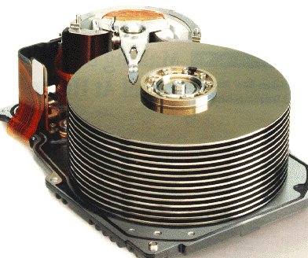
Databases and DBMS
Definition: Database
A database (DB) is a set of related data and the formal organization and interdependence of these data. Access and manipulation of data are provided through a corresponding database management system (DBMS).
A frequent icon to symbolize a database, represented by a hard drive disk platter

Slide 13
Characteristics of DBMS
Characteristics of database management systems
data definition: create, modify, delete the definitions defining organization of data, i.e., the relationship among entries in the database
Name | Birth | Class | Product | Num
… | … | … | … | …
… | … | … | … | …
… | … | … | … | …
… | … | … | … | …
… | … | … | … | …
… | … | … | … | …
… | … | … | … | …
… | … | … | … | …

Slide 14
Characteristics of DBMS
Characteristics of database management systems
data definition: create, modify, delete the definitions defining organization of data, i.e., the relationship among entries in the database
updating: Insert, modify and delete the actual content, i.e., individual data entries in the database
Name | Birth | Class | Product | Num
Hans | 1998 | T1 | Milk | 00111
Fred | 1999 | T1 | Tea | 00222
Hans | 1998 | T1 | Tea | 00222
Anna | 2000 | W1 | Milk | 00111
Pat | 1998 | W1 | Tea | 00222
Hans | 1998 | T1 | Milk | 00111
Anna | 2000 | W1 | Milk | 00111
Fred | 1999 | T1 | Milk | 00111

Slide 15
Characteristics of DBMS
Characteristics of database management systems
data definition: create, modify, delete the definitions defining organization of data, i.e., the relationship among entries in the database
updating: Insert, modify and delete the actual content, i.e., individual data entries in the database
retrieval or querying: return information, given specific query inputs, that can be used by any downstream application
Name | Birth | Class | Product | Num
Hans | 1998 | T1 | Milk | 00111
Fred | 1999 | T1 | Tea | 00222
Hans | 1998 | T1 | Tea | 00222
Anna | 2000 | W1 | Milk | 00111
Pat | 1998 | W1 | Tea | 00222
Hans | 1998 | T1 | Milk | 00111
Anna | 2000 | W1 | Milk | 00111
Fred | 1999 | T1 | Milk | 00111
Product = Tea and Birth < 1999 ?

Slide 16

Characteristics of DBMS
Characteristics of database management systems
data definition: create, modify, delete the definitions defining organization of data, i.e., the relationship among entries in the database
updating: Insert, modify and delete the actual content, i.e., individual data entries in the database
retrieval or querying: return information, given specific query inputs, that can be used by any downstream application
administration: user management, data security, performance, data integrity, concurrency, protection against database corruption and system failure
Name | Birth | Class | Product | Num
Hans | 1998 | T1 | Milk | 00111
Fred | 1999 | T1 | Tea | 00222
Hans | 1998 | T1 | Tea | 00222
Anna | 2000 | W1 | Milk | 00111
Pat | 1998 | W1 | Tea | 00222
Hans | 1998 | T1 | Milk | 00111
Anna | 2000 | W1 | Milk | 00111
Fred | 1999 | T1 | Milk | 00111
X

Slide 17
Why to use a database?
data independence: applications (and users) do not need to worry about how data are structured and stored
logical data independence: protection from changes to logical structure of the data e.g., add new entity or attribute without affecting usage
physical data independence: protection from physical layout changes e.g., user does not have to care about info. coding, disk space, etc.
standardization
data formats, accessing data methods, etc. are platform independent
recall: problems parsing .csv file with conflict events in Python
flexible output schemas serving different users and purposes
concurrency
allow for simultaneous usage by many users without problem of conflicting updates
robust protocols that avoid database corruption

Slide 18
Database Transactions: ACID properties
A transaction is a series of data manipulations that must not be interrupted. All operations in a transaction have to be fully performed or completely rewinded
Database transactions have the following properties:
Atomicity
means that each transaction stands on its own, rewind is possible
Consistency
ensuring that any transaction that succeeds maintains the validity of the database
Isolation
ensures that it does not matter whether we execute our transactions serially or concurrently
Durability
requires that any transaction that has completed will survive permanently (also for error, crash, loss of power)

Slide 19
Relational Databases
Databases
Relational Databases
Structured Query Language (SQL)

Slide 20
Database Models
Database models fundamentally define database structure
sets logical structure of the database in terms of data storage, organization, and manipulation
ultimately about how the relationship between related information is represented
examples:
flat model, a.k.a. spreadsheets:
single, two-dimensional array of data elements
members of a row are related, i.e., an “entry”
members of a column describe the same property or characteristic
relational model:
representation through sets of linked tables that share a common key
intuition: many spreadsheets storing specific pieces of information linked via a unique key

Slide 21
Flat model example
Name | Birth | Class | Product | Productnr | Date
Hans | 1998 | T1 | Milk | 00111 | 06.03.2020
Fred | 1999 | T1 | Tea | 00222 | 06.03.2020
Hans | 1998 | T1 | Tea | 00222 | 06.03.2020
Anna | 2000 | W1 | Milk | 00111 | 06.03.2020
Verena | 1998 | W1 | Tea | 00222 | 07.03.2020
Hans | 1998 | T1 | Milk | 00111 | 07.03.2020
Anna | 2000 | W1 | Milk | 00111 | 08.03.2020
Fred | 1999 | T1 | Milk | 00111 | 08.03.2020

Slide 22
Flat model example
Identical entries
Name | Birth | Class | Product | Productnr | Date
Hans | 1998 | T1 | Milk | 00111 | 06.03.2020
Fred | 1999 | T1 | Tea | 00222 | 06.03.2020
Hans | 1998 | T1 | Tea | 00222 | 06.03.2020
Anna | 2000 | W1 | Milk | 00111 | 06.03.2020
Verena | 1998 | W1 | Tea | 00222 | 07.03.2020
Hans | 1998 | T1 | Milk | 00111 | 07.03.2020
Anna | 2000 | W1 | Milk | 00111 | 08.03.2020
Fred | 1999 | T1 | Milk | 00111 | 08.03.2020
Data is repeated across the table
Inefficient use of space
Problems updating: what if Productnr of Milk is now 00333?

Slide 23
Building a relational database
Table purchase
Table Names
Nr | Date | Name | Product
1 | 06.03.2020 | 1 | 1
2 | 06.03.2020 | 2 | 2
3 | 06.03.2020 | 1 | 2
4 | 06.03.2020 | 3 | 1
5 | 07.03.2020 | 4 | 2
6 | 07.03.2020 | 1 | 1
7 | 08.03.2020 | 3 | 1
8 | 08.03.2020 | 2 | 1
Nr | Name | Birth | Class
1 | Hans | 1998 | T1
2 | Fred | 1999 | T1
3 | Anna | 2000 | W1
4 | Verena | 1998 | W1
Table Product
Nr | Product | Productnr
1 | Milk | 00111
2 | Tea | 00222
Primary key

Slide 24
Building a relational database
Table purchase
Table Names
Nr | Date | Name | Product
1 | 06.03.2020 | 1 | 1
2 | 06.03.2020 | 2 | 2
3 | 06.03.2020 | 1 | 2
4 | 06.03.2020 | 3 | 1
5 | 07.03.2020 | 4 | 2
6 | 07.03.2020 | 1 | 1
7 | 08.03.2020 | 3 | 1
8 | 08.03.2020 | 2 | 1
Nr | Name | Birth | Class
1 | Hans | 1998 | T1
2 | Fred | 1999 | T1
3 | Anna | 2000 | W1
4 | Verena | 1998 | W1
Table Product
Nr | Product | Productnr
1 | Milk | 00111
2 | Tea | 00222
Foreign keys reference primary keys (on another table or same table)

Slide 25
Relational database: normal form example
Table purchase
Table Names
Nr | Date | Name | Product
1 | 06.03.2020 | 1 | 1
2 | 06.03.2020 | 2 | 2
3 | 06.03.2020 | 1 | 2
4 | 06.03.2020 | 3 | 1
5 | 07.03.2020 | 4 | 2
6 | 07.03.2020 | 1 | 1
7 | 08.03.2020 | 3 | 1
8 | 08.03.2020 | 2 | 1
Nr | Name | Birth | Class
1 | Hans | 1998 | 1
2 | Fred | 1999 | 1
3 | Anna | 2000 | 2
4 | Verena | 1998 | 2
Table Classes
Nr | Name
1 | T1
2 | W1
Relational database designs can be standardized using normal forms
For example here: Class should be its own table
Table Product
Nr | Product | Productnr
1 | Milk | 00111
2 | Tea | 00222

Slide 26
Relational database: normal form example
Table purchase
Table Names
Nr | Date | Name | Product
1 | 06.03.2020 | 1 | 1
2 | 06.03.2020 | 2 | 2
3 | 06.03.2020 | 1 | 2
4 | 06.03.2020 | 3 | 1
5 | 07.03.2020 | 4 | 2
6 | 07.03.2020 | 1 | 1
7 | 08.03.2020 | 3 | 1
8 | 08.03.2020 | 2 | 1
Nr | Name | Birth | Class
1 | Hans | 1998 | 1
2 | Fred | 1999 | 1
3 | Anna | 2000 | 2
4 | Verena | 1998 | 2
Table Classes
Nr | Name
1 | T1
2 | W1
Table Product
Now we can update the name of a class to another one without having to edit the purchase table
Nr | Product | Productnr
1 | Milk | 00111
2 | Tea | 00222

Slide 27
Structured Query Language (SQL)
Databases
Relational Databases
Structured Query Language (SQL)

Slide 28
SQL Programming Language
special-purpose language specifically developed for managing data through relational database systems
consists of three (co-dependent) language definitions
data definition language (DDL)
define relational schemata
create/ alter/ delete tables and their attributes
data manipulation language (DML)
insert/ delete/ modify entries in tables
query one or more tables
data control language (DCL)
control access to data stored in database
grant/ revoke/ modify user access rights

Slide 29
SQL Programming Language
SQL is a very high-level programming language
performance is good because actual operations are optimized well
many different standards but typical DBMS support all
execution is highly parallelizable by construction
SQL is a declarative language
You define what you want, the DBMS takes care of how to do it
You can also do "procedural SQL" with special instructions but it is very inefficient
Query
DBMS
DB
SQL
Result

Slide 30
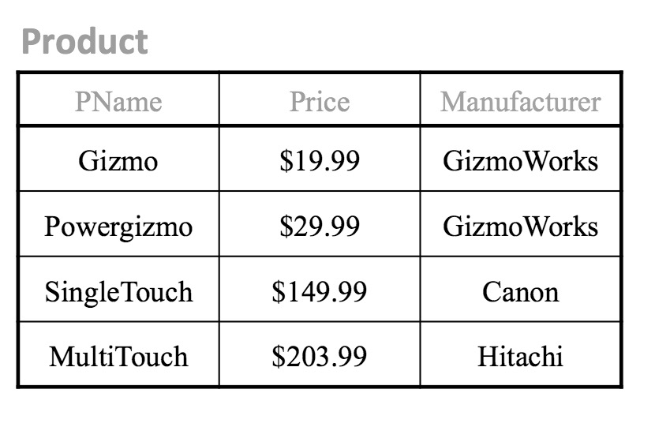
Tables in SQL
Tables
A multiset of tuples coding the attributes specified by the database schema.
Tables are also called relations
Tuples are also called rows
Attributes are also called columns

Slide 31
Tables in SQL
Tables
A multiset of tuples coding the attributes specified by the database schema.
Tables are also called relations
Tuples are also called rows
Attributes are also called columns
Table (relation)

Slide 32
Tables in SQL
Tables
A multiset of tuples coding the attributes specified by the database schema.
Tables are also called relations
Tuples are also called rows
Attributes are also called columns
Row (tuple)

Slide 33
Tables in SQL
Tables
A multiset of tuples coding the attributes specified by the database schema.
Tables are also called relations
Tuples are also called rows
Attributes are also called columns
Row (tuple)
Can we have the same row twice?

Slide 34
Tables in SQL
Tables
A multiset of tuples coding the attributes specified by the database schema.
Tables are also called relations
Tuples are also called rows
Attributes are also called columns
Column (attribute)

Slide 35
Tables in SQL
Tables
A multiset of tuples coding the attributes specified by the database schema.
Tables are also called relations
Tuples are also called rows
Attributes are also called columns
Schema

Slide 36
SQL Data types
Data Types
atomic types:
characters: CHAR(20), VARCHAR(50)
numbers: INT, BIGINT, SMALLINT, FLOAT
others: MONEY, DATETIME, …
every attribute (column) must have an atomic type
consequently tables in SQL are always flat: Cells (in principle) should not contain lists or matrices

Slide 37
SQL Schema
Table Schema
schema of a table is its name, attributes and their types
in our example: Product: (Pname: string, Price: float, Manufacturer: string)
a key is a minimal subset of attributes that acts as a unique identifier for tuples in a relation
implicit constraint on which tuples can be in a relation
if two tuples in the same table agree on the values of the key, they must be the same tuple!
notation: in schema key is underlined - Pname in our example

Slide 38
SQL data definition language
CREATE:
CREATE TABLE extable(col1 INTEGER, col2 VARCHAR(50), PRIMARY KEY (col1));
extable
col1 | col2
Initializes an empty table with the specified schema: name, attributes, and keys

Slide 39
SQL data manipulation language
INSERT
INSERT INTO phone_book (name, number) VALUES ('John Doe', ‘555-1212');
phone_book
phone_book
name | number
Jane Doe | 333-333
Max Mustermann | 4949-4900
name | number
Jane Doe | 333-333
Max Mustermann | 4949-4900
John Doe | 555-1212
before
after

Slide 40
SQL data manipulation language
UPDATE
UPDATE Table1 SET C1 = C1 + 1 WHERE C2 = ‘a‘
Table1
Table1
C1 | C2
1 | a
2 | b
3 | a
4 | x
C1 | C2
2 | a
2 | b
4 | a
4 | x
before
after

Slide 41
SQL data manipulation language
DELETE
DELETE FROM example WHERE column2 = ’N';
DROP
DROP TABLE table_name
Many things can be dropped: indices, columns, whole databases…
ROLLBACK
Discards all data changes since the last COMMIT or ROLLBACK
By default, a set of manipulations are part of a transaction that is executed and finished when we call COMMIT
SQL tutorial: https://www.w3schools.com/sql/default.asp

Slide 42
SQL Queries
SQL queries allow us to define what data to receive from a database
Basic form of a SQL query:
SELECT <attributes> FROM <one or more relations> WHERE <conditions>

Slide 43
SQL Queries: selection
selection example:
SELECT * FROM Product WHERE Manufacturer = ‘Gizmo Works’

Slide 44
SQL Queries: selection + projection
selection + projection example:
SELECT Pname, Price FROM Product WHERE Manufacturer = ‘Gizmo Works’

Slide 45
Aggregation in SQL
SELECT AVG(Price) FROM Product WHERE Manufacturer = ‘Gizmo Works’
AVG(Price)
$24.99

Slide 46
Grouping and aggregating in SQL
SELECT AVG(Price) FROM Product GROUP BY Manufacturer
Manufacturer | AVG(Price)
GizmoWorks | $24.99
Canon | $149.99
Hitachi | $203.99
More about aggregation and grouping in Tutorial sessions

Slide 47
SQL manual join
Join resembles a merge or product operation in other languages
SELECT * FROM purchase, Product WHERE purchase.Product=Product.Nr;
purchase
Nr | Date | Name | Product
1 | 06.03.2020 | 1 | 1
2 | 06.03.2020 | 2 | 2
3 | 06.03.2020 | 1 | 2
4 | 06.03.2020 | 3 | 1
5 | 07.03.2020 | 4 | 3
6 | 07.03.2020 | 1 | 3
7 | 08.03.2020 | 3 | 4
8 | 08.03.2020 | 2 | 4
Product
Nr | Product | Productnr
1 | Milk | 00111
2 | Tea | 00222

Slide 48
SQL manual join
SELECT * FROM purchase, Product WHERE purchase.Product=Product.Nr;
Result:
Nr | Date | Name | purchase.Product | Product.Product | Productnr
1 | 06.03.2020 | 1 | 1 | Milk | 00111
2 | 06.03.2020 | 2 | 2 | Tea | 00222
3 | 06.03.2020 | 1 | 2 | Tea | 00222
4 | 06.03.2020 | 3 | 1 | Milk | 00111
Why are there now only four rows when purchase had 8?
Why are there new column names?
How many rows would we get with SELECT * FROM purchase, Product; ?

Slide 49
Better naming of columns
purchase
ID | Date | Name | ProductID
1 | 06.03.2020 | 1 | 1
2 | 06.03.2020 | 2 | 2
3 | 06.03.2020 | 1 | 2
4 | 06.03.2020 | 3 | 1
5 | 07.03.2020 | 4 | 3
6 | 07.03.2020 | 1 | 3
7 | 08.03.2020 | 3 | 4
8 | 08.03.2020 | 2 | 4
Product
ProductID | Product | Productnr
1 | Milk | 00111
2 | Tea | 00222
References to keys of other columns are called foreign keys
Naming can be done in a smart way to simplify expected joins

Slide 50
SQL INNER JOIN
SELECT * FROM purchase INNER JOIN Product USING (ProductID);
Result:
Nr | Date | Name | ProductID | Product | Productnr
1 | 06.03.2020 | 1 | 1 | Milk | 00111
2 | 06.03.2020 | 2 | 2 | Tea | 00222
3 | 06.03.2020 | 1 | 2 | Tea | 00222
4 | 06.03.2020 | 3 | 1 | Milk | 00111

Slide 51
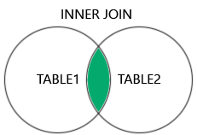
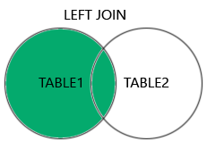
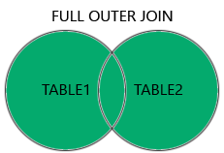
SQL other JOIN operations
There are different kinds of joins based on set operations
If values are missing from one of the columns, they are set to NULL
More on SQL tutorial: https://www.w3schools.com/sql/default.asp

Slide 52

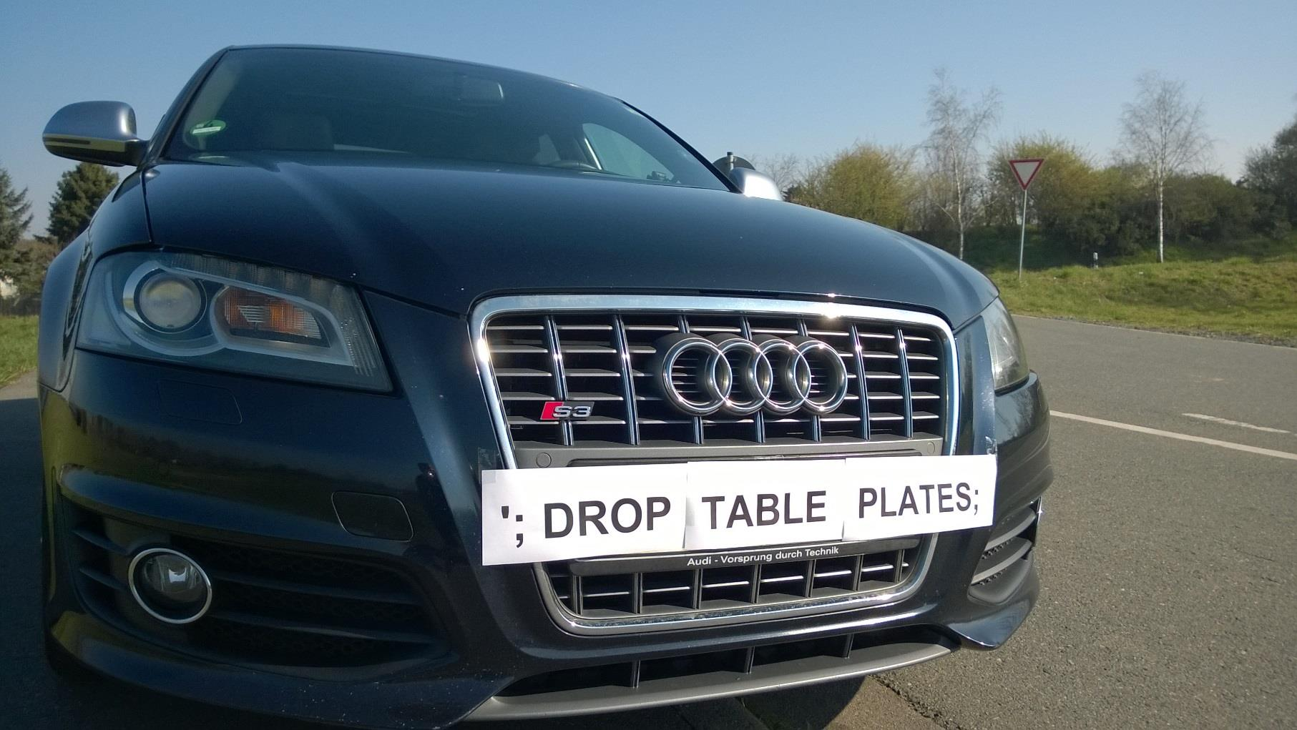
SQL injections
A SQL injection is a security attack to a database that inputs SQL code as user input (e.g. user name).
If the database permissions are not well set, it could be executed
It can be used to delete the database, for illicit data export, or to gain access to other parts of the system

Slide 53
Summary
Databases
Technology to centralize, manage, and provide access to data
DBMS is software that handles the DB while we just operate with it
Relational Databases
When tables refer to each other: more efficient storage and update
Structured Query Language (SQL)
The most used language for relational databases

