Slide 1




Containerized architecture is the key to face some current industry problems nowadays
Notes:
Netflix:
Netflix is the king of microservices. In 2015, JAX unanimously selected Netflix for the Special Jury award, citing the developer team’s huge influence on innovation and IT. In order to keep up with booming demand, Netflix began to move a monolithic architecture to a cloud-based microservices architecture in 2009. At this time, the term microservices didn’t even exist. Operating on a monolithic architecture, Netflix was dealing with rapid growing pains and constant outages when Amazon’s servers went down. Thanks to microservices architecture and modern UI technology, Netflix engineers deploy code thousands of times per day. Today Netflix services 93.8 million users globally, streaming more than ten billion hours of movies and shows.
Amazon:
Before, when amazon was on a monolithic server, it was hard to predict how to meet the fluctuating traffic demands. As a result, Amazon was bleeding money and most of the server capacity was wasted during downtimes. Moving to the Amazon Web Services (AWS) cloud allowed Amazon to scale up or down when necessary, reduce the number and duration of outages, and save money. Microservice architecture allowed Amazon to transition to continuous deployment, and now Amazon engineers deploy code every 11.7 seconds.
Apple:
Apple’s relation to microservices can be highlighted in a different way. Apple developed Swift for building both iOS and Mac OSX applications. Swift code can be used to build microservices frameworks, which gives developers a wide range of opportunity. It is possible to build light-weight containers in Swift, which is an integral part of continuous deployment.

Slide 2
Hints & Tips….
Docker compose file manages all involved containers and defines their configuration
Docker-compose.yml
Falcon
zookeper
There are 5 services: falcon, zookeeper, kafka, spark, Cassandra, with its respectives names: falcon_container, zookeeper_container, kafka_container, spark_container, Cassandra_container
Both Spark and Cassandra containers need some folders in your host to be mapped:
WWM-docker-bc should be mapped to /home/jovyan/work in spark container
Cassandra folder should be mapped to /bdr in Cassandra container
Spark container will need to map ports 8888 , 4040, and 4141 with the same host ports
spark
Cassandra
kafka

Slide 3
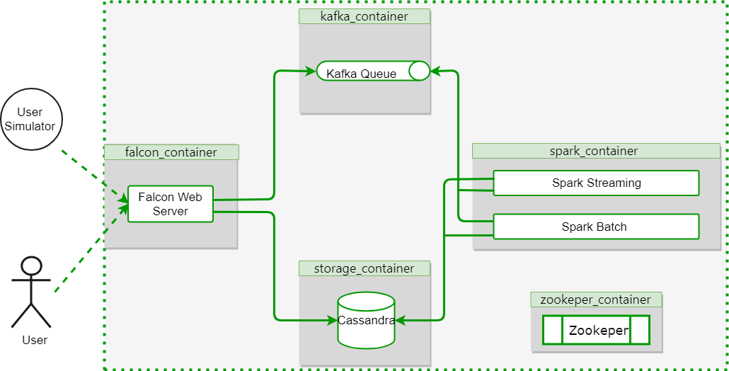
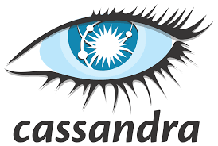

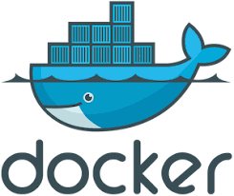



Containerized based Spark Architecture for E-commerce
Architecture Summary
Customer interaction process
Real time shopping emulation
Web server queues events on Kafka
Low Latency Queuing system
Events are buffered within Kafka
Pub/Sub messaging Paradigm
Spark Process
(Near) Real time event processing
Lambda, implementations
Hands-on Examples
Recommendation Engine
Basic AI application on Spark
Product recommendations
Results storage
Recommendations are stored in NoSQL DB
DB/Web Interface
Results can be actively requested via HTTP trough Falcon
General architecture and tools
1
2
2
1
3
4
3
4
6
5
5
6
Notes:
1) overall solution 4 BC (tios que compra items en NRT y le vamos a recomendar otros )
2) LA solucion propuesta
1 slide de background (quick refresher of technologies per container)

Slide 4
A little reminder about Cassandra DB…
2007
2008
2008
2010
Nowadays…
Amazon develops Dynamo
Google creates BigTable
Facebook creates Cassandra
Cassandra is released as open source project
Cassandra becomes top level project at Apache foundation
Cassandra is widely used abroad by different companies such as: Apple, Facebook,Netflix..
Properties
Distributed No SQL DB
Provides Availability and Partition tolerance
Key value oriented with a salt of column structure
Highly scalable and Peer2Peer
Highly scalable*
2
4
8
100k op/s
200k op/s
400k op/s
* Rabl, Tilmann; Sadoghi, Mohammad; Jacobsen, Hans-Arno; Villamor, Sergio Gomez-; Mulero -, Victor Muntes; Mankovskii, Serge (27 de agosto de 2012). «Solving Big Data Challenges for Enterprise Application Performance Management». VLDB. Consultado el 25 de julio de 2013. «In terms of scalability, there is a clear winner throughout our experiments. Cassandra achieves the highest throughput for the maximum number of nodes in all experiments... this comes at the price of high write and read latencies».

Slide 5
Spark
Spark streaming
Framework for cluster computing
Maintained by Apache in response to Map Reduce
Really useful on iterative algorithms
API reachable via spark context
RDDs and Dataframes are its basics objects
Spark Streaming is spark component that allows us to perform streaming analytics
Spark Streaming operates over micro batches
Events
Time
Dstream
RDD 1
RDD2
RDD3
RDD 3
RDD 4
RDD 5
Actions/transformations

